Slide 1



Analysis of the 5Rs in Thailand Medication Error Classification through Natural Language Processing
Peachyasitt Udomnuchaisup
Biomedical Data Science Master's Program,
Faculty of Science, Kasetsart University
The 20th International Joint Conference on Computer Science and Software Engineering
28th June-1st July 2023
Naresuan University Phitsanulok, THAILAND

Slide 2

INTRODUCTION
Over 80% of hospital treatments involve the use of medications.
Donaldson MS, Corrigan JM, Kohn LT, editors. To err is human: building a safer health system.
Notes:
เราเชื่อว่าทุกคนคงเคย error เช่น ลืมกุญแจบ้าน, ลืมปิดไฟ, เอาของมาไม่ครบ แน่นอนว่ามันเกิดขึ้นได้ อาจไม่ใช่ปัญหาใหญ่อะไร
แต่เมื่อ error เกิดในกระบวนการรักษาผู้ป่วย จะกลายเป็นเรื่องที่เราต้องให้ความสำคัญ เนื่องจากจะเกิดผลกระทบต่อความปลอดภัยของผู้ป่วย
ซึ่ง error ที่พบมากที่สุดคงหนีไม่พ้น medication error เพราะการรักษามากกว่า 80% เป็นการรักษาด้วยยา
Over 80% of hospital treatments involve the use of medications.

Slide 3

INTRODUCTION
World Health Organization (WHO) estimates that medication errors cost approximately US$ 42 billion annually
In 2017, WHO launched the "Third Global Patient Safety Challenge: Medication Without Harm."
The objective is to prioritize the development of a system that ensures safety in medication use, with the goal of reducing medication-related harm by 50%.
Challenge WG. Medication without harm. World Health Organization. 2017.
Notes:
The World Health Organization (WHO) estimates that medication errors cost approximately US$ 42 billion annually
worldwide. In recognition of the severity of the issue, WHO has identified medication safety as the "Third Global Patient
Safety Challenge: Medication Without Harm" and aims to improve medication safety by enhancing the systems for mitigating medication errors and preventing avoidable harm

Slide 4

INTRODUCTION
What Happen?
Classifying incidents to identify methods for preventing/reducing the severity of incidents.
Why it Happen?

Slide 5
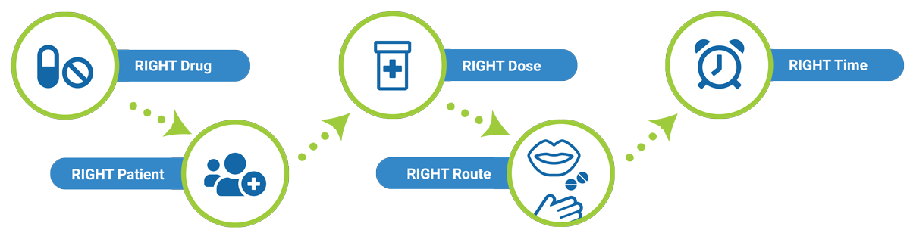
INTRODUCTION
Grouping commonly used practices in hospitals is done by following standard guidelines for medication management for patients, known as the Five Rights (5R). These include ensuring the right patient receives the right drug in the right dose, through the right route and technique, and at the right time.
When it comes to medication errors, they can be categorized into different groups: wrong patient, wrong drug, wrong dose, wrong route and technique, and wrong time.
Grissinger M. The five rights: a destination without a map. Pharmacy and Therapeutics. 2010 Oct;35(10):542.

Slide 6
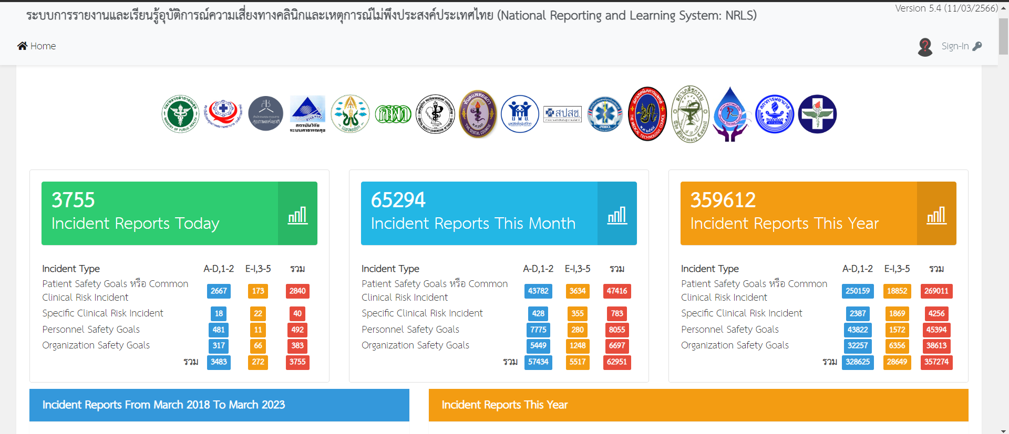
INTRODUCTION
NRLS: National Reporting and Learning System (THAILAND)

Slide 7
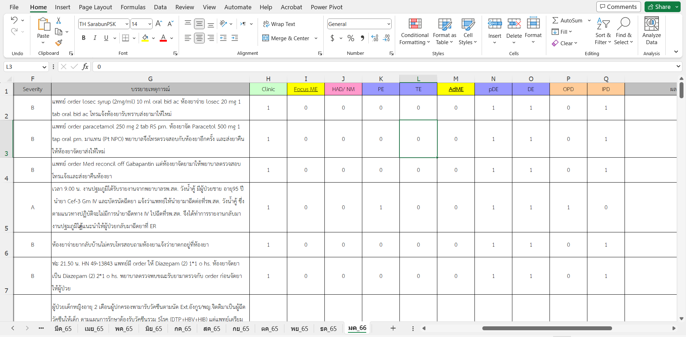
INTRODUCTION

Slide 8
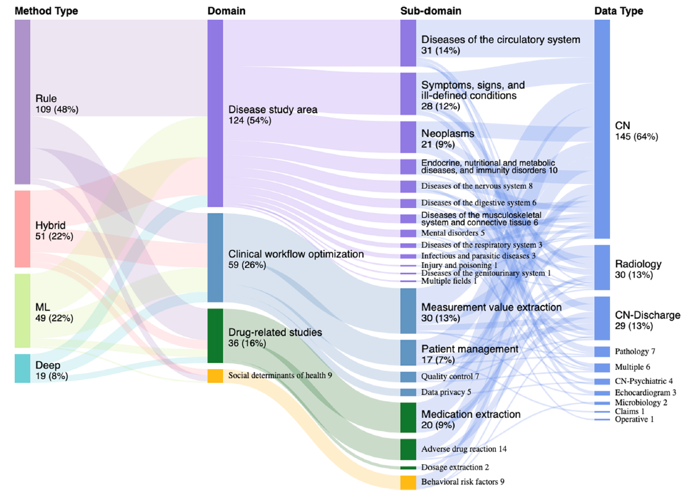
BACKGROUND
Fu S, Chen D, He H, Liu S, Moon S, Peterson KJ, Shen F, Wang L, Wang Y, Wen A, Zhao Y. Clinical concept extraction: a methodology review. Journal of biomedical informatics. 2020 Sep 1;109:103526.

Slide 9
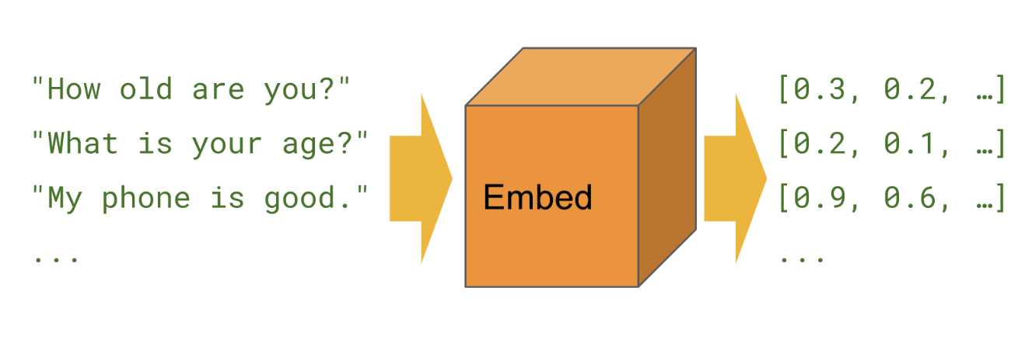
BACKGROUND
Universal Sentence Encoder
The research team has developed a 512-dimensional vector model for sentence embeddings by utilizing a large multi-lingual dataset sourced from Wikipedia, news websites, question-and-answer forums, and incorporating unsupervised learning through training with supervised data from the Stanford Natural Language Inference (SNLI) dataset.
Cer D, Yang Y, Kong SY, Hua N, Limtiaco N, John RS, Constant N, Guajardo-Cespedes M, Yuan S, Tar C, Sung YH. Universal sentence encoder. arXiv preprint arXiv:1803.11175. 2018 Mar 29.
Notes:
NLP ในปัจจุบันมักใช้ word embedding / sentence embedding
ใช้ vector ที่ได้เอาไปใช้งานต่อ เช่น ดู semantic similarity หรือเอาไปเข้า model ต่อที่เราทำในการศึกษานี้

Slide 10
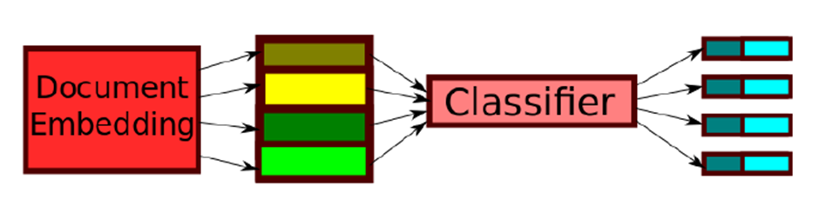
BACKGROUND
Train once, test anywhere: Zero-shot learning for text classification
The research team has created a Zero-shot learning model for text classification. They trained the model using a dataset of over 4,200,000 news headlines, with Search Engine Optimization (SEO) tags serving as labels. These SEO tags encompass more than 300,000 unique and non-repetitive categories, gathered from different webpages.
Afterwards, test datasets from UCI News Aggregator (4 classes) and Tweet Classification (6 classes) were used. The experimental results showed an accuracy higher than 60%.
Pushp PK, Srivastava MM. Train once, test anywhere: Zero-shot learning for text classification. arXiv preprint arXiv:1712.05972. 2017 Dec 16.
Notes:
The researchers concluded that this technique can be used to learn the associations between words and sentences across different datasets, even without specifically training on the data being analyzed.

Slide 11
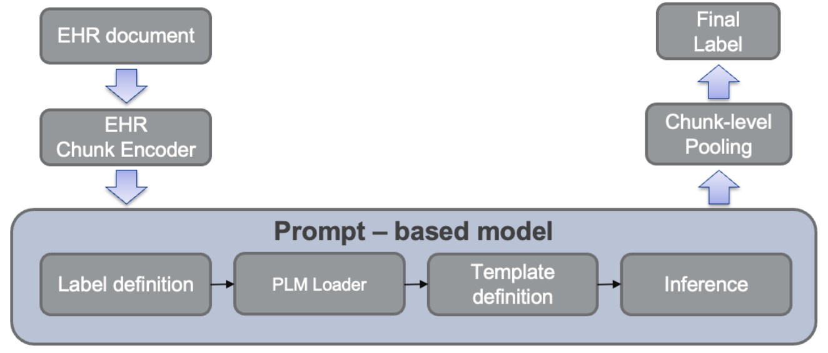
BACKGROUND
HealthPrompt: A Zero-shot Learning Paradigm
for Clinical Natural Language Processing
Sivarajkumar S, Wang Y. HealthPrompt: A Zero-shot Learning Paradigm for Clinical Natural Language Processing. arXiv preprint arXiv:2203.05061. 2022 Mar 9.
Notes:
The researchers concluded that this technique can be used to learn the associations between words and sentences across different datasets, even without specifically training on the data being analyzed.

Slide 12
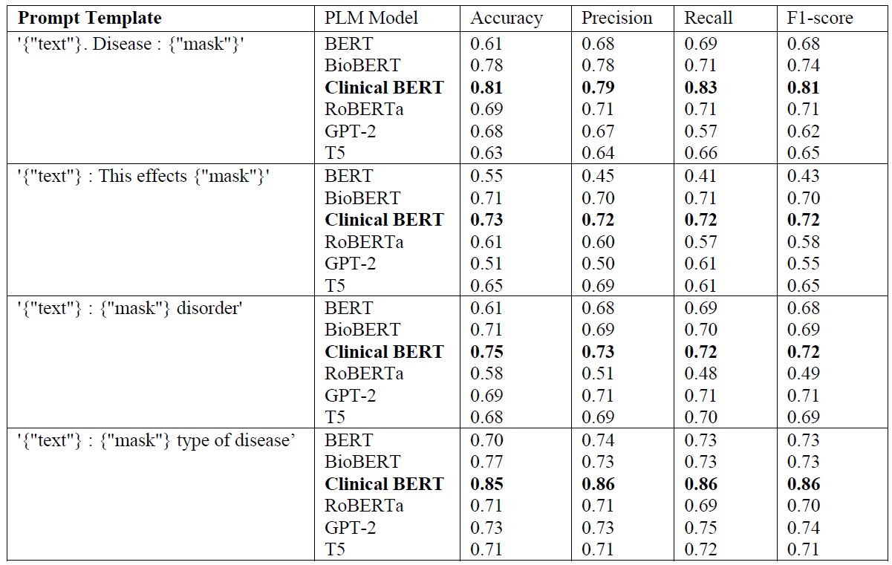
BACKGROUND
HealthPrompt: A Zero-shot Learning Paradigm
for Clinical Natural Language Processing
Sivarajkumar S, Wang Y. HealthPrompt: A Zero-shot Learning Paradigm for Clinical Natural Language Processing. arXiv preprint arXiv:2203.05061. 2022 Mar 9.
Notes:
The researchers concluded that this technique can be used to learn the associations between words and sentences across different datasets, even without specifically training on the data being analyzed.

Slide 13
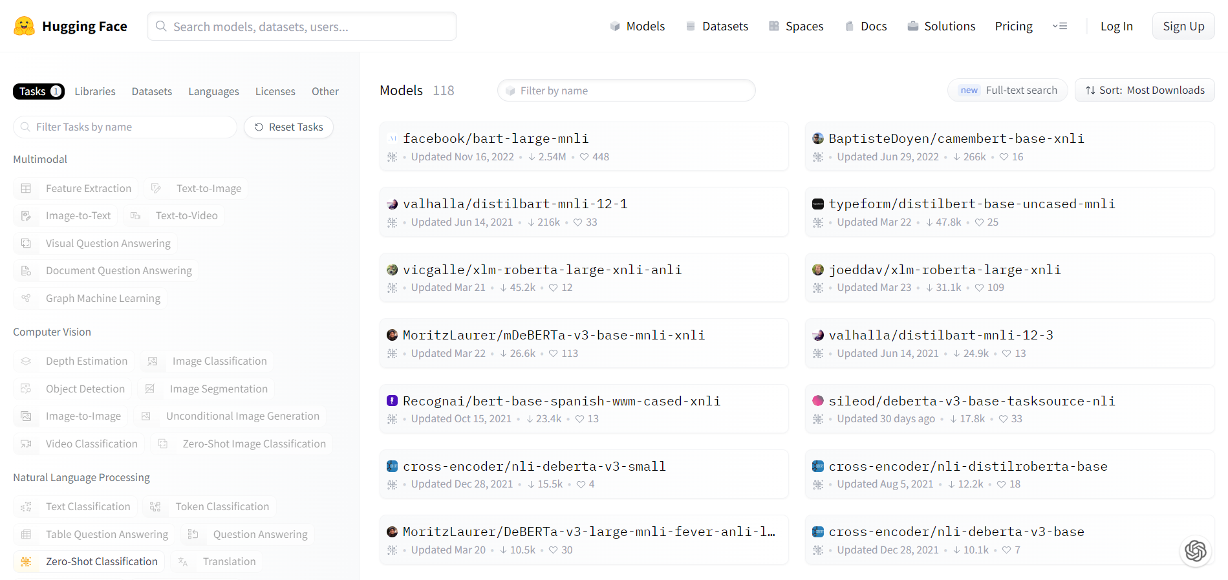
BACKGROUND
An example of a pre-trained language model (PLM) that has been fine-tuned for use in Zero-shot Classification tasks.
Notes:
The researchers concluded that this technique can be used to learn the associations between words and sentences across different datasets, even without specifically training on the data being analyzed.

Slide 14
OBJECTIVE
The research focused on:
Developing a classification model for categorizing medication errors based on the "Five Rights (5R)" concept using natural language processing (NLP) techniques.
Assessing and evaluating the performance of the classification model in accurately categorizing medication errors according to the "Five Rights (5R)" framework.
NRLS
Medication Error
Wrong Patient
Wrong Drug
5R grouping
Wrong Dose
Wrong Time
Wrong Route & Technique

Slide 15
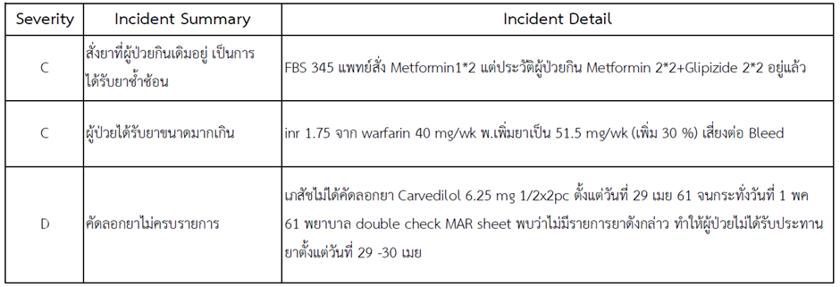
DATA
This study utilized anonymous data from the National Reporting and Learning System (NRLS) in Thailand (https://thai-nrls.org/) to examine medical incidents, including clinical risks and adverse events. The data spanned from March 22, 2018, to January 26, 2022, and encompassed a total of 1,989,337 incidents.

Slide 16
RESEARCH FRAMEWORK
Data Preparation & Labeling
Supervised Learning Classification model
Zero-shot Classification Model
Model Validation
Model Validation

Slide 17
RESEARCH FRAMEWORK
Data Cleaning and Preparation
1,989,337
696,623
688,839
680,431
Data from NRLS (22/03/2018 - 22/01/2022)
Only medication errors were selected
Exclude non-preventable incidents and rational drug use incidents.
Exclude incidents with incomplete data in the incident detail section.
680,431

Slide 18
RESEARCH FRAMEWORK
680,431
1,000
A random sample of 1,000 incidents was selected. Domain experts were tasked with labeling the data by tagging the information from the 'Incident Detail' column. This was done to observe the distribution of data within each group of the 5Rs.

Slide 19
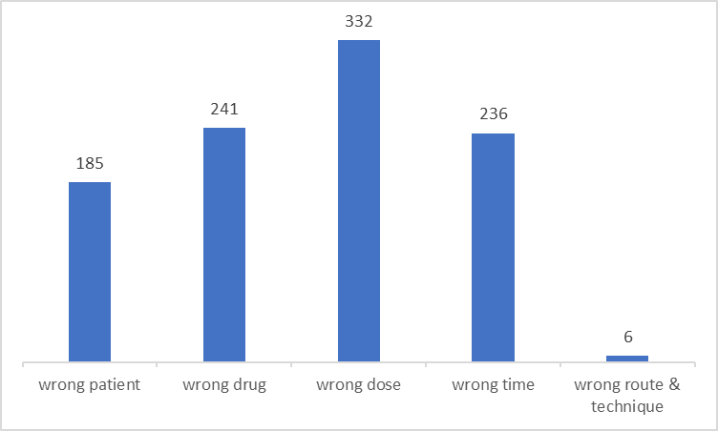
RESEARCH FRAMEWORK
It was observed that the distribution of data within each group was not uniform. The group labeled as 'Wrong Route & Technique' had a significantly low amount of data, making it impractical for domain experts to label the incidents accurately due to the large volume of data that needed to be reviewed.

Slide 20
RESEARCH FRAMEWORK
Data Labeling
We employed a method of defining keywords that are associated with each class of the 5Rs. We utilized regular expressions to search for these keywords within the 'Incident Summary' column, in order to label the incidents that match those specific keywords.
“keyword”

Slide 21
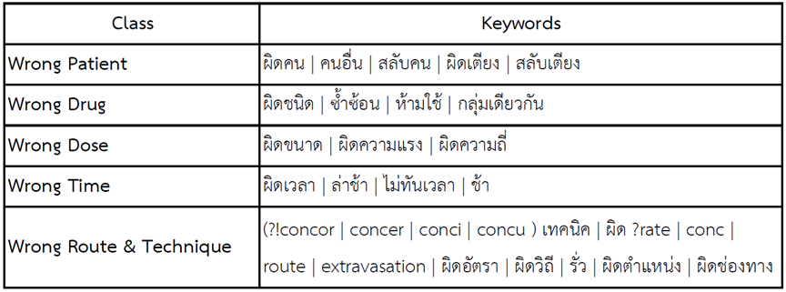
RESEARCH FRAMEWORK
Data Labeling
We have designed keywords to search for incidents that correspond to each specific group, focusing on high specificity. This allows us to accurately label incidents according to the 5Rs. Through testing with various keywords, we have selected the best-performing keywords in each group of the 5Rs, as follows:

Slide 22
RESEARCH FRAMEWORK
Data Labeling
sampling
Wrong Patient
7,640
1,000
sampling
Wrong Drug
36,261
1,000
sampling
Wrong Dose
17,692
1,000
sampling
Wrong Time
4,040
1,000
Wrong Route & Technique
857
857

Slide 23
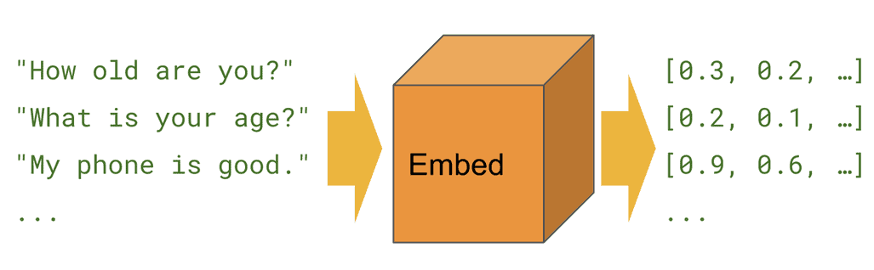
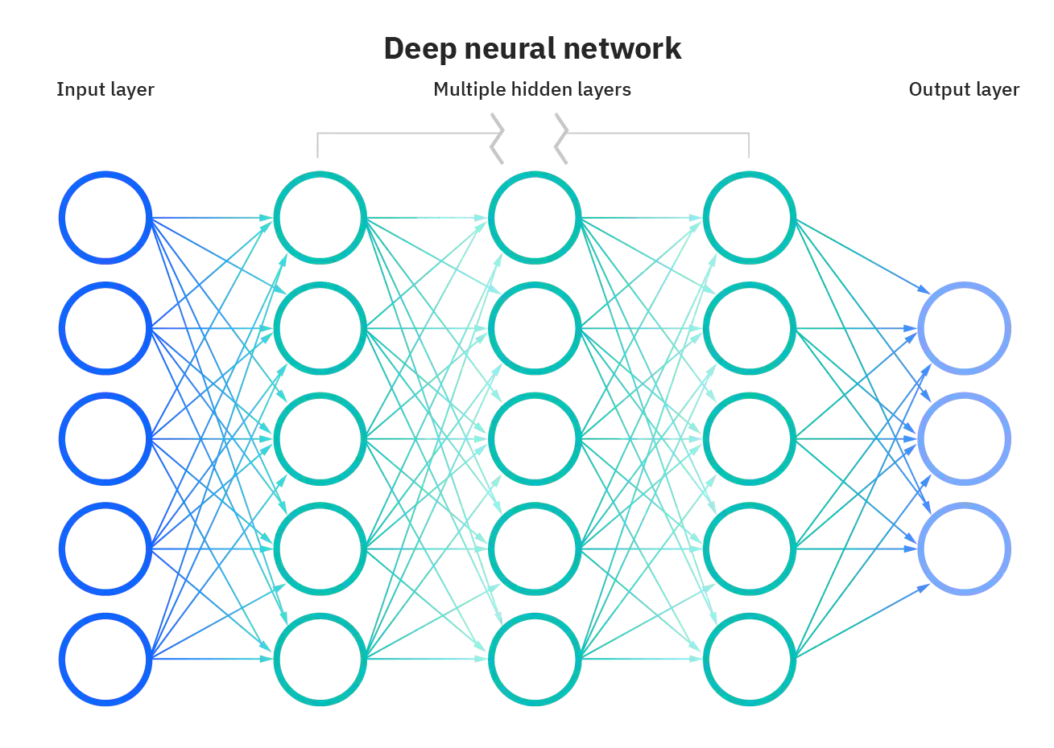
RESEARCH FRAMEWORK
Supervised Learning Classification Model
sampling
Wrong Patient
7,640
1,000
sampling
Universal Sentence Encoder
Wrong Drug
36,261
1,000
sampling
Wrong Dose
17,692
1,000
sampling
Wrong Time
4,040
1,000
Wrong Route & Technique
857
857
Vector
(512 dimensions)
80%
training set
20%
test set
Model Validation
Artificial Neural Network (Classification)

Slide 24
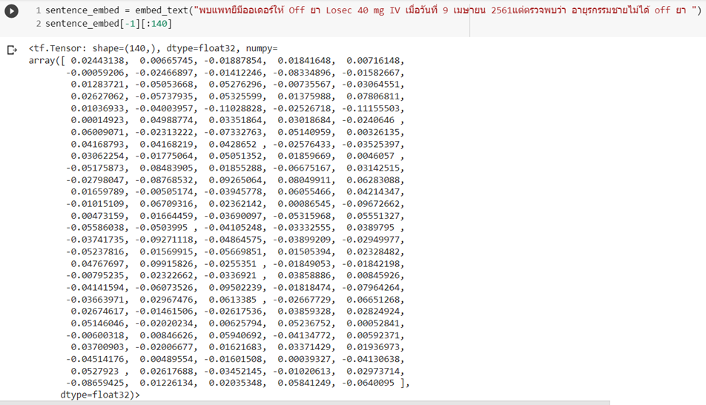
RESEARCH FRAMEWORK
Sentence Embedding Vector (512 dimensions)

Slide 25
RESEARCH FRAMEWORK
Zero-Shot Classification Model with
Multilingual Pre-trained Language model (PLM)
sampling
Zero-shot classification
Wrong Patient
7,640
1,000
sampling
Wrong Drug
36,261
1,000
sampling
PLM
Wrong Dose
17,692
1,000
Label set
sampling
Wrong Time
4,040
1,000
Wrong Route & Technique
857
857
Model Validation
Candidate labels :
ผิดคน (wrong patient), ผิดชนิด (wrong drug), ผิดขนาด (wrong dose), ผิดเทคนิค (wrong technique), ผิดเวลา (wrong time)

Slide 26
RESEARCH FRAMEWORK
Zero-Shot Classification Model with
Multilingual Pre-trained Language model (PLM)
We selected multilingual Pre-trained Language Model (PLM) that was trained with Thai language and fine-tuned for enhanced performance in zero-shot classification tasks. The model was obtained from Hugging Face's repository, which offers three models specifically optimized for zero-shot classification.
joeddav/xlm-roberta-large-xnli
It is a model based on the xlm-roberta-large architecture, which has been fine-tuned using the XNLI dataset. The XNLI dataset is a multilingual natural language inference corpus that consists of diverse languages, including 15 different languages.

Slide 27
RESEARCH FRAMEWORK
Zero-Shot Classification Model with
Multilingual Pre-trained Language model (PLM)
MoritzLaurer/mDeBERTa-v3-base-mnli-xnli
The multilingual model, developed by Microsoft, is a Natural Language Inference (NLI) model that has been pre-trained on more than 100 languages using the CC100 dataset. It has also been fine-tuned using the XNLI dataset, which consists of pairs of hypothetical and posed questions from 15 different languages, including the English MNLI dataset.

Slide 28
RESEARCH FRAMEWORK
Zero-Shot Classification Model with
Multilingual Pre-trained Language model (PLM)
MoritzLaurer/multilingual-MiniLMv2-L6-mnli-xnli
The multilingual model developed by Microsoft is a Natural Language Inference (NLI) model that supports over 100 languages. The base model, multilingual-MiniLM-L6, has undergone distillation from XLM-RoBERTa-large. The model has been further improved by fine-tuning it using the XNLI dataset, which consists of hypothesis-premise pairs from 15 different languages

Slide 29
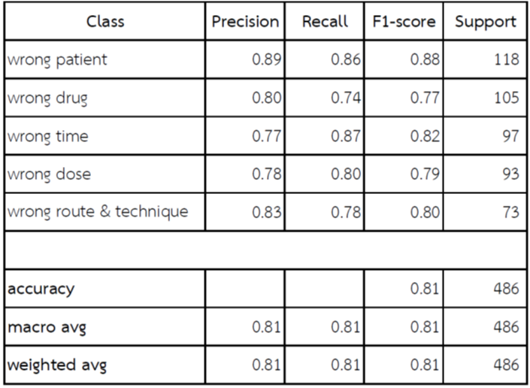
RESULT
Supervised Learning Classification Model

Slide 30
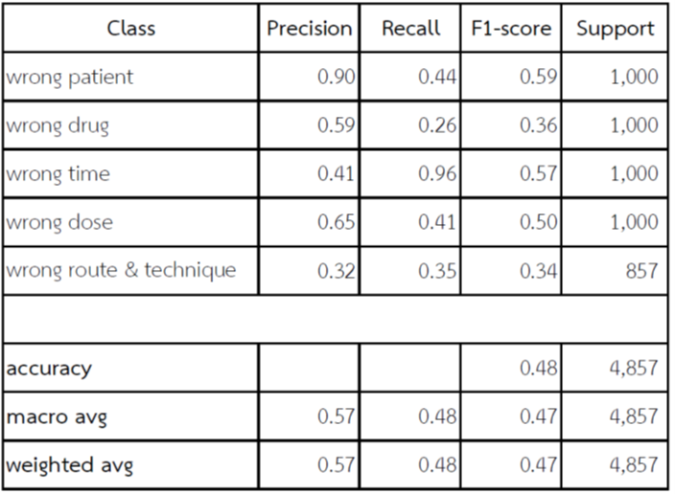
RESULT
Zero-Shot Classification Model with
joeddav/xlm-roberta-large-xnli

Slide 31
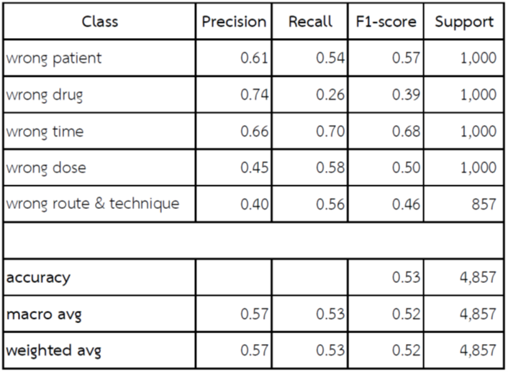
RESULT
Zero-Shot Classification Model with
MoritzLaurer/mDeBERTa-v3-base-mnli-xnli

Slide 32
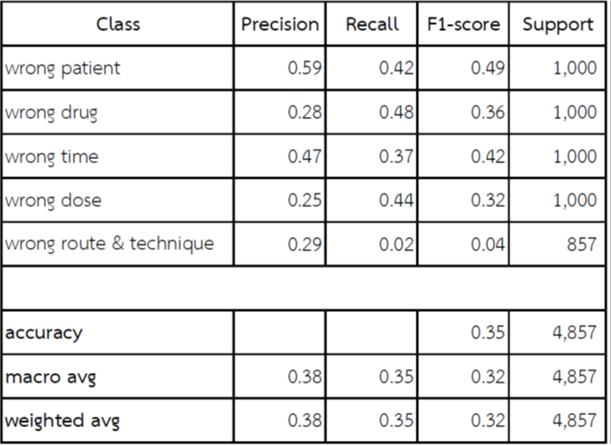
RESULT
Zero-Shot Classification Model with
MoritzLaurer/multilingual-MiniLMv2-L6-mnli-xnli

Slide 33
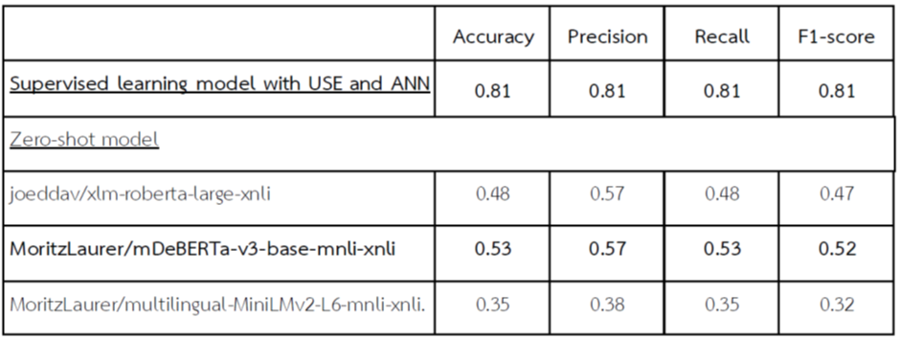
RESULT
All Models

Slide 34
RESULT
Based on the experimental results, it was found that the supervised learning classification model still outperforms the zero-shot classification model in terms of performance.
Partly, this could be due to the current availability of Pretrained Large Language Models (PLMs) that are primarily pretrained on Thai language data from general domains. There is still a lack of PLMs specifically trained on Thai medical data for improved performance in the medical domain.

Slide 35
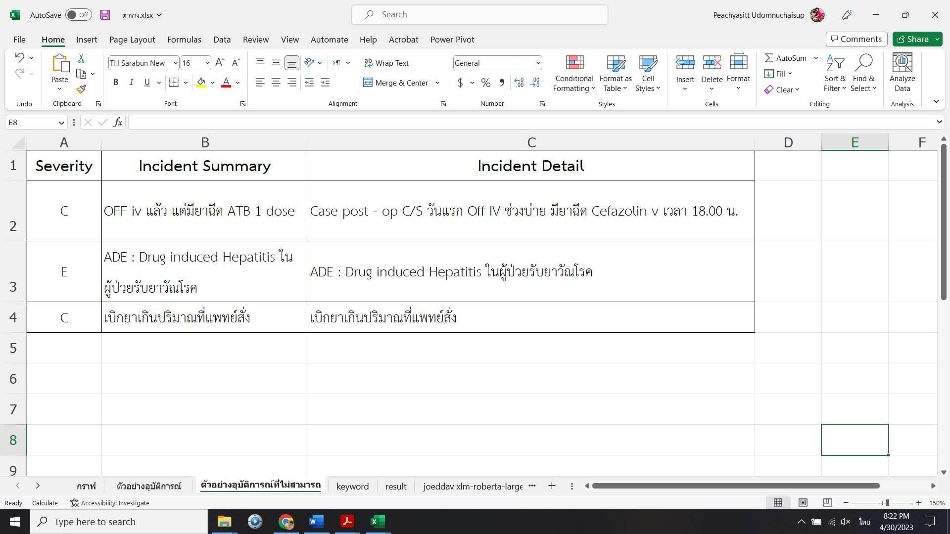
RESULT
In the future, if there is a fine-tuning process using Thai medical datasets, employing zero-shot classification may yield significantly improved performance. It could be a promising approach for medical data that often lacks labeled data or requires substantial resources for data annotation.
In addition, we have also found that some incident reports are still missing crucial and necessary data for analysis.

Slide 36
LIMITATION
The problem of model overfitting arises because some incidents have keywords in both the "Incident Summary" and "Incident Detail" sections that are similar.

Slide 37
LIMITATION
In some incidents, there is unrelated data mixed in for analysis.
case ผู้ป่วยเพศหญิงอายุ 33ปี U/D SLE มาF/U อาการทั่วไปปกติดี ช่วยเหลือตัวเองได้ตามนัดมีผลLab FBS 378 mg/dl แพทย์มี order ให้ RI 6 unit SC stat. ให้ทำนัด DM clinic ขอคิวเร็วสุด ,at 11.09 น. พยาบาลทำนัดและส่งผู้ป่วยให้ยาเคมีบำบัดที่ห้องให้ยาเคมีบำบัดชั้น 4 และส่งห้องให้คำปรึกษายาห้อง 23 เพื่อแนะนำการทานยา ,
15.30 น. ห้องให้คำปรึกษายาโทรแจ้งว่าฉีดยาRI 6 unit SC ก่อนกลับบ้าน ,at 16.00 น.ผู้ป่วยถือOPD card กลับมาพบพยาบาล confrim order พบว่าแพทย์มีorder ให้ RI 6 unit SC stat พยาบาลได้เจาะ DTX stat 485 mg/dl notify แพทย์เจ้าของไข้ ให้ admit , notify staff med ให้เพิ่ม RI 12 unit SC +admit ผู้ป่วยรู้สึกตัวดี ช่วยเหลือตัวเองได้

Slide 38
CONCLUSION
Medication Error
Classification Model
Supervised learning classification model
Zero-shot classification model
Better performance
Data labeling is needed
Lower performance
Data labeling is not needed
If there is a development of Thai-language PLMs in the medical field, it is likely to be more effective.

Slide 39
THANK YOU
QUESTION & ANSWER

