Slide 1



Predicting GameFi’s Daily Market Direction
Using Support Vector Machine
PRATHAN PHUMPHUANG
Faculty of Science and Technology.
Department of Computer Science.
Thammasat University
The 20th International Joint Conference on Computer Science and Software Engineering
28th June-1st July 2023
Naresuan University Phitsanulok, THAILAND

Slide 2
Introduction
GameFi is the idea that gamers can profit from game activity. Every GameFi uses blockchain-based services, which form the framework of the GameFi environment and include e-wallets, digital assets, smart-contract transactions, and data security. The player earns the game’s token by participating or swapping fiat money for digital currency.
This research presents a study predicting GameFi’s daily market by applying the Support Vector Machine algorithm and the important features of GameFi to support GameFi players, who have to do many activities in the game, and this study will provide them with useful information to make the right decisions.

Slide 3
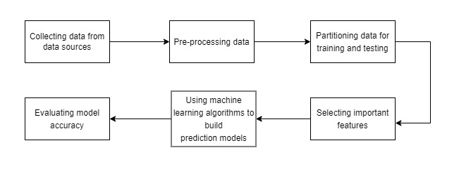
Research Methodology

Slide 4
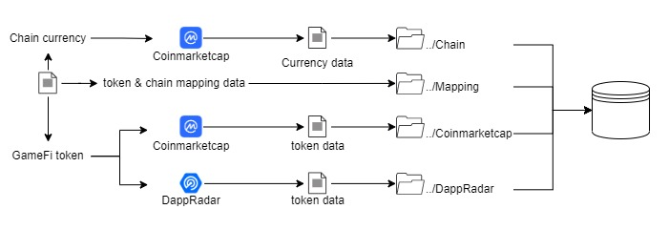
Collecting data
8,676 records

Slide 5
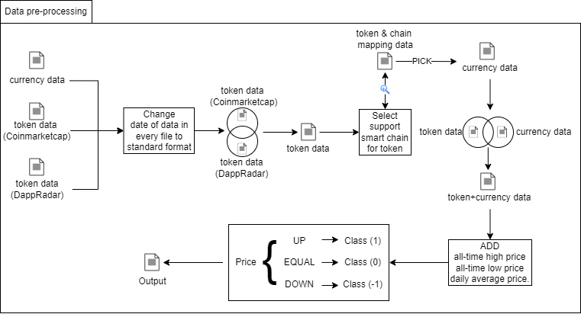
Pre-processing
“UP” has 3,147 recodes and
“DOWN” has 3,876 recodes.

Slide 6
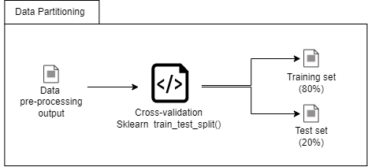
Partitioning data

Slide 7
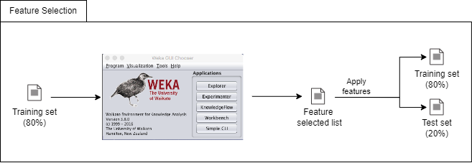
Selecting important features
ClassifierAttributeEval (ranker 1)
CorrelationAttributeEval (ranker 2)
PairwiseCorrelationAttributeEval (ranker 3).

Slide 8
Selecting important features(Cont.)
Feature ranking score
Feature | Ranker 1 score | Ranker 2 score | Ranker 3 score | Total score | Rank
Chain name | 1 | 2 | 13 | 16 | 9
Volume Coinmarketcap | 10 | 7 | 8 | 25 | 5(1)
Market Cap | 12 | 8 | 10 | 30 | 2(1)
UAW | 14 | 3 | 11 | 28 | 3
Volume DappRadar | 13 | 5 | 12 | 30 | 2(2)
Transactions | 9 | 1 | 9 | 19 | 8(1)
Open | 11 | 15 | 15 | 41 | 1
High | 8 | 10 | 1 | 19 | 8(2)
Low | 3 | 13 | 14 | 30 | 2(3)
Close | 2 | 6 | 2 | 10 | 10
Daily average | 4 | 12 | 3 | 19 | 8(3)
Chain open | 6 | 14 | 5 | 25 | 5(2)
Chain high | 5 | 11 | 4 | 20 | 7
Chain low | 7 | 9 | 6 | 22 | 6
Chain close | 15 | 4 | 7 | 26 | 4

Slide 9
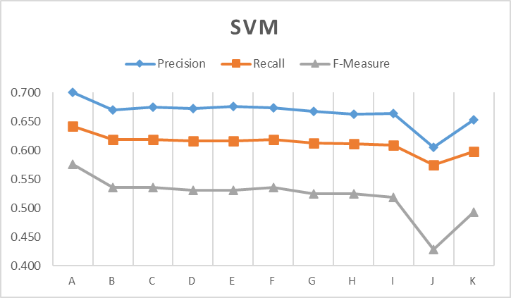
Using machine learning algorithms to build prediction models

Slide 10
Chain name conversion
SVM (Before conversion)
All features
Class | Precision | Recall | F-Measure
UP | 0.807 | 0.214 | 0.338
DOWN | 0.620 | 0.962 | 0.754
 | 0.700 | 0.641 | 0.576 | Weighted Avg.
Remove feature rank 10th
Class | Precision | Recall | F-Measure
UP | 0.756 | 0.159 | 0.262
DOWN | 0.604 | 0.962 | 0.742
 | 0.669 | 0.618 | 0.536 | Weighted Avg.
SVM (After conversion)
All features
Class | Precision | Recall | F-Measure
UP | 0.860 | 0.750 | 0.801
DOWN | 0.829 | 0.908 | 0.867
 | 0.842 | 0.840 | 0.839 | Weighted Avg.
Remove feature rank 10th
Class | Precision | Recall | F-Measure
UP | 0.820 | 0.706 | 0.759
DOWN | 0.800 | 0.884 | 0.840
 | 0.809 | 0.808 | 0.805 | Weighted Avg.
**Chain name conversion is converting all chain names to binary numbers by using One Hot Encoding to divide the categories into binary values

Slide 11
THANK YOU
QUESTION & ANSWER

