Slide 1
Enhancing Student Photography Skills with
Web-based Photo Stock and Learning System

Slide 2




Our team
Nontawat Thongsibsong
Kemachart Kemavuthanon
Surapol Vorapatratorn
Center of Excellence in Artificial
Intelligence and Emerging
Technologies,
School of Information Technology,
Mae Fah Luang University
Center of Excellence in Artificial
Intelligence and Emerging
Technologies,
School of Information Technology,
Mae Fah Luang University
Center of Excellence in Artificial
Intelligence and Emerging
Technologies,
School of Information Technology,
Mae Fah Luang University

Slide 3


Importance of photography education in universities

Slide 4


Problems
Lack of professional staff.
I need production experience.
Real-world training.

Slide 5

Use of stock photography techniques in teaching photography

Slide 6


Definition and purpose of stock photography.

Slide 7


Slide 8

What do stock agencies do?

Slide 9
"Photographers submit their images to an agency or distributor, who then approves the images, adds them to their collection, and sells them to buyers."
— Featureshoot blog at 500px agency.

Slide 10


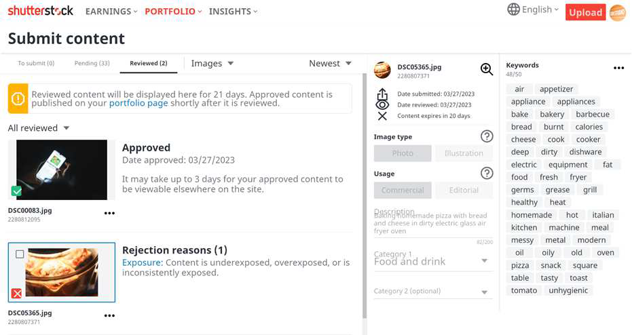

Submission process and licensing
Taking a pictures.
Submit to stock agencies.

Slide 11
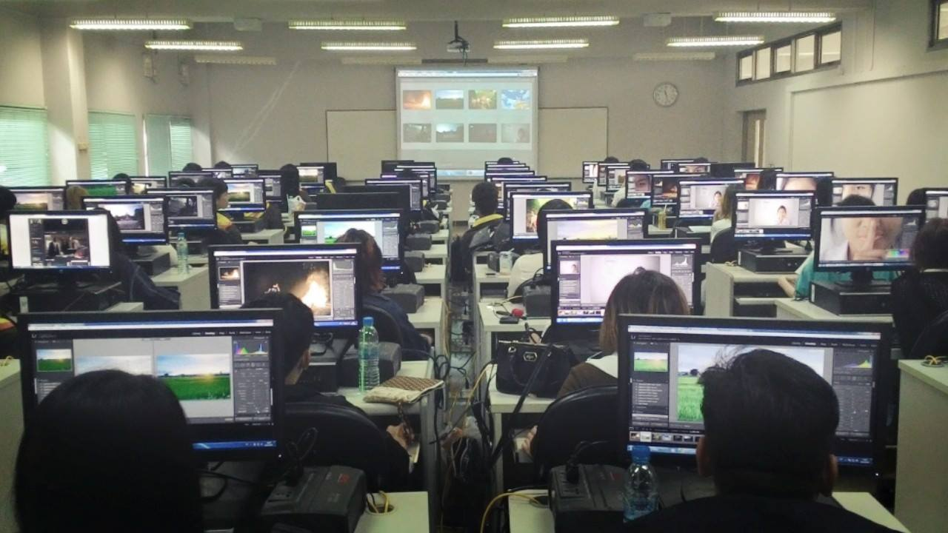
Benefits and challenges of incorporating stock photography in education

Slide 12

Skills
Your work will be checked by a professional.

Slide 13


Earning
Earning money thought licenses.

Slide 14

Experience
In getting accepted and selling your work.

Slide 15


Income
Your authorized permit allows for the ongoing sale of your photos.

Slide 16
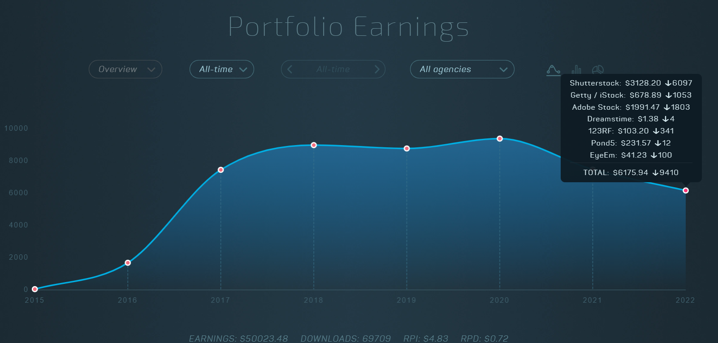
Income

Slide 17
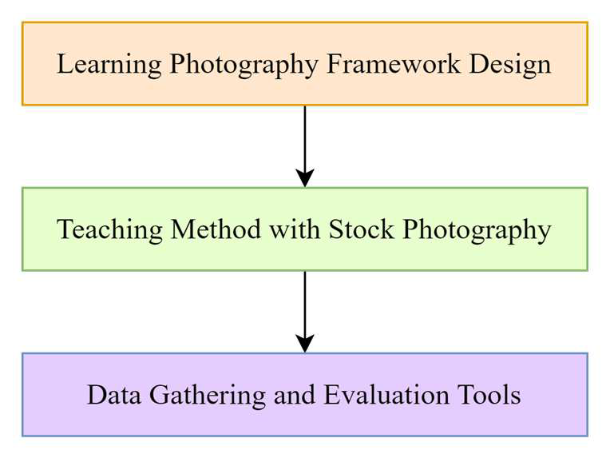
Proposed Method
Challenges faced in traditional teaching methods.
Introduction of a teaching course incorporating stock photography.

Slide 18

Examples of assignment-related factors.
Exposure
not underexposure or overexposure.

Slide 19

Examples of assignment-related factors.
Shutter speed
It refers to “blurred” images, presenting focus and sharpness issues as a result of using a slow shutter speed.

Slide 20

Examples of assignment-related factors.
Focus
Photos must be correctly focused

Slide 21


Examples of assignment-related factors.
Composition
The photo does not comply with the basic composition rules

Slide 22
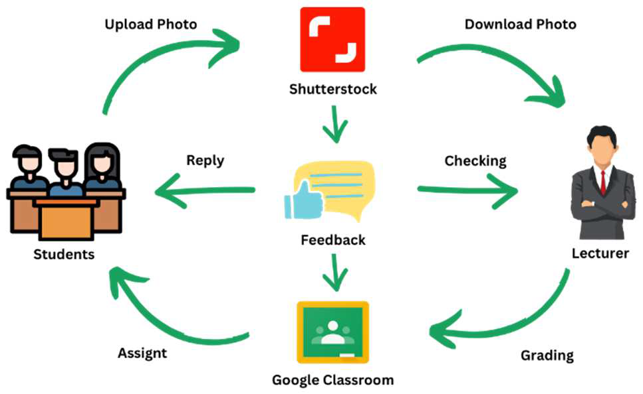
Learning Photography Framework Design
Problem-Based Learning (PBL) framework.
Integration of the PBL framework with the assessment framework.
Implementation in a specific digital photography course.

Slide 23
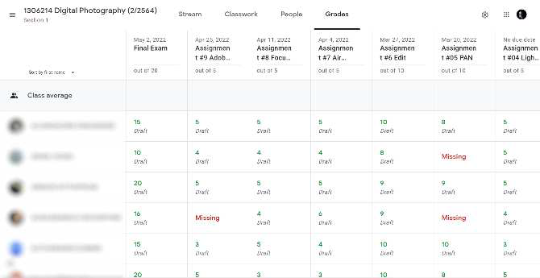
Data Gathering and Evaluation Tools
Two-part data collection process: stock
photo website and Google Classroom.
Submission, evaluation, and feedback workflow.
Grading and evaluation by the instructor.

Slide 24
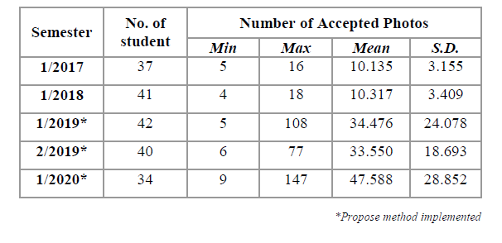
Evaluation and Results
Improvement in the number of accepted photos per student

Slide 25
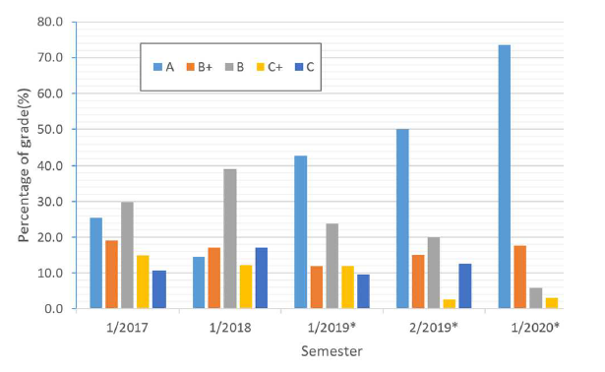
Evaluation and Results
percentage of grades in digital photography class from
semester 1/2017 to 1/2020

Slide 26



Conclusion and Future Challenges
Students have significantly improved their photography skills.

Slide 27

Conclusion and Future Challenges
Opportunities for students in the commercial market.

Slide 28

Conclusion and Future Challenges
Need for further improvements in the teaching system and automation of processes.

Slide 29
Questions and Discussion

