Slide 1



A Comparison of Machine Learning And Neural Network
Algorithms For An Automated Thai Essay Quality Checking
Nichaphan Noiyoo and Jessada Thutkawkornpin
Department of Computer Engineering, Faculty of Engineering
Chulalongkorn University
The 20th International Joint Conference on Computer Science and Software Engineering
28th June-1st July 2023
Naresuan University Phitsanulok, THAILAND

Slide 2
Agenda
Introduction
Objective
Background
Methodology
Result
Conclusion
Q&A

Slide 3
Introduction
Essay quality checking is one complex task.
Takes a lot of time in reading, interpreting and assessment. (at least 10 minutes/essay)
Checking the quality of each essays will have some distorted standards.
Checking the quality of the essays from different reviewers will have some distorted standards.

Slide 4
Objective
Reduce the review time for checking the quality of the essays
Criteria of essay's quality checking for each essay are of the same standard.
Compare the effectiveness of checking the quality of Thai essay writing by different model.

Slide 5
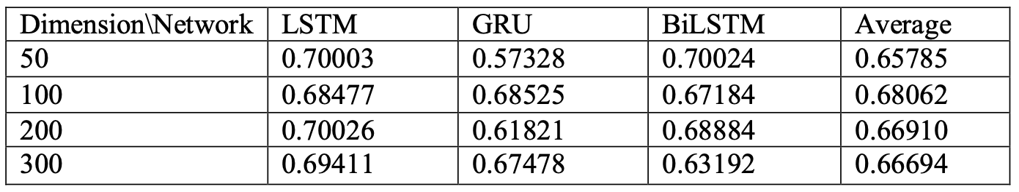
Background
This research, LSTM, GRU and BiLSTM techniques were used with the GloVe embedding technique to develop a linguistic model to compare the predictive score of essay.
Using the ASAP as a dataset on Kaggle for the Automated Essay Scoring (AES) for training.
Quadratic Weighted Kappa (QWK) value as a criterion for performance evaluation.
When comparing, the results found that using an LSTM model with embedding dimensions of 200 produced the best results with a mean of QWK = 0.70
W. Zhu and Y. Sun, "Automated essay scoring system using multi-model machine learning," International Conference on Machine Learning Techniques and NLP(MLNLP), pp. 110-117, 2020.

Slide 6
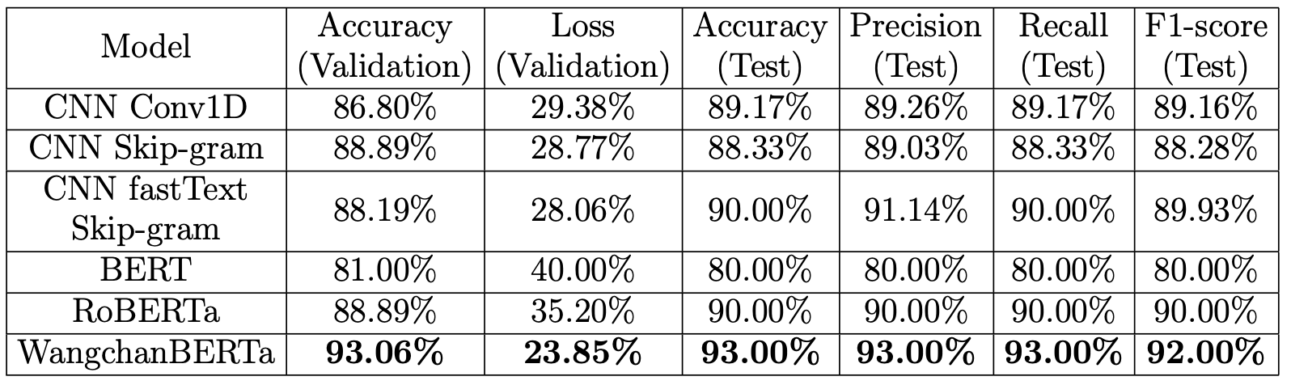
Background
This research applied CNN Conv1D, CNN Skip-gram, CNN FastText Skip-gram, BERT, RoBERTa and WangchanBERTa models aiming to find the best model for text classification processing on a small Thai dataset and obtain a timely-timeless article classification model.
The Thai-language dataset was collected posts from the Aizhongchina Facebook page from January 2019 to October 2021.
The retrieved dataset contains 600 articles (at least 250 words per article) were divided into 3 groups: training set 56%, validation set 24% and testing set 20%
WangchanBERTa has the best performance for both validation and testing accuracy.
P. Gatchalee, S. Waijanya and P. Promrit, "Thai text classification experiment using cnn and transformer models for timely-timeless content marketing," ICIC Express Letters, vol. 19, pp. 91-101, 2023.

Slide 7
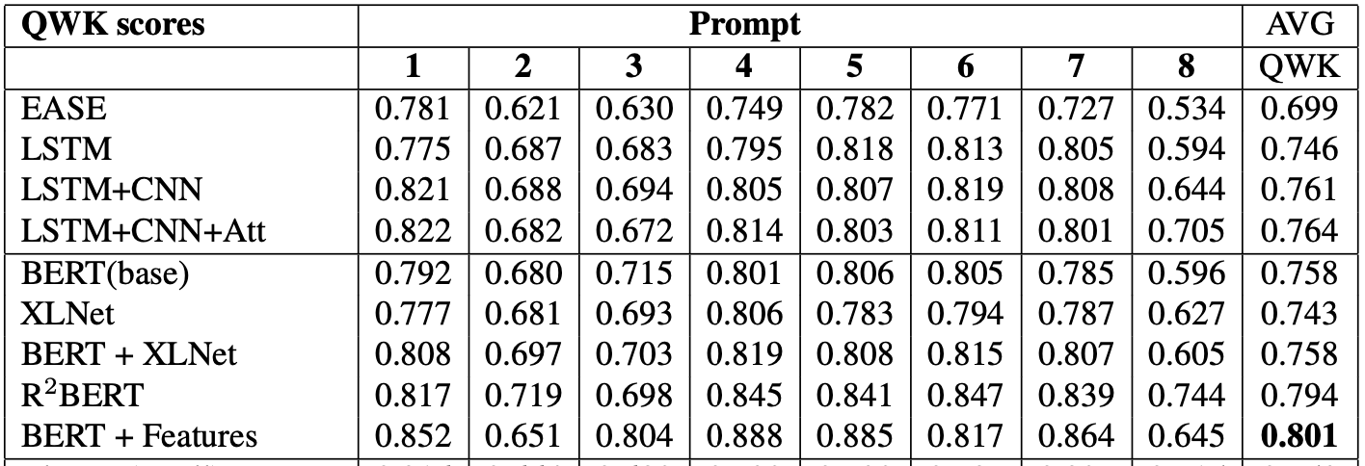
Background
The aim of this research is to develop a linguistic model to compare the predictive performance of essay scores.
Using 8 Automated Student Assessment Prize (ASAP) datasets for training model.
Quadratic Weighted Kappa (QWK) was used as a criterion for performance evaluation.
When comparing, the results found that using BERT model with features produced the best results with a mean of QWK = 0.801
C. Ormerod, A. Malhotra, and A. Jafari, "Automated essay scoring using efficient transformer-based language models," arXiv preprint arXiv: 2102.13136, 2021.

Slide 8
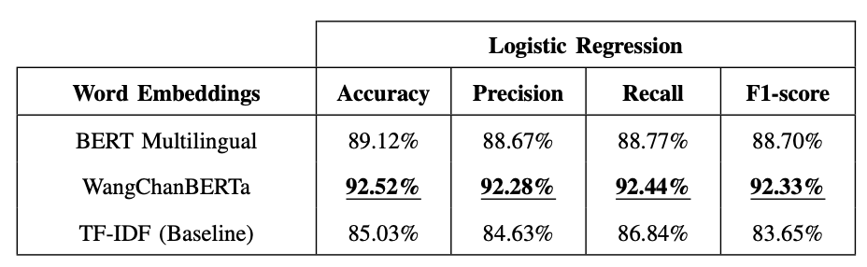
Background
This research developed a language model to compare the effectiveness of the analysis of opinions on Thai stocks.
The training datasets were divided into 3 groups: Buy (Positive polarity), Hold (Neutral polarity), Sell (Negative polarity)
The Accuracy, Precision, Recall, and F1-score were used as criteria for measurement.
The experimental result shows that WangchanBERTa pre-trained model can achieve the best accuracy at 92.52% .
P. Harnmetta and T. Samanchuen, "Sentiment analysis of thai stock reviews using transformer models," 19th International Joint Conference on Computer Science and Software Engineering (JCSSE), pp. 1-6, 2022.

Slide 9
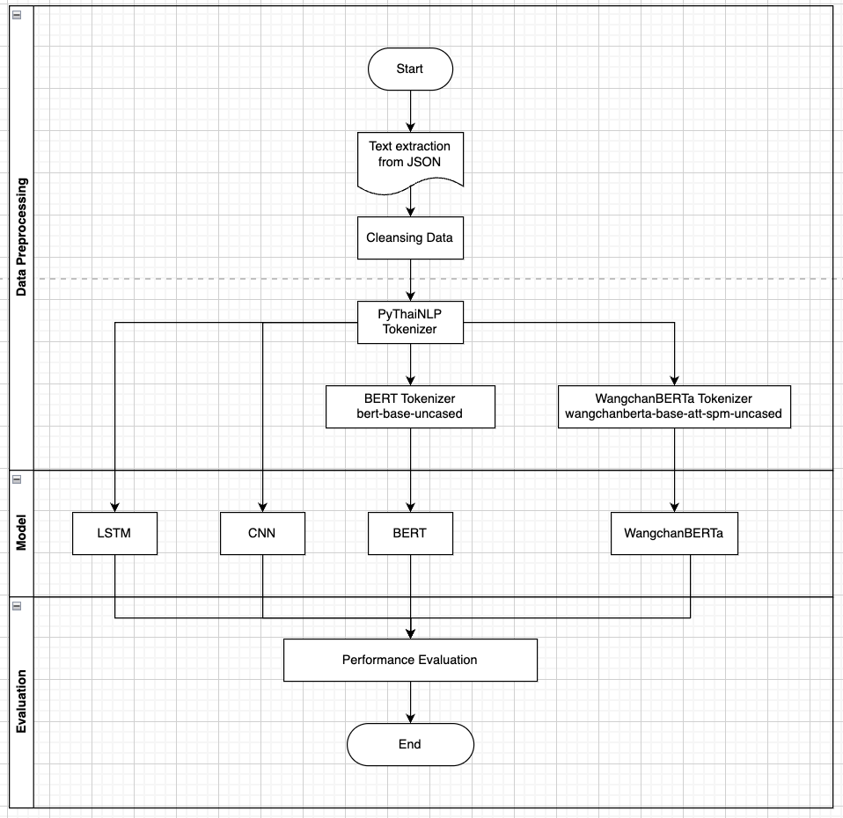
Methodology
The overview workflow for create machine learning model for an automated Thai essay quality checking

Slide 10
PROPOSED METHOD
Data Collecting
Collect essays in Thai Language from Sirindhorn Thai Language Institute
Data Preprocessing
Remove stop word and Tokenization
Classification Model
LSTM
CNN
BERT
WangchanBERTa
Performance Evaluation
Accuracy
Precision
Recall
F1 - Score

Slide 11
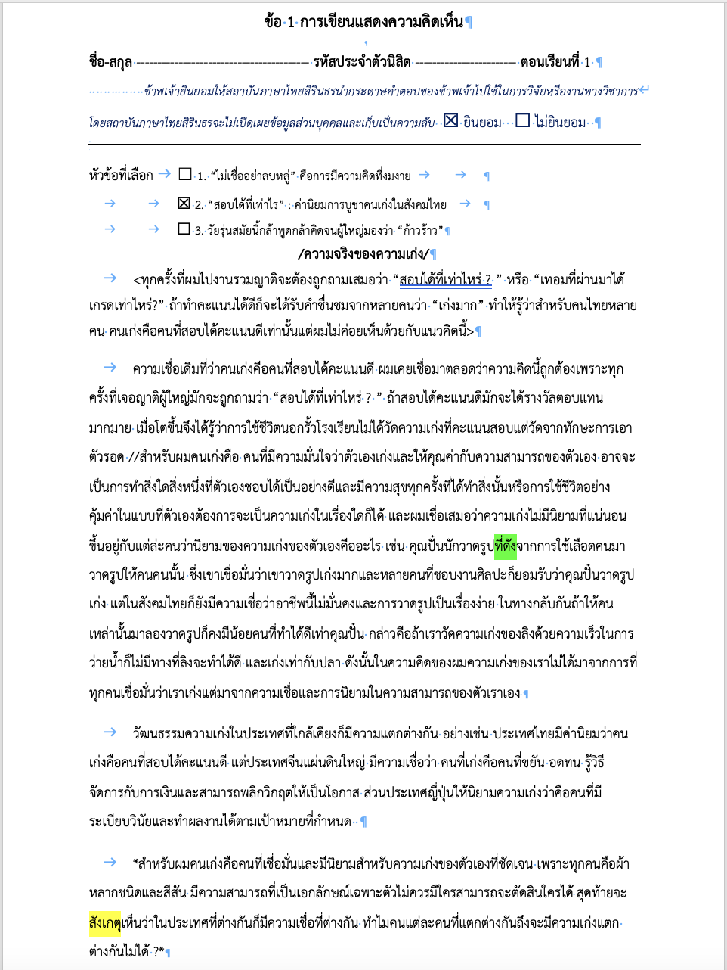
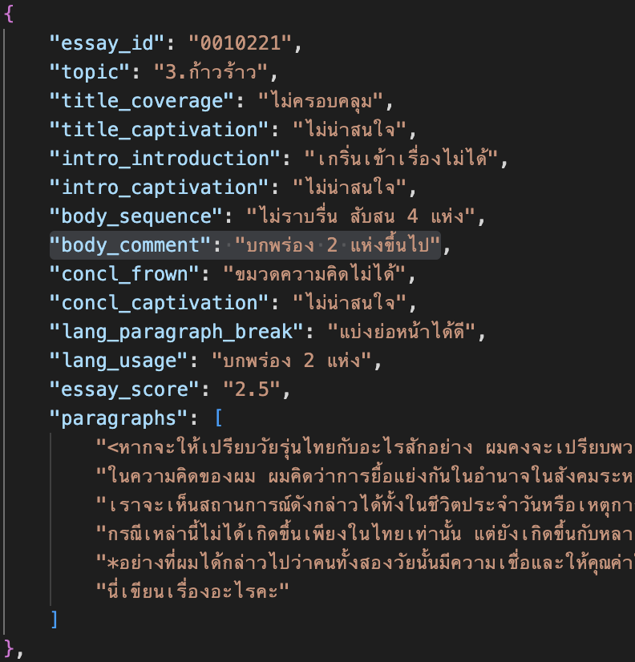
Data Collecting
Collecting essays in Thai Language from Sirindhorn Thai Language Institute
Transform essay data from text format to JSON format

Slide 12
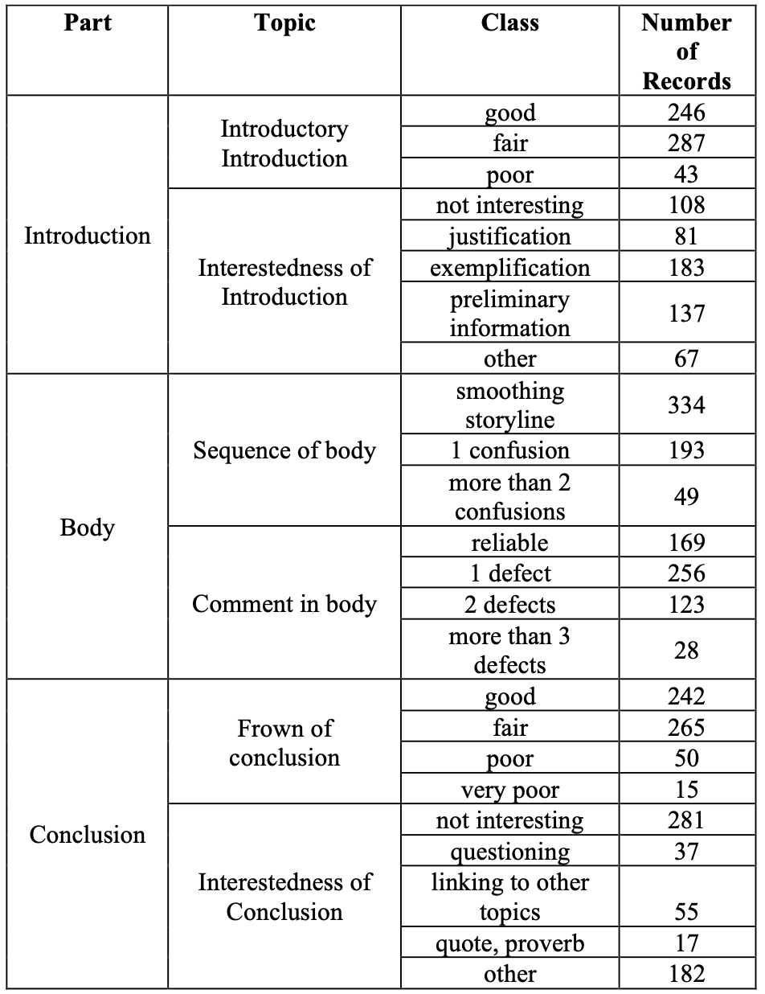
Data Collecting
An essay was divided into 3 parts introduction, body, and conclusion to examine the quality of the writing in 7 topics.
Characteristics of the class description and number of individual data classes are shown in this table.
Regression Problem
Classification Problem
Regression Problem
Regression Problem
Regression Problem
Classification Problem

Slide 13
Data Preprocessing
Oversampling data
Remove special character
Remove stop word
Tokenization
  PyThaiNLP ( Engine : newmm )
  BERT Tokenizer
  WangchanBERTa Tokenizer
Set sequence length of each sample by most common token length in each part of the essay

Slide 14
Data Preprocessing
Split Dataset (576 Essays)
  - Training set (400 Essays)
  - Validation set (57 Essays)
  - Testing set (114 Essays)

Slide 15
Classification Model
We adopted 2 set of configurations for 4 model.
  LSTM
  CNN
  BERT
  WangchanBERTa
Configuration#1 is compiled using Adam optimizer and Binary Crossentropy as loss function.
Configuration#2 is compiled using RMSprop optimizer and Mean Squared Error as a loss function.

Slide 16
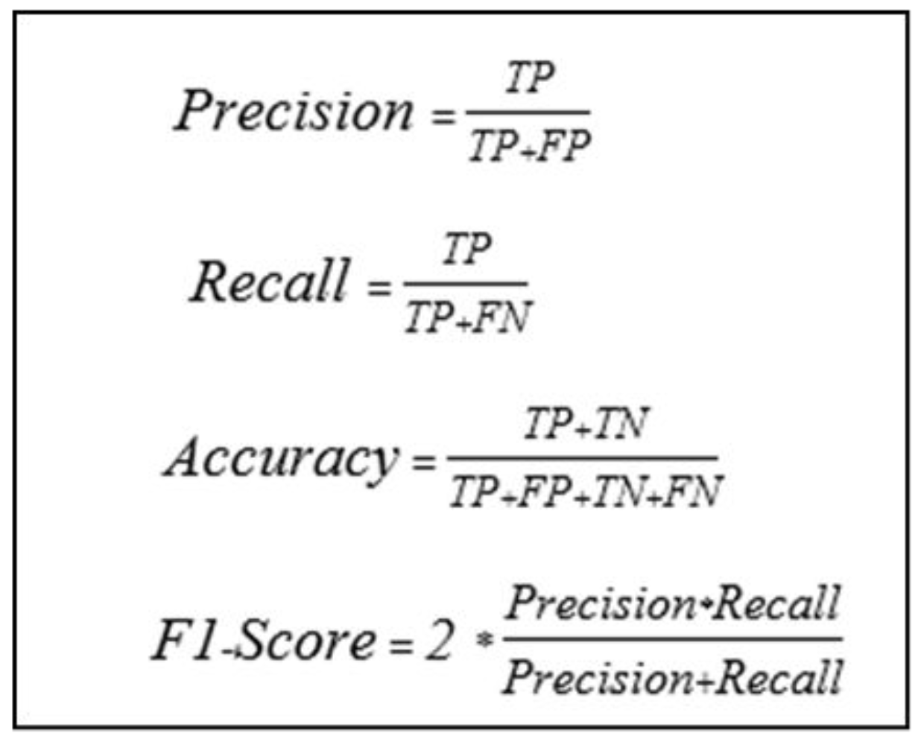
Performance Evaluation
Use testing data that is not included in training model processing for validation
Conclusion Metrix
  Accuracy
  Precision
  Recall
  F1-score
 |  | Actual
 |  | Positive(1) | Negative(0)
Predicted | Positive(1) | True Positive | False Positive
 | Negative(0) | False Negative | True Negative

Slide 17
Accuracy Result
Adam Optimizer
RMSprop Optimizer
Algorithm | LSTM | CNN | BERT | WangchanBERTa
Introductory Introduction | 38.37 | 92.44 | 92.44 | 91.28
Interestedness of Introduction | 20.77 | 87.98 | 77.05 | 90.16
Sequence of body | 88.50 | 96.50 | 64.50 | 97.00
Comment in body | 44.39 | 95.61 | 71.71 | 90.24
Frown of conclusion | 91.98 | 92.45 | 91.04 | 93.40
Interestedness of Conclusion | 95.37 | 96.80 | 59.43 | 97.15
Part of Essay | 55.78 | 98.55 | 93.06 | 97.98
Algorithm | LSTM | CNN | BERT | WangchanBERTa
Introductory Introduction | 59.88 | 92.44 | 36.63 | 36.63
Interestedness of Introduction | 22.95 | 90.71 | 54.10 | 86.89
Sequence of body | 34.00 | 93.00 | 79.00 | 89.00
Comment in body | 26.83 | 91.71 | 81.46 | 51.22
Frown of conclusion | 84.43 | 93.40 | 44.81 | 31.60
Interestedness of Conclusion | 90.39 | 97.15 | 57.30 | 77.94
Part of Essay | 34.39 | 98.27 | 33.24 | 33.24

Slide 18
Precision Result
Adam Optimizer
RMSprop Optimizer
Algorithm | LSTM | CNN | BERT | WangchanBERTa
Introductory Introduction | 45.76 | 92.69 | 92.48 | 91.48
Interestedness of Introduction | 4.15 | 88.73 | 77.52 | 90.10
Sequence of body | 88.42 | 96.56 | 64.49 | 97.45
Comment in body | 46.97 | 96.37 | 72.71 | 90.71
Frown of conclusion | 92.33 | 92.83 | 91.19 | 93.61
Interestedness of Conclusion | 95.39 | 96.81 | 62.30 | 97.02
Part of Essay | 37.26 | 98.65 | 93.06 | 97.98
Algorithm | LSTM | CNN | BERT | WangchanBERTa
Introductory Introduction | 74.10 | 92.56 | 12.21 | 12.21
Interestedness of Introduction | 14.53 | 90.19 | 62.90 | 87.81
Sequence of body | 11.33 | 93.52 | 80.66 | 88.74
Comment in body | 6.71 | 91.66 | 84.60 | 53.63
Frown of conclusion | 85.13 | 93.08 | 35.49 | 58.90
Interestedness of Conclusion | 90.55 | 97.26 | 73.57 | 78.22
Part of Essay | 11.46 | 98.24 | 11.08 | 11.08

Slide 19
Recall Result
Adam Optimizer
RMSprop Optimizer
Algorithm | LSTM | CNN | BERT | WangchanBERTa
Introductory Introduction | 35.19 | 92.08 | 92.59 | 91.62
Interestedness of Introduction | 2.00 | 87.93 | 76.64 | 90.15
Sequence of body | 86.54 | 96.26 | 63.44 | 96.42
Comment in body | 42.65 | 95.05 | 73.00 | 90.87
Frown of conclusion | 91.97 | 92.99 | 91.28 | 93.57
Interestedness of Conclusion | 95.46 | 96.82 | 59.23 | 96.89
Part of Essay | 35.19 | 92.08 | 92.59 | 91.62
Algorithm | LSTM | CNN | BERT | WangchanBERTa
Introductory Introduction | 57.91 | 92.47 | 33.33 | 33.33
Interestedness of Introduction | 20.50 | 90.01 | 54.15 | 86.92
Sequence of body | 33.33 | 93.71 | 80.76 | 88.32
Comment in body | 25.00 | 91.45 | 82.57 | 53.00
Frown of conclusion | 84.91 | 93.06 | 44.86 | 31.25
Interestedness of Conclusion | 90.78 | 97.38 | 57.33 | 76.54
Part of Essay | 33.33 | 98.26 | 33.33 | 33.33

Slide 20
F1-Score Result
Adam Optimizer
RMSprop Optimizer
Algorithm | LSTM | CNN | BERT | WangchanBERTa
Introductory Introduction | 21.61 | 92.26 | 92.53 | 91.44
Interestedness of Introduction | 8.34 | 88.03 | 75.27 | 90.06
Sequence of body | 87.12 | 96.31 | 63.81 | 96.83
Comment in body | 29.85 | 95.38 | 71.87 | 90.55
Frown of conclusion | 92.01 | 92.84 | 91.22 | 93.57
Interestedness of Conclusion | 95.39 | 96.81 | 59.82 | 96.95
Part of Essay | 44.72 | 98.61 | 93.07 | 97.98
Algorithm | LSTM | CNN | BERT | WangchanBERTa
Introductory Introduction | 57.14 | 92.51 | 17.87 | 17.87
Interestedness of Introduction | 8.34 | 90.02 | 52.33 | 87.01
Sequence of body | 16.92 | 93.51 | 78.18 | 88.50
Comment in body | 10.58 | 91.54 | 82.24 | 49.81
Frown of conclusion | 84.17 | 93.04 | 36.90 | 22.42
Interestedness of Conclusion | 90.39 | 97.31 | 57.59 | 75.68
Part of Essay | 17.06 | 98.25 | 16.63 | 16.63

Slide 21
Conclusion
CNN model and WangchanBERTa model with configuration#1 can achieve the best performance in all dimensions.
For configuration#2, CNN model performs the best result in all topics.
When comparing accuracy results of 2 configuration, most of models complied with configuration#1 produced the best result in both of regression and classification problem.
The 2 transformer-based models have poor result for most topics when the models compiled with configuration#2.
Accuracy Result of 2 Configurations
Algorithm | Configuration#1 | Configuration#2
Introductory Introduction | CNN 92.44 | CNN 92.44
Interestedness of Introduction | WangchanBERTa 90.16 | CNN 90.71
Sequence of body | WangchanBERTa 97.00 | CNN 93.00
Comment in body | CNN 95.61 | CNN 91.71
Frown of conclusion | WangchanBERTa 93.40 | CNN 93.40
Interestedness of Conclusion | WangchanBERTa 97.15 | CNN 97.15
Part of Essay | CNN 98.55 | CNN 98.27

Slide 22
Q&A
A
Q

Slide 23
THANK YOU
QUESTION & ANSWER

