Slide 1



Improving Pre-Trained Models for Multi-Label Classification in Stack Overflow:
A Comparison of Imbalanced Data
Handling Methods
Arisa Umparat
Suronapee Phoomvuthisarn
Department of Statistics,Chulalongkorn University
The 20th International Joint Conference on Computer Science and Software Engineering
28th June-1st July 2023
Naresuan University Phitsanulok, THAILAND

Slide 2
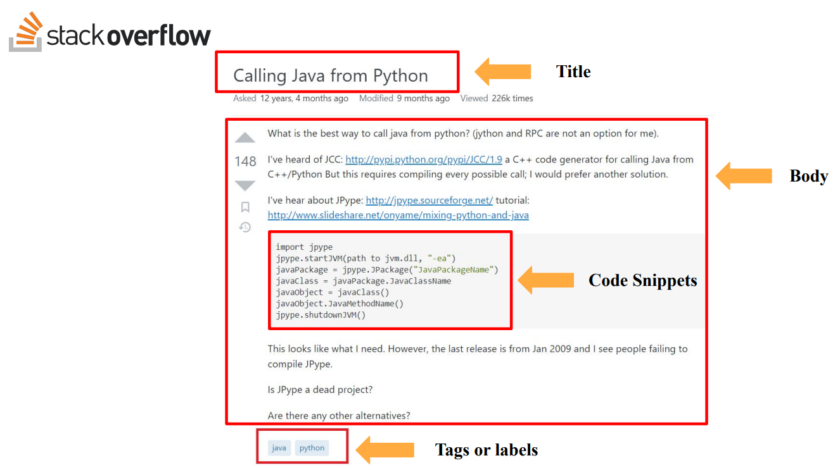
Fig 1. An example of Stack Overflow’s question

Slide 3
MULTI-LABEL
CLASSIFICATION PROBLEM
There are numerous challenges [15] :
- Noisy data from insignificant features in high-dimensionality data
- Degrading the quality of data from cleaning process and label dependency
- Uncertain and imbalance data
- Label uncertainty from adding unnecessary labels and drifting labels.
We focus on imbalances by comparing LP-ROS, ML-ROS, MLeNN, MLTL, MLSOL, MLSMOTE and REMEDIAL resampling methods.

Slide 4
MULTI-LABEL
CLASSIFICATION PROBLEM
There are not much tag recommendation works has studied about the performance of pretrained models in managing a multi-label classification problem from Stack Overflow posts with the thousands of labels. He et al. (2022) [6] combined pre-trained PTM4Tag with multilabel classification problem
- PTM4Tag [6] including pre-trained BERT [7], RoBERTa [8], ALBERT [9], CodeBERT [10] and BERTOverflow [11] which outperform than Post2Vec
- ELECTRA have never been trained for tag recommendation in multi-label classification problem in Stack Overflow Q&A Site

Slide 5
OBJECTIVE
This study aims to address this imbalanced data challenge by comparing various multi-label resampling methods to improve the performance of a deep learning pre-trained model. We focus solely on multi-label classification and the efficiency of ELECTRA, the pre-trained model because ELECTRA can be trained on a single GPU due to our limited resources. Furthermore, it has never been trained for tag prediction in multi-label classification problems in the Stack Overflow Q&A Site.

Slide 6
PRE-TRAINED MODEL
FOR OUR APPROACH
The reasons we select ELECTRA:
- Takes less time-consuming and is superior to RoBERTa [16] and XLNet [17]
- Achieves higher accuracy on downstream tasks when fully trained
- Can be trained on a single GPU [12] due to our limited resources
- Useful in tackling Stack Overflow-related downstream tasks such as Question Answering or Text Classification.
- No previous research that has referred to pre-trained ELECTRA for tag recommendation in multi-label classification problems from Stack Overflow posts.

Slide 7
MULTI-LABEL RESAMPLING
FOR OUR APPROACH
The reasons we select LP-ROS, ML-ROS, REMEDIAL, MLSOL, MLTL, MLeNN, and MLSMOTE
- Undersampling, whether random or heuristic, should not be applied to MLDs, which are not truly imbalanced and cause a significant loss of information potentially useful in the training process [21].
- MLTL, MLeNN, REMEDIAL, LP-ROS, MLSOL, ML-ROS, and MLSMOTE have never been investigated with pre-trained model for the Stack Overflow dataset.

Slide 8
MULTI-LABEL RESAMPLING
FOR OUR APPROACH
ML-ROS and MLSMOTE are appropriate to solve imbalanced issues
in multi-label deep learning [1].
- MLSMOTE, oversampling method, generates each minority sample as a seed for a new synthetic sample and is recommended to use with highly imbalanced multi-label datasets [8].
- MLeNN and MLTL are limited by the construction of features and not clear neighbors for large-scale learning [1].

Slide 9
MULTI-LABEL RESAMPLING
FOR OUR APPROACH
- REMEDIAL and hybridizations do not perform well under deep learning scenarios, since REMEDIAL generates many virtual labelsets and change the paradigm of the label space [1].
- LP-ROS replicates instances whose label set appears the fewest times
- MLROS, oversampling method that works with an individual imbalance evaluation per label, instead of using full labelsets, which use them to decide the instances that will be cloned or removed [18], could be useful for our Stack Overflow with many labels and hard to decide.

Slide 10
RESEARCH QUESTIONS
Which Multi-Label Resampling Method is the Best for Tackling the Imbalanced Problem from SO Posts?
We compare different multi-label resampling methods, such as LP-ROS, ML-ROS, MLSMOTE, MLeNN, MLTL, ML-SOL, and REMEDIAL to decrease imbalanced datasets from Q&A sites, by examining the effectiveness and performance of the pre-trained ELECTRA model. Our evaluation metrics include 𝑃𝑟𝑒𝑐𝑖𝑠𝑖𝑜𝑛@𝑘, 𝑅𝑒𝑐𝑎𝑙𝑙@𝑘, 𝐹1-𝑠𝑐𝑜𝑟𝑒@k, and AUC.

Slide 11
METHODOLOGY
We selected the Stack Overflow dataset from the SO dump,
The posts are divided into three main parts :
- Title
- Body (description)
- Code snippets
- Tags

Slide 12
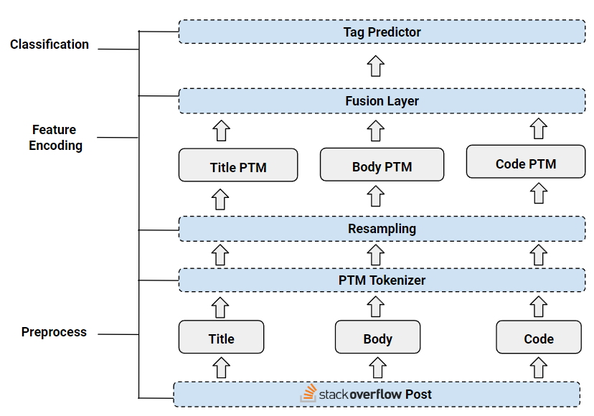
Fig 2. A workflow of Stack Overflow’s tag classification

Slide 13
PRE-PROCESSING
- Stack Overflow posts including Title, Body (description), and Code snippets
- Split from body by “<code> (. *?) </code>.”
- Removing HTML tag, punctuation and stopwords in the posts, the title and body are combined into the texts and convert text into the lowercase.

Slide 14
PRE-PROCESSING
Remove the rare tags ( its occurrence less than a threshold 𝜃 = 50 ) to reduce the noisy data as follow by Xu et al. (2021) [5]. Also the rare and frequent labels in a multi-label dataset reduce effective in the resampling strategies [26].
Converting the labels into vector

Slide 15
PTM-ORIENTED TOKENIZATION
Converting the texts into tokens by ELECTRA tokenizer, the token from tokenization is compounded with special tokens
< 𝐶𝐿𝑆 > (Classification), the first token of every input sequence, and < 𝑆𝐸𝑃 > (Separator), the end token of every input sequence.

Slide 16
RESAMPLING TECHNIQUES
LPROS
ML-ROS
MLSMOTE
MLeNN
MLTL
MLSOL
REMEDIAL

Slide 17
MODEL TRAINING
Learning rate of 7E-5 with a batch size of 64
Utilizing the Adam optimizer
The objective function was set as binary-cross entropy loss.
The best model was selected based on the lowest loss achieved
on the validation set

Slide 18
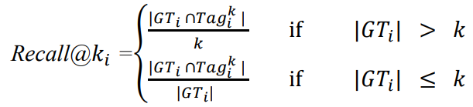

EVALUATION METRICS
Recall@k
The proportion of correctly predicted ground truth tags found in the list of ground truth tags with the same equation as followed by [5].
For average all the values of Recall@ki:

Slide 19


EVALUATION METRICS
F1-Score@k
Define harmonic mean of Precision@k and Recall@k
For average all the values of F1-score@ki:

Slide 20
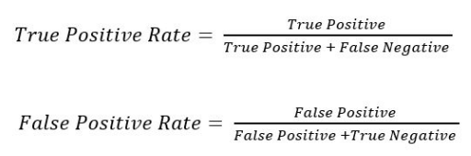
EVALUATION METRICS
Area under the curve ( AUC)
To deal with the imbalance class, we use Area Under the Curve (AUC) to evaluate the model by the Area under the ROC (Receiver Operating Characteristic) curve, which consists of a True Positive Rate and False Positive Rate

Slide 21
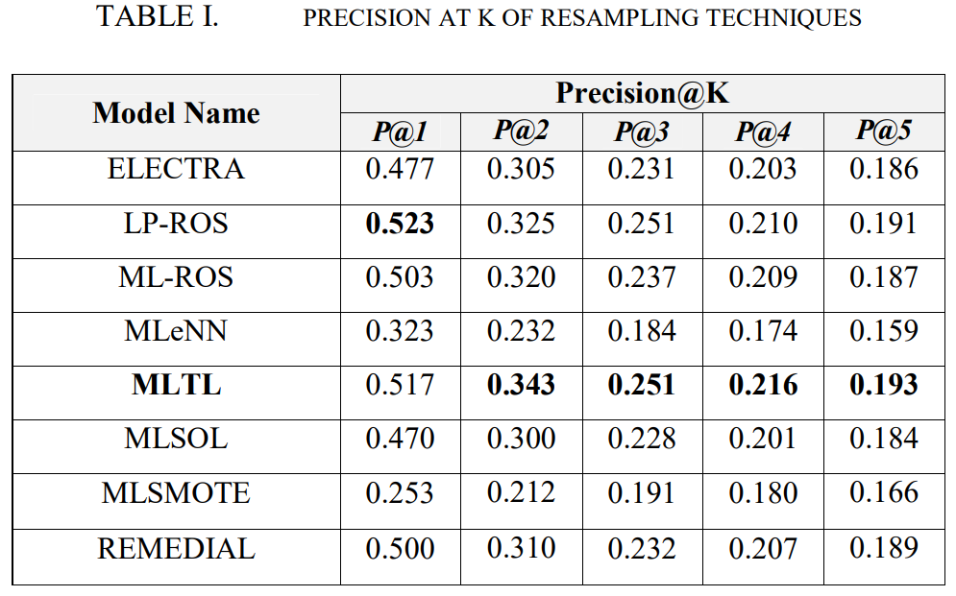
EXPERIMENTAL RESULT

Slide 22
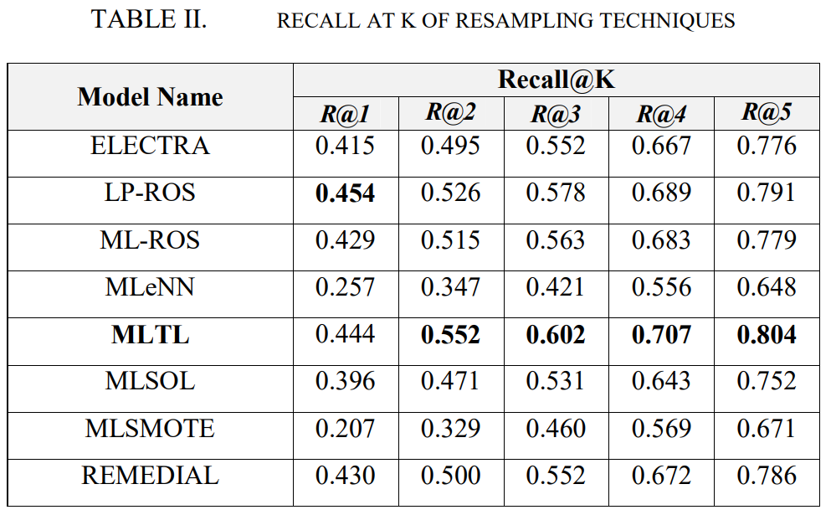

Slide 23
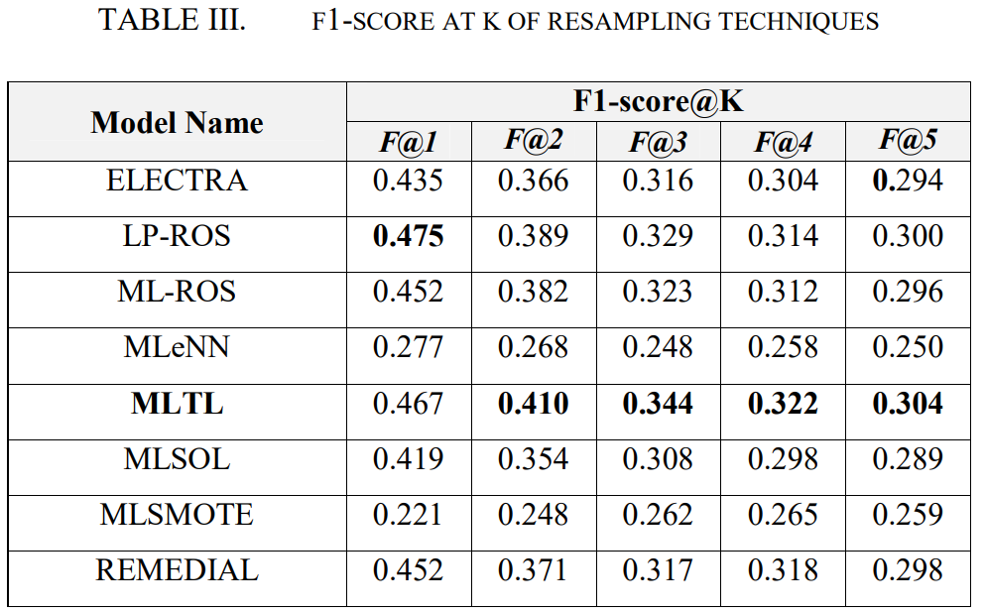

Slide 24
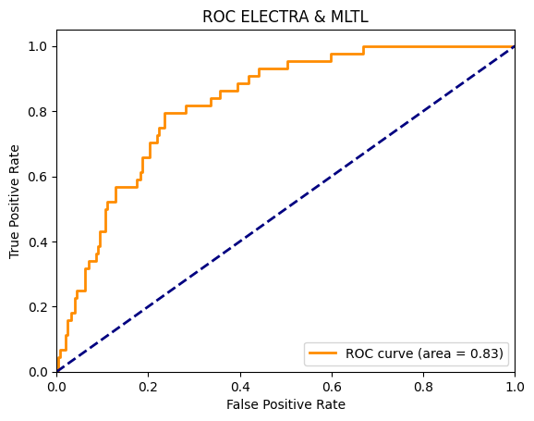
Fig 3. ELECTRA & MLTL ROC curve of class 3

Slide 25
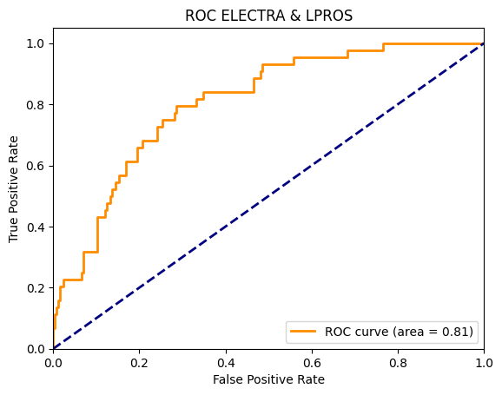
Fig 4. ELECTRA & LPROS ROC curve of class 3

Slide 26
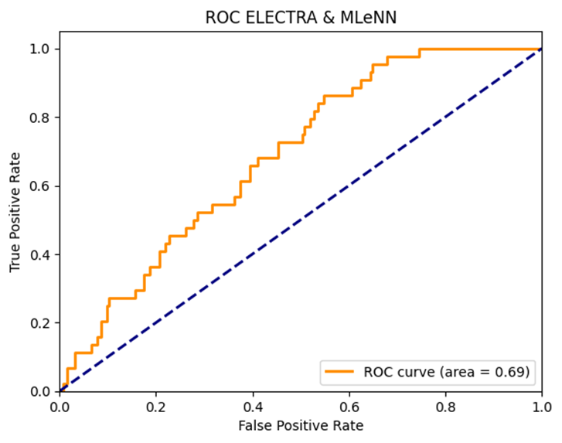
Fig 5. ELECTRA & MLeNN ROC curve of class 3

Slide 27
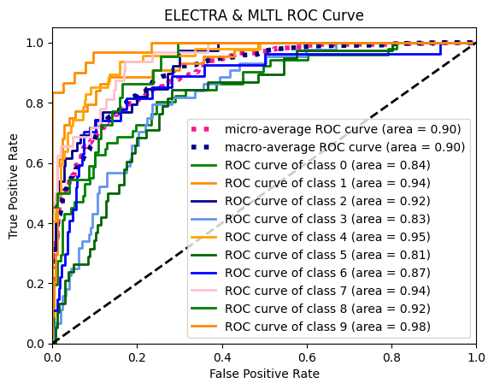
Fig 6. Multi-Class ELECTRA & MLTL ROC curve

Slide 28
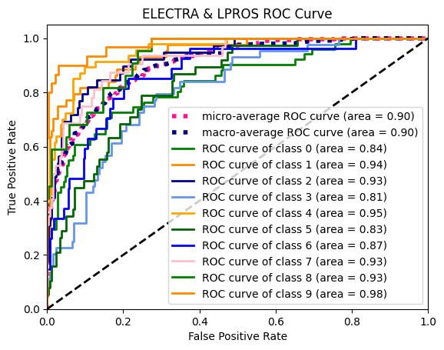
Fig 7. Multi-Class ELECTRA & LPROS ROC curve

Slide 29
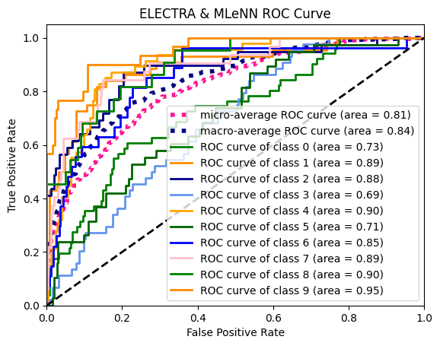
Fig 8. Multi-Class ELECTRA & MLeNN ROC curve

Slide 30
- ML-ROS, the most frequent labels are from the minority samples.
- LP-ROS only considers the whole labelset.
- REMEDIAL changes the pattern of the label space and synthesized too many virtual labelsets.
- MLSOL concentrates only on local label distribution.
- MLSMOTE generates new synthetic samples that are added somewhere in the feature space, causing the class groups to overlap.
- MLeNN underperforms all benchmarks due to its reliance on insignificant features and neighbors.
- MLTL uses the traditional Tomek Link technique to correct the imbalance.

Slide 31
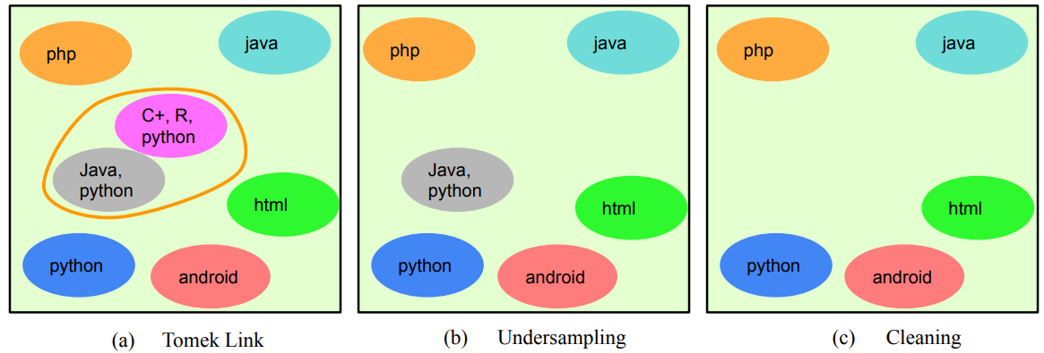
Fig 9. The Multi-label classic Tomek Link modified from [15]
- If used as an undersampling technique, only the samples from the majority class are removed.
- If used as a post-process cleaning step both samples are removed.

Slide 32
For large-scale learning like multi-label in deep learning scenarios, it is difficult to create an unambiguous neighbor relationship. This ultimately results in the inaccurate deletion of significant samples.
As a result, MLeNN struggles with features and a neighbor-based strategy that are distinct from those utilized by MLTL. It uses the traditional Tomek Link technique to correct the imbalance.

Slide 33
CONCLUSION AND FUTURE WORK
The results showed that MLTL is a suitable selection to manage the imbalance in multi-label classification for our Stack Overflow data. Still, with the overfitting issue from the oversampling data, we suggest using other methods to address the issue, such as the hybrid method. Other pre-trained models can improve performance, mainly when used with multiple GPUs. However, researchers should choose the resampling method that is most appropriate for their specific dataset and problem.

Slide 34
THANK YOU
QUESTION & ANSWER

Slide 35
REFERENCES
[1] P. Zhou, J. Liu, X. Liu, Z. Yang, and J. C. Grundy, "Is deep learning better than traditional approaches in tag recommendation for software information sites?," Inf. Softw. Technol., vol. 109, pp. 1-13, 2019.
[2] S. Wang, D. Lo, B. Vasilescu, and A. Serebrenik, "EnTagRec++: An enhanced tag recommendation system for software information sites," Empirical Software Engineering, vol. 23, pp. 800-832, 2014.
[3] P. Zhou, J. Liu, Z. Yang, and G. Zhou, "Scalable tag recommendation for software information sites," 2017 IEEE 24th International Conference on Software Analysis, Evolution and Reengineering (SANER), pp. 272-282, 2017.
[4] J. Liu, P. Zhou, Z. Yang, X. Liu, and J. C. Grundy, "FastTagRec: fast tag recommendation for software information sites," Automated Software Engineering, vol. 25, pp. 675-701, 2018.
[5] B. Xu, T. Hoang, A. Sharma, C. Yang, X. Xia, and D. Lo, "Post2Vec: Learning Distributed Representations of Stack Overflow Posts," IEEE Transactions on Software Engineering, vol. 48, pp. 3423-3441, 2022.

Slide 36
REFERENCES
[6] D. Peng, T. Gu, X. Hu, and C. Liu, "Addressing the multi-label imbalance for neural networks: An approach based on stratified mini-batches," Neurocomputing, vol. 435, pp. 91-102, 2021.
[7] F. Charte, A. J. Rivera, M. J. d. Jesús, and F. Herrera, "Tackling Multilabel Imbalance through Label Decoupling and Data Resampling Hybridization," ArXiv, vol. abs/1802.05031, 2017.
[8] F. Charte, A. J. Rivera, M. J. d. Jesús, and F. Herrera, "A First Approach to Deal with Imbalance in Multi-label Datasets," in Hybrid Artificial Intelligence Systems, 2013.
[9] F. Charte, A. J. Rivera, M. J. d. Jesús, and F. Herrera, "Addressing imbalance in multilabel classification: Measures and random resampling algorithms," Neurocomputing, vol. 163, pp. 3-16, 2015.
[10] F. Charte, A. J. Rivera, M. J. d. Jesús, and F. Herrera, "Resampling Multilabel Datasets by Decoupling Highly Imbalanced Labels," in Hybrid Artificial Intelligence Systems, 2015.

Slide 37
REFERENCES
[11] A. F. Giraldo-Forero, J. A. Jaramillo-Garzón, J. F. Ruiz-Muñoz, and G. Castellanos-Domínguez, "Managing Imbalanced Data Sets in Multi-label Problems: A Case Study with the SMOTE Algorithm," in Iberoamerican Congress on Pattern Recognition, 2013.
[12] F. Charte, A. J. Rivera, M. J. d. Jesús, and F. Herrera, "MLeNN: A First Approach to Heuristic Multilabel Undersampling," in Ideal, 2014.
[13] F. Charte, A. J. Rivera, M. J. d. Jesús, and F. Herrera, "MLSMOTE: Approaching imbalanced multilabel learning through synthetic instance generation," Knowl. Based Syst., vol. 89, pp. 385-397, 2015.
[14] B. Liu and G. Tsoumakas, "Synthetic Oversampling of Multi-Label Data based on Local Label Distribution," in ECML/PKDD, 2019.
[15] R. M. Pereira, Y. M. G. Costa, and C. N. Silla, "MLTL: A multi-label approach for the Tomek Link undersampling algorithm," Neurocomputing, vol. 383, pp. 95-105, 2020.

Slide 38
REFERENCES
[16] F. Charte, A. J. Rivera, M. J. del Jesus, and F. Herrera, "REMEDIAL-HwR: Tackling multilabel imbalance through label decoupling and data resampling hybridization," Neurocomputing, vol. 326, pp. 110-122, 2019.
[17] B. Liu, K. Blekas, and G. Tsoumakas, "Multi-label sampling based on local label imbalance," Pattern Recognition, vol. 122, p. 108294, 2022.
[18] P. Pant, A. S. Sabitha, T. Choudhury, and P. Dhingra, "Multi-label Classification Trending Challenges and Approaches," Advances in Intelligent Systems and Computing, 2018.
[19] J. Von der Mosel, A. Trautsch, and S. Herbold, "On the validity of pre-trained transformers for natural language processing in the software engineering domain," IEEE Transactions on Software Engineering, 2022.
[20] K. Clark, M.-T. Luong, Q. V. Le, and C. D. Manning, "ELECTRA: Pre-training Text Encoders as Discriminators Rather Than Generators," ArXiv, vol. abs/2003.10555, 2020.

Slide 39
REFERENCES
[21] Y. Liu et al., "RoBERTa: A Robustly Optimized BERT Pretraining Approach," ArXiv, vol. abs/1907.11692, 2019.
[22] Z. Yang, Z. Dai, Y. Yang, J. G. Carbonell, R. Salakhutdinov, and Q. V. Le, "XLNet: Generalized Autoregressive Pretraining for Language Understanding," in Neural Information Processing Systems, 2019.
[23] J. He, B. Xu, Z. Yang, D. Han, C. Yang, and D. Lo, "PTM4Tag: Sharpening Tag Recommendation of Stack Overflow Posts with Pre-trained Models," 2022 IEEE/ACM 30th International Conference on Program Comprehension (ICPC), pp. 1-11, 2022.
[24] J. Devlin, M.-W. Chang, K. Lee, and K. Toutanova, "BERT: Pre-training of Deep Bidirectional Transformers for Language Understanding," ArXiv, vol. abs/1810.04805, 2019.
[25] Z. Lan, M. Chen, S. Goodman, K. Gimpel, P. Sharma, and R. Soricut, "ALBERT: A Lite BERT for Self-supervised Learning of Language Representations," ArXiv, vol. abs/1909.11942, 2019.

Slide 40
REFERENCES
[26] Z. Feng et al., "CodeBERT: A Pre-Trained Model for Programming and Natural Languages," ArXiv, vol. abs/2002.08155, 2020.
[27] J. Tabassum, M. Maddela, W. Xu, and A. Ritter, "Code and Named Entity Recognition in StackOverflow," in Annual Meeting of the Association for Computational Linguistics, 2020.
[28] V. García, R. A. Mollineda, and J. S. Sánchez, "On the k-NN performance in a challenging scenario of imbalance and overlapping," Pattern Analysis and Applications, vol. 11, pp. 269-280, 2008.
[29] U. Kotze, "Resampling Algorithms for Multi-Label Classification," Masters, Dept. of Statistics and Actuarial Science., Stellenbosch University, Stellenbosch, 2022.
[30] F. Charte, A. Rivera, M. J. del Jesus, and F. Herrera, "Concurrence among imbalanced labels and its influence on multilabel resampling algorithms," in Hybrid Artificial Intelligence Systems: 9th International Conference, HAIS 2014, Salamanca, Spain, June 11-13, 2014. Proceedings 9, 2014: Springer, pp. 110-12

