Slide 1



An IoT Intensive AI-integrated System for Optimized Surface Water Quality Profiling
MM Mahbubul Syeed, PhD
Associate Professor, Dept. of CSE, IUB, Bangladesh
The 20th International Joint Conference on Computer Science and Software Engineering
28th June-1st July 2023
Naresuan University Phitsanulok, THAILAND

Slide 2
The Challenge..
Surface water quality is declining due to heavy exposure to contamination and pollution - Industrial and domestic wastewater, Sediments, Agricultural runoff, Weather Impact.
Surface water quality is essential
To assess and predict the quality / pollution.
Derive factual observations.
To plan for sustainable use of the water resources & disaster management.
Current process –
Laboratory-based manual sample collection and testing.
Process is tardy, time-consuming, expensive, ad- hoc, error-prone, and untraceable.
Hinders timely assessment, decision making & long term planning for water quality assurance.

Slide 3
Objectives
Real-Time Measurement, Monitoring, Control and logging.
Autonomous Quality Assessment, Profiling, Supervision, and Management.
Data Driven Decision Making, Forecasting, Planning and Research.
Pragmatic and Cost Effective.
System Specification
RQ1. What are the requirements for the development of a technology intensive pragmatic system for surface water quality profiling and management?
Technologies
RQ2. How to apply the IoT principles and AI methods in designing an intelligent system for remote sensing, profiling and management of the same?
Architecture
RQ3. How the system can be constructed by adopting cutting-edge technologies and methods?

Slide 4
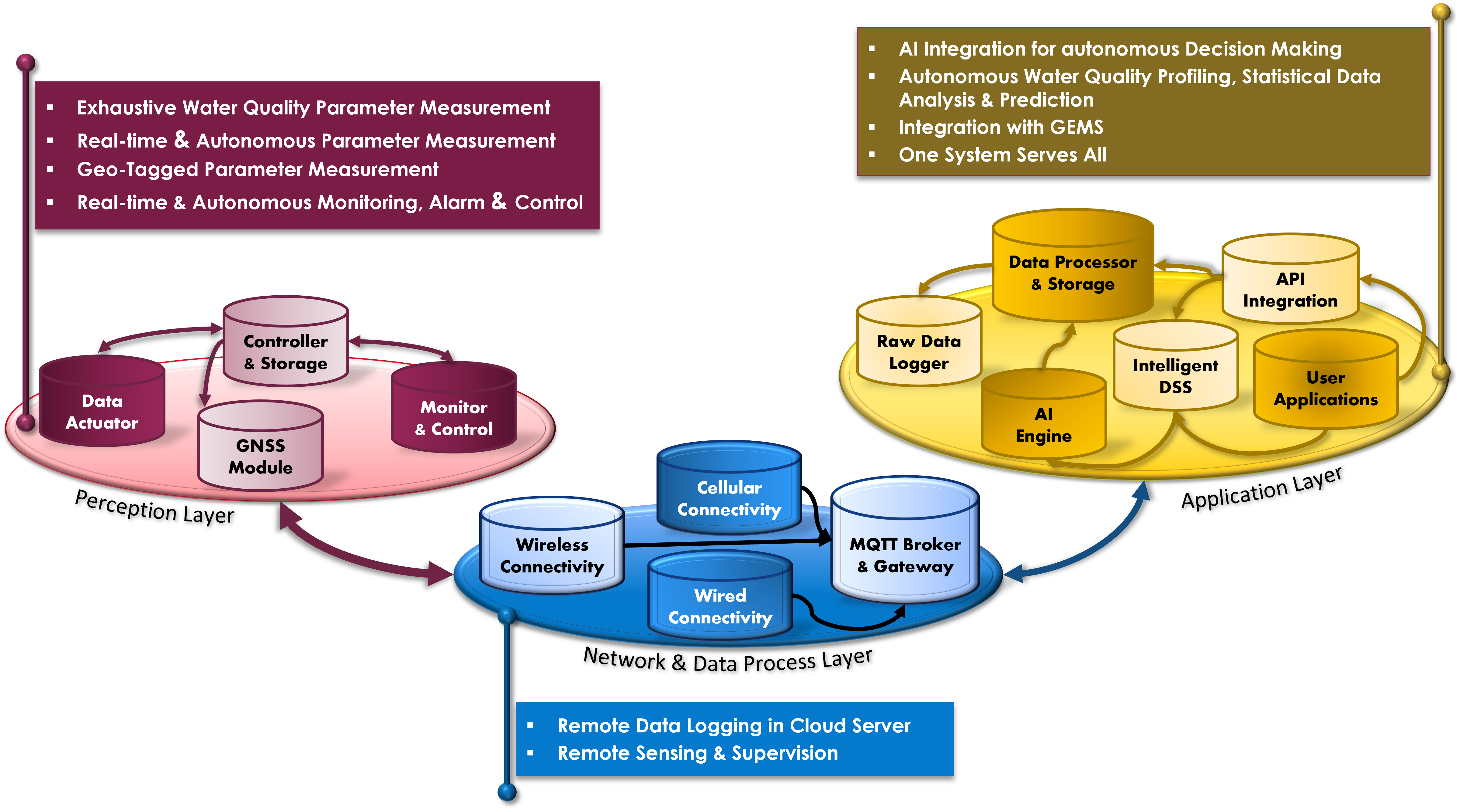
Requirements & System Specification
3-Layer System Architecture.
Supports All requirements of Surface water quality Profiling.

Slide 5
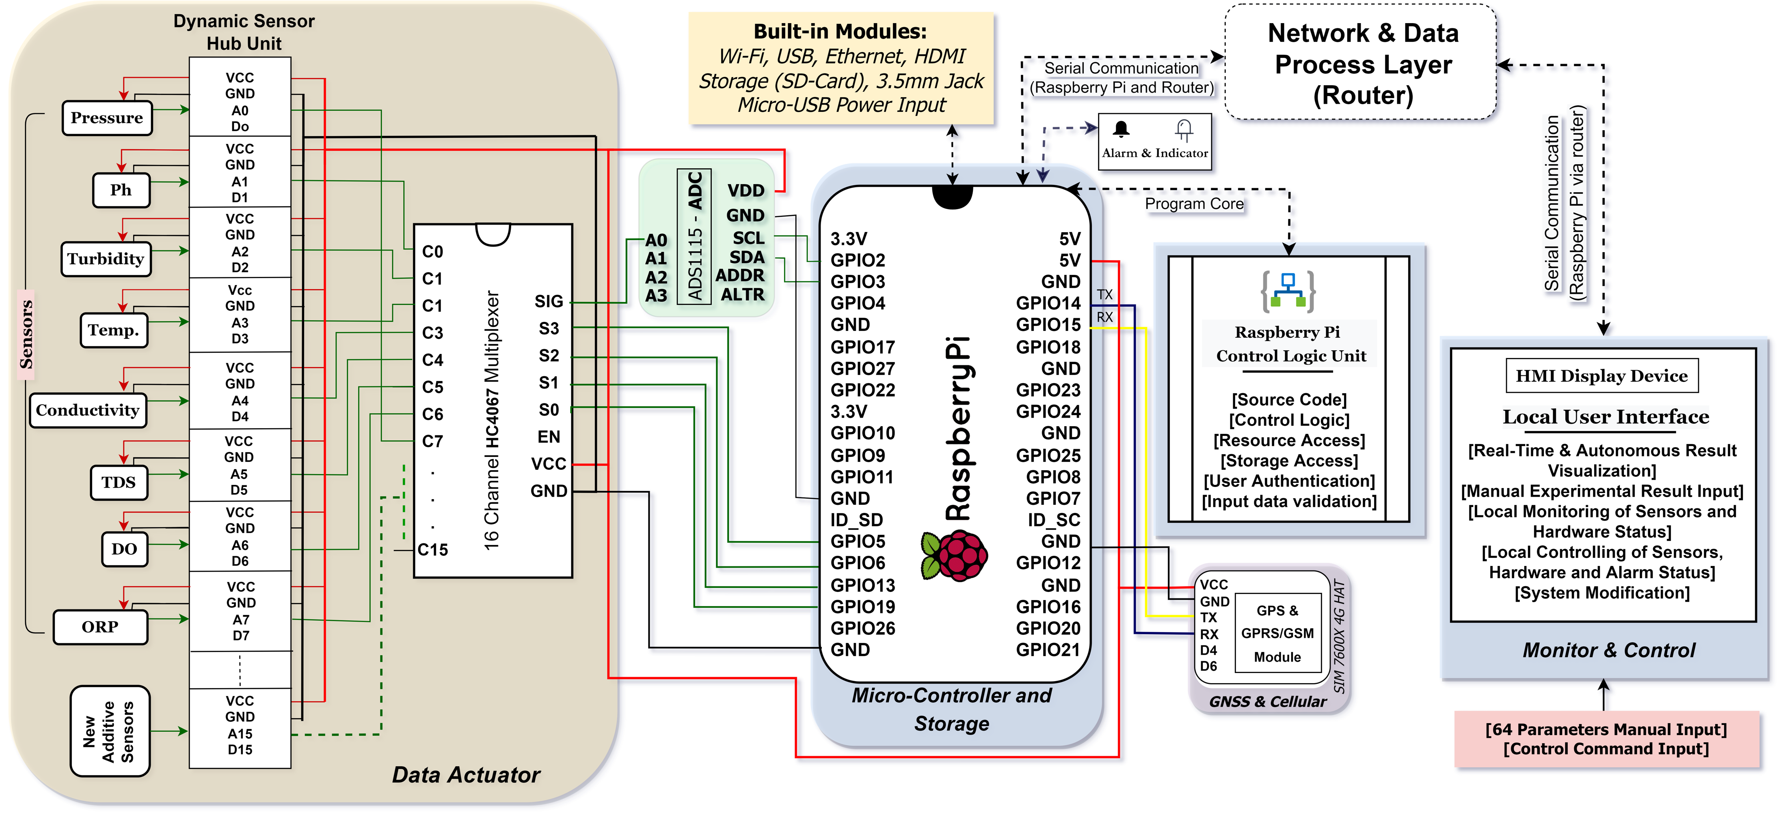
Architecture & Technologies
Perception Layer: water quality parameter measurement & Control.
Handheld / in-situ module. Deployed in multiple locations.

Slide 6
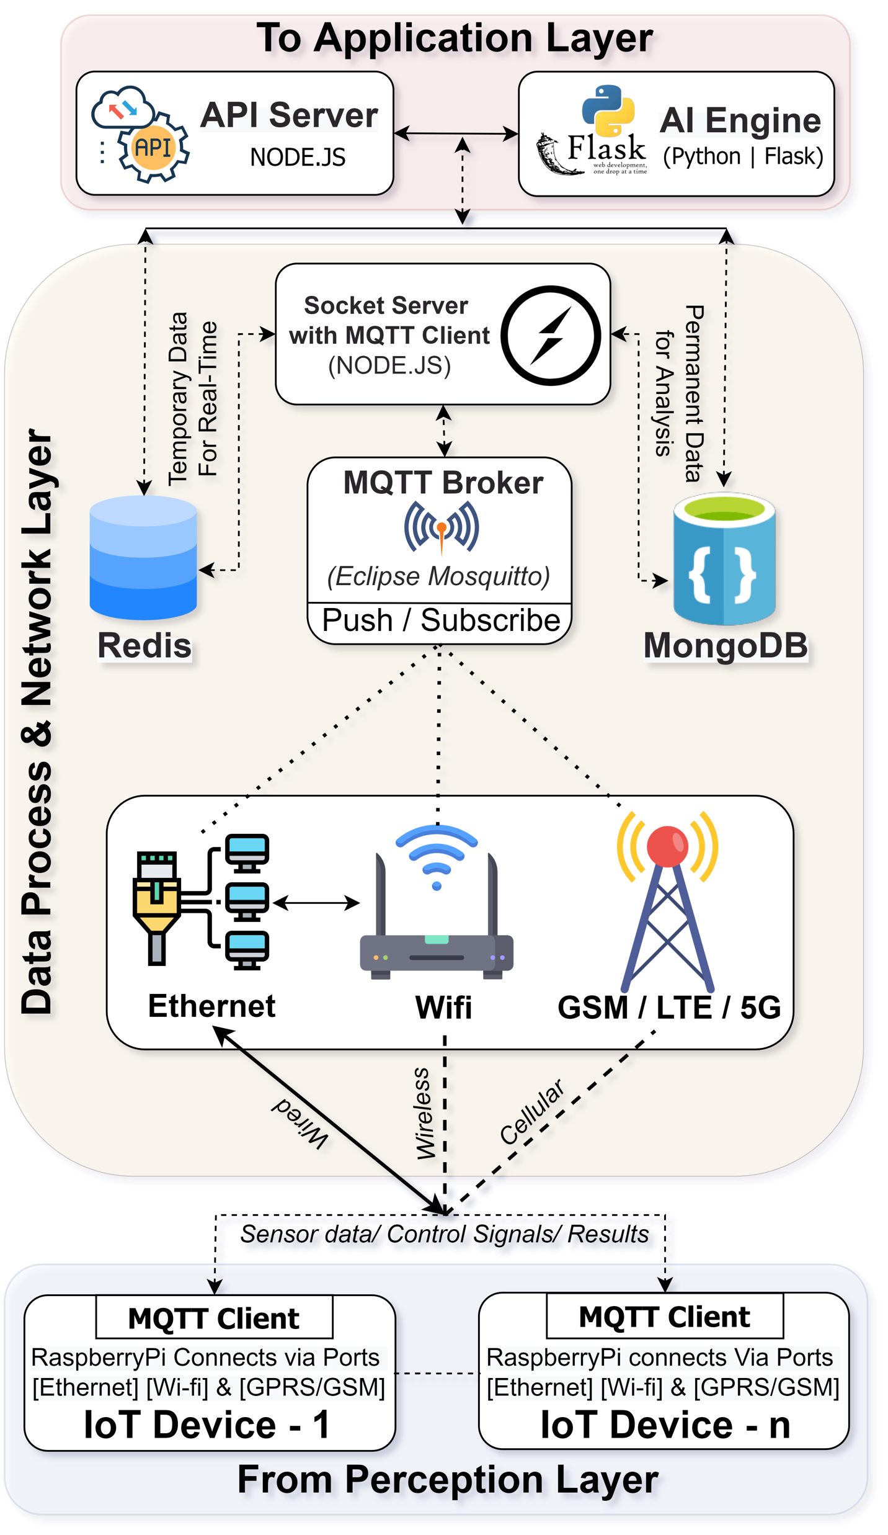
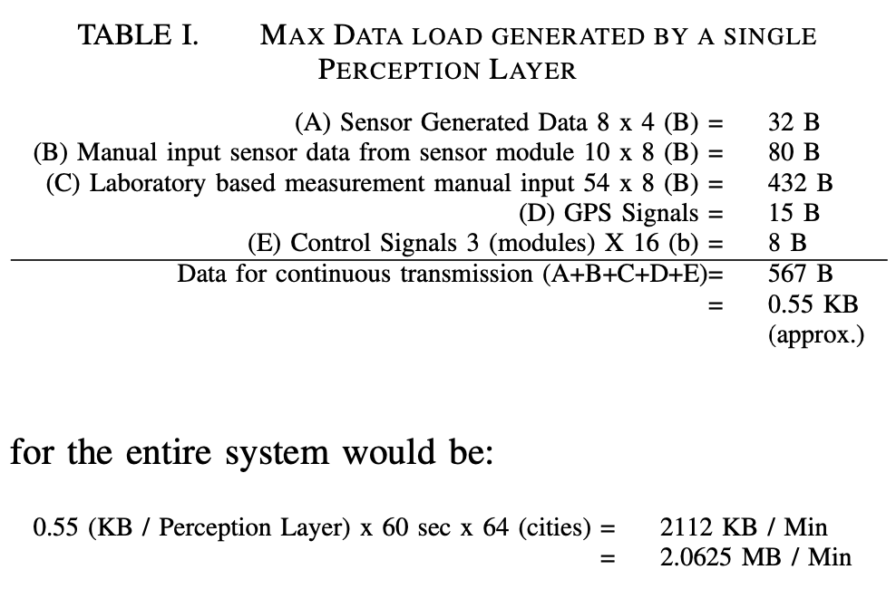
Architecture & Technologies
Network Layer
Reliable & efficient communication.
High degree of availability, scalability, alternation and switching.
Adequate data security.

Slide 7
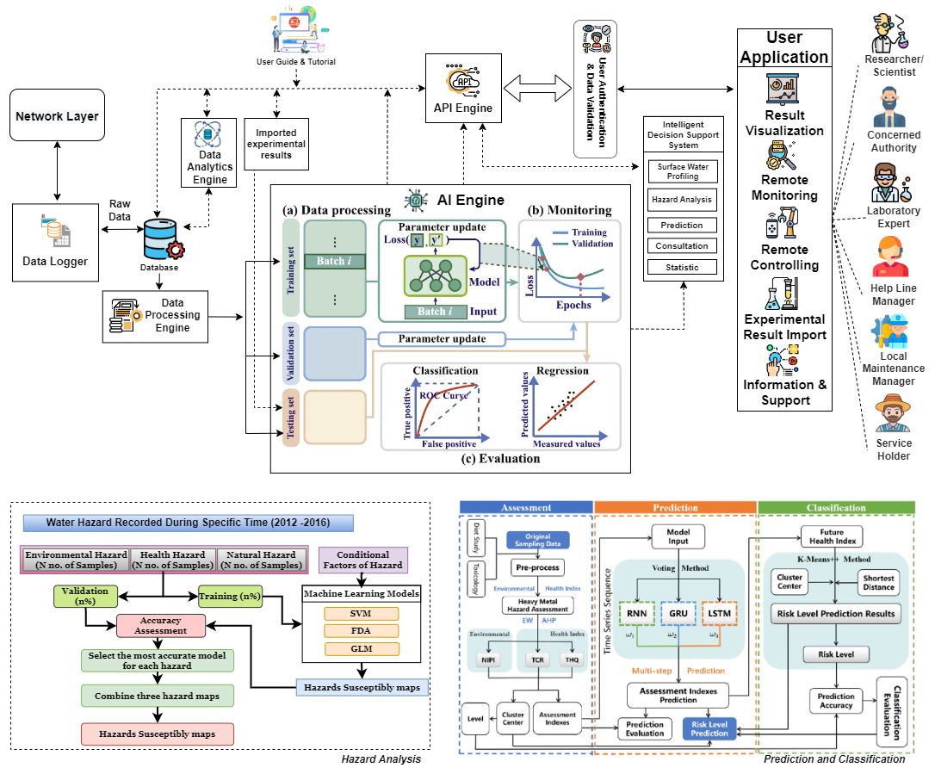
Architecture & Technologies
Cloud Application Layer
Geo-tagged raw sensor data logging.
Pre- processing & storage of the data.
Data processing, WQI assessment & statistical evaluations.
End-user services.
AI powered autonomous data processing, assessment, visualization, and decision making.
API integration for data access, sharing & exchange.
Run user scripts for remote monitoring, supervision, controlling & research.

Slide 8

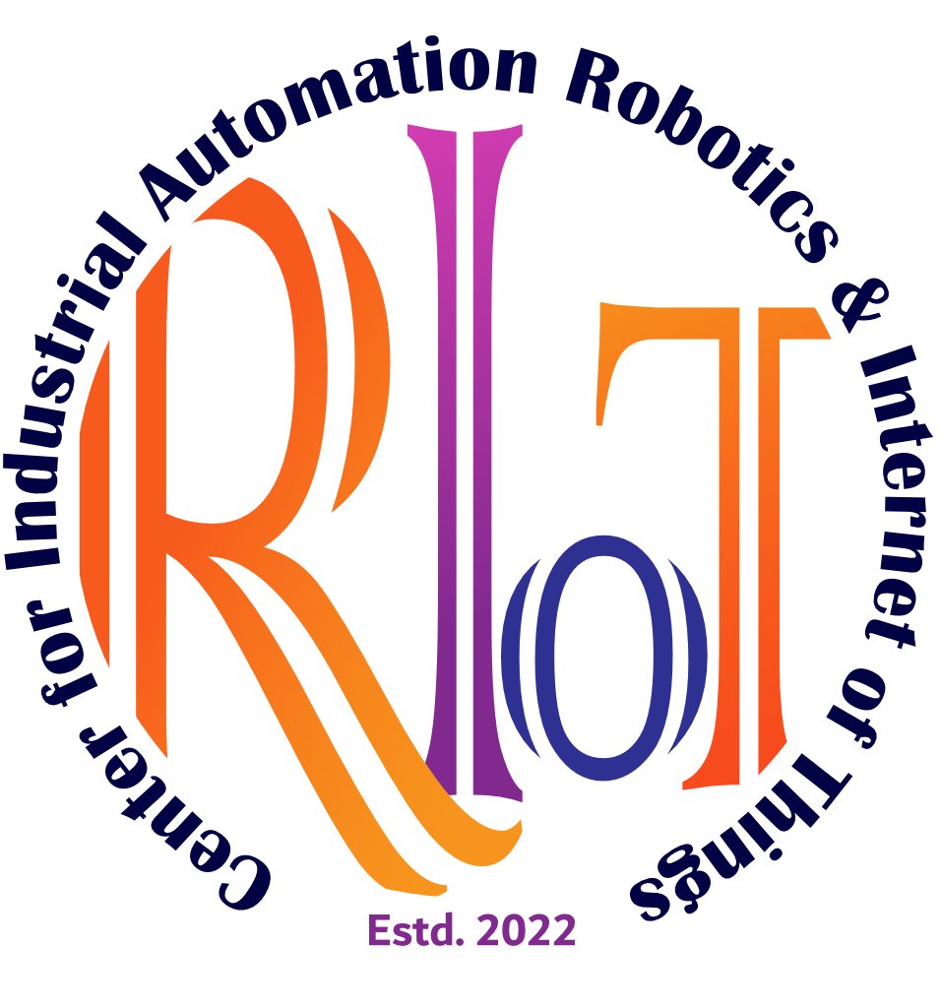
Next..
System Development, Deployment & Technical validation.
Refinement & Customization based on Organizational Needs.
Contributing Researchers in this Project:
Rajaul Karim | Md. Shakhawat Hossain, PhD | Kaniz Fatema, MSc | Md. Faisal Uddion, PhD | R. Hayat Khan, PhD
Center for Industrial Automation, Robotics & IoT
Independent University, Bangladesh
http://www.riot.iub.ac.bd/

Slide 9
THANK YOU
QUESTION & ANSWER

