Slide 1

A practical usability study framework using the SUS and the affinity diagram
A case study on the revised Online Roadshow website
Dr. Leow meng chew
Multimedia university, malaysia

Slide 2
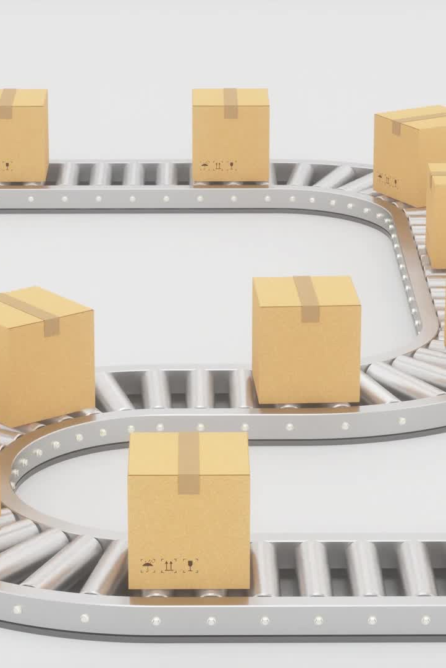
Introduction
An online roadshow (Leow et al., 2021) is an event planned over the Internet to advertise a service or an idea or a product. Location, resource and time are no longer the limiting constraints for the roadshow because it was conducted online.
After the initial trial of online roadshow website version 1.0, it was discovered that there were several aspects of the online roadshow website such as the website interface and functionality that might be improved.
As a result, version 2.0 of the online roadshow website was built based on these enhancements and the pages of the website for the online roadshow were improved and made more aesthetically pleasing.

Slide 3
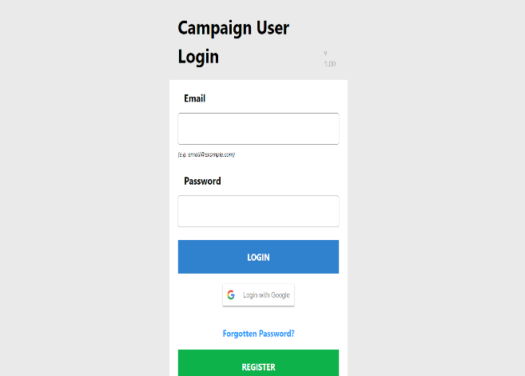
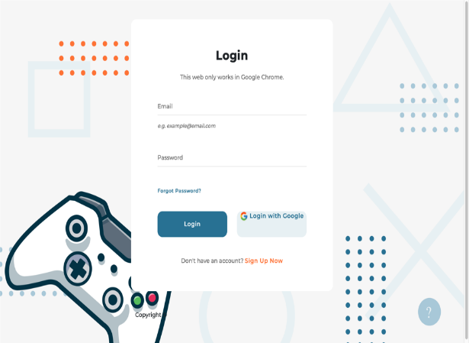
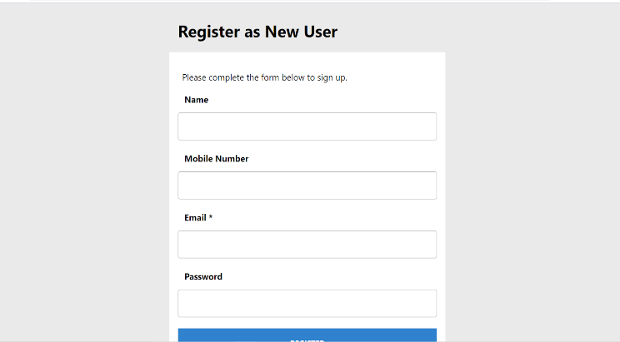
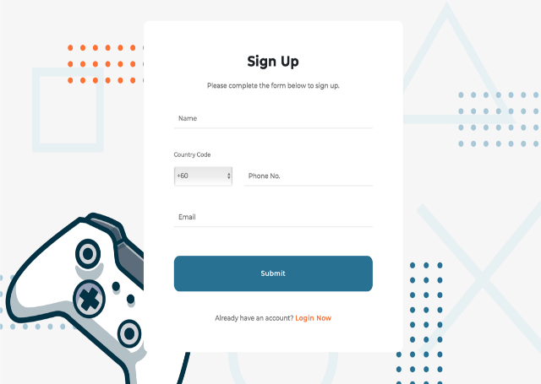
Revision of the Online Roadshow Website: Login & Sign-up page
Version 1.0
Version 2.0

Slide 4



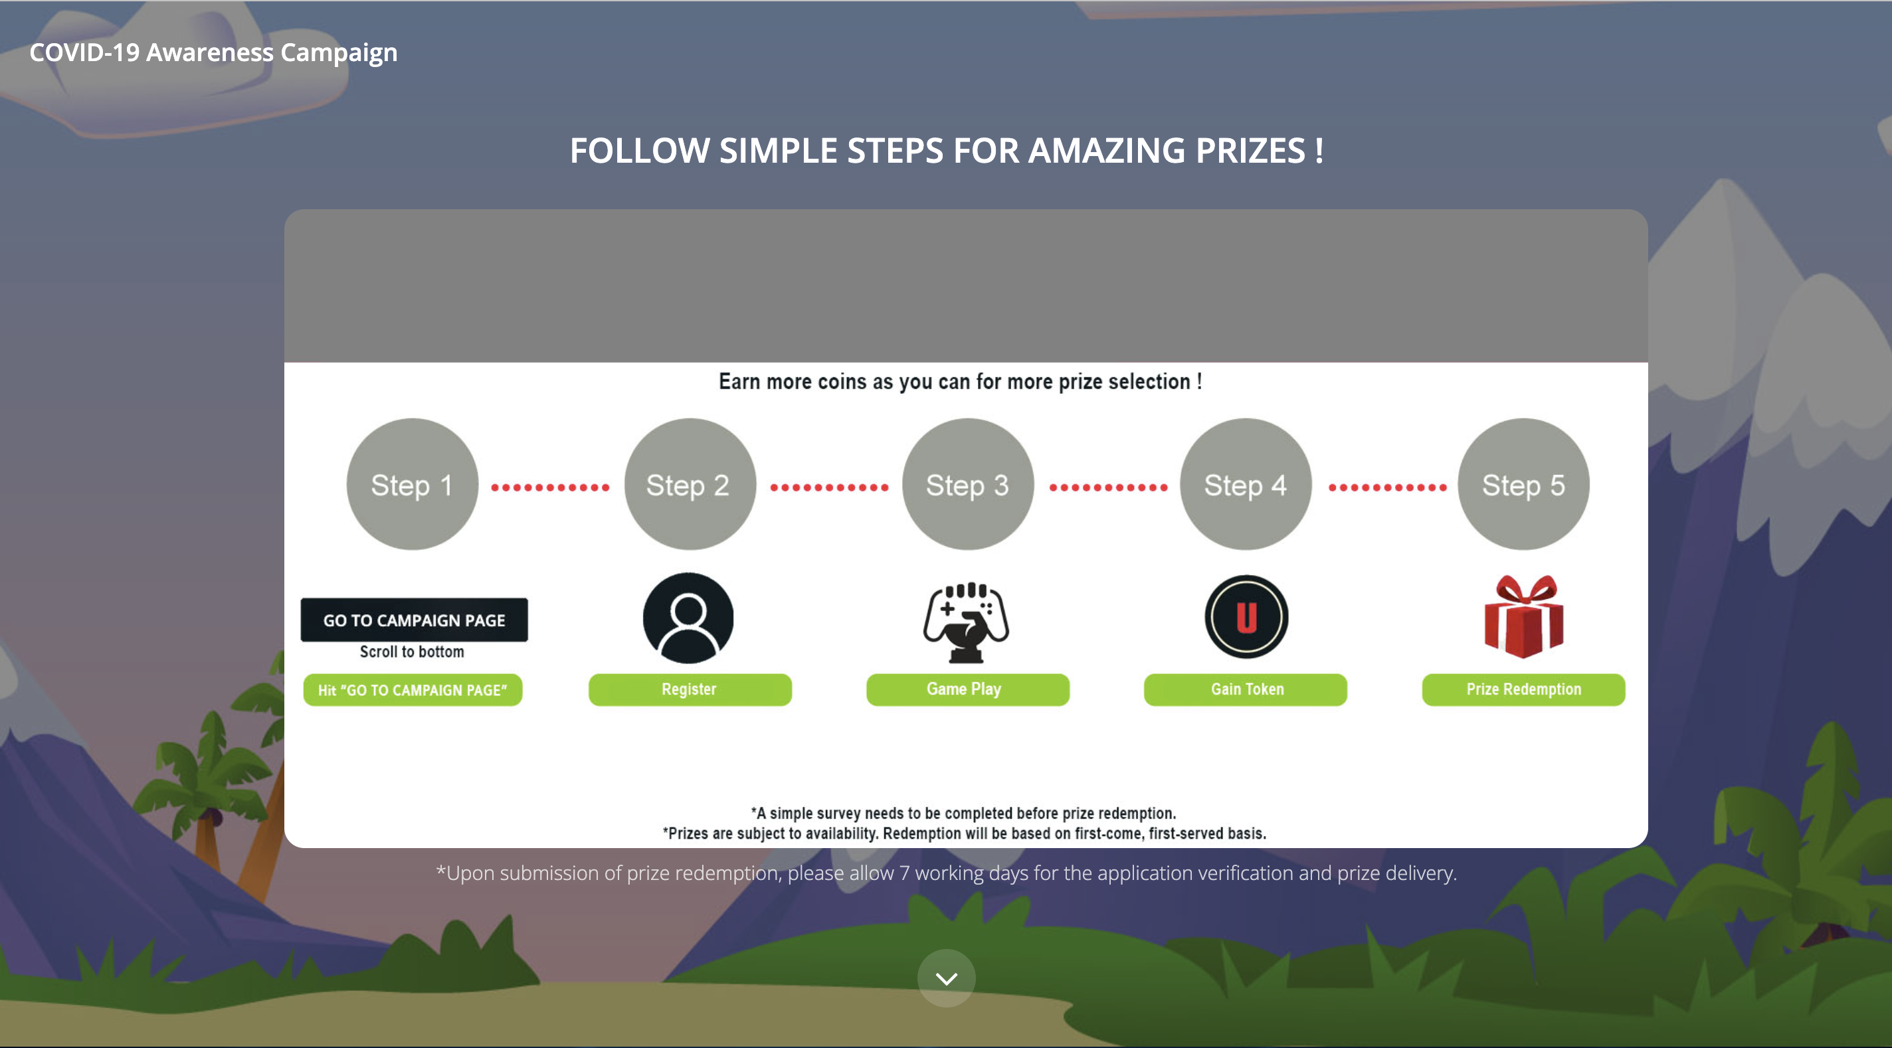
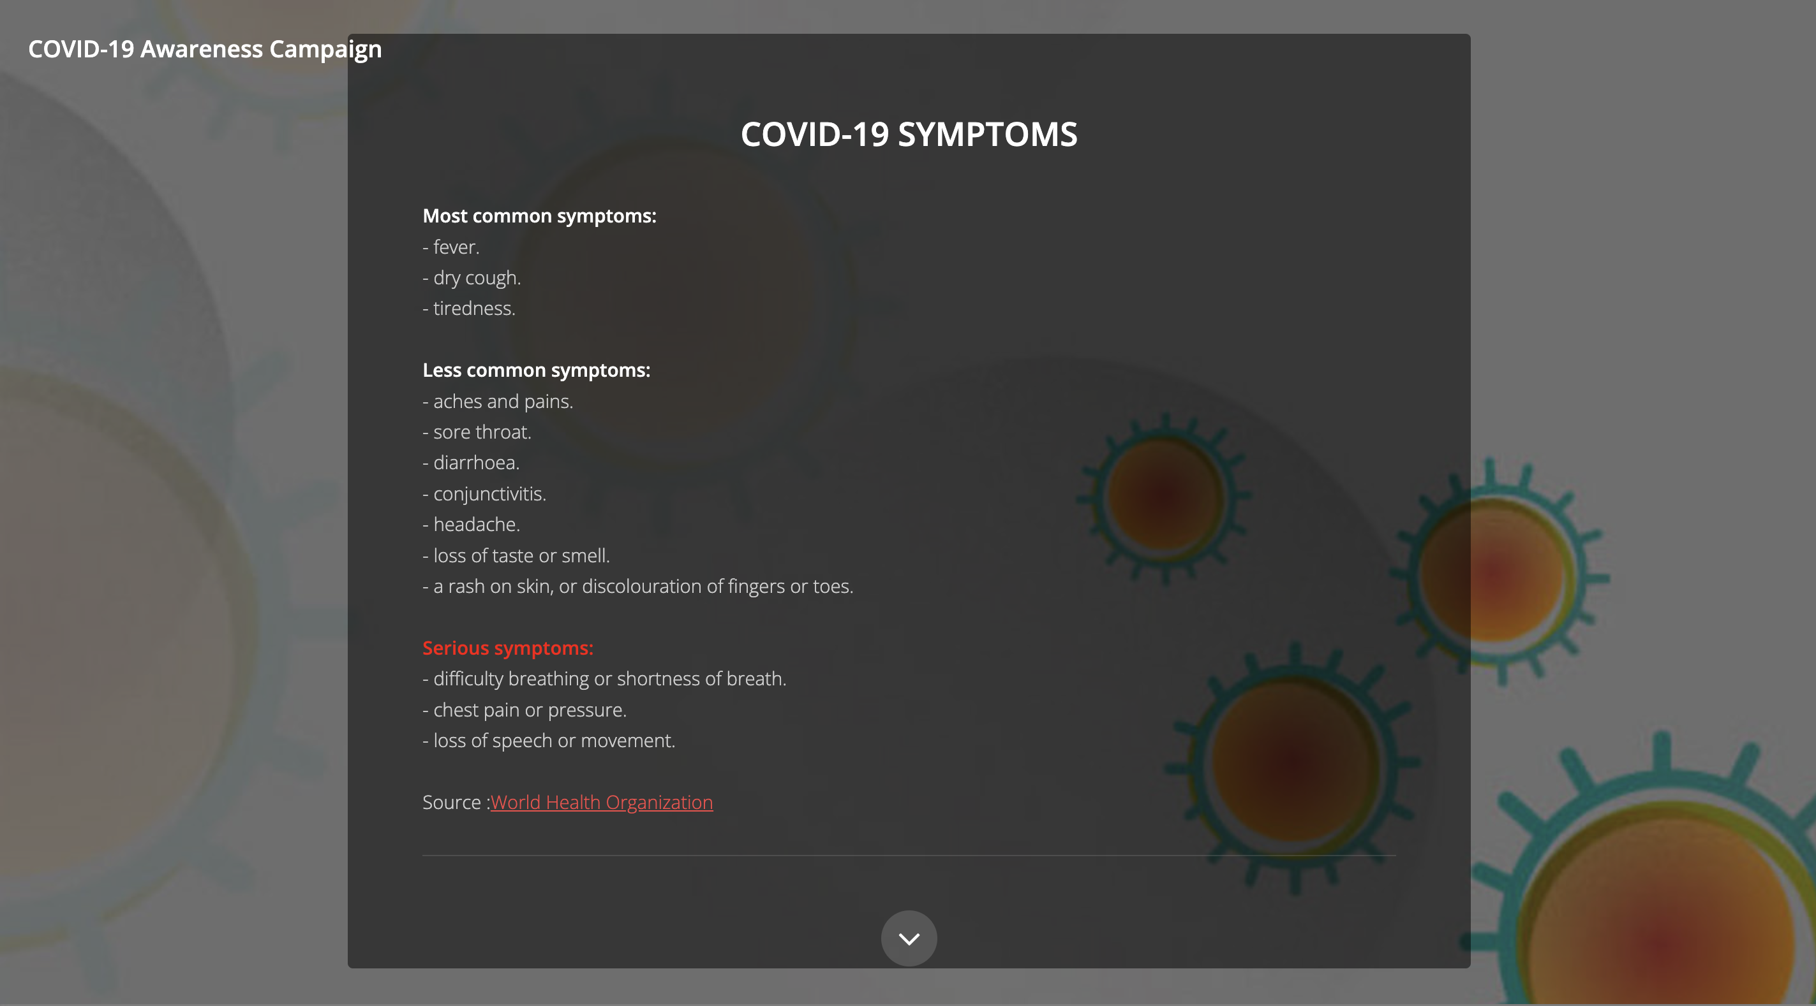
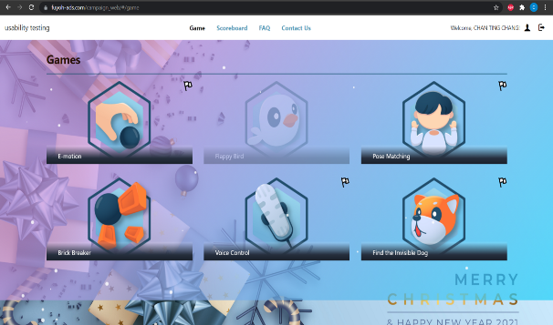
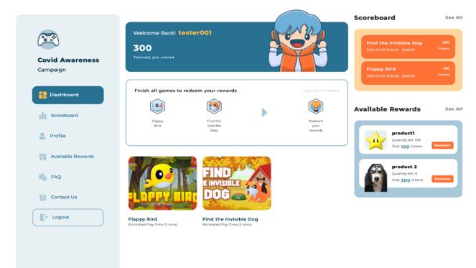
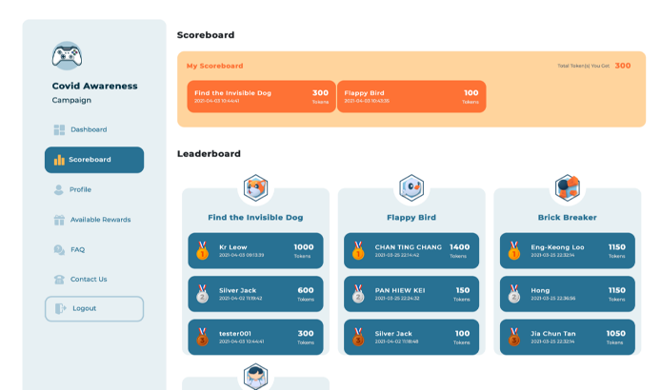
Revision of the Online Roadshow Website: Main page and Game page
Version 1.0
Version 2.0

Slide 5
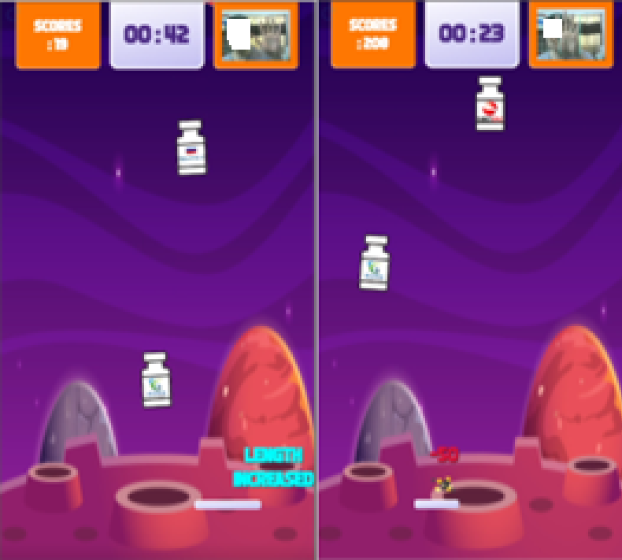
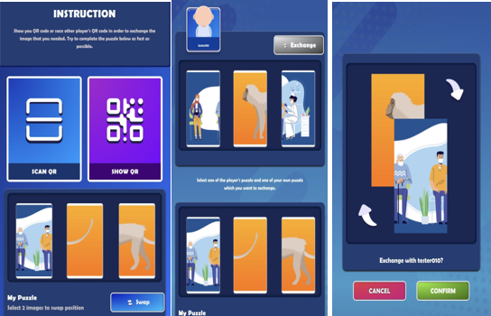
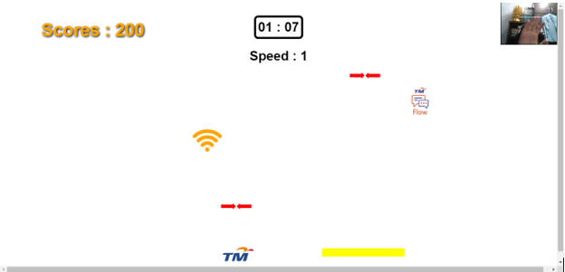
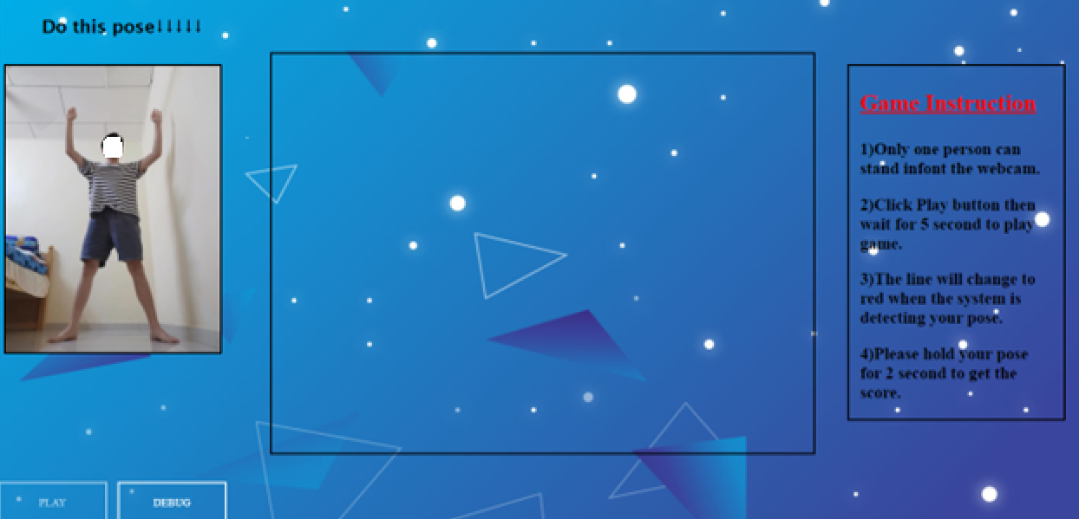
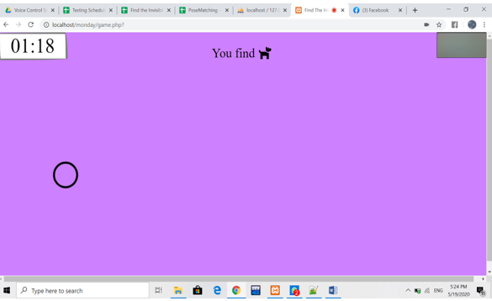
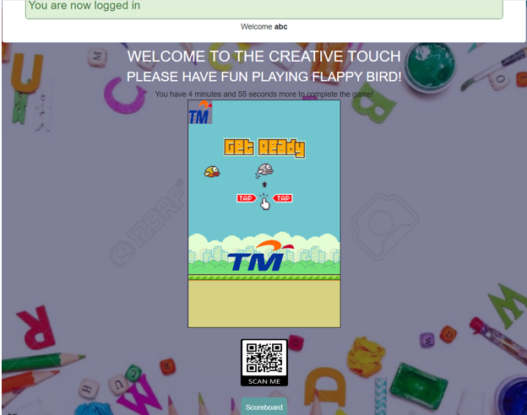

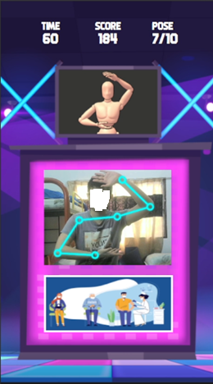
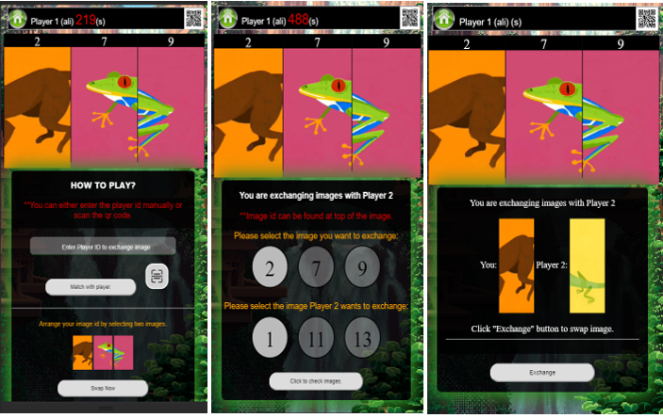
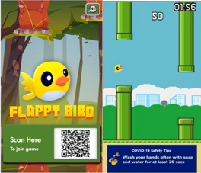
Revision of the Online Roadshow Website: Game interface
Version 1.0
Version 2.0

Slide 6
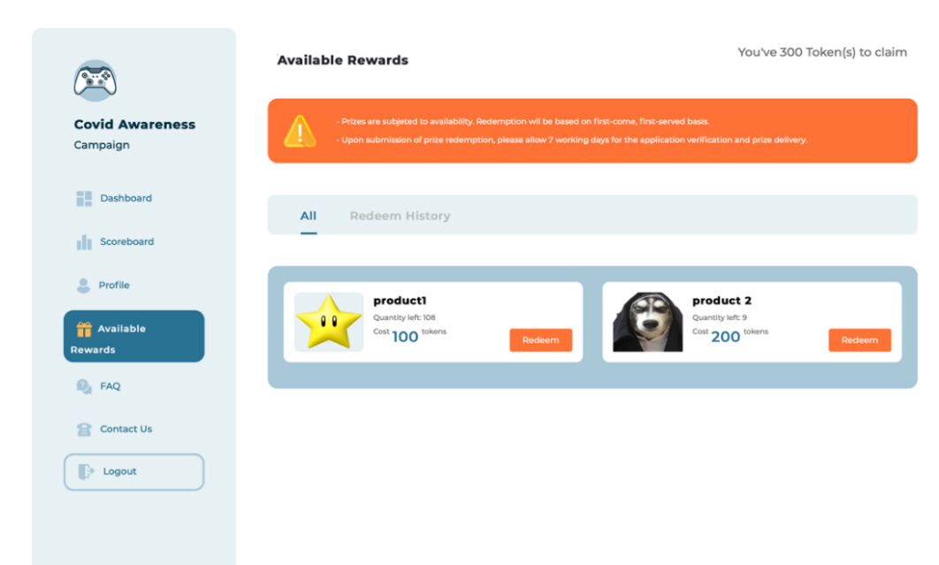
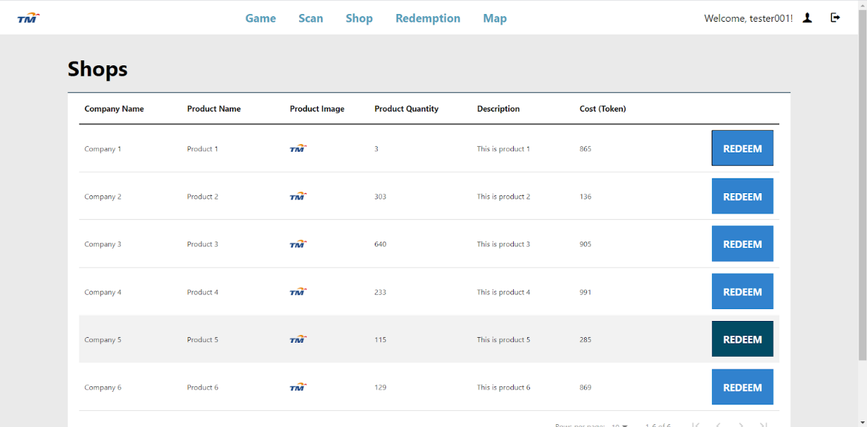
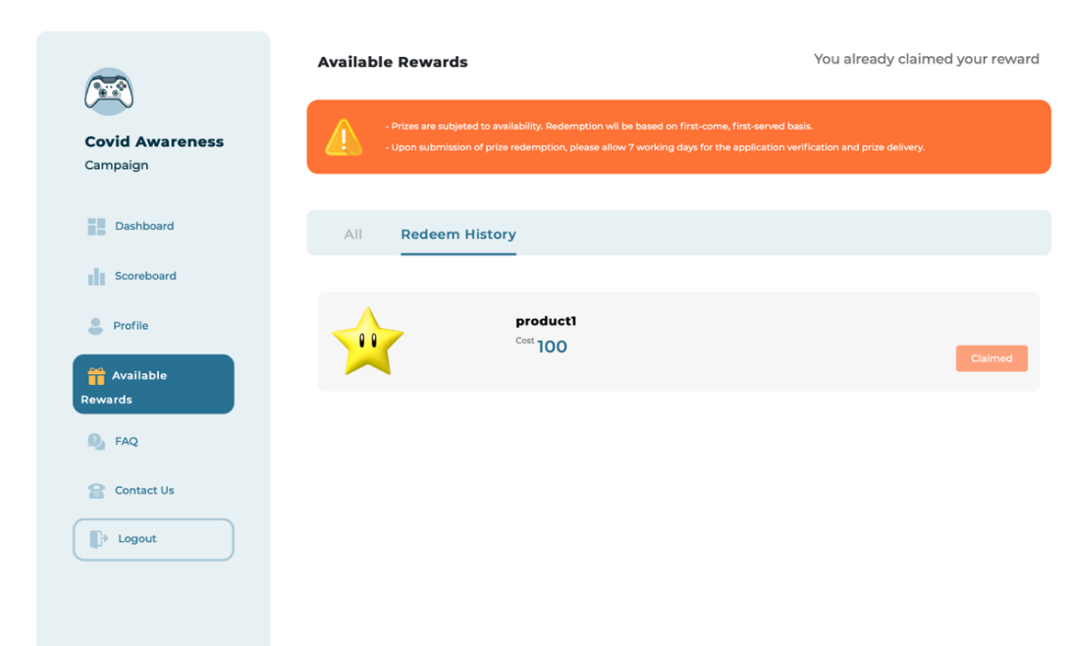
Revision of the Online Roadshow Website: Redemption
Version 1.0
Version 2.0

Slide 7
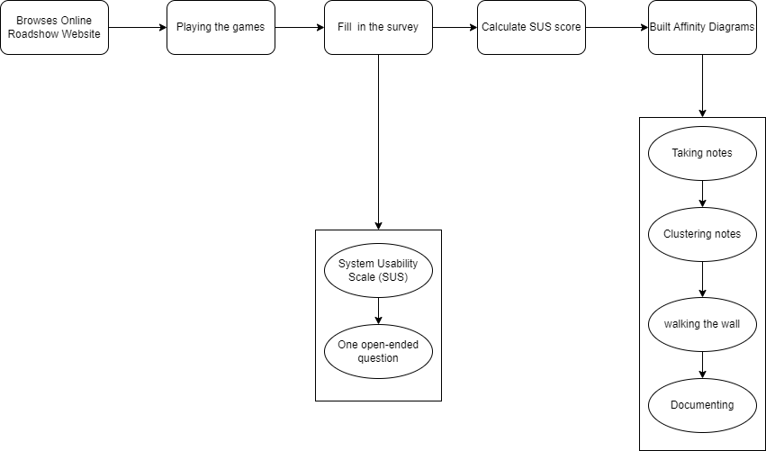
Usability Test Procedure
The practical framework as proposed by Chan et al. (2021) was used to evaluate the usability of the enhanced version 2.0 of the online roadshow website. 250 respondents complete the survey:

Slide 8
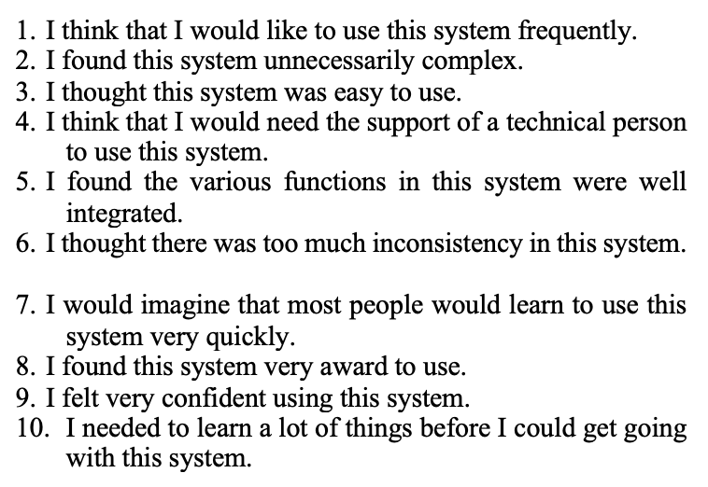

The Practical Usability Assessment Framework

Slide 9
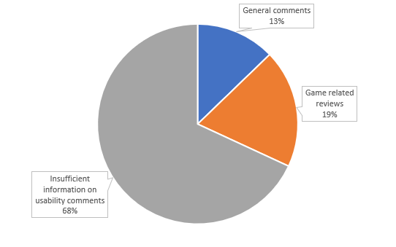
RESULT
The average SUS score of the online roadshow website for the 250 participants was 62.2. The website was rated as SUS D
Affinity diagrams were used to collect and analyze the additional 47 open-ended responses

Slide 10
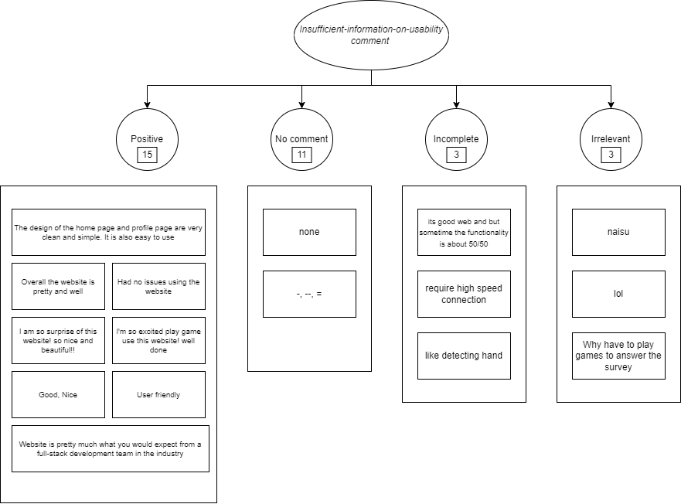
Result
insufficient-information-on-usability comments

Slide 11
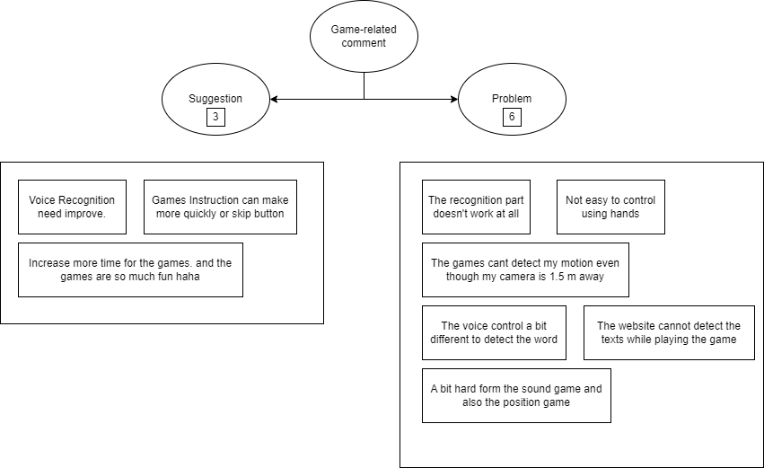
Result
game-related comments

Slide 12
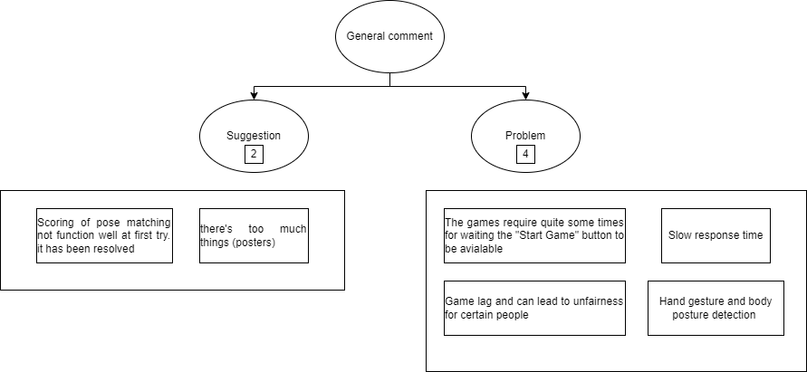
Result
general comments

Slide 13
Discussion
Version 2.0 of the online roadshow website has a slightly higher SUS score than the version 1.0 website, even though both are still in the poor score ranks.
In contrast to the greater number of open-ended comments obtained in version 1.0, it can be deduced that more people believed that the design for version 2.0 was more refined and that its operational flows were also smoother.
Game-related comments:
  Game engine issues were occurring in both versions, including the voice recognition mechanism used in the voice-controlled maze game that was still erratic.
  Comparing the analysis for both versions, it was showed that numerous game-related issues had been resolved.

Slide 14
Discussion
General comments:
  The overall results for version 2.0 similarly showed the convergence of the open reviews towards the problematic usability areas namely the game engine issues.
  These include the game lagging, camera or voice detection problems that resulted in the perception of unfairness for some participants and the slow response time of some games.
  One fresh issue reported was on the content design of the posters having too much information.

Slide 15

Conclusion
The result showed that the even though the new online roadshow website scored 62.6 SUS score, it has significantly improved its user experience
The overall analysis suggests that using the same proposed pragmatic usability assessment framework may practically advise on user experience improvements

