Slide 1



Real-Time Driver Drowsiness Alert System for Product Distribution Businesses in Phuket Using Android Devices
Amonrat Prasitsupparote
Pakorn Pasitsuparoad
Sirathee Itsarapongpukdee
College of Computing, Prince of Songkla University, Thailand
The 20th International Joint Conference on Computer Science and Software Engineering
28th June-1st July 2023
Naresuan University Phitsanulok, THAILAND

Slide 2
Outline
Research Problem
Contribution
Proposed Solution
Results and Discussion
Conclusion

Slide 3
Research Problem
Interview with the manager of Vichai Foods Supply Company Limited Phuket, Thailand.
  Four road accidents caused by drowsy delivery drivers during 2017 – 2022.
  300,000 THB per one accident (20% of the registered capital).
    Heavily affect cash flow and account balance.

Slide 4
Research Problem (Cont.)
Commercial devices to prevent and detect driver drowsiness.
  Guardian System – truck driver safety and accident prevention solution.
    Starting at 59,500 THB per truck for hardware and 2,000 THB per month per truck for SafeGuard application.
  Vigo – Bluetooth headset detects driver drowsiness by using eye blinks and head motion.
    NOT allow the driver to play music in the car.
A driver-assistant system was built for luxury cars.
  Lane departure warnings which the company claims can detect drowsy drivers.

Slide 5
Research Problem (Cont.)
Most research focuses on facial expressions and human behavior to classify drowsiness.
  Raspberry Pi with a camera module to indicate the eye closure of driver.
  Integrate a machine learning.
    Accuracy 83.33% on average but sensitive to lighting and wearing sunglasses conditions.

Slide 6
Contribution
Logistic SMEs community in Phuket, Thailand prefers a low-cost, easy-to-use, and easy-installation drowsiness detection system.
This work proposed a smartphone-based system detecting the eye closure.
  When a drowsy driver was detected, warned by a sound alert, and a message is sent to the manager through Line application.

Slide 7
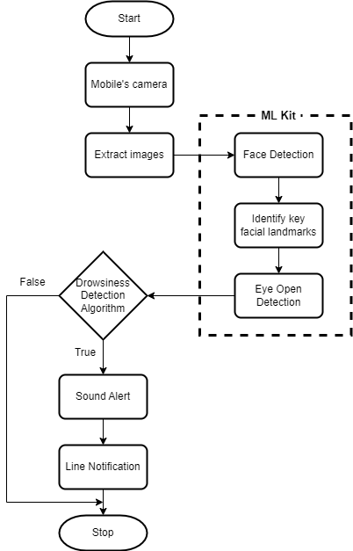
Proposed Solution
Android application integrated
ML Kit and Line Notify.

Slide 8
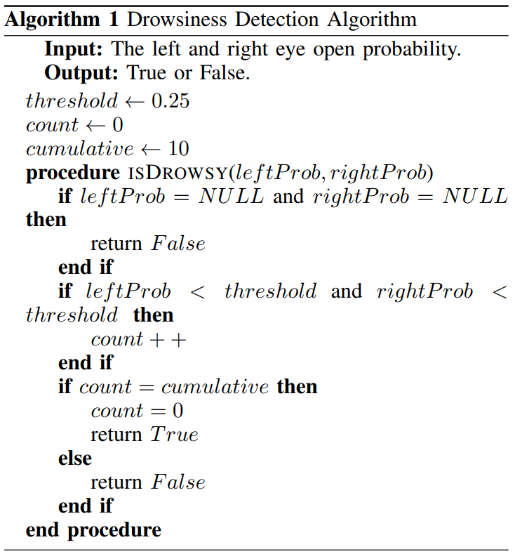
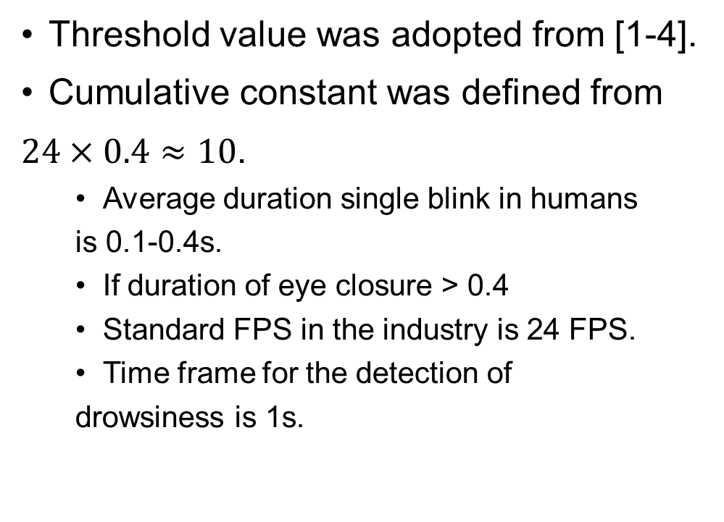
Drowsiness Detection Algorithm
Threshold value was adopted from [1-4].
Cumulative constant was defined from
$24×0.4≈10$.
  Average duration single blink in humans
  is 0.1-0.4s.
  If duration of eye closure > 0.4
  Standard FPS in the industry is 24 FPS.
  Time frame for the detection of
  drowsiness is 1s.
[1] M. Y. Hossain and F. P. George, “IOT based real-time drowsy driving detection system for the prevention of road accidents,” in 2018 International Conference on Intelligent Informatics and Biomedical Sciences (ICIIBMS), vol. 3, pp. 190–195, ISSN: 2189-8723.
[2] S. Sathasivam, A. K. Mahamad, S. Saon, A. Sidek, M. M. Som, and H. A. Ameen, “Drowsiness detection system using eye aspect ratio technique,” in 2020 IEEE Student Conference on Research and Development (SCOReD), pp. 448–452, ISSN: 2643-2447.
[3] A. K. Biswal, D. Singh, B. K. Pattanayak, D. Samanta, and M.-H. Yang, “IoT-based smart alert system for drowsy driver detection,” vol. 2021, pp. 1–13.
[4] R. A. F. Rozali, S. I. Fadilah, A. R. M. Shariff, K. M. Zaini, F. Karim, M. H. A. Wahab, R. Thangaveloo, and A. S. B. Shibghatullah, “Driver drowsiness detection and monitoring system (DDDMS),” vol. 13, no. 6.

Slide 9
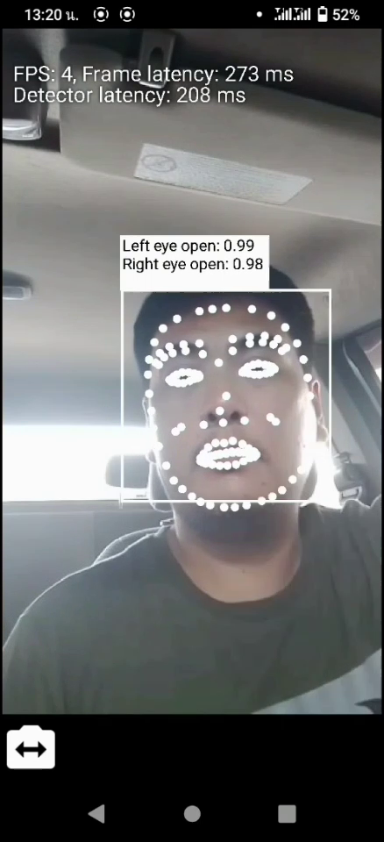
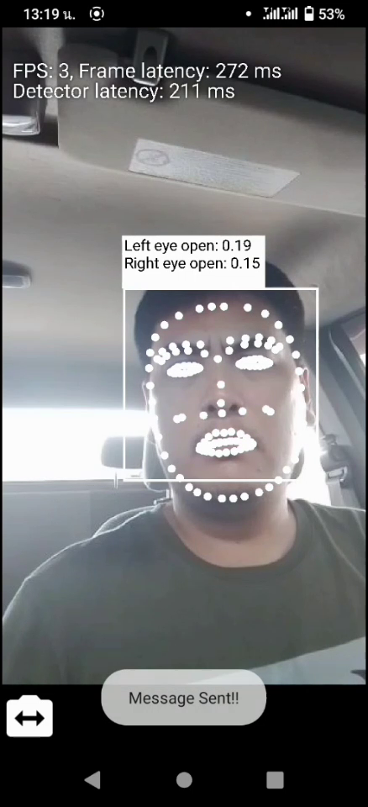
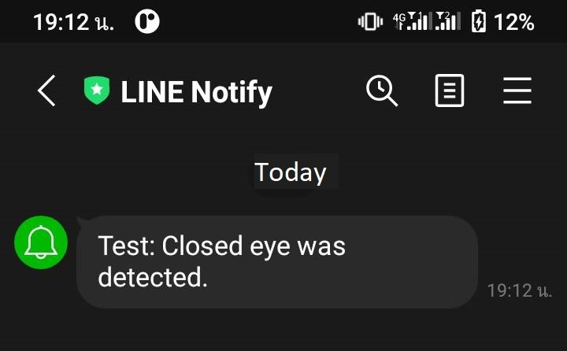
Results and Discussion
Simulated scenario
  Person sat in a car at noon.
  Smartphone was placed on a car phone holder
  at an air outlet.
    True S1 with UNISOC SC963A 1.6GHz and RAM 3GB.
Left and right eye open probability value<0.25
for 10 consecutive frames => drowsy driver.
  Play the defined sound.
  Message was sent through Line Notify.
Application still worked well under low FPS.

Slide 10
Conclusion
Accident from the delivery driver's drowsiness is a critical risk.
  Lost can lead to low cash flow and unbalance account.
  Limited budget
  Low-cost, real-time, easy-to-use, and easy-installation device is preferred
Android smartphone-based system to detect the drowsy drivers.
  Using ML Kit and sends a message through Line Notify API.
  Results showed that the application can differentiate between normal and drowsy drivers.
  Tolerated to the low FPS smartphone.

Slide 11
THANK YOU
QUESTION & ANSWER

