Slide 1



Cell-key perturbation data privacy procedure for Security Operations Center Team
Supornpol Nukrongsin
College of digital Innovation Technology
Rangsit University, Pathumthani, Thailand (supornpol.n65@rsu.ac.th)
The 20th International Joint Conference on Computer Science and Software Engineering
28th June-1st July 2023
Naresuan University Phitsanulok, THAILAND

Slide 2
AGENDA
Problem Statement and Introduction
Literature review
Methology
Experiment
Conclusion
Q & A

Slide 3
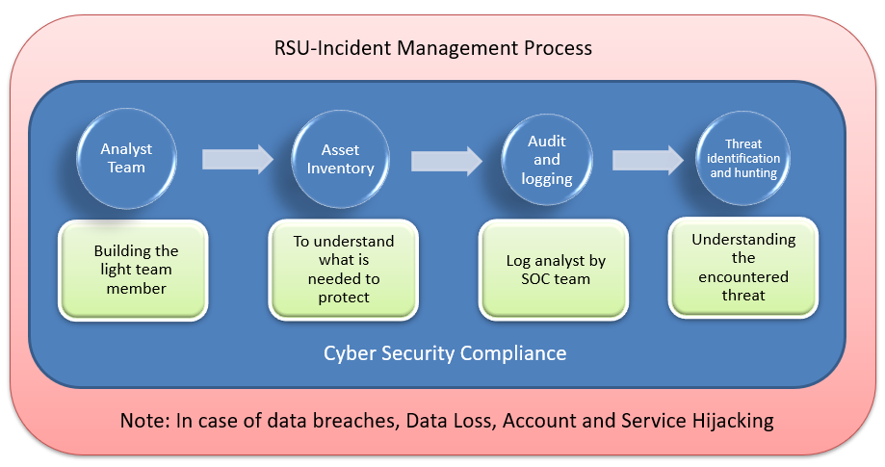
PROBLEM STATEMENT (1)
PDPA/GDPR is a data privacy law.
The National Institute of Standards and Technology Framework
(NIST) is a data security framework.
Data beach hurt both data
privacy and data security
RSU introduce an incident
management framework

Slide 4
PROBLEM STATEMENT (2)
According to The National Institute of Standards and Technology Framework (NIST), it is almost inevitable for a firm to have a data breach. This paper intends to propose a new framework for mitigating a data breach effect.
Thailand PDPA laws argue the data controller to notify the data breach incedent within 72 hours after detecting the event.
We need a noval way to cope with data breach problem (data security) while still keeping data privacy.

Slide 5
INTRODUCTION (1)
Data center becomes a data controller or data processor by GDPR/PDPA laws because it holds a lot of personal data.
PDPA is a new data privacy law in Thailand. The riskiest data controller is a data breach.
The simple way of protecting data is cyber security, but there is no guarantee for data privacy.

Slide 6
INTRODUCTION (2)
The incedent response model was developed based on the procedures and policies that were implemented within the institution.
Once an incident happen, the SOC has to team determine the adjustments needed for the controls that will be implemented in different processes whether for technical or nontechnical aspects.

Slide 7
CELL KEY PERTURBATION
Differencing Attack = “A type of data privacy attack where an attacker can isolate an individual value by combining multiple aggregate statistics about a dataset.”
In order to prevent a differencing Attack, perturbation concepts such as Cell-key perturbation is introduced.
Cell Key Perturbation adds a small amount of noise to some cells in a table, meaning that users cannot be sure whether differences between tables represent a real person are caused by the perturbation. Cell Key Perturbation is consistent and repeatable, so the same cells are always perturbed in the same way.

Slide 8
CELL KEY PERTURBATION METHODOLOGY(1)
Each record in the microdata is assigned a random number record key. These keys are then added together to get the cell key for each cell in a table.
The perturbation table (P-table) determines how much each cell in a table is perturbed by.
Most cells in the P-table are zero, representing no change to the cell, but a small number of cells will contain -2, -1, 1 or 2.

Slide 9
CELL KEY PERTURBATION METHODOLOGY(2)
The cell key is used with the P-table to add a small amount of noise to some of the cells in the table.
As the cell key is created using the records in each cell, this is replicable and the table will always be perturbed in the same way.
The same records appearing together in different tables will have the same cell key value, so will always be perturbed in the same way.

Slide 10
LITERATURE REVIEW (1)
M. Mutemwa, J. Msweni and L. Zimba stated that SOCs responsibility are to detect, investigate and report on all malicious activities that occur.
Hebert Silva et al. demonstrated and reaffirmed that even de-identified data that remove all direct personal data is not enough to protect against re-identify risk. Prior knowledge combined with dataset can reidentify personal information easily.

Slide 11
LITERATURE REVIEW (2)
Dove, Iain & Ntoumos, Christos & Spicer, Keith. Stated that a benefit of Cell-key Purturbation over k-anonymity is that it can provide better privacy protection for individual values. This is because Cell-key perturbation adds noise to each value independently.
T. Enderle and S. Giessing developed “Open Source tools for perturbative confidentiality methods”. The Cell-key method for statistical disclosure limitation by random noise is one of the statistic disclosure control (SDC) methods by the EU project.

Slide 12
METHODOLOGY (1)
According to GDPR laws, Personal Identification Information (PII) has to store secretly away from hackers; therefore, the have to be decomposed from original data.
In this process, the SOCs team has to decompose the original data into two segments including the PII segment and the non-PII segment. For the non-PII segment, we need to add noise to mitigate and reidentify risk. In this experiment, the SOC team applied additive noise to the numerical attributes.

Slide 13
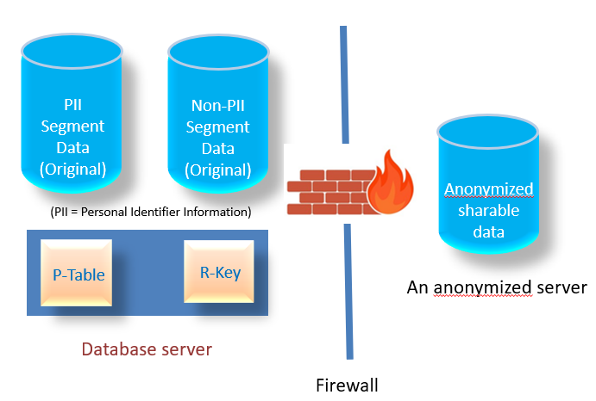
METHODOLOGY (2)
The following steps are the data preparation process. Firstly, PII has to be identified and then separated into a new secret table. Secondly, Cell-Key Perturbation Methodology is applied to the non-PII segment to prevent reidentification risk.
the original data is separated into the de-Identified segment and the Non-PII data segment. The PII segment is a table that contains all PII data such as social security number, name, last name and etc. The non-PII data segment is a de-identified dataset that removes all direct identifiers and has a primary key such as SSN on both table for linkage.

Slide 14
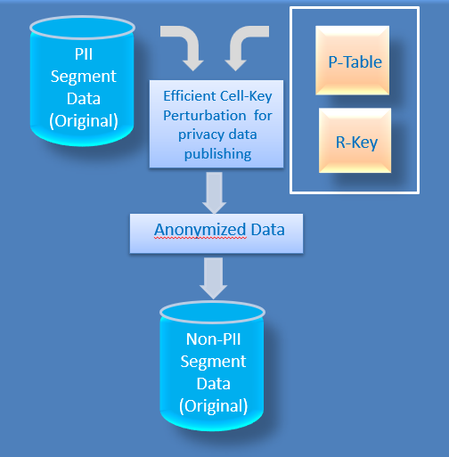
METHODOLOGY (3)
the Cell-key perturbation process by using R-key and P-table. The goal of the P-table package is to produce perturbation tables that can be used for applying noise to statistical tables.

Slide 15
DATASET
The “adult.csv” dataset is a famouse dataset in machine learning. It contains information on individuals from the United States, including demographic information, education level, occupation, and income; therefore, it contain a lot of personal data.
The “adult.csv” dataset is a widely used dataset in machine learning and data analysis. It contains information on individuals from the United States, including demographic information, education level, occupation and income.

Slide 16
“ADULT.CSV” DATASET
Since it contain individuals from USA, it contain a personal data that need to be protected by Laws.
The dataset consists of 48,842 rows and 15 columns, with each row representing an individual and each column representing a different attribute.
The “adult.csv” dataset is commonly used for tasks such as predicting income level based on demographic and employment information, and exploring relationships between different attributes in the dataset.

Slide 17
THE COLUMNS IN THE DATASET (1)
Age: The age of the individual in years.
Workclass: The type of employer for the individual, such as private, government, or self-employed.
Fnlwgt: The sampling weight assigned to the individual in the census.
Education: The highest level of education achieved by the individual.
Education.num: The numerical representation of the education level, ranging from 1 to 16.
Marital.status: The marital status of the individual.
Occupation: The type of occupation of the dindividual.
Relationship: The relationship status of the individual.

Slide 18
THE COLUMNS IN THE DATASET (2)
Race: The race of the individual, such as Whith, Black or Asian.
Sex; The gender of the individual, either Male or Female.
Capital.gain: The capital gains reported by the individual.
Capital.loss: The capital losses reported by the individual.
Hours.per.week: The number of hours worked per week.
Native.country: The country of origin of the individual.
Income: Whether the individual’s income is above of below $50,000 per year.

Slide 19
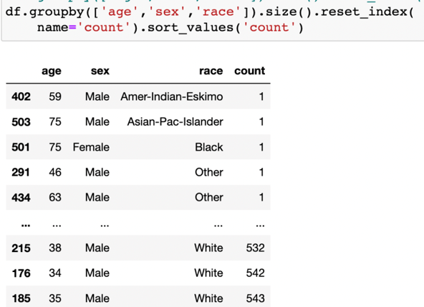
EXPERIMENT
The panda’s crosstab() function in Python is used to build a frequency table in a cross-tabulation table form.
It can show the frequency with which certain groups of data. A famous adult dataset is chosen because it contains a lot of quasi-identifier attributes such as {age, sex, race}.

Slide 20
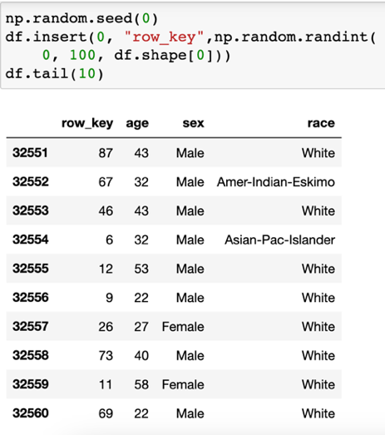
STEP 1 : CREATE A RECORD KEY BYT ASSIGNING A RANDOM NUMBER BETWEEN 0 AND 99
The R-key package generates a row-key to use in a frequency table. The row key is added to a non-PII segment. Since the larger the random number, the longer computation is due to the bigger matrix, two digits between 0 and 99 is a random number range.

Slide 21
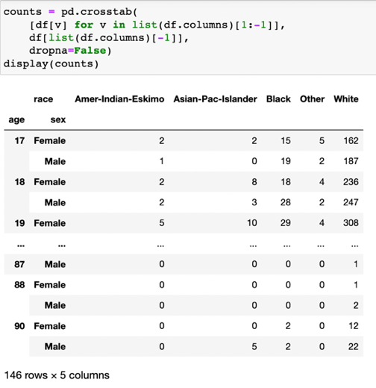
STEP 2 : CREATE A FREQUENCY TABLE USING THE CROSSTAB FUNCTION
In this step, A P-table is constructed, and the crosstab function is used to count the frequency of the cell values group.

Slide 22
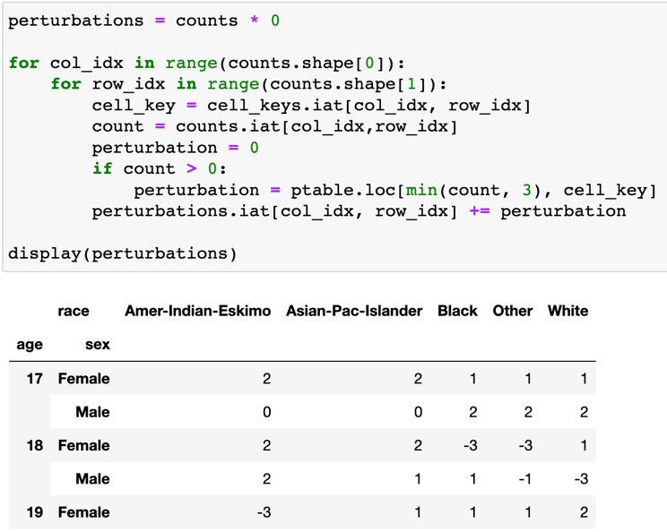
STEP 3 : CALULATE PERTURBATION VALUES ON THE FREQUENCY TABLE FROM CELL VALUE AND CELL KEY

Slide 23
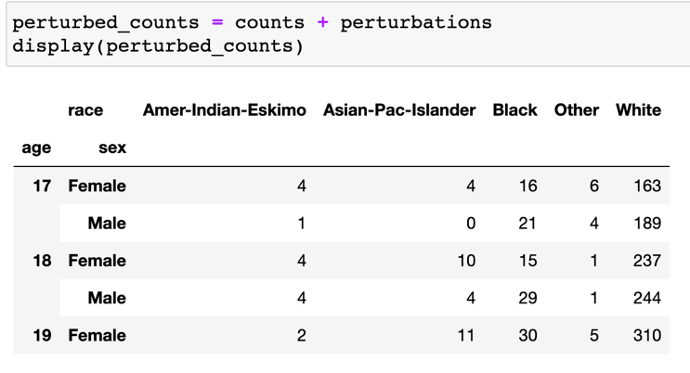
STEP 4 : APPLY ALL PERTURBATION TO CELLS

Slide 24
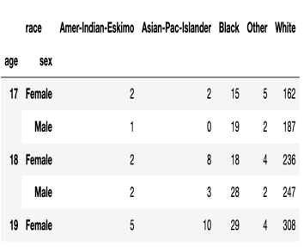
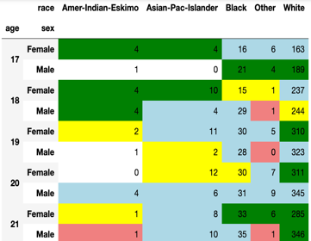
STEP 5 : GENERATE NEW ANONYMIZED DATASET

Slide 25
EXPERIMENT RESULTS (1)
The final step is to construct anonymized dataset that lays in front of a firewall. The advantage of this method is most of cell are not modified called “Zero cells”.
the output generated for all 3 variables before and after perturbation respectively. Then contains the unperturbed frequency counts before values from the P-table are applied. Then contains the perturbed counts; cells with noise added have been highlighted.

Slide 26
EXPERIMENT RESULTS (2)
The reidentification of the record corresponding to the cell with value 1 may take place based on any combination of age=17, male, and Eskimo. This type of personal information discourse is referred to as reidentification. However, attackers are reluctant to attack because they are not sure if the dataset is real values or perturbated.

Slide 27
CONCLUSION (1)
Cell-key perturbation data privacy procedure for the Security Operations Center Team is explained and implemented in this paper. The attackers cannot be so sure whether the information in table are effected by perturbation or its original values. Some of cells are added with noise. Perturbation tables (P-table) are a goal of the cell-key method. Jupyter notebook tool and python are implemented to compute perturbation tables.

Slide 28
CONCLUSION (2)
The anonymizer server was designed to allow users to do queries online. Consistency is so important for online service. The same user will get the same anonymized dataset all the time; therefore, the cell-key perturbation method is a suitable answer for E-Commerce service. The server performs data preparation and then runs Cell Key Perturbation.

Slide 29
ADVANTAGE OF THIS METHOD
The advantage of this method is most of cells are not modified called “Zero cells”.
In Cell-key perturbation, each cell value in the dataset is perturbed by adding a random value generated based on a key. If a cell value is zero, the perturbation value is also zero, meaning that the cell value remains unchanged. This approach ensures that the privacy of individuals whose data includes zero values is protected, while still providing a level of privacy protection for non-zero values.

Slide 30
FUTURE WORK
Perturbation of zeros is a specific type of Cell-key perturbation used in data privacy and security to protect sensitive information. The effect of using perturbation of zeros is that it adds random noise to the cells of a dataset that contain zero values, with the aim of preventing attackers from inferring any sensitive information from the absence of data. Perturbation of zeros is however out of scope in this paper. We will cope with these issues in our future work.

Slide 31
THANK YOU
QUESTION & ANSWER

