Slide 1



Predicting Abundance of Fish Species Populations
in Manila Bay, Philippines Based on Ensemble
Learning Approach
Sherrlyn M. Rasdas*, Dr. Arnel C. Fajardo &
Jomel S. Limbago
Technological Institute of the Philippines Manila, Isabela State University-Cauayan & Cavite State University Naic
The 20th International Joint Conference on Computer Science and Software Engineering
28th June-1st July 2023
Naresuan University Phitsanulok, THAILAND
Notes:
Good day!
This is Sherrlyn M. Rasdas from Technological Institute of the Philippines Manila
And I am here to present our research entitled: Predicting Abundance of Fish Species Populations in Manila Bay, Philippines Based on Ensemble Learning Approach

Slide 2
INTRODUCTION
Lack of data analysis tool to cluster and train datasets
No monitoring tools for fisheries production
CAUSE
Lack of well-presented analyzed data
Cannot addressed the problems in Fisheries Management
CORE PROBLEMS
Visible
No basis for implementation of Effective Sustainable Fisheries Management
Continuous decrease in fisheries production
EFFECT
Visible
Notes:
While data mining has become a widely used tool across various sectors such as commerce, academia, industry, fisheries, and agriculture, the implementation of effective and sustainable fisheries management practices in the fishing industry still poses significant challenges.
One of the key hurdles we face is the lack of reliable data for stock assessment and management. Without access to robust data analysis tools capable of clustering and training datasets, as well as monitoring tools for fisheries production, we are unable to effectively address the core problems plaguing fisheries management. Furthermore, the absence of well-presented and analyzed data exacerbates the situation, leaving us with no solid foundation for implementing sustainable fisheries management practices. As a result, we are witnessing a continuous decline in fisheries production, particularly in Manila Bay, Philippines, which serves as a crucial contributor to the country's overall fish production.
Recent studies have highlighted the detrimental impacts of overfishing, pollution, and environmental damage on the resources of Manila Bay. These factors have not only depleted its marine life but also caused a shift towards less valuable species, further exacerbating the issue.
To combat this multifaceted problem, our research endeavors to develop a comprehensive data analysis tool capable of clustering and training datasets for stock assessment and management. Moreover, we aim to design and implement monitoring tools specifically tailored to fisheries production, ensuring sustainable and efficient fishing practices. By harnessing the power of these tools, we aspire to provide well-presented and thoroughly analyzed data that can serve as a solid basis for addressing the underlying challenges in fisheries management. Ultimately, our goal is to facilitate the implementation of effective and sustainable fisheries management practices, thus reversing the downward trend in fisheries production in Manila Bay and beyond.

Slide 3
OBJECTIVES
Develop KNMLPR prediction ensemble model for fish species populations in Manila Bay, Philippines.
Evaluate the effectiveness of KNMLPR ensemble model using Precision-Recall (PR) and Receiver Operating Characteristic (ROC) plot.
Notes:
k-nearest neighbors, Multi-layer Perceptron (MLP) with Backpropagation, and logistic regression

Slide 4
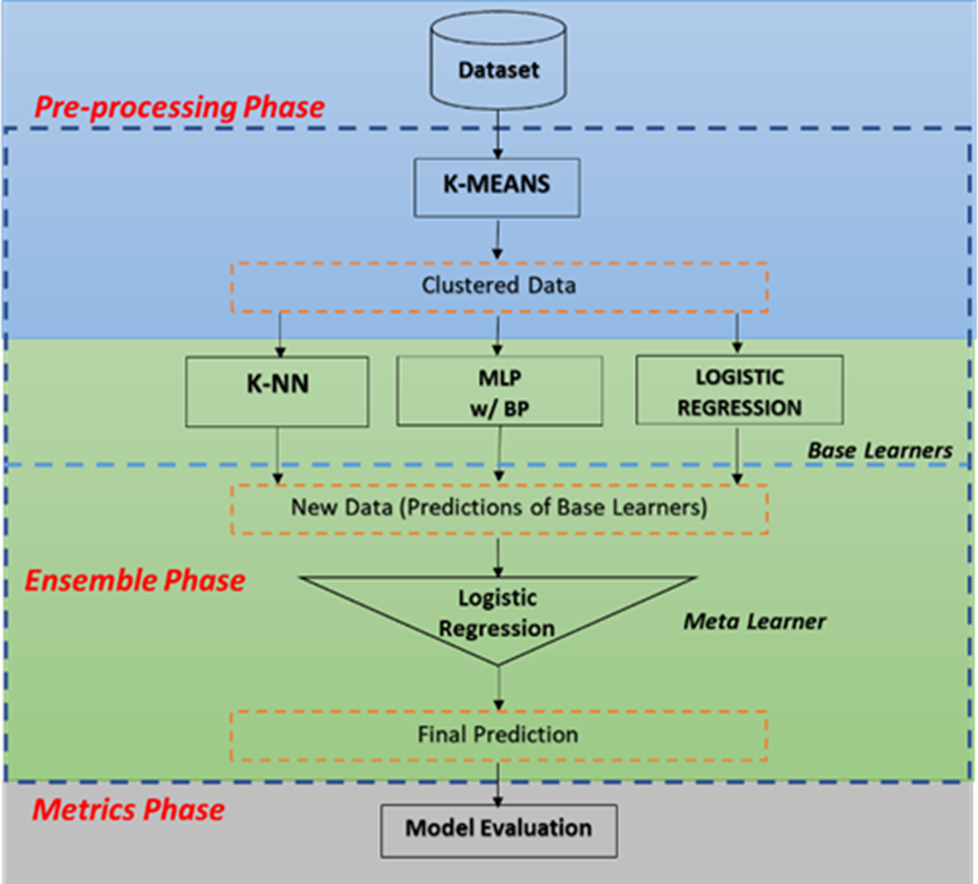
KNMLPR Ensemble Model
METHODS
Notes:
The architecture of the model has pre-processing phase with base learners (the KNN, Multi-layer perceptron with Back Propagation and Logistic regression), ensemble phase, the logistic regression was used to stacked the final prediction and the metrics phase for model evaluation.
This ensemble model effectively addressed training and architecture challenges by carefully selecting appropriate parameter values and leveraging the strengths of diverse base learners through majority voting to arrive at the final prediction.
The approach used in this study recasts the prediction issue as a classification problem. Instead of forecasting the actual values of the time series, the ensemble model is trained to predict the abundance of fish species in relation to the quantity or productivity of fish capture.

Slide 5
RESULTS
EVALUATION METRICES
Model | AUC | CA | F1 | Precision | Recall
K-NN | 98% | 99% | 99% | 99% | 99%
Neural Network | 97% | 94% | 93% | 95% | 94%
Logistic Regression | 99% | 98% | 98% | 98% | 98%
Stack | 99% | 99% | 99% | 99% | 99%
Notes:
In this study, three individual models - k-nearest neighbors, neural network, and logistic regression - performed well in predicting fish species production in Manila Bay, with high scores across various evaluation metrics such as AUC, classification accuracy, F1 score, precision, and recall as you can see in the table. However, there are some differences in their performance when it comes to metrics such as classification accuracy, F1 score, precision, and recall. Stacking the predictions of the three individual models using majority voting has resulted in improved performance in predicting fish species production in Manila Bay.

Slide 6
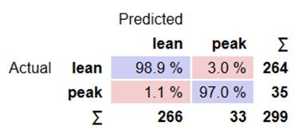
RESULTS
Confusion Matrix for Stack MODEL
Notes:
The Figure shows the confusion matrix of predicted classes of a model against the actual classes. In the case of the ensemble learning approach using majority voting, the confusion matrix showed the number of correct and incorrect predictions for each class after combining the predictions of the three individual models (k-nearest neighbors, neural network, and logistic regression) using majority voting.

Slide 7
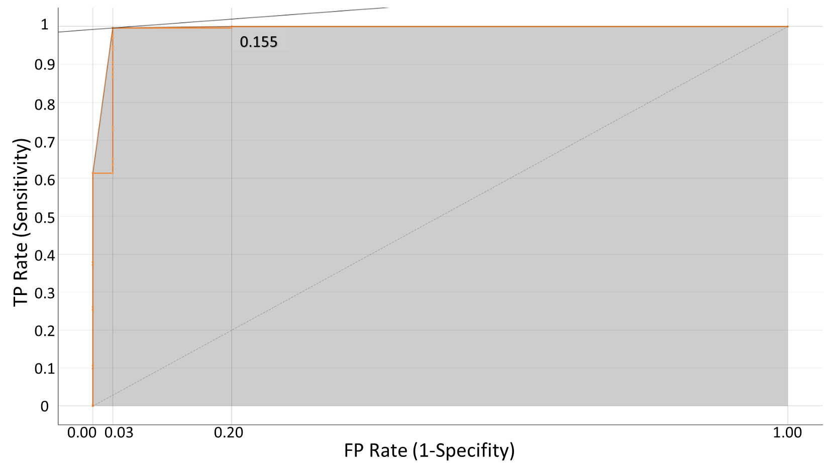
RESULTS
ROC Analysis Results of Stack Model

Slide 8
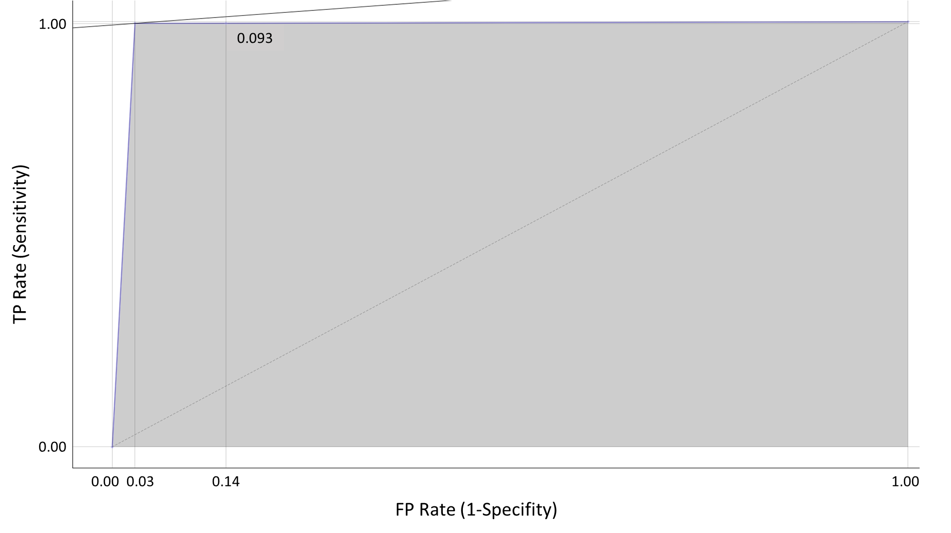
RESULTS
ROC Analysis Results of K-Nearest Neighbor Model

Slide 9
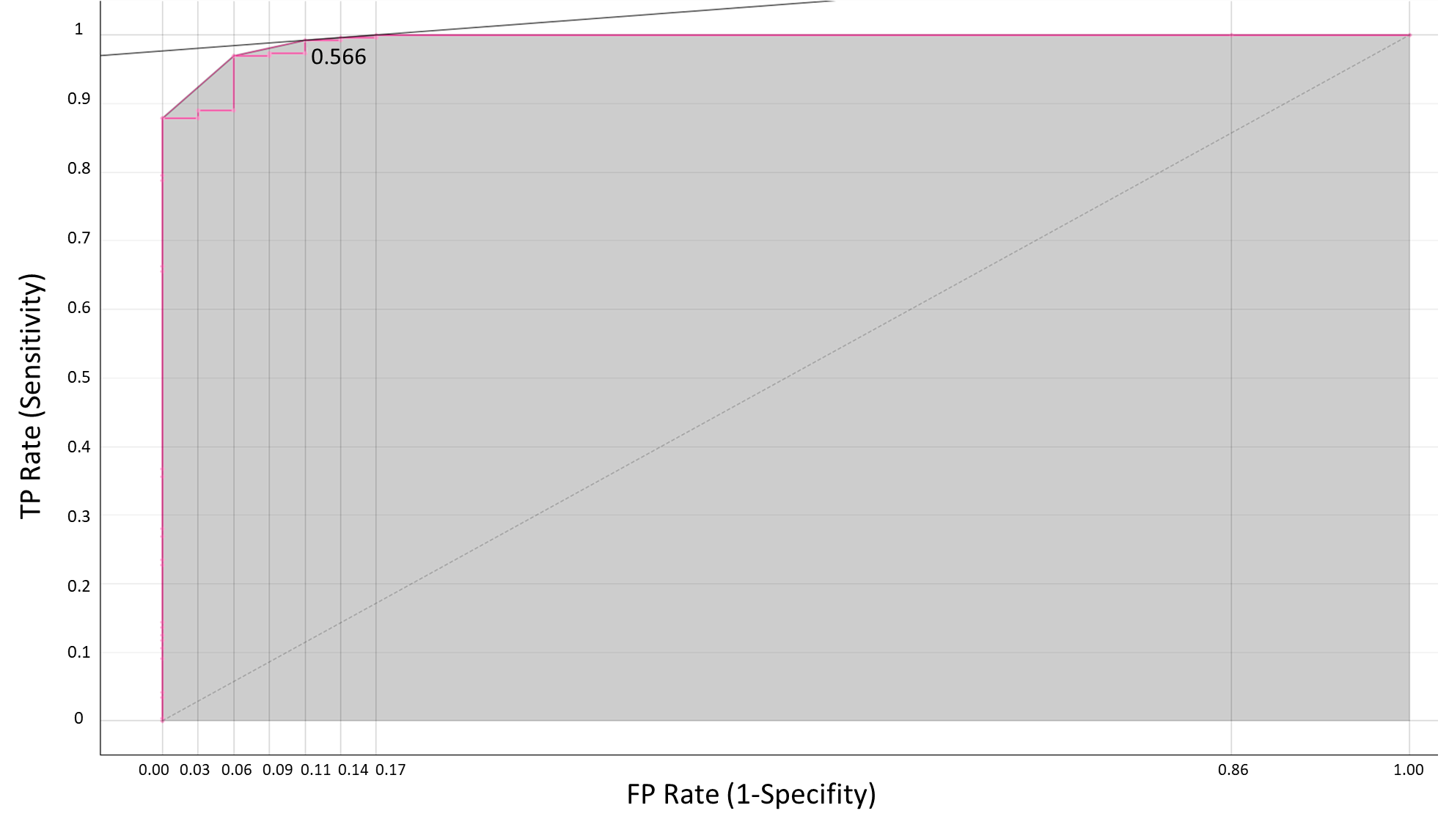
RESULTS
ROC Analysis Results of Logistic Regression Model

Slide 10
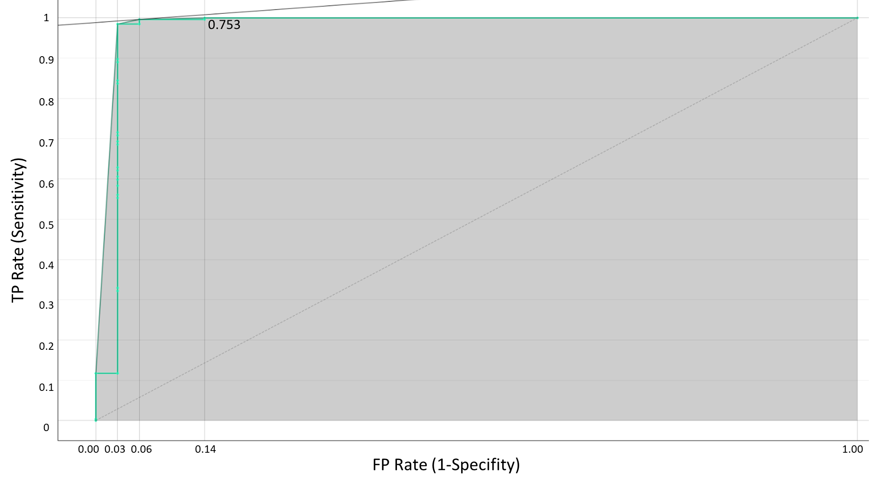
RESULTS
ROC Analysis Results of Neural Network (MLP) Model
Notes:
In ROC analysis, the costs of false positives (FP) and false negatives (FN) are important factors to consider in determining the optimal classification threshold for a model. As shown in the Figure, the cost of false positives is 500, which means that for each false positive, there is a cost of 500. The cost of false negatives is also 500, which means that for each false negative, there is also a cost of 500. The target probability of 88.0% refers to the desired probability of correctly identifying the positive class (e.g., correctly identifying a fish species as present in Manila Bay). In other words, the model should have a probability threshold at which it can correctly identify the positive class with 88.0% accuracy. To determine the optimal classification threshold, the ROC curve is plotted, and the point on the curve that is closest to the upper left corner (representing perfect classification) is selected. This point corresponds to the threshold at which the true positive rate is high and the false positive rate is low, leading to the highest accuracy and lowest cost. In this study, the costs of false positives and false negatives are equal, and the target probability is 88.0%.

Slide 11
CONCLUSIONS
Possible to predict fish species populations in Manila Bay, Philippines with high accuracy.
Development of sustainable fisheries management practices in the region.
Possible to combine the strengths of multiple models and improve overall predictive performance.
K-nearest neighbors and logistic regression models have the best performance in predicting fish species populations, while the neural network model shows slightly lower accuracy.
Provide valuable insights for policymakers and stakeholders in the fisheries industry.
Notes:
Based on the results of the ensemble learning approach, particularly k-nearest neighbors, neural network, and logistic regression, it is possible to predict fish species populations in
Manila Bay, Philippines with high accuracy. These findings are important for the development of sustainable fisheries management practices in the region, which is crucial given
the decline in fish catch and quality in recent years due to overfishing and pollution. By utilizing ensemble learning approach, it is possible to combine the strengths of multiple
models and improve overall predictive performance. The results suggest that the k-nearest neighbors and logistic regression models have the best performance in predicting
fish species production, while the neural network model shows slightly lower accuracy. Overall, the findings of this study provide valuable insights for policymakers and
stakeholders in the fisheries industry, as they can utilize these predictive models to make informed decisions about resource allocation, sustainable fishing practices, and policies that can
help protect and enhance the fisheries in Manila Bay. Further research could also investigate the potential impact of climate change on fish species production and how these models can
be adapted to accommodate changing environmental conditions.

Slide 12
THANK YOU
QUESTION & ANSWER

