Slide 1



SmartPoultry: Early Detection of Poultry Disease from Smartphone Captured Fecal Image
Kaniz Fatema
Senior Lecturer
Dept. of CSE, Independent University, Bangladesh
The 20th International Joint Conference on Computer Science and Software Engineering
Naresuan University Phitsanulok, THAILAND

Slide 2
Introduction
In Bangladesh,1.4% GDP comes from livestock sector and 71.95% of it are chicken.
Major percentage of chicken comes from local poultry farmers who are not trained
They rely on their experience to detect diseases to seek professional’s help, which occasionally fails and results in widespread chicken death
Livestock population of Bangladesh

Slide 3
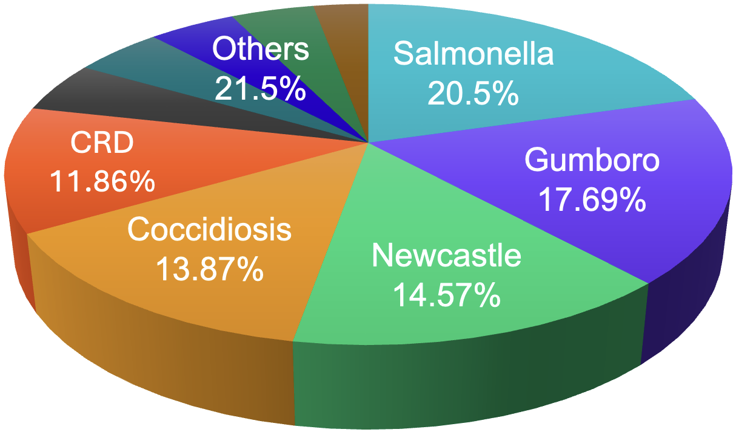
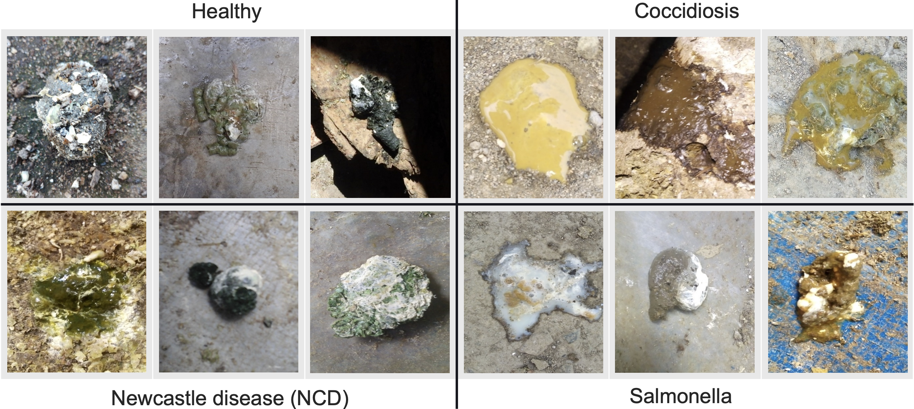
Introduction (2)
Early detection of chicken disease can save the chicken and prevent money loss
Salmonella is the most common chicken disease in Bangladesh, followed by Gumboro, NCD and Coccidiosis

Slide 4
Problem Statement
Methods based on the behavioral characters are expensive, difficult to implement and not user friendly
Feces image-based methods are more practical, but the existing methods fail to identify the disease type with sufficient accuracy
We propose a practical, cheap and rapid system to detect chicken disease from smartphone captured fecal image

Slide 5
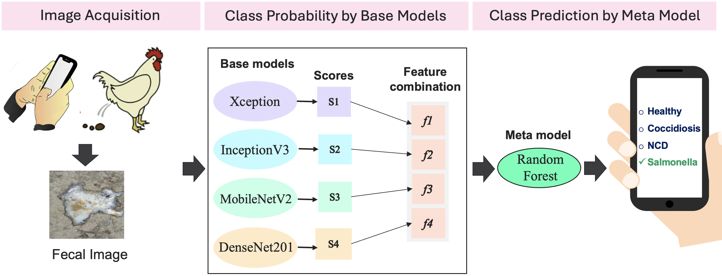
Proposed System
A total of 1080 feces images which include 270 images of each category: healthy, salmonella, NCD and coccidiosis. Data augmentation was also applied for training.
To achieve the best performance epoch, batch size, optimizer, learning rate and dropout hyperparameters were optimized using grid-base approach.

Slide 6
Results: Base Model Selection
Networks | Pre-trained Models | Training accuracy | Training loss | Validation accuracy | Validation loss | Test Accuracy | Micro-average AUC
Network 1 | MobileNetV2 | 0.99 | 0.14 | 0.950 | 0.24 | 0.987 | 1.00
Network 2 | InceptionV3 | 0.993 | 0.070 | 0.930 | 0.285 | 0.975 | 1.00
Network 3 | DenseNet201 | 0.99 | 0.080 | 0.960 | 0.29 | 0.962 | 1.00
Network 4 | Xception | 0.99 | 0.050 | 0.910 | 0.240 | 0.937 | 1.00
Network 5 | VGG19 | 0.980 | 0.276 | 0.928 | 0.200 | 0.927 | 0.99
Network 6 | VGG16 | 0.960 | 0.30 | 0.928 | 0.201 | 0.922 | 0.98
Network 7 | ResNet152 | 0.942 | 0.360 | 0.965 | 0.365 | 0.907 | 0.98
Network 8 | ResNet50 | 0.972 | 0.454 | 0.910 | 0.458 | 0.850 | 0.97
Networks 1-4 achieved the best classification accuracy for the validation and test dataset.

Slide 7
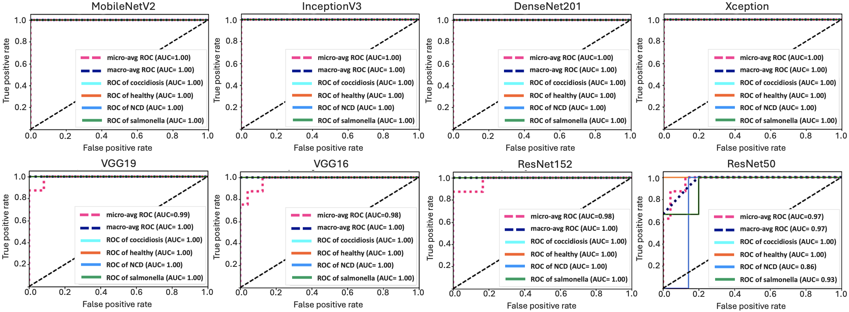
Results: ROC of Base Models
Network 1
Network 2
Network 3
Network 4
Network 5
Network 6
Network 7
Network 8

Slide 8

Results: Comparison with state-of-the-art
Machuve, D., et al. Poultry diseases diagnostics models using deep learning. Frontiers In
Artificial Intelligence. pp. 168 (2022) is the current state of the art.
 | State of the art | Proposed method
Disease | Coccidiosis, Salmonella | Coccidiosis, NCD, Salmonella
Validation Accuracy | 94% | 99%
Test accuracy | - | 92.8%
AUC | - | 1
Precision | - | 93.2%
F1 score | - | 1
Dataset type | Homogeneous | Heterogenous
Turnaround time | - | 30±5 seconds
Te-retest | Not performed | Performed
The proposed system outperformed the existing state of the art
Turnaround time and te-retest consistency on heterogenous data ensured practical usability

Slide 9
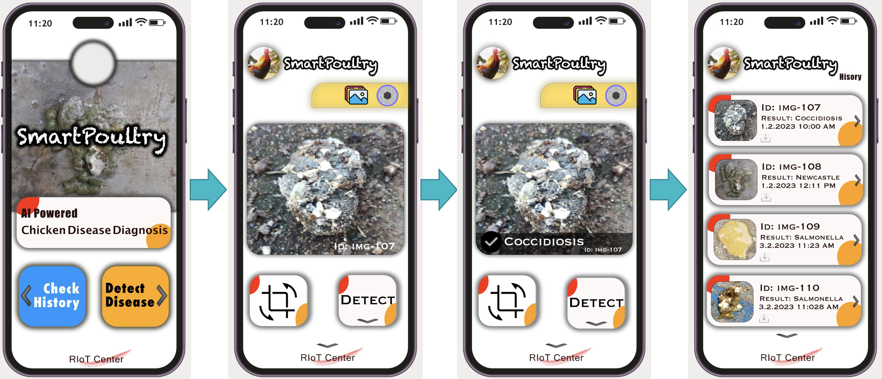
Android Application for Practical Use

Slide 10
THANK YOU
QUESTION & ANSWER

