Slide 1



What Affects the Adoption of Metaverse in Education?
A SEM-based Approach
Rohani Rohan, Pranab Roy, Vajirasak Vanijja, Suree Funilkul, Subhodeep Mukherjee, Debajyoti Pal
SCHOOL OF INFORMATION TECHNOLOGY (SIT)
KING MONGKUT’S UNIVERSITY OF TECHNOLOGY THONBURI (KMUTT)
The 20th International Joint Conference on Computer Science and Software Engineering
28th June-1st July 2023
Naresuan University Phitsanulok, THAILAND

Slide 2
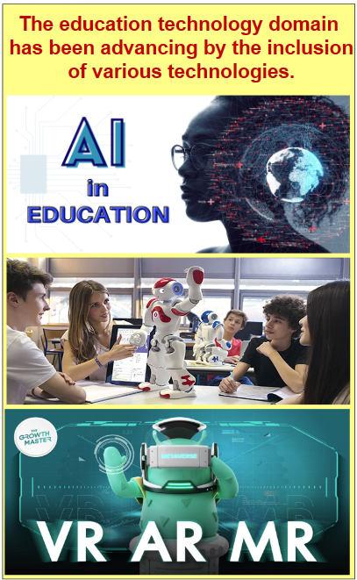
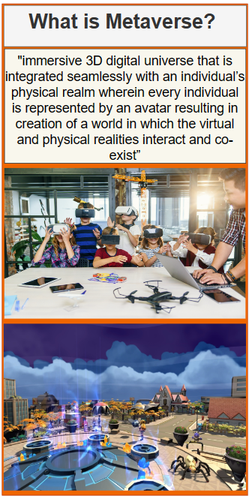
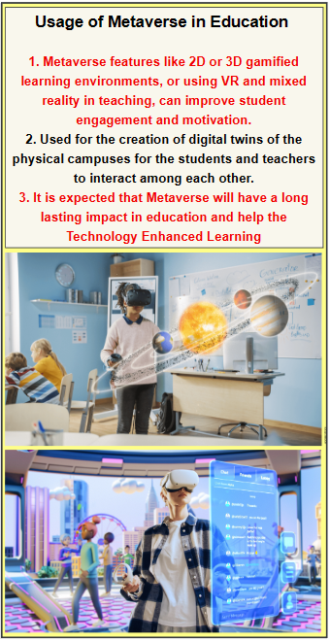
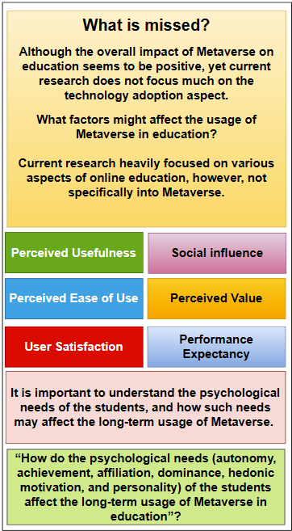
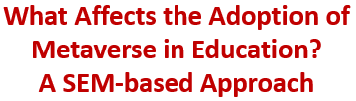
The following Poster presents the fundamental concept of our Study.
1. Roy, R., Babakerkhell, M. D., Mukherjee, S., Pal, D., & Funilkul, S. (2023). Development of a framework for metaverse in education: A systematic literature review approach. IEEE Access.
2. S.-M. Park and Y.-G. Kim, “A Metaverse: Taxonomy, components, applications, and open challenges,” IEEE Access, vol. 10, pp. 4209– 4251, 2022.
3. Copyright free websites: 1. https://stocksnap.io/ 2. https://www.pexels.com/ 3. https://pixabay.com/

Slide 3
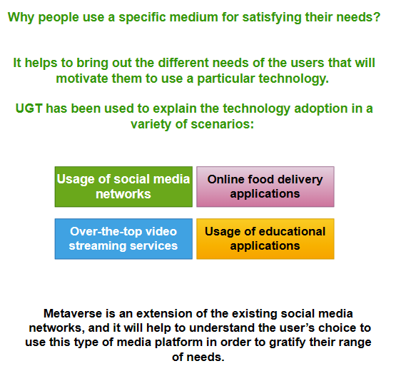
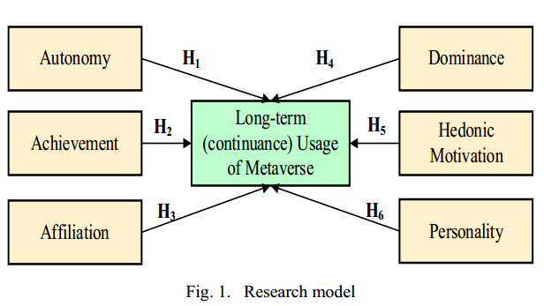
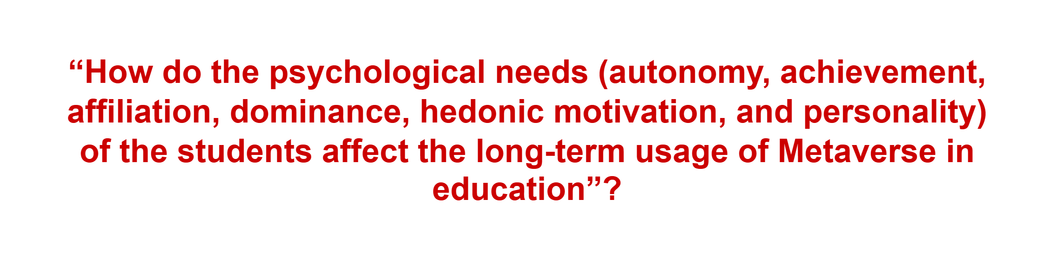
Factors, Uses and Gratification Theory (UGT), and Research Model.
1. W. J. Severin and J. W. Tankard, Communication theories: Origins, methods, and uses in the mass media. Longman New York, 1997.
2. D. Menon, “Purchase and continuation intentions of over -the –top video streaming platform subscriptions: a uses and gratification theory perspective,” Telematics and Informatics Reports, vol. p. 100006, Mar. 2022.
3. D. Menon, “Uses and gratifications of educational apps: A study during COVID-19 pandemic,” Computers and Education. Open, vol. 3, p. 100076, Dec. 2022.

Slide 4
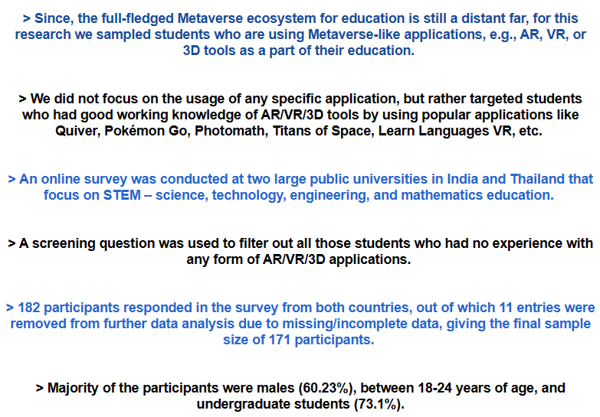
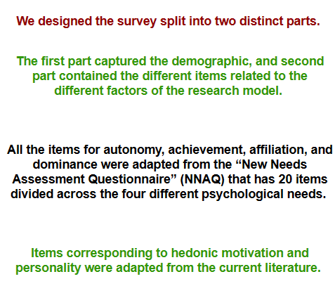
Research Methodology and Data Collection
1. T. M. Heckert et al., “Creation of a new needs assessment questionnaire,” Journal of Social Behavior and Personality, vol. 15, no. 1, p. 121, 2000.
2. H. V. Osei, K. O. Kwateng, and K. A. Boateng, “Integration of personality trait, motivation and UTAUT 2 to understand e-learning adoption in the era of COVID-19 pandemic,” Education and Information Technologies, vol. 27, no. 8, pp. 10705–10730, Sep. 2022.
3. D. Pal, M. D. Babakerkhell, and X. Zhang, “Exploring the determinants of users’ continuance usage intention of smart voice assistants,” IEEE Access, vol. 9, pp. 162259–162275, 2021.

Slide 5
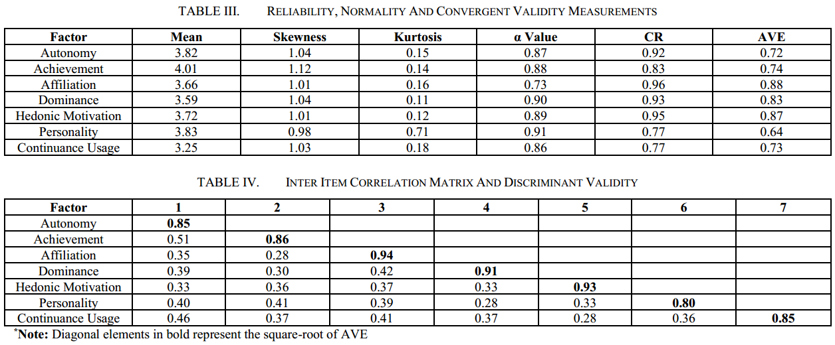
Results
FIRST: Measurement model. We assessed the reliability of the survey items by checking the internal consistency in terms of the Cronbach’s Alpha (α) values.
The validity of the measurement instrument is checked from two aspects: convergent and discriminant validity. Convergent validity is checked using two criteria: Composite Reliability (CR) and Average Variance Extracted (AVE).
The discriminant validity is checked by using the Fornell Larcker criterion, which states that the square-root of the AVE of each of the latent factors must be greater than its correlation with any other factor in the model.

Slide 6
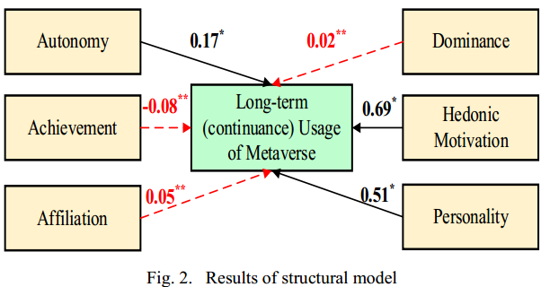
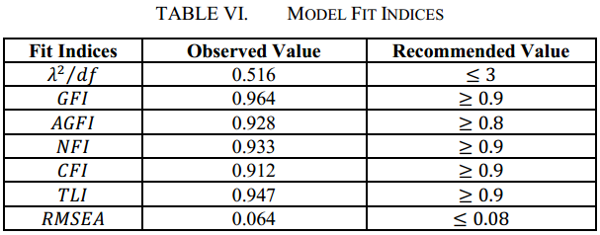
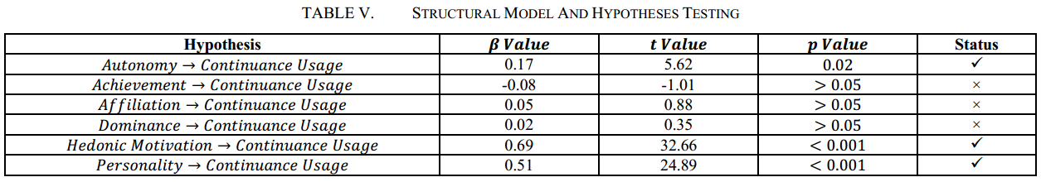
Results (Cont.)
SECOND: We assessed the structural model, together with the process of hypotheses testing.
1. Autonomy is a significant predictor of continuance usage of Metaverse that will ensure its sustainability (𝑡 = 5.62, 𝛽 = 0.17, 𝑝 = 0.02).
2. We also estimated the different model fit indices of the proposed model and report the different parameters in Table VI.

Slide 7
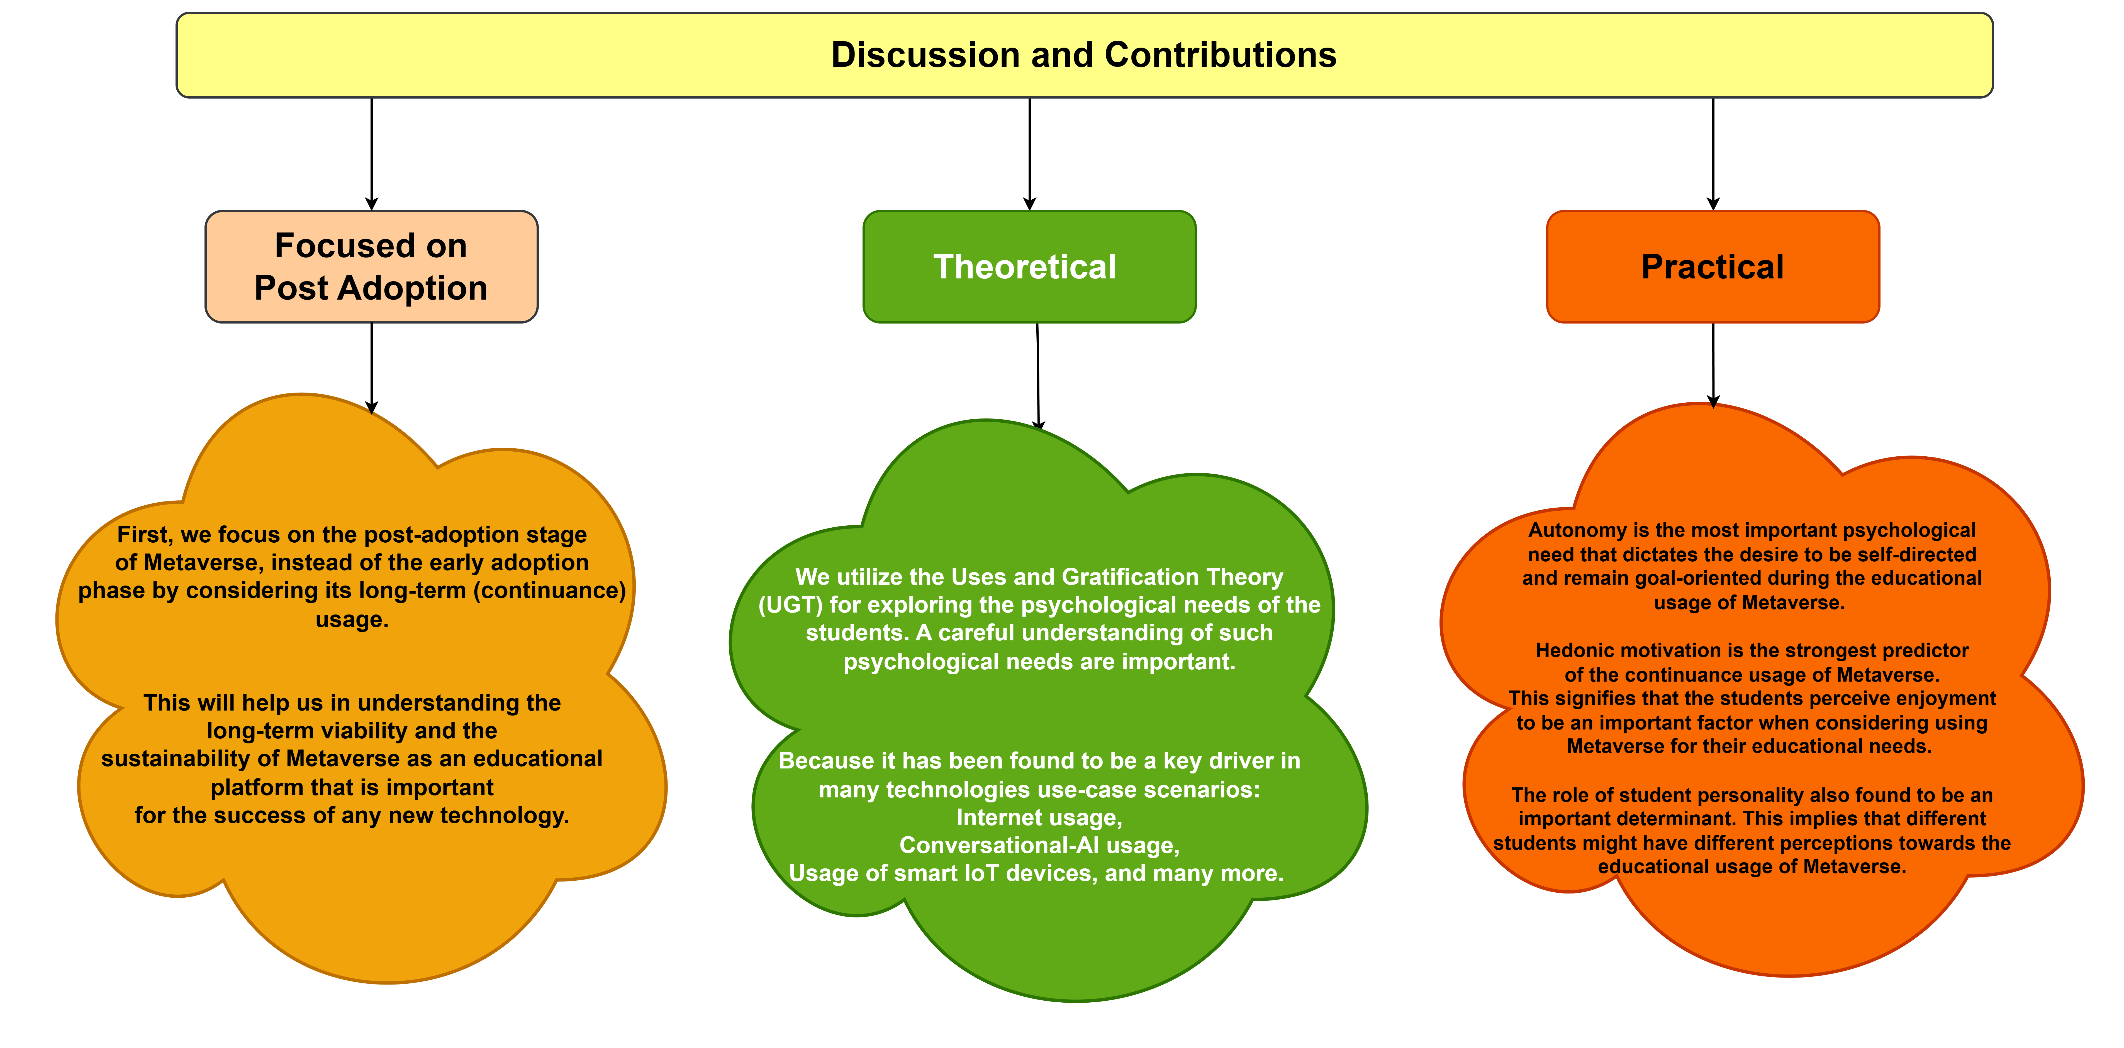
1. F. L. I. Dutsinma, D. Pal, P. Roy, and H. Thapliyal, “Personality is to a conversational agent what perfume is to a flower,” IEEE Consumer Electronics Magazine, pp. 1–1, 2022.
2. H. V. Osei, K. O. Kwateng, and K. A. Boateng, “Integration of personality trait, motivation and UTAUT 2 to understand e-learning adoption in the era of COVID-19 pandemic,” Education and Information Technologies, vol. 27, no. 8, pp. 10705–10730, Sep. 2022.
3. X. Zhang, Q. Yan, S. Zhou, L. Ma, and S. Wang, “Analysis of unsatisfying user experiences and unmet psychological needs for virtual reality exergames using deep learning approach,” Information, vol. 12, no. 11, p. 486, Nov. 2021.

Slide 8
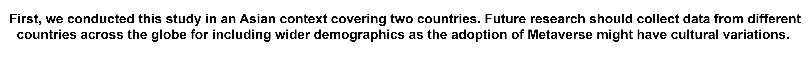
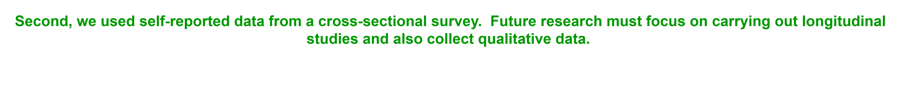
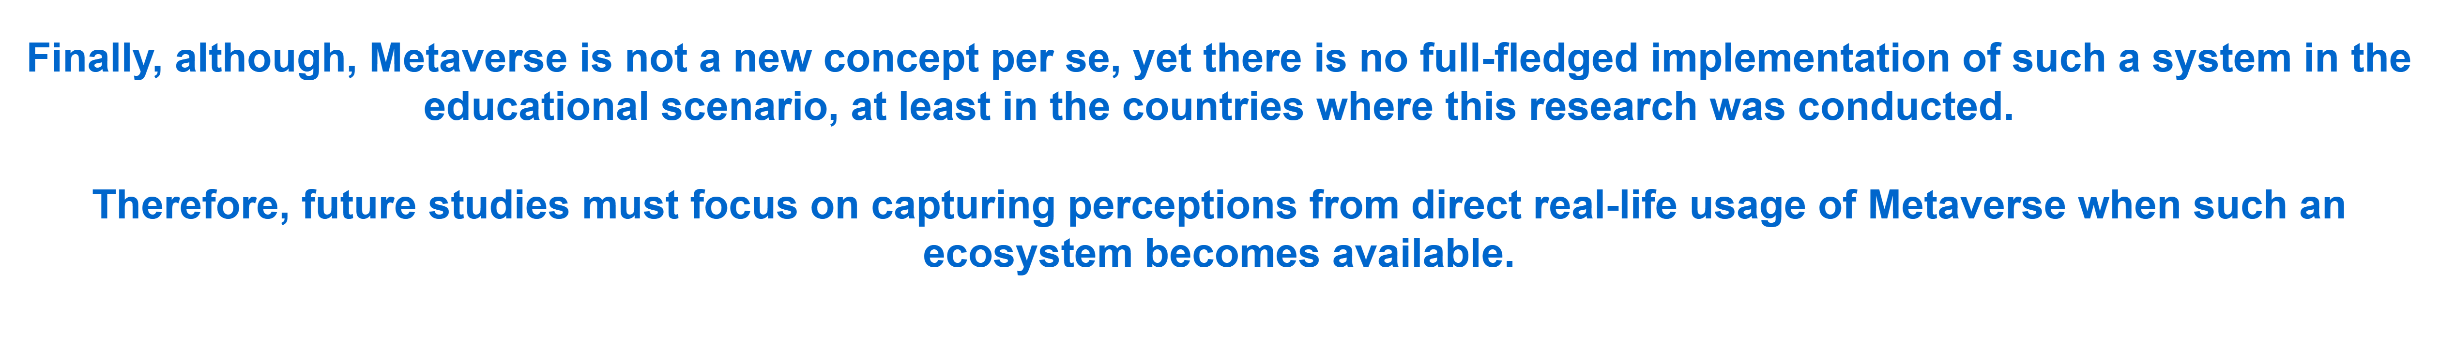
Limitations and Future Work
1. Mushtaha, E., Abu Dabous, S., Alsyouf, I., Ahmed, A., Raafat Abdraboh, N.: The challenges and opportunities of online learning and teaching at engineering and theoretical colleges during the pandemic. Ain Shams Eng. J. 13, 101770 (2022).
2. Martin, F., Xie, K., Bolliger, D.U.: Engaging learners in the emergency transition to online learning during the COVID-19 pandemic. J. Res. Technol. Educ. 54, S1–S13 (2022).

Slide 9
THANK YOU
Q & A

