Slide 1



Development of a Compact System to Recognize 26 Letters in American Sign Language Alphabet Based on Flexible Ionic Liquid Strain Sensors
Chi Tran Nhu, Tiep Dang Dinh, Phu Nguyen Dang, Van Nguyen Thi Thanh, Cuong Vu Manh, Tung Bui Thanh
VNU – University of Engineering and Technology
Military Institute of Science andTechnology
VNU – Construction Department
The 20th International Joint Conference on Computer Science and Software Engineering
28th June-1st July 2023
Naresuan University Phitsanulok, THAILAND

Slide 2
Contents
Introduction
Ionic Liquid Strain Sensor
System Design
Signal Processing Algorithm
Experiments and Results
Conclusions

Slide 3
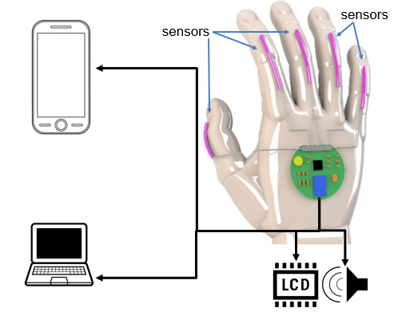
Introduction
Sign language is a form of communication that uses visual-manual gestures and facial expressions instead of spoken words.
More than 8 million deaf people around the world
American Sign Language (ASL) being the most used
In this report, a compact sign language recognition and translation system was developed based on flexible strain sensors
Proposed system

Slide 4
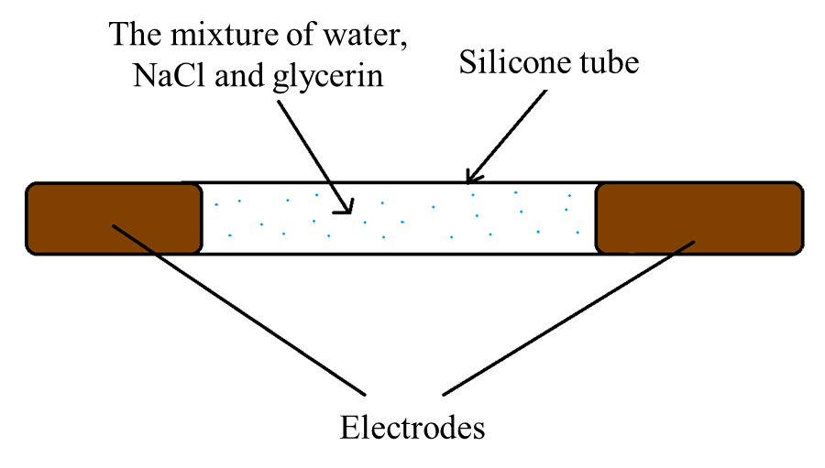
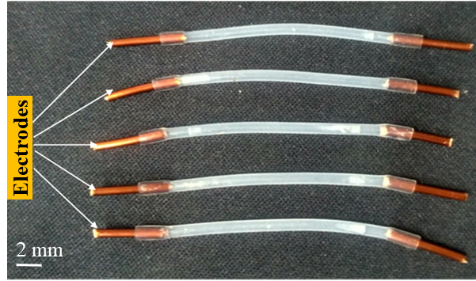
Ionic Liquid Strain Sensor
The ionic liquid strain sensor is a type of resistive sensor that converts a mechanical elongation or displacement into an electrical signal.
The structure model of the strain sensor
Some prototypes of the ionic liquid strain sensor

Slide 5
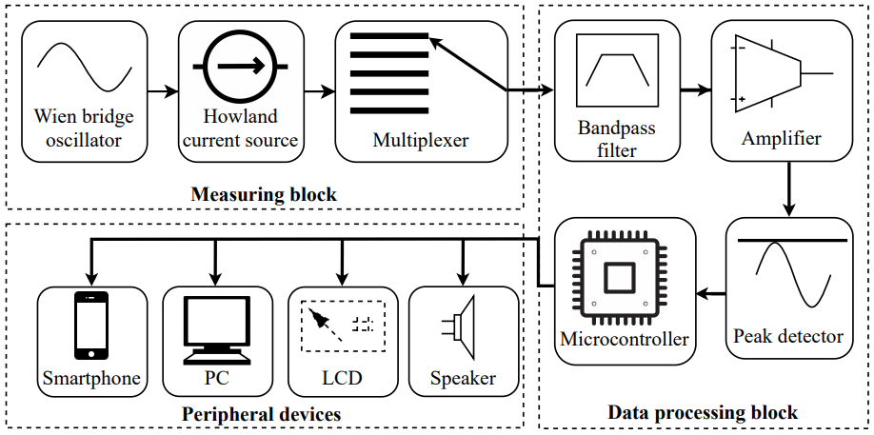
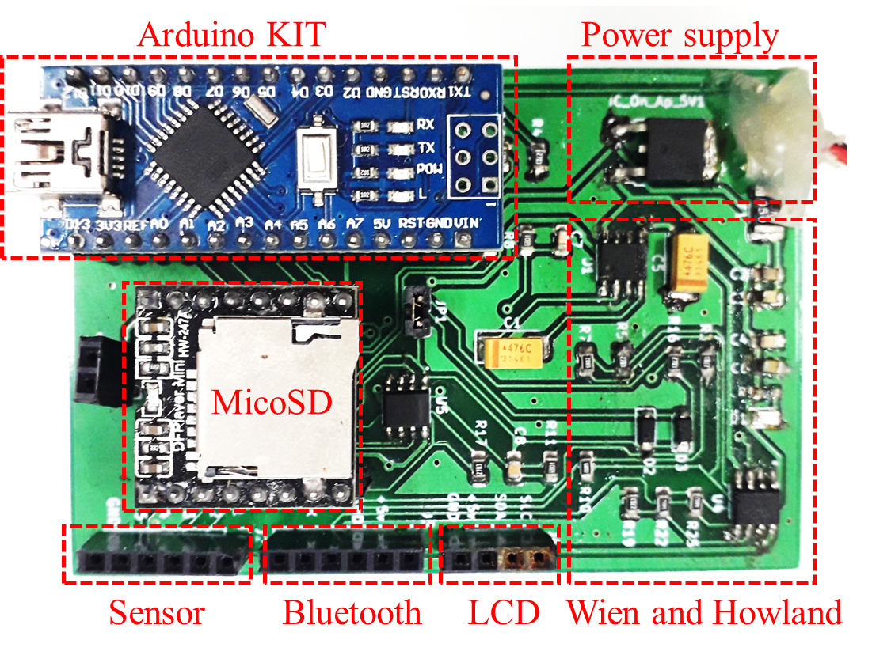
System Design
The system consists of three main blocks: measuring block, data processing block and peripheral devices.
Block diagram of the proposed system
The system circuit is designed and fabricated by multi-layer PCB technology.

Slide 6
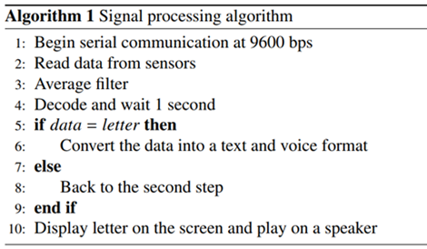
Signal Processing Algorithm
The Arduino Nano KIT was used to interpret the signals from the five strain sensors in accordance with Algorithm 1.
The signals from the strain sensors are then captured through the multiplexer and underwent filtering to eliminate noise due to the intensity variation between adjacent data points

Slide 7
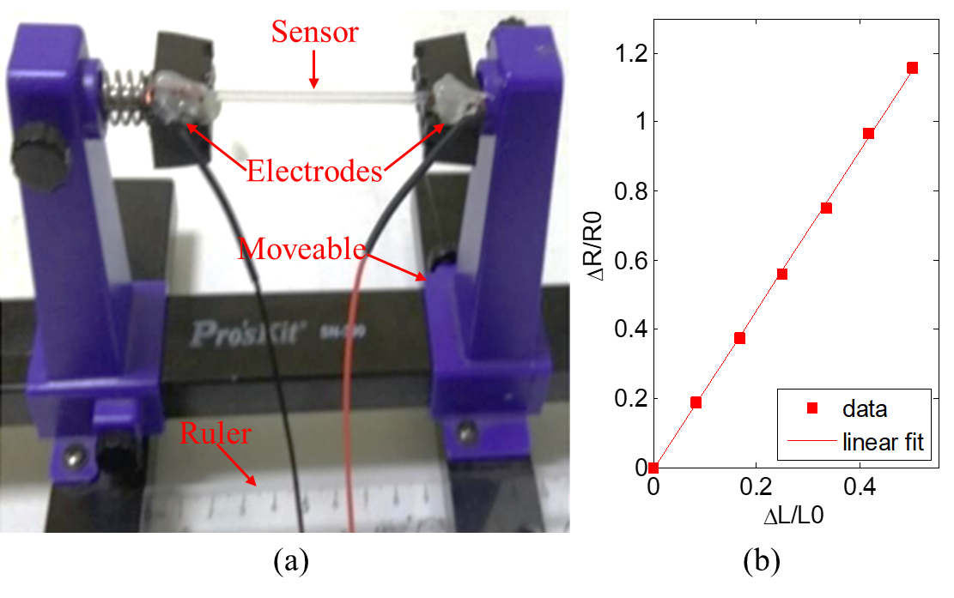
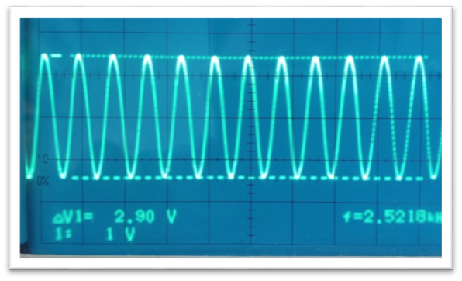
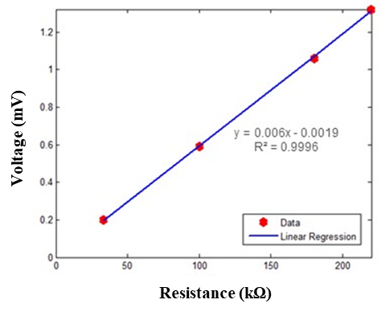
Experiments and Results
A. Investigation of Strain Sensor and System
The investigation result of the proposed strain sensor
The investigation results of Wien bridge oscillator circuit and and Howland current source

Slide 8
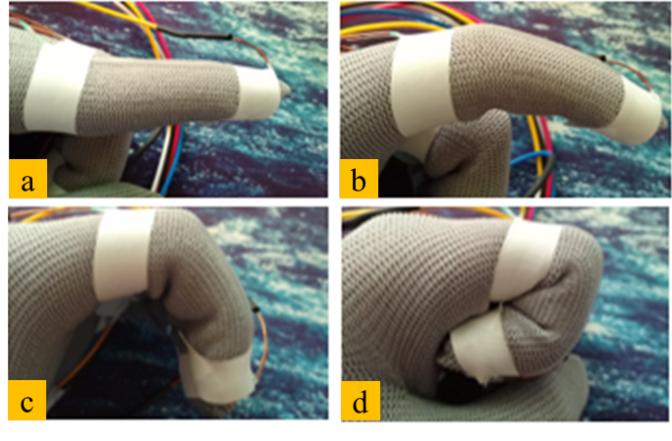
Experiments and Results
Level | Sen. #1 (index) | Sen. #2 (middle) | Sen. #3 (ring) | Sen. #4 (little) | Sen. #5 (thumb)
1 | 14-16 | 21-23 | 14-16 | 19-21 | 14-16
2 | 25 -27 | 24-46 | 29-31 | 29-31 | 18-30
3 | 35-37 | 55-57 | 40-42 | 39-41 | more
4 | more | more | more | more | -
Four different bending states of the finger: (a) open; (b) slight bending; (c) strong bending; (d) fully closed.
Table I. Resistance value corresponding to the levels of the fingers (unit: kilo ohm)

Slide 9
Experiments and Results
  B. The Experimental Results on The Human Fingers
Letter | Index (Sen. #1) | Middle (Sen. #2) | Ring (Sen. #3) | Little (Sen. #4) | Thumb (Sen. #5) | Letter | Index (Sen. #1) | Middle (Sen. #2) | Ring (Sen. #3) | Little (Sen. #4) | Thumb (Sen. #5)
A | 4 | 4 | 4 | 4 | 1 | N | 3 | 3 | 4 | 4 | 3
B | 1 1 | 1 1 | 1 1 | 1 1 | 3 2 | O | 3 | 3 | 3 | 3 | 2
C | 2 3 2 2 2 | 2 2 3 2 2 | 2 2 2 3 2 | 2 2 2 2 3 | 2 2 2 2 2 | P | 1 | 2 | 4 | 4 | 1
D | 1 1 | 3 3 | 3 3 | 3 4 | 3 3 | Q | 1 1 | 4 3 | 3 3 | 3 3 | 1 1
E | 3 3 | 3 3 | 3 3 | 3 2 | 3 3 | R | 1 | 2 | 3 | 3 | 3
F | 3 | 1 | 1 | 1 | 3 | S | 3 3 | 4 4 | 4 4 | 4 4 | 2 3
G | 1 1 | 3 4 | 4 4 | 4 4 | 2 2 | T | 2 | 4 | 4 | 4 | 2
H | 1 1 1 | 1 1 1 | 3 4 3 | 3 3 4 | 2 2 2 | U | 1 | 1 | 4 | 4 | 2
I | 3 | 3 | 3 | 1 | 3 | V | 1 | 1 | 3 | 3 | 3
J | 3 | 3 | 3 | 2 | 3 | W | 1 1 | 1 1 | 1 1 | 3 3 | 3 2
K | 1 1 | 1 1 | 3 4 | 3 4 | 1 1 | X | 2 2 2 | 4 3 4 | 4 4 3 | 4 4 4 | 3 3 3
L | 1 1 | 4 3 | 4 4 | 4 4 | 1 1 | Y | 3 | 3 | 3 | 1 | 1
M | 3 | 3 | 3 | 4 | 3 | Z | 1 | 4 | 4 | 4 | 3

Slide 10
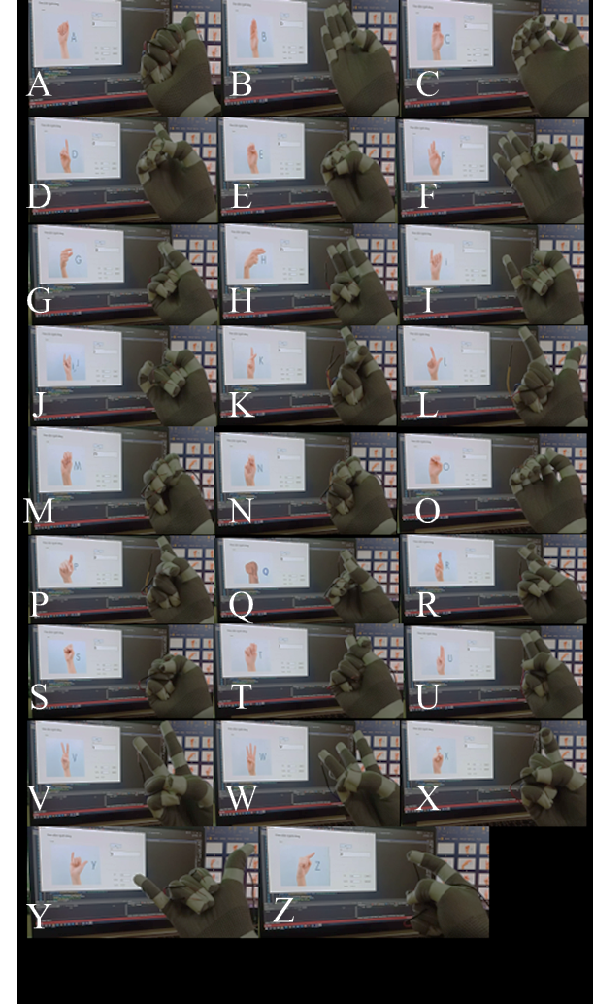
Experiments and Results
No. | Letter | Correct | Error | Accuracy
1 | A | 20 | 0 | 100%
2 | B | 20 | 0 | 100%
3 | C | 19 | 1 | 95%
4 | D | 20 | 0 | 100%
5 | E | 20 | 0 | 100%
6 | F | 20 | 0 | 100%
7 | G | 19 | 1 | 95%
8 | H | 20 | 0 | 100%
9 | I | 20 | 0 | 100%
10 | J | 20 | 0 | 100%
11 | K | 20 | 0 | 100%
12 | L | 19 | 1 | 95%
13 | M | 20 | 0 | 100%
14 | N | 20 | 0 | 100%
15 | O | 19 | 1 | 95%
16 | P | 20 | 0 | 100%
17 | Q | 19 | 1 | 95%
18 | R | 20 | 0 | 100%
19 | S | 19 | 1 | 95%
20 | T | 20 | 0 | 100%
21 | U | 18 | 2 | 90%
22 | V | 19 | 1 | 95%
23 | W | 20 | 0 | 100%
24 | X | 20 | 0 | 100%
25 | Y | 20 | 0 | 100%
26 | Z | 20 | 0 | 100%
Total |  | 511/520 | 9 | 98.27%

Slide 11
Conclusions
The development of a sign language recognition system utilizing strain sensors composed of ionic liquid was successfully carried out.
The fabrication of the strain sensors was achieved by injecting the ionic liquid into a silicone tube and attaching it to the fingers.
The results indicate that the system is capable of recognizing all 26 letters in American Sign Language with a high level of accuracy (98.27%).
The proposed system is designed to function with both smartphones and PCs, displaying the letters the user wishes to convey

Slide 12
THANK YOU
QUESTION & ANSWER

