Slide 1

Office Syndrome Treatment
Using Augmented Reality Technology on Mobile Applications
Pattiyaporn Srahongthong, Apichaya Nimkoompai
Immersive Technology Laboratory
Faculty of Information Technology
Thai-Nichi Institute of Technology

Slide 2
1
  Introduction
  Literature review
Topics
  Methodology
What we'll discuss today
  Experimental results
  Conclusion

Slide 3

2
Introduction
COVID pandemic (2020 - 2022)
The company began to change its way of working to a hybrid workplace. The new normal for office workers resulted in 60% of employees working at their office, and 40% working online.

Slide 4

3
Operational Barriers of Work from Home
(1) communication problems
(2) rising personal, home utility costs.
(3) Environmental problems
(4) Health problems from non-facilitated
work equipment

Slide 5
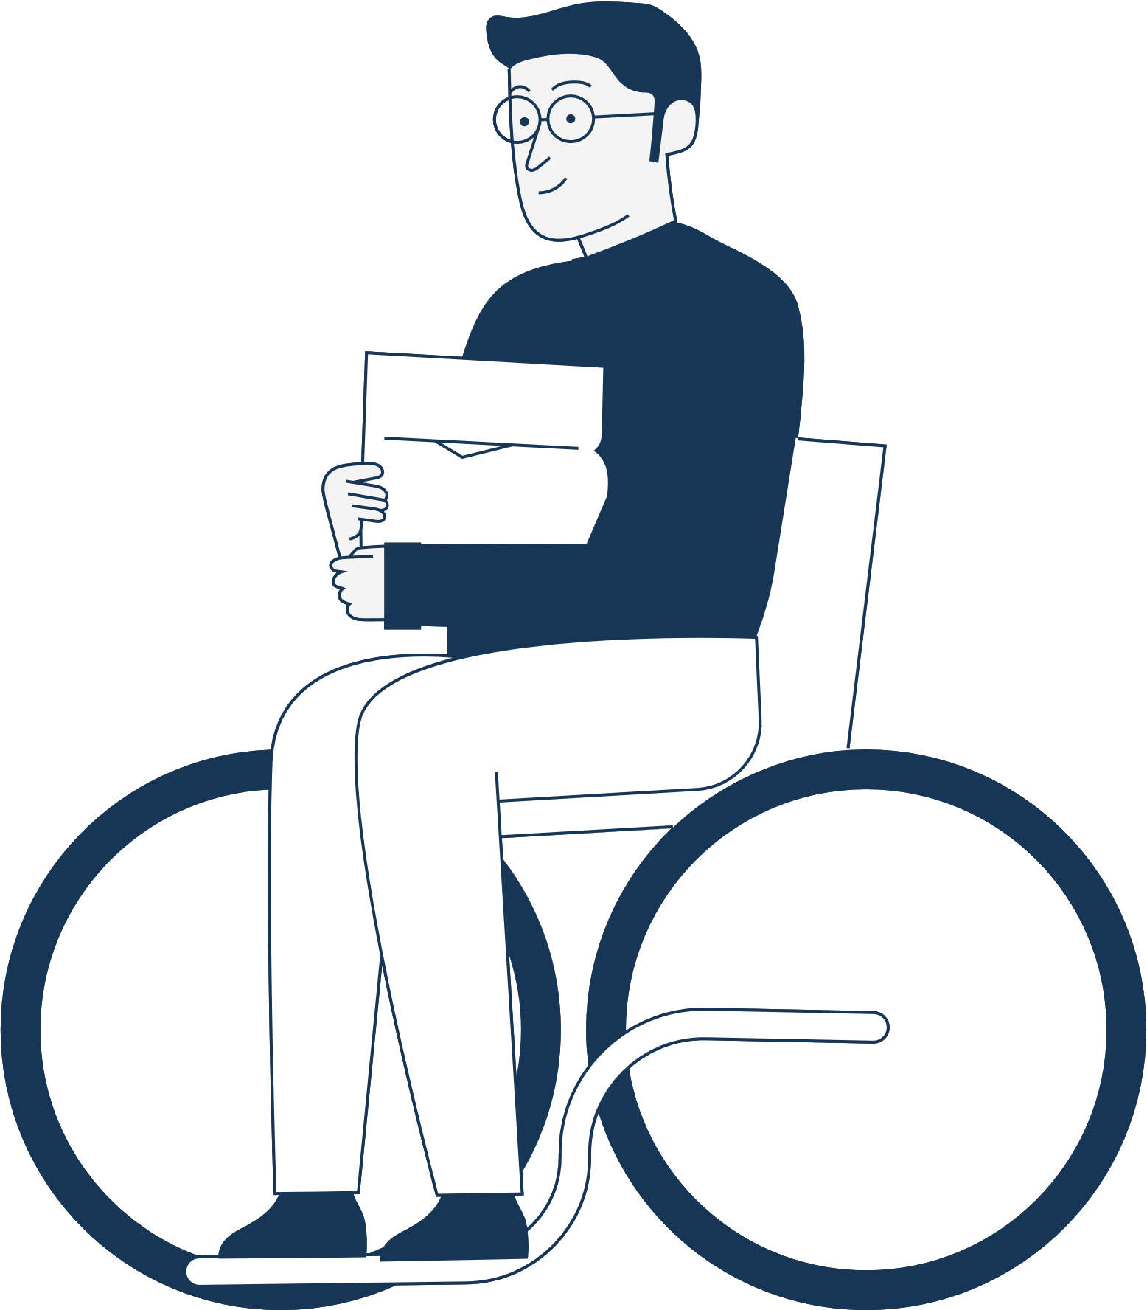
4
The Department of Mental Health - 2022
More than 10% of urban workers are at risk of what is termed "Office Syndrome"

Slide 6
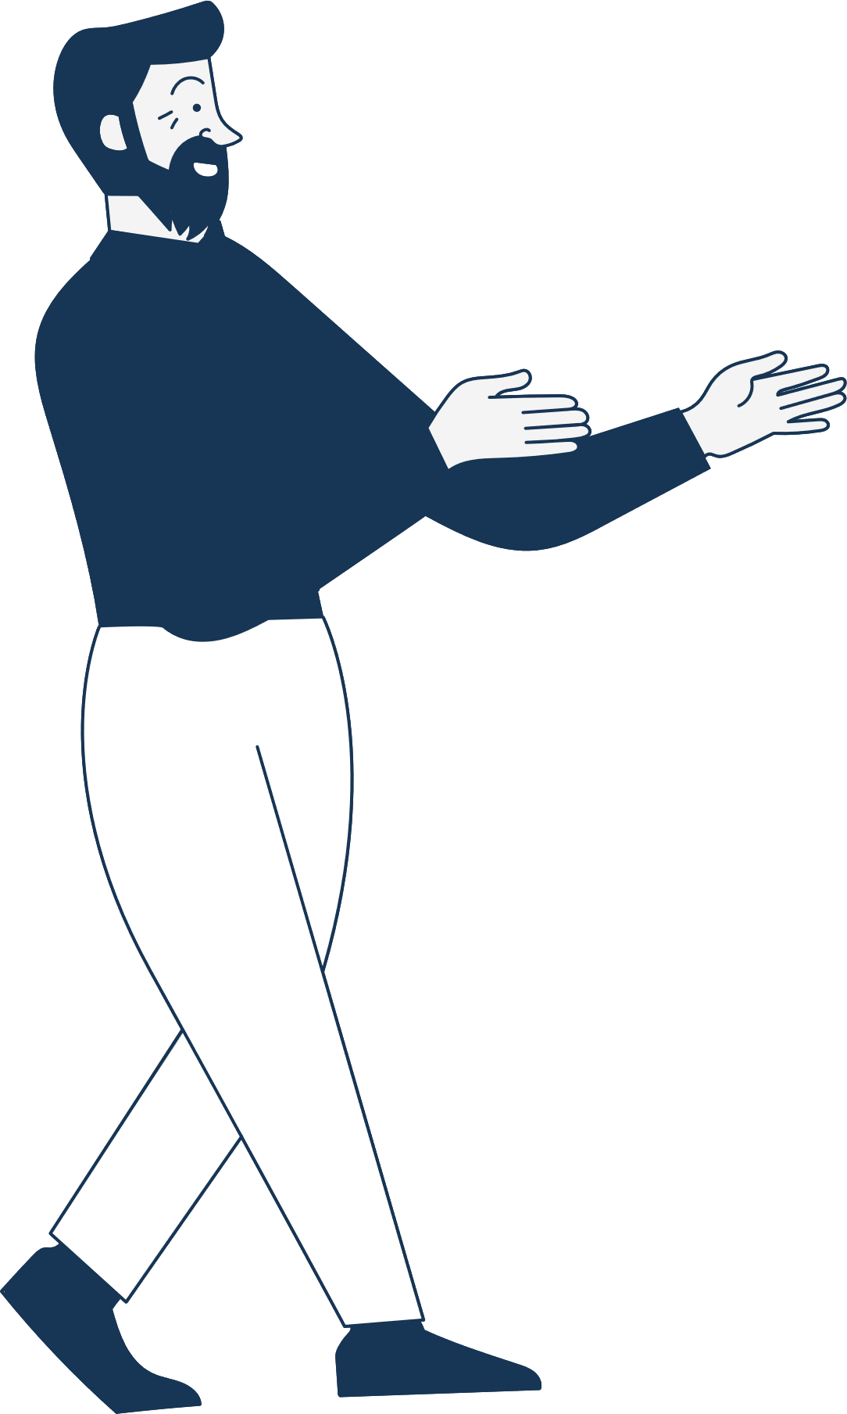

5
LITERATURE REVIEW

Slide 7

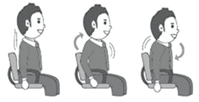
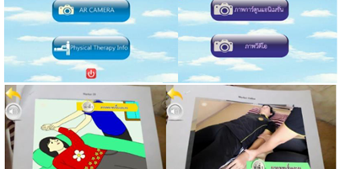
6
LITERATURE REVIEW
Causes of Office Syndrome
Exercise techniques to prevent Office Syndrome
Augmented Reality

Slide 8
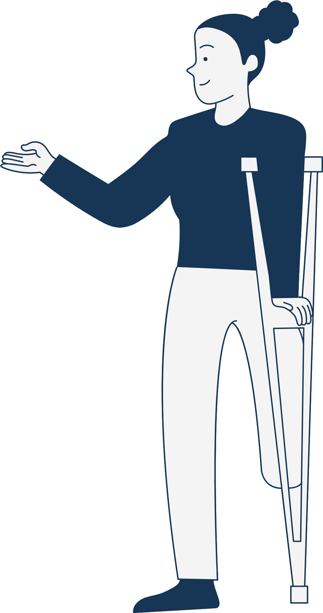




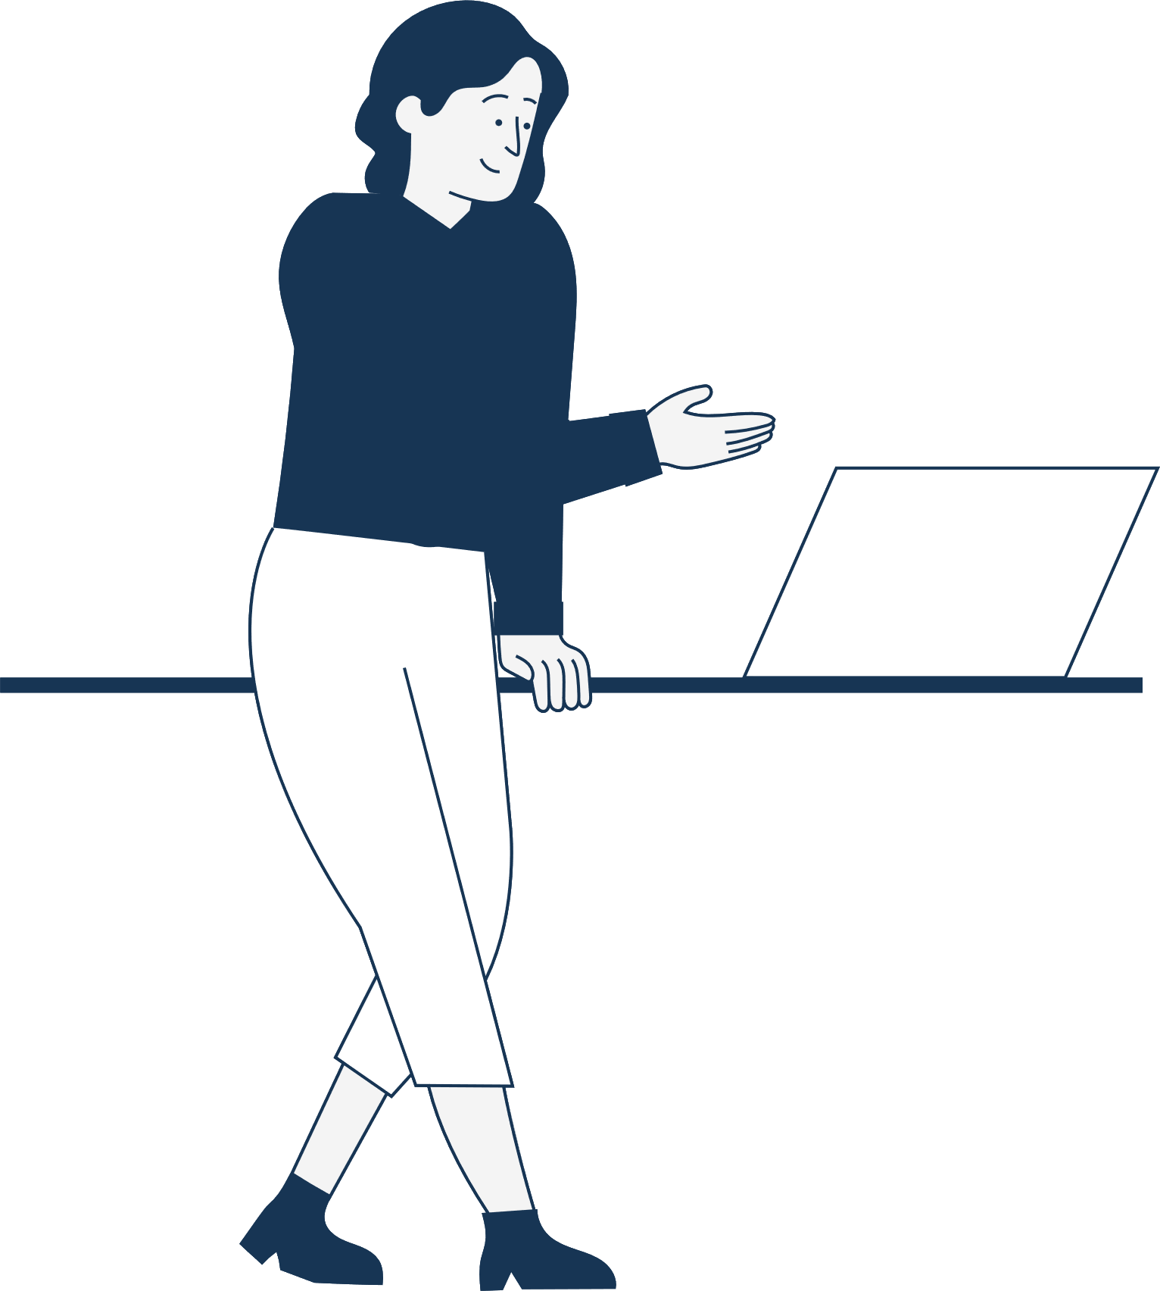

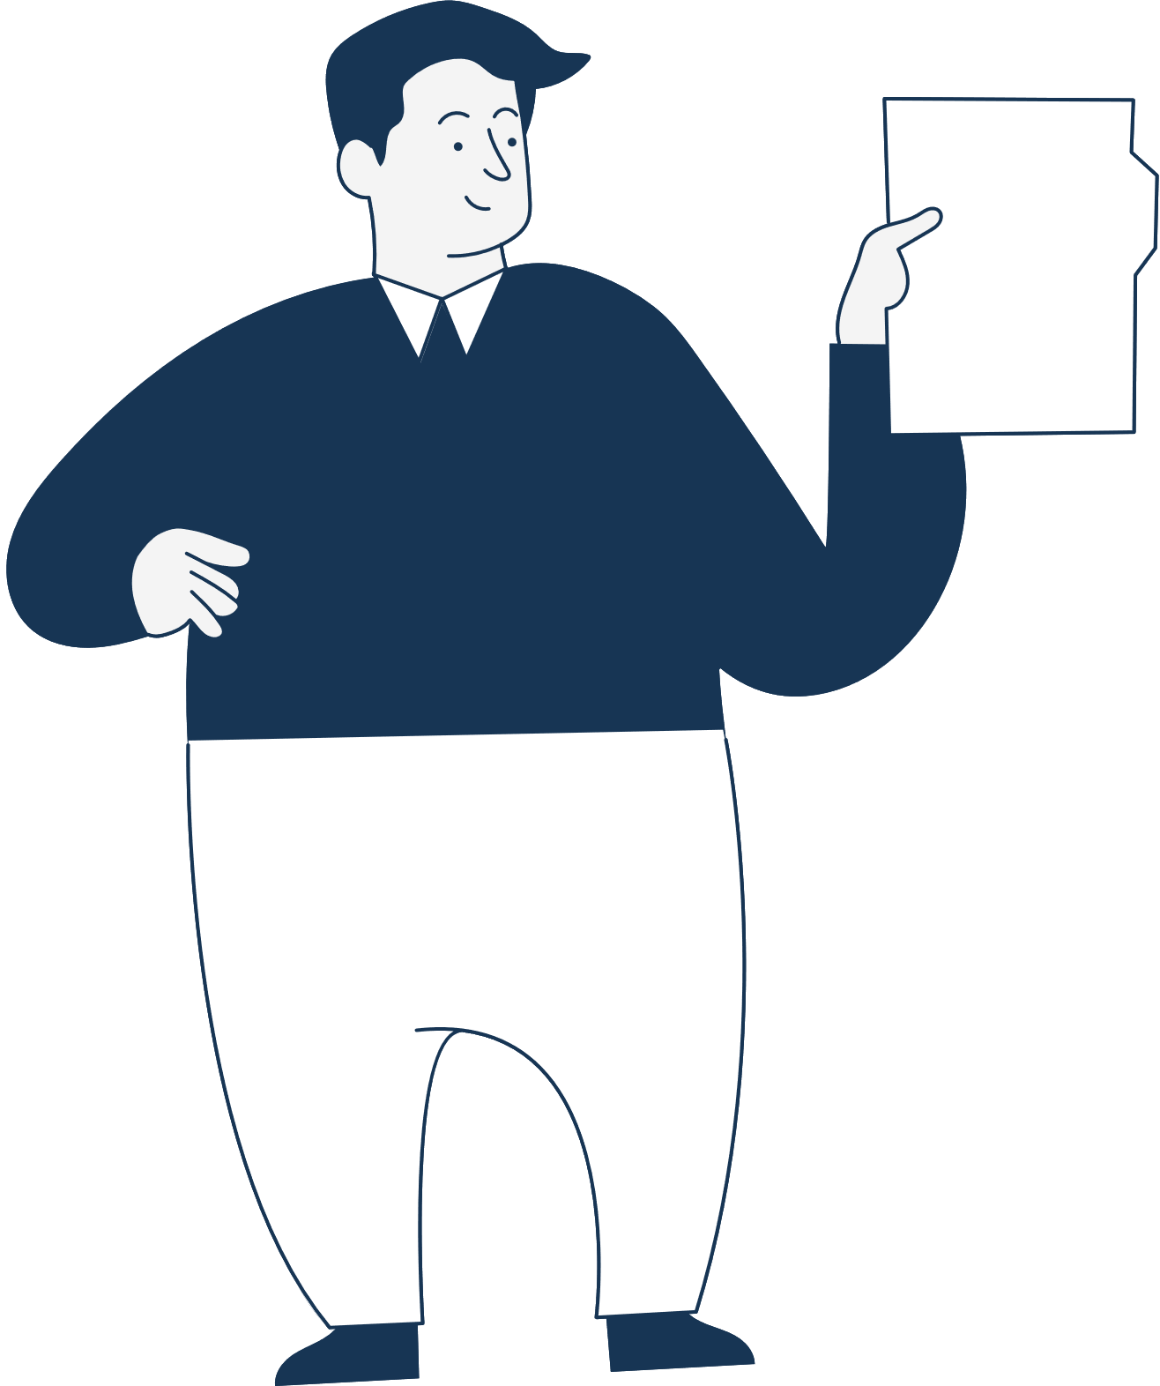



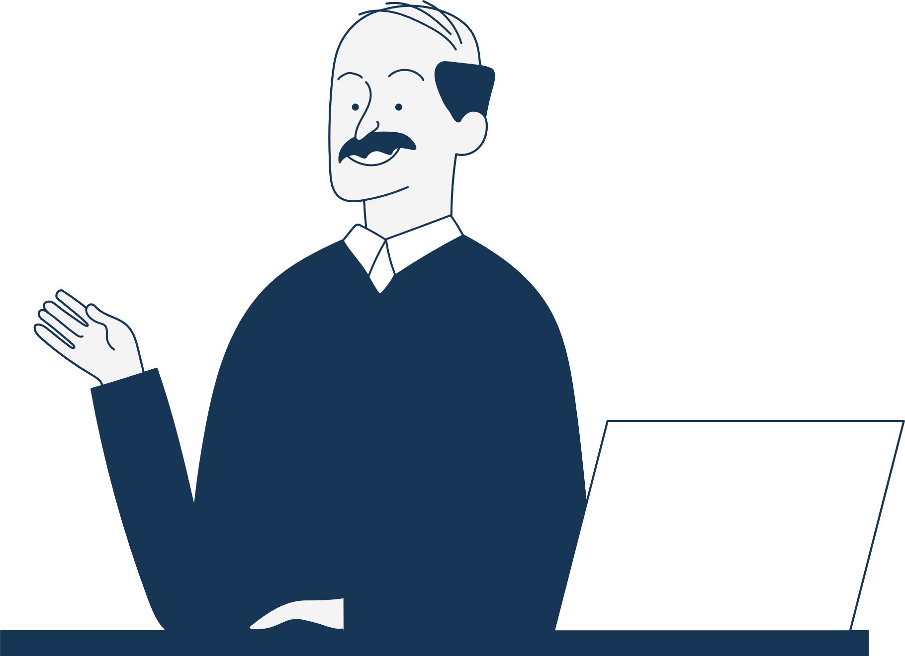
7
METHODOLOGY

Slide 9
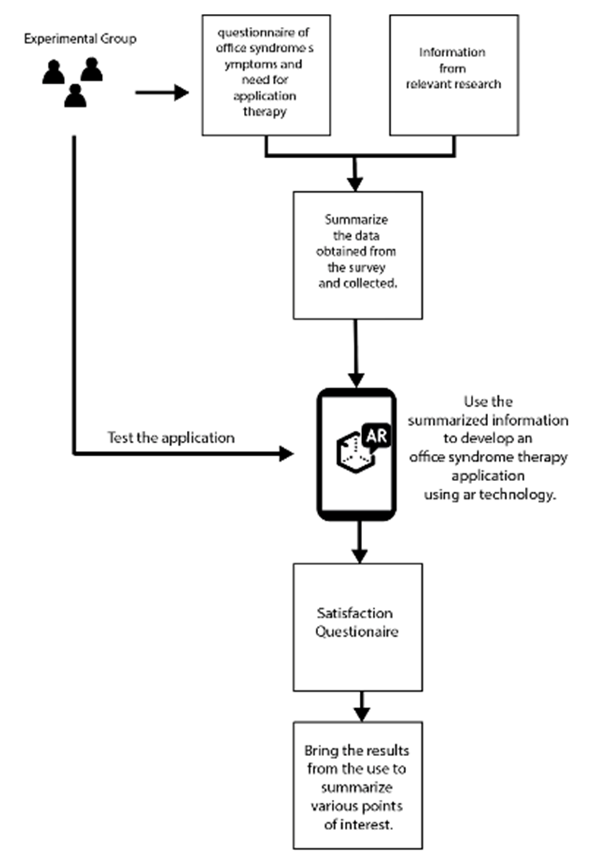
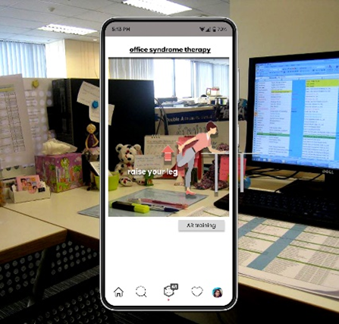
8
METHODOLOGY

Slide 10
9
EXPERIMENTAL RESULTS

Slide 11
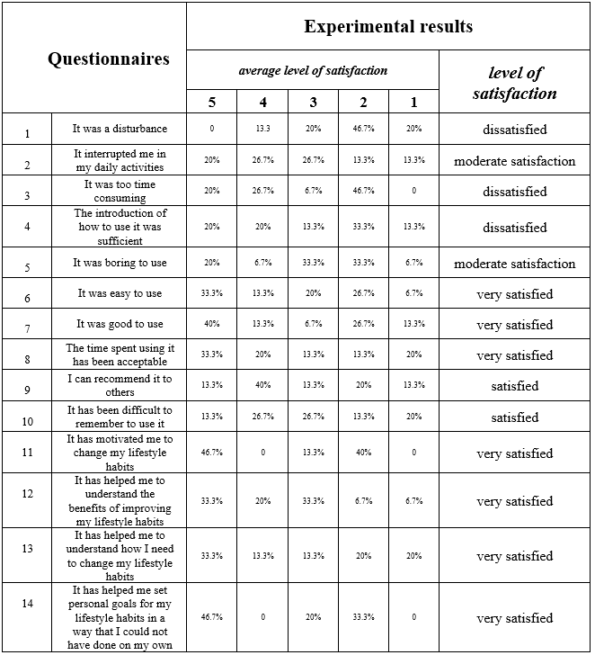
10
EXPERIMENTAL RESULTS
EXPERIMENTAL RESULTS
Top 3 questionaires of satisfaction of using the application
  Q.14: It has helped me set personal goals
for my lifestyle habits in a way
that I could not have done on my own
  Q.11: It has motivated me
to change my lifestyle habits
  Q.7: It was good to use

Slide 12

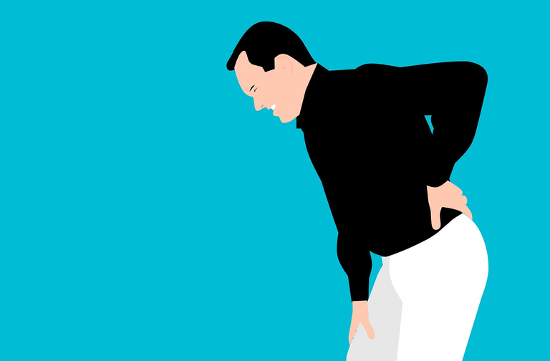



11
CONCLUSION

Slide 13

12
Thank you!

