Slide 1



A Backup Mechanism of Virtual Machine Checkpoint Image using ZFS Snapshots
Tinnaphob Angkaprasert, Kasidit Chanchio
Department of Computer Science Thammasat University
The 20th International Joint Conference on Computer Science and Software Engineering
28th June-1st July 2023
Naresuan University Phitsanulok, THAILAND

Slide 2
Introduction
The ability to checkpoint a VM is an important mechanism.
It allows us to restore a VM at the checkpoint.
During the normal execution, VM can periodically checkpoint and backup its VM disk image to backup server.
In case of failure or disaster occurs, the VM must be able to recover at checkpoint in timely manner.

Slide 3
Introduction
Our work focus on using QEMU-KVM as a hypervisor and QCOW2 disk image as the VM disk image.
The traditional checkpoint and backup mechanism of QEMU-KVM is inefficient.
Checkpointing saves CPU, Memory, and Device states.
It does not save the disk state.
QEMU-KVM creates a new QCOW2 overlay disk image to save the disk state.

Slide 4
Introduction
There will be many overlay disk images created throughout VM lifetime.
Deleting image will results in data loss, and VM will cease to function.
Although merging operation of overlay exists, they takes time and significant CPU cycles.
We propose a Snapshot Manager that leverages ZFS commands to address the problems.

Slide 5
Background
QEMU-KVM is a popular hypervisor that runs on Linux
It uses QCOW2 disk image format as a VM disk image
The checkpointing mechanism does not save disk states
To save disk state, QEMU-KVM need to create QCOW2 overlay disk image
VM will continue to make changes on newly created image.
If we checkpoint 3 times a day, there will be 90 overlay at the end of the month
Merging overlay disk image takes a lot of time, depending on the data inside image

Slide 6
Background
ZFS is a copy-on-write transactional filesystem
It takes snapshot at filesystem level
Snapshot does not take extra spaces
Deleting snapshot take less than 0.05 seconds per snapshot.
We checkpoint into the same disk image
The checkpoint will be kept in ZFS snapshot

Slide 7
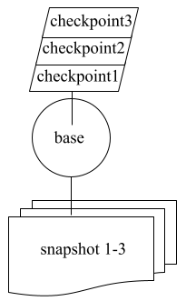
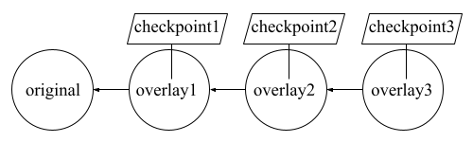
Background
ZFS
Traditional

Slide 8
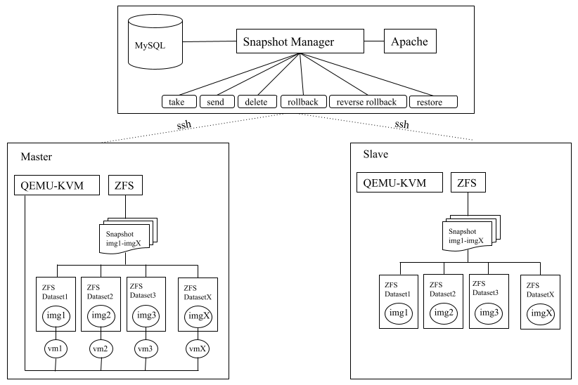
Architecture Design

Slide 9
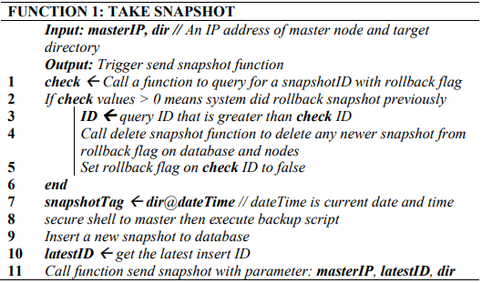
Snapshot Manager’s Function

Slide 10
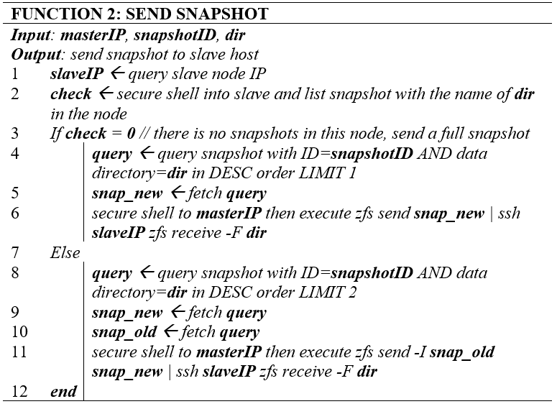
Snapshot Manager’s Function

Slide 11
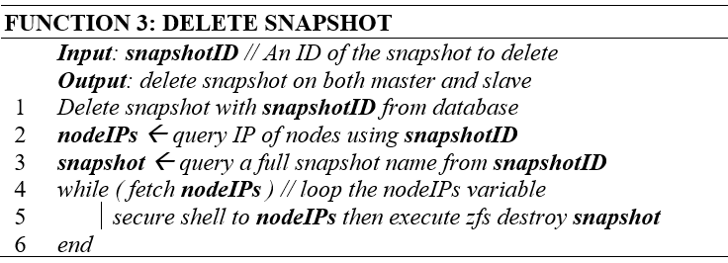
Snapshot Manager’s Function

Slide 12
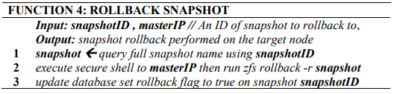
Snapshot Manager’s Function

Slide 13
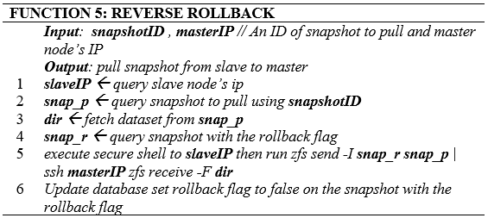
Snapshot Manager’s Function

Slide 14
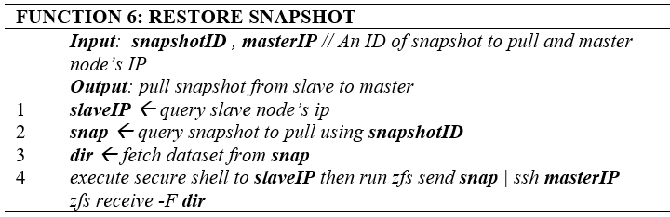
Snapshot Manager’s Function

Slide 15
Snapshot Manager’s Function
Snapshot Manager can configured to take snapshot or delete snapshot automatically
Configure to take snapshot everyday , every hour, or every week
Configure the maximum number of snapshot to keep.

Slide 16
Experiment Setup
Create a preinstalled VM disk image contains Ubuntu 22.04 with Nextcloud application
Create a test file to upload to Nextcloud
500MB, 1GB, 2GB, 10GB, 20GB
VM is configured to have 4vCPU
RAM is 8GB

Slide 17
Experiment Steps
Each file size will be tested in separately, by following steps below:
1. We launch VM with Nextcloud disk image
2. We uploaded file to Nextcloud
3. We measure checkpoint time, snapshot time, and transfer time.
4. We measure disk image sizes.
5. We redo step 2-4 four more times

Slide 18
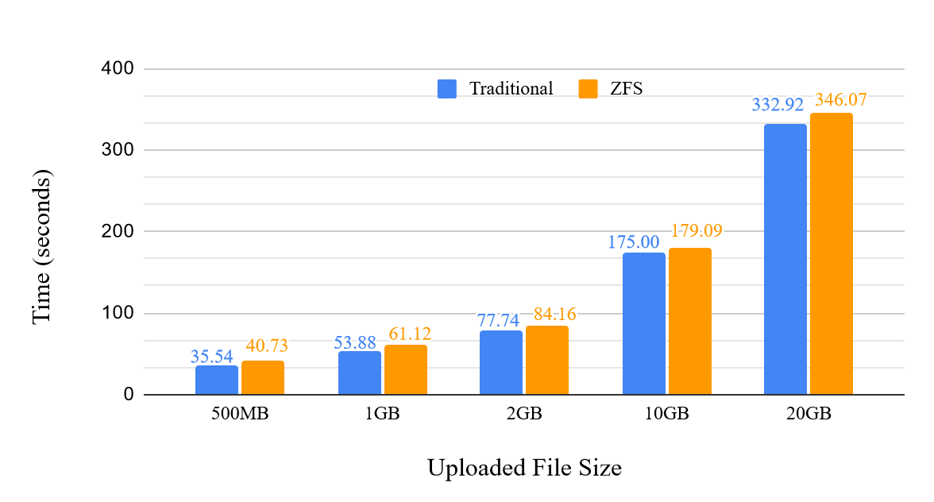
Results and Discussions
We found that ZFS takes slightly longer to backup per checkpoint than traditional method.

Slide 19
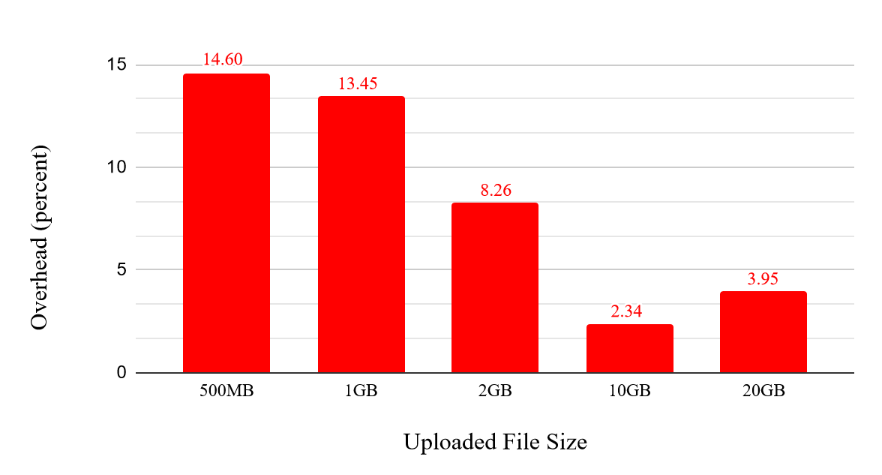
Results and Discussions
We found that overhead when using ZFS is lower from 15% to 2% as data size increases.

Slide 20
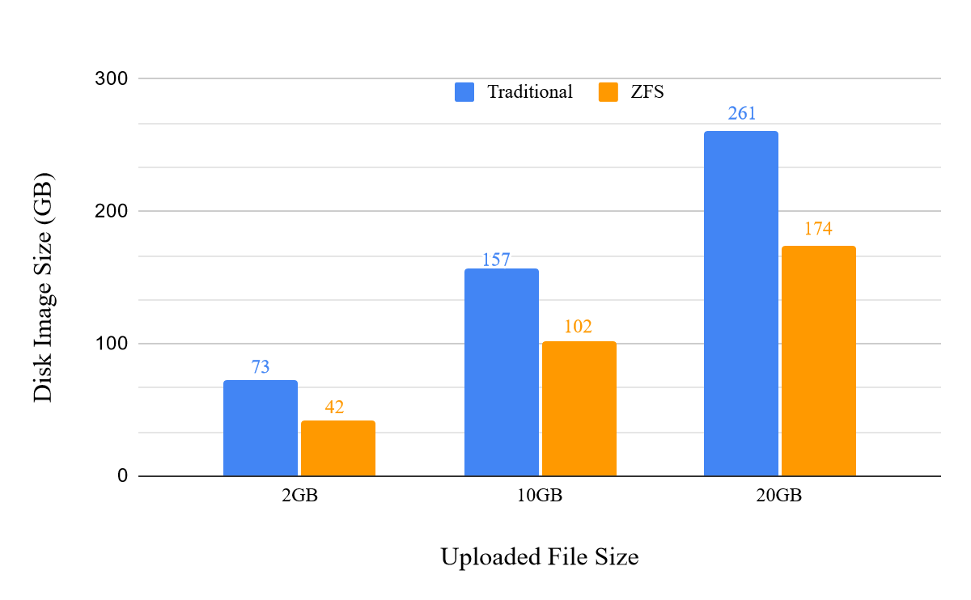
Results and Discussions
We chose 3 cases to do restoration experiment.
We send the disk image at fifth checkpoint back to the master host.
ZFS has to sent 33% to 42% less data back to the master host.

Slide 21
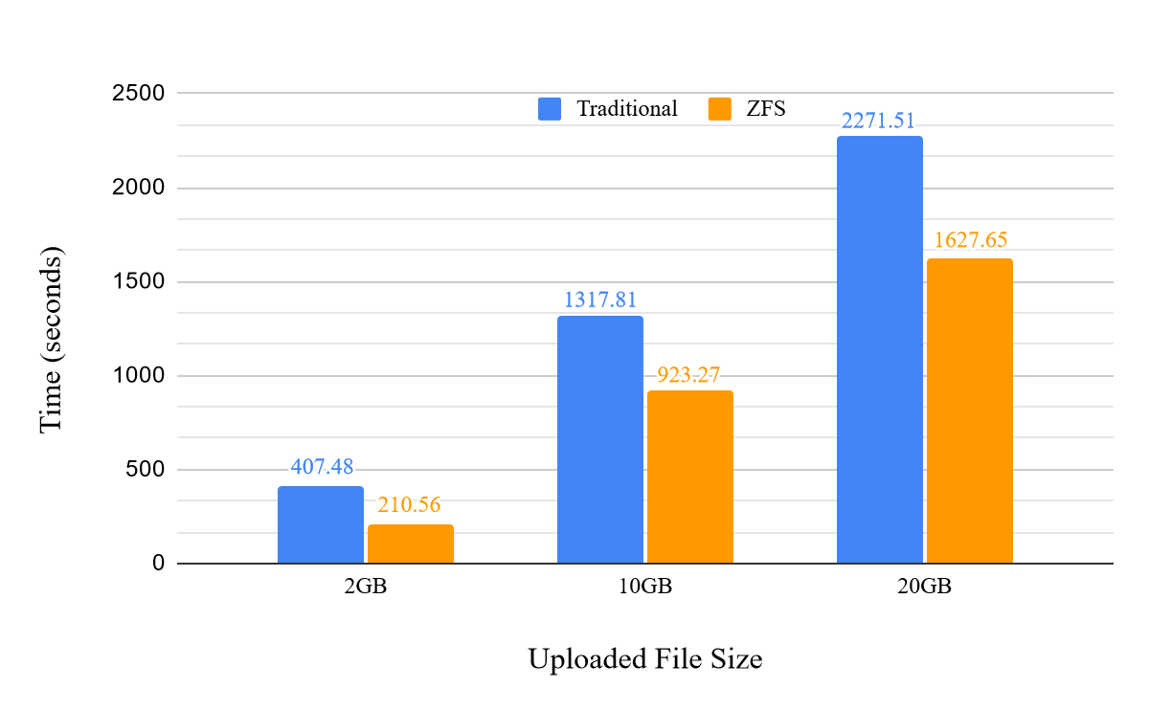
Results and Discussions
A restoration of VM using ZFS is 28 to 43% faster

Slide 22
Conclusion & Future work
Traditional QEMU-KVM must creates QCOW2 disk image
ZFS has lower restore time, at a cost of moderately higher backup time.
The majority of backup time is transfer time, which runs in background while the VM is running.
ZFS makes it more convenient to manage VM disk image
Next, we plan to integrate ZFS to other checkpointing mechanism to reduce VM downtime.

Slide 23
THANK YOU
QUESTION & ANSWER

