Slide 1



A Resilient Cloud-based DDoS Attack Detection and Prevention System
Somchart Fugkeaw, Narongsak Moolkaew, Theerapat Wiwattanapornpanit,Thanyathon Saengsena, Pattavee Sanchol
School of ICT, Sirindhorn International Institute of Technology
Thammasat University, Pathum Thani, Thailand
The 20th International Joint Conference on Computer Science and Software Engineering
28th June-1st July 2023
Naresuan University Phitsanulok, THAILAND

Slide 2
Problem Statement
Web applications or web services deployed on cloud are susceptible to DDoS attack due to the high degree of accessibility via the public network.
Cloud service providers (CSPs) implement firewall, IDS, and IPS to detect suspicious traffic volume. However, such common countermeasures may introduce false positive, false negative due to the different transaction processing patterns of web servers run in the cloud.
Existing works developed techniques to detect HTTP flooding and mitigate the high rate of traffic attacks such as setting a speed floor of network flow, limiting bandwidth, specifying the number of requests for each period.
Some works [4, considered the user behavior analysis, deep learning [11] technique, or using firewall [12] to detect DDoS on cloud.
Nevertheless, no research works have been done on resilient detection and prevention based on the flexible rule specification and traffic profile analysis, and offer timely response as an integrated solution for web applications or web services deployed in cloud environment.

Slide 3
Research Challenge
Handling flexible and adaptive DDoS attack detection on cloud where a number of web applications or services are hosted is thus challenging.

Slide 4
Our Research Contributions
We proposed a system called CloudGuard as a flexible and DDoS attack detection and prevention system.
  our proposed scheme corelates the rule-based analysis leveraging the rule sets for filter the attack based on volume-based analysis and re-confirmation of the genuine attack based on normal traffic profile. → Reduce false positive rate of detection.
We introduced a tree-based DDoS analysis model based on rules-based approach to enable fast classification of the attack type for the detection of DDoS in cloud → fast detection and classification
The CloudGuard system is unique in its ability to accurately detect DDoS attacks such as volume-based attack, protocol attack, and application-based attack. → Coverage of Common DDoS attack
The CloudGuard provides recommendations to network or security administrator on what actions to take when the attack is detected. → Preventive action

Slide 5

What is CloudGuard?
A cloud based DDoS Detection and Prevention system constructing from a set algorithm rules that function as a defensive security of web servers or application on cloud supporting a high volume of requests from the clients.

Slide 6
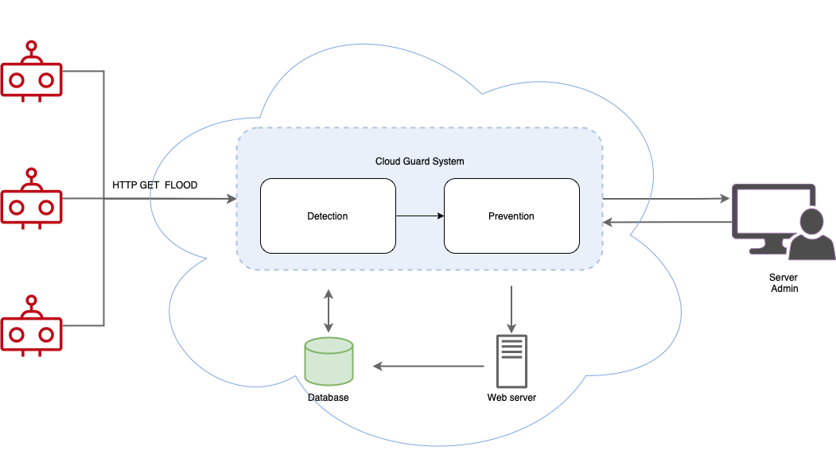
System perspective

Slide 7




Function
Transaction
collection
Rule-Based
Analysis
Database
Prevention System

Slide 8
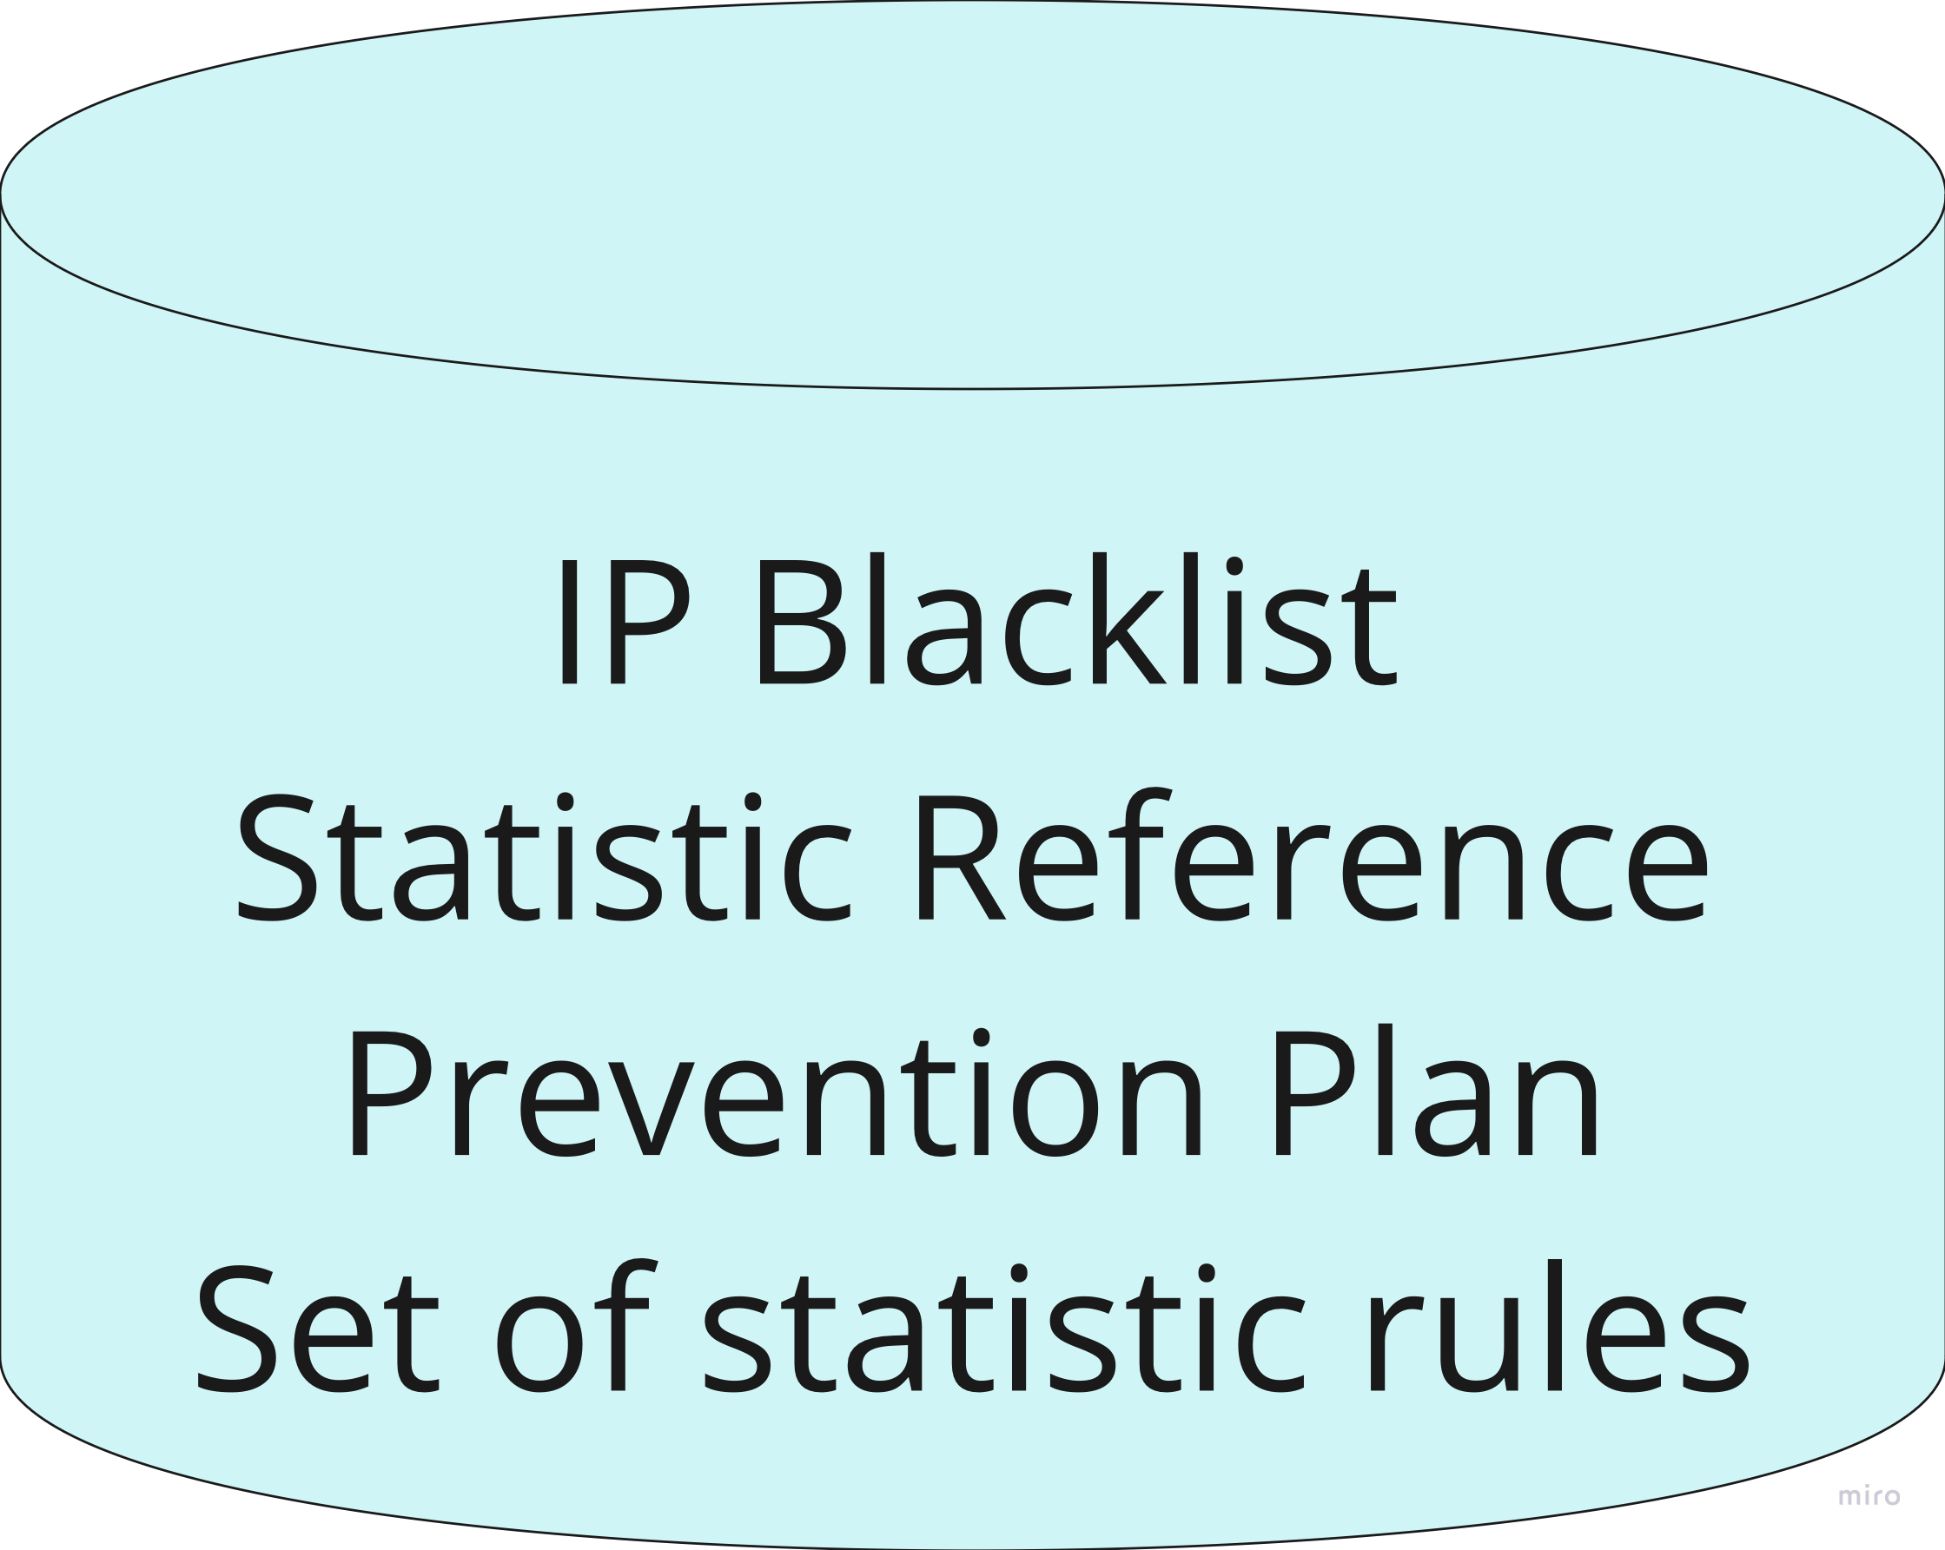



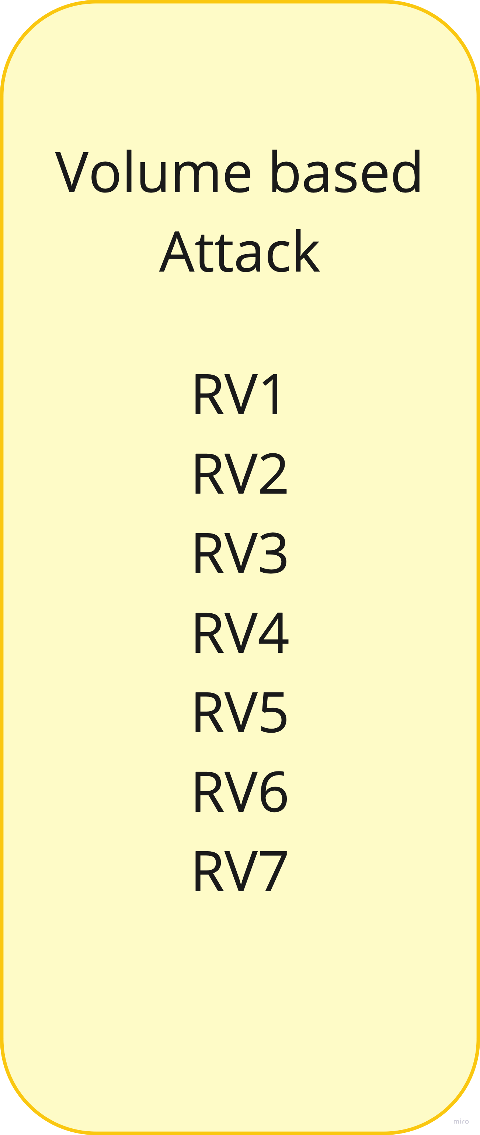
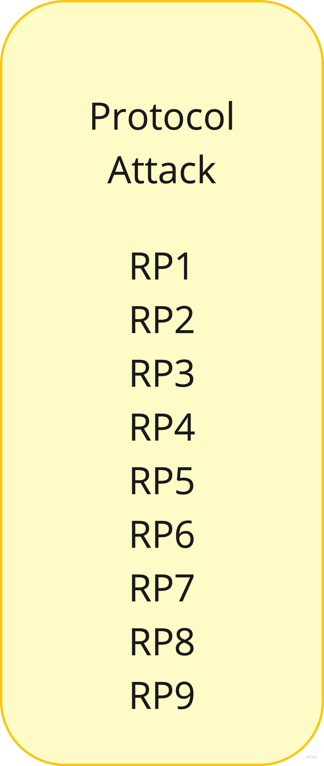

System Components
Statistical Rule Profile
Database

Slide 9
Rule based analysis
Volume based attack
Protocol based attack
Application layer attack

Slide 10
Volume based Attack
Rule ID | Condition | DDoS Detected | Action
RV1 | If the bandwidth is utilized >= 95% | Yes | Disconnect network session
RV2 | If the bandwidth is utilized between 80%-95% | Maybe | Check volume-based statistical profile
RV3 | If the packet is utilized >= 95% | Yes | Disconnect network session
RV4 | If incoming packet is utilized between 80%-95% | Maybe | Check protocol-based statistical profile

Slide 11
Volume based Attack
Rule ID | Condition | DDoS Detected | Action
RV5 | If the request is utilized >= 95% | Yes | Disconnect network session
RV6 | If the requests is utilized between 80%-95% | Maybe | Check volume-based statistical profile
RV7 | If the network bandwidth utilized by the specific IP address > Max limit | Yes | Block request and add to blacklist

Slide 12
Protocol based Attack
Rule ID | Condition | DDoS Detected | Action
RP1 | If TCP connection >= Max TCP connection per seconds | Yes | Block and add IP to Blacklist
RP2 | If TCP connection <= Max TCP connection per seconds | No | Do nothing
RP3 | If the incoming UDP/ICMP packets > maximum number of volume allowed per second to be sent to a host | Yes | Disable port
RP4 | If IP address(source) sends a ICMP echo request to server >100 packets | Yes | Block and add IP to blacklist

Slide 13
Protocol based Attack
Rule ID | Condition | DDoS Detected | Action
RP5 | If IP address(source) sends a ICMP echo request to server <100 packets | Yes | Block and add IP to Blacklist
RP6 | If Server send a ICMP echo reply to Address(destination)>=100 packets | No | Do nothing
RP7 | If Server sends a ICMP echo reply to IP address(destination) <=100 packets | Yes | Disable port
RP8 | If IP packet = IP in blacklist | Yes | Block and add IP to blacklist
RP9 | If same size of incoming packets > 100 times | Yes | Block and add IP to blacklist

Slide 14
Application layer Attack
Rule ID | Condition | DDoS Detected | Action
RA1 | If the GET utilized by the specific IP address > Max limit | Yes | Block request and add to blacklist
RA2 | If the GET packet utilized by the specific IP address < Max limit | No | Do nothing
RA3 | If the POST utilized by the specific IP address > Max limit | Yes | Disable port
RA4 | If the POST packet utilized by the specific IP address < Max limit | Yes | Do nothing

Slide 15
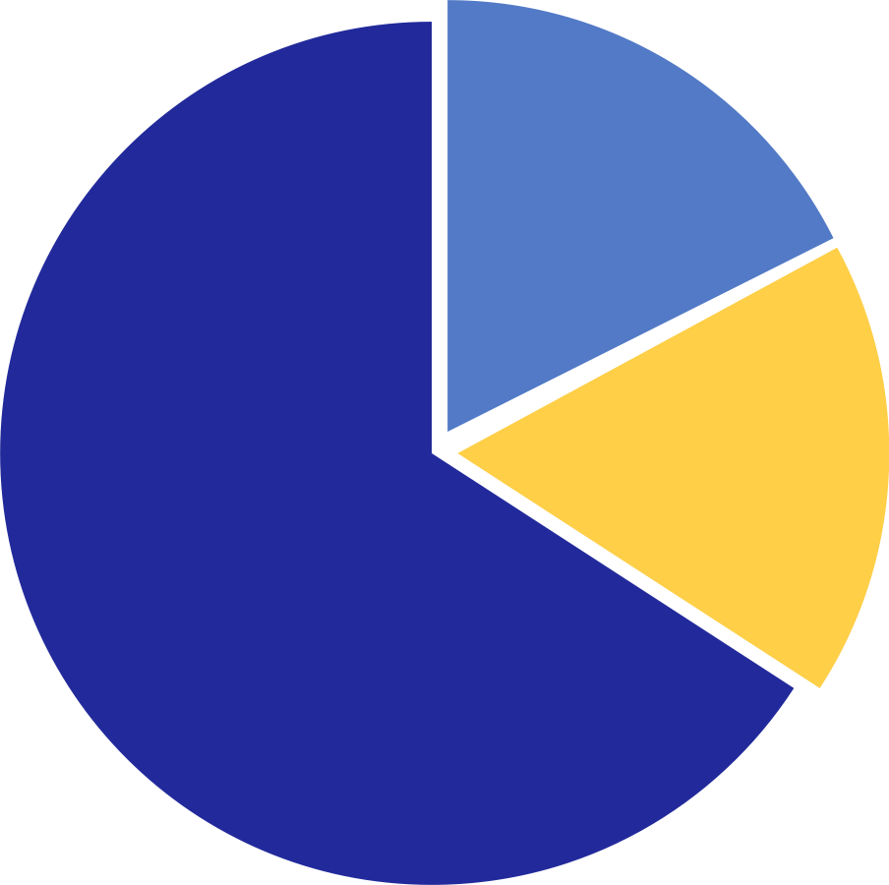

Statistical rule profile
Rule ID | Condition | DDoS Detected | Action
VSRP1 | If incoming bandwidth > Time reference | Yes | Check VSRP3 and VSRP4
VSRP2 | If incoming bandwidth < Time reference | No | Upgrade server storage
VSRP3 | If current day != Prime time | Yes | Block request and add malicious IP Address to blacklist
VSRP4 | If the current day = Prime time | No | Upgrade server storage

Slide 16
Statistical rule profile
Rule ID | Condition | DDoS Detected | Action
PSRP1 | If incoming packet >Time reference | Maybe | Check PSRP3 and PSRP4
PSRP2 | If incoming packet < Time reference | No | Scaling up storage Upgrade server
PSRP3 | If current day! == Prime time | Yes | Block and add IP to Blacklist
PSRP4 | If current day == Prime time | No | Scale up storage

Slide 17
Statistical rule profile
Rule ID | Condition | DDoS Detected | Action
ASRP1 | If the bandwidth > Time reference | Maybe | Check ASRP3 and ASRP4
ASRP2 | If the bandwidth < Time reference | No | Upgrade server storage
ASRP3 | If current day !== Prime time | Yes | Block request and add malicious IP Address to blacklist
ASRP4 | If current day == Prime time | No | Scale up storage

Slide 18
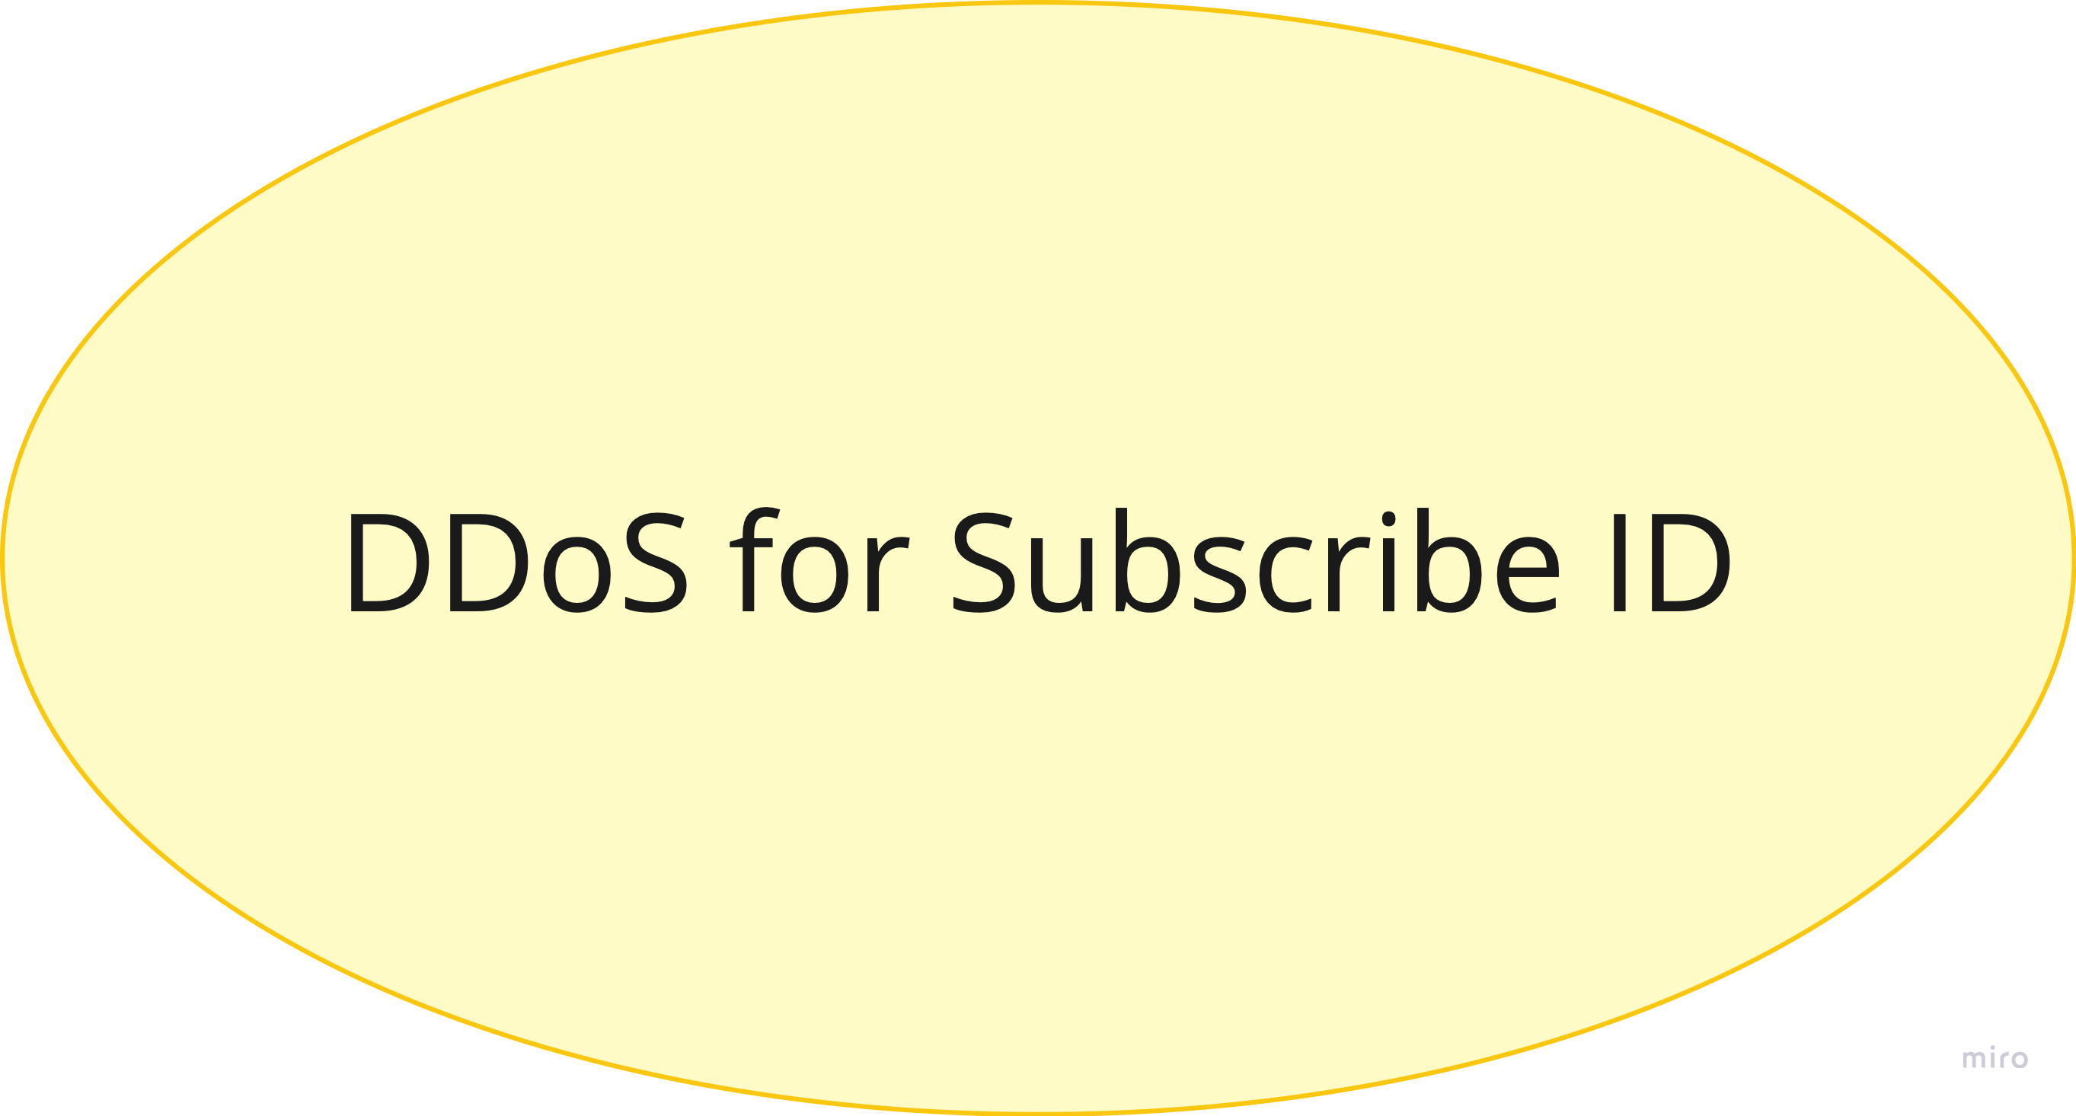
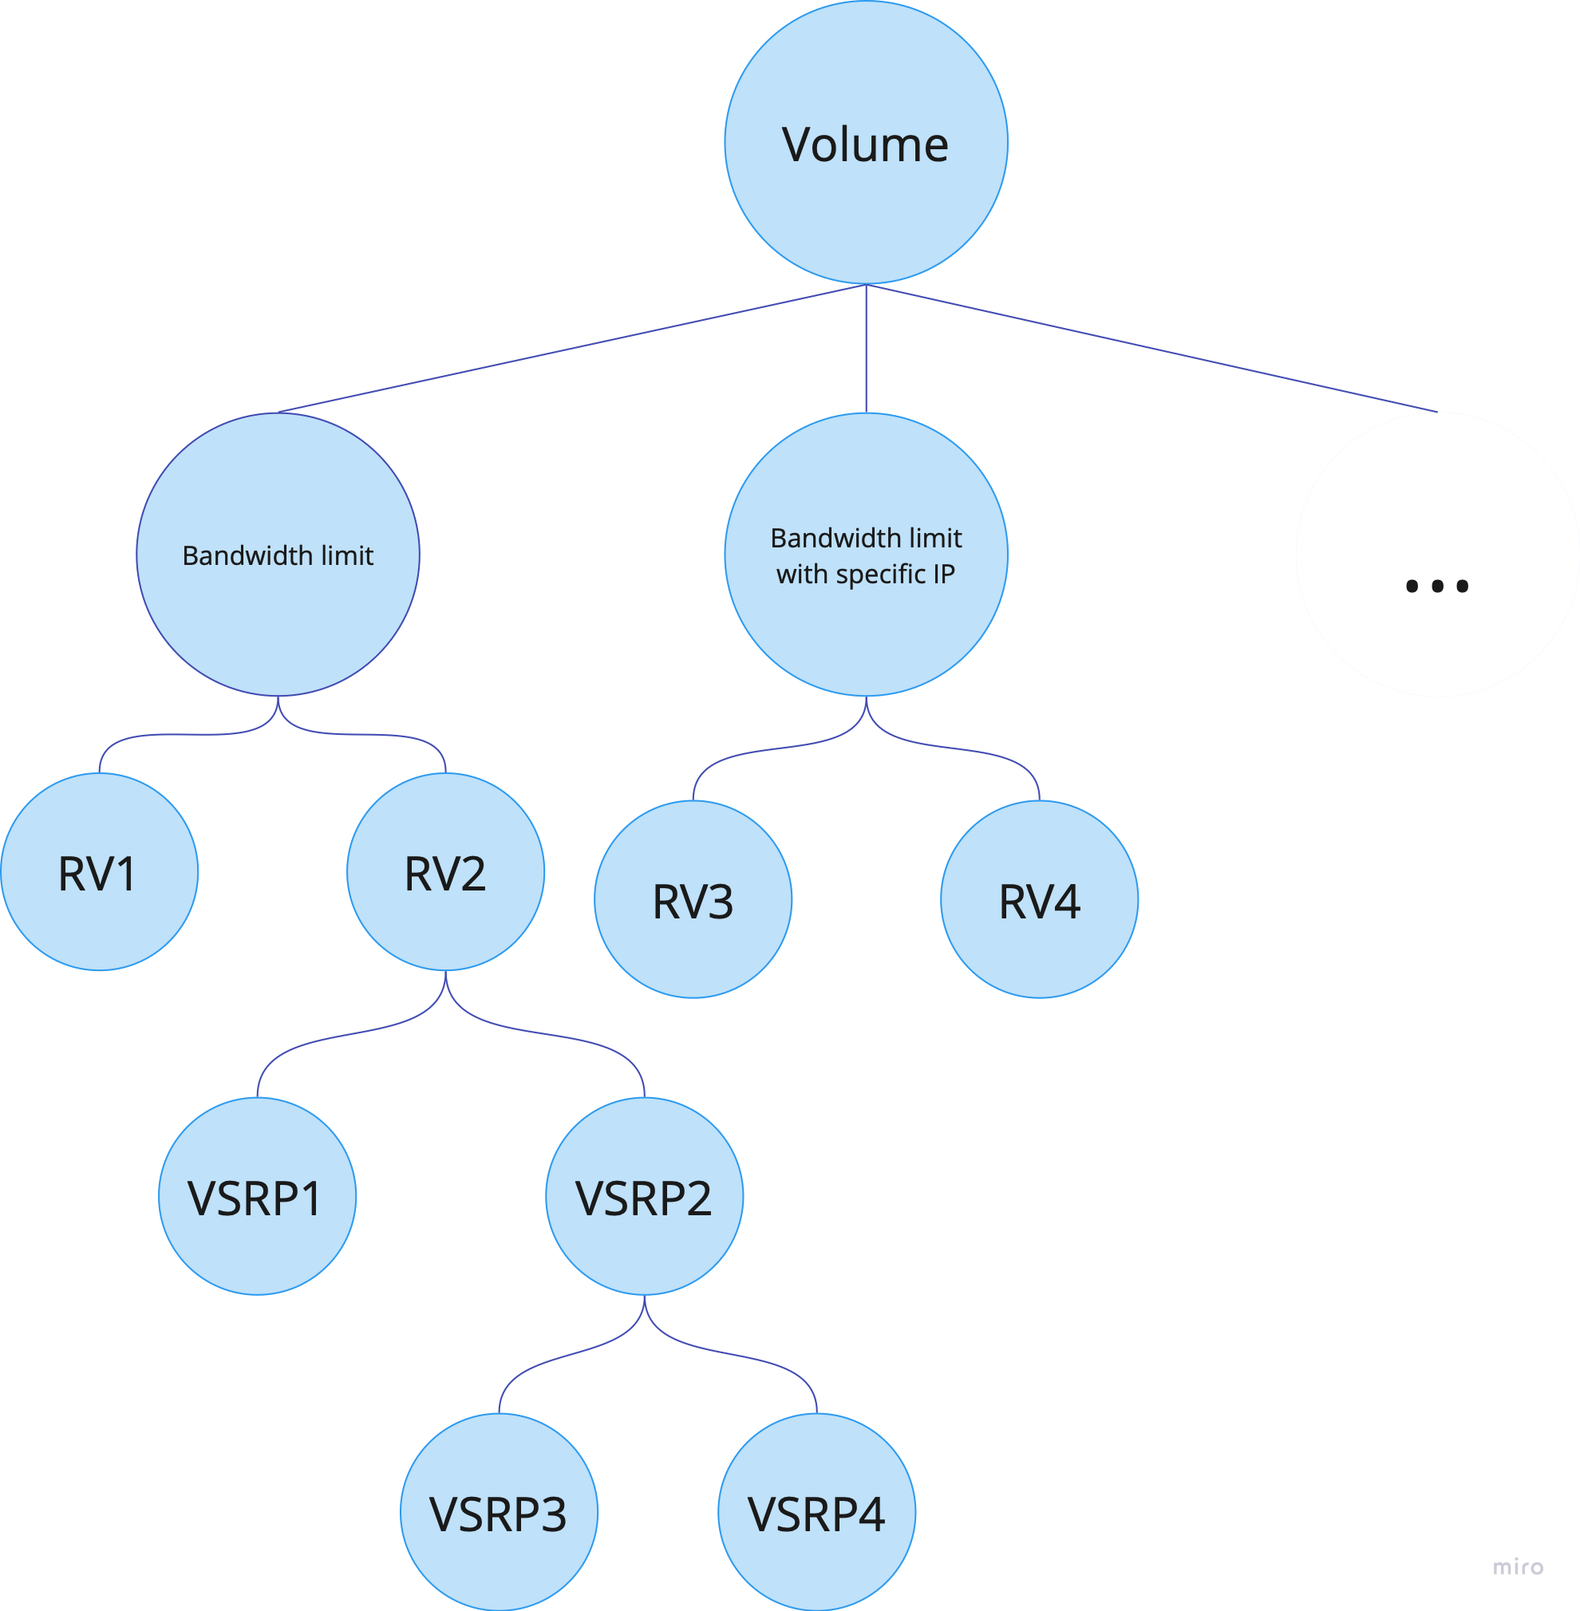
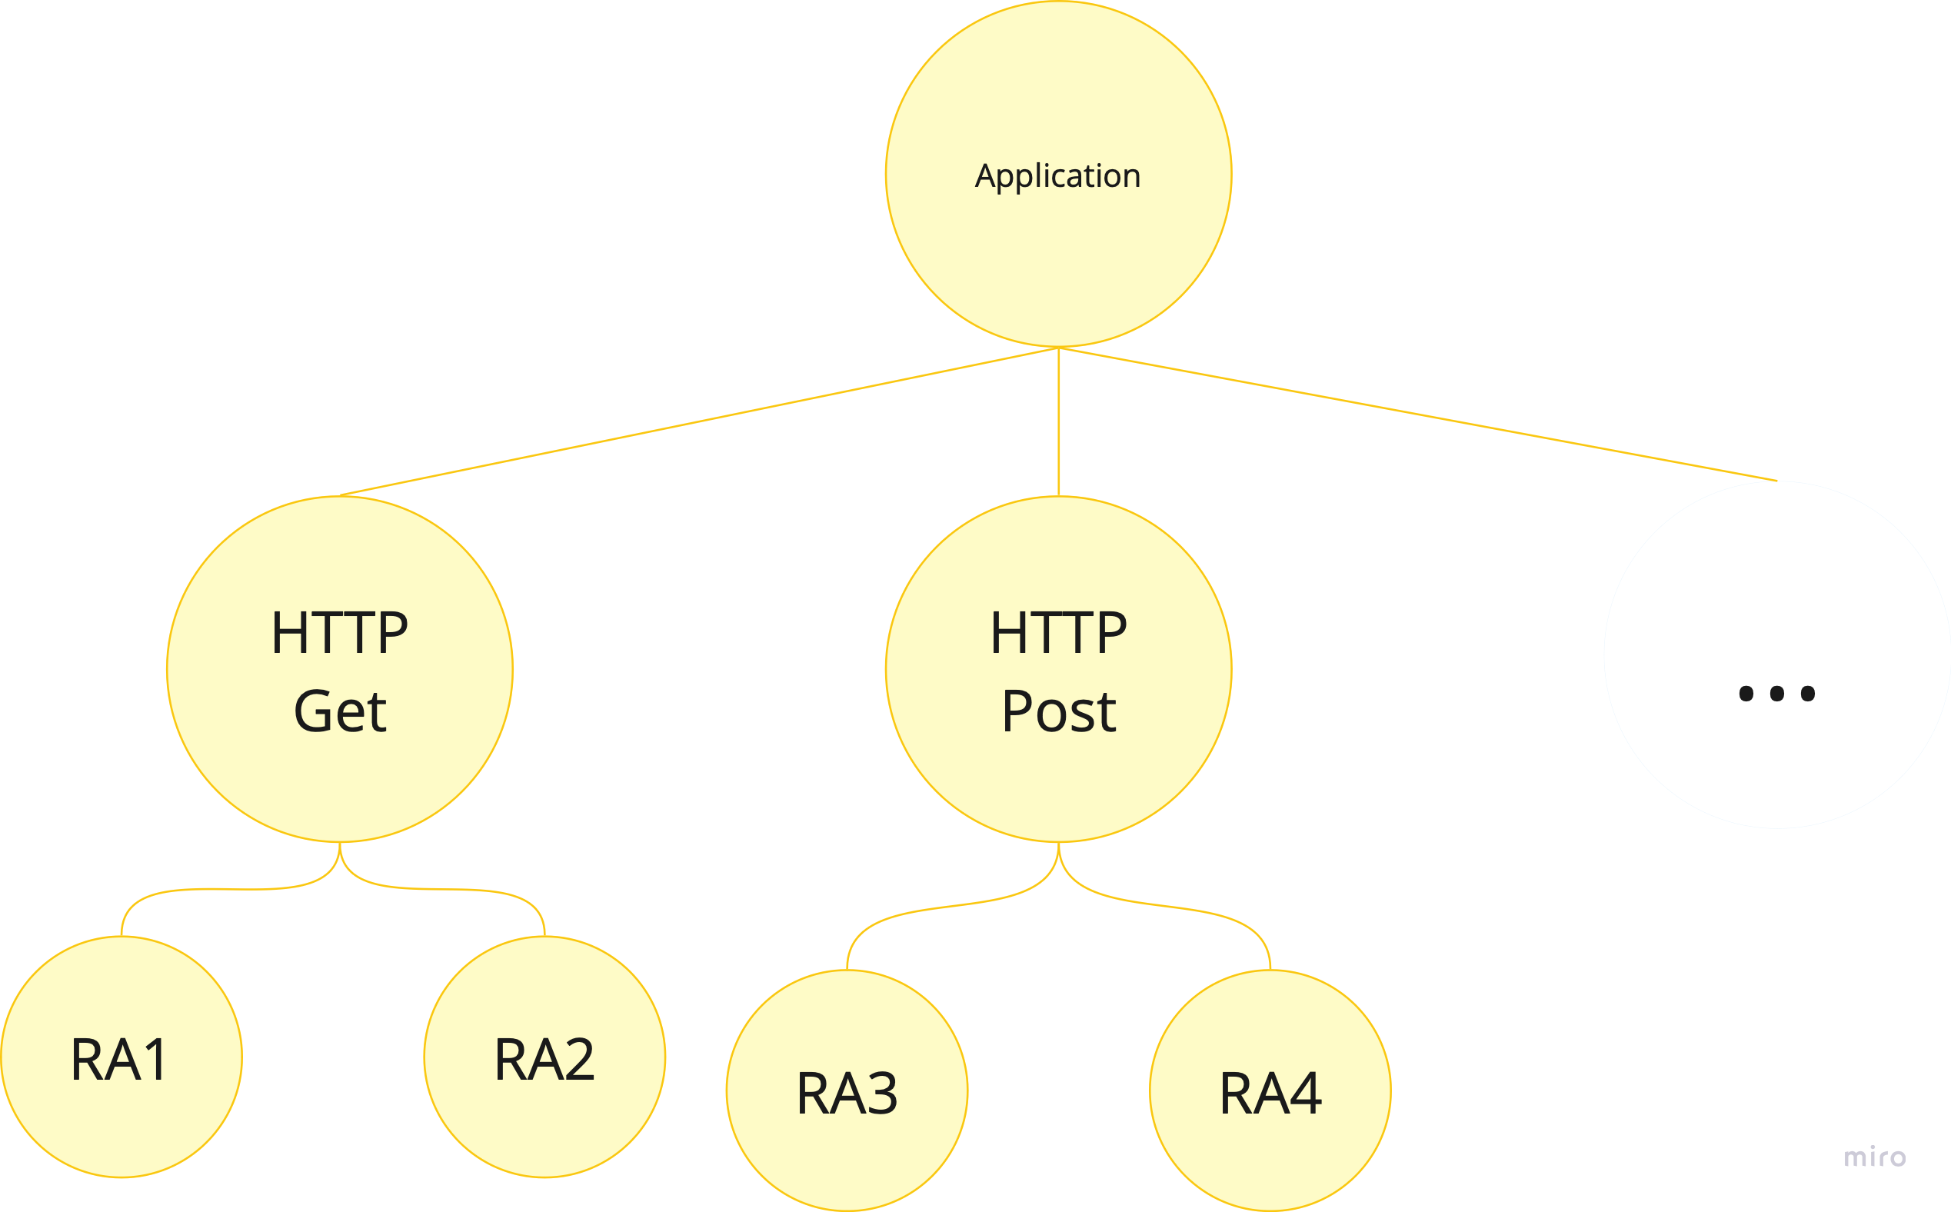
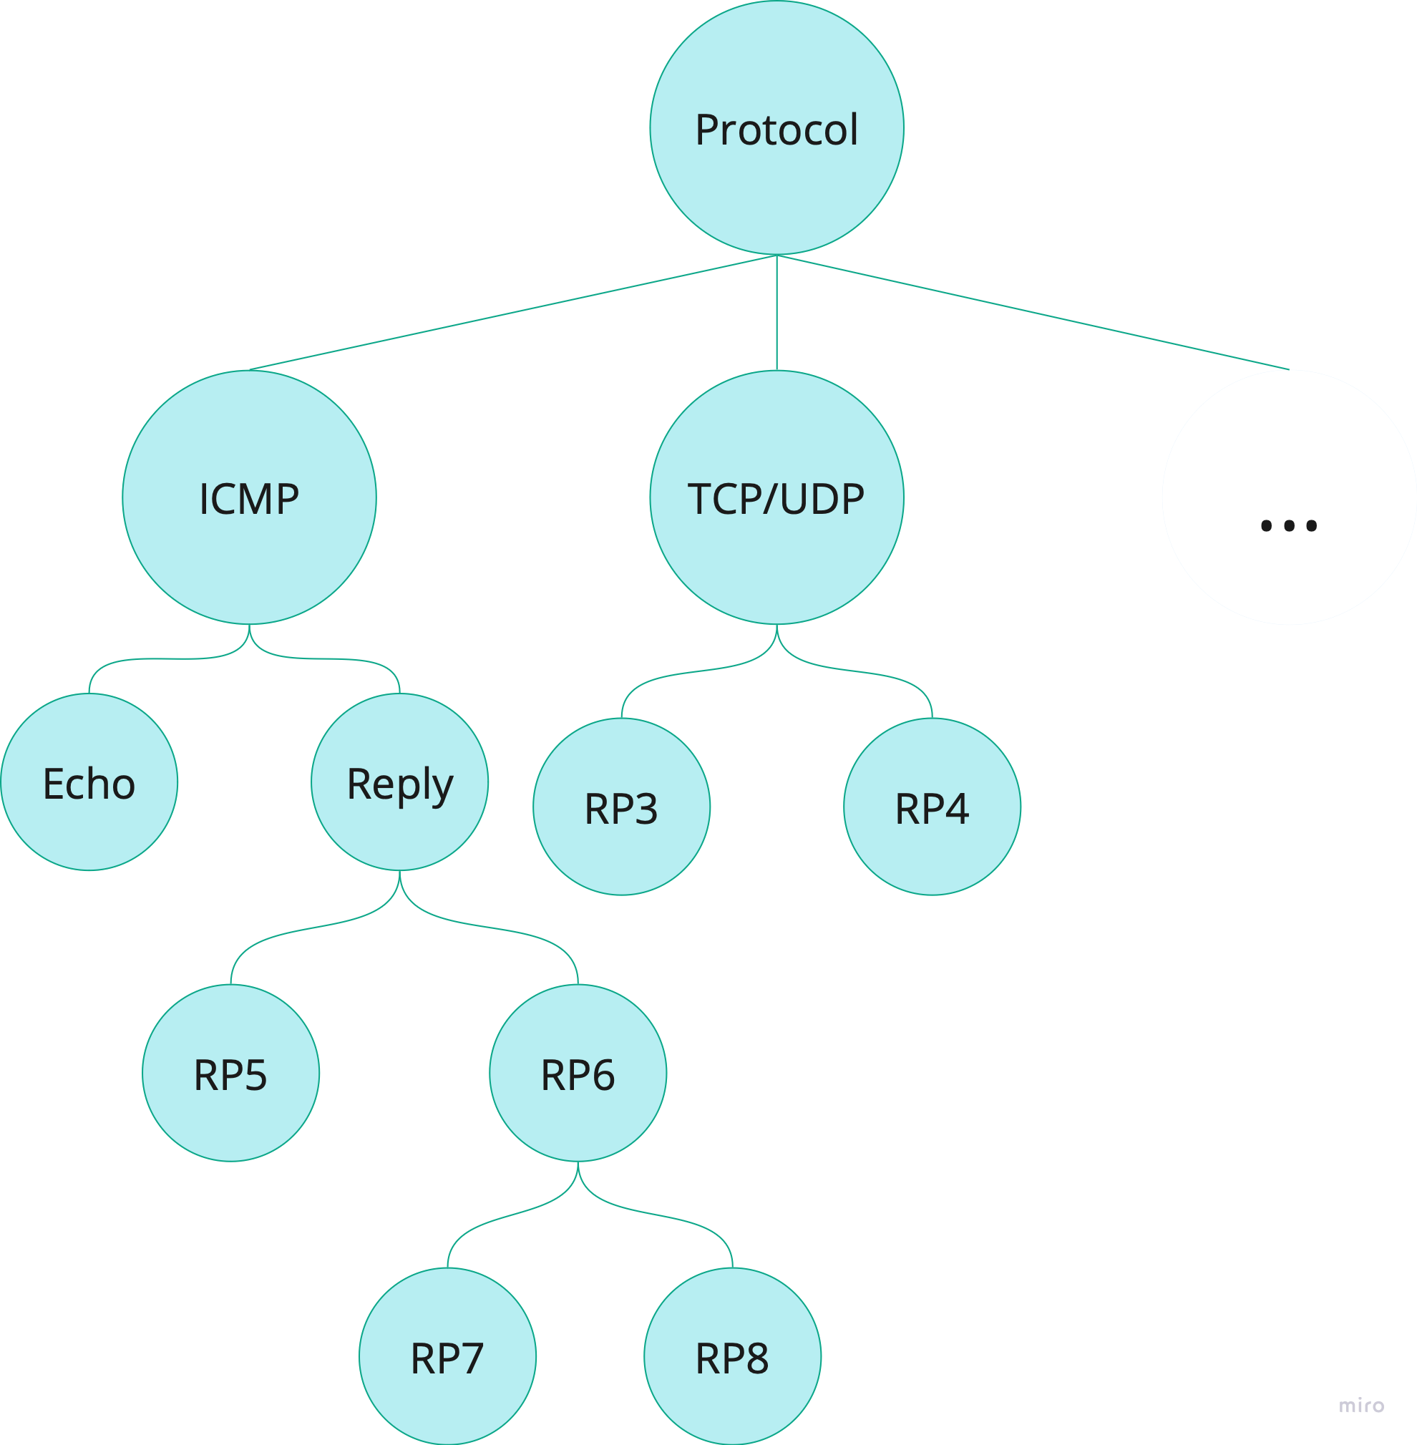
Tree-based DDoS detection model
A Tree-based DDoS is a tree that structurally correlates rules actions in three categories: Volume-based, Protocol-based, and Application Layer node, where each node has its relation to major attack type.

Slide 19
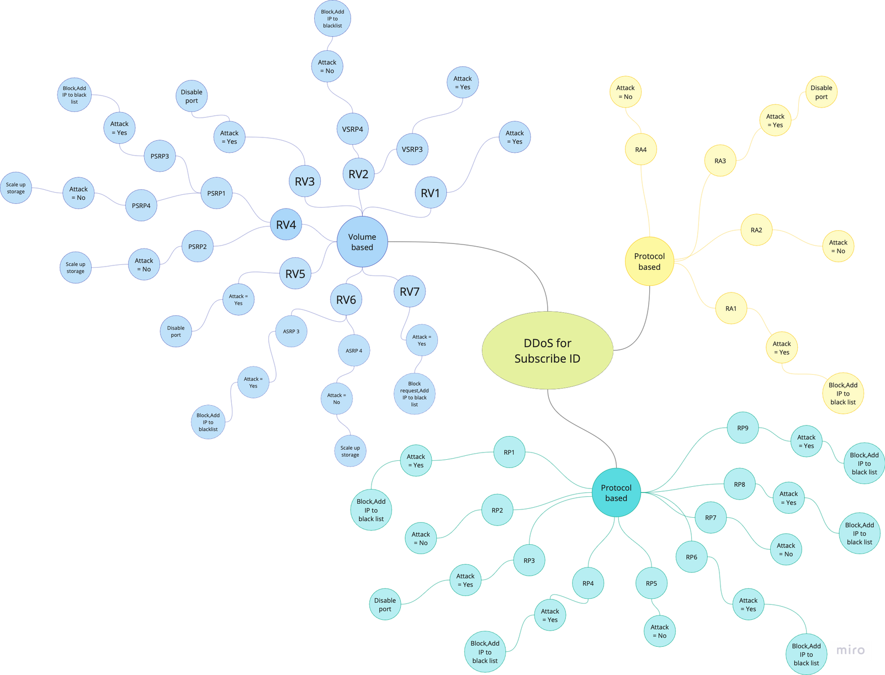

Slide 20




Implementation Overview
Languages | Cloud service provider | Database
Node.js + Typescript | Google cloud compute engine e2-small CPU Intel Broadwell 2.20GHz RAM 2 GB | MongoDB to store IP blacklist

Slide 21
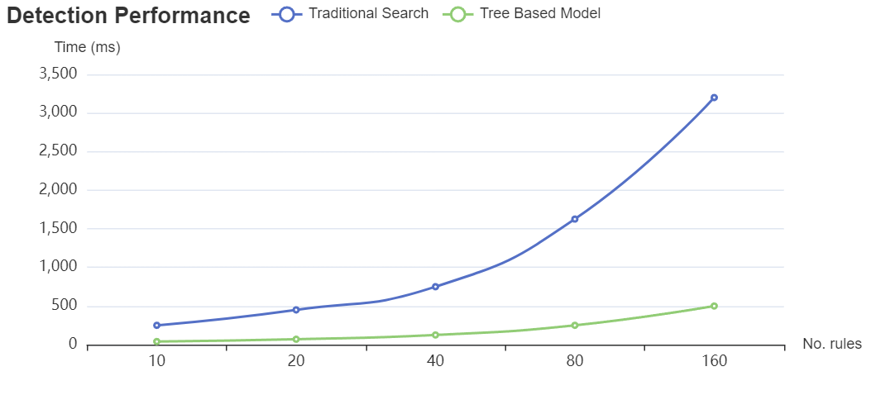
System Evaluation Plan
Functionality Test
Attack Types | No. of Test cases | % of detection
Volume-based Attack | 50 | 100
Protocol-based Attack | 50 | 100
Application-layer | 50 | 100
Detection Performance

Slide 22
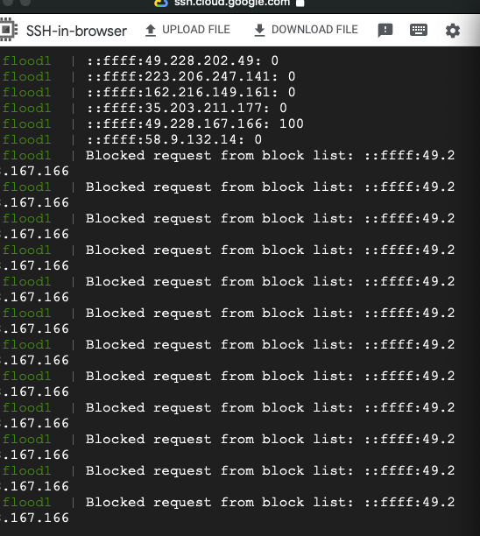
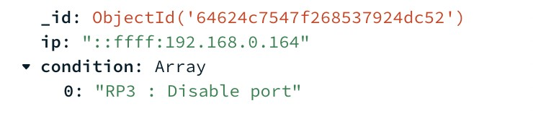
Simulation result

Slide 23
Conclustion and Future Work
We have proposed a CloudGuard system that provides a more resilient and fine-grained DDoS detection for cloud-based web applications based on the integration of our proposed volume-based analysis and statistical web profile-based approach.
To support efficient analysis of DDoS detection for multi cloud applications, we proposed a tree-based DDoS detection model to rapidly detect and give response to DDoS attacks based on the rule-based and traffic statistical profile of the application usage.
We conducted the experiments to show that our proposed model was functionally correct and efficient in practice.
For future works, we plan to apply machine learning technique to support DDoS detection for unknown attacks.

Slide 24
References
[1] Mohamed Idhammad, Karim Afdel, and Mustapha Belouch, Detection System of HTTP DDoS Attacks in a Cloud Environment Based on Information Theoretic Entropy and Random Forest, Security and Communication Networks, Vol.2018,
[2] J. Choi, C. Choi, B. Ko, and P. Kim, “A method of DDoS attack detection using HTTP packet pattern and rule engine in cloud computing environment,” Soft Computing, vol. 18, no. 9, pp. 1697–1703, 2014.
[3] C. Tang, A. Tang, E. Lee and L. Tao, "Mitigating HTTP Flooding Attacks with Meta-data Analysis," 2015 IEEE 17th International Conference on High Performance Computing and Communications, 2015 IEEE 7th International Symposium on Cyberspace Safety and Security, and 2015 IEEE 12th International Conference on Embedded Software and Systems, New York, NY, USA, 2015, pp. 1406-1411, doi: 10.1109/HPCC-CSS-ICESS.2015.203.
[4] Raja Sree, T., Mary Saira Bhanu, S. Detection of HTTP flooding attacks in cloud using fuzzy bat clustering. Neural Comput & Applic 32, 9603–9619 (2020). https://doi.org/10.1007/s00521-019-04473-6
[5] Dhanapal A & Nithyanandam P. (2021). The HTTP Flooding Attack Detection to Secure and Safeguard Online Applications in the Cloud. In I. Management Association (Ed.), Research Anthology on Combating Denial-of-Service Attacks(pp. 455-475). IGI Global. https://doi.org/10.4018/978-1-7998-5348-0.ch024
[6] D. Nashat and S. Khairy, "Detecting Http Flooding Attacks Based on Uniform Model," 2021 International Conference on Networking and Network Applications (NaNA), Lijiang City, China, 2021, pp. 94-98, doi: 10.1109/NaNA53684.2021.00024.
[7] S. -J. Yang and H. -L. Huang, "Design a Hybrid Flooding Attack Defense Scheme under the Cloud Computing Environment," 2019 IEEE/ACIS 18th International Conference on Computer and Information Science (ICIS), Beijing, China, 2019, pp. 41-46, doi: 10.1109/ICIS46139.2019.8940313.
[8] A. Praseed and P. S. Thilagam, "Multiplexed Asymmetric Attacks: Next-Generation DDoS on HTTP/2 Servers," in IEEE Transactions on Information Forensics and Security, vol. 15, pp. 1790-1800, 2020, doi: 10.1109/TIFS.2019.2950121.
[9] L. Wirz, R. Tanthanathewin, A. Ketphet and S. Fugkeaw, "Design and Development of A Cloud-Based IDS using Apache Kafka and Spark Streaming," 2022 19th International Joint Conference on Computer Science and Software Engineering (JCSSE), Bangkok, Thailand, 2022, pp. 1-6, doi: 10.1109/JCSSE54890.2022.9836264.
[10] Y. Fu, M. H. Au, R. Du, H. Hu and D. Li, "Cloud Password Shield: A Secure Cloud-based Firewall against DDoS on Authentication Servers," 2020 IEEE 40th International Conference on Distributed Computing Systems (ICDCS), Singapore, Singapore, 2020, pp. 1209-1210, doi: 10.1109/ICDCS47774.2020.00154.
[11] B. R, Y. P. Singh and N. S. Narawade, "Deep Learning Dependent DDOS Attack Sensing in Environment of Cloud Computing," 2022 IEEE 7th International conference for Convergence in Technology (I2CT), Mumbai, India, 2022, pp. 1-5, doi: 10.1109/I2CT54291.2022.9825199.
[12] NPM load test (9.5.0) Accessed: Feb. 1,2023. Available : https://www.npmjs.com/package/loadtest

Slide 25
THANK YOU
QUESTION & ANSWER

