Slide 1



Sleep Behavior Classification Based on Clusters of Sleep Quality
Pawonrat khumngoen
Sukree sinthupinyo
Chulalongkorn University, Thailand
Chulalongkorn University, Thailand
The 20th International Joint Conference on Computer Science and Software Engineering
28th June-1st July 2023
Naresuan University Phitsanulok, THAILAND

Slide 2
1
Introduction
2
Method
AGENDA
3
Result
4
Conclusion

Slide 3
Introduction
Dr. Frank Qian a clinical fellow in medicine at Harvard Medical School said
“If we can improve sleep overall, and identifying sleep disorders is especially important, we may be able to prevent some of this premature mortality”
Good sleep habits
5 years to men’s life
2.5 years to women’s life
Dr. Frank Qian, a clinical fellow in medicine at Harvard Medical School and internal medicine resident physician at Beth Israel Deaconess Medical Center in Boston.

Slide 4
Introduction
Low sleep latency
High sleep efficiency
High total sleep time
Good sleep habits
Low wake after sleep onset
Avoiding the use of electricity before bed
Normal livelihood
Etc.

Slide 5
Introduction
Hypothesis
We believed that sleep patterns have changed day by day thus we compare the sleep quality of the day and the previous day for classifying sleep behavior that effect good sleep.
We believed that the clustering of people who have similar sleep patterns affects classification better than using individual data or whole data.

Slide 6
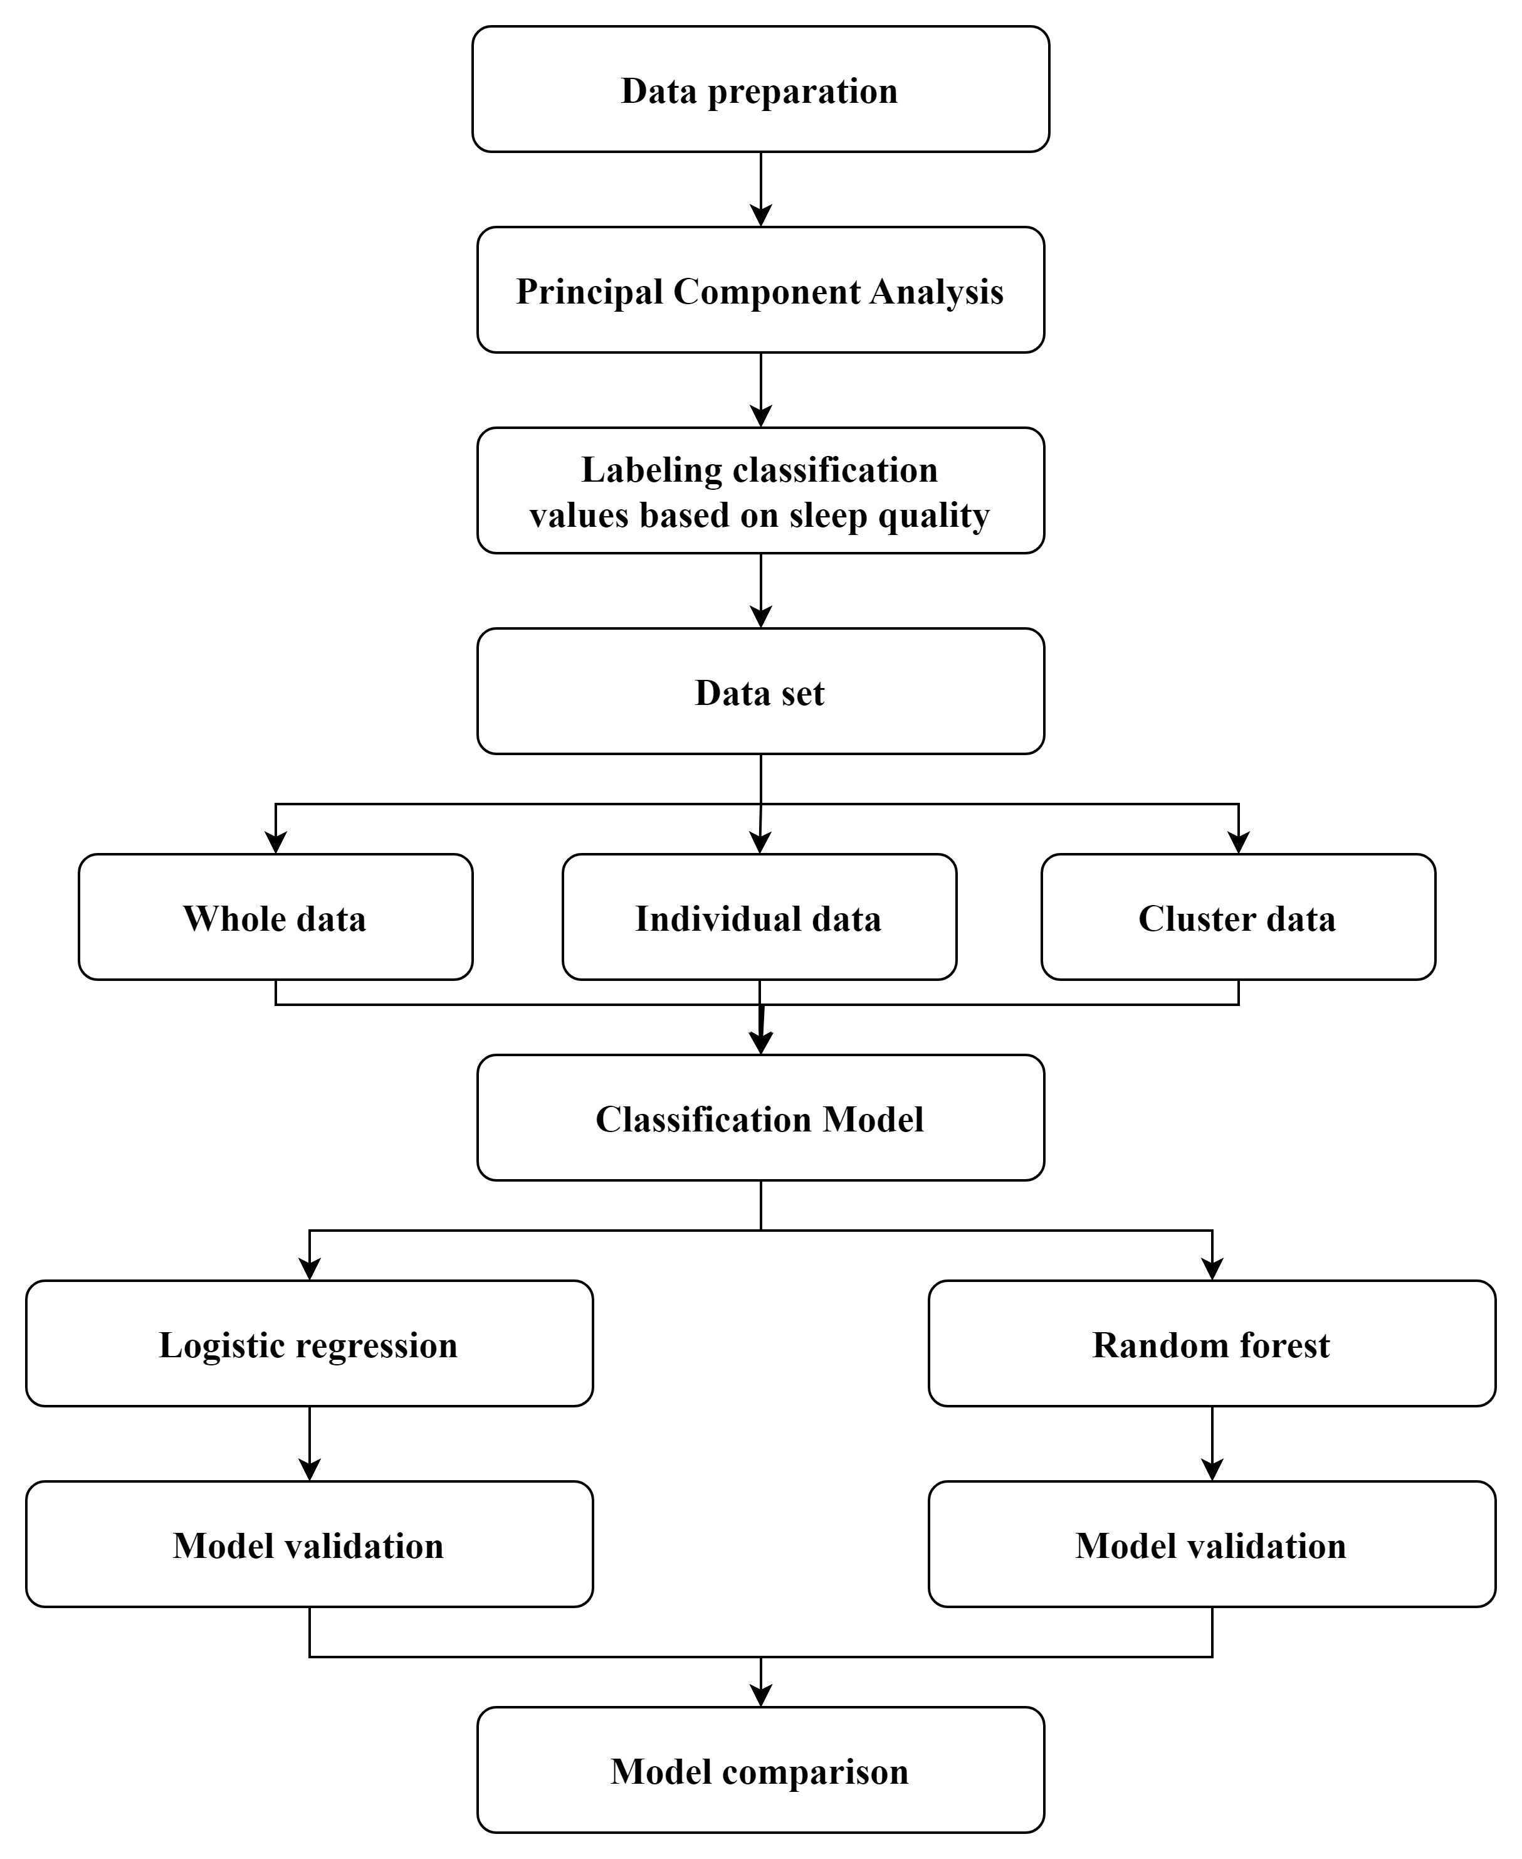
Method
Raw data about Sleep behaviors from
the Service Solution Business (SSB) at SCG CBM

Slide 7
Result
Data | Accuracy
 | Logistic regression |  |  |  | Random forest
 | Min | Max | Mean | STD. | Min | Max | Mean | STD.
Whole data | - | - | 60.3% | - | - | - | 61.1% | -
Individual data | 35.4% | 77.1% | 62.9% | 7 | 32% | 83.3% | 62% | 8.2
Cluster data | 58.5% | 64.1% | 61.5% | 2.9 | 61.1% | 67.1% | 64.6% | 3.1

Slide 8
Conclusion
The models from cluster data gave a minimum accuracy improvement higher approximately 48% compared to the minimum accuracy from individual data and had a higher mean accuracy than whole data.
The models from cluster data using Random Forest have classified accuracy better than Logistic Regression between 61.1% to 67.1% or higher 2.1% to 7.6%.

Slide 9
THANK YOU
QUESTION & ANSWER

