Slide 1



Explainable AI for Systematic Detection of Potential Problems in Natural Language Datasets
Aphinan Peerachaidacho, Nairat Kanyamee, Pinyo Taeprasartsit
Department of Computing
Faculty of Science, Silpakorn University
The 20th International Joint Conference on Computer Science and Software Engineering
28th June-1st July 2023
Naresuan University Phitsanulok, THAILAND

Slide 2
Introduction

Slide 3
Quality of training data is a major issue in machine learning
The quality of training data is not only about labeling correctness, but also about class balance, wording, text clarity, and other factors.
In some cases, the machine may underperform when it is to classify rare subtopics within a class, even if the overall prediction performance in that class is relatively high.

Slide 4
Detection of problematic samples becomes essential
We propose to employ explainable AI (XAI), a method conveying reasoning behind AI’s decision, to find disagreement of reasoning, prediction, and labels among samples in the dataset.
This analysis categorizes the potential problems into 3 types: rare samples, label conflicts, feature conflicts

Slide 5
Detection of problematic samples becomes essential
The method finds similar samples and uses SHAP (XAI) to calculate feature attributions, which helps to efficiently detect conflicts between samples and highly attributed features.
The method is allowing for the identification of many root causes of misclassification. By improving dataset quality, the predictive performance of a model can be enhanced.

Slide 6
Method

Slide 7
Method
Data preprocessing
Train model
Choose the best model
Detection of potential problems
Improve the quality of the dataset

Slide 8
Datasets
This research utilizes two datasets:
Event Planner Survey
Wisesight Sentiment Corpus

Slide 9
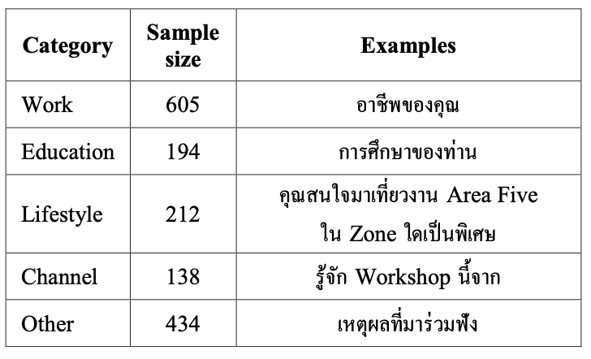
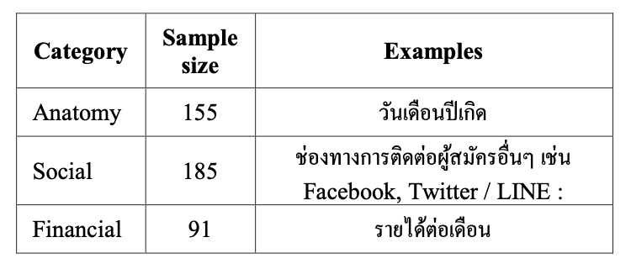
Datasets
Event Planner Survey (EPS) is a dataset about questionnaire at the event. It contained 2,014 samples.

Slide 10
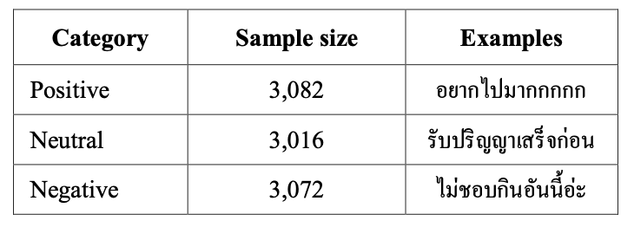
Datasets
Wisesight Sentiment Corpus (WSC) is a dataset about opinions in online social media. It contained 9,170 samples.

Slide 11
Data preprocessing
For the WSC dataset, emojis and English sentences were removed from the inputs, as the model is designed to classify sentiment from Thai sentences.
However, for dataset Event Planner Survey, only emoji were removed but English symbols are preserved as English words are necessary for classifying questions in the survey.

Slide 12
Choose the best model
Once data preprocessing is finished, the method builds and trains five models (CNN, LSTM, BLSTM, CNN-LSTM, CNN-BLSTM) and benchmarks them to find the best model for each dataset.
The best performant model based on the average of accuracy and F1 score is selected for further analysis in detecting a potential problem of samples.

Slide 13
Choose the best model
We want to show that if the data is quality, Any model will also perform well.
We select the best models because if the data has serious problems, Even the best models won't be able to classification correctly.
We didn't use Transformers (Machine learning model) because the example small amounts and the text is not long.

Slide 14
Type of potential problems
This analysis categorizes the problems into three types:
Rare samples
Label conflicts
Feature conflicts

Slide 15
Detection of potential problems in datasets
Finding Similar Samples
Calculating Feature Attributions
Detecting Conflicts

Slide 16
Detection of potential problems in datasets
1. Finding Similar Samples: For each misclassified testing sample, the proposed method finds other samples in the training set that are highly similar greater than or equal 80% to it via the sentence similarity function of Thai2Vec.
2. Calculating Feature Attributions: The method utilizes SHAP (XAI) to calculate feature attributions. SHAP assigns importance values to each feature based on its contribution to the classification decision made by the model.
3. Detecting Conflicts: Analyze the conflict between prediction and highly attributed features, the method can identify potential root causes of misclassification.

Slide 17
Algorithmic steps for handling problems
Rare sample issues:
Step one: Take a problematic sample into similarity checking process.
Step two: The results which often reveal few or no similar sample.
Step three: If there is no similar sample, add similar examples to the training set to increase the number of examples in that group.

Slide 18
Algorithmic steps for handling problems
Label conflict issues:
Step one: Take a problematic sample into similarity checking process.
Step two: Similarity checking result.
The results which often finds similar training samples.
Their actual labels usually differ regardless of high similarity among these samples.
Step three: Apply SHAP to explain the prediction.
If SHAP shows high correlation of attribution values between two samples, but their labels are conflicting.
This suggests that the labels of these samples need further intervention.

Slide 19
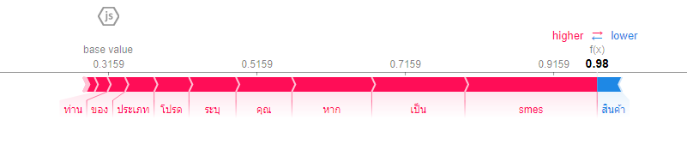
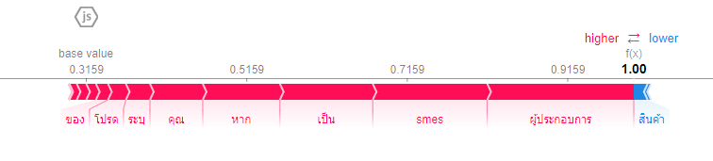
SHAP showing word attributions
Fig 1. SHAP diagram showing word attributions for the misclassified question
“หากคุณเป็น SMEs โปรดระบุประเภทสินค้าและบริการของท่าน”
Fig 2. SHAP diagram showing word attributions for the most similar sample
“หากคุณเป็นผู้ประกอบการ SMEs โปรดระบุประเภทสินค้าและบริการของท่าน”
In Fig. 1, The question sample was labeled as class “Other,” while the model predicted it as “Work”. This highly similar sample was labeled as Work (Fig. 2).
In such a situation, it is barely possible that these two samples belong in different classes. Consequently, the method flagged a label conflict for the misclassified sample.
Notes:
Fig. 1 and Fig. 2 visualize SHAP analysis that our method employed to detect discrepancy.
Red values indicate highly relevant features for that class, while blue values indicate features that are not associated with that class.

Slide 20
Algorithmic steps for handling problems
Feature conflict issues:
Step one: Take a problematic sample into similarity checking process.
Step two: Similarity checking result.
The results which often finds similar training samples.
However, the model failed to make accurate prediction, even though a test sample is label correct.
Step three: Apply SHAP to explain the prediction
Sometimes, SHAP can identify that the problem may arise from two main factors: a conflict in terminology and a conflict in text organization.
Therefore, we can find and solve the problem’s root causes accordingly.
Notes:
Terminology : คำศัพท์
Text organization : การจัดลำดับข้อความ

Slide 21
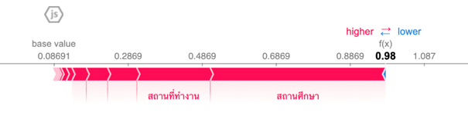
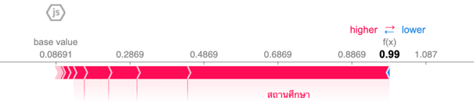
SHAP showing word attributions
Fig 3. SHAP diagram showing word attributions toward class Education for the misclassified survey question “สถานที่ทำงาน/สถานศึกษา”
Fig 4. SHAP diagram showing word attributions for the most similar sample “สถานศึกษา”
In Fig. 3, This sample was correctly labeled “Work” but the model misclassified the sample as Education because word สถานศึกษา significantly attributed to the prediction.
This was similar to what happened with the only similar sample, which was labeled Education (Fig. 4).

Slide 22
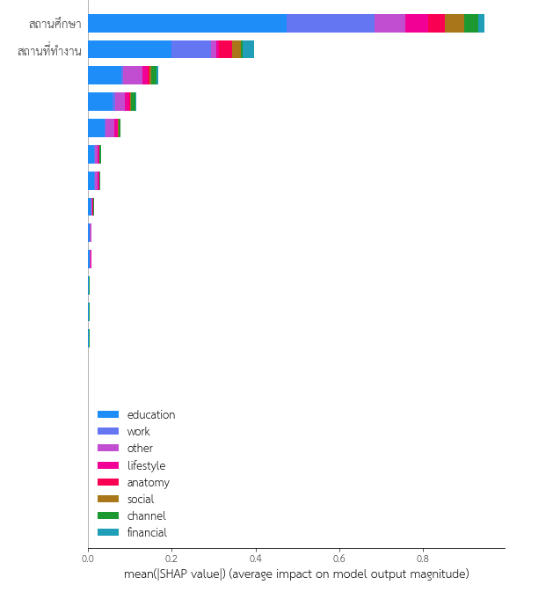
SHAP showing word attributions
Interestingly, word สถานที่ทำงาน attributed to class
Education the most when the entire dataset
was considered (Fig. 5). Therefore, underlying
features of this misclassified sample were mostly associated with Education.
The issue was resolved by manually augmenting data with word rearrangement.
This helped the model associate more weight of class Work to the words whose contexts are likely to be encountered in a real-world scenario.
Fig 5. SHAP diagram showing word attributions average impact all class of
“สถานศึกษา” and “สถานที่ทำงาน”

Slide 23
Experiments and Results

Slide 24
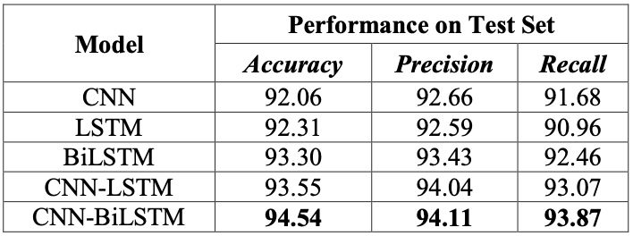
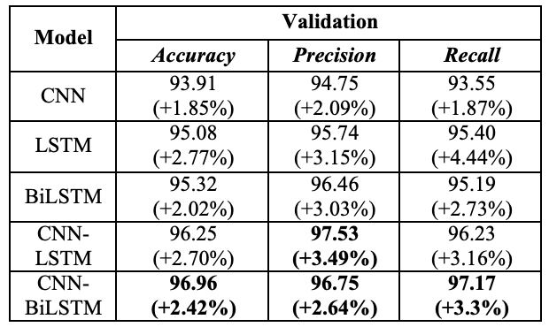
Performance of the five models for Event Planner Survey
Before the data quality was improved.
After the data quality was improved.
After the data quality was improved, it is evident that the best models in each respective domain may be correlated with the quality of the available data.

Slide 25
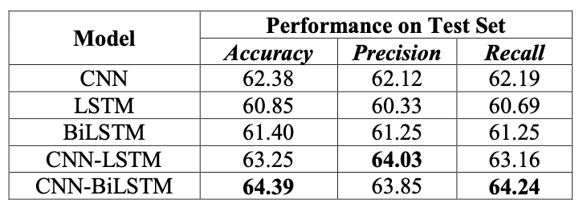
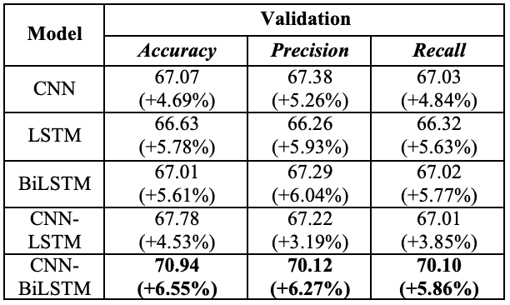
Performance of the five models for Wisesight Sentiment Corpus
Before the data quality was improved.
After the data quality was improved.
After the data quality was improved, it is evident that the best models in each respective domain may be correlated with the quality of the available data.

Slide 26
Performance gap in WSC
In the Crowd-Sourced database (WSC), the contributors may come from diverse backgrounds and may not necessarily be experts in the field. Therefore, there can be a higher likelihood of errors and inaccuracies.
The Event Planner Survey comes directly from the industry and possesses expertise, our approach is crucial when it comes to the Crowd-Sourced database.
This is because even two experienced individuals can make simultaneous errors, highlighting the significance of our methodology.

Slide 27
Conclusion

Slide 28
Conclusion
The proposed method uses explainable AI to explore how text misclassification occurs and how to systematically identify whether the issue arises from a dataset.
The proposed method finds similar samples and uses SHAP to calculate feature attributions, which helps to efficiently detect conflicts between samples and highly attributed features, allowing for the identification of many root causes of misclassification.

Slide 29
Conclusion
Based on our experiments, the WSC dataset had the most labeling errors, while the Event Planner Survey dataset mostly had rare-samples issues due to its relatively small amounts of data per class.
Data quality in WSC was probably much more problematic because we corrected labels of 331 samples and there were no other types of data improvements. This alone could reduce misclassification from 653 to 553 in WSC out of 1,834 testing samples.

Slide 30
Conclusion
For Event Planner Survey, there were only 6 samples that were relabeled, while there were 120 newly added training samples mostly due to rare sample issues. In the process of label correction and data augmentation, the method reduced misclassifications from 22 to 13 samples out of 403 testing samples.
After we found some problems and improved the quality of the dataset. Performance of all deep learning models in both datasets were improved throughout.

Slide 31
THANK YOU
QUESTION & ANSWER
Notes:
Method limitations
Dataset Specificity: The proposed method's effectiveness may vary depending on the specific dataset and problem domain. It may require customization or fine-tuning to achieve optimal results for different datasets.
Computational Complexity: The use of explainable AI techniques, such as SHAP, can introduce additional computational complexity. This may impact the scalability and efficiency of the method, especially for large-scale datasets.
Interpretability Challenges: While the method provides insights into the decision-making process, interpreting and understanding the feature attributions and conflicts may still pose challenges. It requires domain expertise and careful analysis to make meaningful interpretations.

