Slide 1



Research Topic:
Machine Learning Approaches for Quality Control In Pulp Packaging Manufacturers
Rattana Ceesay, Thapana Boonchoo and Prapaporn Rattanatamrong
Department of Computer Science, Faculty of Science and Technology Thammasat University, Pathumthani, Thailand

Slide 2
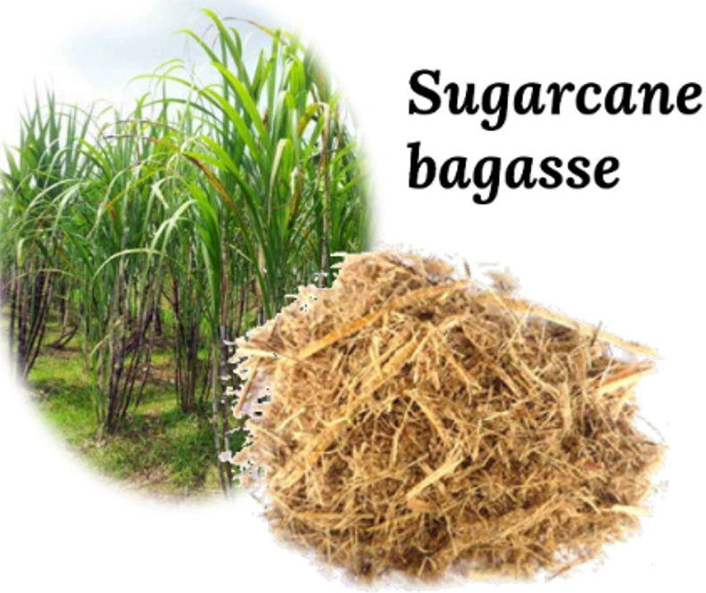
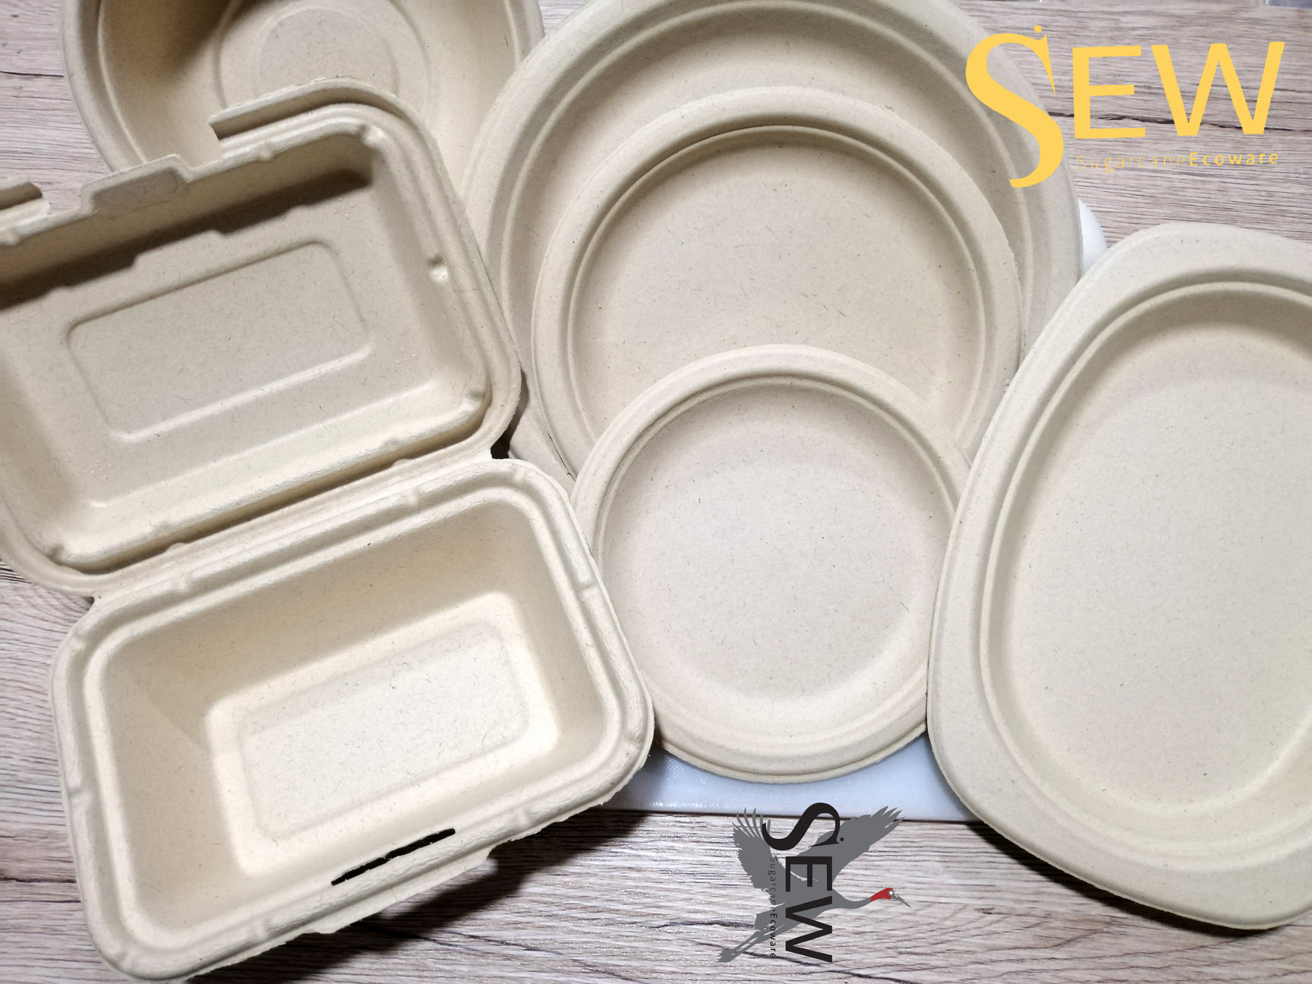
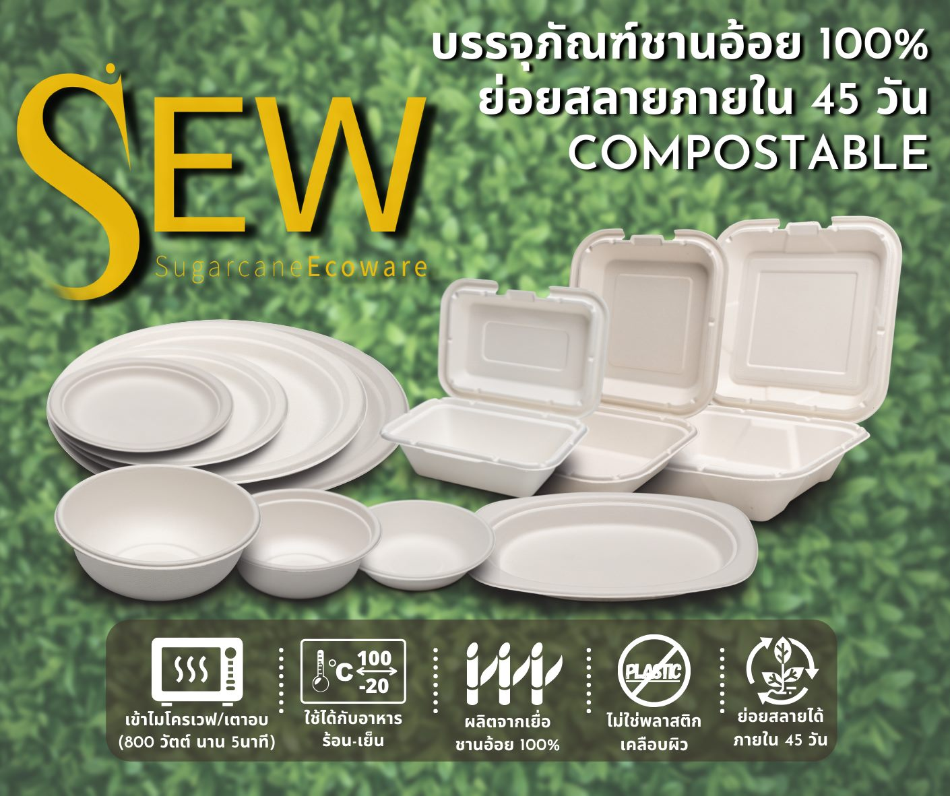


Quality Control in Sugarcane Bagasse Molded Pulp Packaging
Biodegradable and eco-friendly packaging alternatives to plastic packaging
2

Slide 3
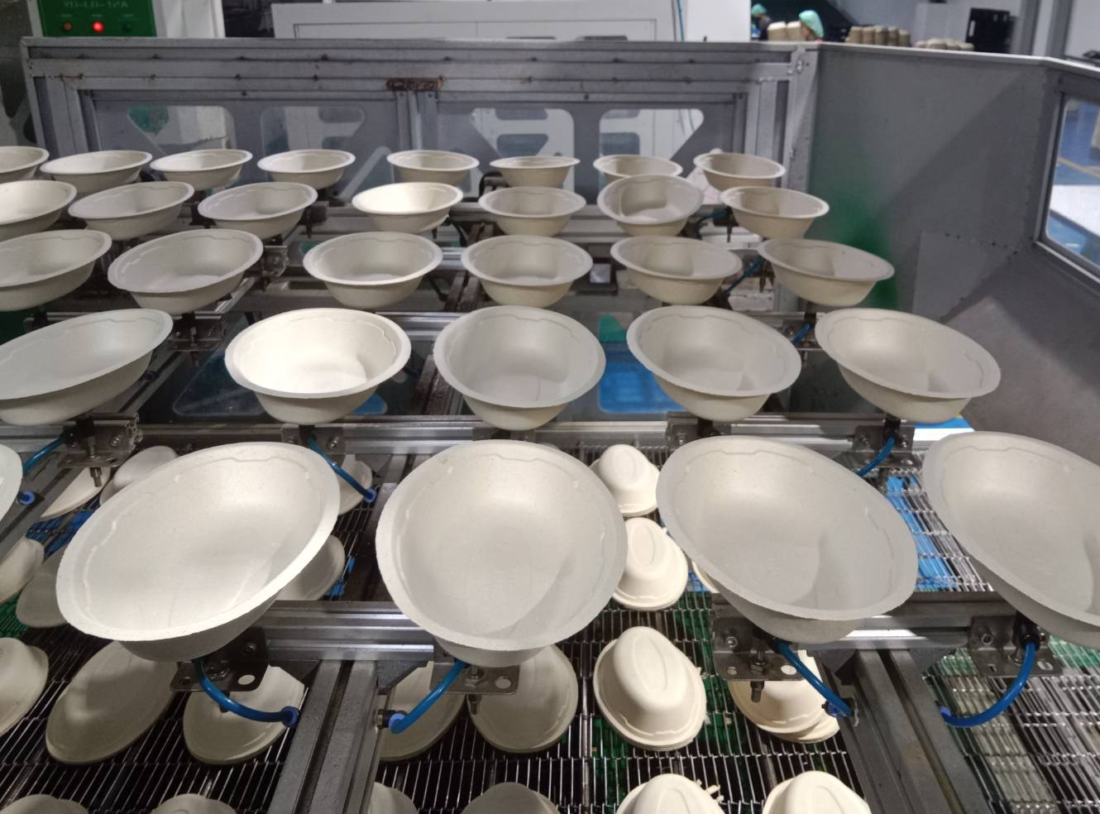
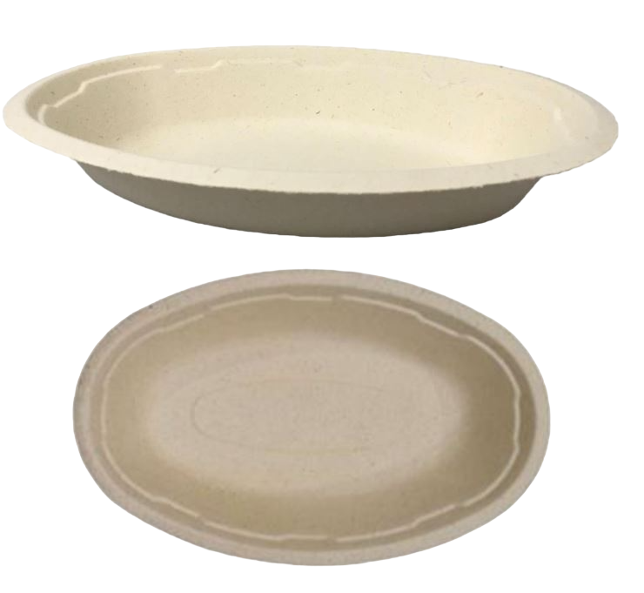
Sugarcane Bagasse Molded Pulp Packaging
Research’s target product : 32 oz burrito bowl”
5

Slide 4
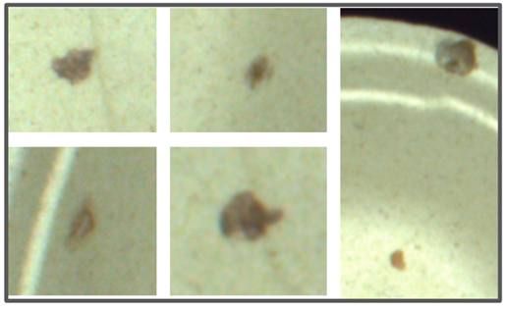
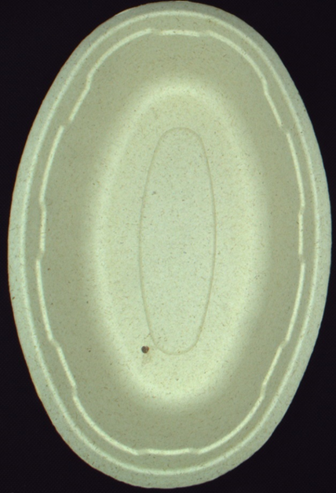
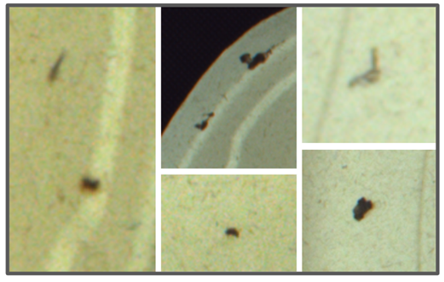
Surface defects
Some rejects could be reworked, while others must be scrapped.
Oil Spot
Deposits of oil that have fallen onto the product from some processing step
Oil Spot
Particle contaminant
/ Dirt impurities
Small dark brown impurities and black specks caused by foreign substances
Normally defects size
between 0.8 – 3 mm
Dirt Impurities
6

Slide 5
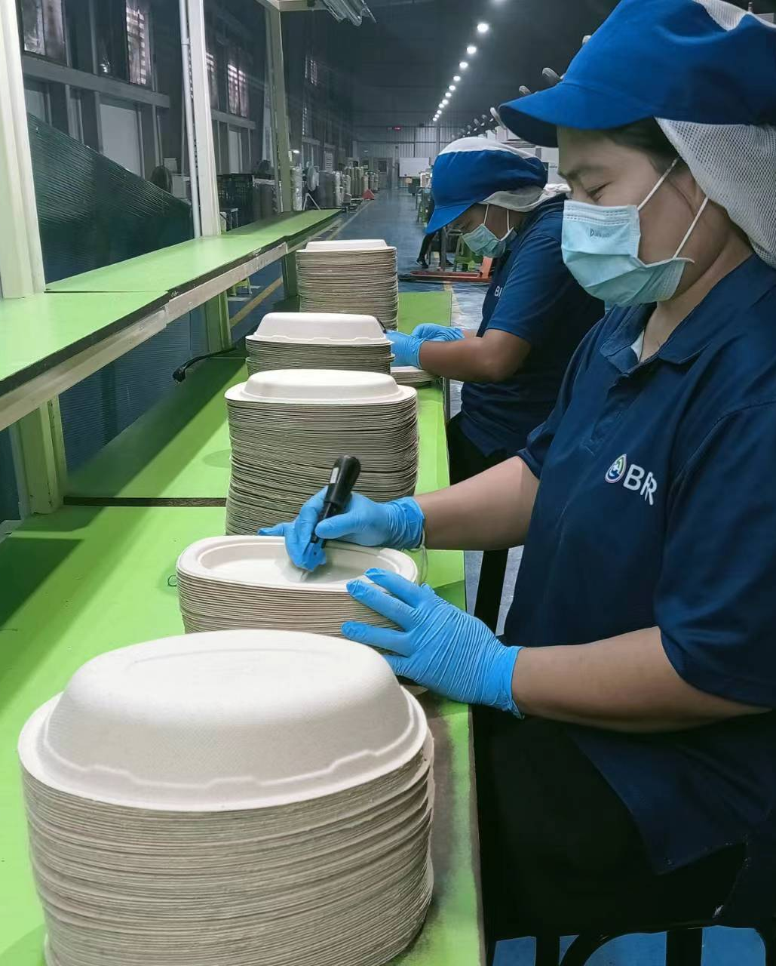
Visual inspection for quality control
Objective
To detect the defect in early production
Procedure
Performed manually by well-trained operators
  Inspect product piece by piece to ensure
  product quality
Business Risk
Major defects escaped the quality control
could lead to customer complaints
and financial loss
7

Slide 6
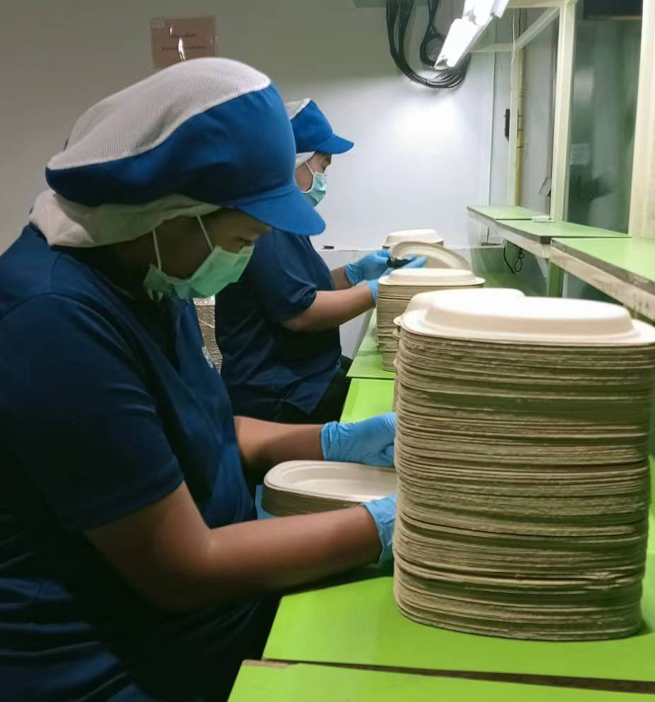
Problem in Visual Inspection Process for Quality Control
Process Risk
"Human Visual Inspection" is not effective
and unreliable due to
  High possibility for human error
  High labor cost & Labor-intensive
  Slow conventional process
An automatic defect-detection system has obvious benefits over conventional human manual detection
8

Slide 7
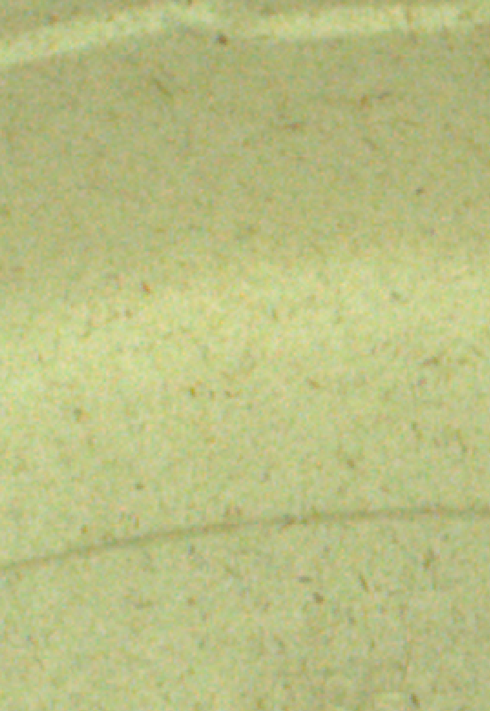
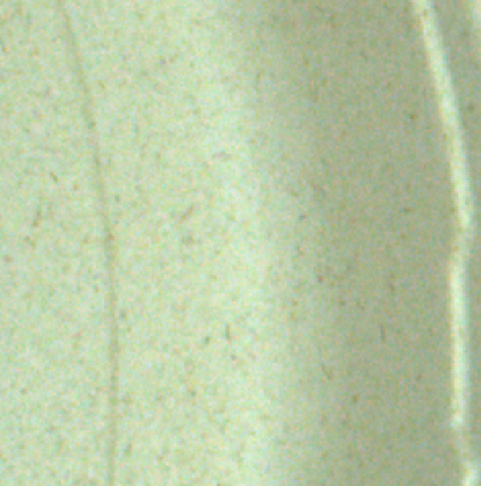
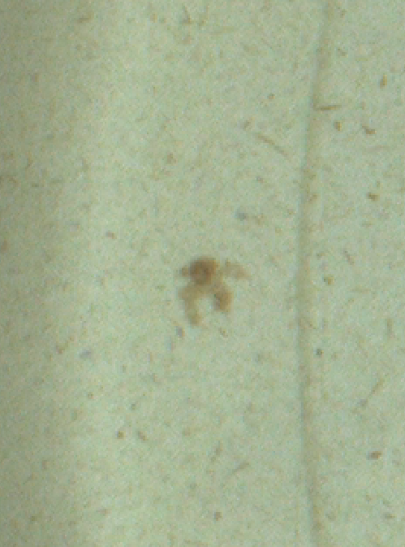
Visual Inspection Problem & Challenge
Major problem: Quality control in the pulp packaging industry is at risk due to an unreliable
and ineffective manual visual inspection process.
Proposed Solution: Introduce an end-to-end Implementation of machine vision hardware and machine learning to build a framework for an automated molded pulp packaging defect detection
Challenge in target object :
  Surface fluctuation by grain pulp fiber
  Unstable product color due to
  variation of raw material lots
  Non-repeated defect patterns
  & Small defect size
9

Slide 8
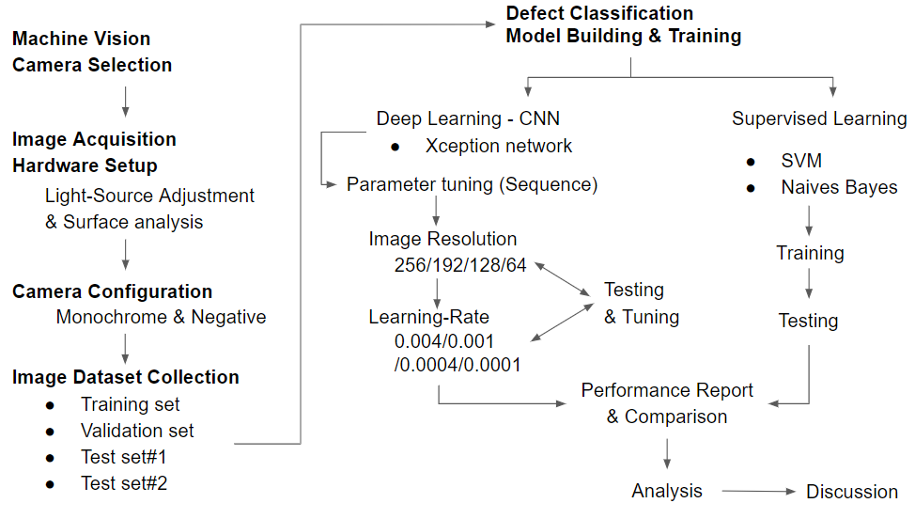
Research Workflow
Image
Acquisition
Module
Machine Learning Module
10

Slide 9
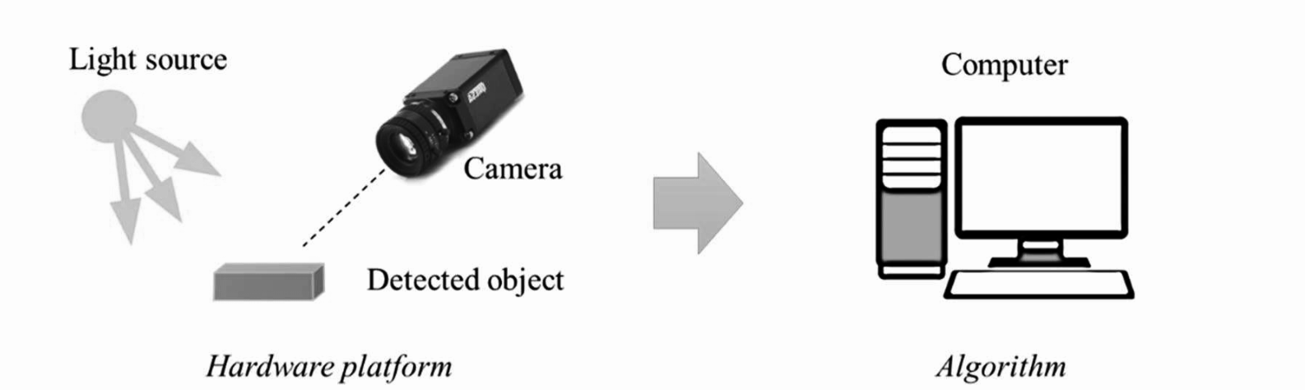
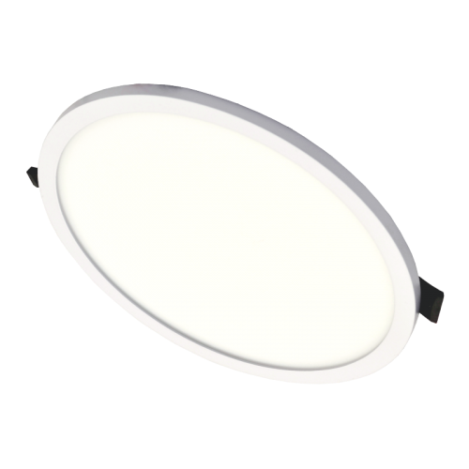

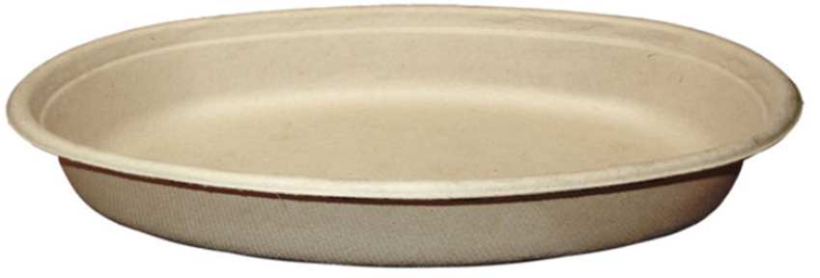
Machine Learning Based Visual Inspection
An automated visual inspection system based on machine learning consists of two modules:
Image acquisition module converts the target objects placed in the light field into images and transfers them to a computer
(2) Machine learning module applies
machine learning algorithms on images
to build a defect detection model
11

Slide 10
Image Acquisition Module

Slide 11
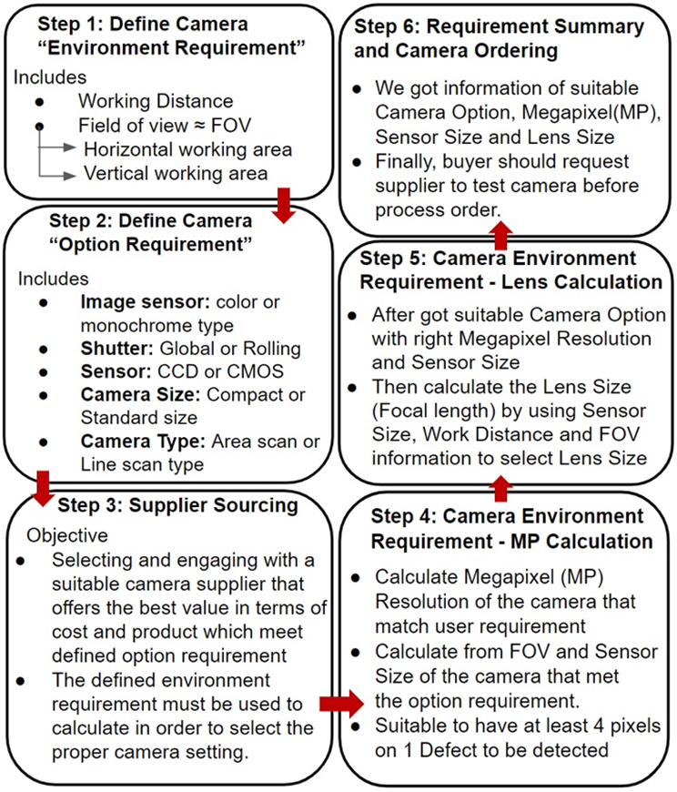
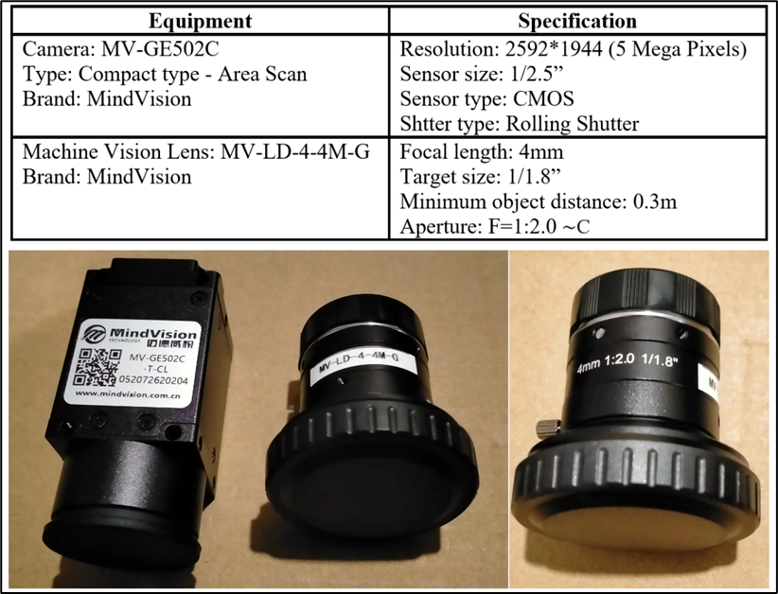
Machine Vision Camera
Images quality is important for visual inspection and defect detection
,several factors must be concerned:
Working environment, e.g., working distance & working area, and Camera option, e.g., sensor, type, size
Our research suggests “Machine vision hardware selection process to prepare a suitable camera”
Camera
Lens
13

Slide 12
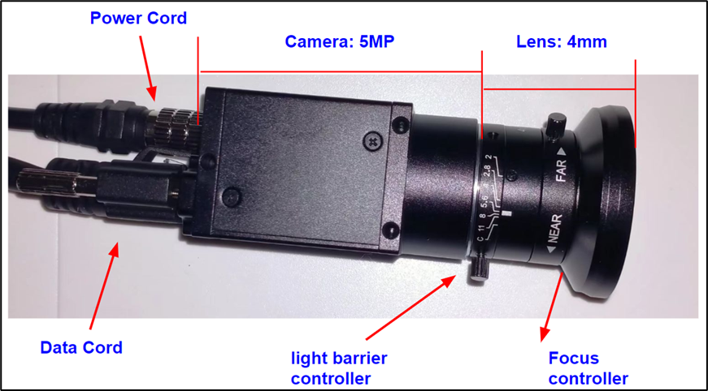
Project Machine Vision Camera Selection
Hardware detail of project selected machine vision camera
14

Slide 13
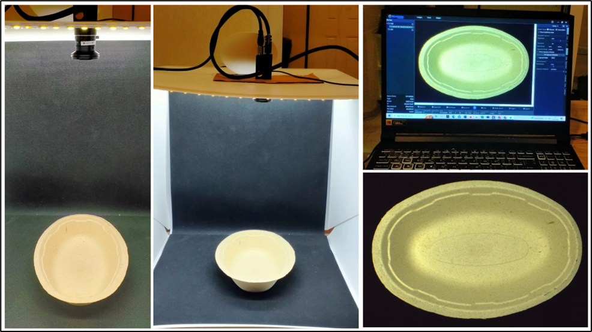
Machine Vision Hardware Platform Setup
Project Experimental Hardware Setup
15

Slide 14
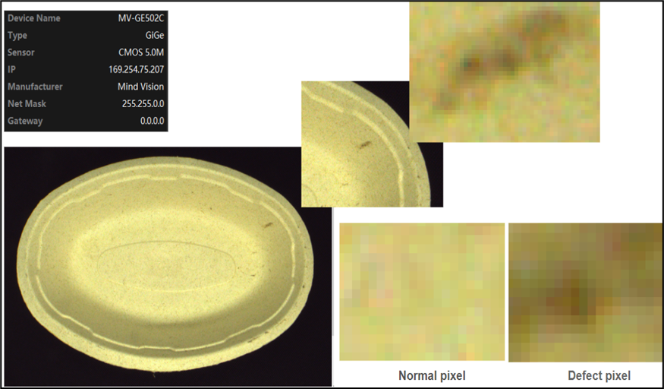
Machine Vision Hardware Platform Setup
Could differentiate defective and non-defective pixel
Also found that surface of the product have unstable color and shade on curve side due to lighting
16

Slide 15
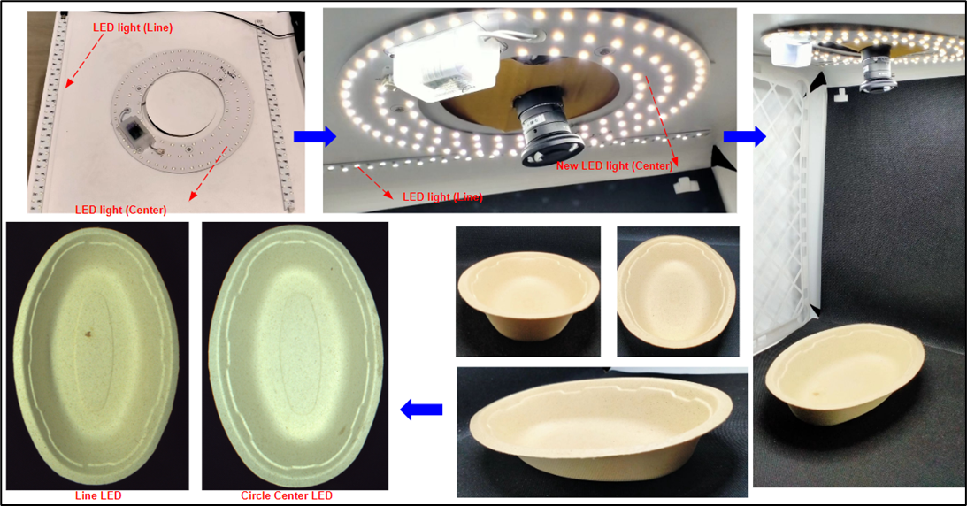
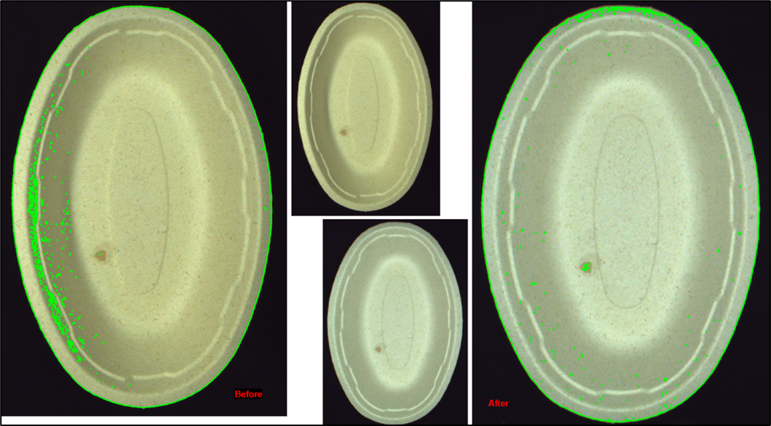
Light Source Configuration
Objective of the LEDs light-source platform
To make the defect features of the target objects visible
Reduce undesired features of the objects especially imbalanced shade which could cause issue on the model performance
17

Slide 16
Light Source Configuration
Line
LED
Circle-center
LED
By implementing OpenCV Image Thresholding and Contour techniques
to analyze light & shade distribution on the object surface
18

Slide 17
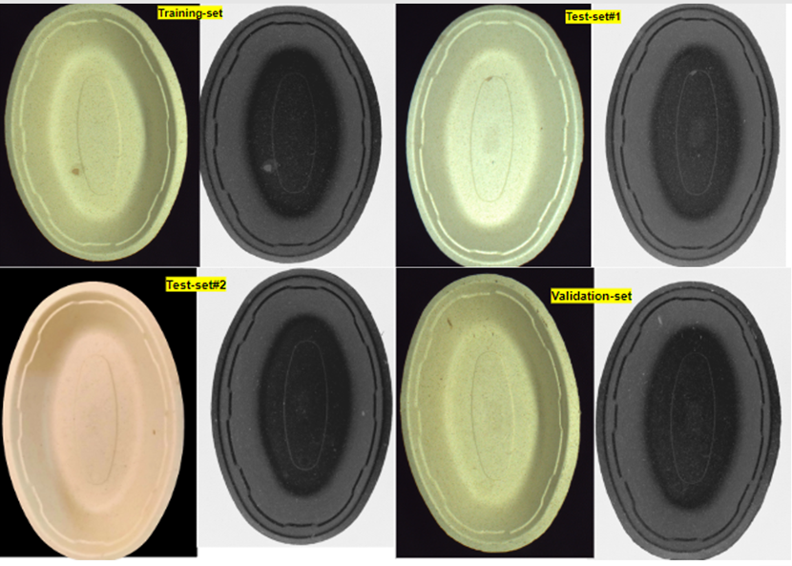
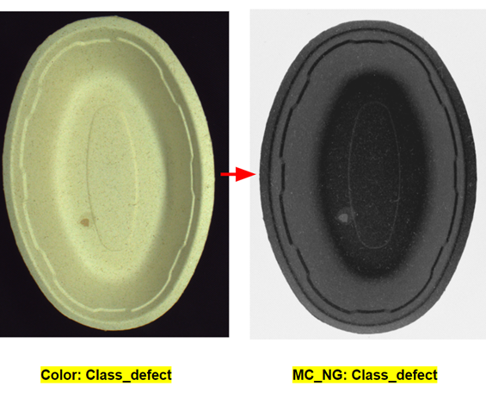
Machine Vision Camera Configuration
3.2 Image Acquisition Module
Negative Monochrome (NGMC) camera configurations is applied with aim..
To prevent color problems in products that change across raw material lots
19

Slide 18
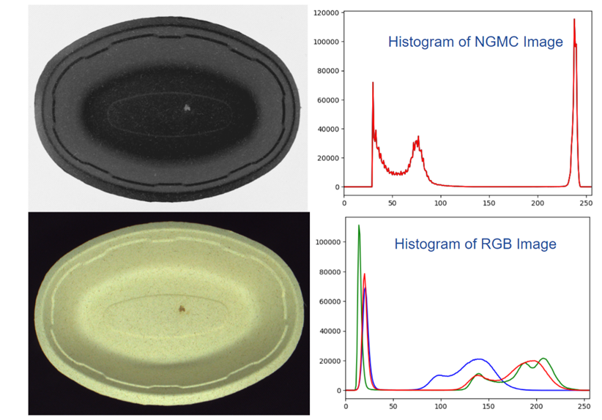
Machine Vision Camera Configuration
Negative Monochrome (NGMC) camera configurations
Build image datasets that more generalize & reduce the effect of product color shifting
Reduces the number of inputs that must be optimized by the model for the classification task
Storage saving, cut down image transfer time over the network, efficiently use computing resources and reduce model training time
20

Slide 19
Machine Learning Module

Slide 20
Classification Model
For our objective
To develop a conceptual framework for automated defect detection system on the molded pulp packaging in the way that potentially serve as an industry-specific practical case study.
The model must be able to classify whether the product images belong to a defect category or not.
The research algorithm is based on
Deep learning algorithm, CNN - Xception architecture with hyper-parameter tuning
  Image Resolution
  Learning rate
  Batch size
In comparison with Supervised learning algorithms; SVM & Naive Bayes
  Implement ORB (Oriented FAST and Rotated BRIEF)
  & Bag-of-Visual-Word (BoVW) features extraction techniques
22

Slide 21
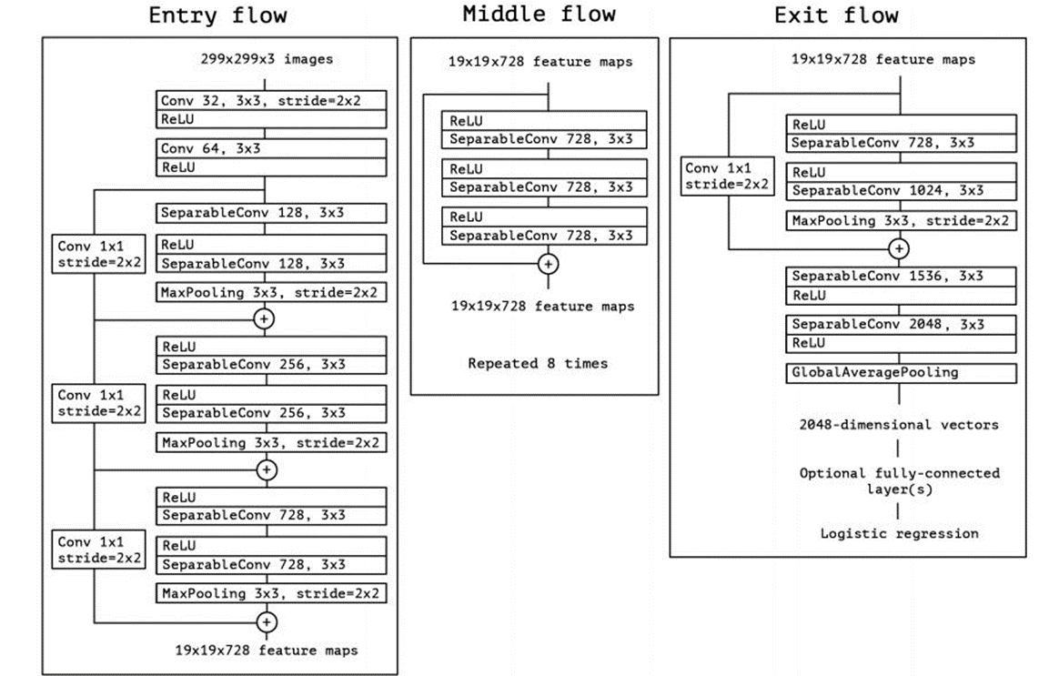
Deep Learning CNN - Xception architecture
Proposed by Google, Inc.
Applied depthwise separable convolution and shortcuts between convolution blocks as in ResNet
Can reduce the convolution operation cost and has overperformed VGG-16, ResNet and Inception V3 based on research paper by Google, Inc
Few use cases of the Xception model can be found in the literature
Our research, we have decided to make contribution by implementing the advantage of Xception model.
Depth of 126
36 convolutional layers
to extract features
23

Slide 22
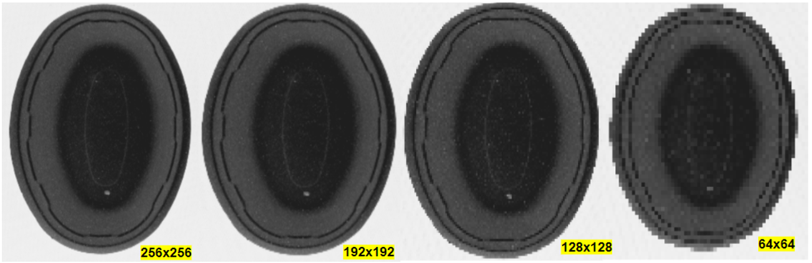
Xception architecture
To choose the suitable value of hyper-parameters, it is important to build a robust CNN model
Image Resolution Tuning
To find optimal resolution that suited our model’s application.
Image resolution affect the visual information contained in the images
and computation resource requirements
24

Slide 23
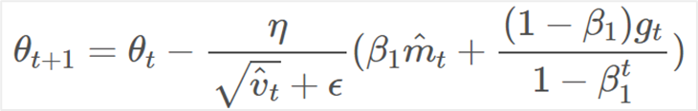
Xception architecture
Learning Rate (LR) Tuning
To find the optimal learning rate for the model
To study how defect detection model performance was affected by different Learning Rate
LR is varied to include 0.004, 0.001(default), 0.0001 and 0.0004
Nadam optimizer
LR
25

Slide 24
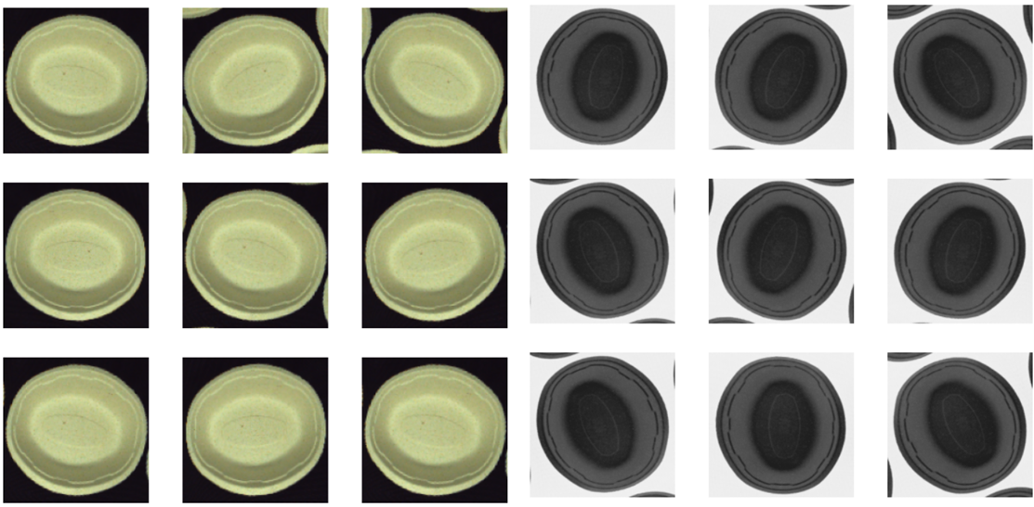
Xception architecture
In our research, we treat image augmentation and the optimizer algorithm as constant parameters
Image Augmentation technique
Nesterov-accelerated Adaptive Moment Estimation (Nadam) optimizer
The techniques implemented in our research are
Image Flip
Image Rotation
Advantages from a fusion of Adam
and Nesterov momentum (Nadam)
Can improve the speed of convergence
Require the least exhaustive parameter tuning
LR
26

Slide 25
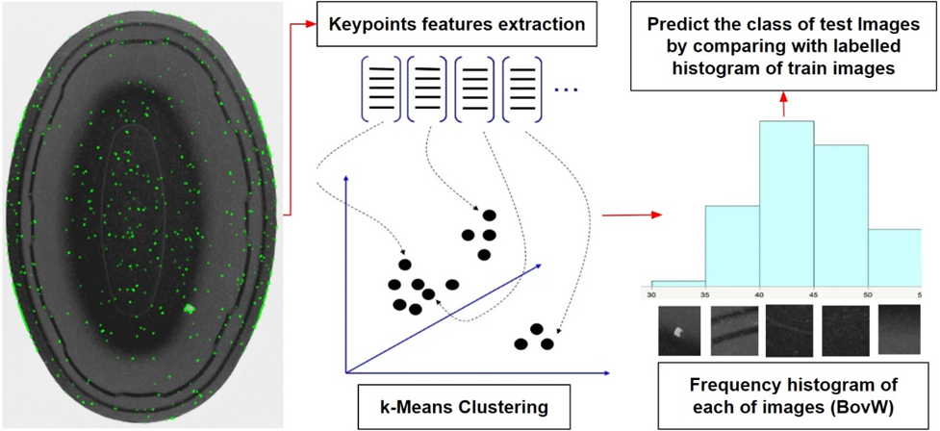
Supervised Learning
In comparison to the deep learning model - Xception architecture, we build supervised learning models
SVM and Naive bayes
Implemented the ORB & Bag-of-Visual-Word (BoVW) approach to extract features from images
27

Slide 26
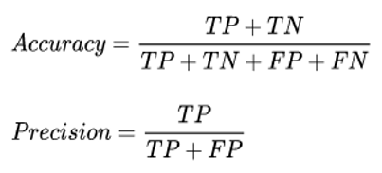
2.5 Defect Detection in Manufacturing Overview
Evaluation of Machine Learning
How to notices which of its results were appropriate and which contained mistake.
The accuracy and misclassification rate
  Model must classify product accurately
The precision value of defective category
  Avoid misclassifying a defective product as a non-defective one
  Lower the precision value, the more overlooked cases cause more defective products to escape quality control to consumers, which could lead to consumer complaints and company losses.
28
Notes:
Precision ที่ทายถูก จากที่ทายมาทั้งหมด
Recall ที่ทายถูก จากที่ควรจะเป็น

Slide 27
Experimental & Result

Slide 28
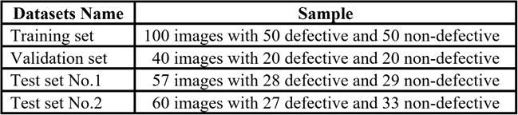
Datasets Acquired by Image Acquisition Module
Samples of a molded pulp packaging product named "32oz burrito bowl"
The samples were collected from
4 different production lots
The advantages of Negative Monochrome (NGMC) camera configurations are implemented to
preprocess image datasets
30

Slide 29
Deep learning - CNN
Xception architecture

Slide 30
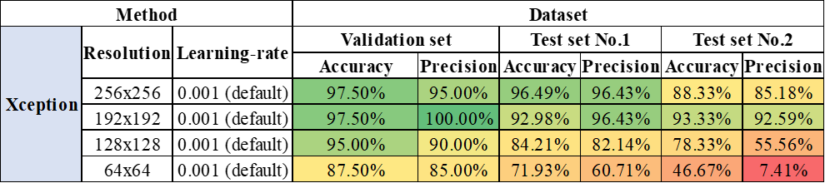
Model Performance on NGMC Datasets
4.2 Deep learning - Xception architecture
Image Resolution Tuning
Image quality affects the model’s performance - higher image resolutions result in higher accuracy and more generalization for deep learning models
Reduction of image resolution could eliminate the visual information (e.g., fine defects and contamination), which leads to the loss of important information in the image that is used for the classification
192x192 pixels, the lower input resolutions achieve better generalizability
smaller number of input features - fewer parameters that need to be learned and optimized
reduce the risk of model overfitting
32

Slide 31
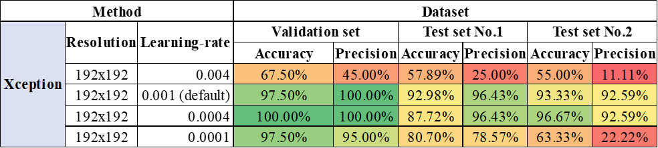
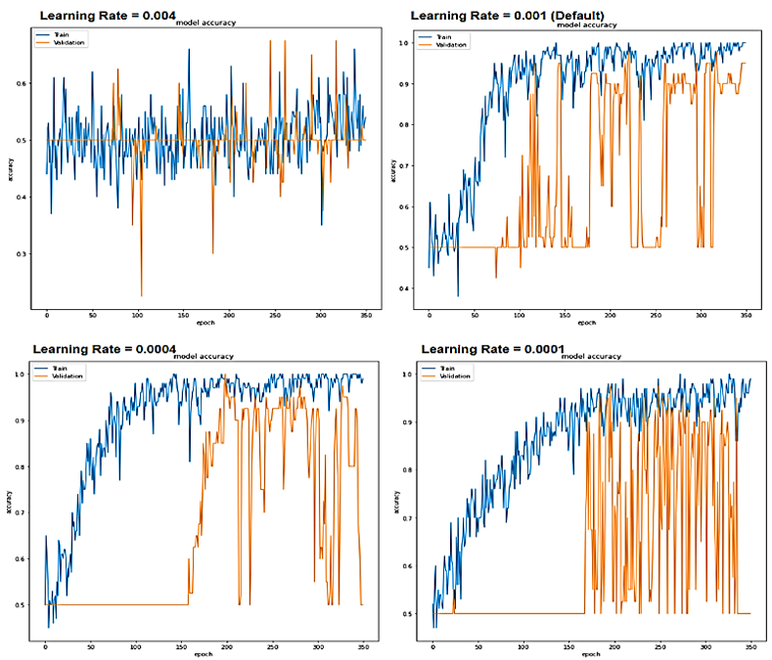
4.2 Deep learning - Xception architecture
Learning-Rate (LR) Tuning
33

Slide 32
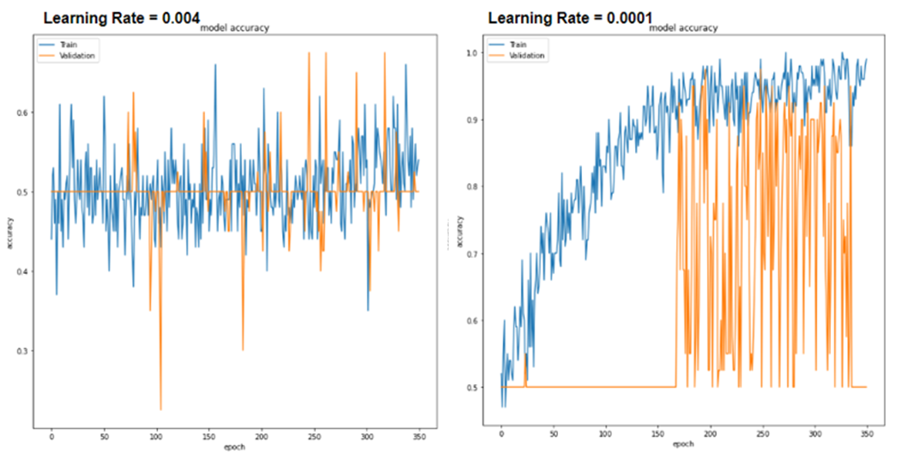
Xception architecture
LR is varied to include 0.004, 0.001(default), 0.0001 and 0.0004
Too large (LR-0.004)
training process will very slowly
The model and making very tiny updates to the weights and lead to model not learning
Too small (LR-0.0001)
Weight updated will be too large
Led to undesirable divergent behavior in loss function and result in oscillate over training epochs
34

Slide 33
4.2 Deep learning - Xception architecture
Learning-Rate (LR) Tuning
the learning rate is too large, accuracy will be poor due to Nadam optimizer making very tiny updates to the weights and lead to model not learning
the learning rate is too small, Nadam optimizer weight updated will be too large which could result in oscillate over training epochs
Smaller learning rate shows no improvement and have low generalization accuracy across test set
35

Slide 34
Supervised learning
SVM & Naive Bayes

Slide 35
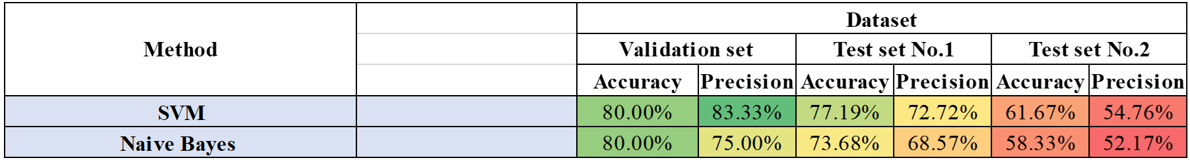
4.3 Supervised learning - SVM & Naive Bayes
Supervised learning - SVM & Naive Bayes
In comparison with the Xception architecture
we build and train supervised learning SVM & Naive Bayes on NGMC image datasets by implementing
  ORB (Oriented Fast and Rotated Brief) to create a descriptor for each extracted keypoints feature
  Bag-of-Visual-Word (BoVW) for feature extraction
When it comes to test set no.2, the accuracy and precision drop to 61.67% and 58.33%, respectively, which suggests the learned keypoints and descriptors are not generalized enough to classify defects in the new test set
A supervised learning algorithm, including SVM and Naïve Bayes, requires pre-feature extraction from raw data via a human engineering algorithm, which could be a drawback to learn the deep details of features.
Fluctuations in grain pulp fiber and non-repeating defect patterns, which were never learned
36

Slide 36
Performance Comparison

Slide 37
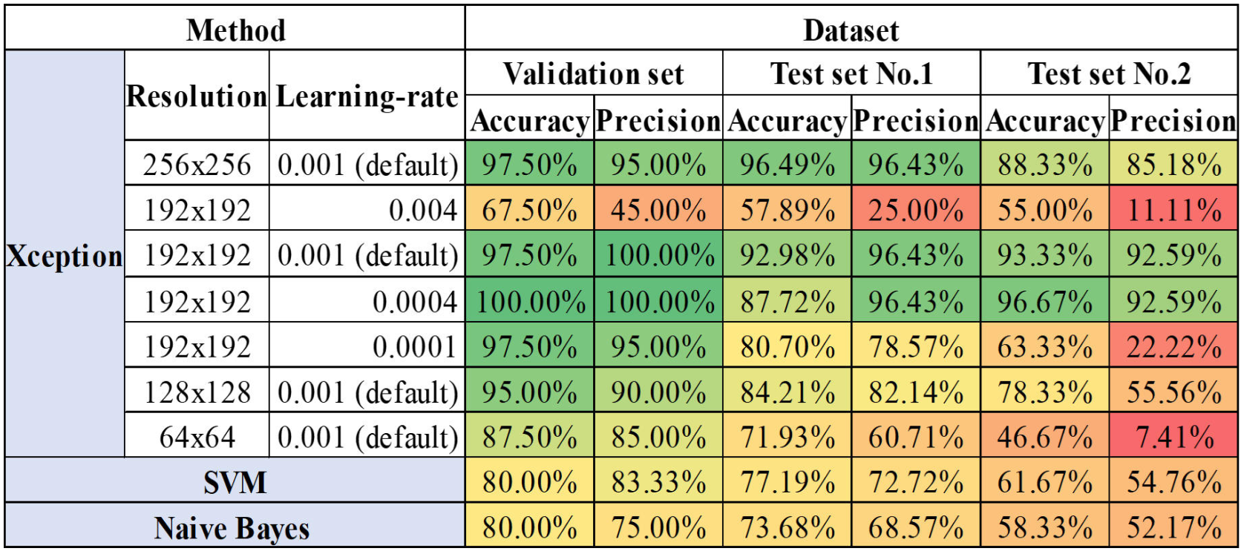
4.3 Model Performance Comparison
Model Performance Comparison
38

Slide 38
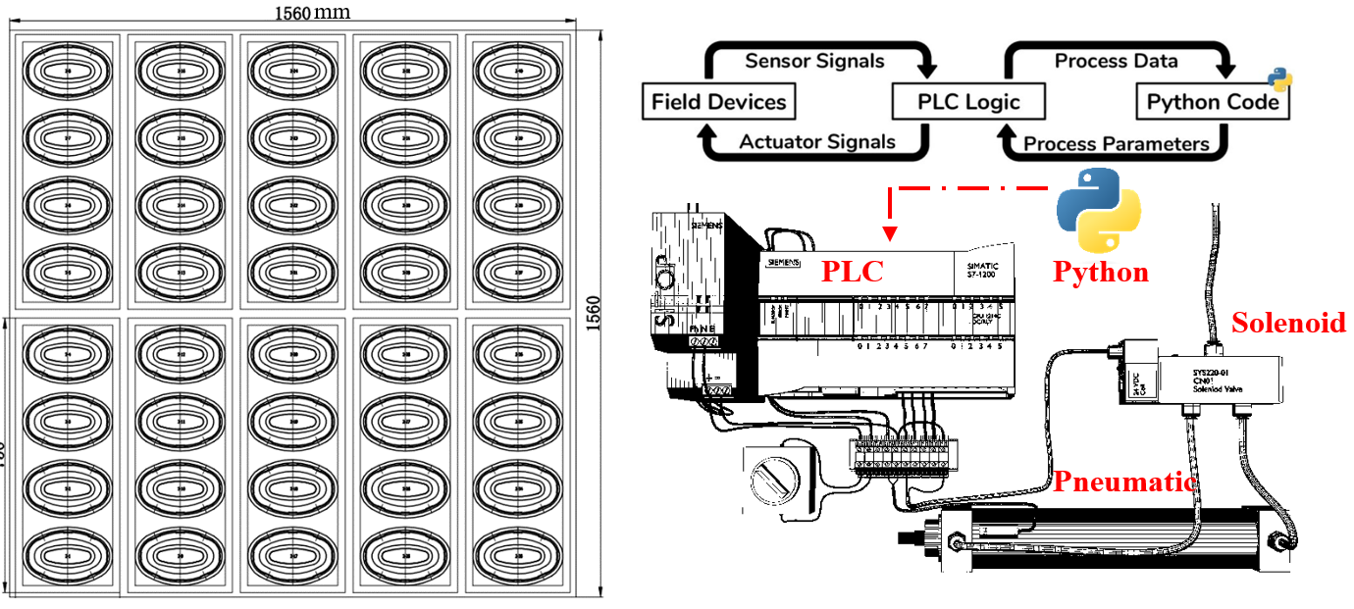
Recommendations
Real-time processing speed
To build a model that is practical and real-time, we must aim for both classification accuracy and the cost of inference time
Output: 40 pcs/cycle
Procedure | Result
Xception model with suitable hyper-parameter configuration | Achieve 1 s 900 ms inference time per 60 images in binary classification with more than 92.98% accuracy
Human manual inspection piece by piece | Requires 1 s per piece (1 minutes per 60 pcs)
In experimental, the model outperforms humans
by 97% in terms of speed
Since our framework is limited to an experimental hardware setup.
There is still opportunity to integrate our defect detection framework with an on-field scenario

Slide 39
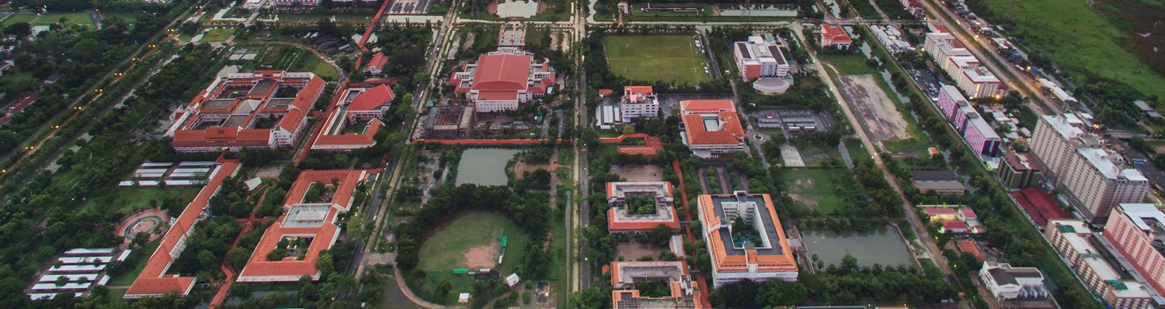

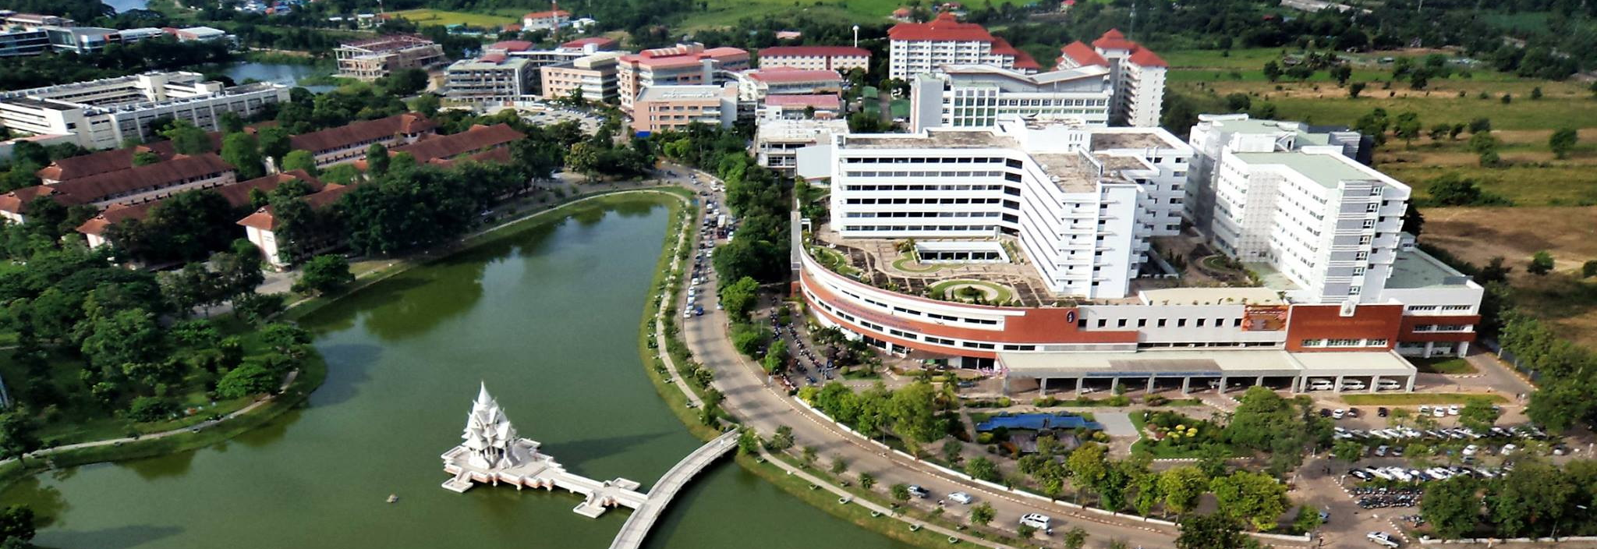


Slide 40
BACKUP

Slide 41
MODEL PARAMETER

Slide 42
Xception model uses the following settings:
Use the binary_crossentropy loss function,
Callbacks monitor max val_accuracy.
To study the learning curve of the model across parameters tuning, we must set epochs at a number of hundred but not too high to prevent overfitting, waste computing power and time. Hence, decided to train for 350 epochs.
Supervised Learning model
Our training model setting was based on ORB_create() at default value
BoVW cluster size 500, the clustering size was decided to make visual words be able to represent all image patches but not too large to cause quantization artifacts or over-fitting.
Input image pixel resolution of 1056 x 1520
53 Machine Learning Approaches for Quality Control In Pulp Packaging Manufacturers

Slide 43
CAMERA CALCULATION

Slide 44
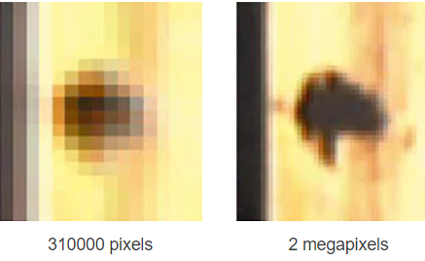
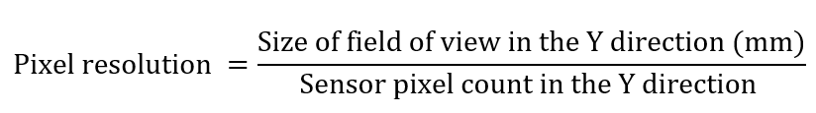
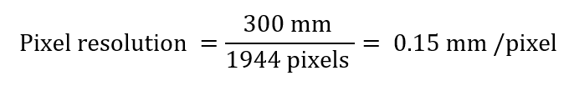
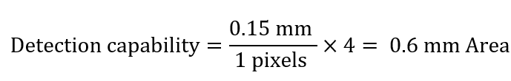
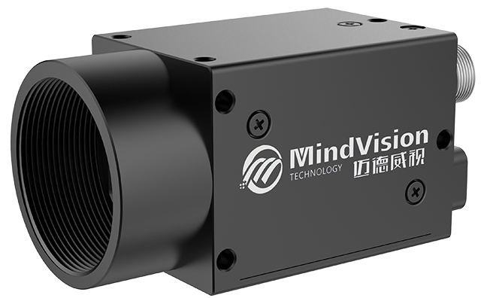
Camera Megapixel (MP)
Example:
If user have FOV of (H) 200mm x (V) 300mm, user have the image sensor type 5MP 2594x1944
Capability of 5-megapixel camera:
Detection of defect that are not smaller than 0.6 mm
with a field of view (Y) of 300 mm is suitable with this 5MP camera
(H) x (V)
Step 4
Sensor Size
Megapixel (MP)
17 Machine Learning Approaches for Quality Control In Pulp Packaging Manufacturers

Slide 45
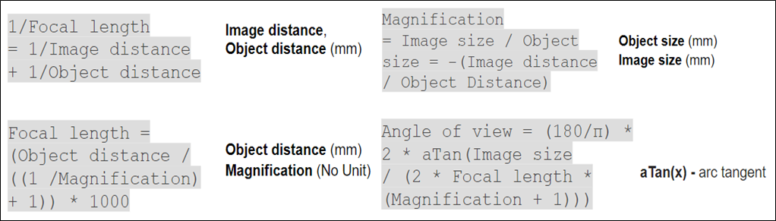
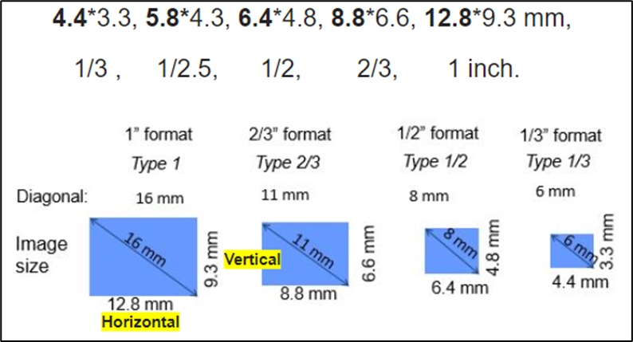


Focal Length Calculation
User Input
  Working Distance (dw) or Object distance
  Object Size (FOV) is real-size of an object
  Horizontal FOV and Vertical FOV.
  Typical Image Sensor- camera Specific
Step 5
Sensor Size
Megapixel (MP)
Step 4
Lens
Focal Length Calculation
Typical Sensor size / Image size of camera
19 Machine Learning Approaches for Quality Control In Pulp Packaging Manufacturers

Slide 46



Project Selected Camera
Selected Camera 5MP / CMOS / Color Sensor / Rolling Shutter / Optical Size 1 / 2.5”
Detection capability of 5-megapixel camera = 0.15 mm/pixel × 4 pixel area = 0.6 mm area
Suitable for project smallest inspection at 0.8mm
Working Distance (dw) or Object distance = 300mm
Object Size is real size of an object, given in mm (Horizontal FOV and Vertical FOV) = 300*300
Typical Sensor size / Image size
Camera Lens size 1 / 2.5” = 5.8mm*4.3mm
∴ Suitable LENS (f) = 4mm
Suitable Megapixel = 5MP

Slide 47
SUPERVISED LEARNING

Slide 48
Pre-feature extraction technique
2.2 Defect Detection in Manufacturing Overview
The bag of visual words (BoVW) model has proven to be efficient for image classification since it can effectively represent keypoints image features in vector space
The image has keypoints or local features
  image regions that have rich local information
  these features can be detected using different
  detection and description method
ORB, an efficient alternative to SIFT or SURF, is a fusion of the FAST keypoint detector and the BRIEF descriptor with many modifications to enhance its performance.
Extracting keypoints from images
using ORB feature detection and description algorithm
Create descriptor for each
extracted keypoints
Clustering features using
k-means clustering algorithm
Save the resulting “visual words” frequency histogram
(BoVW)
29 Machine Learning Approaches for Quality Control In Pulp Packaging Manufacturers

Slide 49




Pre-feature extraction technique
Descriptor
keypoint
Histogram
Train & Test model
28

Slide 50
CONCLUSIONS AND RECOMMENDATIONS

Slide 51

Recommendations and challenges:
B. The integration of machine vision
and machine learning with molded
pulp packaging production machine
The future work must study on Python-based real-time control system with PLC to control the servo motors
and pneumatic system
Control
Molding Machine
41 Machine Learning Approaches for Quality Control In Pulp Packaging Manufacturers

Slide 52
Additional Experimental

Slide 53


Exploration on RGB Datasets
4.2 Deep learning - Xception architecture
Our initial model building is based on batch size 32, LR=0.001 (Default)
RGB image resolutions of 128x128 and 64x64 to minimize the computation resource
Compare between RGB 128x128 and 64x64, the higher image resolution provider the better model accuracy
When testing the RGB models on a new testing set from a different production lot, the model fails to predict the new dataset
On the contrary, the NGMC model has higher generalizability
53 Machine Learning Approaches for Quality Control In Pulp Packaging Manufacturers

Slide 54


4.2 Deep learning - Xception architecture
Batch Size (BS) Tuning
53 Machine Learning Approaches for Quality Control In Pulp Packaging Manufacturers

Slide 55

4.2 Deep learning - Xception architecture
Batch Size (BS) Tuning
53 Machine Learning Approaches for Quality Control In Pulp Packaging Manufacturers

Slide 56

4.2 Deep learning - Xception architecture
Batch Size (BS) Tuning
The batch size is vital to how the model learns the features and has an impact on the model's generalization performance
For high-complexity data of molded pulp packaging, the smaller batch size provides more gradient computation, yielding more stable and reliable training results
53 Machine Learning Approaches for Quality Control In Pulp Packaging Manufacturers

Slide 57

4.2 Deep learning - Xception architecture
Final Model Performance with Stratified k-fold
After the exploration and hyper-parameter tuning stages, the stratified k-fold (5-fold and 10-fold) will be applied to our most generalized model parameter
Xception model; Nadam Optimizer (LR-0.001); NGMC image resolution 192x192 (batch size 8)
Trained with stratified k-fold has slightly better accuracy and generalizability when compared with normal training.
53 Machine Learning Approaches for Quality Control In Pulp Packaging Manufacturers

