Slide 1



Static Class-Level Approach For Test Impact Analysis
Alon Basin, Arthorn Luangsodsai, Krung Sinapiromsaran
Department of Mathematics and Computer Science, Faculty of Science, Chulalongkorn University
The 20th International Joint Conference on Computer Science and Software Engineering
28th June-1st July 2023
Naresuan University Phitsanulok, THAILAND

Slide 2
Table of Contents
Introduction & Background
Research
Results
Future Work & Conclusion

Slide 3
Introduction
&
Background

Slide 4
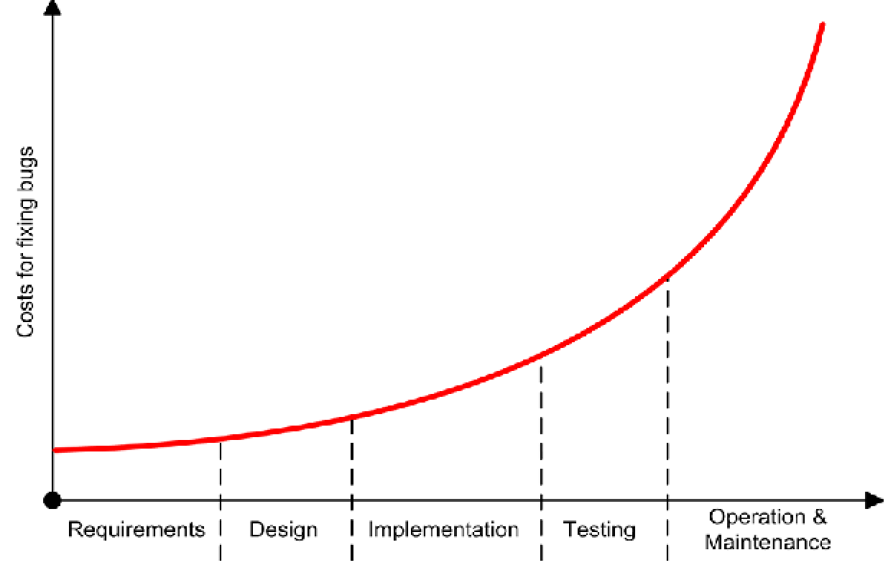
Software Maintenance
Software maintenance is the most challenging, costly, and labor-intensive activity throughout the SDLC
Software naturally adapts and modifies to fulfill evolving system and user requirements
Modifying software can lead to unforeseen consequences and inconsistencies with other original components
Software change impact analysis (CIA) aids in evaluating the potential effects of proposed changes on different software components
CIA can help select suitable test cases, also known as test impact analysis (TIA)
Notes:
Software maintenance - is widely acknowledged throughout the software development stages as the most challenging, costly, and labor-intensive activity.
Software products undergo natural adaptations and modifications in response to evolving system and user requirements.
Therefore, modifying software is a crucial component of software maintenance.
Software changes may arise from various factors, including new requirements, defect resolutions, change requests, and others.
As modifications are made to the software, unforeseen consequences are likely to arise, and inconsistencies with other components of the original software may occur.
To evaluate the potential impact of proposed changes on different parts of the software, software change impact analysis (CIA) might be used with various techniques. These techniques can be essential for software development, maintenance, and regression testing, and can be conducted both pre- and post-implementation of a code change.
Before making modifications, CIA can aid in understanding the program, predicting the impact of the change, and estimating the associated costs.
On the other hand, after implementing changes, CIA can be utilized to track the ripple effects, choose appropriate test cases (TIA), and carry out change propagation.

Slide 5
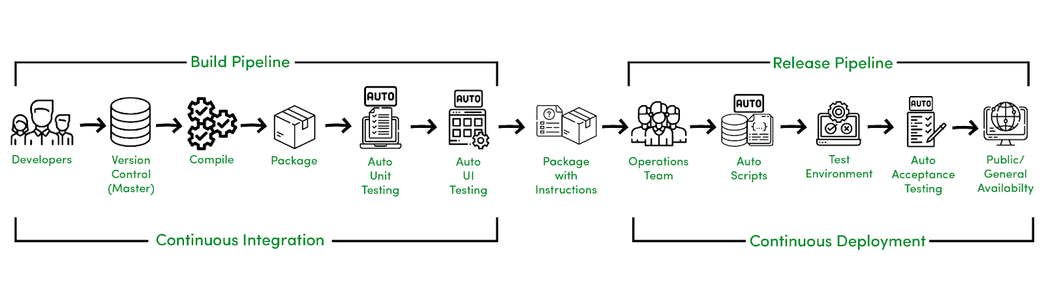
Continuous Integration / Continuous Deployment (CI/CD)
Modern software development commonly employs CI/CD to facilitate software maintenance
CI/CD process includes regularly merging modified code into a codebase
Continuous testing (CT) is commonly performed to ensure the quality of merged code
CT can also be highly demanding on time and resources
Extensive research has been conducted to minimize testing overhead by reducing the execution of test cases
Notes:
Modern software development commonly employs continuous integration (CI) to facilitate software maintenance.
This process involves merging modified code into a codebase, which can occur multiple times daily to lessen software maintenance overhead and deliver the latest software version to users.
Software engineers typically conduct continuous testing (CT) for quality assurance of merged code, which entails running a set of test suites for each merge.
Nonetheless, this process can also be demanding on time and resources.
Through analyzing the connection between source codes and test cases, it is feasible to efficiently identify a subset of test cases that have links with the modified code and are therefore considered as "impacted".
The technique used for this purpose is referred to as test impact analysis (TIA).

Slide 6
Related Studies
Continuous Integration (CI) & Continuous Testing (CT)
Test Case Prioritization (TCP) & Test Case Selection (TCS)
Test Case Dependencies & Test Case Quality
Notes:
A previous study revealed that implementing CI enhances productivity in software development and contributes to identifying a more significant number of bugs.
Another research highlighted the advantages of continuous testing to identify system errors arising from inaccurate data. Their study demonstrated that continuous data testing could tackle important data debugging issues .
Google conducted a study detailing the methods they employed to scale continuous testing, which involved managing 2 billion lines of code and running 150 million tests daily.
Numerous research studies have investigated techniques for test case prioritization (TCP) and test case selection (TCS).
TCP methods prioritize test cases that are more prone to failure, enabling software engineers to focus on addressing any issues as quickly as possible.
While TCS techniques are designed to elect a smaller segment of test cases to reduce the overall run time.
One study compared class-level and method-level static Test Case Selection (TCS) techniques in 22 Java systems, analyzing 985 revisions in total. The results indicated that class-level static TCS techniques exhibited promising results and performed comparably to dynamic-based methods.
In another work the author implement a blend of strategies for prioritizing and selecting test cases to optimize the cost-effectiveness of continuous testing.
In other research aimed to decrease the waiting time for developers to receive feedback from continuous testing following a commit, the researchers proposed a method that employs factors related to test failures or resolutions to enhance test case prioritization.
Also, companies like Microsoft and Facebook utilize techniques such as predictive test selection and TIA to reduce the overhead associated with the execution of tests and enable continuous testing to be more robust for sizable codebases.
In one study the researches did evaluation of 58 Java systems and compared four static TCP techniques with a state-of-the-art dynamic-based approach. According to their findings, static techniques can be highly efficient in relation to detecting faults and reducing costs.
In another work, the researches introduced a systematic and data-driven approach called PRADET for identifying test dependencies.
In other research, the researchers investigated the progression of test cases and discovered that software engineers frequently reformat and fix test cases.
Test quality, particularly regarding flaky tests, is another area currently receiving attention from researchers.
According to one research over 50% of unstable tests exhibit test smells, and addressing these smells can lead to better software design and reduced test flakiness.
In another empirical research, the researches investigated bugs within test code and discovered that flaky, semantic, and environment-based bugs are frequently encountered issues.
A recent study explored the performance of TIA in continuous testing setup and the influence of code dependency on TIA efficacy. The study found that many test cases aim to test a high-level functionality of the system that is under test (i.e., integration tests), which naturally include a greater level of dependencies that may hinder TIA effectiveness.

Slide 7
Research

Slide 8
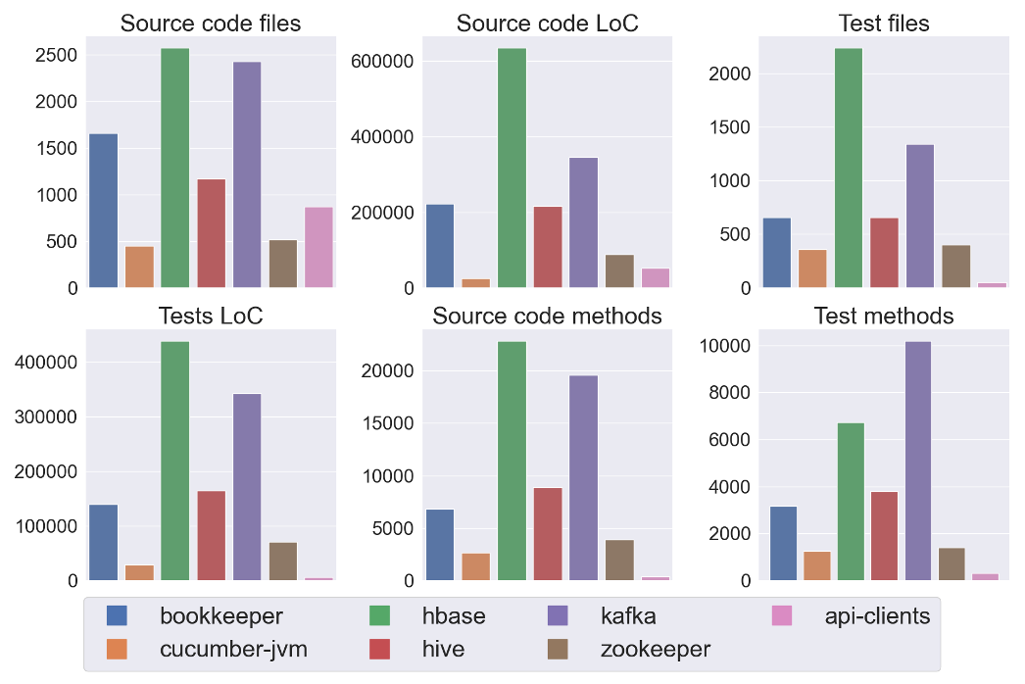
Systems Overview
System | Source files | Test files | LoC in source | Loc in test | Source methods | Test cases
bookkeeper | 1656 | 656 | 221359 | 139972 | 6828 | 3171
cucu.-jvm | 449 | 358 | 25475 | 29368 | 2658 | 1257
hbase | 2569 | 2234 | 633376 | 439158 | 22851 | 6734
hive | 1167 | 658 | 215637 | 165185 | 8911 | 3798
kafka | 2422 | 1339 | 345014 | 343064 | 19558 | 10195
zookeeper | 519 | 400 | 88304 | 71124 | 3880 | 1398
api-clients | 870 | 53 | 52611 | 6203 | 400 | 303
Notes:
Our case study focuses on seven Java-based projects with a wide range of domains, including distributed storage and coordination systems, databases for real-time data processing, behavior-driven development testing, and data warehousing.
The table provides an overview of these systems, and the plot illustrates their relative sizes.
The data shows that the largest projects are HBase and Kafka, while the smallest ones are ZooKeeper and API-clients.

Slide 9
Methodology
Shared Systems
bookkeeper
cucumber-jvm
hbase
hive
kafka
The proposed technique consists of two main phases:
  1. Create a dependency graph between test cases and classes
  2. Collect commits with code changes and apply TIA to determine impacted test cases
Utilize JavaParser to identify dependency graphs between test cases and source code
The studied systems strictly adhere to continuous integration (CI) practices
Consider test case as impacted if it depends on the modified code
Analyze all the Java files in the seven systems under study
Check if method uses testing framework to identify it as a test case
Exclude binaries and focus only on source code files within the system
Compare the results with a state-of-the-art static class-level technique on shared systems
Notes:
Main Points:
Our technique can be broken down into two main phases in a high overview. Initially, we create a dependency graph that captures dependencies among test cases and source code files and helps to track whether a dependency exists among a specific test case and source code. And in the second phase, we gather commits containing source code changes and employ TIA to identify a subset of impacted test cases for each commit (i.e., code change).
To conduct our analysis, we examine all Java files within each of the seven systems.
The studied projects were primarily chosen because they adhere to continuous testing practices, are actively maintained, and have been the subject of prior studies.
To detect dependency graphs among test cases and source codes within the studied systems, we utilize JavaParser [41], a Java-based open-source library for static analysis that is compatible with the most recent Java release and capable of representing a Java source code file as AST.
We consider a test case impacted if it depends on the modified code (i.e., commit) and, as a result, requires execution. To achieve that, our approach extracts relevant node types from ASTs and recursively examines their dependency for each test case.
Additionally, our technique explores class-level static dependencies among modified source codes and test cases (i.e., test methods) to identify impacted test cases that directly or indirectly invoke the modified code. To determine whether a method is a test case, we check if it employs testing framework APIs like JUnit or TestNG (i.e., utilizing the @Test annotation).
Furthermore, we exclude binaries and restrict our analysis to dependencies corresponding to source code files within the system.
To evaluate the effectiveness of our approach, we compared it with a state-of-the-art static class-level technique on shared projects.
???
Our proposed TIA approach differs from the compared method in two main ways. First, we build a tests-to-class dependency graph between test cases and their dependent classes instead of test files and dependent classes, which ensures that each test case contains specific information on all the dependent classes that are relevant to it. Since a test file can have multiple test cases with different dependent classes, a code modification may only affect certain test cases within the file. Our approach identifies the subset of impacted test cases by constructing a tests-to-class dependency graph that directly links each test case to its dependent classes rather than considering all the test cases in a file as impacted. Secondly, we collect relevant information on dependent classes by analyzing specific node types (e.g., ClassOrInterfaceType, FieldAccessExpr, and MethodCallExpr) while building the dependency graph, which can lead to a more precise and comprehensive dependency graph between test cases and dependent classes.

Slide 10
Research Question
How does our proposed static class-level test impact analysis technique perform compared to the state-of-the-art static class-level test impact analysis technique?
Notes:
RQ: How does our proposed static class-level test impact analysis technique perform compared to the state-of-the-art static class-level test impact analysis technique?

Slide 11
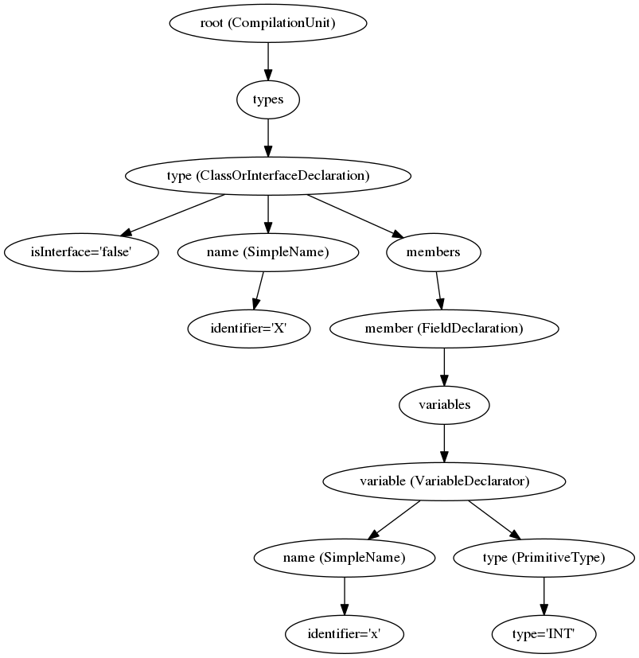
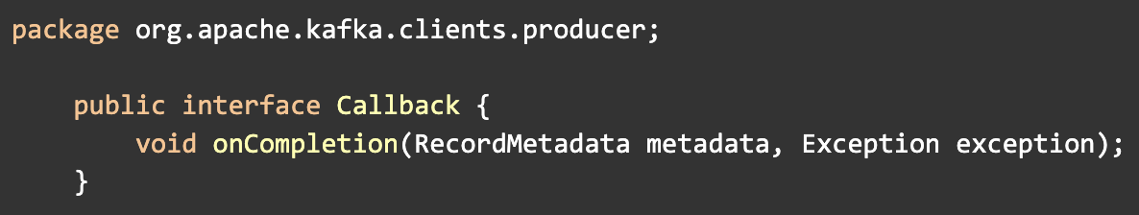
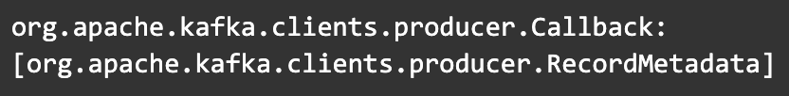
Approach
Creating a class-to-classes dependency graph:
  Develop a set of all classes
  Represent classes as a set of compilation units
  Establish a dependency graph between classes and their dependent classes
Notes:
For creating a dependency graph between test cases and classes,
Initially, we develop a set of all-classes by gathering the Java source code files present within the source code path exclusively.
Next, we represent these files as a set of compilation units while extracting the qualified name of each compilation unit.
In the JavaParser framework, CompilationUnit is a class that represents the entire Java file as an Abstract Syntax Tree (AST) (see Fig)
Next, we establish a dependency graph between classes and their dependent classes by traversing the AST, accumulating relevant node types, resolving the node using the JavaParser JavaSymbolSolver to retrieve the qualified name of the node class, and filtering only the nodes that exist within the project scop.

Slide 12
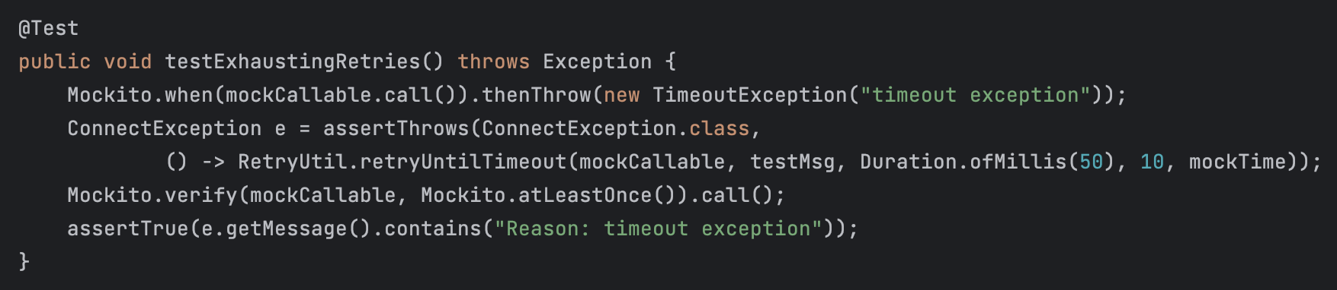
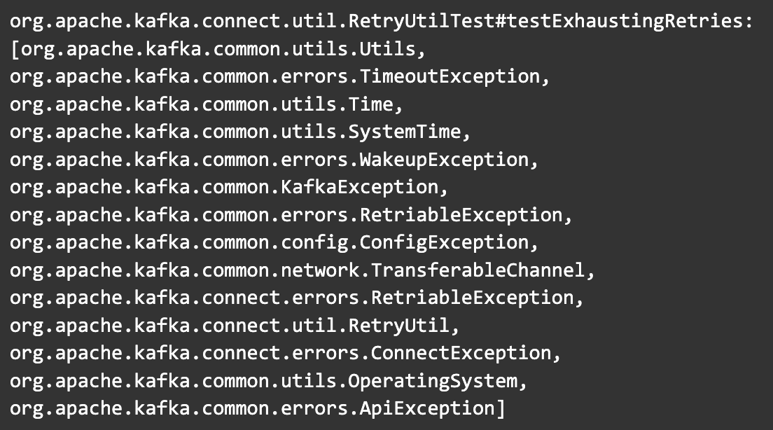
Approach
Creating a tests-to-classes dependency graph:
  Collect all the test cases
  Retrieve qualified names of depended classes
  Extract classes for non-test code in each test file
  Traverse recursively class names and their dependent class based on class-to-classes
  Establish a dependency graph between test cases and their dependent classes
Notes:
Next, to obtain the dependency graph between test cases and classes, we first collect all the test methods by filtering out the methods under the test path that contain the @Test annotation.
For each test method, we retrieve the qualified names of the relevant nodes.
Additionally, since test cases often use shared resources such as test fixture methods (e.g., @Before, @BeforeClass), we repeat the process of extracting the class names for all non-test codes in each test file.
Which finally results in the test-to-classes dependency graph.
The graph includes the test case qualified name as the key and a set of 14 dependent classes qualified names as the value.
Finally, for applying TIA, we collected the source code files that had changed from commits (see Table 2), filtering only those commits that had made some code changes to at least one Java source file. We then retrieved the corresponding qualified names for each source file, like in the previous steps. Using the test-to-classes dependency graph, we filtered the impacted test cases that contained the changed classes, resulting in a subset of impacted test cases for each commit.

Slide 13
Approach
System | Commits | Changed source files (median) | Pct. of impacted tests (median) | Num. of impacted tests (median)
bookkeeper | 57 | 10.912 | 39.51% | 1253
cucumber-jvm | 14 | 1.571 | 6.96% | 88
hbase | 45 | 3.511 | 44.85% | 3024
hive | 24 | 4.125 | 26.20% | 1027
kafka | 52 | 3.057 | 22.41% | 2325
zookeeper | 48 | 3.312 | 62.39% | 874
api-clients | 67 | 2.761 | 43.77% | 132
Applying TIA:
  collect commits with code changes to at least one Java source file
  retrieved the corresponding qualified names for each changed source file
  Using the test-to-classes dependency graph, filter the impacted test cases that contained the changed classes
  Resulting a subset of impacted test cases per commit
Notes:
Finally, for applying TIA, we collected the source code files that had changed from commits (see Table), filtering only those commits that had made some code changes to at least one Java source file.
We then using the test-to-classes dependency graph, filtered the impacted test cases that contained the changed classes, resulting in a subset of impacted test cases for each commit.
The table presents the number of commits, the median count of modified files, the average percentage of impacted tests for each system, and the avg number of impacted test cases.

Slide 14
Results

Slide 15
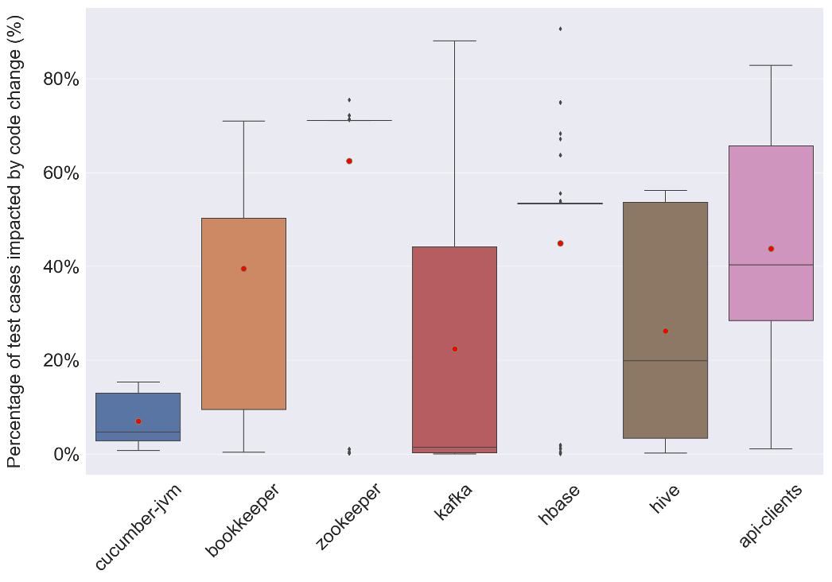
Notes:
In most systems analyzed, although the average number of modified files is below 4, the median rate of impacted test cases can reach up to 62%.
The Fig displays the rate breakdown of impacted test cases by code changes.
The average rate of impacted test cases ranges from 22% to 62% for six of the seven systems examined.
Our results also indicate that Cucumber-JVM has a comparatively lower number of impacted test cases, with a median percentage of only 6.96%.
Upon further examination, we discovered that this could be attributed to the median number of modified files in Cucumber-JVM being relatively small, at only 1.5, compared to the other studied systems.
To better understand the results, we further analyzed the dependencies between classes to classes (i.e., how many references to other classes each class holds).

Slide 16
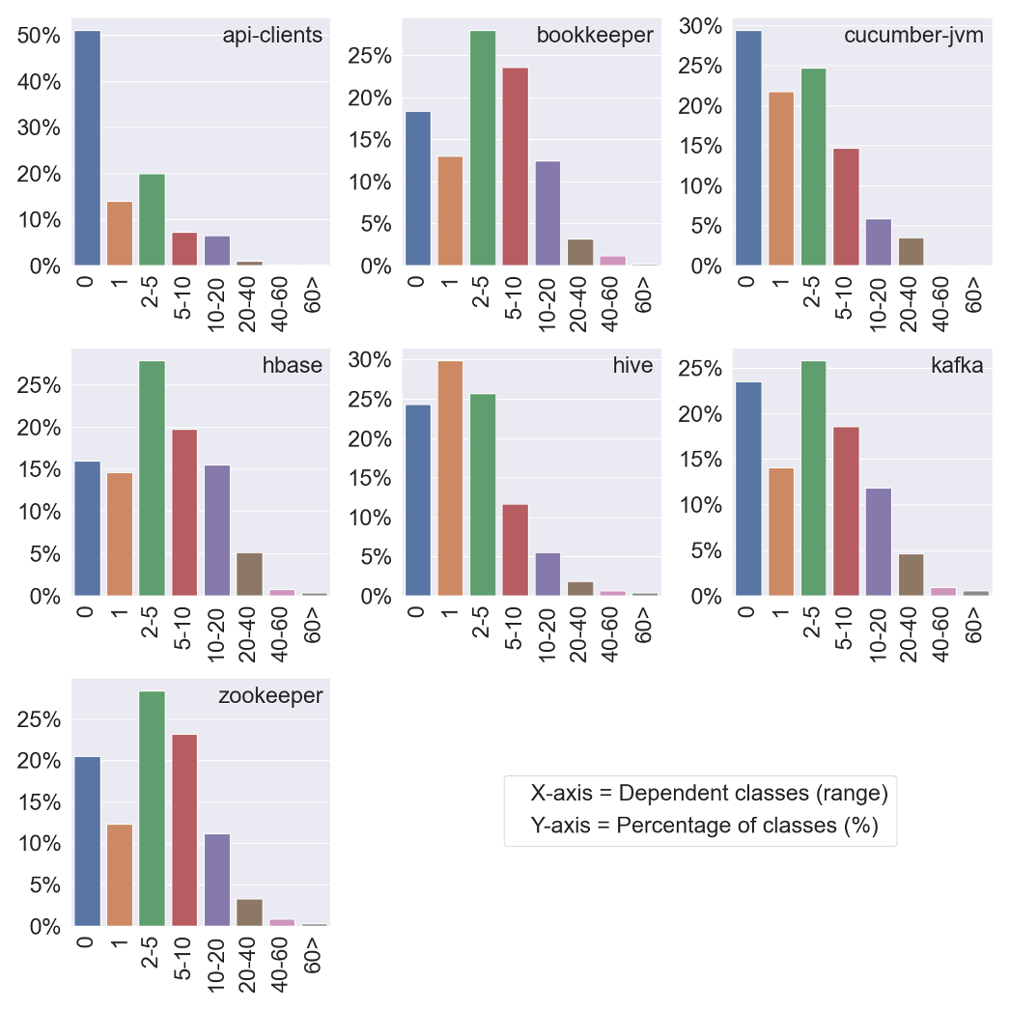
Notes:
The relationship between the percentage of classes and the distribution of dependent classes by range is illustrated in this Fig.
It is apparent that in all the studied systems, the rate of classes that do not depend on other classes is greater than 15%, with a maximum of 51.1% observed in the case of API-clients.
Additionally, our analysis revealed that a relatively small proportion of classes (less than 5% on average) have 20-40 dependencies on other classes in all the studied systems.

Slide 17
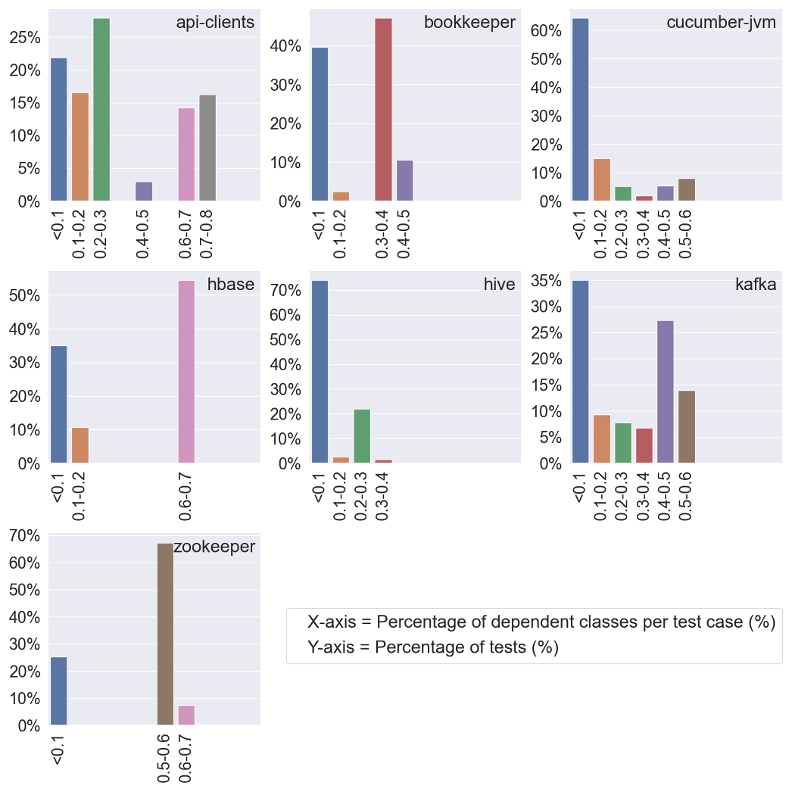
Notes:
The correlation between test cases and the dependent classes (in percentage) is presented in the next Fig.
In all the studied systems, 20% of the test cases depend less than 10% on the total classes in the system. However, in the case of Hive, this percentage exceeds 70%.
Also, the data suggest that the highest median rate of impacted test results (as shown in Table 2), observed in ZooKeeper and HBase, is associated with the percentage of dependent classes (with more than 75% of test cases depending on 50%-70% of total classes in the case of ZooKeeper, and with more than 50% of test cases having a dependency on 60%-70% of total classes in the case of HBase, respectively).
The data also shows that even though the number of changed classes (i.e., source code files) is minimal (less than 0.5% on average) in the commits collected from analyzed systems, a significant proportion of test cases can be impacted (with a median of around 47% detected in four out of the seven studied systems).
However, the data also shows that the suggested static class-level TIA approach can reduce test overhead by approximately 60% on average.

Slide 18
System | Proposed technique | State-of-the-art technique
bookkeeper | 39.51% | ~40%
cucumber-jvm | 6.96% | ~15%
habse | 44.85% | ~72%
hive | 26.20% | ~48%
kafka | 22.41% | ~33%
Notes:
Percentage of impacted tests (median)
We evaluated our findings on commonly analyzed systems to compare our results with the current state-of-the-art static class-level approach (as presented in the Table).
Our proposed method demonstrated an average improvement (i.e., reduction) of about 13% in selecting impacted test cases on avg.

Slide 19
Future Work
&
Conclusion

Slide 20
Future Work
The studied systems implemented mostly in Java
The study was confined to a subset of commits
The research relies on static analysis to detect dependency graphs
Static analysis used to recover dependencies at the class-level
Dependencies between tests and classes revealed through static analysis
Method categorized as a test case if it includes invocations to testing libraries
The study analyzes only Java source code and its corresponding test cases
Notes:
Our studied systems were implemented solely in Java, so the outcomes might not be transferable to software projects written in different coding languages.
Future research should investigate their generalizability to extend our results' applicability to other coding languages.
Our study was confined to a subset of code changes (i.e., commits) and did not encompass the entire early phases of software system development.
Future research could conduct a more extensive TIA and extend the study to cover the complete software history to address this limitation.
Our research relies on static analysis to detect dependency graphs, but it is important to note that this method may have constraints in terms of accuracy.
For instance, issues such as resolving nodes from ASTs could lead to inaccuracies in the results.
While we did not encounter such problems in our research, upcoming studies should validate our results by testing them on different systems.
We decided to use static analysis instead of dynamic analysis to recover dependencies at the class-level, as previous research [35], [37] indicated that static TIA performs similarly to dynamic methods,
and class-level dependency graph produces superior outcomes evaluated to the method-level dependency graph.
Future investigations may consider using dynamic analysis or exploring method-level dependency to reassess our results.
The dependencies between test cases and other source codes were revealed in this paper through static analysis.
While our manual examination found no false positives resulting from our static analysis approach,
future research should also investigate the proposed technique and other static methods for TIA concerning false positives,
which measures the number of test cases impacted by the modified code but not identified by the TIA technique.
We categorize a method as a test case if it includes invocations to testing libraries like JUnit or TestNG, signified by the presence of the "@Test" annotation.
While we didn't encounter any false detection in our examination, it is feasible that during the execution part of the pinpointed
test cases could be ignored by using annotations like "@Ignore" or "@Test(enabled=false)".
Further research is required to confirm the precision of our method for identifying test cases.
This research analyzes source code (in Java) and its corresponding test cases.
Although most of the systems we study are coded in Java, there are instances where other programming languages are used.
For example, Scala and Python account for 21.8% and 2.5% of the code in Kafka, respectively, while Perl and Ruby make up 0.9% and 1.8% of HBase’s code, respectively.
Hence, further research is required to investigate how different programming languages can influence the outcomes of TIA.

Slide 21
Conclusion
New static class-level TIA technique which evaluated in the context of CI setup
Despite minimal changes to the code → ~40% of test cases are impacted
Implementing the proposed TIA technique → ~60% reduction of test cases
The proposed TIA approach → ~13% reduction in identifying impacted test cases compared to the state-of-the-art approach
Integrating TIA into the SDLC can yield significant benefits
Notes:
This paper presents a new static class-level TIA technique and evaluates its effectiveness in the context of continuous testing on seven Java systems.
Our findings indicate that despite minimal changes to the code in collected commits, a considerable proportion of test cases (averaging around 40%) are still impacted.
However, at the same time, implementing our proposed approach can reduce the accumulated testing overhead in continuous integration (CI) setups as we observed approximately 60% reduction of tests on average.
To benchmark our results with the current state-of-the-art static class-level approach, we compared our findings and observed an average improvement (i.e., reduction) of about 13% in identifying impacted test cases.
Overall, our results suggest that integrating test impact analysis (TIA) into the SDLC can yield significant benefits, considering the increasing frequency of tests and associate overhead.

Slide 22
THANK YOU
Q&A

