Slide 1



Improvement of Message-Oriented Middleware (MOM) for the Surveillance Platform
Seoulcha Ratmumad¹ and Wannarat Suntiamorntut²
^{1,2}Department of Computer Engineering, Faculty of Engineering,
²Digital Research and Innovation Institute (DRII),
Prince of Songkla University, Hat Yai, Songkhla, Thailand
The 20th International Joint Conference on Computer Science and Software Engineering
28th June-1st July 2023
Naresuan University Phitsanulok, THAILAND

Slide 2
Table of Content
Introduction
  1.1 Surveillance Platform
  1.2 Literature Review
  1.3 Objective
Proposed Research Conceptual Idea
  2.1 Image Processing Pipeline
  2.2 Existing System Problems
  2.3 Proposed System
Experimental and Results
Conclusion

Slide 3
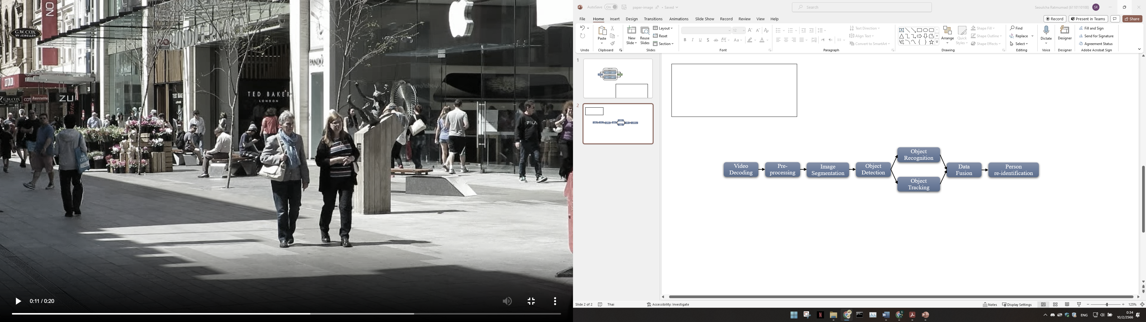



1.1 Surveillance Platform
Video Frames
Face Recognition
Image Processing
Process
Results
CCTV or Video Source
Behavior
Recognition
Real-time video processing system for CCTV and cloud-stored videos.
Performs frame-by-frame analysis such as Includes face recognition , behavior detection , etc.
Deployed for security in indoor and outdoor areas of diverse organizations.

Slide 4
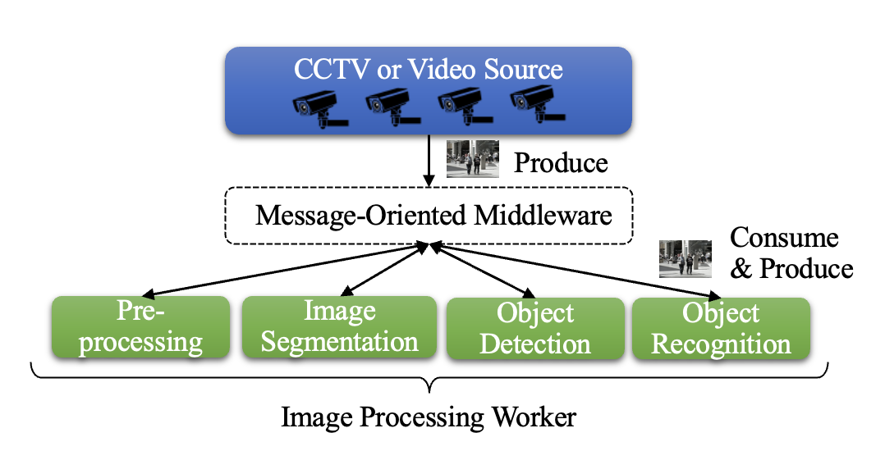
1.2 Literature Review
1. Surveillance Platform
  Data transmission technique: Image data is sent through a central distribution worker.
  Communication medium for workload distribution: Used to send image to a central system called message-oriented middleware (MOM).
  Specialized software processing: Microservices employed for tasks like face and object detection upon receiving data in the central system.

Slide 5
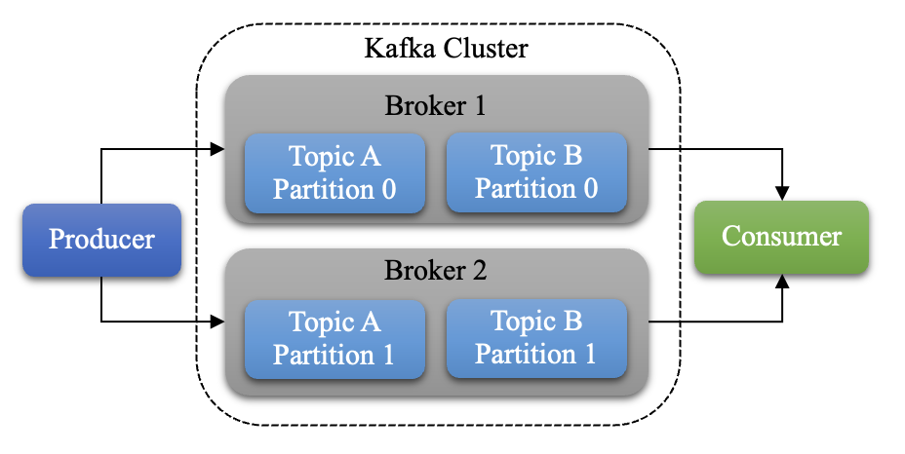
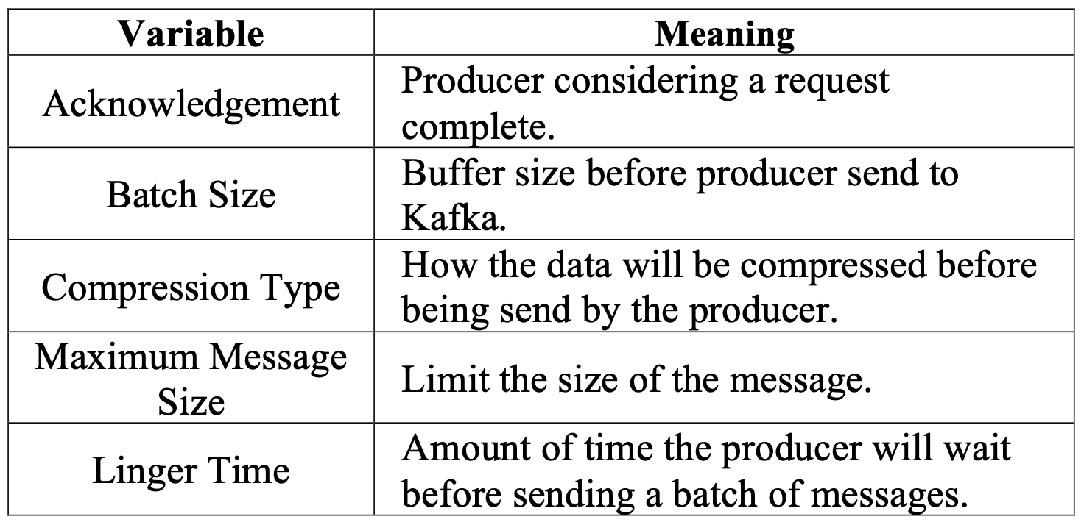
1.2 Literature Review
2. MOM Improvement using Apache Kafka

Slide 6
1.3 Objective
Enhancing image processing speed: Focus on improving the speed of image processing for each frame.
Improving system throughput: Aim to enhance the overall throughput of the system.
Supporting growing CCTV demands: Address the increasing demands associated with closed-circuit television (CCTV) systems.

Slide 7
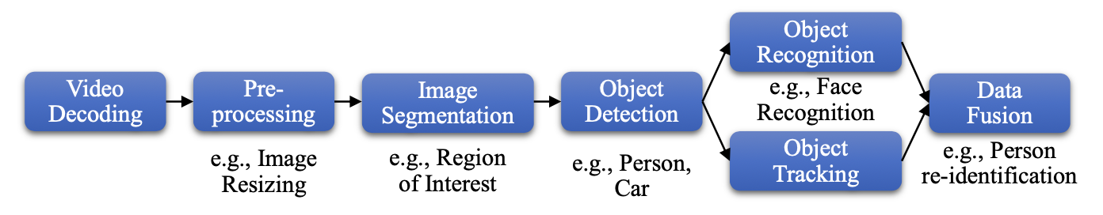
2.1 Image Processing Pipeline
Typical process of video analytics
1
2
3
4
5
6
Processing Step

Slide 8
2.2 Existing System Problems
Iterative image transmissions: Literature review and analysis reveal that continuously sending images to the data bus in the image processing pipeline results in iterative image transmissions.
Inefficient resource utilization: This iterative transmission can lead to sending the same image multiple times, which inefficiently utilizes system resources.
Increased processing latency: The repetitive transmission contributes to increased processing latency, as Kafka's storage involves writing to the hard disk.

Slide 9
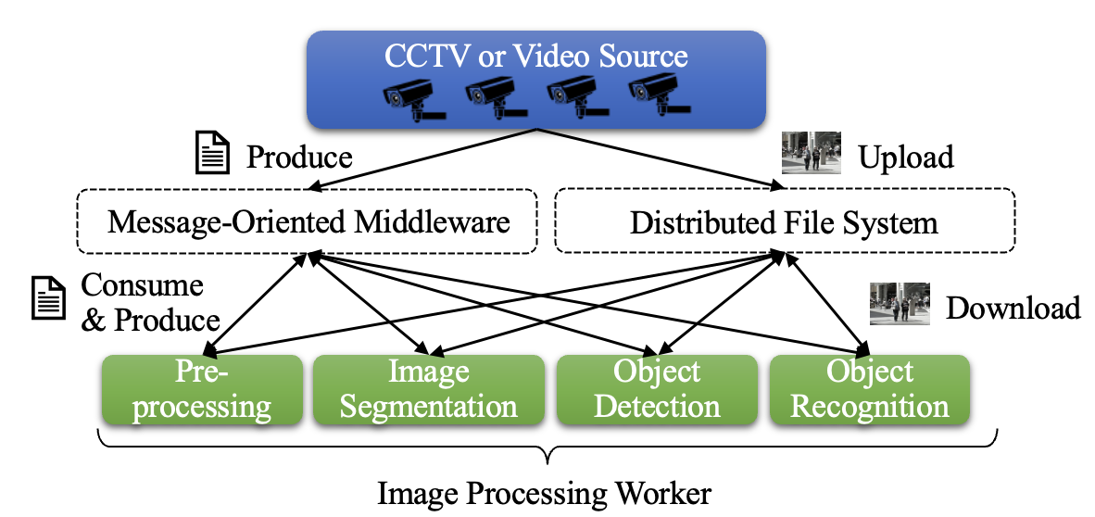
2.3 Proposed System
Decoupling image transmission from message transmission: The concept involves utilizing a Distributed File System (DFS) to store image frames separately from the message transmission in MOM.
Metadata-based approach: Instead of sending the actual image frames, only necessary metadata (e.g., link or path) is sent to access the corresponding file in the DFS.
Efficient resource usage: By avoiding duplicate image transmissions and sending only metadata, redundancy is reduced, and resource utilization is optimized within the image processing pipeline.

Slide 10
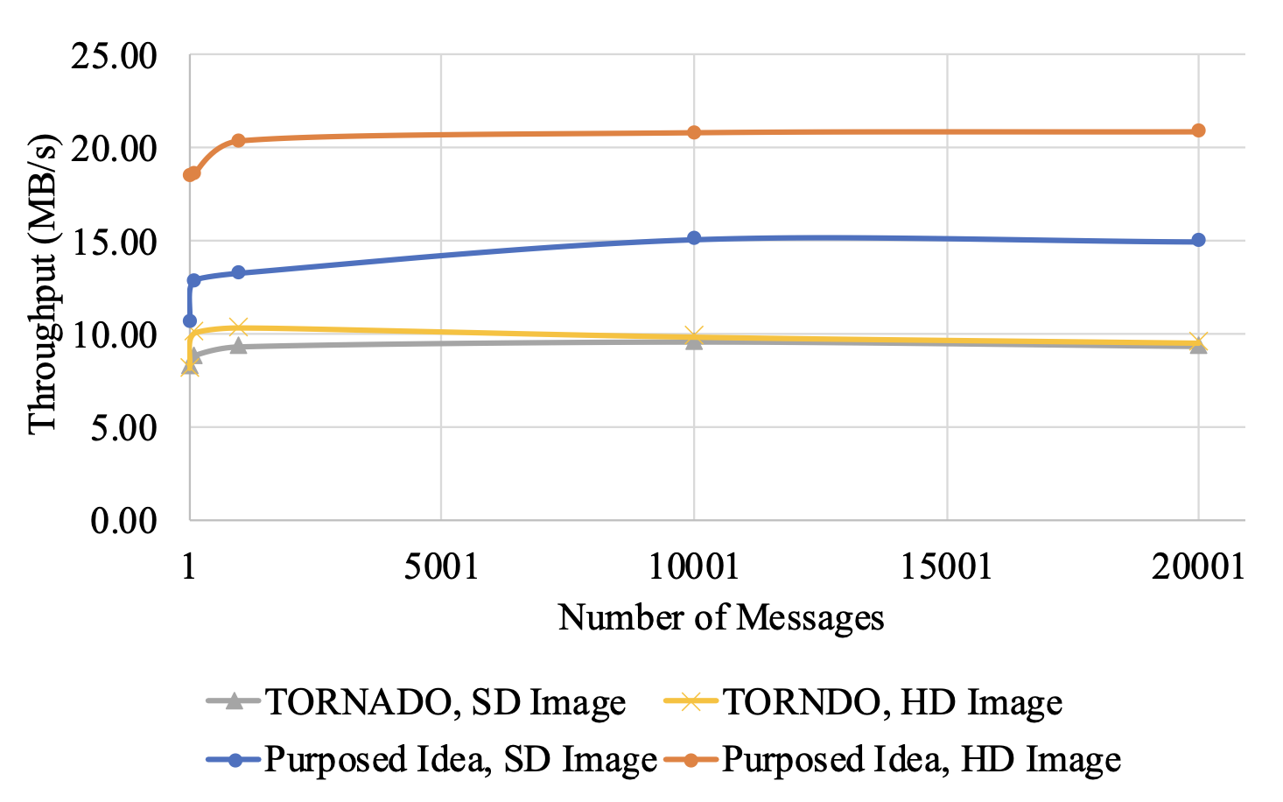
3. Experimental and Results
1. Throughput Comparison
  SD image throughput: Our proposed approach achieved an average throughput of 13.38 MB/s, representing a 46.95% improvement compared to the referenced research's average throughput of 9.11 MB/s.
  HD image throughput: Our proposed approach achieved an average throughput of 19.81 MB/s, demonstrating a significant 106.26% improvement compared to the referenced research's average throughput of 9.61 MB/s.
Notes:
SD: From 9.11 MB/s to 13.38 MB/s -> 46.95%
HD: From 9.61 MB/s to 19.81 MB/s -> 106.26%

Slide 11
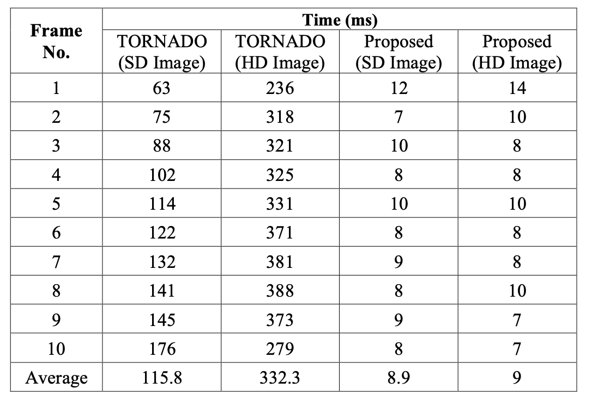
3. Experimental and Results
2. Each Frame Acquisition Time
  SD image frame acquisition time: Our proposed approach achieved a substantial 92.31% reduction compared to the referenced research.
  HD image frame acquisition time: Our proposed approach demonstrated an impressive 97.29% reduction compared to the referenced research.
Notes:
SD: reduce 92.31%
HD: reduce 97.29%

Slide 12
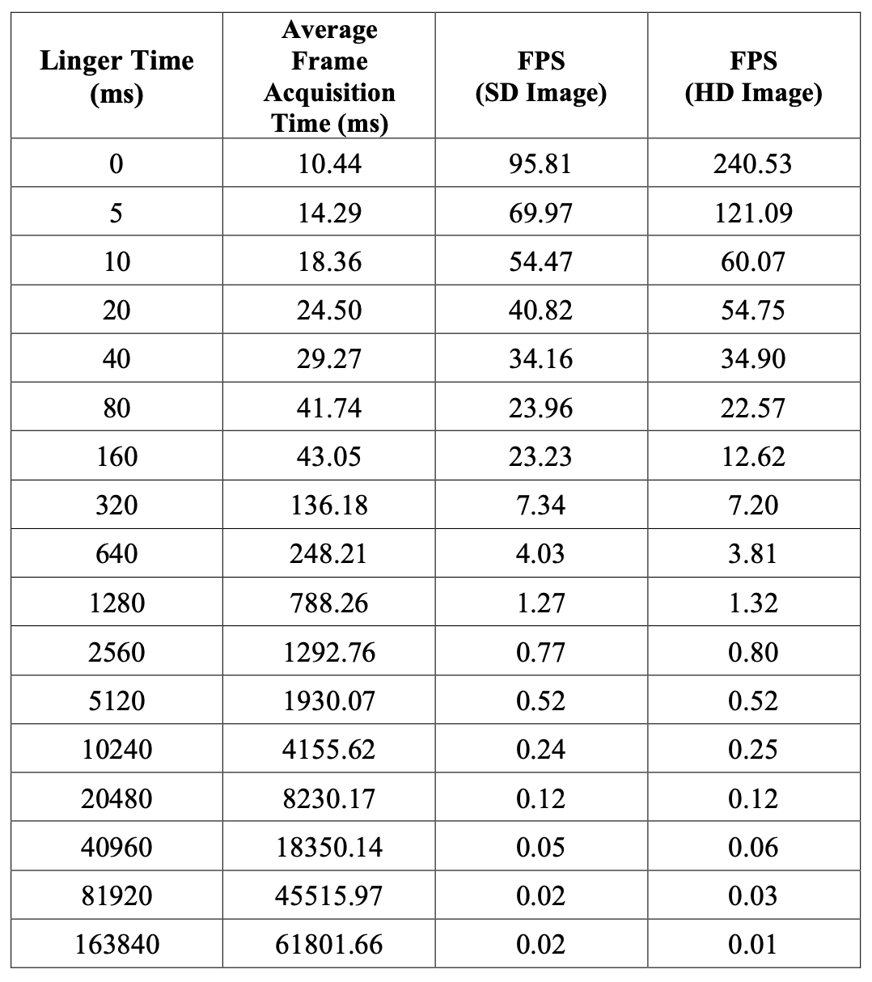
3. Experimental and Results
3. Average Frame Acquisition Time
  Achieved frame rates: With a linger time of 40 ms, frame rates of 34.16 FPS (SD) and 34.90 FPS (HD) were achieved, enabling efficient image processing using one consumer per camera in the system.
  Real-time image processing: These frame rates align with the typical frame rate of CCTV cameras (30 FPS), enabling real-time image processing.
Notes:
Selected 40ms -> SD: 34.16, HD 34.90 FPS

Slide 13
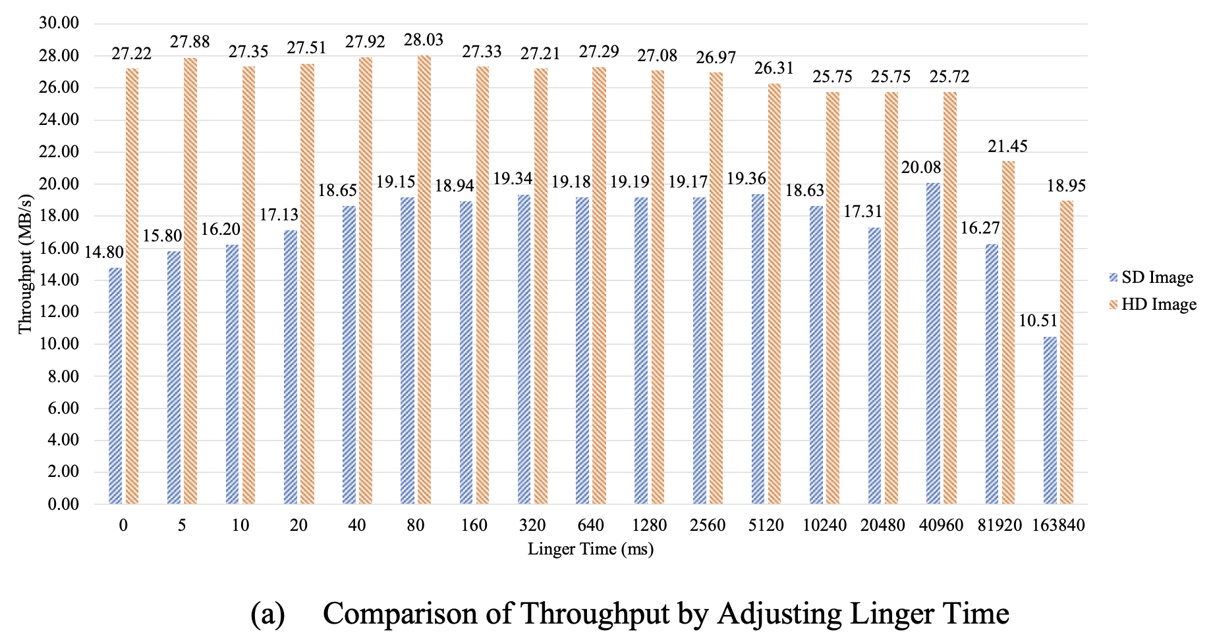
3. Experimental and Results

Slide 14
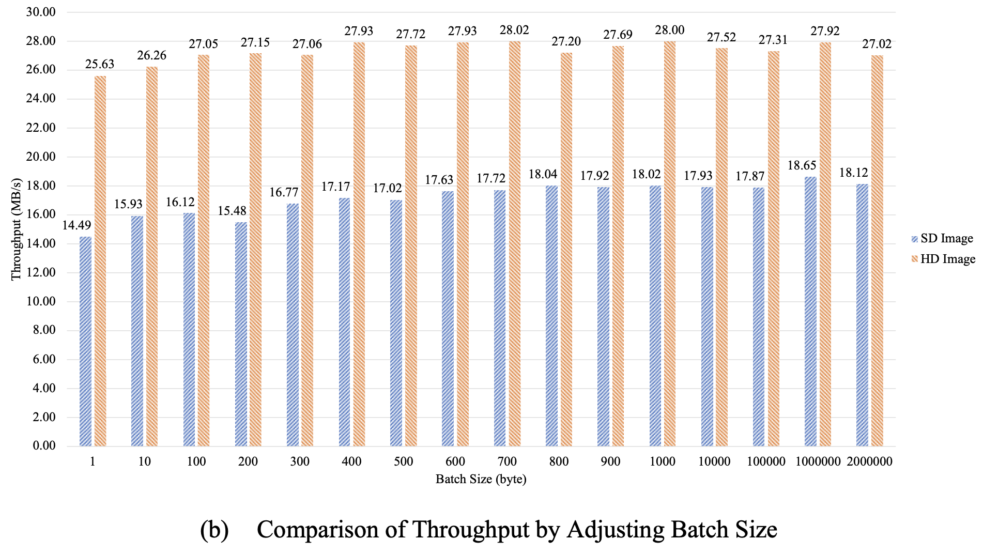
3. Experimental and Results

Slide 15
4. Conclusion
Proposed concept resulted in up to 45.95% and 106.26% improvement for SD and HD resolution images, respectively.
After adjusting producer settings, our concept showed higher throughput compared to referenced research, with an increase of 88.55% for SD images and 190.75% for HD images using a linger time of 40 ms and a batch size of 400 bytes.

Slide 16
5. Limitation
Limited comparison to other MOMs: The concept focuses on optimizing the image processing workflow using a specific MOM. Further studies can explore comparisons with other MOMs to enhance performance.
Unexplored potential of MOM clustering: While addressing workflow optimization, MOM clustering's potential for improving research development efficiency remains unexplored.
Scope for broader research: Although the concept enhances system performance, further research can explore additional factors to optimize the image processing workflow in surveillance systems.

Slide 17
THANK YOU
QUESTION & ANSWER

