Slide 1





Improved Heart Rate Estimation From
Facial Videos Using Hair Detection and
Majority Vote in Subintervals
Panupong Sunkom
Denchai Worasawate
Chadchai Srisurangkul
Minoru Nakayama
The 20th International Joint Conference on Computer Science and Software Engineering
28th June-1st July 2023
Naresuan University Phitsanulok, THAILAND
Notes:
Good afternoon. My name is Panupong Sunkom. I am a master's student from Kasetsart University and one of the authors of this work, which is called… .
This work also has co-authors, who are professor Denchai from Kasetsart University, Dr. chad chai from NSTDA and professor minoru from Tokyo tech

Slide 2
Table of contents
Introduction & objective
Related work and material
Proposed method
Result and discussion
Conclusion and future work
Question & Answer
Notes:
In this slide, I will talk about the table of contents in this presentation, It will be divided into 7 sections, which start with the introduction and objective, related work and material, Proposed method,
Result and discussion, Conclusion and future work, and question and answer if you have any questions, you can ask them in this section.

Slide 3
01
Introduction & Objectives
Notes:
I will start with the first section, which is the introduction and objectives

Slide 4
Introduction
Heart rate (HR) is one of the important physiological signs that is used for monitoring the health of a person
Many researchers have tried to find non-contact methods to detect the HR and one of the promising methods is remote photoplethysmography (rPPG)
Notes:
Nowadays,…

Slide 5
Introduction
The region of interest (ROI) on the subject’s face must be selected to extract the rPPG signals
  The forehead or cheek areas are appropriate to use as an ROI [1]
In some facial videos, some parts of the subject’s hair may cover the forehead, which can lead to the erroneous result of the rPPG signal (we need to extract this signal from the skin area)
[1] M. Kumar, A. Veeraraghavan, and A. Sabharwal, “DistancePPG: Robust non-contact vital signs monitoring using a camera,” Biomed. Opt. Express, vol. 6, no. 5, pp. 1565–1588, May 2015.
Notes:
To obtain the rppg signal, we need to define the region of interest or ROI on the subject face.
In past research, the forehead or cheek areas were appropriate to use as an ROI.
However, when we focus on the forehead roi, some parts of the subject’s hair may cover the forehead and lead to the bad result of the rPPG signal

Slide 6
Objectives
Improve the estimated HR that is obtained from the rppg signal of the forehead area by detecting and eliminating hair areas that cover some parts of the subject’s forehead
Using the majority vote to reduce the spurious spikes of frequencies that were caused by the changes in ambient light in the facial videos, which might be stronger than the HR frequency in the extracted rPPG signal
Notes:
Because of these reasons, this is the objective of our work
First, we want to improve the estimated HR that is obtained from the rppg signal of the…
Second, we also found that the changes in ambient light in the facial videos produce a frequency that might be stronger than the HR frequency, so we will use the concept of the majority vote to reduce this frequency

Slide 7
02
Related work and material
Notes:
We will move to the next section which is related work and material

Slide 8
UBFC-RPPG Dataset [2]
Im
The video was recorded while the subject played a time-sensitive mathematical game for one minute with the web camera (Logitech C920 HD Pro) at 30 fps with a resolution of 640 × 480
Each video shows the subject’s face and provides the ground truth PPG signal that is obtained from a CMS50E transmissive pulse oximeter
Seven videos of the subjects whose hair covered some parts of the forehead area were selected from the UBFC-RPPG dataset
[2] S. Bobbia, R. Macwan, Y. Benezeth, A. Mansouri, and J. Dubois, “Unsupervised skin tissue segmentation for remote photoplethysmography,” Pattern Recognit. Lett., vol. 124, pp. 82–90, June 2019.
Notes:
I will talk about the material first, we use the public dataset called the UBFC-RPPG dataset.
This dataset contains the facial video of the subject when they play a mathematical game for one minute
The video was recorded by the web camera at 30 fps with this resolution
This dataset also provides the ground truth ppg signal that was obtained from the pulse oximeter
In our work, we used seven videos of the subject whose hair covered some parts of the forehead area

Slide 9
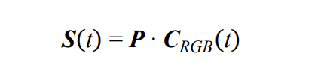
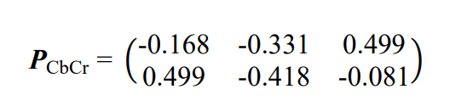
Related work
In our work, we extracted the rppg signal by using the model-based method, which is called Modified POS [3]
1
where S(t) is a 2 × N (N is the number of video frames) projected signal matrix
f
f
C (t) denotes a 3 × N temporal normalization of the RGB color matrix
RGB
f
P is a 2 × 3 projection matrix
[3] J. Ryu, S. Hong, S. Liang, S. Pak, Q. Chen, and S. Yan, “Research on the combination of color channels in heart rate measurement based on photoplethysmography imaging,” J. Biomed. Opt., vol. 26, no. 2, Feb 2021.
Notes:
For the related work, we used the modified pos method to extract the rppg signal, which is proposed by J. Ryu. et al.
To calculate the rppg signal, we need to calculate the projected signal matrix, or the matrix s from the first equation
To calculate matrix s you need to have the temporal … or crgb matrix and the projection matrix or matrix p
For the modified pos, matrix p is defined like this

Slide 10
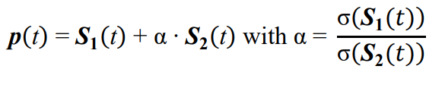

Related work
After obtain S(t) from equation 1, the rppg signal (p(t)) can be computed using equation 2
2
th
where S (t) is the i row of S(t)
i
$\text{σ}$(•) is the standard deviation operator
Notes:
After obtaining matrix s from the first equation, you can calculate the rppg signal by using equation number 2.
s1 and s2 denote the first and second row values in the matrix s
Alpha is calculated by dividing the standard deviation values of s1 and s2

Slide 11
03
Proposed method
Notes:
We will go to the next section, which is the proposed method

Slide 12
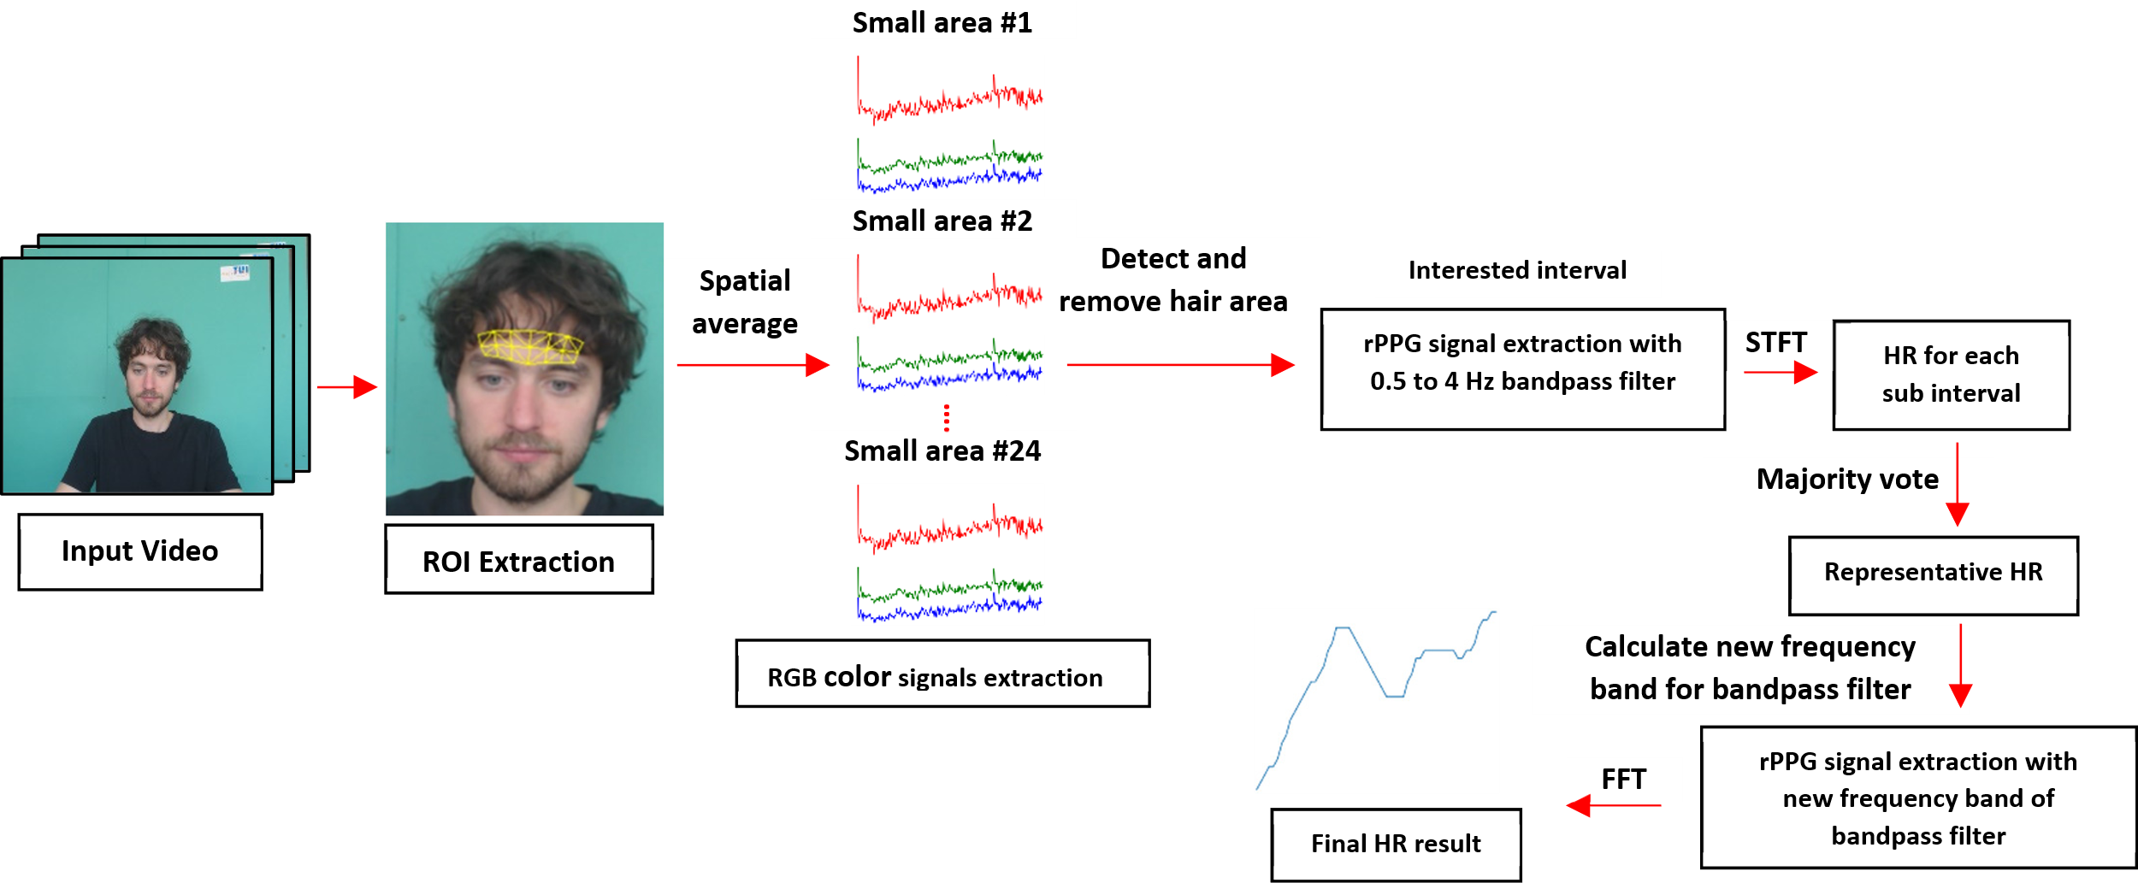
Overview of the proposed method
3. rPPG extraction and HR calculation
1. ROI Extraction
2. Raw RGB color signal extraction and hair area detection
4. Find optimum rPPG frequency band using the majority vote
Notes:
This is the overview of the proposed method in our work
we will divide it into 4 parts,
The first one is roi extraction, the second is raw rgb extraction and hair area detection, the third is rppg extraction and hr calculation, and the last one is how to optimize the rppg frequency band by using the majority vote

Slide 13
ROI Extraction
The MediaPipe Face Mesh model [4] was used to detect and track the subject’s face, the ROI can be created by selecting the facial landmark points
In this work, the experiments were tested on the two types of forehead ROI
  Whole forehead ROI
  Small areas of the forehead ROI
[4] Y. Kartynnik, A. Ablavatski, I. Grishchenko, and M. Grundmann, “Real-time facial surface geometry from monocular video on mobile GPUs,” July 2019, arXiv:1907.06724.
Notes:
To extract the roi, the mediapipe face mesh model was used to detect and track the subject’s face.
The facial landmark points were then created from this model.
The roi can be created by selecting those facial landmark points
In our work, we experiment on two types of forehead roi

Slide 14
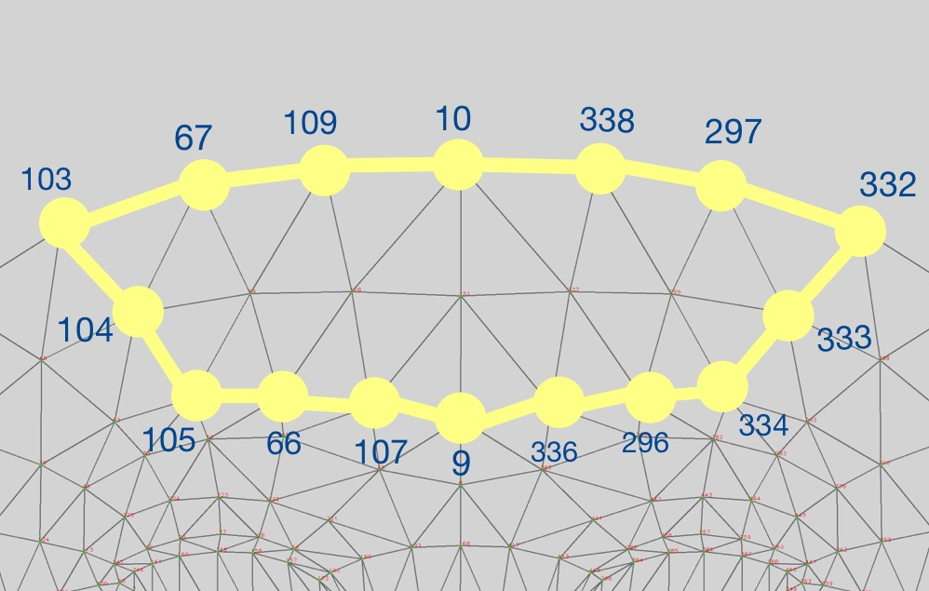
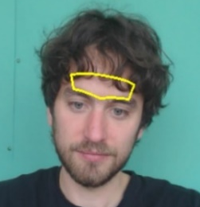
Whole forehead ROI
This is the conventional forehead ROI that was used to extract the rppg signal in many works in the past
The whole forehead ROI is created by enclosing the facial landmark numbers 9, 10, 66, 67, 103, 104, 105, 107, 109, 296, 297, 332, 333, 334, 336, 338, as shown in Fig. 1 (a)
The subject’s hair may cover some parts of the ROI, as shown in Fig. 1 (b)
(a)
(b)
Fig. 1. The whole forehead ROI.
(a) the ROI created by enclosing the selected facial landmark points, (b) the whole forehead ROI on the subject’s face
Notes:
The first one is called the whole forehead ROI which is the roi that was used to extract the rppg signal from the forehead in the past
This roi is shown in fig 1a and 1b where the subject’s hair may cover some parts of the roi

Slide 15
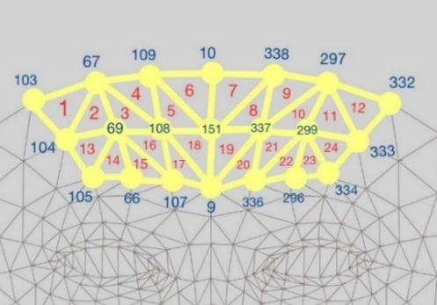
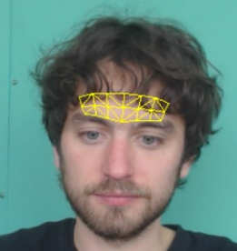
Small areas of the forehead ROI
The small areas of the forehead ROI are created by dividing the whole forehead ROI into 24 small areas, as shown in Fig. 2 (a)
The rppg signal will be extracted from each area rather than the whole area
Fig. 2 (b) shows some small triangle areas covered by the subject’s hair, these allow us to detect and remove the hair areas
(a)
(b)
Fig. 2. Small area of the forehead ROI.
(a) the ROI created by enclosing the selected facial landmark points, (b) the small area of the forehead ROI on the subject’s face
Notes:
The second one is the roi that we proposed which is called the small areas of the forehead roi.
This roi is created by dividing the whole forehead roi into 24 small areas, as shown in fig 2a
The rppg signal will be extracted from each small area, these allow us to detect and remove the hair area

Slide 16
Raw RGB color signal extraction and hair area detection
Hair area(s)
Remove
24 small areas from the small areas of the forehead ROI
Spatial average
Hair detection
Skin area(s)
Collect
Average of the RGB color values in each video frame
**In this work, only the subjects with black-colored hair are considered**
Ha
r
Notes:
To extract raw rgb color signal, the average of the rgb color in each video frame is extracted from those 24 small areas by using the spatial average technique
The hair area will be removed, and the skin area will be used to extract the rppg signal
Note that we will focus on the subjects with black-colored hair only

Slide 17
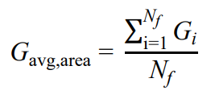
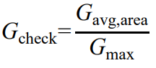
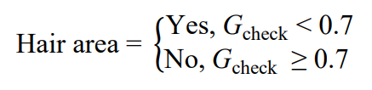

Hair detection
ra
The green color signal, which has a strong component of pulse signal [5] is used for detecting the hair area
Find the average value of the green color signal in the interest interval of each area
Find the largest value of the average green color signal between those areas
Normalized green color value in each area
Check if it is a hair area or not
3
4
5
6
[5] L. F. Corral Martinez, G. Paez, and M. Strojnik, “Optimal wavelength selection for noncontact reflection photoplethysmography,” in 22nd Congress of the International Commission for Optics: Light for the Development of the World, 2011.
Notes:
The green color signal will be used as the input of our hair detection algorithm
Equation 3 is used to calculate the average value of the green color signal in the interest interval of each area.
Find which area has the largest value by using equation 4, normalize the green color value in each area using equation 5.
And equation 6 will be used to find which area is a hair area or a skin area

Slide 18
rPPG extraction and HR calculation
The modified POS method was used to extract the rppg signal in each skin area
1
2
rPPG signal
** We need to find the Matrix
Notes:
After we obtain the skin area, the modified pos method was used to extract the rppg signal in each skin area, by using equations 1 and 2 from the relate work
For equation 1, we already have the projection matrix, or matrix p, so we just need to find the temporal normalize matrix, or matrix Crgb from the video

Slide 19
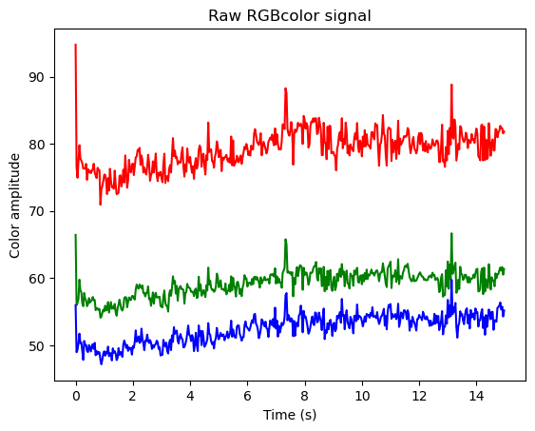
How to create interest interval
Remove (1s)
Interval
……
Adding (1s)
Notes:
In our work, we want to find the rppg signal and hr from the interest interval of the skin area
Each interval has ten seconds, or 300 video frames, of raw rgb color signal data, this interval will be used to calculate the matrix crgb.
The interval is updated each second by removing the first 1s data from the beginning of the interval and adding the new 1s data to the end of the interval. And so on
This process is applied to every skin area

Slide 20
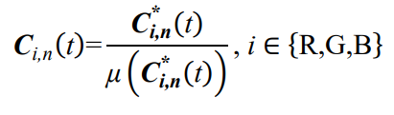

rPPG extraction and HR calculation
How to calculate the temporal normalization matrix
7
where C_{i,n}(t) is the normalized RGB color signals
${\text{C}}_{\text{i}\text{,}\text{n}}^{\text{∗}}\left(\text{t}\right)$ is the raw RGB color signals
µ(•) denotes the operator used to find the average value
subscript n denotes the values of the n^{th} skin area
The temporal normalization of the RGB color matrix is then created as C_{RGB,n}(t) as shown below
8
Notes:
To calculate the matrix crgb, first we need to normalized rgb color by using equation 7.
Where c star is the raw rgb color in the interest interval, miw is the operator used to find the average value, and subscript n denotes the skin area index.
The matrix crgb of each skin area is then created from equation 8

Slide 21
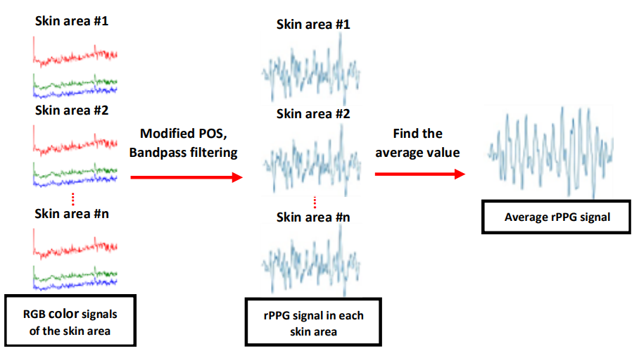
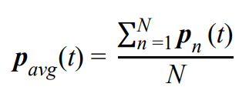
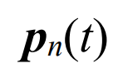
rPPG extraction and HR calculation
Overview of the rPPG signal extraction process
9
The bandpass filter with order = 3 and passband frequency of 0.5 – 4 Hz, corresponding to a heart rate of 30-240 beats per minute (BPM) is used to filter the rPPG signal of each skin area
Notes:
The modified pos with matrix crgb from the previous page and the bandpass filter with passband frequency equal to 0.5-4 hz are used to obtain the rppg signal in each skin area
After that, the average value of the rppg signal or p average is obtained by using equation 9 (upper case n is the total number of skin area)

Slide 22

rPPG extraction and HR calculation
HR is computed by applying an 1800-point Fast Fourier Transform (FFT) to p_{avg}(t)
The frequency component that has the highest amplitude is considered as HR in Hz.
HR in BPM is obtained by multiplying the frequency with 60
10
where f_{max} is the frequency component having the highest amplitude
Notes:
HR is computed by applying an 1800-point fft to the p average to find the frequency component that has the highest amplitude.
Equation 10 is used to obtain hr in bpm, where fmax is the frequency component having the highest amplitude

Slide 23
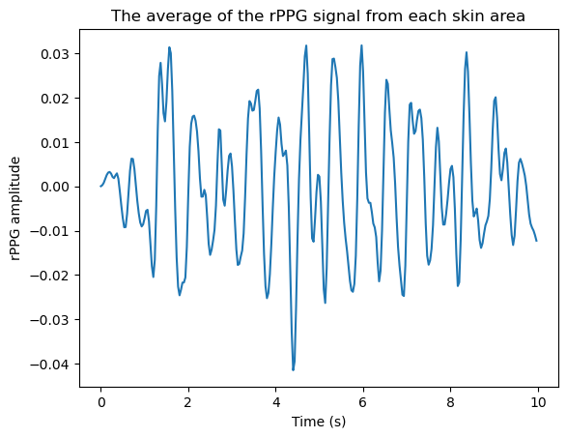
Find optimum rPPG frequency band using the majority vote
Short Time Fourier Transform (STFT) with nperseg = 90 (3 seconds), noverlap = 75, and nfft = 1800 is used to divide the 10-sec average rPPG signal, p_{avg}(t), into 15 subintervals
The HR of each subinterval is calculated using equation 10
Sub interval #1
HR#1
Sub interval #15
HR#15
……
Sub interval #2
HR#2
Remove (0.5s)
Adding (0.5s)
Notes:
To optimize the rppg frequency band using the majority vote, first the stft with these settings is applied to the interest interval of the p average and the p average is divided into 15 subintervals.
Each subinterval has 3 seconds data
The subinterval is updated by removing the first 0.5s data from the beginning of the subinterval and adding the new 0.5s data to the end of the subinterval
The HR of each subinterval is then computed by using equation 10

Slide 24
Find optimum rPPG frequency band using the majority vote
HRs from subintervals are then divided into multiple groups with the same size, starting from 5
The majority vote is determined by counting the number of HR values in each group
The group with the highest count is voted as the majority group
The representative HR (rHR) is the middle value of the majority group
If multiple majority groups are found, the size of the group increases until a single majority group is found
70-74 BPM
75-79 BPM
80-84 BPM
85-89 BPM
70-74 BPM
75-79 BPM
80-84 BPM
85-89 BPM
70-79 BPM
80-89 BPM
Majority group
1
2
10
2
1
5
5
4
6
9
Majority group
Notes:
The hr values from each subinterval were then divided into multiple groups with the same size, starting from 5
Then the majority vote is determined by counting the number of HR values in each group
The group highest count is vote as the majority group
For example, if we have a HR value divide into groups like this
In this case, the majority group is the group that has a HR value between 80 and 84.
The majority group was then used to find the representative HR (rHR), which is the middle value of the majority group.
However, if we obtain multiple majority groups, we will increase the size of the group until a single majority group is found.
For example, if we divide the group and count the HR values like this, the size will increase from 5 to 10, and we can obtain the majority group.

Slide 25


Find optimum rPPG frequency band using the majority vote
The rHR is used to set the upper and lower cut-off frequencies (f_{high} and f_{low}) of the bandpass filter using equation 11 and 12.
11
12
Notes:
The rHR from the majority group is then used to calculate the new upper and lower cut-off frequencies of the bandpass filter by using equations 11 and 12.

Slide 26
rPPG extraction and HR calculation
*
*
9
The bandpass filter with order = 3 and passband frequency of f_{low} – f_{high} Hz, is used to filter the rPPG signal of each skin area
*
The final HR is computed by applying an 1800-point FFT to the p_{avg}(t) and using eq. 10 to obtain the final HR in BPM
*
Notes:
To extract the rppg signal and calculate hr after using the majority vote, most of the process is the same but the passband frequency will change into flow and fhigh instead of 0.5 and 4 hz
With this process, we obtain the new average rppg signal, the p-star average
The final hr is then computed by applying 1800 fft to the p star average and using equation 10 to obtain hr in bpm

Slide 27
04
Result and discussion
Notes:
We will go to the result and discussion

Slide 28
Hair detection result
Table 1: Number of correct detected: wrong detected: actual hair areas
Subject ID | correct detected: wrong detected: actual hair areas
#5 | 10:3:12
#10 | 2:1:4
#14 | 2:5:3
#23 | 4:0:4
#30 | 10:1:11
#32 | 6:2:6
#35 | 2:1:5
Notes:
On this page, table 1 shows the comparison between the number of correctly detected, incorrectly detected and the actual hair areas from our hair detection.
As seen in this table, most subjects have a number of correct detected hair areas close to the number of actual hair areas
These results show our hair detection can detect hair area correctly
However, our hair detection also has errors due to misinterpreting some skin areas as hair areas, as seen from the wrong detected hair area number

Slide 29
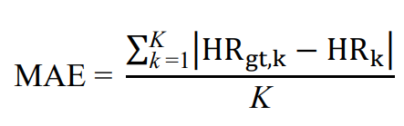
Evaluation metric
Mean absolute error (MAE)
  Show the average of the absolute error values
13
Notes:
For the evaluation metric, we use the mean absolute error, or mae
This metric measures the average of the absolute error value
In our case, we measure the absolute error between the ground truth hr and the result hr, as shown in equation 13

Slide 30
HR results from each method
Table 2: HR results from each method
Subject ID | MAE (bpm) ± std
 | Whole forehead ROI (forehead ROI with hair) | Small areas of the forehead ROI (only hair detection) | Small areas of the forehead ROI (hair detection with majority vote)
#5 | 0.60 ± 0.18 | 0.69 ± 0.2 | 0.73 ± 0.15
#10 | 0.48 ± 0.17 | 0.41 ± 0.15 | 0.46 ± 0.17
#14 | 2.20 ± 2.42 | 2.17 ± 2.49 | 2.13 ± 2.28
#23 | 0.57 ± 0.37 | 0.51 ± 0.36 | 0.61 ± 0.29
#30 | 0.49 ± 0.21 | 0.40 ± 0.17 | 0.36 ± 0.15
#32 | 6.81 ± 12.94 | 5.16 ± 9.86 | 3.94 ± 7.70
#35 | 1.10 ± 1.49 | 1.03 ± 1.45 | 1.04 ± 1.56
Conventional forehead roi
Our proposed method
Notes:
On this page, the mae of the hr result from each method is shown in Table 2
After using our proposed method, the MAE of the HR results of most subjects improved when compared to the results obtained from the forehead ROI with hair
However, the MAE results in some subjects were not improved due to the misinterpretation in our hair detection that caused some skin areas to be removed.
And when those skin areas were removed, it meant we lost the pulse component from those areas, which can affect the accuracy of the rppg signal and hr result

Slide 31
05
Conclusion and future work
Notes:
We will go to the conclusion and future work

Slide 32
Conclusion
We have proposed a method to improve the accuracy of the estimation of HR from the rPPG signal obtained from the forehead ROI by using our hair detection algorithm and using the majority vote
The MAE of the HR results of most subjects improved when compared to the MAE of the HR results obtained from the forehead ROI before removing the hair areas and using the majority vote
The results show that hair areas and the sudden change in ambient light in facial videos can affect the result of the HR calculated from the rPPG signal and must be removed
Notes:
To be conclude, …

Slide 33
Future work
We will improve the computation time of our proposed method
We will then deploy our proposed method to improve the heart rate variability (HRV) from the rPPG signal
Notes:
For the future work, we want to improve the computation time of our work
And we want to deploy our work to improve another feature call hrv that calculate by finding the peak in the rppg signal

Slide 34
06
QUESTION & ANSWER
sf
ex
cs

Slide 35
THANK YOU

Slide 36
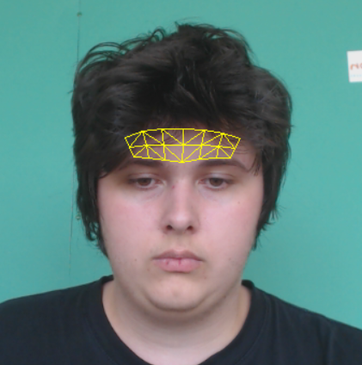
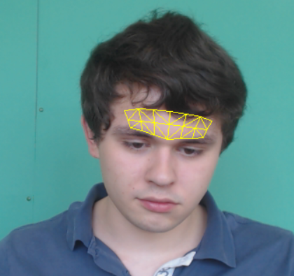
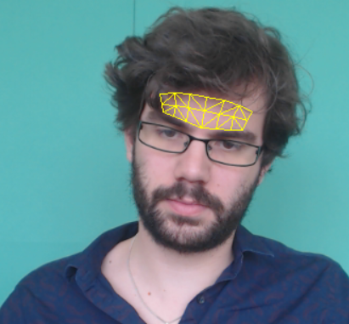
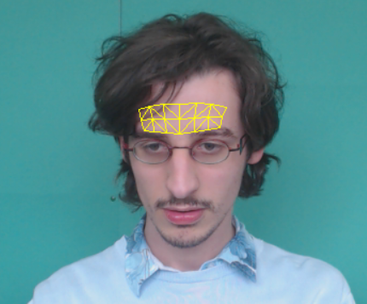
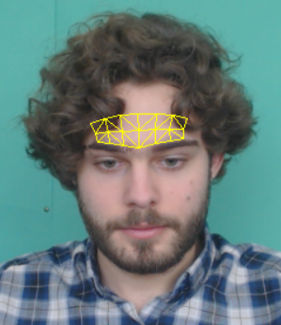
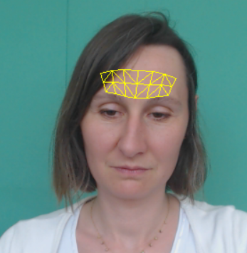
The small areas of the forehead ROI on subject face
qa
#5
#10
#14
#23
#30
#32
#35

Slide 37
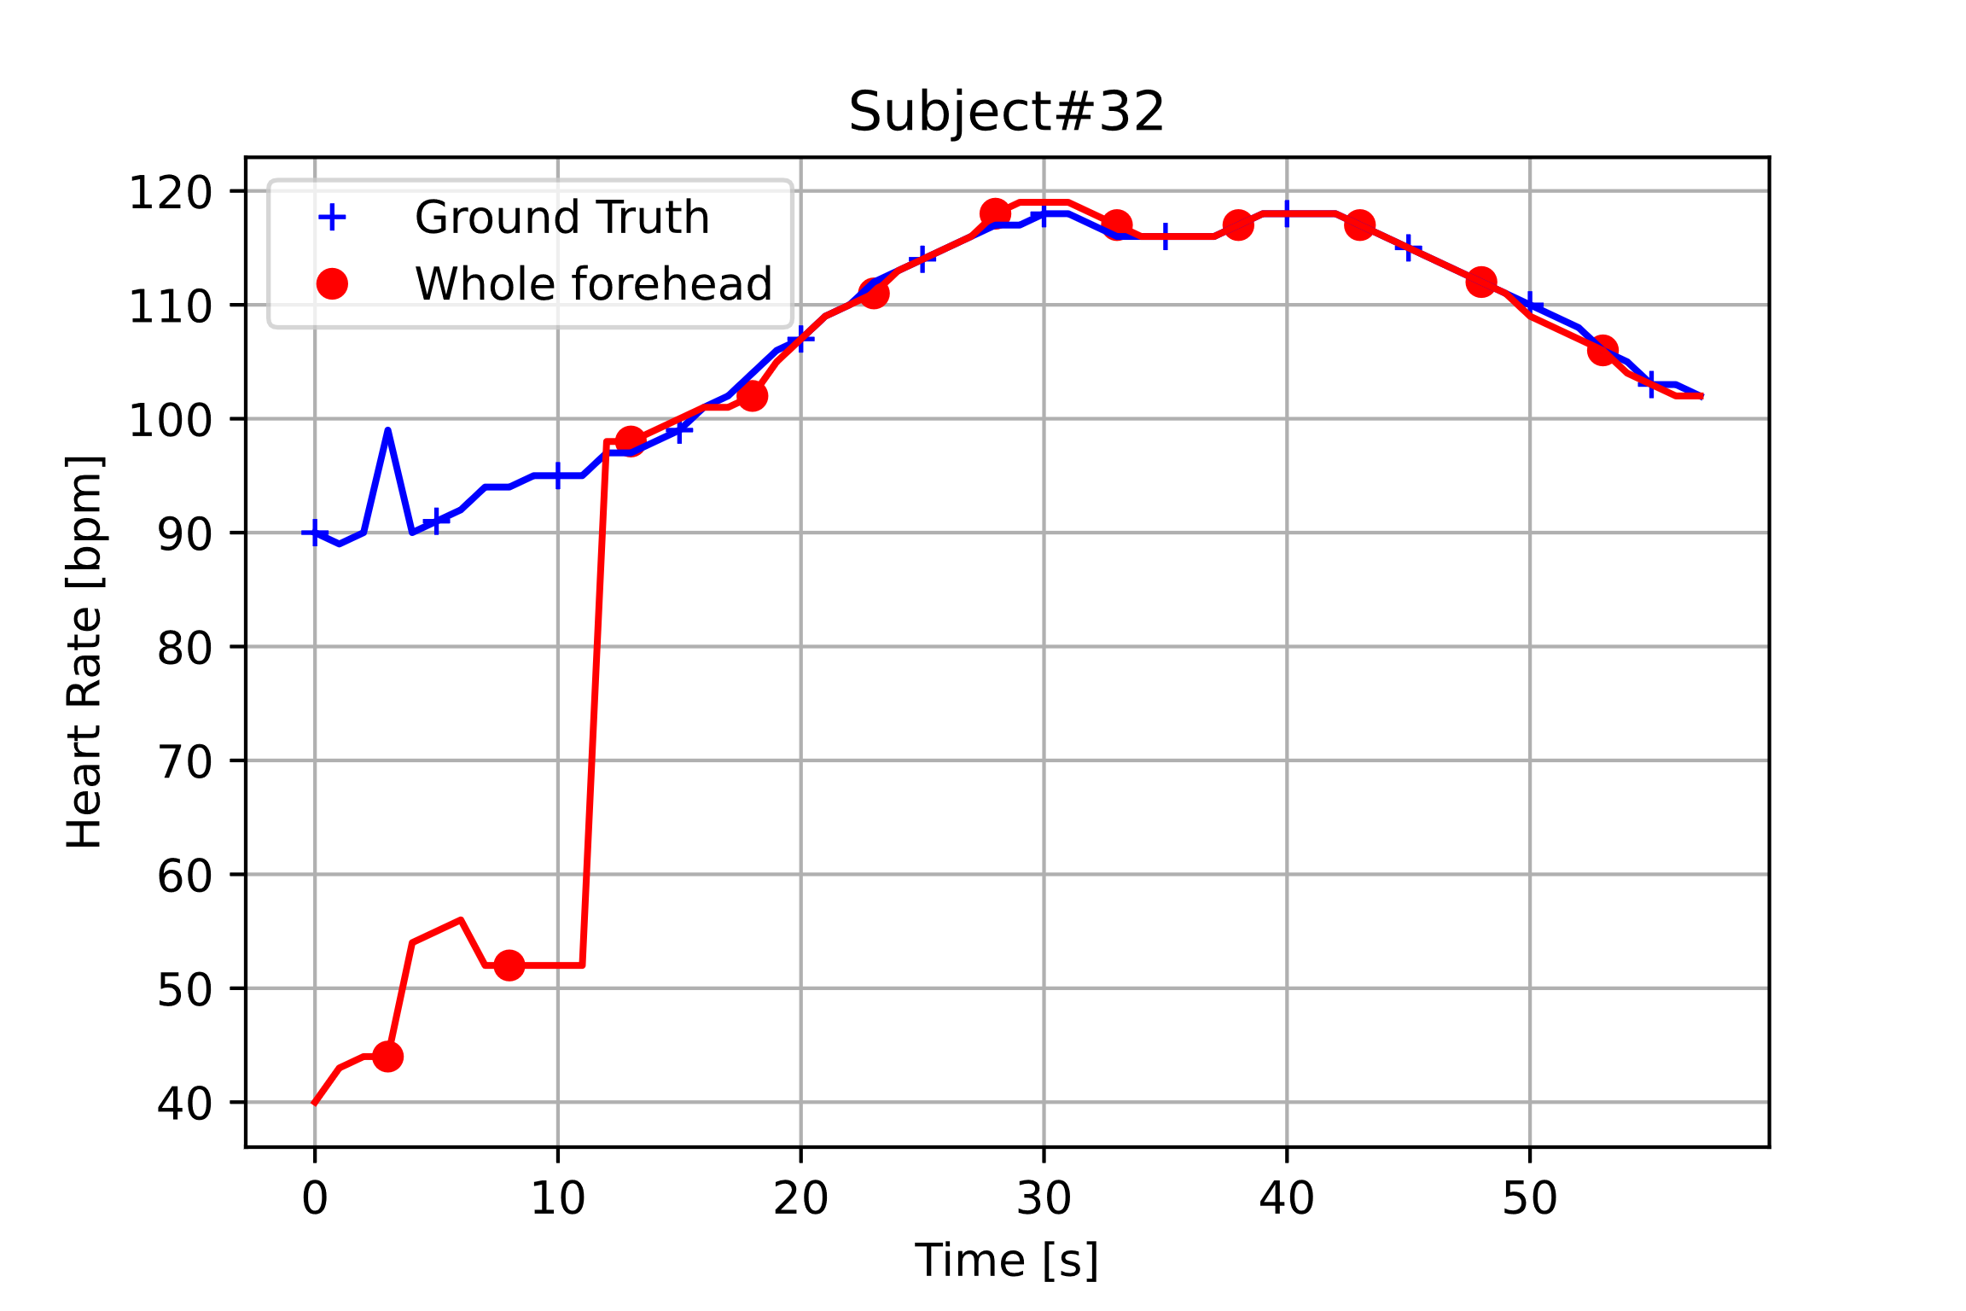
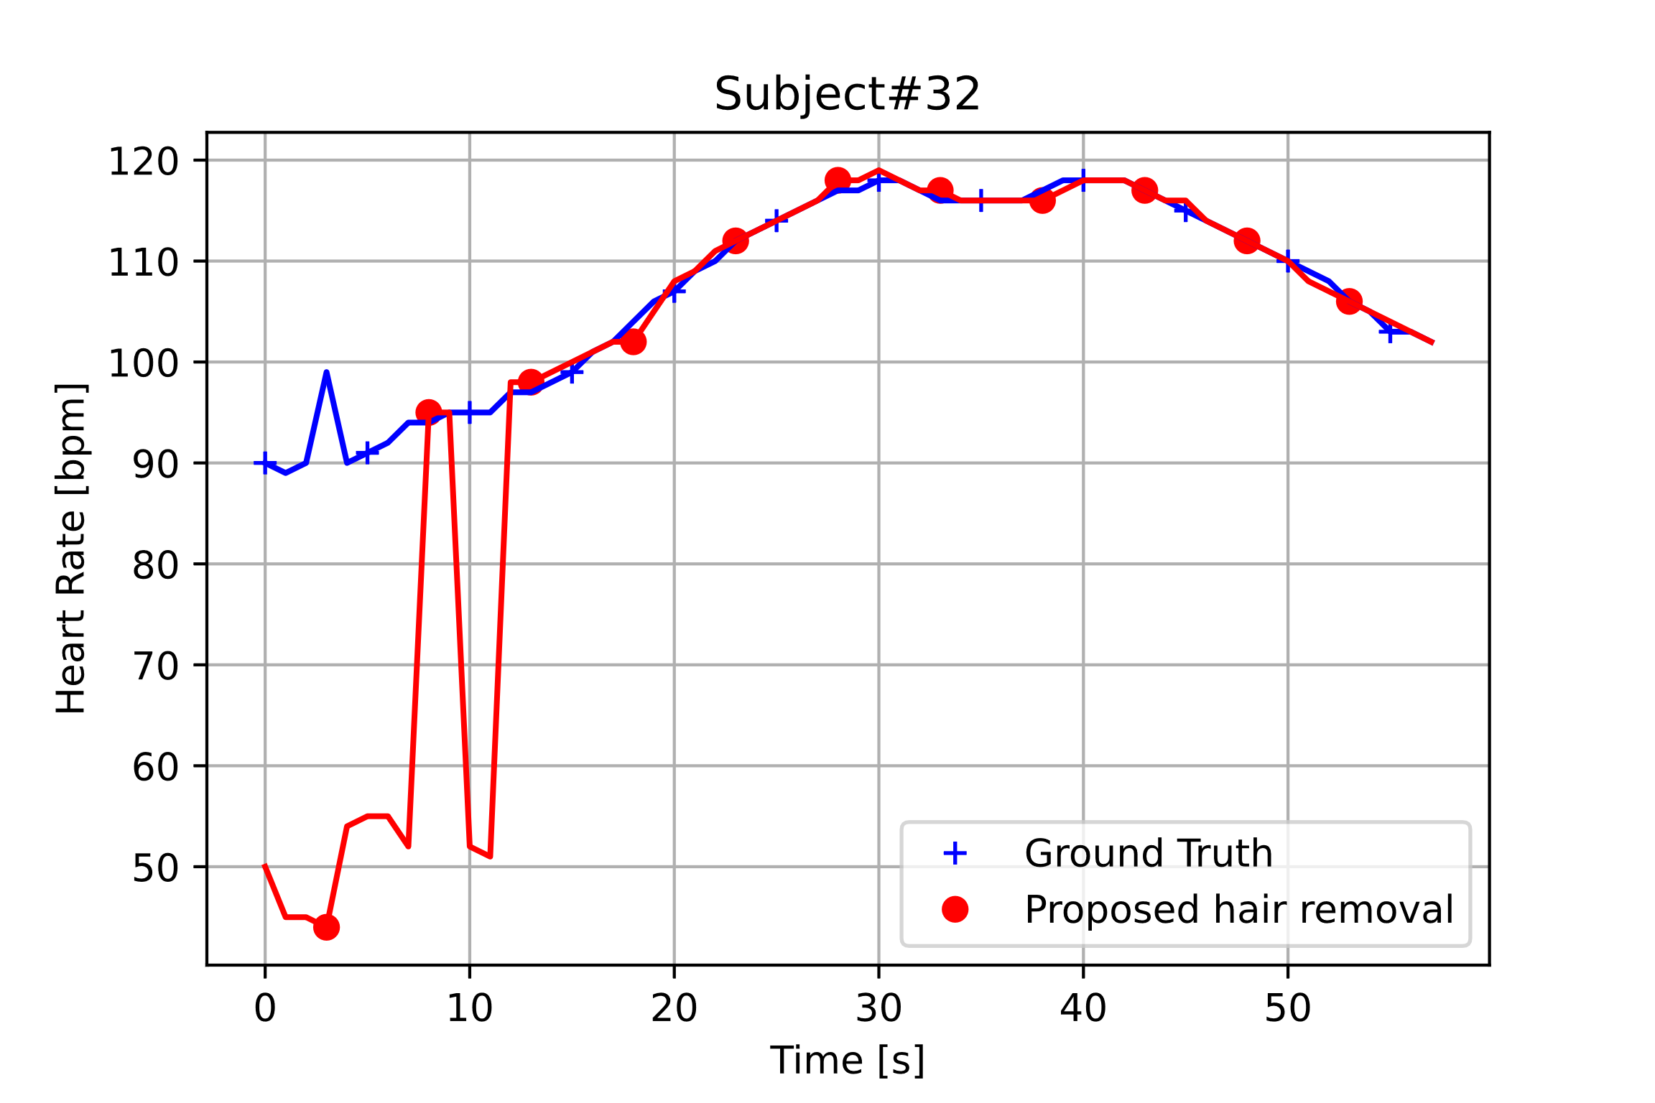
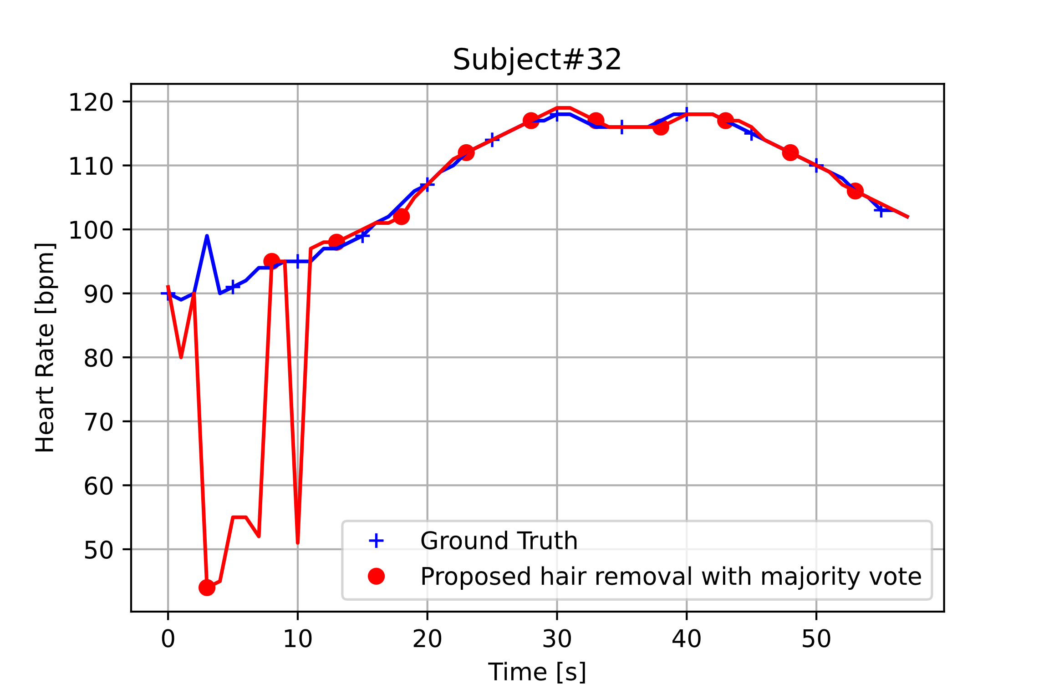
The comparison between HR result and ground truth HR
(a)
(b)
(c)
Fig. 3. Subject #32's HR results from each method with ground truth. (a) Whole forehead ROI ( forehead ROI with hair), (b) Small areas of the forehead ROI (using only our hair detection algorithm), and (c) Small areas of the forehead ROI (using our hair detection algorithm together with majority vote)

Slide 38
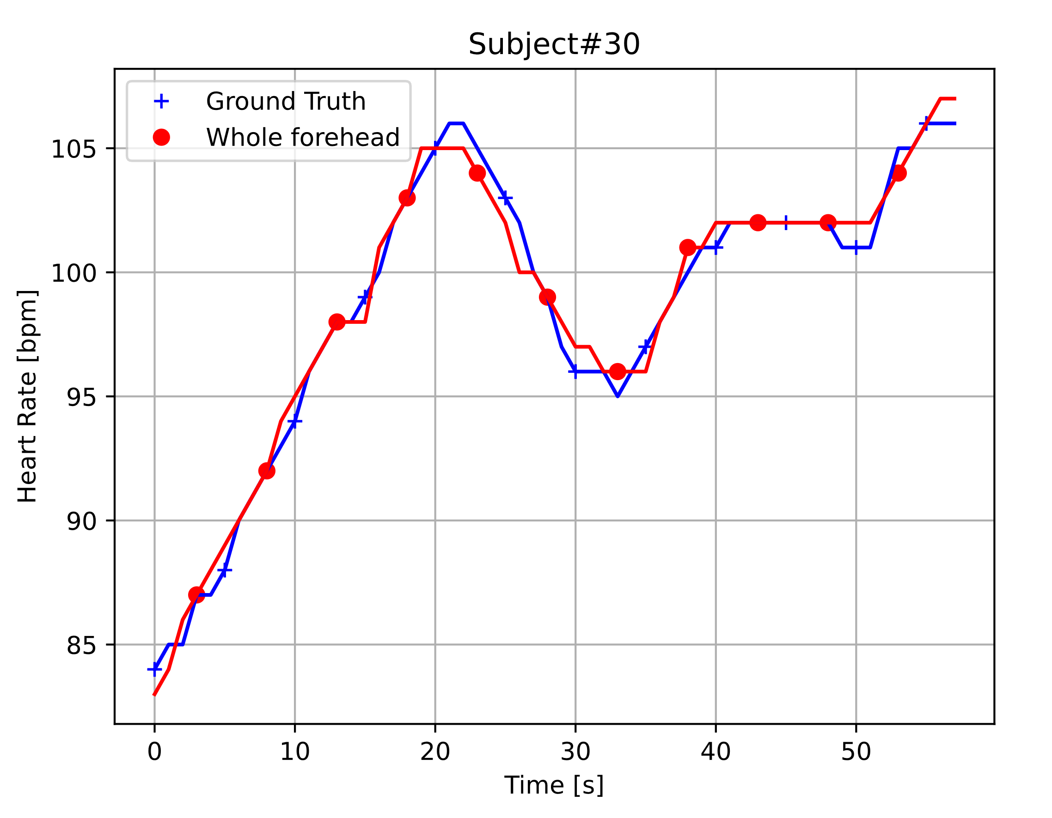
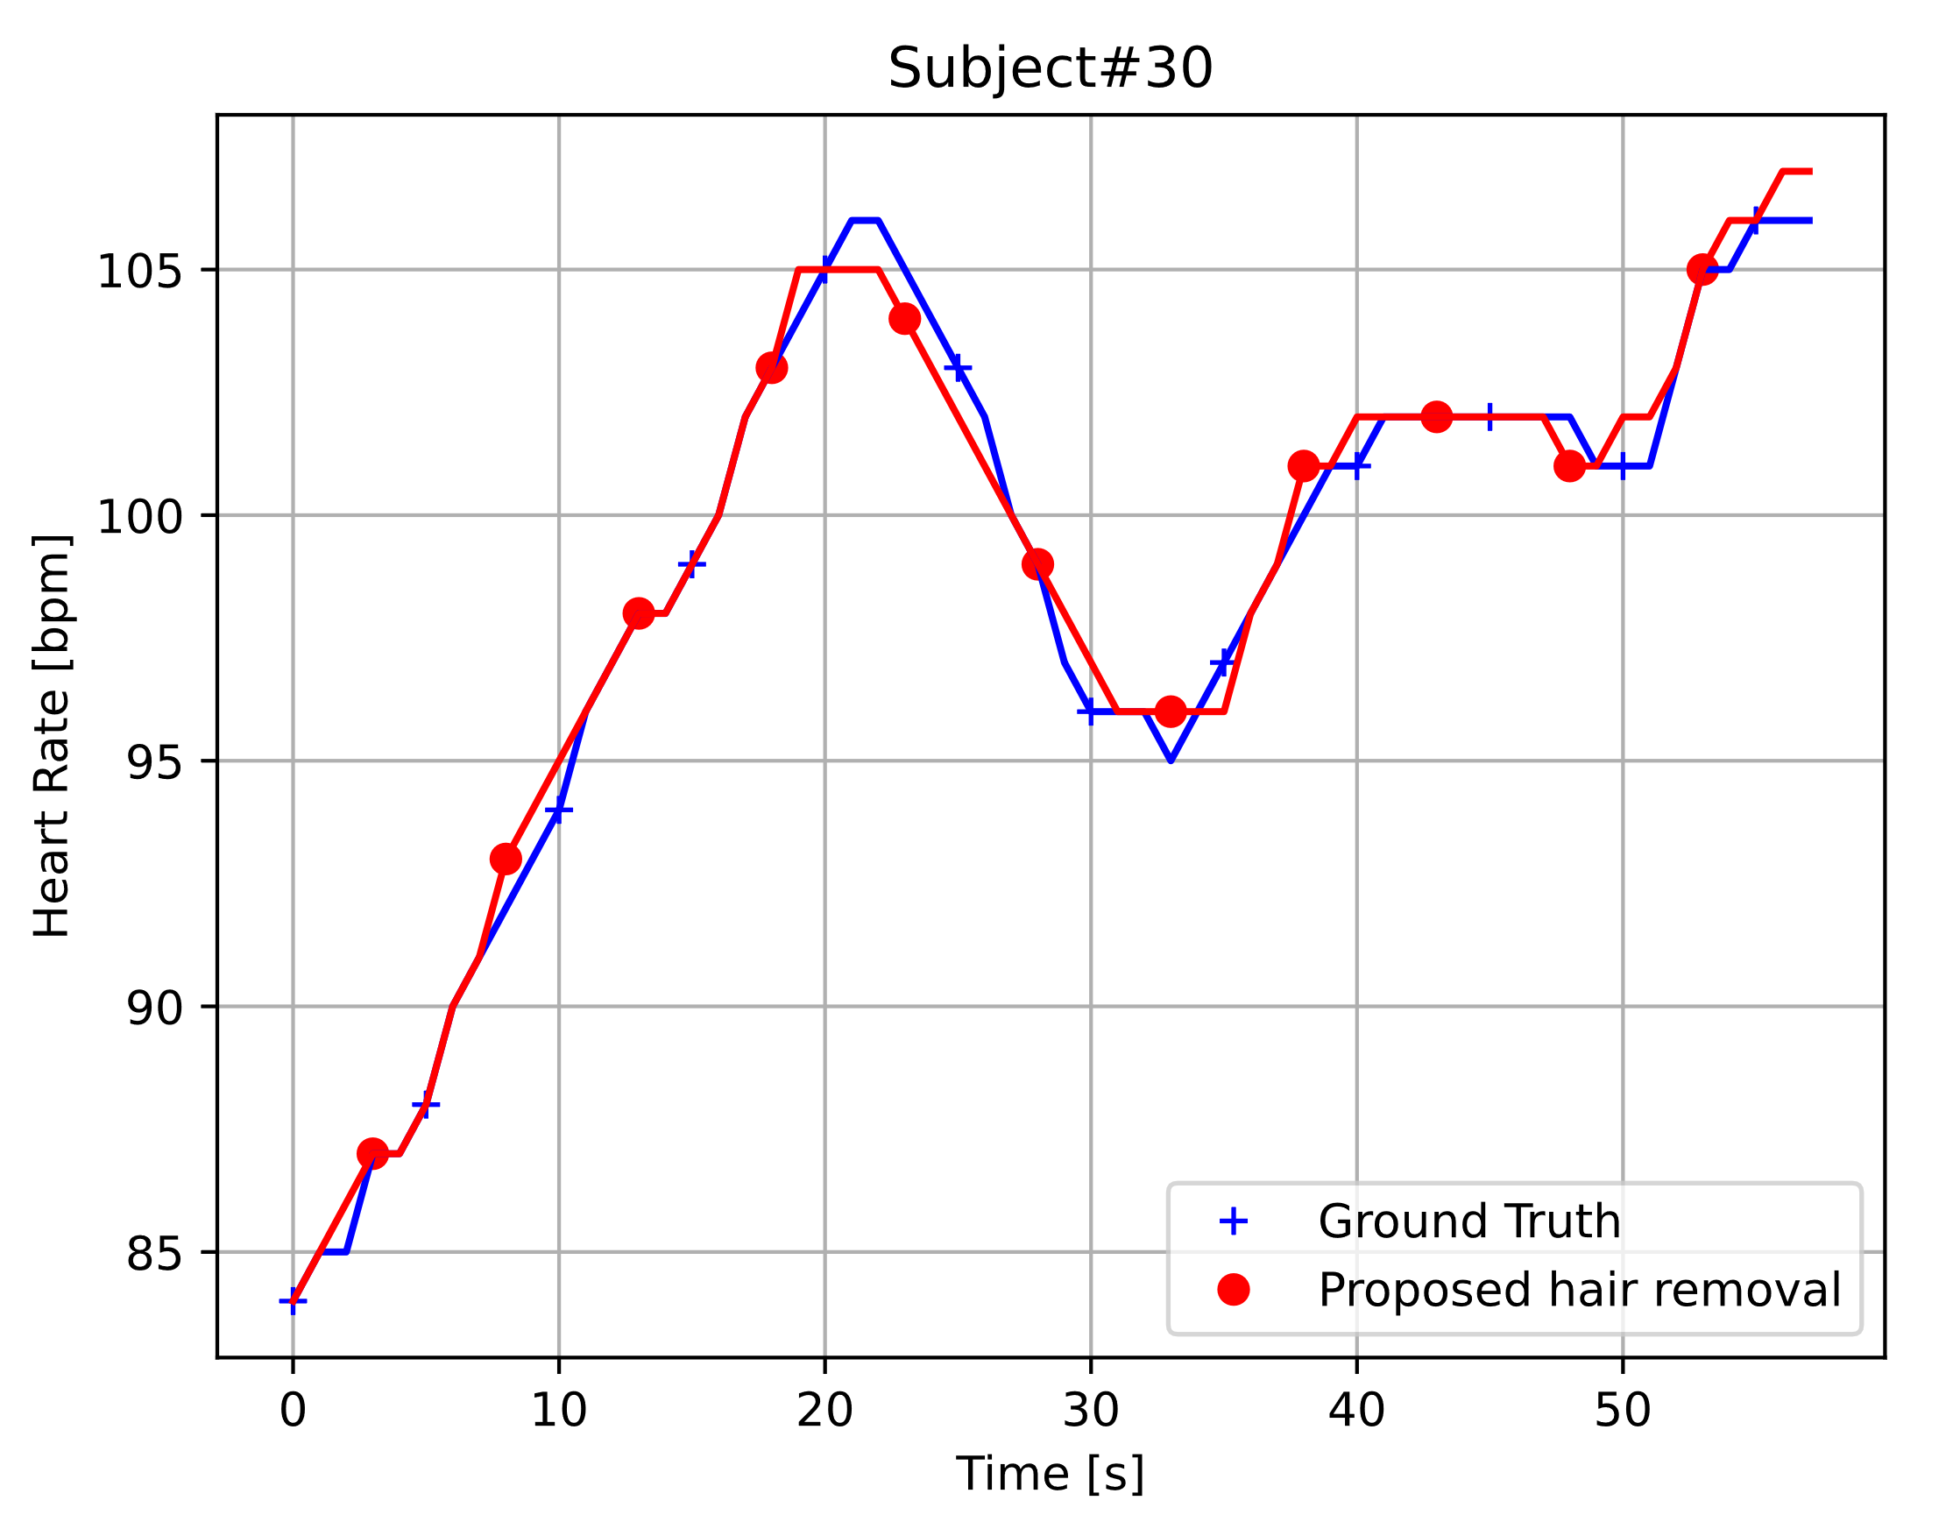
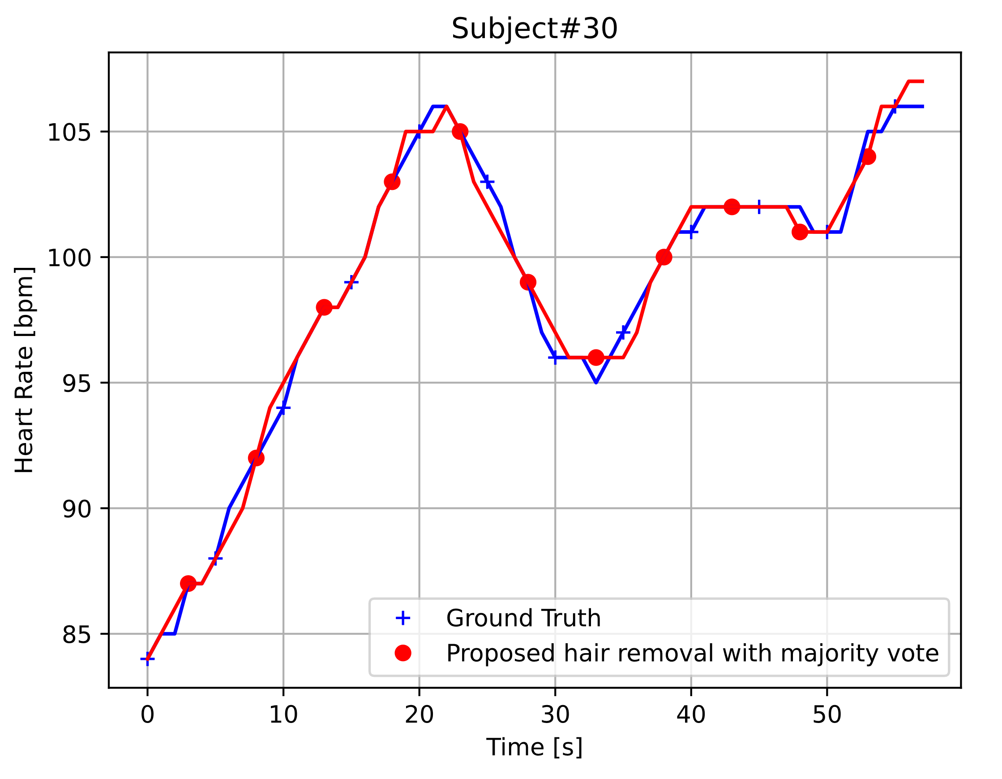
The comparison between HR result and ground truth HR
qa
(a)
(b)
(c)
Fig. 4. Subject #30's HR results from each method with ground truth. (a) Whole forehead ROI ( forehead ROI with hair), (b) Small areas of the forehead ROI (using only our hair detection algorithm), and (c) Small areas of the forehead ROI (using our hair detection algorithm together with majority vote)

Slide 39
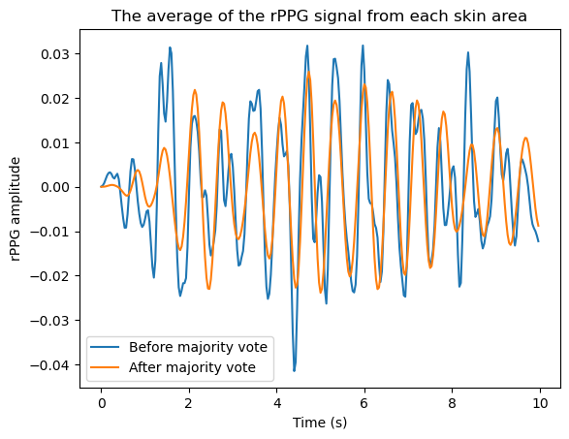
The comparison of the rppg signal between before and after using the majority vote
qa
Fig. 5. The comparison of the rppg signal between before and after using the majority vote

