Slide 1



Player Optimal Positioning Analysis Using FIFA Video Game Data and Classification Models
Sifat Tanvir
Tasmia Shakerin
Department of Computer Science and Engineering
Brac University, Dhaka, Bangladesh
The 20th International Joint Conference on Computer Science and Software Engineering
28th June-1st July 2023
Naresuan University Phitsanulok, THAILAND

Slide 2
Motivation
National team positions vs club positions
Are the players playing at the right positions?
Best position for each player to play in

Slide 3
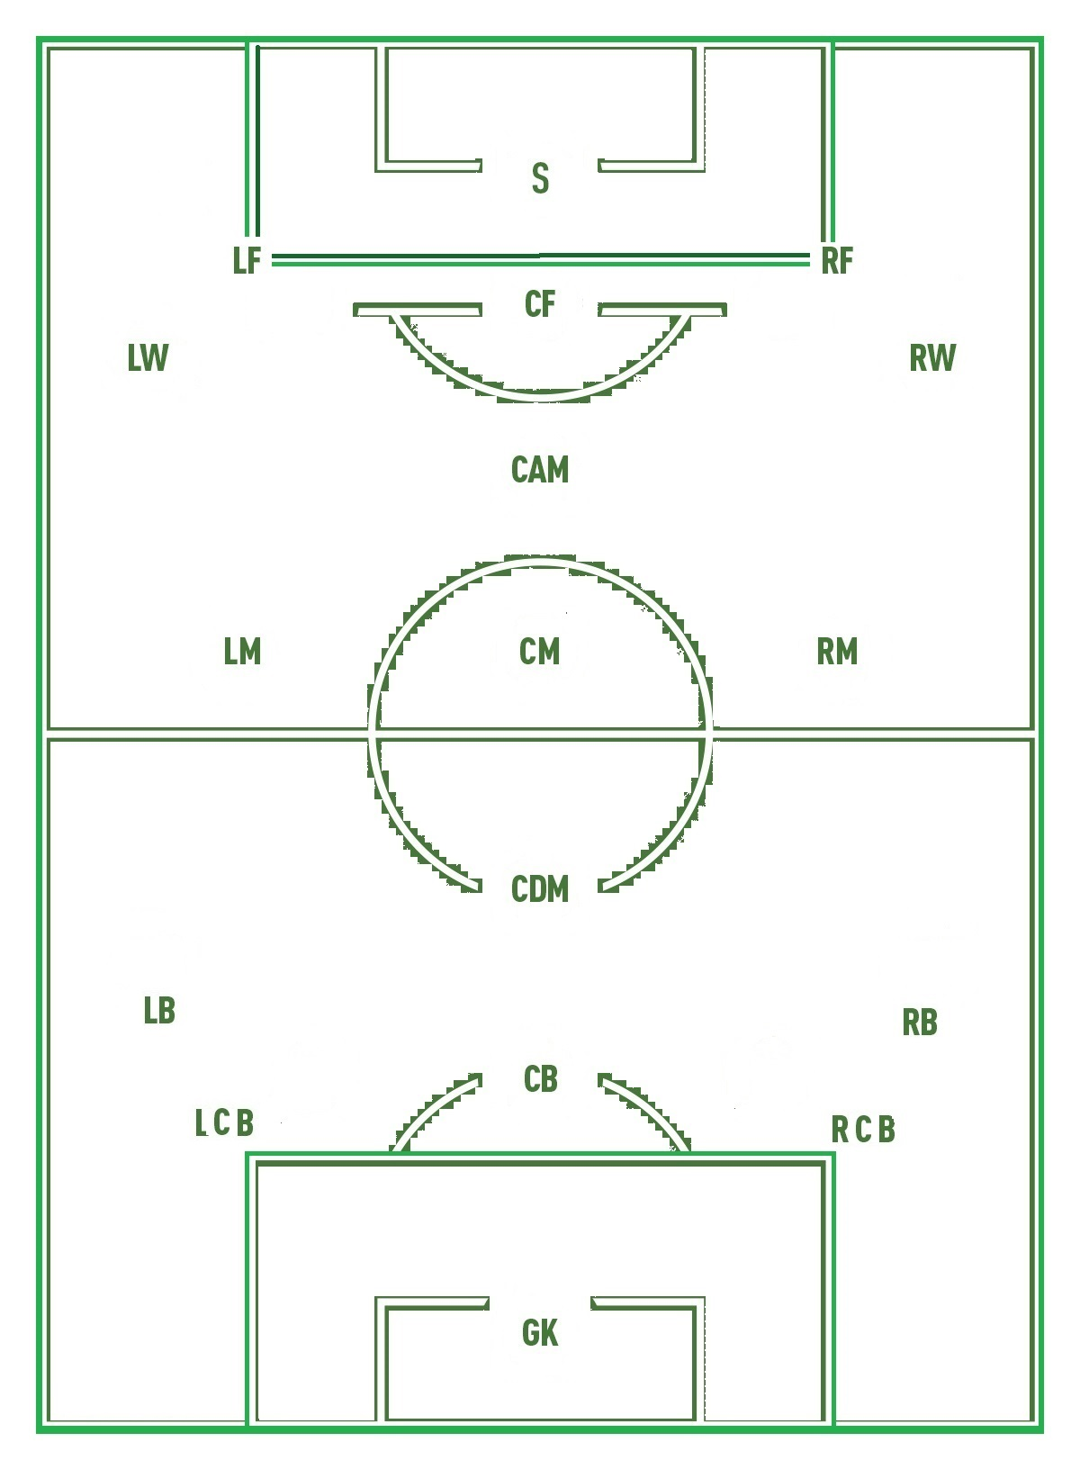
Football Player Positions
Position | Sub-Position | Sl | Full Form of Sub-Position
Forward | LW | 1 | Left winger
 | RW | 2 | Right winger
 | CF | 3 | Center forward
 | RF | 4 | Right forward
 | LF | 5 | Left forward
 | S | 6 | Striker
Mid-fielders | LM | 7 | Wide left midfielder
 | RM | 8 | Wide right midfielder
 | CM | 9 | Central midfielder
 | CDM | 10 | Defensive midfielder
 | CAM | 11 | Attacking midfielder
Defenders | RCB | 12 | Right corner back
 | LCB | 13 | Left corner back
 | RB | 14 | Right back
 | LB | 15 | Left back
 | CB | 16 | Center back
Goal-Keeper | GK | 17 | Goal keeper

Slide 4
Dataset
FIFA 22 Complete Player Dataset
Every Player Statistics Available in FIFA 15-22
10.0 Usability
100+ Physical and Psychological Attributes such as
  Height, weight, age, stamina, vision
  Dominant feet, weak foot, pace
  Shooting, passing, dribbling, long shot
  Composure, aggression, positioning
  Tackling, sliding, diving, jumping, balancing
Attributes Reflect Real-Life Characteristics

Slide 5
Preprocessing
Feature Selection
  67 Features used out of 110
Deliberate Removal of Classes
  “RES” and “SUB”
Categorical Class Reduction
  Combining Overlapping Classes
Categorical Feature Encoding

Slide 6
Narrowing Down the Possibilities
Previous Position | Updated Position
Central Defensive Midfielder (CDM) | Central Midfielder (CM)
Left Central Midfielder (LCM) | Central Midfielder (CM)
Right Centre Midfielder (RCM) | Central Midfielder (CM)
Left Defensive Midfielder (LDM) | Defensive Midfielder (CDM)
Left Striker (LS) | Left Forward (LF)
Right Striker (RS) | Right Forward (RF)
Right Wing Back (RWB) | Right Back (RB)
Right Attacking Midfielder (RAM) | Attacking Midfielder (CAM)
Left Attacking Midfielder (LAM) | Attacking Midfielder (CAM)

Slide 7
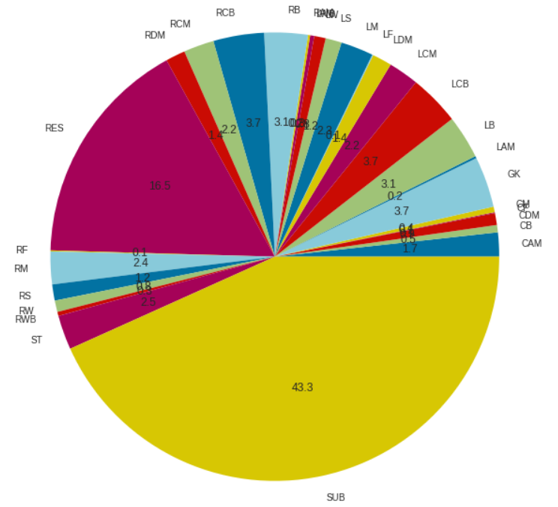
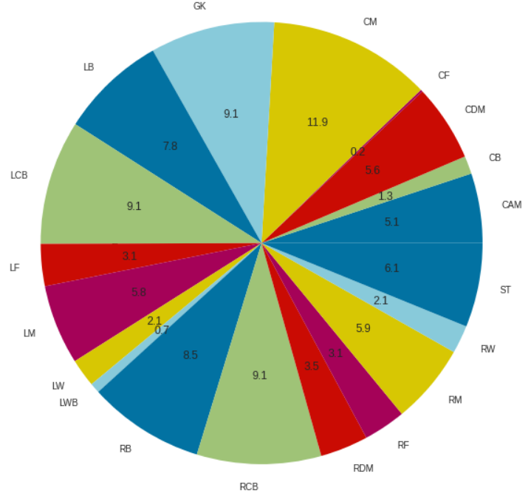
Class Distribution
Before Deliberate and
Categorical Class Reduction
After Deliberate and
Categorical Class Reduction

Slide 8
Classification Model Accuracy
Classification Models Applied
Random Forest
Decision Tree
KNN
Naïve Bayes
Accuracy | Random Forest | Decision Tree | KNN | Naïve Bayes
Without Categorical Class Reduction | 45.54% | 40.44% | 33.13% | 27.72%
With Categorical Class Reduction | 61.19% | 57.38% | 50.54% | 48.39%

Slide 9
Club Positions vs Predicted Positions
Player Name | Club Position | Predicted Position
Lionel Messi | RW | RM
Robert Lewandowski | ST | ST
Cristiano Ronaldo | ST | ST
Neymar Jr | LW | LM
Kevin De Bruyne | RCM | RCM
Kylian Mbappé | ST | ST
M. Neuer | GK | GK
Mohamed Salah | RW | RM
Karim Benzema | CF | CAM
Sergio Ramos | LCB | LCB
Paul Pogba | CDM | CM
Luka Modrić | CM | CM

Slide 10
THANK YOU
QUESTION & ANSWER

