Slide 1

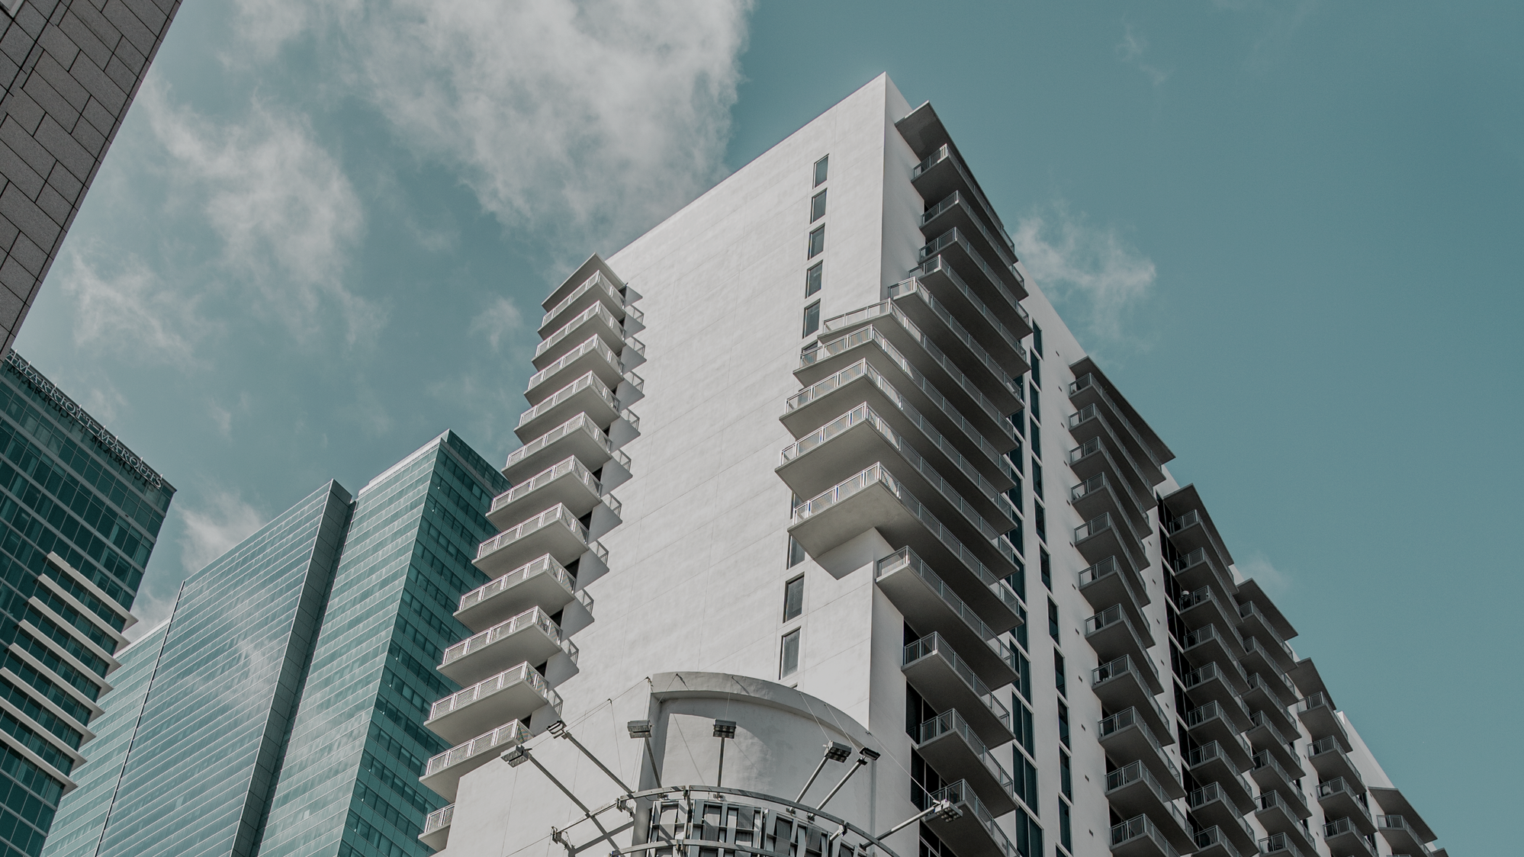



MACHINE LEARNING MODELS FOR CONDOMINIUM APPRAISAL WITH RESULT TUNING
THE 20TH INTERNATIONAL JOINT CONFERENCE ON COMPUTER SCIENCE AND SOFTWARE ENGINEERING
28TH JUNE-1ST JULY 2023 | NARESUAN UNIVERSITY PHITSANULOK, THAILAND
SAHASSAWAT POSUNGNERN
THE SIRINDHORN INTERNATIONAL THAI-GERMAN
GRADUATE SCHOOL OF ENGINEERING
KING MONGKUT’S UNIVERSITY OF TECHNOLOGY NORTH BANGKOK
Notes:
Good afternoon everyone, my name is Sahassawat Posungnern. Today, I will present about machine learning models for condominium appraisal with result tuning

Slide 2


OUTLINE
  Introduction
  Objective
  Method
  Result
  Conclusion
Notes:
This is the outline for this presentation

Slide 3
INTRODUCTION
Our observation
The condominium's sales will return to the same point as before the occurrence of COVID 19 [1]
Value
Cause
Landmark
Bangkok & Metropolitan
50 billion THB [1]
Chinese comeback [2]
[1] REIC (2022). https://www.reic.or.th/News/RealEstate/456647
[2] Wealth, THE STANDARD (2022). https://thestandard.co/china-condominium-purchase
Notes:
First, we observe from the forecast of condominium’s sales in 2023 from real estate information center that sales level will return to the same point as before the occurrence of COVID 19. Its value around 50 billion thai baht. Because of chinese comeback, who is the main customer for this market, and the main area for this market is bangkok and metropolitan

Slide 4

Random Forest
From decision tree, every tree has a high variance, but when we combine all of them in parallel, the resultant variance is low because each decision tree is perfectly trained on that specific sample data, and thus the output is dependent on multiple decision trees rather than one. The final output of a regression problem is the mean of all the outputs.
Notes:
Algorithms that usually used in real estate appraisal are Random Forest, XGBoost, and Deep Neural Network. Random forest combine multiple decision tree to decrease variance by each decision tree trained on individual sample data. The final output is the mean of all the outputs.

Slide 5
XGBoost
Or Extreme Gradient Boost
A model that takes Decision Tree to train multiple trees in succession. Each decision tree learns from the previous tree's errors, making prediction accuracy more and more accurate. When a tree is learned continually to a sufficient depth, the model stops learning when there are no more error patterns from the previous tree to learn.
Notes:
XGBoost or Extreme Gradient Boost a model that trained from decision tree in succession or learn from the previous tree’s errors to make prediction more and more accurate until reach a sufficient depth or no more errors from the previous tree.

Slide 6
Deep Neural Network
Deep neural networks are networks with an input layer, an output layer, and more than one hidden layer in between. The process of sorting and arranging what each layer accomplish is known as "feature hierarchy". Dealing with unlabeled or unstructured data is one of these powerful neural networks' main applications.
Notes:
Deep Neural Network are networks that combine an input layer, an output layer, and more than one hidden layer. And aims to mimic the information processing of the brain.

Slide 7



4. Developer & Customer
1. Key Objective
New condominium appraisal
Appropriate initial opening price
OBJECTIVE
2. Improvement
3. Improvement
Using feature engineering
Similar Name &
Near Area
Notes:
The objective for this research is to deal new condominium appraisal and improve machine learning on this topic using feature engineering with similar name and near area method to find appropriate initial openning price.

Slide 8
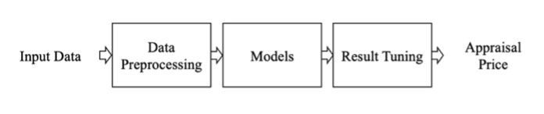
METHOD
The overview process of this research
Notes:
This is the overview for this research, first collect data from website, preprocess and train and test data on models, then tuning results to get the appraisal price.

Slide 9
METHOD
Dataset
From Bestimate by Baania
Including Project, and Unit Type data.
8573 cases with 41 features
Preprocessing
Clear features that have 70% of Nan value
Boxplot to eliminate outlier in price feature
Divided price feature by area into price per square
6040 cases with 22 features
Notes:
The dataset that we use, comes from bestimate by baania website including Project and Unit type data, there are 8573 cases with 41 features. (31 features including name, property)

Slide 10

Feature | Correlation coefficient
area_usable_min | 0.520398
count_room_bed | 0.457999
count_floor | 0.424075
facility_pool | 0.418093
facility_fitness | 0.417108
facility_park | 0.339446
count_room_bath | 0.338685
facility_security | 0.151767
Correlation
To price feature, other features have a very little correlation

Slide 11
Phetchaburi
1.1%
Prachuap Khiri Khan
2%
Phuket
4.5%
Distribution of province
Samut Prakan
4.5%
Chiang Mai
5.5%
  Bangkok is the main province
Bangkok
55.2%
Nonthaburi
6.4%
  More than 60% when combining with Metropolitan
Chonburi
12.7%

Slide 12
Regression model and Evaluation
  Random Forest
    n_estimators = 100
    max_depth = None (expanded until all leaves are pure)
    Default settings
  XGBoost
    objective = reg:linear
    n_estimators = 100
    max_depth = 3
    Default settings
  Deep Neural Network
    activation = relu
    optimizer = rmsprop
    loss = mean absolute error
  Evaluation
    Training and Test set 80:20
    MAPE
Notes:
Regression model and Evaluation, Random Forest and XGBoost will config with default setting, Deep Neural Network used Relu as activation, RMSprop as optimizer, and MAE as loss function. We divided into two set training and test set at 80:20 and used MAPE as evaluation criteria.

Slide 13

SIMILAR NAME METHOD
  Pull out the name of the condominium we want the price to search in the training set.
  If not found, it cuts off one syllable and continues until it reaches the last syllable.
  Calculate Euclidean distance to find the top 10 condominiums in the list that has the most similar feature to the interested one.
  It will calculate the mean from the list
Notes:
First method from result tuning, similar name method, start at using the name of the condominium that we want the price to search in training set, if not found, it will cut last syllable from the back and search again until it reaches the first syllable. And calculate mean from the acquired price list.

Slide 14
SIMILAR NAME METHOD
Condominium name | Search Name | Mean | STD | MAPE
I Condo Ngamwongwan 2 | I Condo | 57500 | 9984 | 17.36
Supalai Loft Sathorn-Ratchaphruk | Supalai Loft | 69007 | 16330 | 23.664
Chewathai Phetkasem 27 | Chewathai | 110976 | 11939 | 10.76
Notes:
Here, first example I Condo Ngamwongwan 2 use I Condo as search name and get 57500 as similar name price.

Slide 15
NEAR AREA METHOD
Use latitude & longitude from the interested condominium.
To create buffer area within 3 km.
Calculate Euclidean distance to find the top 10 condominiums in the area that has the most similar feature to the interested one.
Calculate the mean price from the acquired condominium’s price
Notes:
Next method, near area method, we start at latitude and longitude from the interested condominium to create buffer area in 3 km, calculate euclidean distance to find top 10 condominiums in this area that has the most similar feature, and calculate mean from the acquired price list.

Slide 16
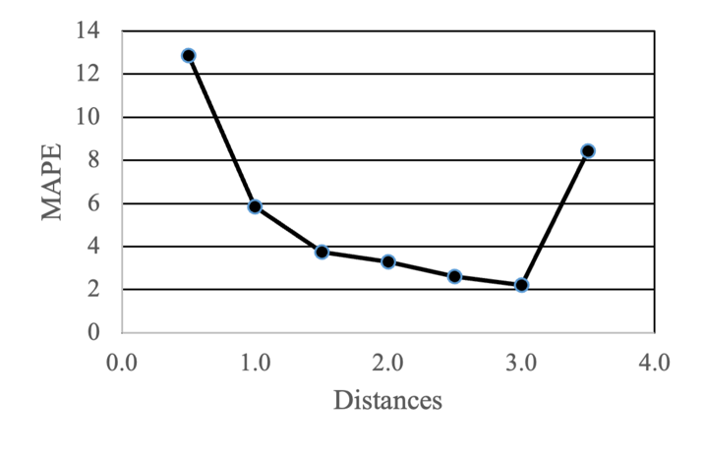
NEAR AREA METHOD
Elbow method to confirm the radius of buffer area
Figure shows the lowest MAPE at distances equal to 3 kilometers tested from 600 condominium cases.
The relation of distance applied to MAPE.

Slide 17

APPRAISAL PRICE
Appraisal Price=0.7a+0.1b+0.2c
Where
a is the predicted price from 3 regression models
b is the price from Similar name method
c is the price from Near area method

Slide 18
HYPOTHESIS
Significant value at 0.05
RH: Mean of MAPE after tuning results equals or more than before tuning
Ho: Mean of MAPE after tuning results less than before tuning Ha: Mean of MAPE after tuning results equals or more than before tuning

Slide 19
RESULT
Model | MAPE Before | MAPE After
Random Forest | 52.28 | 52.47
XGBoost | 49.40 | 48.49
Deep Neural Network | 45.80 | 44.75

Slide 20
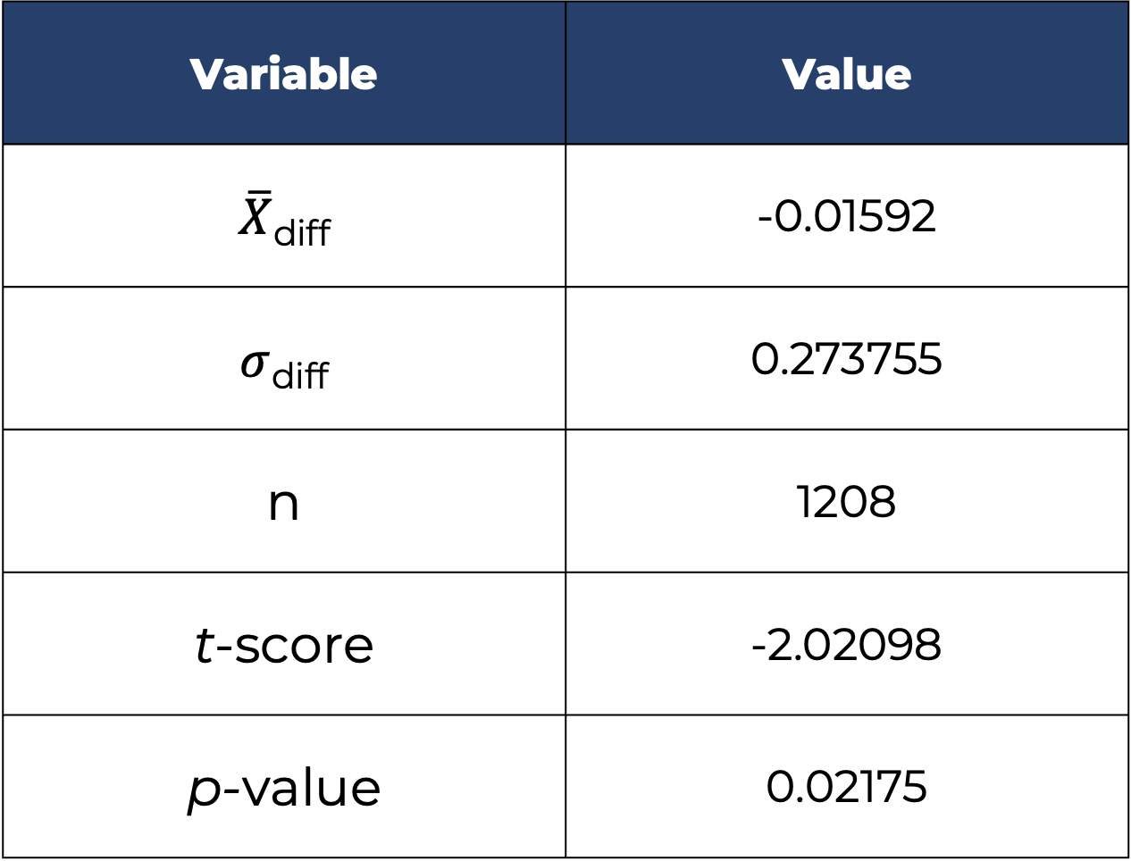
RESULT
Hypothesis
Variable | Value
$\overline{X}$_{diff} | -0.01592
$σ$_{diff} | 0.273755
n | 1208
t-score | -2.02098
p-value | 0.02175

Slide 21
CONCLUSION
DNN with Result Tuning gets the best performance at 44.75%.
Almost no difference. The appraisal equation need to re-think.
Find a way to use another type data to improve models to challenge this topic like the distance between the building and the road.

Slide 22

THANK YOU for your kind attention
QUESTION & ANSWER

