Slide 1



Effects of Genetic Operators on Neural Architecture Search Using Multi-Objective Genetic Algorithm
Praiwan Patcharabumrung, Yutana Jewajinda, and Kata Praditwong
Department of Electrical Engineering, Silpakorn University
The 20th International Joint Conference on Computer Science and Software Engineering
28th June-1st July 2023
Naresuan University Phitsanulok, THAILAND

Slide 2
Abstract
This paper presents the effects of crossover and mutation operators on neural architecture search using a multi-objective genetic algorithm. The proposed algorithm employs a dual population approach with non-dominated sorting, namely, elite, and mixed population, to increase the diversity of the search. To evaluate the effect of genetic operators, we use a simple layer-based encoding for VGG-like convolution neural network models that resemble the model. We also present the effects of the initialized populations' diversity on the solutions' quality with three types of genetic operators: crossover, mutation, and crossover with a mutation in two groups of experiments initialized with low and high diversity. The experimental results are reported on the Cifar-10 dataset and compared to the state-of-the-art approach.

Slide 3
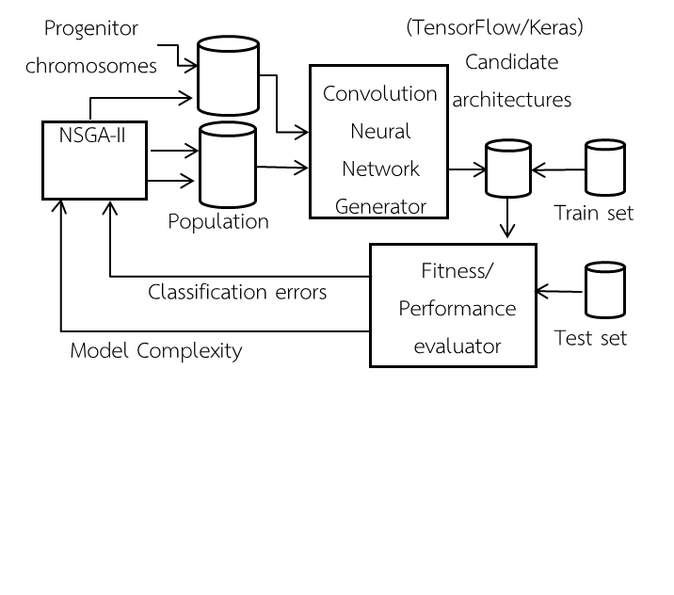
The Proposed NAS Approach
The process works as follows:
First, starting with the initialization of the dual population, which are chromosomes representing CNN.
Second, the chromosomes are generated to Tensorflow/Keras CNN models.
Third, for fitness evaluation, training and testing is performed using Cifar-10.
Fourth, the NSGA-II optimizes and generates dual populations as chromosomes.
Finally, repeat this process until the stopping criteria are met.
Fig. 1. Overall process of
the proposed method

Slide 4
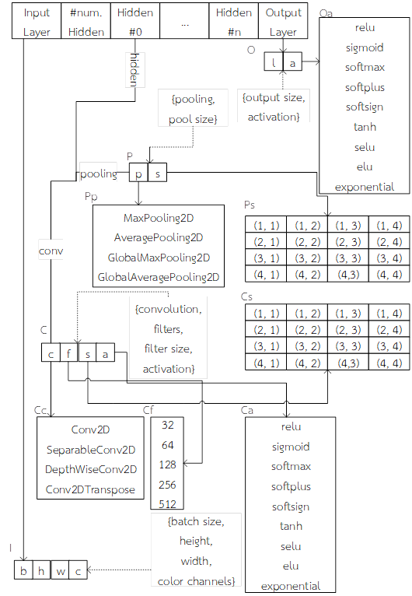
CNN Model Solution
The solution representation of a CNN model as a
variable-length direct encoding. The encoding is
layer-based.
For the top level, the first block is the
input layer, followed by the second block that
specifies the number of hidden layers next the hidden layers, and finally output layer,
The encoding represents VGG-like models but supports various types and sizes of convolutions and pooling
Fig. 2. Solution representation of a CNN model

Slide 5
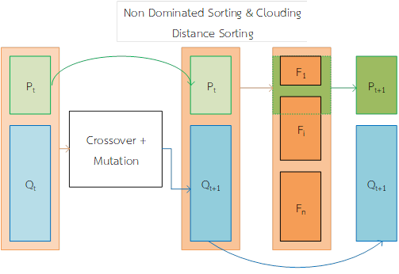
Modified NGSA-II
The NAS is formulated as a
multiobjective optimization.
We propose a modified NSGA-II to
search for the Pareto front using
the non-dominated sorting and
Crowding distance of NSGA-II.
By modifying NSGA-II, we
propose a method to create a
dual population with crossover and mutation.
Fig. 3. Modified NSGA_II procedure

Slide 6
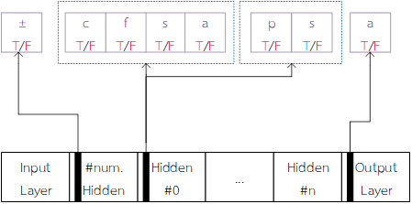
Control Chromosome
We propose a control chromosome
to control mutations, allowing
desirable building blocks to be
passed on to the next generation.
Alternatively, we restrict mutation if
some layers of the model are
already promising
Fig. 4. Control chromosome inside
subblocks of solution representation

Slide 7
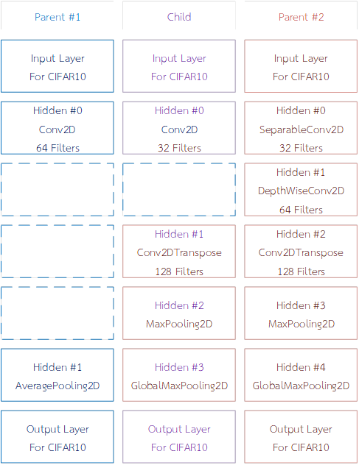
Virtually Extending Crossover
The proposed crossover method randomly
selects two parents, the same as binary
tournament selection.
To deal with the different lengths of two parents, the shorter parent is extended virtually block-wise to match the size of the longer parents.
Fig.5. The proposed virtually extending crossover

Slide 8
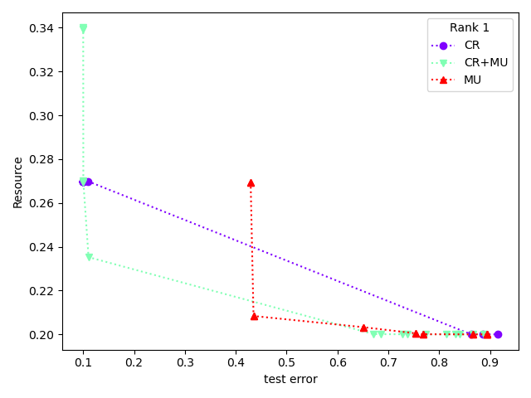
Experimental Result
CR: Crossover (purple)
CR+MU: Crossover and Mutation (green)
MU: mutation (red)
Low Diversity No Control Gene
Mutate only (red) is the best overall.
Crossover only (purple) and
Crossover+Mutate (green) produce smaller CNNs.
Fig. 6. Low diversity: Pareto fronts of rank 1 in the
elite population without the control gene at the 127th generation.

Slide 9
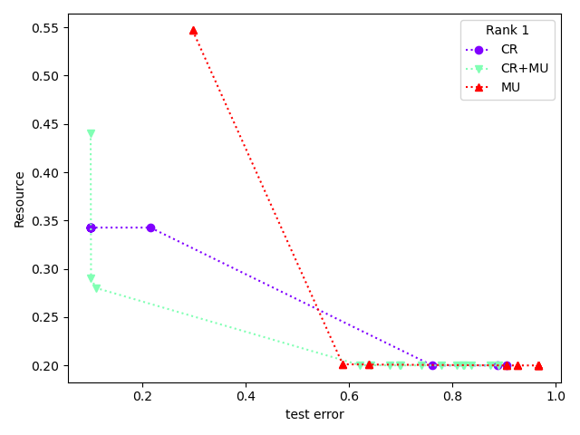
Experimental Result
CR: Crossover (purple)
CR+MU: Crossover and Mutation (green)
MU: mutation (red)
High Diversity No Control Gene
Crossover+Mutate
reigns supreme.
Mutate only get worse, but not
by much.
Fig. 7. High diversity: Pareto fronts of rank 1 in the
elite population without the control gene at the 127th generation.

Slide 10
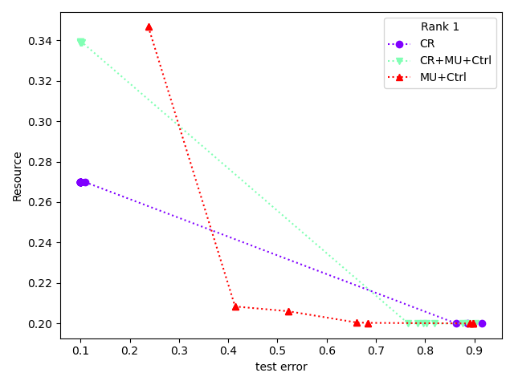
Experimental Result
CR: Crossover (purple)
CR+MU: Crossover and Mutation(green)
MU: mutation (red)
Low Diversity With Control Gene
Mutate only becomes the best.
Notice the improved (smaller)
CNN size of the mutate only.
Fig. 8. Low diversity: Pareto fronts of rank 1 in the
elite population with the control gene at the 127th generation.

Slide 11
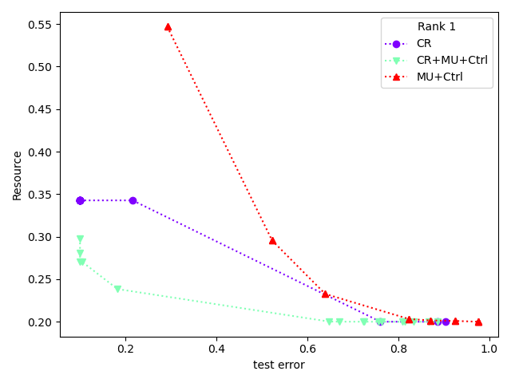
Experimental Result
CR: Crossover (purple)
CR+MU: Crossover and Mutation (green)
MU: mutation (red)
High Diversity With Control Gene
Crossover+Mutate is the best here.
Mutate only got worse (to the point
it got beaten by crossover only,
which didn’t happen in
previous matchups).
Fig. 9. High diversity: Pareto fronts of rank 1 in the
elite population using the control gene at the 127th generation.

Slide 12
Experimental Result
Crossover is not affected
by mutate control gene.
Mutate gets better at low diversity
but gets worse at high diversity.
Crossover + Mutate gets worse at
low diversity, but gets better at
high diversity.
 | No Control Gene
 | 0 – 4 | 0 – 36
CR | ~ | ~
MU | ✓ good | ↓ poor
CR + MU | ↓ poor | ✓ good
Table I. Result Table

Slide 13
Conclusion
The effects of the genetic operators on a proposed evolutionary multiobjective optimization with a dual population for neural architecture search is presented.
The proposed method uses block-chained encoding resulting in VGG-like CNN models.
Combining crossover and mutation balance exploration and exploitation during the search delivers better solutions than those using only mutation or crossover.
The experimental results are then compared with other state-of-the-art methods of using EMOAs for NAS.

Slide 14
THANK YOU
QUESTION & ANSWER

