Slide 1



Using Buses as Edge Nodes in Vehicular Networks
Natthanon Manop, Karnkitti Kittikamron,
Adsadawut Chanakitkarnchok and Kultida Rojviboonchai
Department of Computer Engineering
Faculty of Engineering, Chulalongkorn University
Bangkok, Thailand
The 20th International Joint Conference on Computer Science and Software Engineering
28th June-1st July 2023
Naresuan University Phitsanulok, THAILAND
Notes:
Total = 24 slides
Good afternoon, everyone. My name is Natthanon Manop
I come from Chulalongkorn University, Bangkok
Today I will present Using Buses as Edge Nodes in Vehicular Networks
Introduction - 2:18
Literature Review - 1:14
Approaches - 2:54
Performance and Evaluation - 4:23
Conclusion - 0:48
Total = 11:37

Slide 2
Outline
Introduction
Literature Review
Approaches
Performance and Evaluation
Conclusion
Notes:
There are 5 parts in this presentation
First, we will start with the introduction

Slide 3
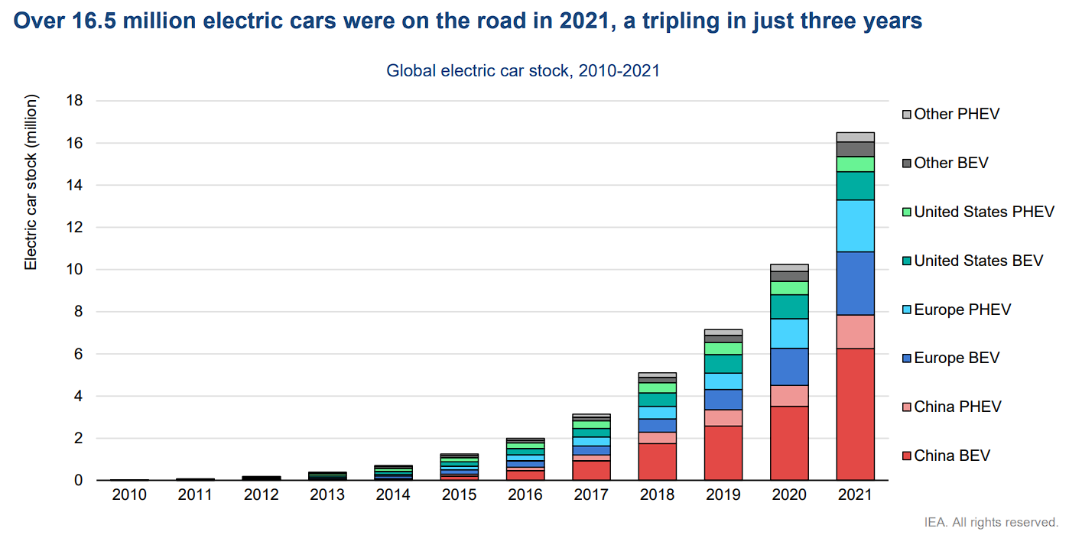
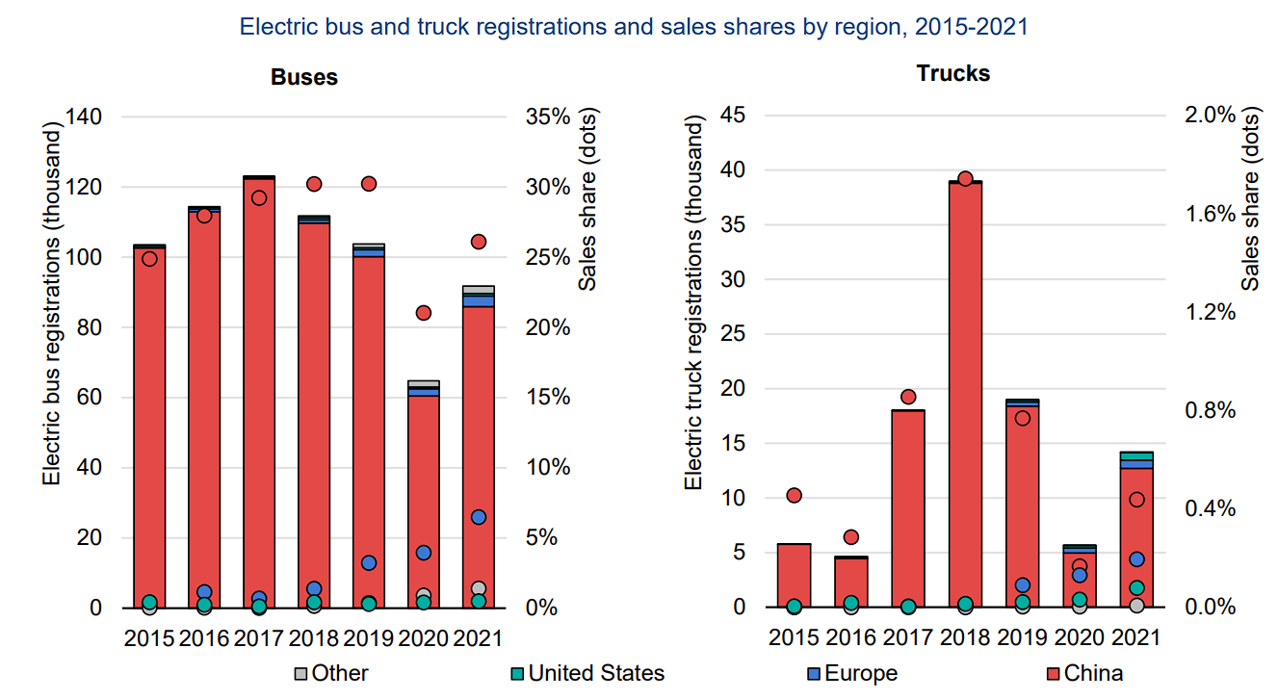
Introduction - Trends in EV market
Light-duty vehicles
2018 – 2021: 16.5 million increase (~ tripled)
2020 – 2021: 6.6 million increase (~70%)
Heavy-duty vehicles
Buses: new registrations continue to increase in China and Europe
Reference: IEA. (2022). Global EV Outlook 2022
Notes:
The EV market has experienced tremendous growth over the past few years.
On the light-duty vehicle side
There are over 16.5 million in EV stock across the world in 2021, tripled in just 3 years from 2018.
And the EV stock was largely grown by 6.6 million from 2020 to 2021 which is around 70% increase.
On the heavy-duty vehicle side
We can see from the dots on the right graph that the sales share of EV bus is significantly large around 26% in China and 6% in Europe.
From the growth of the EV market, so it is inevitable that the vehicular network will play a big role in term of connecting these EV vehicles.

Slide 4



Introduction - Vehicular edge computing framework
Cloud
Cloud layer
  Operate applications in a global view
  High processing capability
  Long distance to users
Edge layer
  Process data that needs low latency and low computation requirements
  Closer distance to users
User layer
  The vehicles are users
  Data will be generated over time
RSU
5G-based station
Vehicles
Buses
Notes:
Generally, the vehicle edge computing framework are consisted of 3 layers
The Cloud layer for operating applications in a global view such as traffic monitoring and management with high processing capability but has the long distance to users
The Edge layer for processing data that needs low latency and low computation requirements with a closer distance to users
The User layer is for users who transfer data with the edge layer

Slide 5
Introduction - Applications and challenges
Applications
  Traffic control
  Autonomous driving
  Virtual/augmented reality (VR/AR)
Challenges
  Low latency
  High deployment cost
Notes:
With the emerging of vehicular edge computing framework
there are many application that can be happened such as traffic control, autonomous driving and virtual and augmented reality
Some applications are challenging in many ways such as low latency requirement and high deployment cost

Slide 6
Outline
Introduction
Literature Review
Approaches
Performance and Evaluation
Conclusion
Notes:
In the second part, we talk about the previous researches on edge deployment in vehicular networks

Slide 7
Literature Review
Stationary edge node
  Dimensioning and Layout Planning of 5G-Based Vehicular Edge Computing Networks Towards Intelligent Transportation (IEEE Open Journal of Vehicular Technology, 2020)
  Large-Scale Many-Objective Deployment Optimization of Edge Servers (IEEE Transactions on Intelligent Transportation Systems, 2021)
  Edge Server Placement for Vehicular Ad Hoc Networks in Metropolitans (IEEE Internet of Things Journal, 2022)
Mobile edge node
  BUS-VANET: A BUS Vehicular Network Integrated with Traffic Infrastructure (IEEE Intelligent Transportation Systems Magazine, 2015)
Notes:
In the previous research about edge deployment, the edge nodes can be classified into stationary and mobile edge nodes which are separated by movability
Most stationary edge node operate on 5G Micro Base Station and Road-Side Unit
And most mobile edge node operate on Taxicab and Bus

Slide 8
Literature Review
Year | Paper Reference | Objective |  | Vehicle location data is considered | Vehicle-to-Vehicle(V2V) Support | Type of edge nodes
 |  | Latency | Deployment cost
2015 | [1] | ✔ | ✘ | ✘ | ✔ | Bus
2020 | [2] | ✔ | ✔ | ✘ | ✘ | 5G Micro Base Station
2021 | [3] | ✔ | ✔ | ✘ | ✘ | RSU
2022 | [4] | ✔ | ✔ | ✔ | ✘ | RSU
 | Our Framework | ✔ | ✔ | ✔ | ✔ | Bus
References
[1] BUS-VANET: A BUS Vehicular Network Integrated with Traffic Infrastructure (IEEE Intelligent Transportation Systems Magazine, 2015)
[2] Dimensioning and Layout Planning of 5G-Based Vehicular Edge Computing Networks Towards Intelligent Transportation (IEEE Open Journal of Vehicular Technology, 2020)
[3] Large-Scale Many-Objective Deployment Optimization of Edge Servers (IEEE Transactions on Intelligent Transportation Systems, 2021)
[4] Edge Server Placement for Vehicular Ad Hoc Networks in Metropolitans (IEEE Internet of Things Journal, 2022)
Notes:
All previous researches’ objective is latency as you can see in summary table
The differences of these researches are deployment cost as an objective, consideration of the vehicle location data, support of Vehicle-to-Vehicle or V2V and the type of edge nodes
So, we proposed our framework that have latency and deployment as objectives, consider vehicle location data, with V2V support by using bus as the type of edge nodes

Slide 9
Outline
Introduction
Literature Review
Approaches
Performance and Evaluation
Conclusion
Notes:
Next, in the third part, we will talk about our approaches

Slide 10
Approaches - Contributions
Our new framework - Buses as an Infrastructure
  Using buses as edge nodes for providing computational resources and services to the users
Our new heuristic algorithm
  To find the optimal route of buses for edge node deployment by prioritizing the number of workloads with the top-N technique to minimize the deployment cost
Notes:
So, our contributions are
our new framework called Buses as an Infrastructure to use buses for providing computational resources and services and
our new heuristic algorithm to find the optimal route of buses for edge node deployment
So, let’s start with our new framework

Slide 11
Approaches - Our new framework
Buses as an Infrastructure
Cloud
Cloud layer
Edge layer
Buses
User layer
Vehicles
Notes:
Our framework is adapted from regular vehicle edge computing framework
The differences is at the edge layer which we use buses as edge nodes instead of stationary edge nodes which are moved from user layer due to some advantages which we will explain later in the next slides
The cloud layer and the user layer is still the same

Slide 12
Approaches - Advantages of using buses as edge nodes
Short distance to users
Passing through high density areas of user
High V2V connectivity time
Notes:
Next, we will explain the advantages of using buses as edge nodes compared to stationary edge nodes which are consist of 3 things

Slide 13



Approaches - Advantages of using buses as edge nodes
Short distance to users
  Buses are close to both nearby vehicles
  Provides lower delay than stationary edge nodes
Notes:
One is that buses is usually close to the users, in our case is other vehicles. So, it can provide lower delay

Slide 14

Approaches - Advantages of using buses as edge nodes
Passing through high density areas of user
  Most of buses’ route are usually well-planned to support large number of citizen
  Mostly at Point Of Interests(POI)
  Provides more coverage area than stationary edge nodes
Notes:
Two is that most of buses’ route are usually well-planned to support large number of citizen and mostly pass the Point Of Interests such as school or shopping mall
So. It can provide more coverage area

Slide 15
Approaches - Advantages of using buses as edge nodes
High connectivity time
  In case buses and nearby vehicles are moving in the same direction, the nearby vehicle could have higher connectivity time with the buses compared to stationary edge nodes
Notes:
And three is that it can provide higher connectivity time between the buses and nearby vehicles compared to stationary edge nodes in case the buses and vehicles are moving in the same direction

Slide 16
Approaches - Our new heuristic algorithm
Select an optimal number of bus routes to be deployed as edge nodes by prioritizing the number of workloads
Using Top-N technique to minimize the deployment cost
Notes:
Next, we will talk about our new heuristic algorithm
This algorithm is for selecting an optimal number of bus routes to be deployed as edge nodes by prioritizing the number of workloads
And we use top-n technique to minimize the deployment cost

Slide 17
Approaches - Our new heuristic algorithm
Record the number of vehicles in each road as workload
Calculate workloads per distance for each bus route
Select N bus routes that have the
most N workloads per distance
  N is limited budget constraint
75
50
50
75
75
50
50
75
100
50
50
100
100
50
75
100
75
50
75
75
50
50
50
50
Notes:
The first step of this algorithm is recording the number of vehicles in each road as the workloads

Slide 18
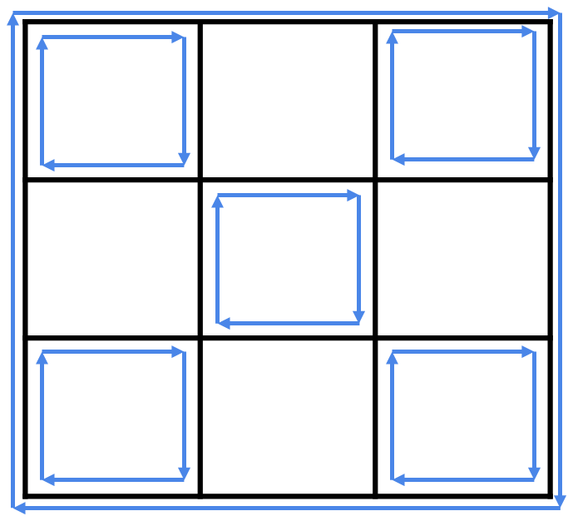
Approaches - Our new heuristic algorithm
Record the number of vehicles in each road as workload
Calculate workloads per distance for each bus route
Select N bus routes that have the most N workloads per distance
  N is limited budget constraint
100
54.2
75
50
62.5
62.5
Notes:
Then the algorithm calculate the workloads per distance for each bus route which the bus route is notated as the blue cycle

Slide 19
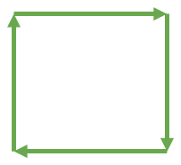
Approaches - Our new heuristic algorithm
Record the number of vehicles in each road as workload
Calculate workloads per distance for each bus route
Select N bus routes that have the most N workloads per distance
  N is limited budget constraint
100
54.2
75
50
62.5
62.5
N = 4
Notes:
Lastly, the algorithm select N bus routes that have the most N workloads per distance which N is 4 in this example. So, the 4 bus routes are selected notated as the green cycle.
N is limited budget constraint that the edge node provider can determine.

Slide 20
Outline
Introduction
Literature Review
Approaches
Performance and Evaluation
Conclusion
Notes:
Next, in the fourth part, we will talk about performance and evaluation

Slide 21
Performance and Evaluation - Simulation setup
Simulated traffic is generated by SUMO
The heuristic algorithm is implemented on Python program
Vary vehicle density
  20, 30, 40, 50, 60 vehicle/km
Notes:
For the Simulation setup
Our simulated traffic is generated by SUMO
The heuristic algorithm is implemented on Python program
And we have varied vehicle density from 20 to 60 vehicle/km

Slide 22
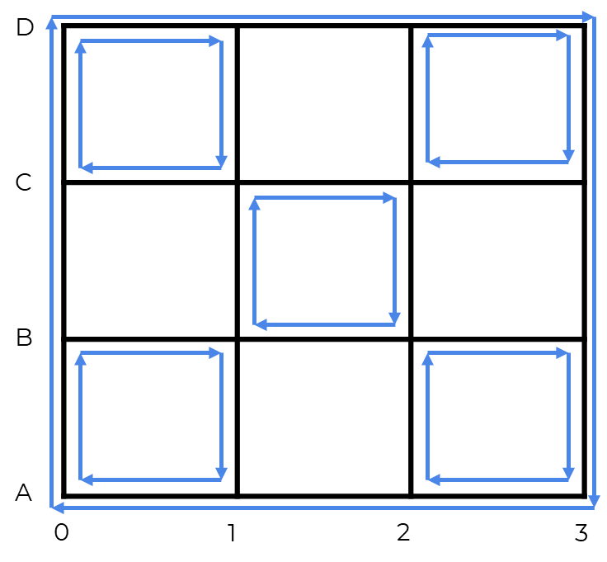
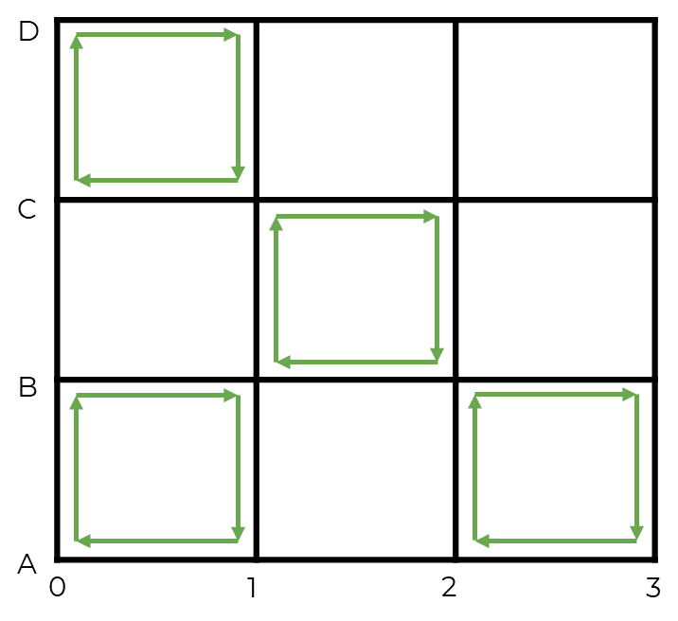
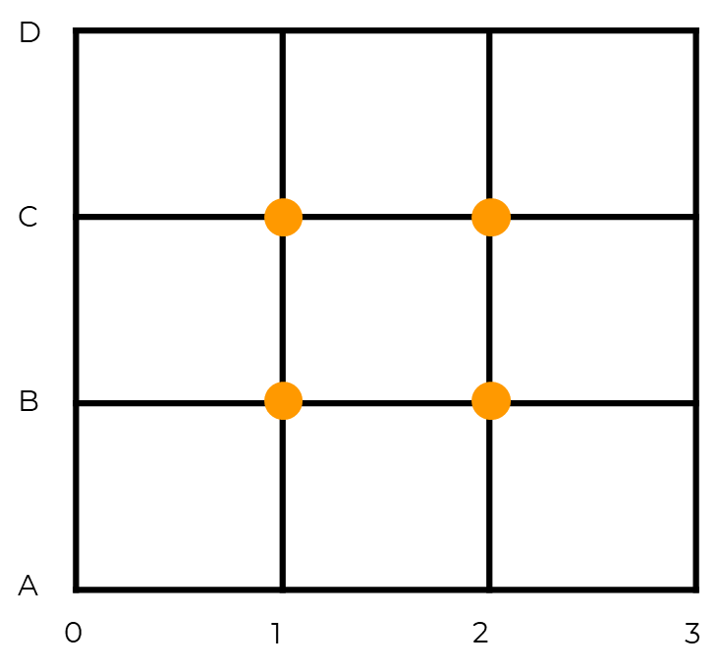
Performance and Evaluation - Scenarios
  The full deployment approach
  The top-4 heuristic algorithm
  The fixed RSUs approach
Notes:
We evaluate performance of our proposed framework with two scenarios
One is the full deployment approach which has 6 total bus cycles covered all roads on the simulated environment
And Two is the top-4 heuristic algorithm that our heuristic algorithm will select 4 bus route as edge nodes
แก้เป็น top N แล้วบอก N = 4
อธิบายด้วยว่าทำไม N=4

Slide 23
Performance and Evaluation - Parameters
Parameter | Value
Map size | 4km x 4km
Number of lanes | 2
Vehicle density | [20, 30, 40, 50, 60] vehicle/km
Maximum vehicle velocity | 19.44 m/s
Maximum bus velocity | 19.44 m/s
Number of bus lines | 6
Bus station length | 24 m
Bus stop duration | 20 seconds
Range of communication | 300 m
Warm-up time | 600 seconds
Simulation time | 600 seconds

Slide 24
Performance and Evaluation
Benchmark
Compare our full deployment approach and our top-4 heuristic algorithm with
the fixed RSUs approach
Evaluation Metrics
Number of served vehicle
  The total number of vehicle that can communicate to an edge node
Average connectivity time (s)
  The period that vehicles and edge nodes can communicate to each other
Notes:
For the benchmark, we use a scenario called the fixed RSUs approach that 4 stationary edge nodes are deployed on each RSU in the middle of each intersection
For evaluation metrics, we evaluate the performance in term of
Number of served vehicle which is the total number of vehicle that can communicate to an edge node
And Average connectivity time which is the period that vehicles and edge nodes can communicate to each other

Slide 25
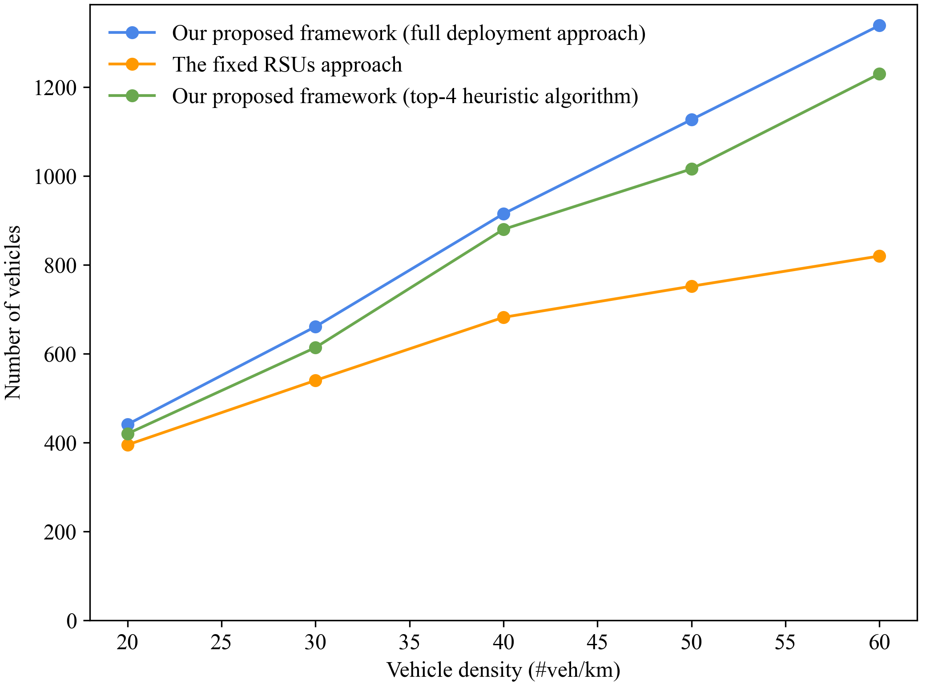
Performance and Evaluation - Results
The number of served vehicle for different vehicle density
50% increased
6% increased
Notes:
The result shows that the full deployment approach provides higher number of served vehicles compared to the fixed RSUs.
Moreover, the result shows that the number of served vehicles of our heuristic algorithm is greater than the fixed RSUs approach by 6% at 20 vehicles per kilometer and up to 50% at 60 vehicles per kilometer
This is because the buses move in a cycle, so it increases the probability that a vehicle will be in communication range of a bus. On the other hand, the stationary edge nodes is deployed at the intersections, so it has a low chance to communicate with the vehicles.

Slide 26
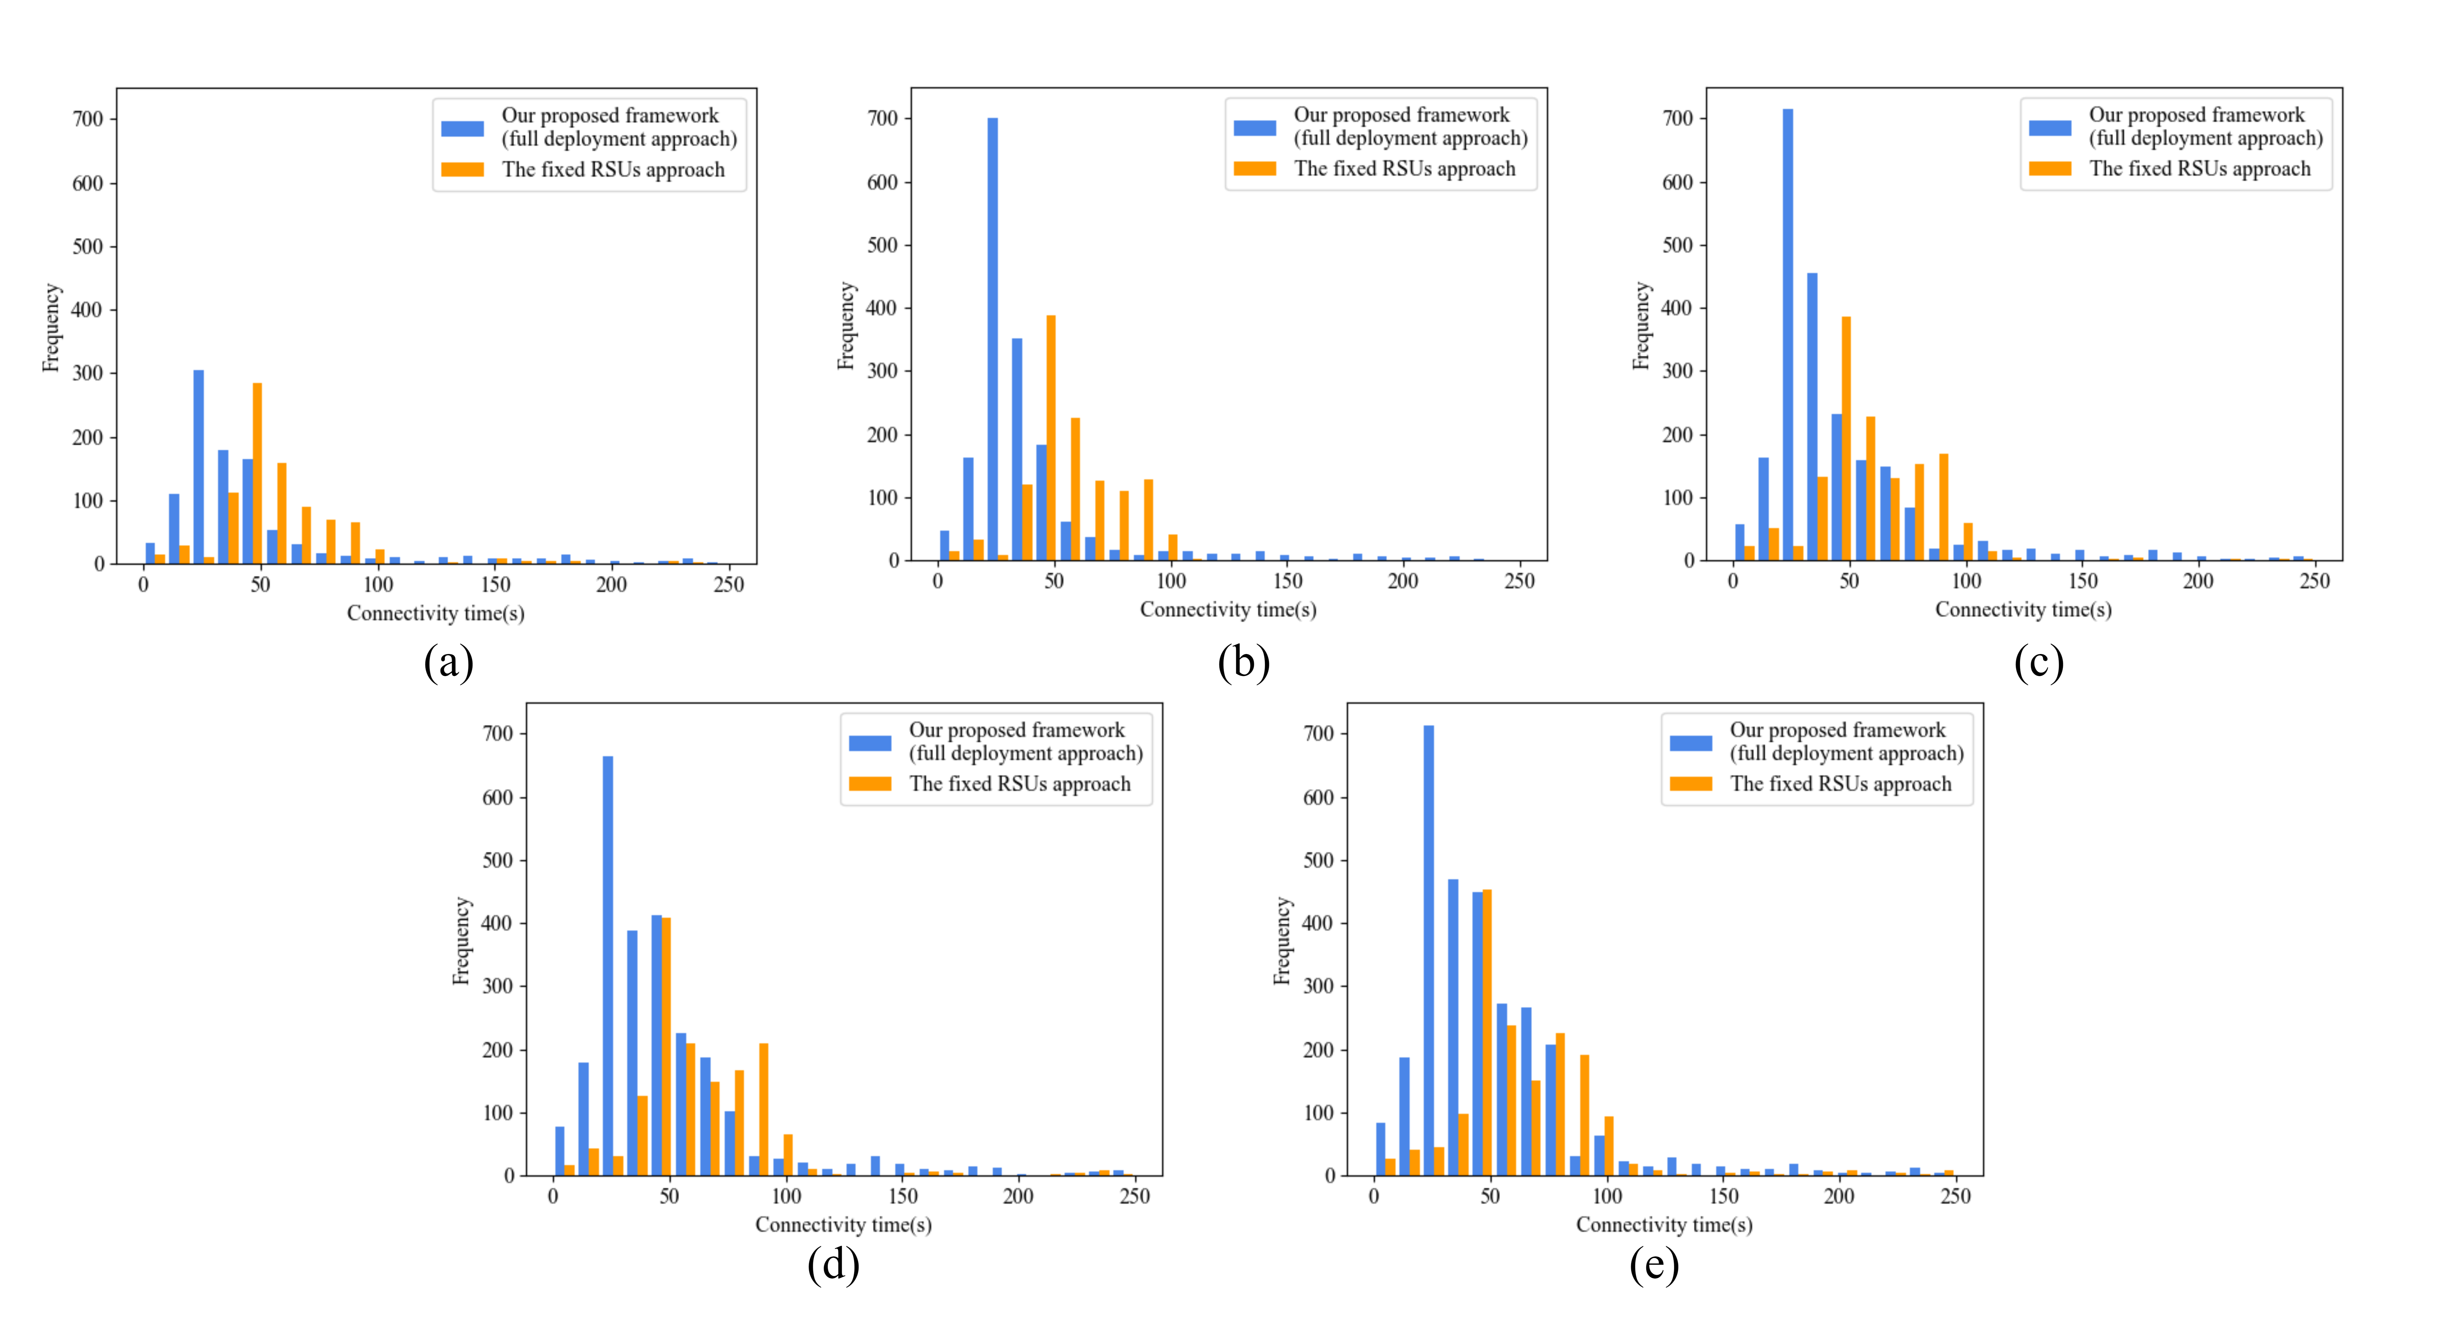
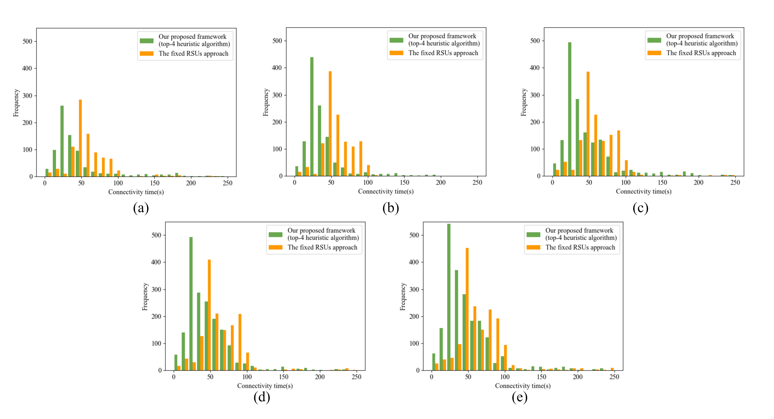
Performance and Evaluation - Results
The average connectivity time
The Fixed RSUs approach
  65 seconds
The Full deployment approach
  49 seconds
The top-4 heuristic algorithm
  46 seconds
  Nearly close to Full deployment approach
  Two edge node less to be deployed
Notes:
We also perform the experiment to show the connectivity time
First, we compare the result between the Fixed RSUs approach and The Full deployment approach
The result shows that the average connectivity time of the Fixed RSUs approach is higher than the full deployment approach
Because the vehicle tends to be clustered at each intersection, the RSUs, which are usually deployed at the intersection, can provide higher connectivity time than the buses that travel along its route
Then, we compare the result to the top-4 heuristic algorithm
The result shows that the average connectivity time is around 46 seconds which is very close to the Full deployment approach, but the top-4 heuristic algorithm requires two edge node less which can significantly reduce the deployment cost

Slide 27
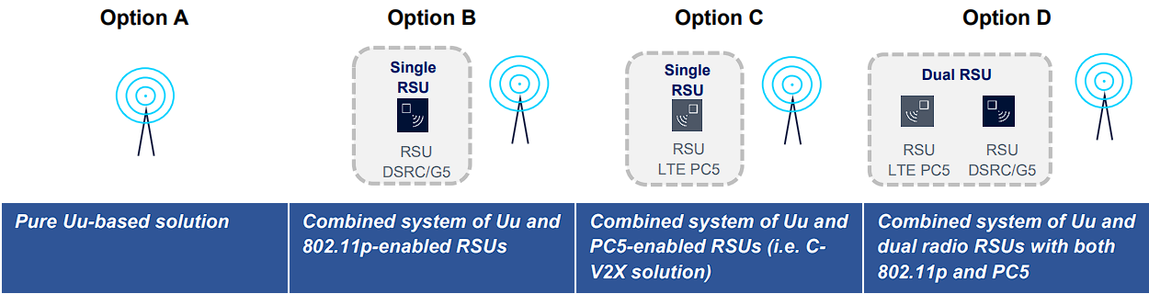
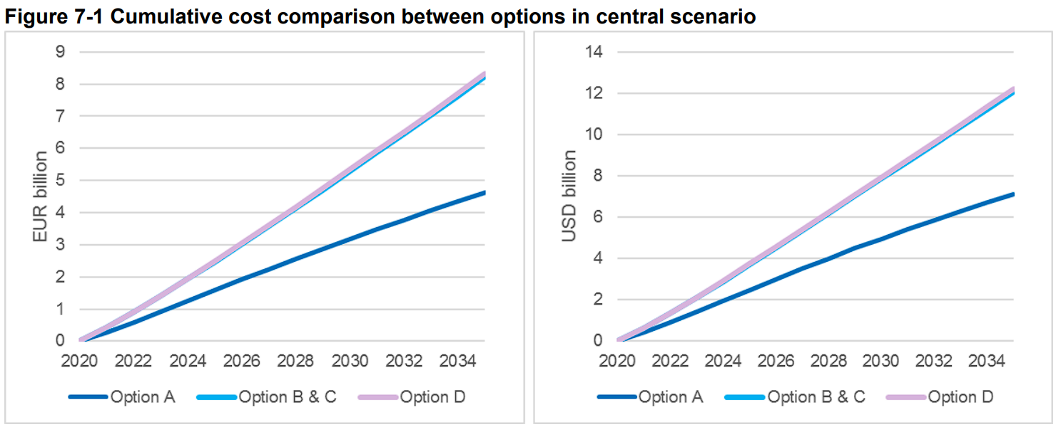
Performance and Evaluation
Practical deployment cost for RSU
Cost come from CAPEX and OPEX
  CAPEX – Infrastructure costs
  OPEX – Operation and maintenance costs
For 100% road coverage for EU and US
A linear increase in cumulative costs through to 2035
  EUR 5 billion / USD 7 billion for Option A
  EUR 8 billion / USD 12 billion for
  Options B, C and D
Reference: Cost Analysis of V2I Deployment Final Report. 5G Automotive Association (5GAA), 2020
Notes:
In practical deployment cost, the cost come from Infrastructure costs or CAPEX and Operation and maintenance costs or OPEX
The analysis report of 5G Automotive Association 2020 shows that it cost over 8 billion EUR or 12 billion USD for base station and RSU to cover 100% of the road in EU and US
So, if our heuristic algorithm could be applied, we would save a lot of deployment cost for regular RSU

Slide 28
Outline
Introduction
Literature Review
Approaches
Performance and Evaluation
Conclusion
Notes:
Finally, we will conclude this presentation

Slide 29
Conclusion
To address the challenges
  Low latency requirement
  High deployment cost
By using advantages of public transport (Buses)
We propose
  A new framework - Buses as an Infrastructure
  A new heuristic algorithm
Our framework and heuristic algorithm
  Provides 6-50% more served vehicles than the fixed RSUs approach
    in case of the service requires a computation time of less than the average of 46 seconds
  Reduces deployment cost
Notes:
Low latency requirement and high deployment cost are the major challenges in Vehicular edge computing framework
To address the challenges, we use the advantages of public transport such as Buses
So, we propose
A new framework called Buses as an Infrastructure and
A new heuristic algorithm
Our framework and heuristic algorithm provides 6 to 50% more served vehicles than the fixed RSUs in case of the service requires a computation time of less than the average of 46 seconds
and reduce deployment cost

Slide 30
THANK YOU
QUESTION & ANSWER
Notes:
Thank you everyone for listening, if you have any question feel free to ask me

Slide 31
Back up slides

Slide 32
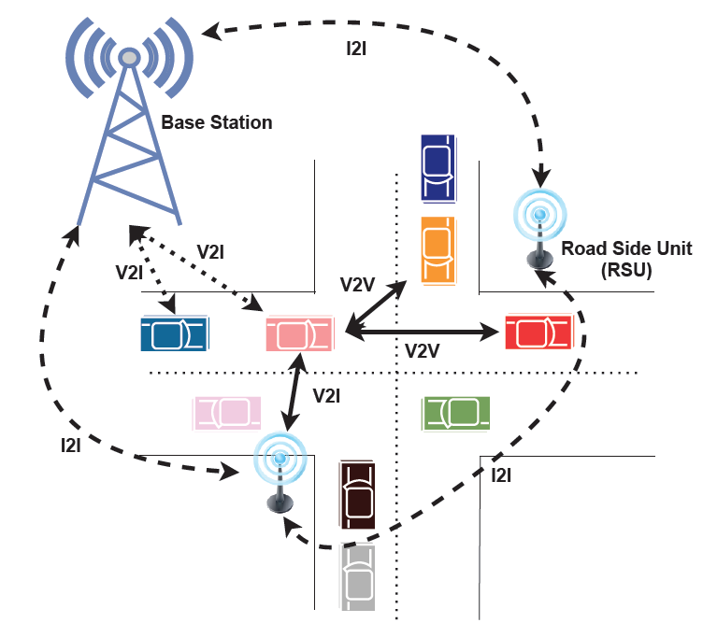
Introduction - Vehicular network architecture
Three components
  Vehicle
  Road-Side Unit (RSU)
  Base station
Three communication types
  Vehicle-to-Infrastructure (V2I)
  Vehicle-to-Vehicle (V2V)
  Infrastructure-to-Infrastructure (I2I)
Image: Karunathilake, T.; Förster, A. A Survey on Mobile Road Side Units in VANETs. Vehicles 2022, 4, 482–500. https://doi.org/10.3390/ vehicles4020029
Notes:
In vehicular network architecture, there are 3 components consists of Vehicle, Road-Side Unit or RSU and Base station working together to make the communication happens.
And the communication are categorized into 3 types, Vehicle-to-Infrastructure (V2I), Vehicle-to-Vehicle (V2V) and Infrastructure-to-Infrastructure (I2I)

Slide 33
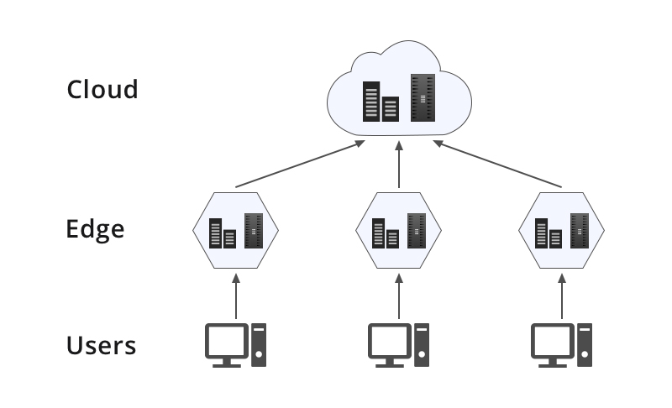
Introduction: Edge node placement
A process to find suitable locations for edge node deployment to satisfy the application’s needs
The edge nodes can be deployed on user’s device or nearby infrastructure
The closer the edge nodes are, the better the delay between users and computational resources

Slide 34
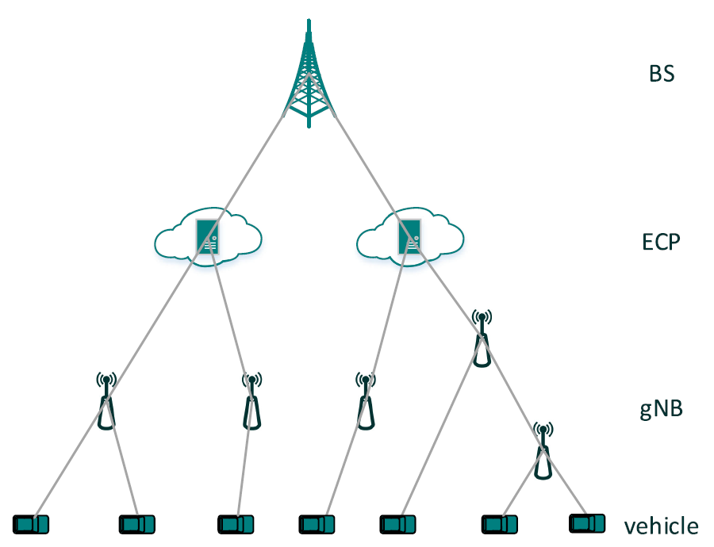
Literature Review [1]
[Bin Lin, IEEE Open Journal of Vehicular Technology 2020] the Dimensioning and Layout Planning (DLP) problem under 5G-based Vehicular Edge Computing Network (VECN) has studied
The integrated 5G Micro Base Station (gNB) and Edge Computing (EC) are being used instead of the conventional RSU
The network topology of VECN
References
[1] B. Lin, X. Zhou and J. Duan, "Dimensioning and Layout Planning of 5G-Based Vehicular Edge Computing Networks Towards Intelligent Transportation," in IEEE Open Journal of Vehicular Technology, 2020

Slide 35
Literature Review [1]
A greedy algorithm has proposed to place Father Nodes(FN) which could connect to more Child Nodes(CN) forming as FN-CN pairs, so the least FNs that could cover the most child nodes are produced as a result
A Cost-Effective Heuristic Algorithm (CEHA) has proposed to avoid the local optimal solution by using Probability Matrix to guide the CN to connect to FN for improving the randomness
Aims
  To improve response time and bandwidth of communication
  To minimize the total placement cost under the coverage constraints
Advantages
  The proposed VECN could support a stable connectivity in a high-speed scenario and facilitate the fast response
References
[1] B. Lin, X. Zhou and J. Duan, "Dimensioning and Layout Planning of 5G-Based Vehicular Edge Computing Networks Towards Intelligent Transportation," in IEEE Open Journal of Vehicular Technology, 2020

Slide 36
Literature Review [2]
[Bin Cao et al, IEEE Transactions on Intelligent Transportation Systems 2021] six aspects from viewpoint of both user and service provider have considered
The edge servers deployment optimization model constructed by six objectives simultaneously using many-objective evolutionary algorithm has proposed
Aims
  To consider six-objective optimization models when deploying ESs (latency, workload balancing, energy consumption, deployment costs, transmission reliability and edge server quantity)
Advantages
  The greatest number of objectives has considered to deploy edge servers compared to other research
References
[2] B. Cao et al., "Large-Scale Many-Objective Deployment Optimization of Edge Servers," in IEEE Transactions on Intelligent Transportation Systems, June 2021

Slide 37
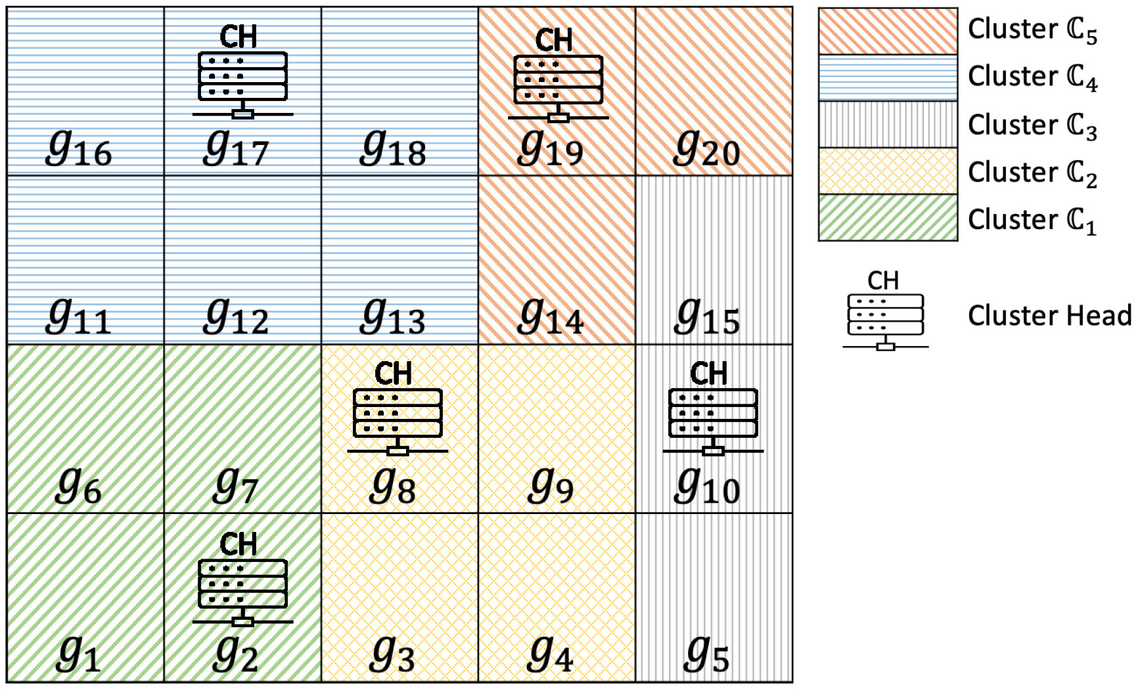
Literature Review [3]
[Le Chang, IEEE Internet of Things Journal 2022] a heuristic multi-objective optimization method considering latency, deployment and runtime cost for a metropolitan area has proposed
Trace information has processed into grids then transition between grids has considered for forming clusters and the cluster’s heads are identified to deploy edge servers
System model of edge server placement in VANETs
References
[3] L. Chang, X. Deng, J. Pan and Y. Zhang, "Edge Server Placement for Vehicular Ad Hoc Networks in Metropolitans," in IEEE Internet of Things Journal, Jan 2022

Slide 38
Literature Review [3]
Aims
  To find solutions that optimize the trade-off of the initial cost of deploying these servers, the runtime overhead and the average delay of tasks
Advantages
  The real data set (Shanghai taxi trace) has considered to gain insights of the traffic pattern for the heuristic optimization
System model of edge server placement in VANETs
References
[3] L. Chang, X. Deng, J. Pan and Y. Zhang, "Edge Server Placement for Vehicular Ad Hoc Networks in Metropolitans," in IEEE Internet of Things Journal, Jan 2022

Slide 39
Literature Review
In the past researches, latency/delay is the most concerned objective that authors need to achieve
Therefore, most researchers focus on the optimization for finding the optimal edge node placement
However, to reduce the latency/delay, the most effective way is to bring the edge nodes closer to the users
Many edge node placement related researches did not consider or take advantages of the existing public transportation, such as buses, which is very close to users

Slide 40
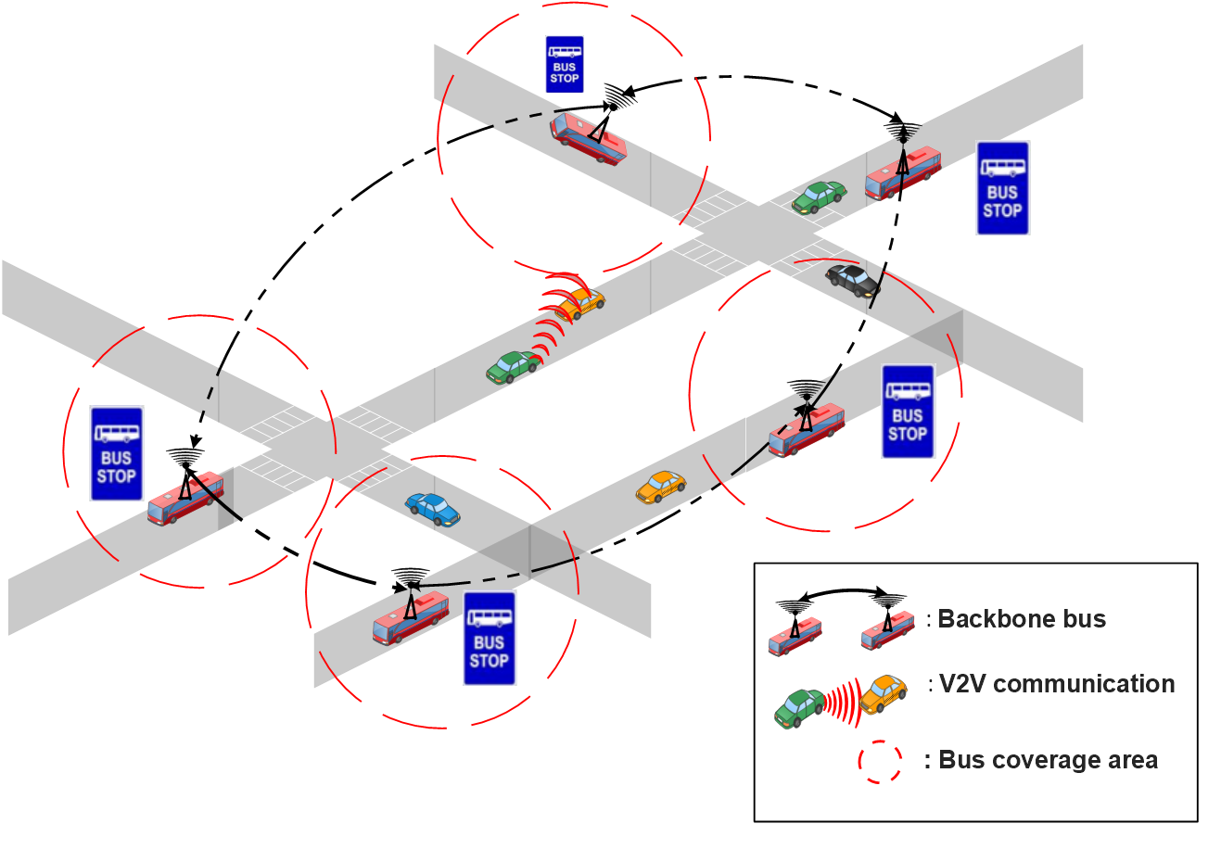
Literature Review
Bus Line Management as RSU
The buses can be used as relay nodes to constitute the backbone network for improving the messages dissemination process
The buses act like the intermediates (not edge node) to serve data traffic between the vehicles and the existing RSUs
References
Guerna A, Bitam S, Calafate CT. Roadside Unit Deployment in Internet of Vehicles Systems: A Survey. Sensors. 2022; 22(9):3190. https://doi.org/10.3390/s22093190

Slide 41

Approaches - Our new heuristic algorithm
Select an optimal number of bus routes to be deployed as edge nodes by prioritizing the number of workloads
Using Top-N technique to minimize the deployment cost
Assumption
The number of vehicles on each road is considered as workload of the road
The number of bus routes and bus route information (i.e., current lane) is predetermined
Notes:
Next, we will talk about our new heuristic algorithm
This algorithm is for selecting an optimal number of bus routes to be deployed as edge nodes by prioritizing the number of workloads
We use top-n technique to minimize the deployment cost
This algorithm are based on the 2 assumption.
One is that the number of vehicles on each road is considered as workload of the road
Two is that the number of bus routes and bus route information such as current lane is predetermined

Slide 42
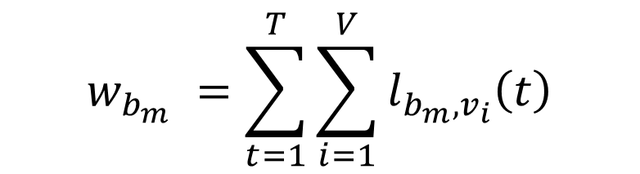

Heuristic algorithm: Workload calculation
Bus routes is notated as B where B is a set of bus routes {b₁, …, b_{m}}
First, the number of vehicles K in each period [1, T] is accumulated and grouped by bus routes b_{i} for calculating workloads on a specific bus route $w_{b_{i}}$ as in equation below
$$w_{b_{m}} =\sum_{t=1}^{T}{\sum_{i=1}^{V}{l_{b_{m}{,v}_{i}}\left(t\right)}}$$
$l_{b_{m}{,v}_{i}}(t)$ refers to the vehicle $i$ is driving on the lane $l_{b_{m}}$ which is a subset of bus route $b_{m}$ at time $t$
$l_{b_{m}{,v}_{i}}\left(t\right)$ $=\left\{\begin{aligned}1,\text{i}\text{f} \text{a} \text{vehicle} i \text{which} \text{is} \text{driving} \text{on} \text{the} \text{lane} l_{b_{m}} \text{at} \text{a} \text{specific} \text{time} \text{t} \\ 0, otherwise\end{aligned}\right.$

Slide 43

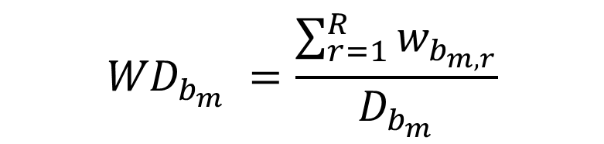
Heuristic algorithm: Workload per distance calculation
Then, the workloads per distance for bus route b is calculated as workload density WD_{b} as in equation below
$${WD}_{b_{m}} =\frac{\sum_{r=1}^{R}{w_{b_{m,r}}}}{D_{b_{m}}}$$
Where $D_{b_{m}}$ is the total distance of bus route $b_{m}$
$w_{b_{m,r}}$ is the workload of bus route $b_{m}$ in road $r$

Slide 44
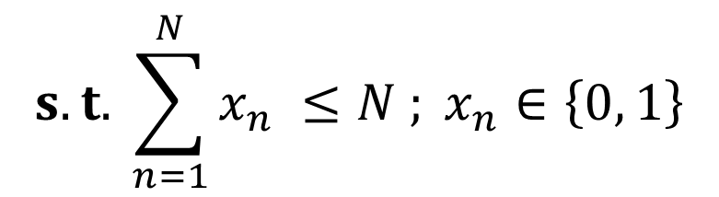

Heuristic algorithm: Optimization model
Finally, the optimization model is formulated as in equation below
$$max \sum_{b ∈B }{{WD}_{b}x_{n}}$$
$$s.t. \sum_{n=1}^{N}{x_{n} ≤N ;} x_{n}∈\left\{0, 1\right\}$$
The optimal number of bus routes N are selected to deploy edge nodes within the limited budget constraint

Slide 45
Performance and Evaluation : Experiment process
1
2
Map generation
Bus routes and schedule
3
4
Traffic simulation
Heuristic algorithms

Slide 46
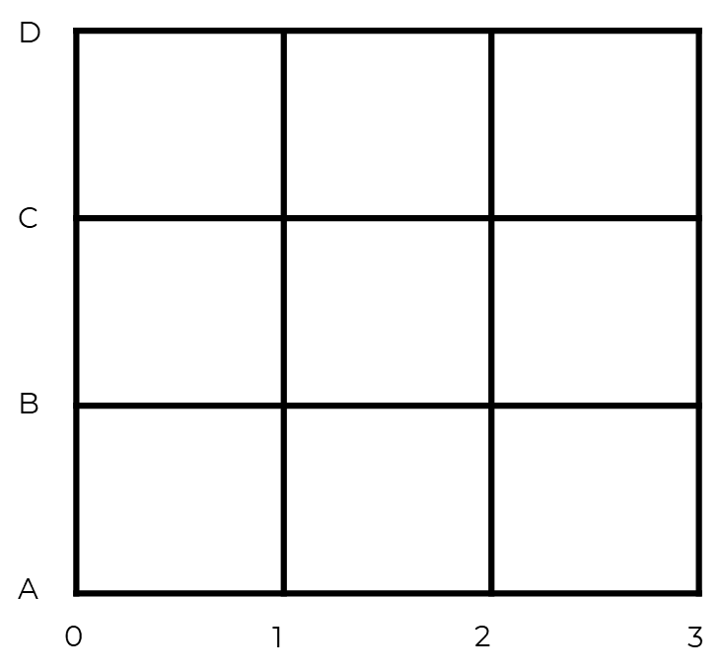
Performance and Evaluation : Experiment process
Map generation - Generate square of grids

Slide 47
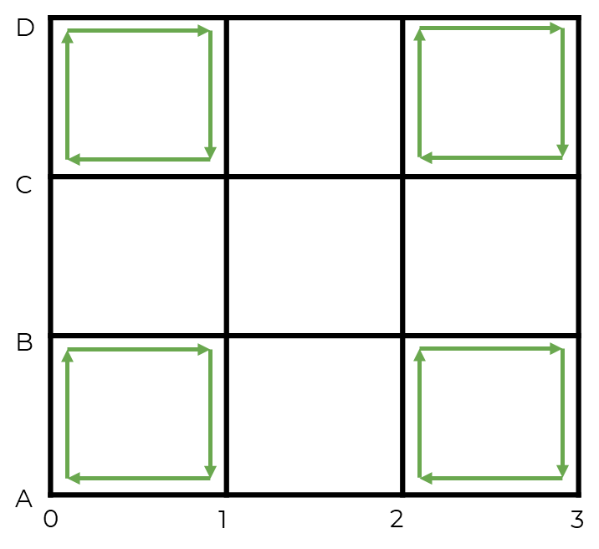
Performance and Evaluation : Experiment process
Bus routes and schedule - Determine bus routes and schedule
  The full deployment approach
  The top-4 heuristic algorithm

Slide 48

Performance and Evaluation : Experiment process
Traffic simulation - Simulate traffic on the grids

Slide 49
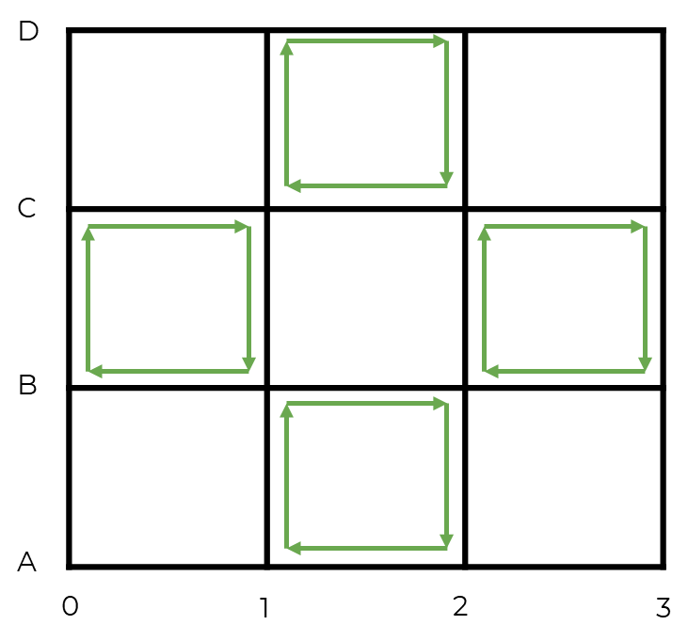
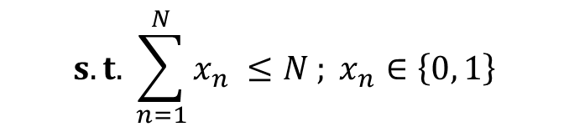

Performance and Evaluation : Experiment process
Heuristic algorithms - Apply heuristic optimization algorithms
$$max \sum_{b ∈B }{{WD}_{b}x_{n}}$$
$$s.t. \sum_{n=1}^{N}{x_{n} ≤N ;} x_{n}∈\left\{0, 1\right\}$$
N = 4

