Slide 1



A Comparative Study on Out-of-Scope Detection for Chest X-ray Images
Nuttapol Kamolkunasiri
Proadpran Punyabukkana
Ekapol Chuangsuwanich
Computer Engineering
Chulalongkorn University
Computer Engineering
Chulalongkorn University
Computer Engineering
Chulalongkorn University
The 20th International Joint Conference on Computer Science and Software Engineering
28th June-1st July 2023
Naresuan University Phitsanulok, THAILAND

Slide 2
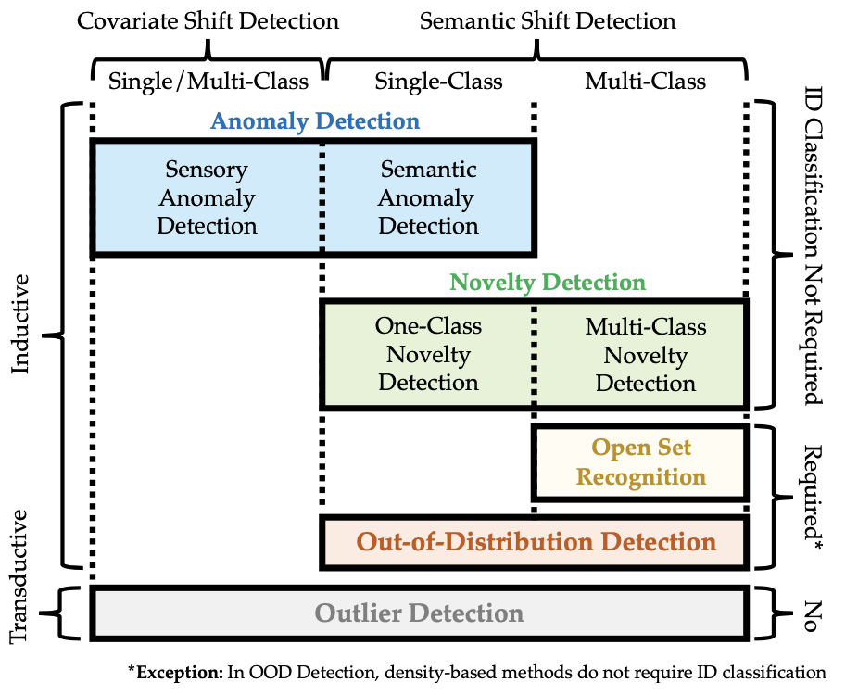
What is “Out-of-Scope” ?
Out-of-Distribution (OOD) detection has emerged as a prominent research area since 2017.
Anomaly detection (AD), novelty detection (ND), open set recognition (OSR), and outlier detection (OD) are closely linked to OOD detection in terms of motivation and methodology.
However, these topics often develop independently, leading to confusion among readers and practitioners due to slight variations in definition and problem settings.
Jingkang et al. proposed
“a unified framework, generalized OOD detection”,
which encompasses AD, ND, OSR, OOD detection, and OD.
We employed the term "Out-of-Scope" to delineate the detection scope for identifying covariate shift and semantic shift.

Slide 3
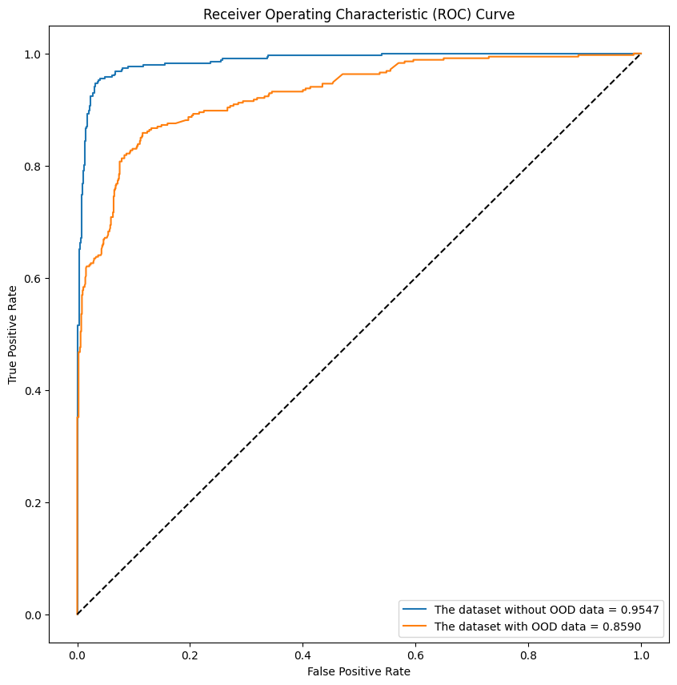
Why it is important?
In certain domains, allowing a model to make incorrect decisions can lead to devastating consequences and profound tragedies.

Slide 4
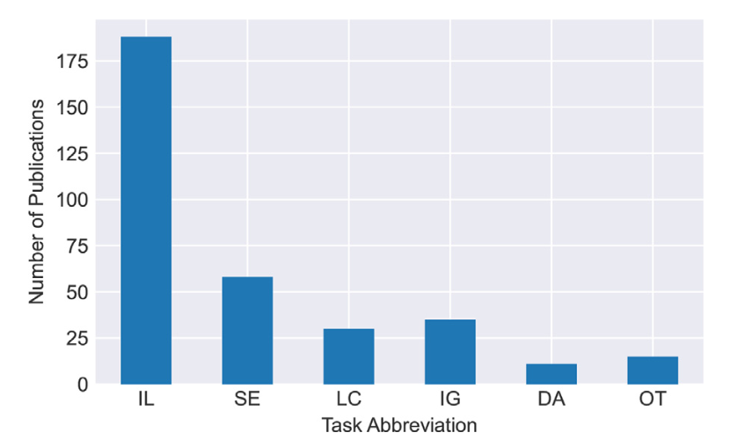
Related works
Regrettably, there is a scarcity of research on out-of-distribution (OOD) analysis specifically in the medical field, particularly concerning X-ray analysis.
This observation is supported by a survey on deep learning for chest X-ray analysis conducted by Erdi Çallı et al. in 2021, which indicated a limited number of studies published before March 2021.
Tasks: IL=Image-level Predictions, SE=Segmentation, LC=Localization, IG=Image Generation, DA=Domain Adaptation, OT=Other.

Slide 5
Related works
Two closely related studies to this research are:
"Confidence-based Out-of-Distribution Detection: A Comparative Study and Analysis" by Christoph et al. in 2021.
  This study specifically examines confidence-based models for out-of-distribution detection.
"Out of Distribution Detection for Medical Images" by Oliver et al. in 2021.
  Similarly, this study focuses on out-of-distribution detection but within the context of medical images. It also emphasizes the use of confidence-based models.

Slide 6
Related works
  This study aims to survey and study the effect of different OOD detection methods on X-ray images.
  The objective is to identify problematic anomalies for OOD detection and determine the best methods to handle them.
  The study re-implements and compares different approaches using a common testing framework for a fair and comprehensive comparison.

Slide 7
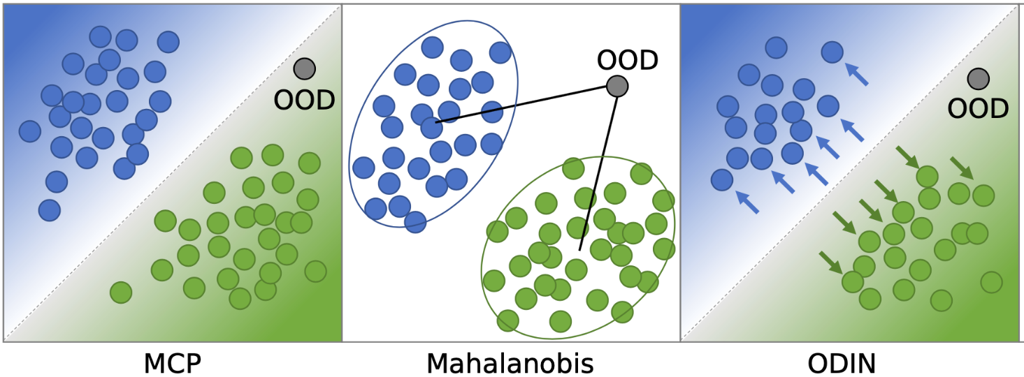
OOD Detection Methods
Confidence-based Models
These models rely on the confidence scores or probabilities assigned to predictions. They assess the certainty of a model's predictions and use thresholds to determine if an input is in-distribution or out-of-distribution.
Ref: https://github.com/christophbrgr/ood_detection_framework/blob/main/figures/figure1.png

Slide 8
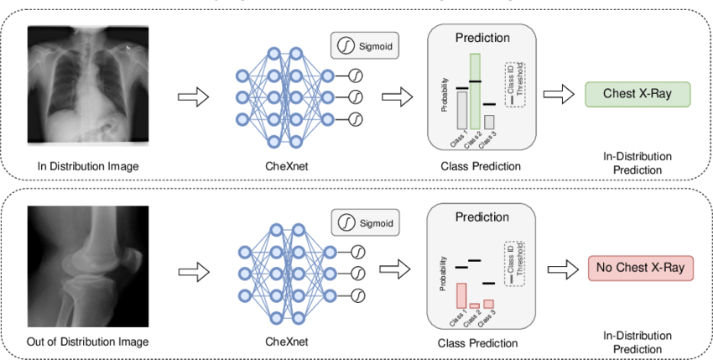
OOD Detection Methods
Classification Models
Classification models are traditional machine learning models or deep learning models trained to classify inputs into specific classes. In the context of out-of-distribution detection, classification models can be used to differentiate between in-distribution and out-of-distribution samples.
https://www.researchgate.net/figure/Out-of-distribution-OOD-detection-using-our-proposed-method-in-distribution-voting_fig2_362430550

Slide 9
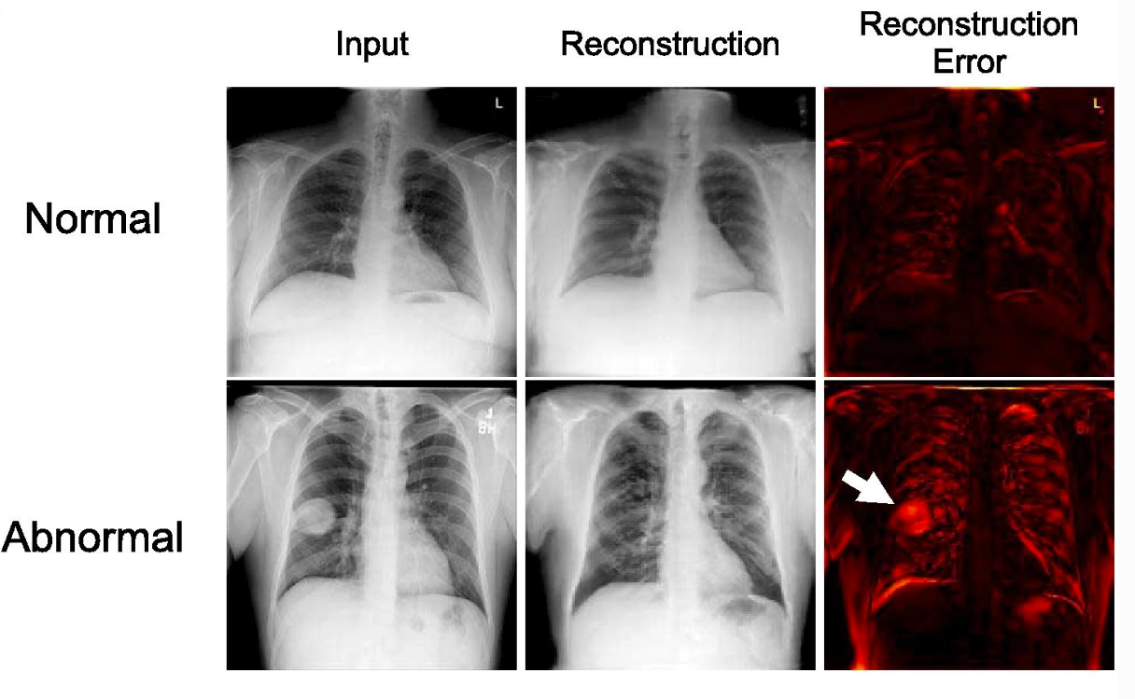
OOD Detection Methods
Generative Models
Generative models aim to learn the underlying data distribution of the training dataset. They generate new samples similar to the training data and use discrepancies between generated and input data to detect out-of-distribution samples.
Ref: https://link.springer.com/article/10.1007/s10278-020-00413-2/figures/1

Slide 10

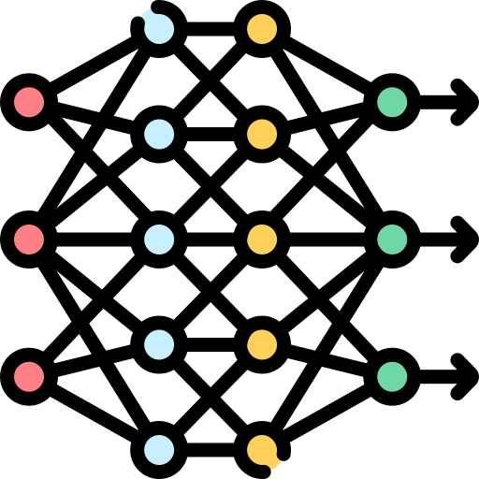

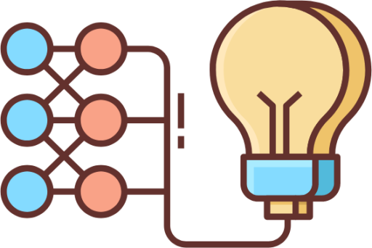
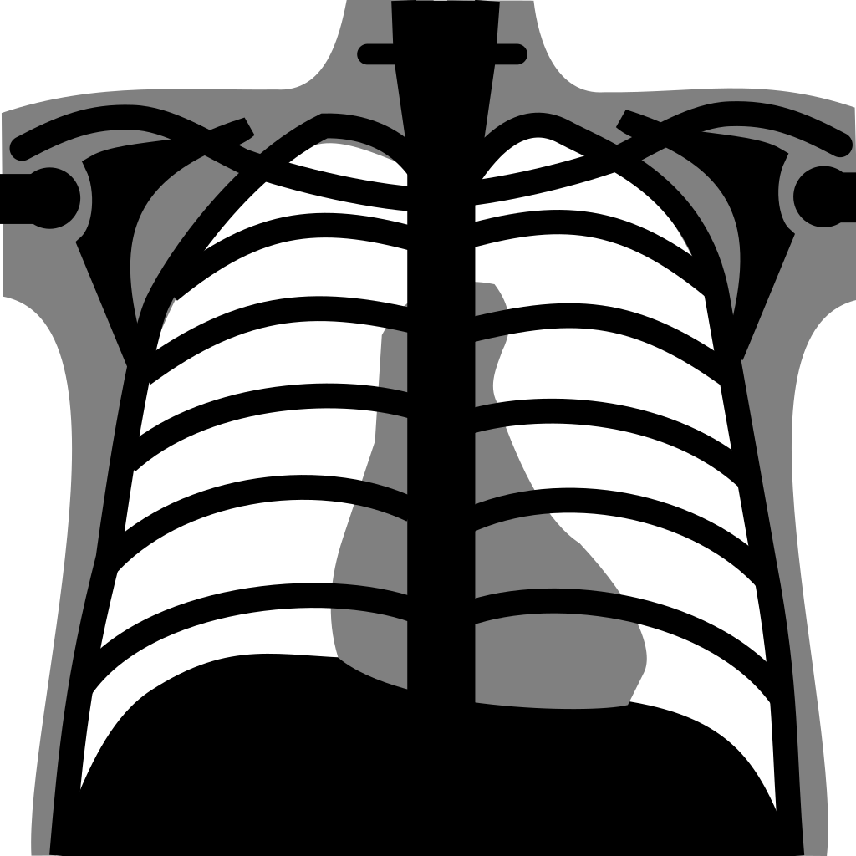
Experimental Setup
1. Datasets
2. Preparation
3. Model
4. Evaluation

Slide 11
Experimental Setup
1. Datasets
2. Preparation
3. Model
4. Evaluation

Slide 12
Datasets
In our study, we utilized a combined dataset consisting of four X-ray resources. These resources include:
  RSNA Pneumonia Detection Challenge
  Montgomery County and Shenzhen Chest X-ray Set
  RSNA Pediatric Bone Age Challenge
  X-ray images from patients with HIV
By combining these diverse sources, we aimed to create a comprehensive and representative dataset for our evaluation. Each resource contributes unique cases and characteristics, allowing us to capture a broad range of medical imaging scenarios.

Slide 13
Experimental Setup
1. Datasets
2. Preparation
3. Model
4. Evaluation

Slide 14
Preparation
Synthetic corruption was used to evaluate the models' performance since access to corrupted image datasets was unavailable.
A total of 15 corruption/OOD classes were identified, generated by applying the same corruptions to images from the test splits.
The RSNA dataset was separated into in-distribution (ID) and OOD images, and additional datasets representing different sources and unseen diseases were used.

Slide 15
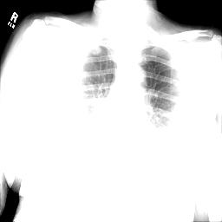
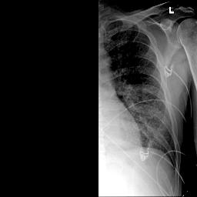
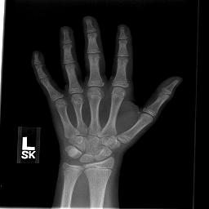
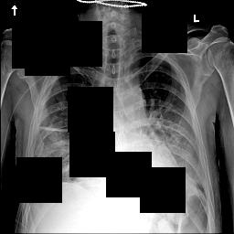

Preparation
Corruption Classes:
In-Distribution
Wrong Position
Blur
Gaussian Blur
Contrast
Gaussian Noise
Uniform Noise
Flat Value
Horizontal Half
Vertical Half
Coarse Dropout
Wrong Position
Different Source
Out-of-Distribution 1 (Different Domain)
Out-of-Distribution 2 (Different Symptom)
5. Contrast
10. Vertical Half
14. OOD1
11. Coarse Dropout
8. Flat Value

Slide 16
Experimental Setup
1. Datasets
2. Preparation
3. Model
4. Evaluation

Slide 17
Models
Confidence-based Models
Maximum Class Probability (MCP)
Classification Models
Visual Geometry Group (VGG)
Generative Models
Adversarially learned anomaly detection (ALAD)
Mahalanobis Distance
Out-of-Distribution Detector for Neural Networks (ODIN).
Residual Network (ResNet)
Densely Connected Convolutional Networks (DenseNet)
Pyramid Localization Network (PYLON)
f-AnoGAN
The Efficient GAN-Based Anomaly Detection (EGBAD)
GANomaly
HealthyGAN
To ensure consistency and fairness, we followed the configuration values and hyperparameters specified in the original papers for each model.

Slide 18
Experimental Setup
1. Datasets
2. Preparation
3. Model
4. Evaluation

Slide 19
Evaluation Metrics
We utilized 2 metrics to measure the accuracy and performance of the model in classifying ID and OOD tasks
Area under the receiver operating characteristic (AUROC)
Area under the precision-recall curve (AUCPR)

Slide 20
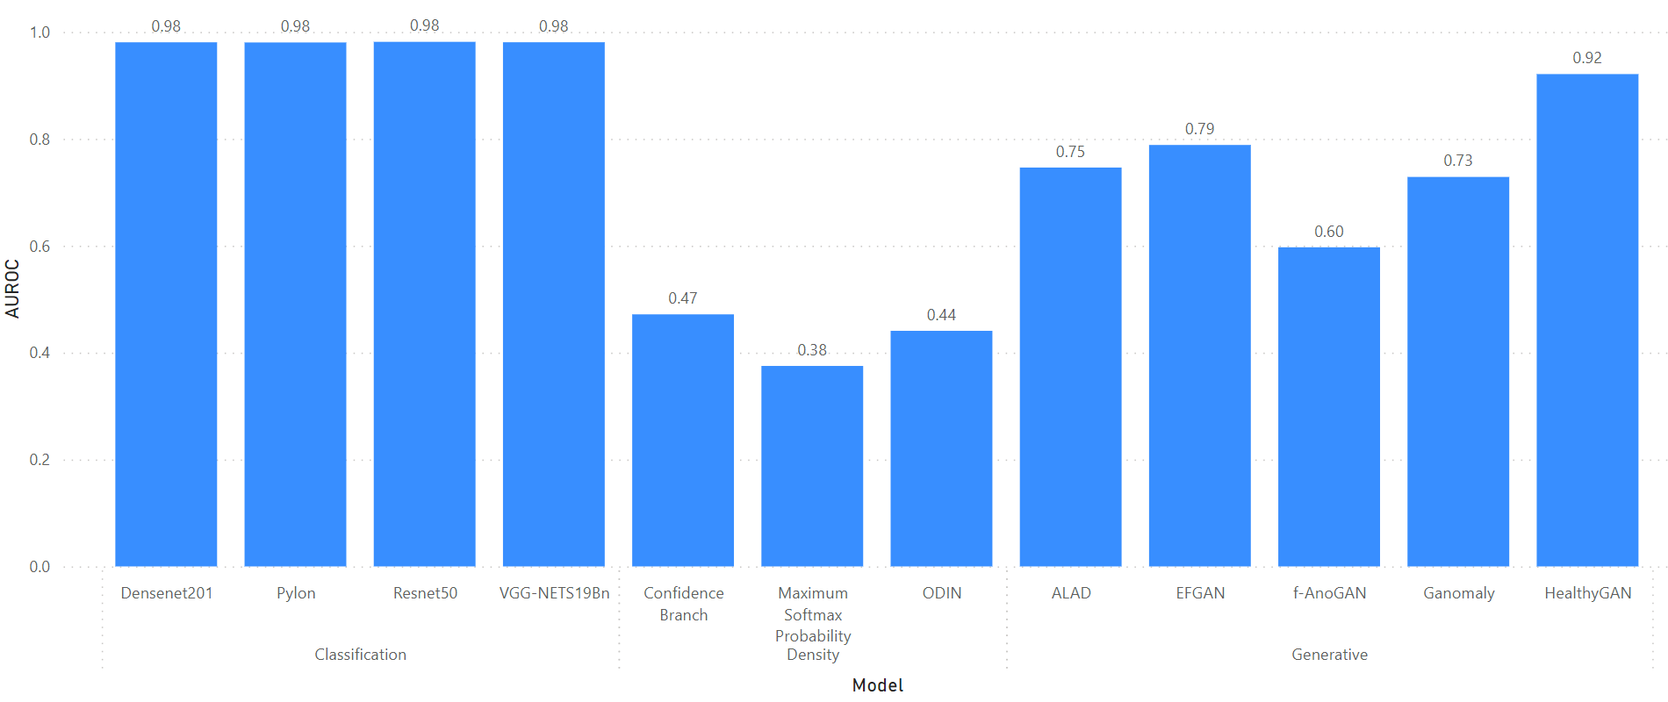
Results and Findings
Classification
Confidence-based
Generative
Pylon
ODIN
ALAD
EFGAN
Resnet50
F-AnoGAN
Ganomaly
HealthyGAN
Densenet201
VGG-NETS19Bn
Confidence Branch
Maximum Softmax

Slide 21
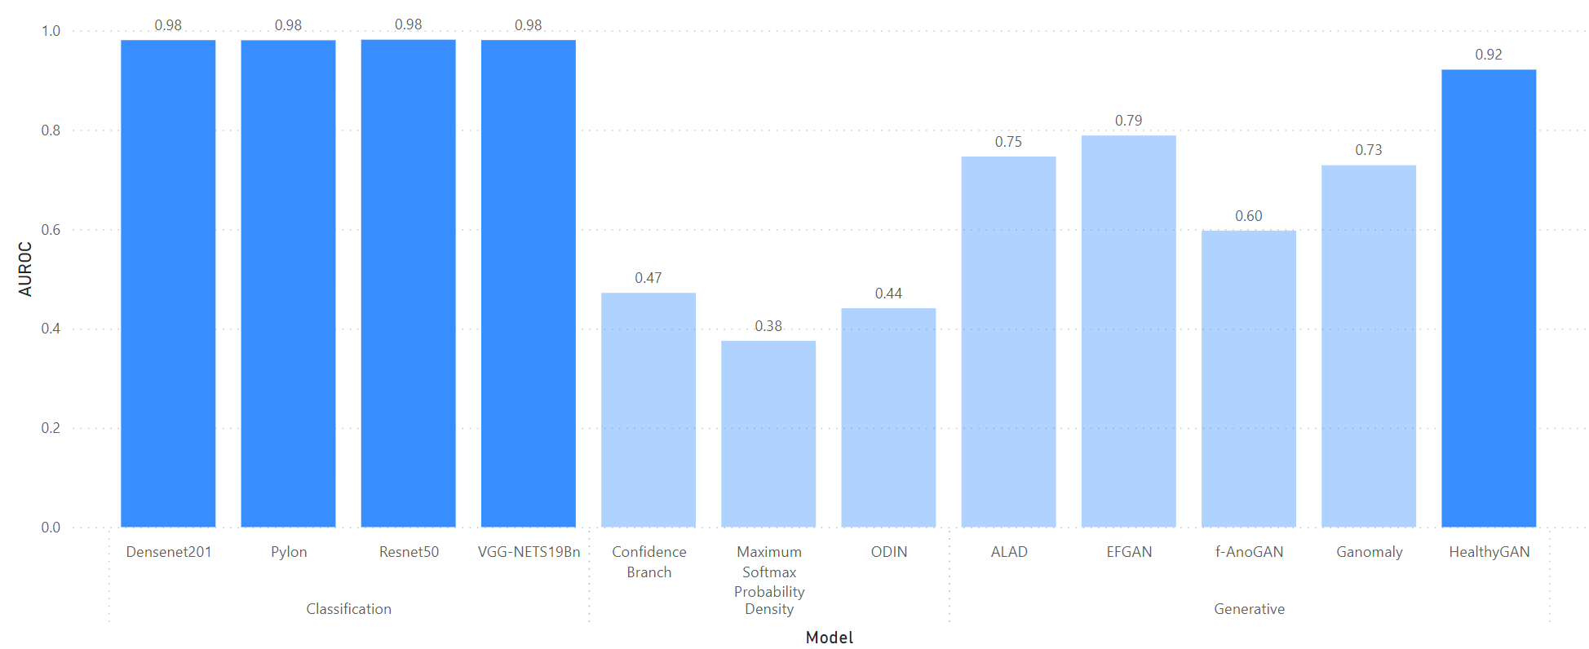
Results and Findings
Classification
Confidence-based
Generative
Pylon
ODIN
ALAD
EFGAN
Resnet50
F-AnoGAN
Ganomaly
HealthyGAN
Densenet201
VGG-NETS19Bn
Confidence Branch
Maximum Softmax

Slide 22
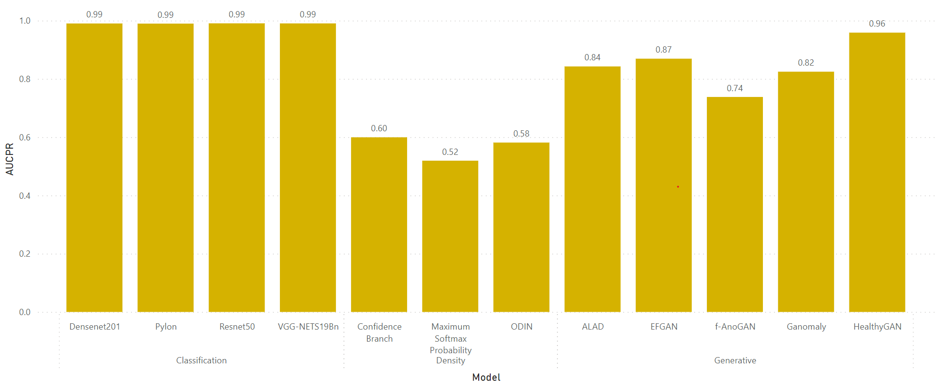
Results and Findings
Classification
Confidence-based
Generative
Pylon
ODIN
ALAD
EFGAN
Resnet50
F-AnoGAN
Ganomaly
HealthyGAN
Densenet201
VGG-NETS19Bn
Confidence Branch
Maximum Softmax

Slide 23
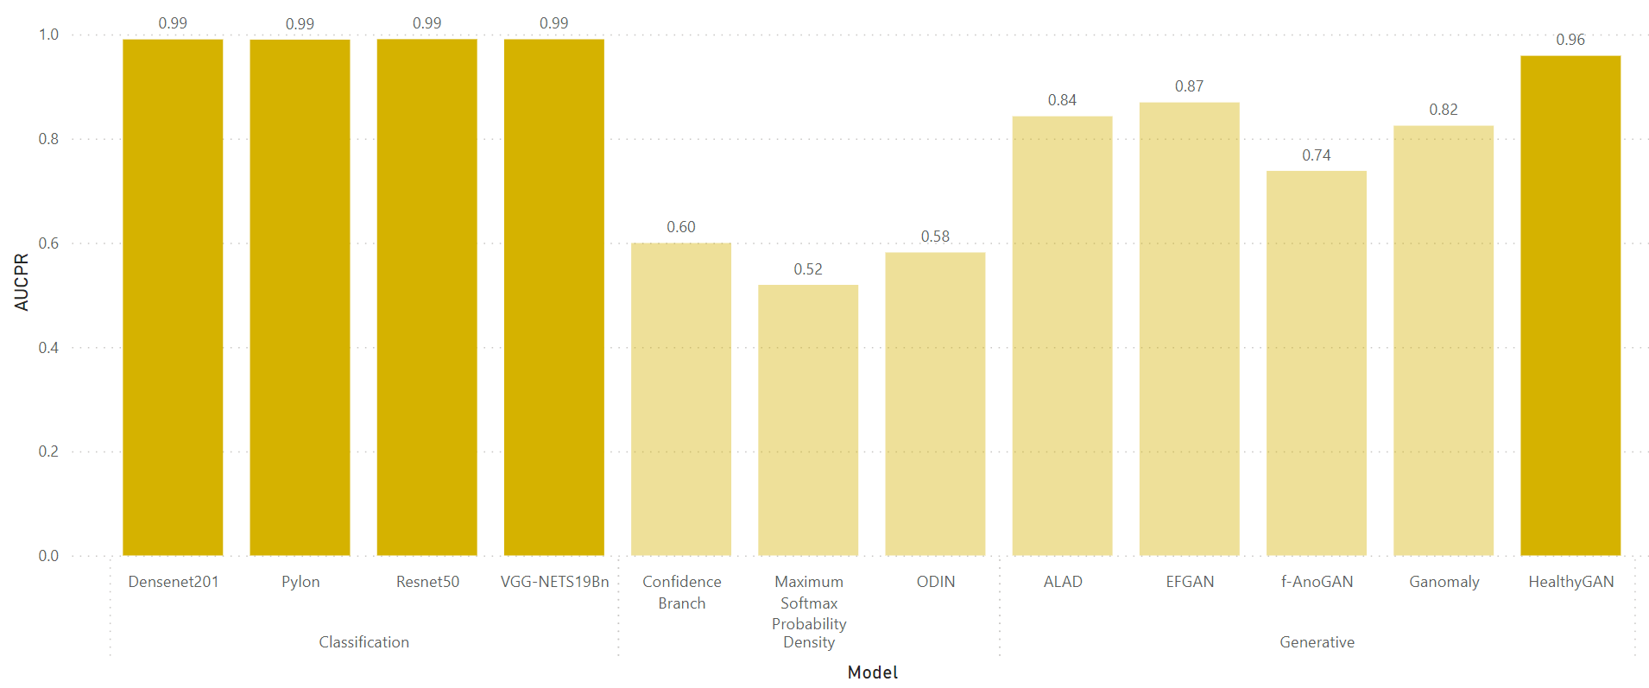
Results and Findings
Classification
Confidence-based
Generative
Pylon
ODIN
ALAD
EFGAN
Resnet50
F-AnoGAN
Ganomaly
HealthyGAN
Densenet201
VGG-NETS19Bn
Confidence Branch
Maximum Softmax

Slide 24
Open-world scenario
To address the disparity between testing and real-world scenarios, we conducted full-loop testing by simulating various scenarios and utilizing a new private dataset obtained from three distinguished hospitals in Thailand: Banglamung Hospital, Bureau of Tuberculosis, Thailand, and Maesot Hospital, Thailand.

Slide 25
Open-world scenario
  Employed an OOD detection model (Resnet50)
  Scored the images and identified top 20% as OOD images
  Removed OOD images from the dataset
  Assessed model's performance to evaluate if removing OOD data improved its robustness

Slide 26

Experimental Setup
1. Datasets
2. Preparation
3. Model (OOD)
4. Model
5. Evaluation

Slide 27
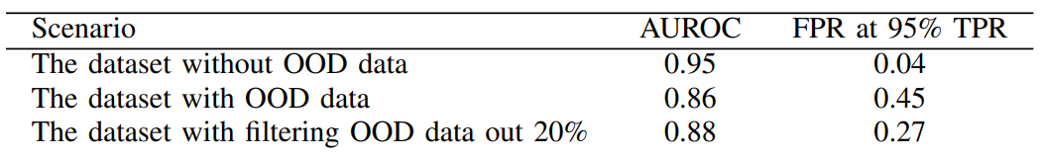
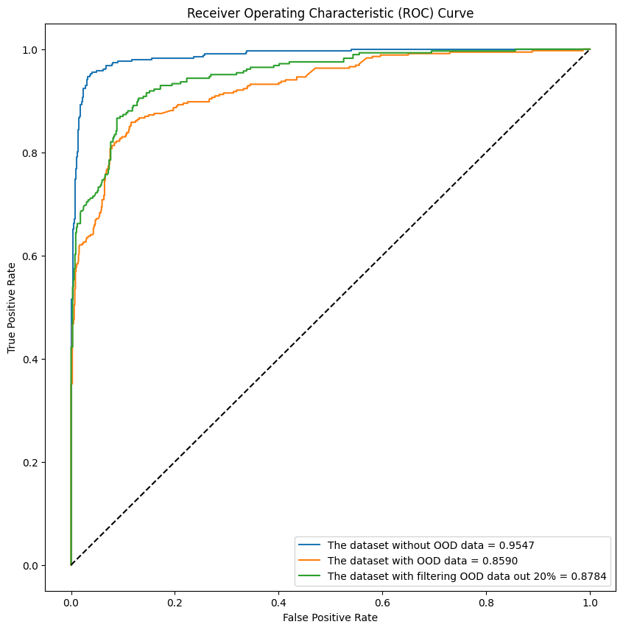
Results and Findings
In the first scenario, the model achieved a high accuracy of 95% and a low false positive rate (FPR) of 0.04 when classifying TB patients at a true positive rate (TPR) of 95%.
However, when the dataset included out-of-distribution (OOD) data, the model's accuracy dropped to 86%, and the FPR at 95% TPR significantly increased to 0.45.
In the third scenario, the results demonstrated that detecting and removing OOD data prior to model input improved its robustness.
The model's accuracy slightly improved when using an OOD detector to screen the input, and the FPR at 95% TPR decreased significantly by 18%.

Slide 28
Conclusion
This study aimed to assess state-of-the-art methods for out-of-distribution (OOD) detection in medical imaging.
Findings revealed that simple classification models outperformed confidence-based and generative methods in medical imaging tasks.
The utilization of Coarse Dropout significantly influenced OOD detection performance for both classification models and HealthyGAN.
A real-world scenario demonstrated the positive impact of OOD data screening, enhancing model robustness and reducing false positives.
Future research should explore OOD detection methods across diverse datasets and tasks, emphasizing the effects of corrupted classes on performance and reliability in real-world deployment

Slide 29
THANK YOU
QUESTION & ANSWER

Slide 30
Further Analysis
In real-world scenarios, it is impractical to train models with every possible corruption class. Therefore, we make the assumption that if a model has not encountered a specific corruption class before, can it still maintain robustness?
This assumption allows us to evaluate the models' ability to generalize and handle previously unseen corruption classes. By assessing their performance under these conditions, we gain insights into their overall robustness and adaptability in real-world settings.

Slide 31
Experimental Setup
1. Datasets
2. Preparation
3. Model
4. Evaluation

Slide 32
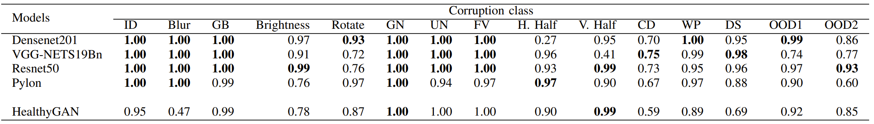
Results and Findings
Results indicated that specific corruption classes had a significant impact on the performance of the models.
Coarse Dropout was found to be the most challenging corruption class to detect.
Among the models evaluated, Resnet50 demonstrated the best overall performance.

