Slide 1



Enhanced Machine Learning-Based Code Smell Detection Through Hyper-Parameter Optimization
Peeradon Sukkasem and Chitsutha Soomlek
Department of Computer Science
College of Computing, Khon Kaen University
The 20th International Joint Conference on Computer Science and Software Engineering
28th June-1st July 2023
Naresuan University Phitsanulok, THAILAND

Slide 2
AGENDA
Introduction
Background
Methodology
Results
Conclusion

Slide 3
1) INTRODUCTION

Slide 4
CODE SMELL
Code smell is a part or structure of the code that imply poor implementation or design of a software system.
Code smell affects the maintainability and quality.
Poor design and implemention could caused a code smell.
Code smell is not a bug !

Slide 5
CODE SMELL
Code refactoring is a solution to eliminate code smells.
Code smell detection process is required before refactor the code.
Common code smell detection approaches:
  Metric-based
  Rule-based
  Search-based
  Machine learning-based

Slide 6
MACHINE LEARNING-BASED
CODE SMELL DETECTION
The model is directly learned using relative software properties.
Provide reliable code smell detection results.
Mitigate the subjectivity issues rised by different developer’s perception.

Slide 7
RESEARCH OBJECTIVE
To improve the efficiency of machine leaning-based code smell classfiers using Hyper-parameter optimization (HPO) techniques.

Slide 8
2) BACKGROUND

Slide 9
MACHINE LEARNING-BASED
CODE SMELL DETECTION
Main procedures:
  Software metrics extraction using static/dynamic analysis tools
  Code smell labeling by experts or detection tools
  Model training
  Model evaluation and testing
Tree-based algorithms like decision tree and random forest are the most well-performed algorithm.

Slide 10
MACHINE LEARNING-BASED
CODE SMELL DETECTION
ML-based code smell detection still have low performance compared to traditional approaches.
Feature selection and hyper-parameter opitmization (HPO) can significantly enhance the performance.
Limited number of reseach apply HPO to code smell detection problem.

Slide 11
MACHINE LEARNING-BASED
CODE SMELL DETECTION
Recommended related works:
“Comparing and experimenting machine learning techniques for code smell detection” – F. Arcelli Fontana et al. (2016)
“Machine learning techniques for code smell detection: A systematic literature review and meta-analysis” – M.I. Azeem et al. (2019)
“Comparing heuristic and machine learning approaches for metric-based code smell detection” – F. Pecorelli et al. (2019)

Slide 12
HYPER-PARAMETER OPTIMIZATION
Hyper-parameter is a parameter that define the model architecture.
Hyper-parameters are initialized before the training process.
The main goal of HPO is to find optimal hyper-parameter configuration that minimizes the model loss.

Slide 13
3) RESEACH METHODOLY

Slide 14
EXPERIMENTAL DESIGN
The experiment procedures consist of
  Data preparation
  Model training and optimizing
  Model evaluation and comparison

Slide 15
DATASET
“Qualitus Corpus” code smell dataset is used, which consists of 4 code smell types:
  God class
  Data class
  Feature envy
  Long method
The dataset includes 74 Java software systems.

Slide 16
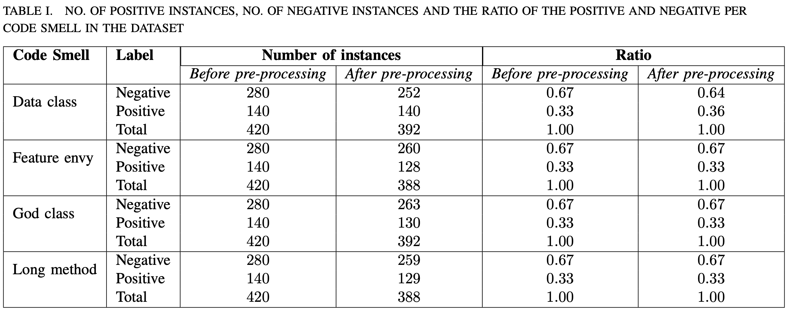
DATA PREPARATION

Slide 17
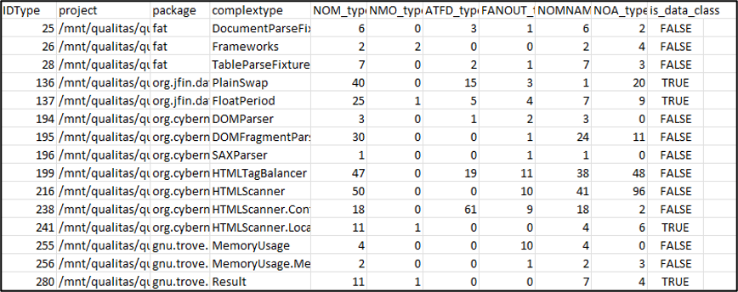
DATA PREPARATION
Example of Qualitas corpus’s data class code smell dataset

Slide 18
MODEL TRAINING & OPTIMIZING
Deicision tree and random forest algorithm are used to create code smell classifiers.
Selected HPO techniques are:
  Bayesian optimization using tree parzen estimator (BO-TPE)
  Bayesian optimization using random forest (SMAC)
  Particle swarm optimization (PSO)

Slide 19
MODEL EVALUATION
Each experiment is evaluate using 10-fold cross validation with 10 repetitions.
The experiments were conducted repeatedly for 10 iterations.
The number of maximum iteration of all HPO methods was set to 50.
All HPO methods were using the same hyper-parameter configuration space.

Slide 20
4) RESULTS

Slide 21
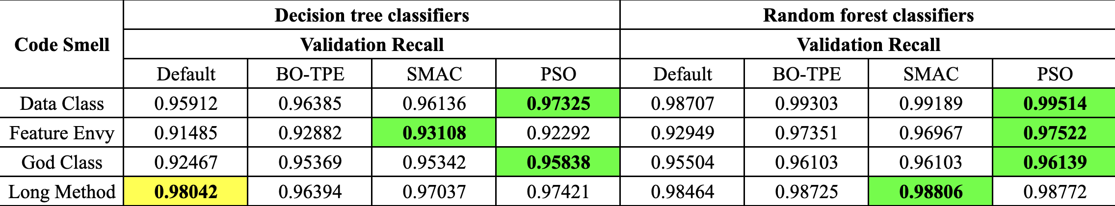
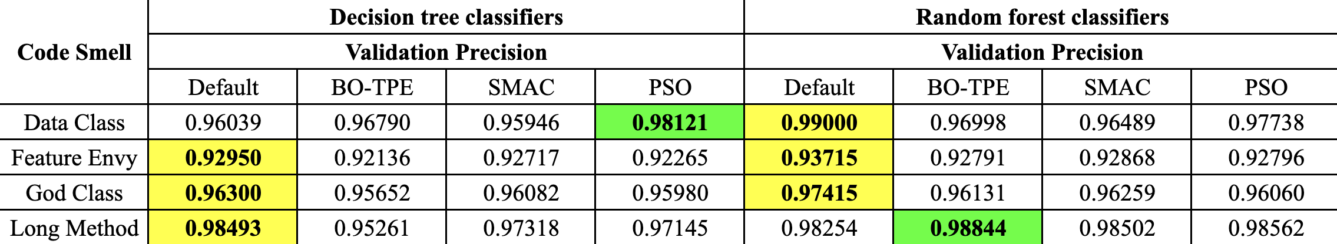
RECALL
PRECISION
Notes:
Recall improvement for each code smell:
Data class : ≈ 1%
Feature envy : ≈ 2 – 5%
God class : ≈ 1 – 3%
Long method : < 1%

Slide 22
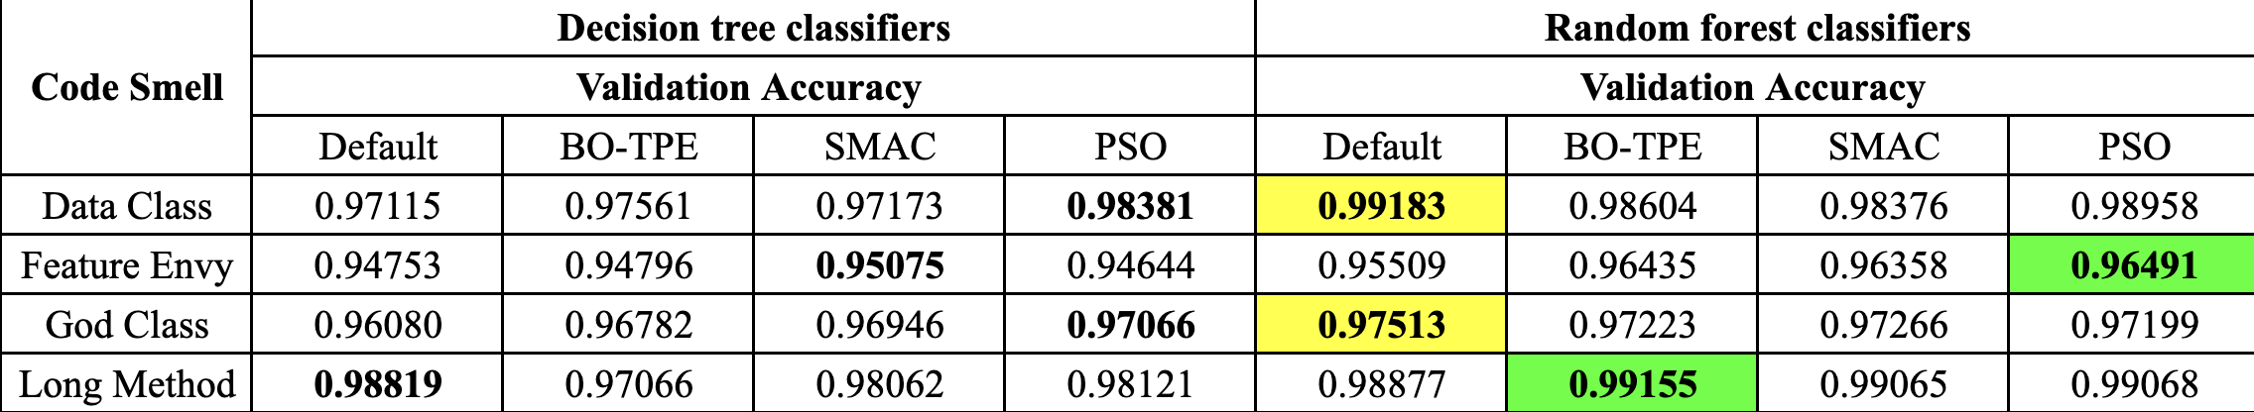
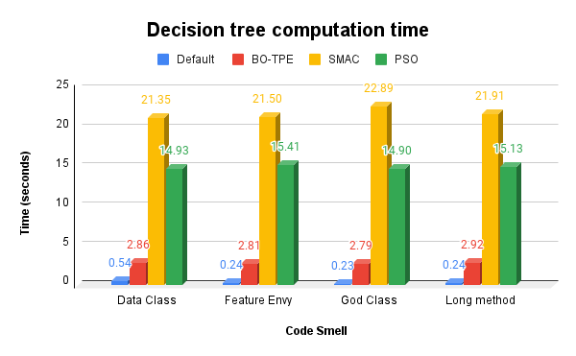
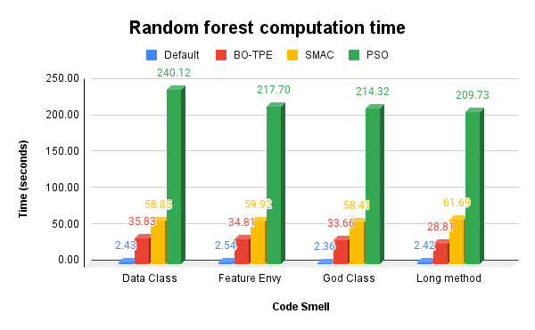
ACCURACY
COMPUTATION TIME

Slide 23
5) CONCLUSION

Slide 24

CONCLUSION
HPO has positive effects on the machine learning-based code smell classifiers in term of recall and accuracy in some cases.
No significant difference on the precision.
There is a trade-off between performance and computational time.

Slide 25
KEY TAKEAWAYS
HPO significantly affects recall and accuracy of ML-based code smell classifiers.
The improvement comes with additional resources costs.
There is a room for exploring more HPO techniques and ML algorithms.

Slide 26



CONTACT US
Peeradon Sukkasem
peeradon_s@kkumail.com
Chitsutha Soomlek
chitsutha@kku.ac.th

