Slide 1



Contextualized vs. Static Word Embeddings for Word-based Analysis of Opposing Opinions
Wassakorn Sarakul, Attapol T Rutherford
Department of Linguistics, Faculty of Arts, Chulalongkorn University
The 20th International Joint Conference on Computer Science and Software Engineering
28th June-1st July 2023
Naresuan University Phitsanulok, THAILAND

Slide 2
Word Embedding
A vector that represent a word
Word embedding is based on the distributional hypothesis, which is that the meaning of a word is derived from its context. (Harris, 1954)
Similar words
Similar contexts
Similar word embedding

Slide 3
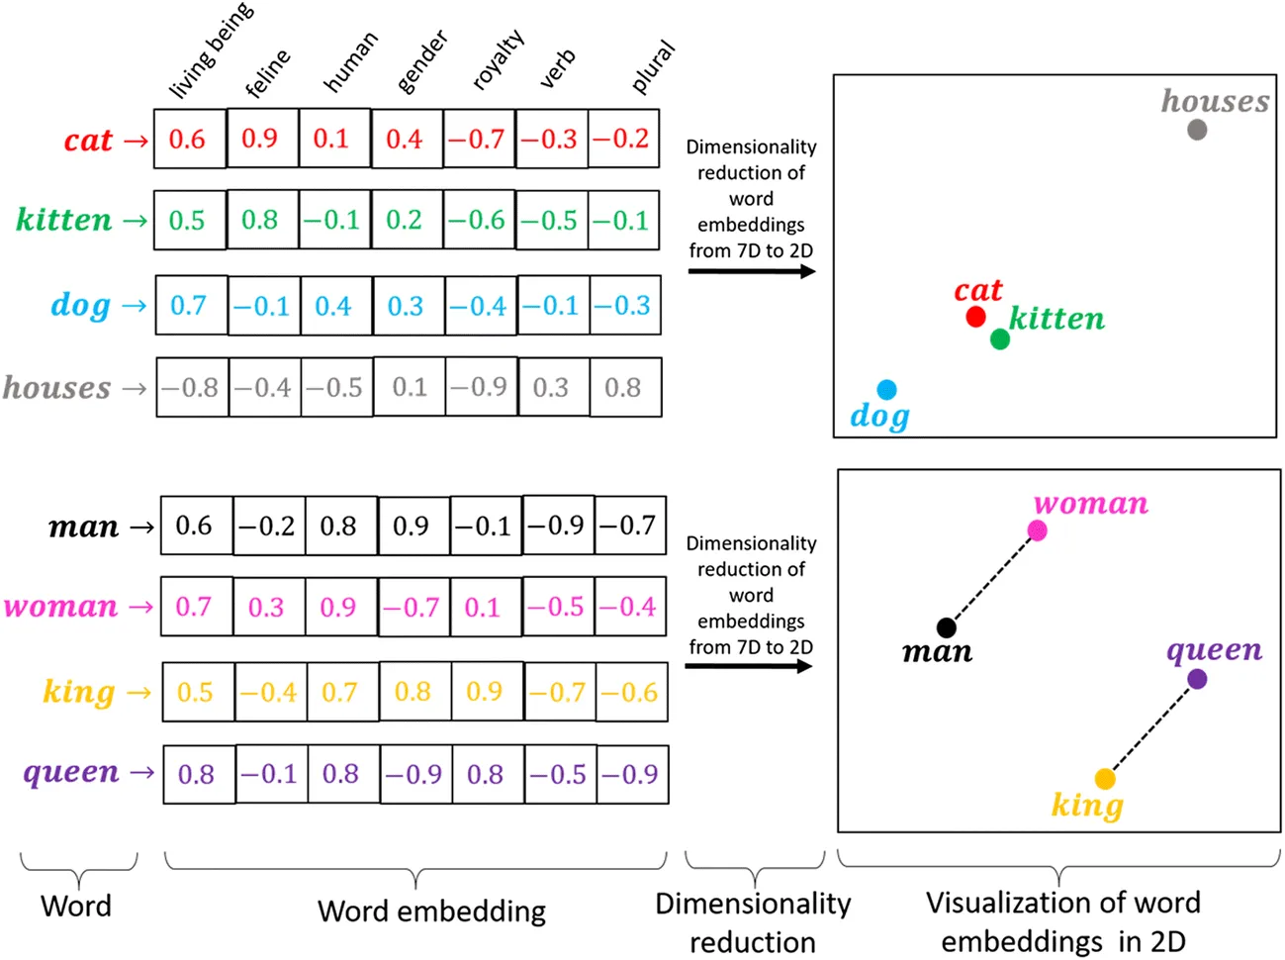
Example
Source: https://lengyi.medium.com/word-embedding-word2vec-nlp-model-dbc4c892dfb9
Notes:
Here is an example of word embedding. You will see that cat and kitten are more similar relative to dog and house, so their embeddings are more similar.

Slide 4
Word-based opinion analysis
Tweets before COVID-19
Tweets after COVID-19
Word embedding before COVID-19
Word embedding after COVID-19
“china” embedding
“china” embedding
Compare
Most similar word of “china”
Most similar word of “china”
More Sinophobic word
(Tahmasbi et al., 2021)

Slide 5
2 types of word embeddings
Static word embedding: word2vec (Mikolov et al., 2013), fasttext (Bojanowski et al., 2017), GloVe (Pennington et al., 2014).
Contextualized word embedding: Bert (Devlin et al., 2018), ELMo (Peters et al., 2018)
“The poor bird couldn't fly because it had a broken wing.” (Cambridge Dictionary, 2022a)
The gunman shot the princess and ran to the east wing of the palace.
“The extreme right-wing of the party has dominated the discussion.” (Cambridge Dictionary, 2022a)

Slide 6
Gaps
Most word-based analysis utilized static word embedding, and fewer works utilized contextualized word embedding.
No work studied the differences between these two embeddings in word-based analysis tasks.

Slide 7
Research Questions
How does the pre-training process affect the output of the static word embeddings in the word-based opinion analysis task?
Which of the two embeddings is more effective in delineating the opposing opinion in two opposing focus corpora?
How do static and contextualized word embeddings behave differently in the word-based opinion analysis?

Slide 8
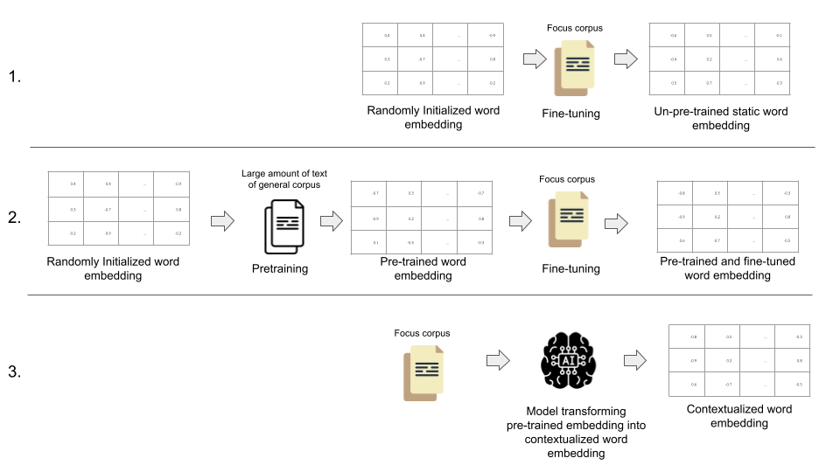
Our Approach
Un-pre-trained static word embedding
Pre-trained static word embedding
Contextualized word embedding

Slide 9
Experiment setup
Embeddings
Model | Architecture
Un-pre-trained static word embeddings | Word2vec (Mikolov et al., 2013)
Pre-trained static word embeddings | Word2vec (Mikolov et al., 2013)
Contextualized word embeddings | WangchanBERTa (Lowphansirikul et al., 2021)

Slide 10
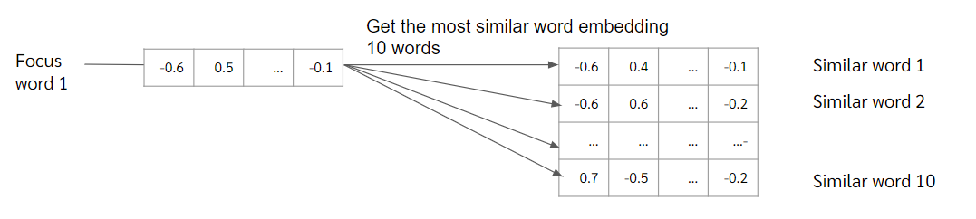
Experiment setup

Slide 11
Experiment setup
Focus Dataset: The 2020–2022 Thai protests Twitter data
Name | Corpus | Tweets
The Protest Twitter | The Protest Twitter | 34,186
Opposition Twitter | Opposition Twitter | 30,106
The Protest Twitter - small | The Protest Twitter | 3,419
Opposition Twitter - small | Opposition Twitter | 3,011

Slide 12
Experiment setup
Selected focus word:
  แกง “v. deceive”
  ม็อบ “protest”
  เรียกร้อง “demand/call for”
  สลิ่ม “Sa-lim”
  ชาติ “nation”
  ประชาชน “people”
  ประเทศ “country”
  ภาษี “tax”
  รัฐบาล “government”

Slide 13
Experiment setup
Evaluate 9 selected focus word in 3 following criteria
  Syntactic relation (same syntactic tree)
  Semantic relation
  Usefulness (ability to express corpus specific opinion)
Lexical Relation

Slide 14
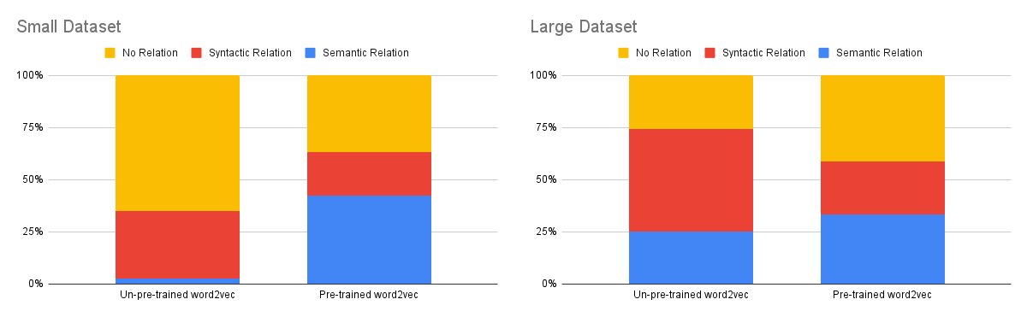
Results and Discussion
How does pre-training affect the output of the static word embeddings in the word-based opinion analysis task?
Pre-training improve embedding quality in small dataset, but yield reverse effect in large dataset.

Slide 15
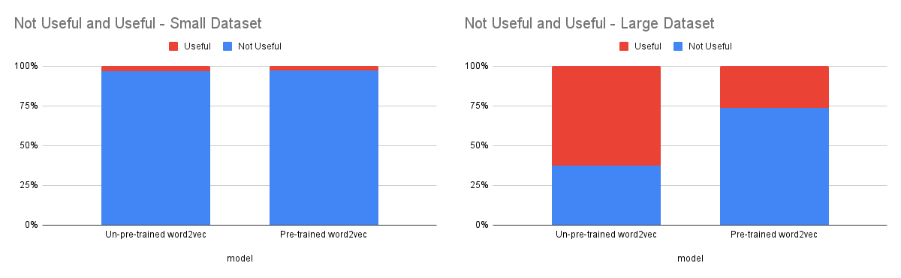
Results and Discussion
1. How does pre-training affect the output of the static word embeddings in the word-based opinion analysis task?
In small dataset, static word embedding is not effective in word-based analysis regardless of pre-training.
In large dataset, pre-training leads to fewer useful words.

Slide 16


Q.1: The gigantic size of the general corpus dilutes the effect of the focus corpus
General corpus: 4.33 GB
Focus corpus: ~2.0 MB each
Focus corpus: ~2.0 MB each
General corpus: 4.33 GB
Open-access Thai text corpus
(Lowphansirikul et al., 2021b)

Slide 17
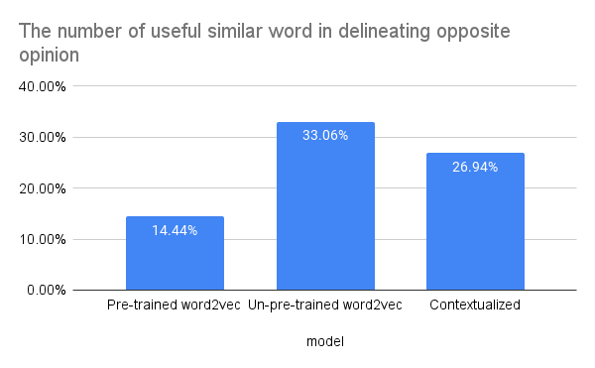
Results and Discussion
2. Which of the two embeddings is more useful in delineating the opposing opinion in two opposing focus corpora?
Overall, un-pre-trained static word embedding is the most effective in word-based analysis.

Slide 18
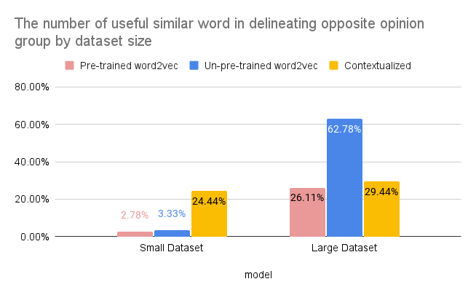
Results and Discussion
2. Which of the two embeddings is more useful in delineating the opposing opinion in two opposing focus corpora?
The result still confirms that word-based analysis is not recommended for small-sized dataset.

Slide 19
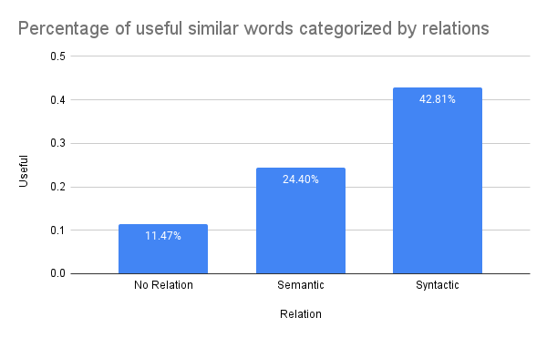
Results and Discussion
3. How do static and contextualized word embeddings behave differently in word-based analysis?
Syntactic relation is the most useful.

Slide 20
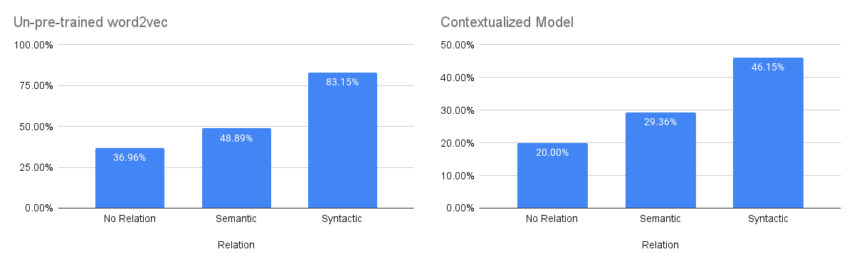
Results and Discussion
3. How do static and contextualized word embeddings behave differently in word-based analysis?
Syntactic relation is the most useful relation regardless of models.

Slide 21
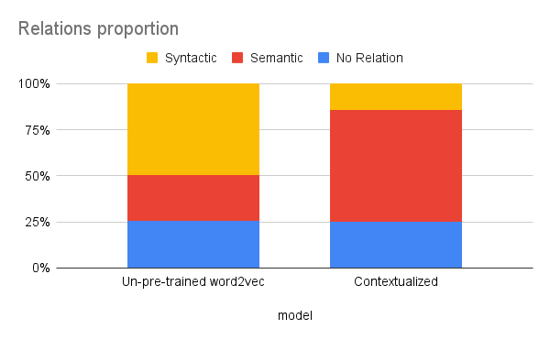
Results and Discussion
3. How do static and contextualized word embeddings behave differently in word-based analysis?
Un-pre-trained word2vec: Syntactic relation
Contextualized: Semantic relation

Slide 22
Conclusion
Pre-training improve embedding quality in small-sized dataset,
It is not advisory to do word-based analysis task in small-sized dataset.
Un-pre-trained word2vec is useful for delineating the opposing opinion in two opposing focus corpora.
Static word embedding is preferable than contextualized model, because syntactical-related similar word is useful for delineating the opposing opinion corpora. Word2vec gives similar word that are syntactically related to focus word, while contextualized model give semantic-related similar word.

Slide 23
THANK YOU
QUESTION & ANSWER

Slide 24
Q&A

Slide 25
Examples of word embeddings in social sciences
Static word embeddings | Contextualized word embeddings
Biases and stereotypes: (Garg et al., 2018) | Multiple uses of words in financial text: (Montariol et al., 2020)
Macroeconomics: (Kaveh-Yazdy & Zarifzadeh, 2021) | Semantics shift in financial text: (Hu et al., 2019)
Market regulation: (Di Porto et al., 2021) | Depression detection (classification): (Hämäläinen et al., 2021)
Immigrant Perspective: (Stoltz & Taylor, 2021), (Nelson, 2021)
Sinophobic Language: (Tahmasbi et al., 2021)
News Portrayal of Hong Kong's 2019-2020 protest: (McCarthy et al., 2021)

Slide 26
Static word embedding
Input: Smooth like butter, like a criminal undercover → 8 tokens
“Smooth”, “like”, “butter”, “,”, “like”, “a”, “criminal”, “undercover”
Smooth | [-0.3542, 0.2574, 0.0917, …]
like | [-0.0320, -0.1310, 0.4184, …]
butter | [0.1605, 0.4662, 0.0530, …]
, | [0.0602, -0.1017, 0.0564, …]
a | [-0.1567, 0.8709, -0.6458, …]
criminal | [0.8596, -0.2345, 0.7451, …]
undercover | [-0.9654, 0.1247, 0.6486, …]
Static word embedding
7 unique word embedding

Slide 27
Contextualized word embedding
Input: Smooth like butter, like a criminal undercover → 8 tokens
“Smooth”, “like”, “butter”, “,”, “like”, “a”, “criminal”, “undercover”
Smooth | [-0.3542, 0.2574, 0.0917, …]
like | [-0.0320, -0.1310, 0.4184, …]
butter | [0.1605, 0.4662, 0.0530, …]
, | [0.0602, -0.1017, 0.0564, …]
like | [-0.330, -0.1152, 0.4544, …]
a | [-0.1567, 0.8709, -0.6458, …]
criminal | [0.8596, -0.2345, 0.7451, …]
undercover | [-0.9654, 0.1247, 0.6486, …]
Contextualized word embedding
8 unique word embeddings

Slide 28
Models
Static word embedding
Contextualized word embedding
Word embedding from the model
Average embedding of all embedding of that word
The averaged version of contextualized word embeddings retains the embedding quality and is the most effective pooling method (Bommasani et al., 2020).

