Slide 1



A Comparison of Machine Learning and Neural Network Algorithms for an Automated Thai Essay Scoring
Suttichai Suriyasat
Department of Computer Engineering
Chulalongkorn University
Thailand
Sapa Chanyachatchawan
The National Electronics and
Computer Technology Center
Thailand
Nuengwong Tuaycharoen
Department of Computer Engineering
Chulalongkorn University
Thailand
The 20th International Joint Conference on Computer Science and Software Engineering
28th June-1st July 2023
Naresuan University Phitsanulok, THAILAND

Slide 2
Introduction
Students from Thailand have relatively low scores on reading literacy and tend to decline continuously. [1]
[1] OECD, PISA 2018 Results (Volume II): Where all students can succeed. OECD, 2019. doi: 10.1787/b5fd1b8f-en.

Slide 3
Objective
Develop machine learning and neural network models for automated essay grading in Thai language
Reduce raters’ essay grading time and improve grading efficiency
Encourage students to work harder by providing prompt feedback

Slide 4
Backgrounds
Traditional Machine Learning Models with Handcrafted Features:
  Focus on linguistic features
  Excellent agreement between system predictions and human rater's scores
Deep Learning Models with Word Embedding Features:
  Automated feature extraction using CNN and LSTM
  Outperformed traditional models in the ASAP dataset
Transformers-based Models with Contextualized Embedding Features:
  Leveraging pre-trained language models like BERT and RoBERTa

Slide 5
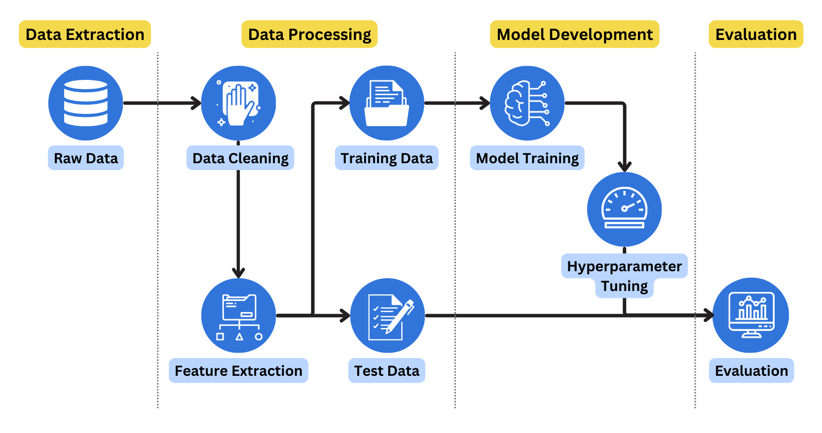
Research Methodology

Slide 6
Dataset statistics

Slide 7
Dataset attributes
Attribute | Description | Data type
id_diary | Essay ID | Numerical
title | Essay title written by student | Text
content | Written content of essay | Text
grade | Student grade | Numerical
time_spent | The total time spent including writing and decorating an essay’s web page | Numerical
time_to_write | The time spent on writing an essay | Numerical
total_character | The total text characters on an essay | Numerical
shelf_name | Assigned essay topic | Text
description | Description of assigned topic | Text
rubric_story | Essay writing score | Numerical
rubric_media | Score for attached media in an essay’s web page | Numerical
rubric_beautiful | Score for essay web page decoration | Numerical

Slide 8
Rubric Scoring Guideline
The essay is on point and relevant to the assigned topic.
The essay includes writer’s experience or personal perspective.
The essay structure is clear and conforms to the topic.
The essay is interesting and creative.
The essay structure is organized and not monotonous.

Slide 9
Models
Support Vector Machine (SVM)
K-Nearest Neighbors (kNN)
Gradient Boosting
Logistic Regression
Random Forest
eXtreme Gradient Boosting (XGBoost)
Long Short-Term Memory (LSTM)
Convolutional neural network (CNN)
BERT-based

Slide 10
Evaluation metrics
Accuracy
Quadratic weighted kappa (QWK)
Precision
Recall
F1-score

Slide 11
Evaluation metrics
Best overall performing model
Best traditional machine learning model with handcrafted linguistic and essay attribute features
Best deep learning model with automatically extracted features

Slide 12
Overall Results

Slide 13
Deep Learning Models Results

Slide 14
Conclusion
This study compared various machine learning and deep learning models for automated essay scoring written in Thai language
The XGBoost model with handcrafted linguistic and essay attribute features outperforms other models in most scenarios
LSTM with the word2vec model has better performance than other deep learning models
Non-linguistic features such as time spent relate to the essay score

Slide 15
THANK YOU
QUESTION & ANSWER
Notes:
Thank you for your attention. If you have any questions, please let me know.

Slide 16
Related Works
Research | Dataset | Feature | Model | Result
More efficient processes for creating automated essay scoring frameworks: a demonstration of two algorithms [2] | ASAP | Coh-Metrix Bag-of-words | SVM CNN | QWK = 0.73
Automated essay scoring by maximizing human-machine agreement [3] | ASAP | Linguistics | Random forest | QWK = 0.78
Automated essay scoring system based on rubric [4] | Japanese information literacy | Linguistics | SVM | Error rate = 0.429
Automated essay scoring based on two-stage learning [5] | ASAP | Word embedding Linguistics | LSTM + XGBoost | QWK = 0.77
A neural approach to automated essay scoring [6] | ASAP | Word embedding | CNN+LSTM | QWK = 0.76
Neural Networks for Automated Essay Grading [7] | ASAP | Word embedding TF-IDF | 2-layer NN | QWK = 0.94
A novel automated essay scoring approach for reliable higher educational assessments [8] | ASAP | RoBERTa embedding | Bi-LSTM | QWK = 0.80

Slide 17
References
[1] OECD, PISA 2018 Results (Volume II): Where all students can succeed. OECD, 2019. doi: 10.1787/b5fd1b8f-en.
[2] J. Shin and M. J. Gierl, “More efficient processes for creating automated essay scoring frameworks: a demonstration of two algorithms,” Language Testing, vol. 38, no. 2, pp. 247–272, Apr. 2021, doi: 10.1177/0265532220937830.
[3] H. Chen and B. He, “Automated essay scoring by maximizing human-machine agreement,” in Proc. 2013 Conf. on Empirical Methods in Nat. Lang. Process., Seattle, Washington, USA: Association for Computational Linguistics, Oct. 2013, pp. 1741–1752.
[4] M. Yamamoto, N. Umemura, and H. Kawano, “Automated essay scoring system based on rubric,” in Applied Computing & Information Technology, vol. 727, R. Lee, Ed. Cham: Springer International Publishing, 2018, pp. 177–190. doi: 10.1007/978-3-319-64051-8_11.
[5] J. Liu, Y. Xu, and Y. Zhu, “Automated essay scoring based on two-stage learning.” To be published. Accessed: May 22, 2023. [Online]. Available: http://arxiv.org/abs/1901.07744
[6] K. Taghipour and H. T. Ng, “A neural approach to automated essay scoring,” in Proc. 2016 Conf. on Empirical Methods in Nat. Lang. Process., Austin, Texas, 2016, pp. 1882–1891.
[7] H. T. T. Nguyen, “Neural Networks for Automated Essay Grading,” Dept. Comput. Sci., Stanford Univ., California, Stanford Rep. 1-11, 2016.
[8] M. Beseiso, O. A. Alzubi, and H. Rashaideh, “A novel automated essay scoring approach for reliable higher educational assessments,” J Comput High Educ, vol. 33, no. 3, pp. 727–746, Dec. 2021, doi: 10.1007/s12528-021-09283-1.

