Slide 1




Midnight
An Efficient Event-driven EVM Transaction Security Monitoring Approach For Flash Loan Detection
Shahin Ramezany, Rachsuda Setthawong, Pisal Setthawong
Computer Science Department
Assumption University Of Thailand
The 20th International Joint Conference on Computer Science and Software Engineering
28th June-1st July 2023
Naresuan University Phitsanulok, THAILAND

Slide 2
Outline
Intro to blockchain and DeFi
Previous works
Core contribution
Midnight
EVM events
Flash Loans
AAVE
Outcome
Conclusion and future works

Slide 3
Intro to blockchain and DeFi
Blockchain != cryptocurrencies

Slide 4
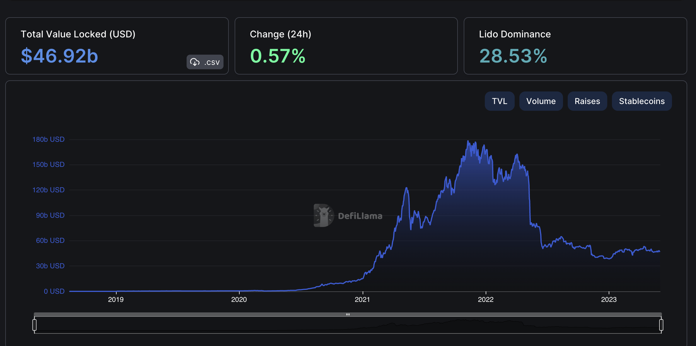
Current Stats
DeFillama.com

Slide 5
Previous works
Topic is new
Fewer research available
Notable related researches :
  Towards A first step to understand flash loan and its applications in DeFi ecosystem
  Attacking the DeFi ecosystem with flash loans for fun and profit,

Slide 6
Core Contributions
Analyze the current methods
Suggest detailed alternative (midnight)
Low level transactions & EVM events guide
Simplified dataset generation
Real world case study : AAVE v3 protocol

Slide 7
Midnight
Architecture

Slide 8
Solidity Events
pragma solidity ^0.8.17;
contract Midnight {
event howl (address owner, uint time);
constructor () {
emit howl (msg.sender, 1);
}
}

Slide 9
ABI , Event Encoding Decoding
[
{
"anonymous": false,
"inputs": [
{
"indexed": false,
"internalType": "address",
"name": "owner",
"type": "address"
},
{
"indexed": false,
"internalType": "uint256",
"name": "time",
"type": "uint256"
}
],
"name": "howl",
"type": "event"
}
]
{"logIndex":1,"blockNumber":1,"blockHash":"0xc2b
158385f6bb6c2677174c63f8dbc92e3d7c1c48b8b045cb42e
3dcce4c0ffa0","transactionHash":"0x542c48de5ebf95
6e0f16f7698960cf874d83149af9f751e5870df68ebf59ba1
c","transactionIndex":0,"address":"0xd8b934580fcE
35a11B58C6D73aDeE468a2833fa8","data":"0x000000000
0000000000000005b38da6a701c568545dcfcb03fcb875f56
beddc40000000000000000000000000000000000000000000
000000000000000000001","topics"["0x5743f3b67735da
bb6e485a02334a7e198288a4e0fa7b1b1c17be0cfa19f462a
6"],"id":"log_100cfe2c"}
{
"from": "0xd8b934580fcE35a11B58C6D73aDeE468a2833fa8",
"topic": "0x5743f3b67735dabb6e485a02334a7e198288a4e 0fa7b1b1c17be0cfa19f462a6",
"event": "howl",
"args": {
"0": "0x5B38Da6a701c568545dCfcB03FcB875f56beddC4",
"1": "1",
"owner": "0x5B38Da6a701c568545dCfcB03FcB875f56beddC4",
"time": "1"
}
}

Slide 10
Flash loan a whole new era
Unique to non-traditional finance
Generalized on EIP-3156 ERC
MFL = MU - TS
$2^{256}-1$

Slide 11
AAVE
A lending protocol
  Supply, Earn, Borrow
Open source protocol

Slide 12
AAVE Code
Open source protocol
event FlashLoan(
address indexed target,
address initiator,
address indexed asset,
uint256 amount,
DataTypes.InterestRateMode
  interestRateMode,
uint256 premium,
uint16 indexed referralCode)
{
"network" : "0x89",
"address" : "0x794a61358D6845594F94dc1DB02A252b5b4814aD",
}

Slide 13
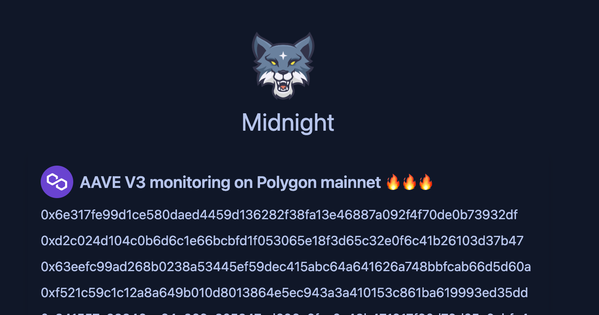
Outcome

Slide 14
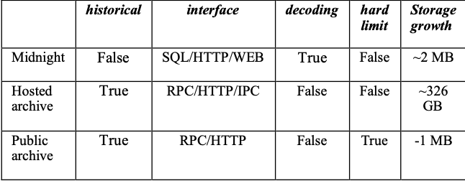
High Level Compression

Slide 15
Conclusion And Future Works
This research only on EVM and solidity
Touched the surface
Can be extended to more chains and protocols

Slide 16
THANK YOU
QUESTION & ANSWER

