Slide 1



An Efficiently Revocable Cloud-based Access Control
Using Proxy Re-encryption and Blockchain
Khanadech Worapaluk
Sirindhorn International Institute of Technology (SIIT)
Thammasat University, Bangkok, Thailand
The 20th International Joint Conference on Computer Science and Software Engineering
28th June-1st July 2023
Naresuan University Phitsanulok, THAILAND

Slide 2
Agenda
Problem Statement
Our Contribution
Our Proposed System
Security Analysis
Evaluation and Experimentation
Conclusion and Future Work

Slide 3
Problem Statement
Inability to support both users and attribute revocation with revocation transaction traceability
Dependency on the data owner and/or data user to generate cryptographic component for revocation process
Lack of details procedure to invoke the affected ciphertext to be updated or re-encryption

Slide 4
Our contribution
Introduce a set of cryptographic protocol for revocation that support both user and attribute revocation via proxy re-encryption technique
Applied blockchain and smart contract to support user authentication, ciphertext indexing, events transaction, and cryptographic component for revocation

Slide 5
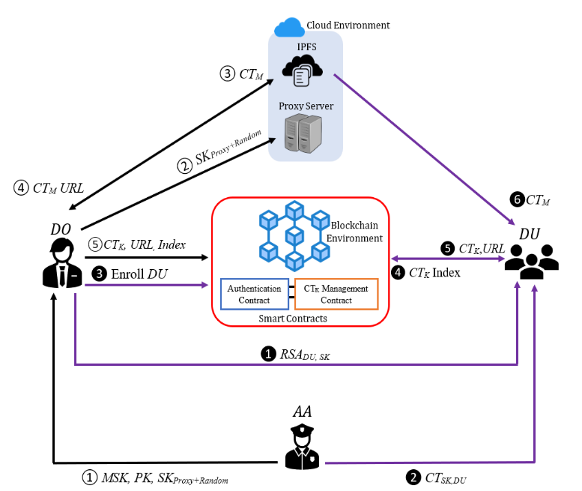
Proposed System
DO (Data Owner) refers to the owner of the data outsourced in the cloud.
DU (Data User) is a user who is authorized to access shared data. DU has a secret key issued by the AA, and their identity is registered in the blockchain and has a valid Ethereum account.
AA (Attribute Authority) generates the user’s secret key based on their attributes. Then, the key is broadcast based on public key encryption to users in the system.
IPFS (Interplanetary File System) is used to store encrypted data from the DO and can communicate with the proxy directly when the revocation request occurs in the system.
Blockchain is an immutable, distributed, transparent, and traceable ledger that records the provenance of digital data. Blockchain stores encrypted symmetric keys, indexes, the URL of the data, and all transactions that occur in the system. Blockchain also contains the validity status of each user for authentication purposes.
Smart contracts are programmable objects that operate on the blockchain. In our system, there are two major contracts: The authentication contract used for user authentication and the CT_{K} Management contract used for CT_{K} upload and query.
Proxy is a semi-trusted server located on the cloud. It is responsible for supporting the revocation process by the means of re-encryption of the affected ciphertext.

Slide 6
Cryptographic Process

Slide 7

System Initialization
CreateAttributeAuthority(λ) → PK, MSK.
  The algorithm selects a bilinear group G­₀ of prime order p with generator g. After that, the algorithm then chooses two random $α$, $β$∈$Z_{p}$ and compute a public key and master secret key as:
PK = $\left\{G_{0}, g, h= g^{β}, f=g^{\frac{1}{β}}, {e\left(g,g\right)}^{α}\right\}.$
MSK = (β, g^{α})

Slide 8
Key Generation
AESKeyGen(RandomString) → AES_Key
  The algorithm takes random string as an input to generate 256-bit AES_key. DO uses AES_key to encrypt the data before uploading them to cloud storage.
RSAKeyGen(2 Random Large Prime Number) → RSA_{DU,PubK}, RSA_{DU,PrivK}
UserKeyGeneration (PK, MSK, S_{DU},VER)→ SK_{DU}
  The algorithm first chooses a random r and r_{j} ∈ Zp for each attributes j ∈ S. Then the algorithm compute SK_{DU} as:
  SK_{DU} = (D = g^{(α+r)/β}, ∀ j ∈ S : Dj = g^{r} . H(j)^{rj} ,D′j = g^{rj} ).
  As for proxy’s key, the procedure follows UserKeyGeneration. But after the key generation, the key will be appended by 156-bit random number. To prevent key leakage problem

Slide 9
Encryption
Algorithm 1: CT_{K} Upload (CT_{K}, URL, Index)
Input: CT_{K}, URL, Index Output: Bool
If msg.sender is not (dataOwner or Proxy) then Return false End if Set CT_{K}Index[Index].CT_{K} = CT_{K} Set CT_{K}Index[Index].CT_{K}_URL = URL Return true
2-Step Encryption
AES Symmetric Key Encryption
  ENC_{AES}(AES_Key, M) → CT_{M}
CP-ABE Encryption
  ENC_{CP-ABE}(PK, T, AES_Key) → CT_{K}
Then the CT_{M} is uploaded to IPFS while CT_{K} stored in the blockchain system via Algorithm1

Slide 10
Decryption
Algorithm 2: CT_{K} Query(Index)
Input: Index Output: CT_{K} and URL or NULL
If CT_{K}Index[Index].CT_{K} is not exist then Return NULL Else Return CT_{K}Index[Index].CT_{K} and CT_{K}Index[Index].CT_{K}_URL
The DU does the decryption after the successful authentication via the Authentication Contract and retrieves the ciphertext. Here, the blockchain returns the CT_{k} and their corresponding URL to the DU and records the access transaction.
CP-ABE Decryption:
  DEC_{CP-ABE}(SK_{DU}, CT_{K}) → AES_Key
AES symmetric key Decryption:
  DEC_{AES}(AES_Key, CT_{M} ) → M
Algorithm 3: Authentication( )
Input: null Output: Bool
If USER is in Revocation List[] then Return false and terminate connection; Else Return true

Slide 11

Revocation
(User & Attribute)
Affected CT_{K} Retrieval
Re-generate Symmetric Key
Re-Encrypted Ciphertexts
Key Update
This step only required for User Revocation

Slide 12
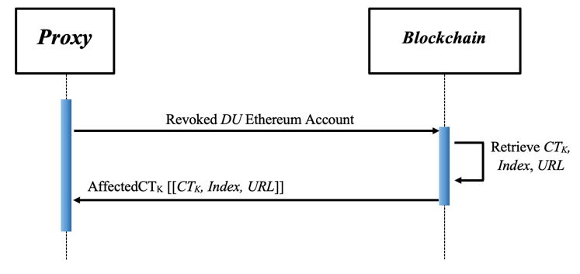
Affected CT_{K} Retrieval
(User Revocation)
Proxy connects to the blockchain and checks what ciphertexts the revoked user can access. Then, the blockchain retrieves the CT_{K}, Index, and URL for the affected ciphertexts by running Algorithm2 and returning them to the proxy.

Slide 13
Re-Generate Symmetric Key
Re-GenSymKey(Rs, r) → (AES_Key_{R})
  The algorithm takes random string Rs and a random parameter r as an input. Then the algorithm generates a new AES_Key_{R} which is a symmetric key with random parameter attach to it.

Slide 14
Re-Encrypted Ciphertexts
Re-Encryption (affectedCT_{k}, SK_{Proxy+Random}, AES_Key_{R}[ ], PK, T’) return (Array[CT’_{Ki}, Index_{i}, URL_{CTMi}]) {
SK_{Proxy} = ExtractRandom(SK_{Proxy+Random});
For ( i = 0 ; i <= len(affectedCT_{k}) ; i++){
CT_{Ki} = affectedCT_{k} [i][0];
AES = DEC_{CP-ABE­} (SK_{Proxy}, CT_{Ki});
if (len (AES_Key_{R}) != 0) {
CT_{M} = download(affectedCT_{k} [i][2])
M = DEC_{AES} (AES, CT_{M});
AES’ = AES_Key_{R}[i] – r;
CT_{M}’ = ENC_{AES} (AES’, M);
CT_{M}’URL = Upload (CT_{M}’);
affectedCT_{k} [i][2] = CT_{M}’URL;
AES = AES’;
}
CT’_{Ki} = ENC_{CP-ABE}(PK, T’, AES);
affectedCT_{k} [i][0] = CT’_{Ki};
}
SK_{Proxy} = “0”;
Return affectedCT_{k};
}
Notes:
The re-encryption process is including extract the proxy secretkey,
Then perform CP-ABE Decryption to get AES key
Afterthat the algorithm will check that the AES_KEY array is empty or not the algorithm then download the affect Data ciphertext
And perform AES_Decryption with ol AES key and perform AES_Decryption with a new AES key
Finallt the new AES key will be encrypted with CP-ABE encryption and return to proxy
After the algorithm returns the array of affectedCT_{K} to the proxy, the proxy runs a recursive function based on the number of ciphertexts in the array. The proxy initiates Algorithm1 from the CT_{K} Management contract to update their respective value.

Slide 15
Key Update (User Revocation)
AA generates an update parameter UP based on Ver’ parameter.
  UP = g^{(rj’ - rj)/β} where rj = Ver
AA applies an UP to all non-revoked users in the system. The update secret key function is as follows:
  SK’_{DU} = (D = g^{(α+r)/β}, ∀ j ∈ S : Dj = g^{r} . H(j)^{rj} ,D′j = g^{rj}, D’j’ = D’j ∙ UP where rj = Ver)
AA then encrypts the new SK’_{DU} with user’s public key and sends to the users.
Proxy update revocation list on the blockchain system to prevent revoked user from access to the data.

Slide 16
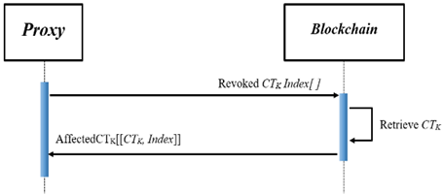
Affected CT_{K} Retrieval
(Attribute Revocation)
Proxy connects to the blockchain and runs Algorithm2 based on the revoked attribute CT_{K} Index array. The blockchain then returns CT_{K} for the affected ciphertexts to the proxy based on the order of revoked CT_{K} Index.

Slide 17
Re-Encrypted Ciphertexts
Re-Encryption (affectedCT_{k}, SK_{Proxy+Random}, AES_Key_{R}[ ], PK, T’) return (Array[CT’_{Ki}, Index_{i}, URL_{CTMi}]) {
SK_{Proxy} = ExtractRandom(SK_{Proxy+Random});
For ( i = 0 ; i <= len(affectedCT_{k}) ; i++){
CT_{Ki} = affectedCT_{k} [i][0];
AES = DEC_{CP-ABE­} (SK_{Proxy}, CT_{Ki});
if (len (AES_Key_{R}) != 0) {
CT_{M} = download(affectedCT_{k} [i][2])
M = DEC_{AES} (AES, CT_{M});
AES’ = AES_Key_{R}[i] – r;
CT_{M}’ = ENC_{AES} (AES’, M);
CT_{M}’URL = Upload (CT_{M}’);
affectedCT_{k} [i][2] = CT_{M}’URL;
AES = AES’;
}
CT’_{Ki} = ENC_{CP-ABE}(PK, T’, AES);
affectedCT_{k} [i][0] = CT’_{Ki};
}
SK_{Proxy} = “0”;
Return affectedCT_{k};
}
Notes:
After the algorithm returns the array of affectedCT_{K} to the proxy, the proxy runs a recursive function based on the number of ciphertexts in the array. The proxy initiates Algorithm1 from the CT_{K} Management contract to update their respective value.

Slide 18
Key Update
(Attribute Revocation)
AA generates an update parameter UP based on Attr parameter.
  UP = g^{(rj’ - rj)/β} where rj = Attr
AA applies an UP to all non-revoked users in the system. The update secret key function is as follows:
  SK’_{DU} = (D = g^{(α+r)/β}, ∀ j ∈ S : Dj = g^{r} . H(j)^{rj} ,D′j = g^{rj}, D’j’ = D’j ∙ UP where rj = Attr)
AA then encrypts the new SK’_{DU} with user’s public key and sends to the users.

Slide 19
Security Analysis
The security construct of our proposed scheme is based on the original CP-ABE construction, and AES symmetric key encryption. Since our scheme is relying on the CP-ABE scheme, the collusion resistance and the standard security model are guaranteed
Forward and Backward security property is assured by the key update mechanism. Essentially, the key update done by the AA will not be issued to the revoked user as of the verification of the revocation list and the update parameter verification. In addition, all the ciphertexts accessed by the revoked user will be re-encrypted with a new AES key, and then the new AES key will be encrypted by a new access policy.
The proxy's secret key is padded with the 156-bit random number. Even if the attacker can gain the proxy's secret key without padding number knowledge, the attacker cannot use the proxy's secret key.

Slide 20
Functional Comparison
 | Blockchain | Revocation |  | Ciphertexts Indexing Functionality
 |  | User. | Attr.
[1] | ✓ | ✓ | x | ✓
[2] | ✓ | x | ✓ | ✓
[4] | x | x | ✓ | x
Ours | ✓ | ✓ | ✓ | ✓
[1] R. Guo et al. scheme
[2] Y. Jiang et al. scheme
[4] S. Fugkeaw et al. scheme
Notes:
In general, our scheme, [1], and [2] employed blockchain to support access control functions. For the revocation aspect, [1] only supports user revocation, while [2] and [4] only support attribute revocation. In [1] and [2], the cost of the key update is on the data user, while in [4], the cost of the key update is on the data owner. In our proposed scheme, we support both user and attribute revocation levels. And the key update cost is offloaded to the proxy server. And for the indexing aspect, our proposed schemes, [1], and [2] provide ciphertext indexing functionality on the blockchain. Lastly, our scheme also provides the formal method for ciphertext retrieval based on the indexing with their respective elements on the blockchain system upon the user or attribute revocation.

Slide 21
Experimentation Setting
Cryptographic Library
CP-ABE Toolkits
AES-Toolkits
Java-Pairing based Cryptography library
Computer Specification
AMD Ryzen 5 (3.90 GHz)
16 Gb Ram
Window 11
Proxy Specification
E2-Micro Computer Engine (Google Cloud)
Intel Xeon (2.20 GHz)
1 Gb Ram
Ubuntu 20.04 OS
Blockchain Environment
Ethereum Blockchain system
Ganache Truffle Suite

Slide 22
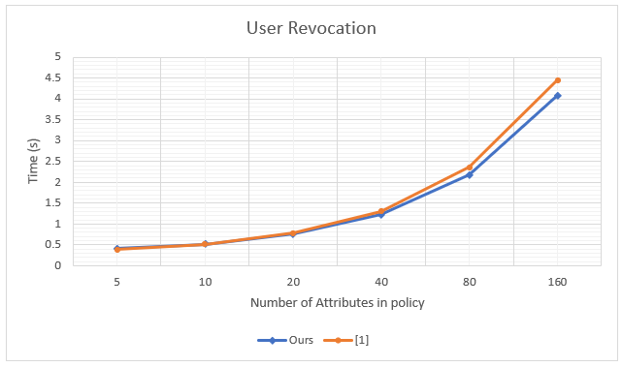
User Revocation Performance
[1] R. Guo et al. scheme
Notes:
For the user revocation case, scheme [1] requires the transformation of the ciphertext based on the policy update for re-encryption. The operations related to exponential and bilinear pairing operation of CP-ABE and user secret key transformation generation were major overheads. In our scheme, the number of attributes that need to be updated is subject to an exponential with constant pairing and AES encryption. As shown in Fig.4, our scheme delivered the processing time used for the user revocation on par with [1]. However, when we increase the number of attributes contained in the access policy, our scheme delivers a lower processing time than [1].

Slide 23
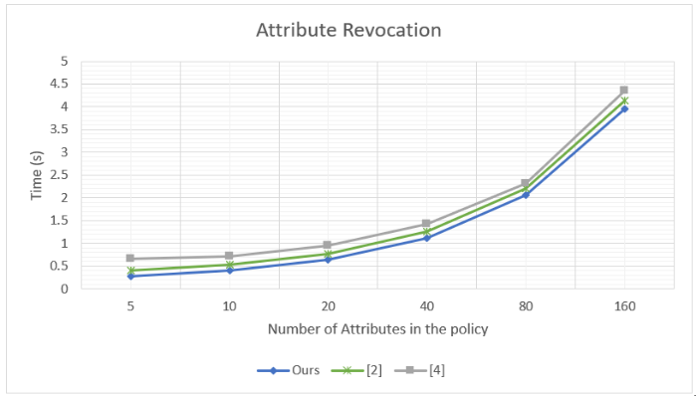
Attribute Revocation Performance
[2] Y. Jiang et al. scheme
[4] S. Fugkeaw et al. scheme
Notes:
In the attribute revocation case, scheme [2] relied on the policy update protocol, which reduces the cost of re-encryption of the entire ciphertexts. However, the proxy also needs to perform partial decryption for each user whose attributes were removed. As shown in Fig.5, the performance of [2] contains both policy update protocol and partial decryption, which are used to update the revocation attributes. In our scheme, we only require to re-encrypt the AES key which is technically smaller in size compared to the ciphertext. In [4], it required two encryption steps, including AES and CP-ABE. Thus, their re-encryption cost was higher than the partial re-encryption of ciphertext [2], and ours required the re-encryption of the AES key.

Slide 24
Conclusion & Future Work
We have proposed a revocable CP-ABE protocol supporting proxy re-encryption technique in combination with a blockchain system.
We provided a ciphertext indexing and retrieval protocol using the smart contract operated on the blockchain system.
Most of the revocation process is offloaded to the proxy server to reduce the computation and communication cost done at the data owner side when there is a revocation case. To optimize the revocation cost, we designed a re-encryption protocol so that the CP-ABE is only used to encrypt the AES key.
For future work, we will conduct a larger scale of experiments to test the scalability of our proposed system. Also, we will introduce the attribute hiding protocol to the CP-ABE algorithm in the scheme to protect the confidentiality of the policy content.

Slide 25
Reference
[1] R. Guo, G. Yang, H. Shi, Y. Zhang and D. Zheng, "O3-R-CP-ABE: An Efficient and Revocable Attribute-Based Encryption Scheme in the Cloud-Assisted IoMT System," in IEEE Internet of Things Journal, vol. 8, no. 11, pp. 8949-8963, 1 June1, 2021, doi: 10.1109/JIOT.2021.3055541.
[2] Y. Jiang, X. Xu and F. Xiao, "Attribute-based Encryption with Blockchain Protection Scheme for Electronic Health Records," in IEEE Transactions on Network and Service Management, 2022, doi: 10.1109/TNSM.2022.3193707.
[3] X. Liu, Y. Zheng and X. Li, “A revocable attribute-based access control system using blockchain.”, Journal of Physics: Conference Series, Bristol Vol. 1971, Issue 1, 2021, doi: 10.1088/1742-6596/1971/1/012058
[4] S. Fugkeaw and S. Sato, “Achieving Scalable and Optimized Attribute Revocation in Cloud Computing”, IEICE Transactions on Information and Systems, 2017, Volume E100.D, Issue 5, Pages 973-983
[5] S. Maiti and S. Misra, "P2B: Privacy Preserving Identity-Based Broadcast Proxy Re-Encryption," in IEEE Transactions on Vehicular Technology, vol. 69, no. 5, pp. 5610-5617, May 2020, doi: 10.1109/TVT.2020.2982422.
[6] D. Sethia, A. Shakya, R. Aggarwal and S. Bhayana, "Constant Size CP-ABE with Scalable Revocation for Resource-Constrained IoT Devices," 2019 IEEE 10th Annual Ubiquitous Computing, Electronics & Mobile Communication Conference (UEMCON), 2019, pp. 0951-0957, doi: 10.1109/UEMCON47517.2019.8993103.
[7] V. Malamas, P. Kotzanikolaou, T. K. Dasaklis and M. Burmester, "A Hierarchical Multi Blockchain for Fine Grained Access to Medical Data," in IEEE Access, vol. 8, pp. 134393-134412, 2020, doi: 10.1109/ACCESS.2020.3011201.
[8] M. Jemel and A. Serhrouchni, "Decentralized Access Control Mechanism with Temporal Dimension Based on Blockchain," 2017 IEEE 14th International Conference on e-Business Engineering (ICEBE), 2017, pp. 177-182, doi: 10.1109/ICEBE.2017.35.
[9] M. Xu, X. Chen and G. Kou, “A systematic review of blockchain.”, Financ Innov 5, 27, 2019. https://doi.org/10.1186/s40854-019-0147-z
[10] J. Bethencourt, A. Sahai, and B.Waters. Ciphertext-policy attribute-based encryption. Proc. of IEEE Symposium on Security and Privacy, pp. 321–334. IEEE, 2007.
[11] PBC (Pairing-Based Cryptography) library. Accessed: Oct. 14, 2022. [Online]. Available: https://crypto.stanford.edu/pbc/
[12] A. De Caro and V. Iovino, “jPBC:Java pairing based cryptography”, 2011, IEEE Symposium on Computers and Communication (ISCC), 2011, pp.850-855, doi:10.1109/ISCC.2011.59883948
[13] Ganache Truffle Suite (Personal Blockchain Environment). Accessed: Jan. 27, 2023, [Online] Available: https://trufflesuite.com/ganache/

Slide 26
THANK YOU
QUESTION & ANSWER

