Slide 1





Procedural Content Generation of Super Mario Levels Considering Natural Connection
Dr. SangGyu Nam¹, Asst. Prof. Dr. Chu-Hsuan Hsueh², Prof. Dr. Ikeda Kokolo²
¹ School of Information, Computer, and Communication Technology (ICT), Sirindhorn International Institute of Technology (SIIT), Thammasat University, Pathum Thani, Thailand.
² School of Information Science (IS), Japan Advanced Institute of Science and Technology (JAIST), Ishikawa, Japan.
The 20th International Joint Conference on Computer Science and Software Engineering (JCSSE)
28th June-1st July 2023 | Naresuan University Phitsanulok, Thailand.

Slide 2



Introduction
Artificial Intelligent (AI) has been used to substitute a variety of human tasks, such as computer graphics, natural language processing, education, and games.
Game AI contributes to increased human entertainment and the quality of game content in many aspects.
In AI research, games are often used as benchmarks for developing methods to be applied to real-world problems.

Slide 3


Applications of AI in Games
AI has surpassed humans’ capability in many games (Chess¹, Shogi², Go³, Atari games⁴, and Starcraft⁵). Still, there are many challenges to be addressed.
Examples of AI in Games
AI for teaching players
AI that detects beginners’ decision-making and explains⁶.
AI for entertaining players
AI acts based on players’ preferences⁷.
AI that behaves like a human⁸.

Slide 4

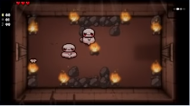
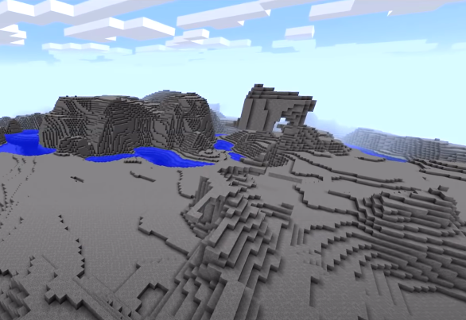
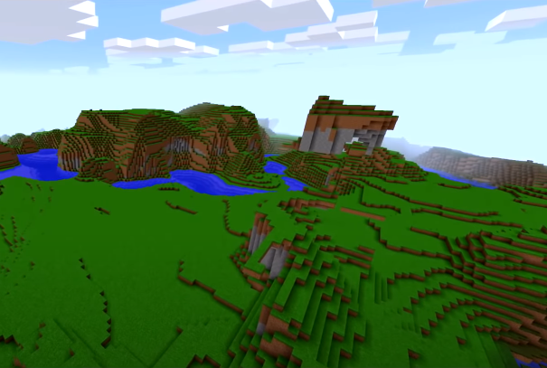
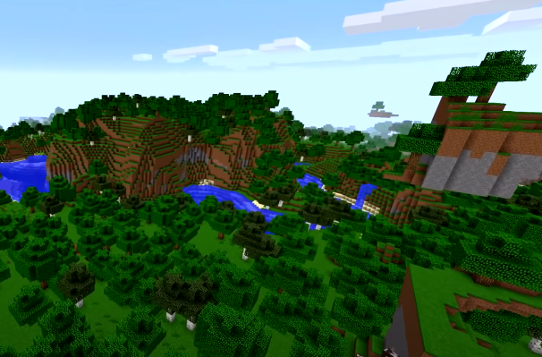
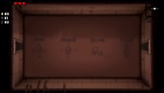
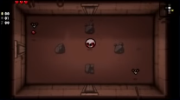
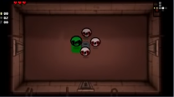
Procedural Content Generation (PCG)
PCG is to procedurally generate various game content with algorithms.
Examples of game elements can be generated using PCG
Dungeon
(Binding of issac)
World
(Minecraft)
Why PCG is required in the game industry?
To respond to the growing game content consumption.
To generate a variety of content at less cost than manually.

Slide 5
Objective
This research aims to develop a novel PCG method that generates on-demand & naturally connected levels in the Super Mario game.

Slide 6
Related Literature on PCG in Games
Most previous studies focused on content (making entertaining levels, puzzles for assisting beginners, etc.) mainly using search-based PCG and PCG via machine learning.

Slide 7
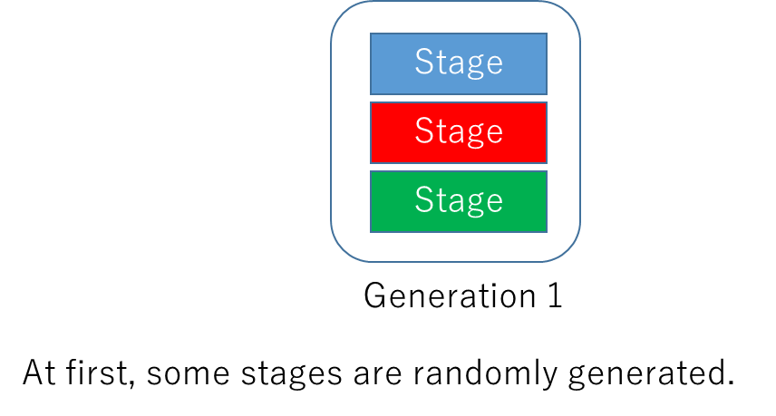
1. Search-based PCG
Repeat processes of “generation→ filtering by evaluation.”
A genetic algorithm (GA) is employed.

Slide 8
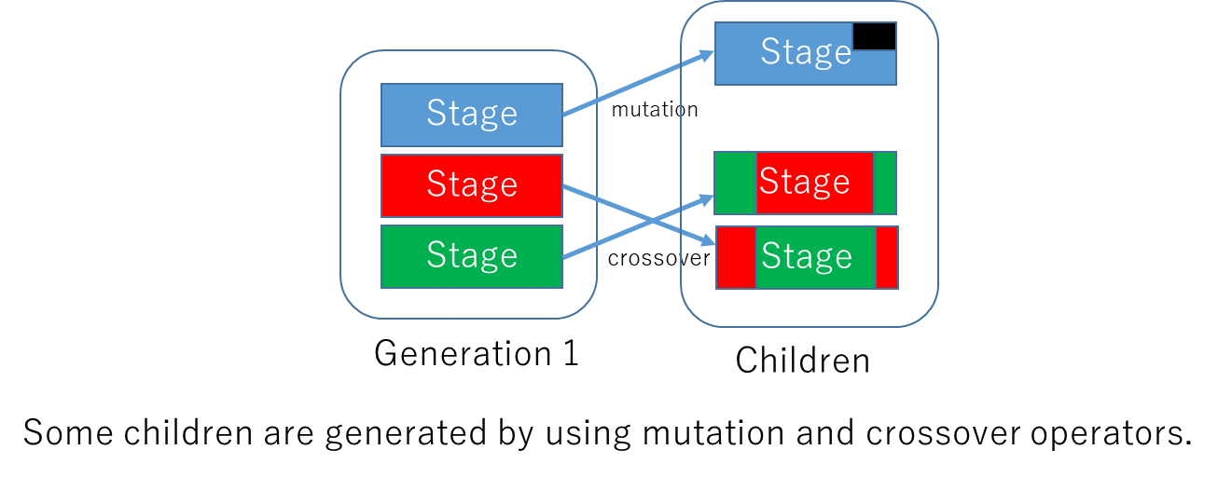
1. Search-based PCG
Repeat processes of “generation→ filtering by evaluation.”
A genetic algorithm (GA) is employed.

Slide 9
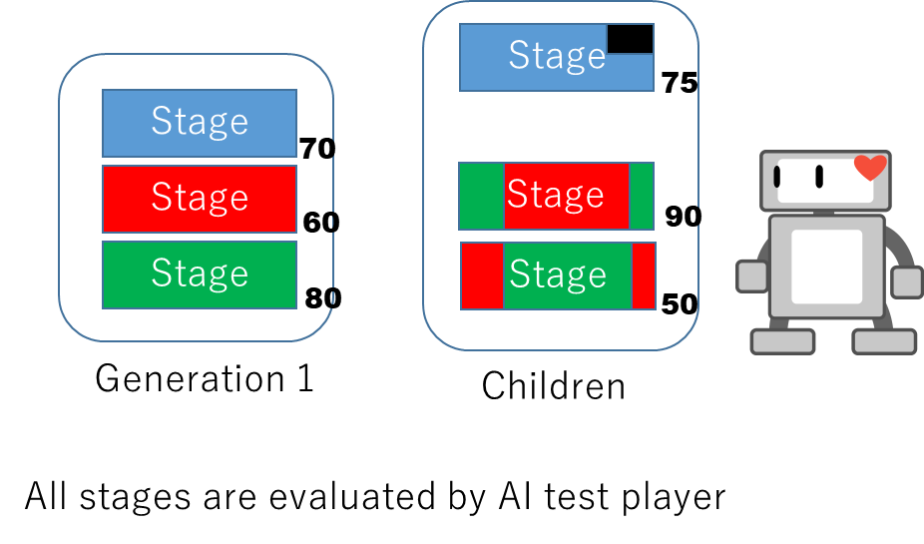
1. Search-based PCG
Repeat processes of “generation→ filtering by evaluation.”
A genetic algorithm (GA) is employed.

Slide 10
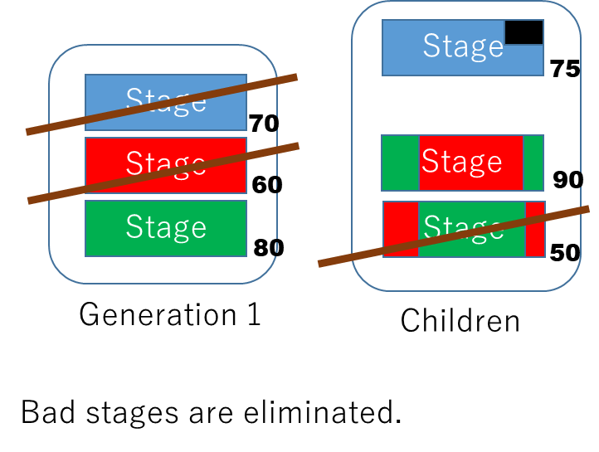
1. Search-based PCG
Repeat processes of “generation→ filtering by evaluation.”
A genetic algorithm (GA) is employed.

Slide 11
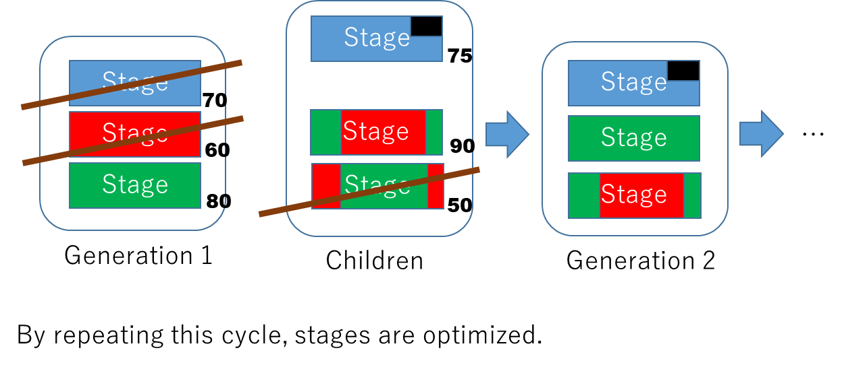

1. Search-based PCG
Repeat processes of “generation→ filtering by evaluation.”
A genetic algorithm (GA) is employed.
Issues in Search-based PCG
Diversity
Online generation
GAs tend to generate similar individuals.
(provide content immediately upon request)
Numerous evaluation processes increase the content generation time.

Slide 12
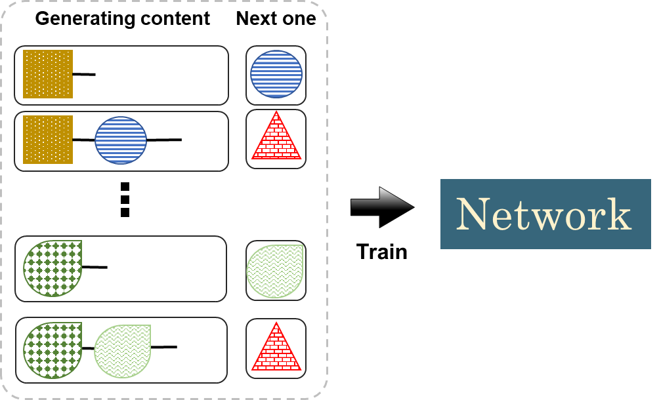
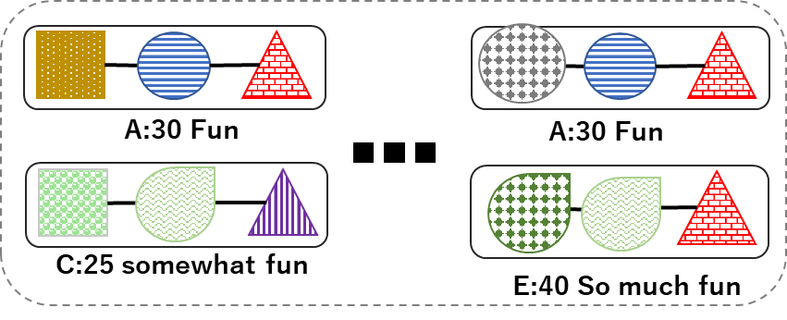
2. PCG via machine learning (PCGML)
Selected training data
Example of PCGML & how it works
Only gathers good content as training data (left).
A pair of “generating content” & “next one” is used as input/output (right).
When generating content is input to the network, the next event will be output.

Slide 13
2. PCG via machine learning (PCGML)
Selected training data
Characteristics of PCGML
New content is directly generated from the trained models.
Models learn how to generate content using existing content.
The results are more likely to exhibit human-made naturalness.

Slide 14
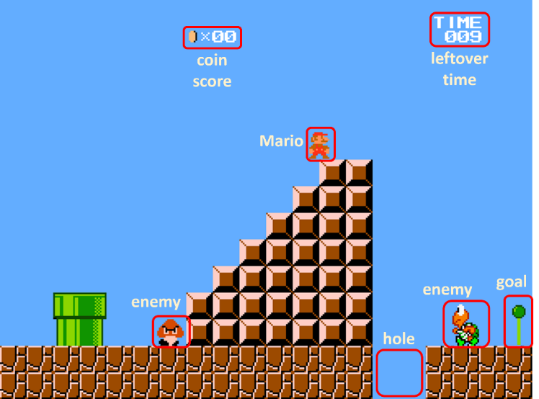
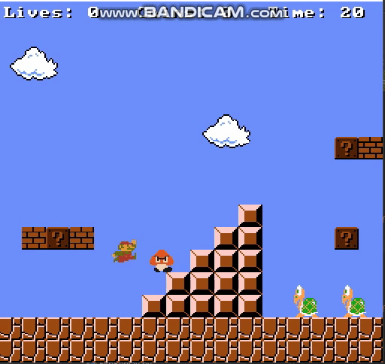



Target game: Super Mario
Players control Mario to pass various obstacles.
Objective is to reach the goal placed at the right-most side within the time limit.
The player loses the game once Mario gets damaged or falls into the holes.
Game Characteristics
Real time action game
Action decisions are made in every frame.
Diverse tiles
Wall tiles block Mario’s movements. Enemy and hole tiles affect difficulties.
Two dimension
Available movements are up, down, left, and right.
Super Mario gameplay

Slide 15
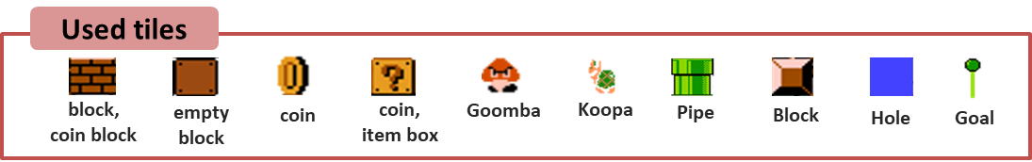
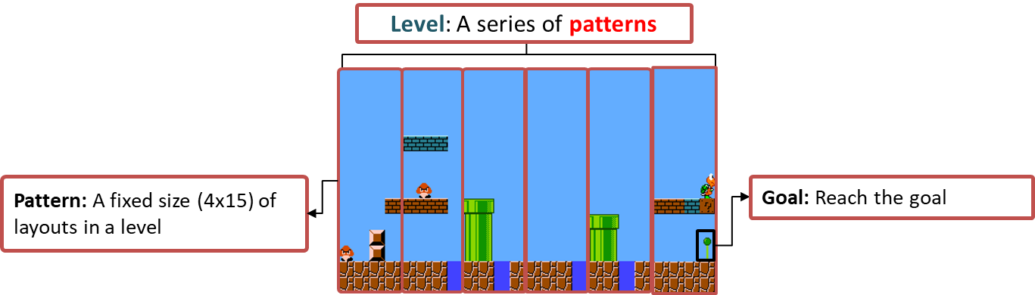
Generation target: Level
For research purposes, we used a simplified version of Super Mario.
General structure of Super Mario levels

Slide 16
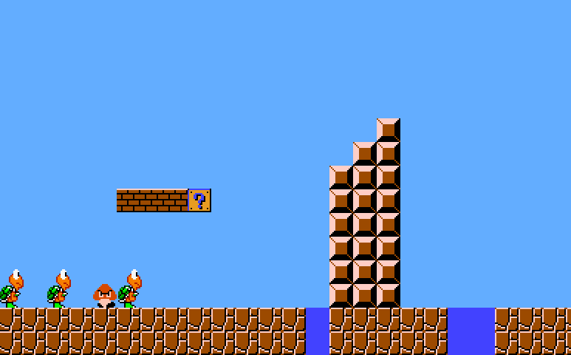
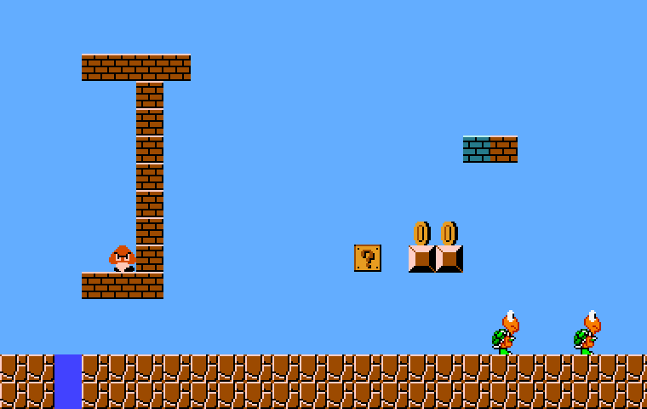

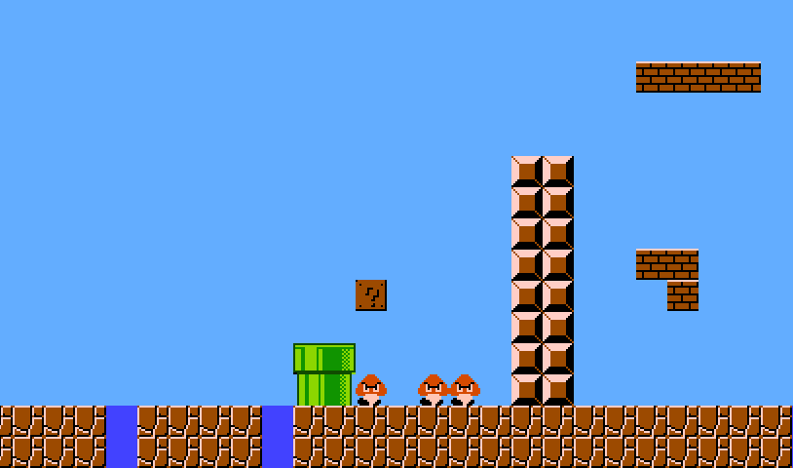
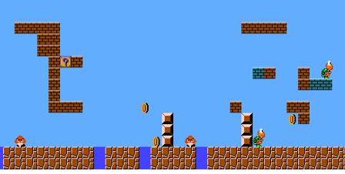
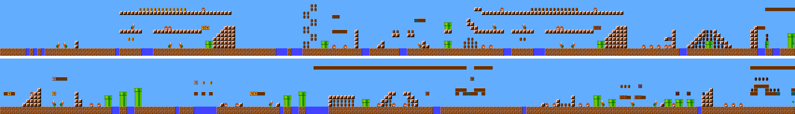

Desirable characteristics of a level
Bad
Unplayable
Unnatural
Good

Slide 17

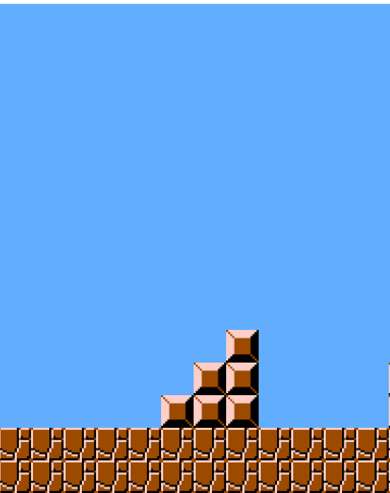
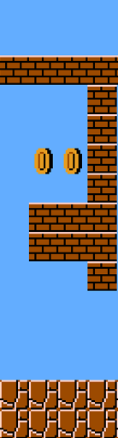
Naturalness
The following patterns have a similar feature/appearance to the previous ones.
good
natural connection
Function
Approximator
previous patterns
bad
bad connection
The Conditional Generative Adversarial Network (CGAN) is suitable because it can generate content (next pattern) based on the given condition (the previous pattern).

Slide 18
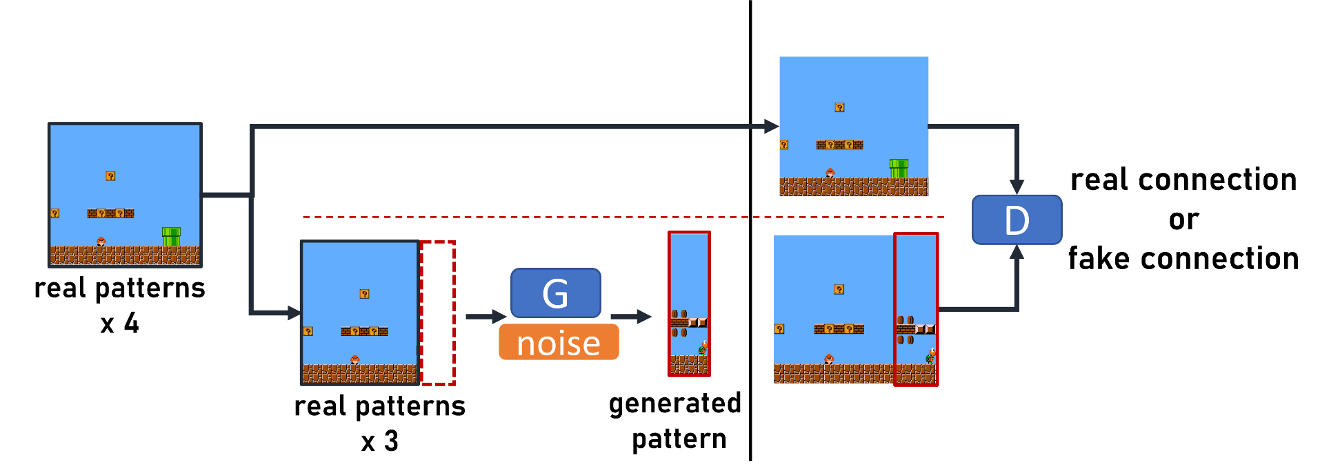
Function approximator: CGAN
A set of four patterns are given as training data. The last pattern is cut.
The remaining three patterns are given to the generator with noise.
The generator outputs the last pattern.
Discriminator distinguishes whether connection & pattern are real.
The generator provides the following pattern that is naturally connected to the given three patterns

Slide 19


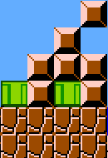
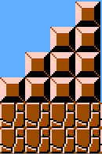
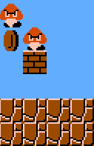
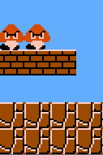
The Matching mechanism
Outputs from CGAN may be defective and may not seem real.
  Shu et al.⁹ proposed a CNet-assisted Evolutionary Repairer. However, their method involves GA, which is not timely for online generation.
  We proposed a Matching mechanism to find the closest actual pattern to the generated pattern. The Euclidean distance is employed as a distance criterion.
If the level size is 100:
6232²⁵ ≃ 10⁹⁵ variation of levels can be obtained.

Slide 20
Playability
Unplayable levels should be discarded.
Playability is evaluated by simulation with a strong A* AI agent implemented by R. Baumgarten¹⁰.
If the A* AI agent cannot complete a level, the level is considered not playable.
Super Mario gameplay

Slide 21
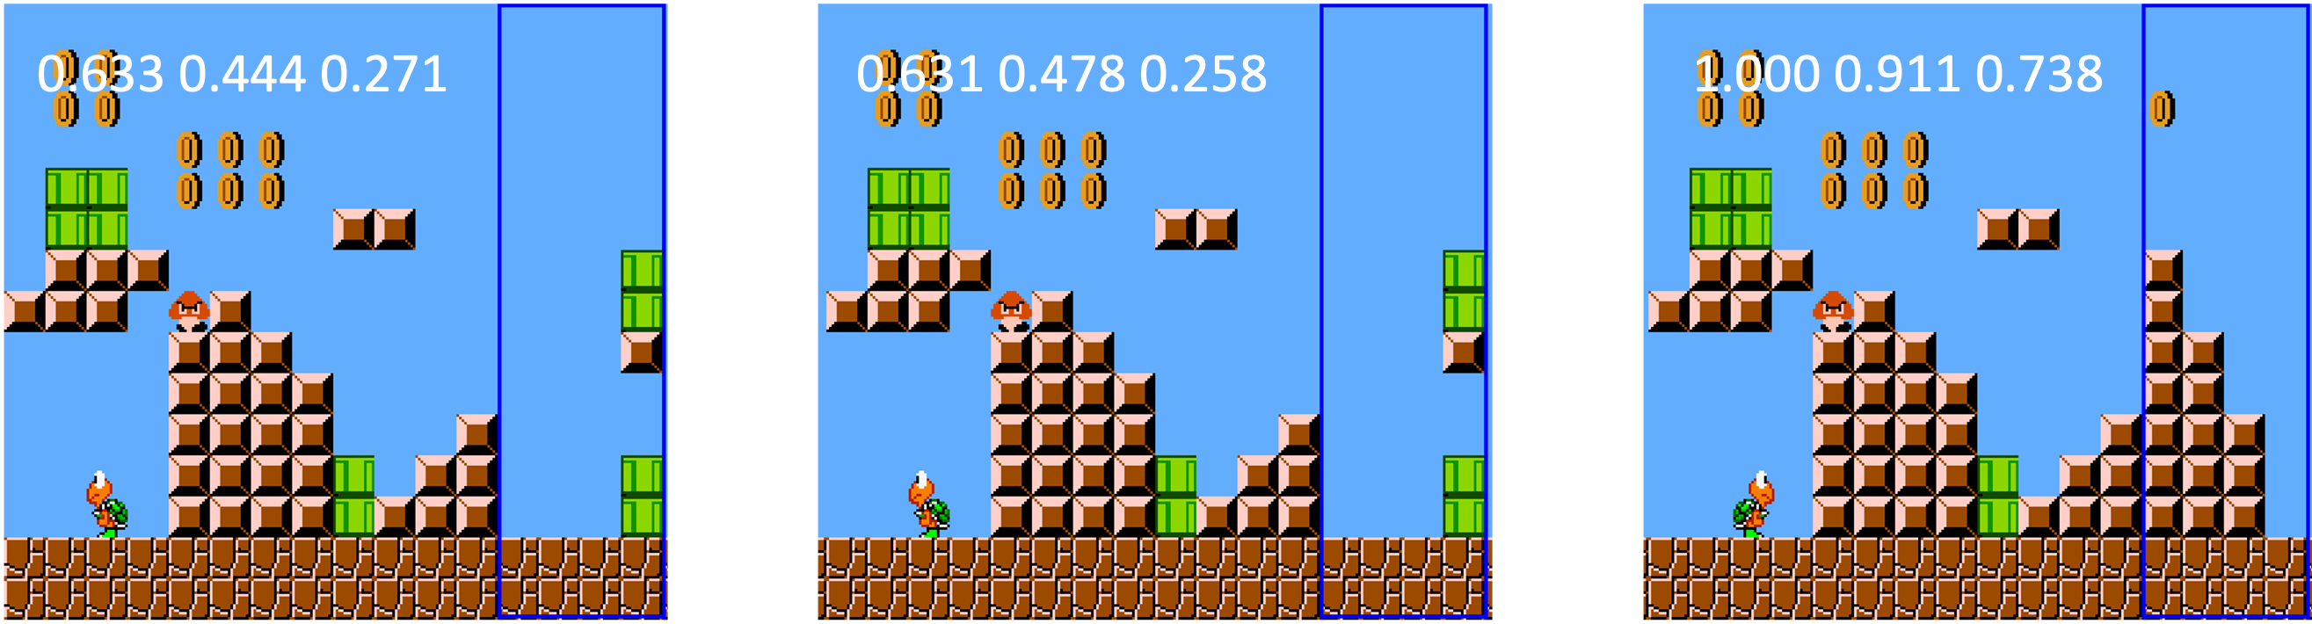
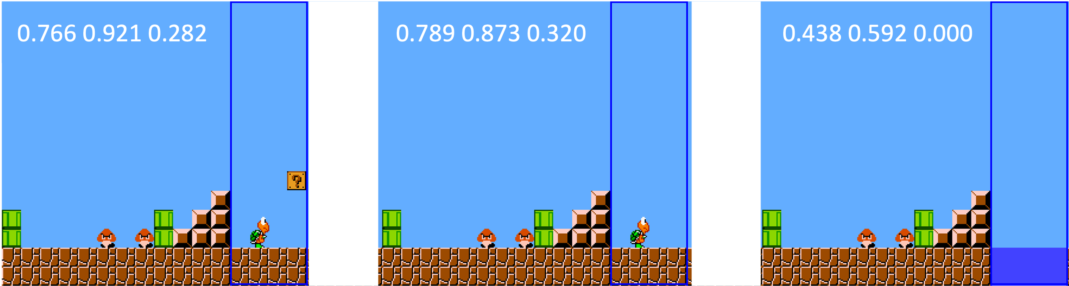
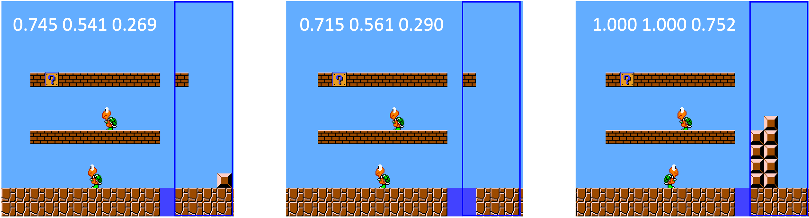

Experiment: CGAN + Matching
Desirable result → The closer vector values are input to CGAN, the more similar patterns CGAN generates and vice versa.
P₁
P₂
P₃
Our proposed method allows designers to freely control the generated patterns via vector values.
Process
1. Prepare three vectors. ($v1≡v2≠v3$)
$v1$ is a random 3d-vector [0~1]
$v2$ = $v1$ + [-0.05~0.05]
$v3$ = $v1$ $±$ [0.5~0.2]
2. Generate pattern
Patterns ($P_{n}$) = GAN(P_{init}, $v_{n}$)
3. Apply Matching
Experimental
Results
The generated patterns from our CGAN+Matching exhibit desirable characteristics.

Slide 22
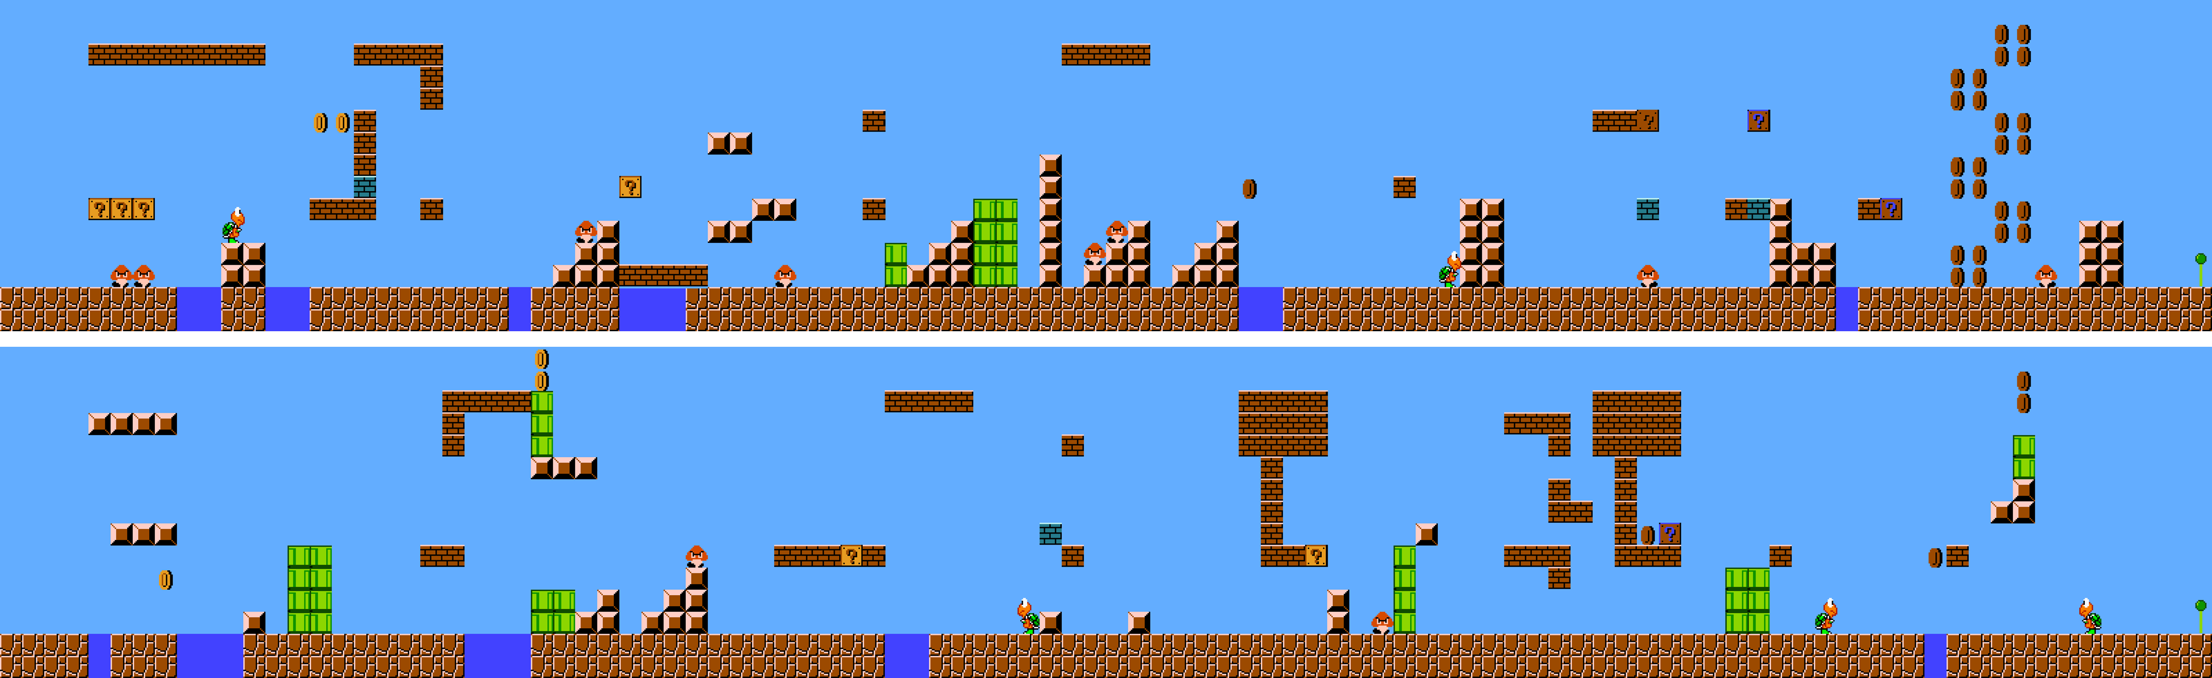
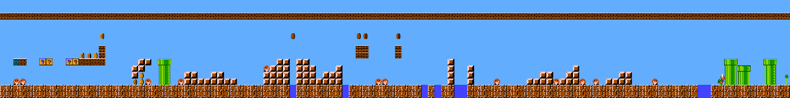
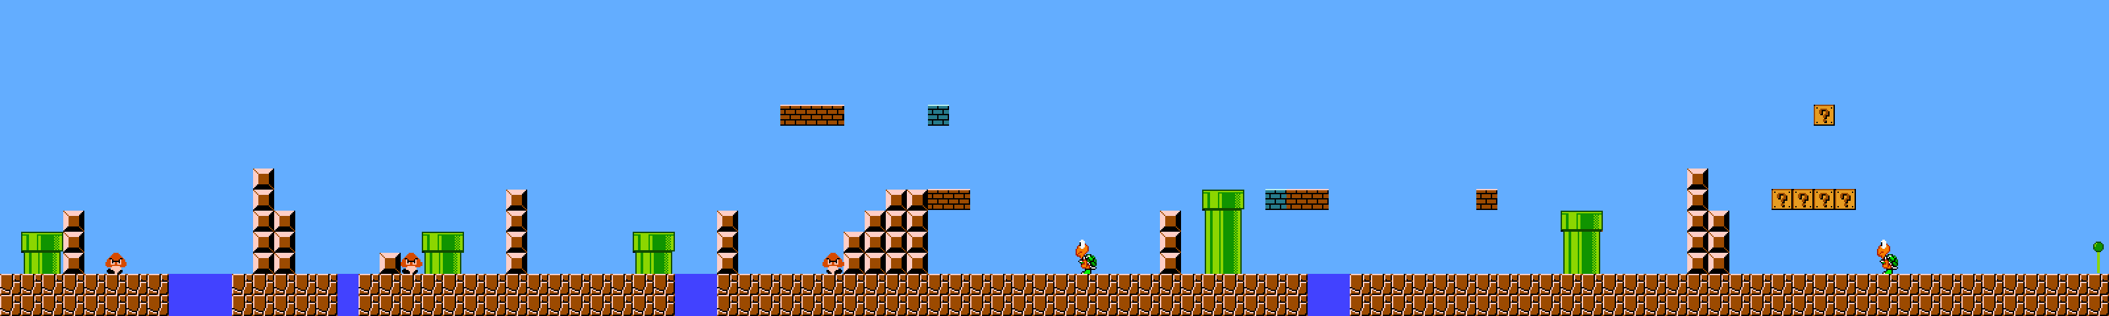
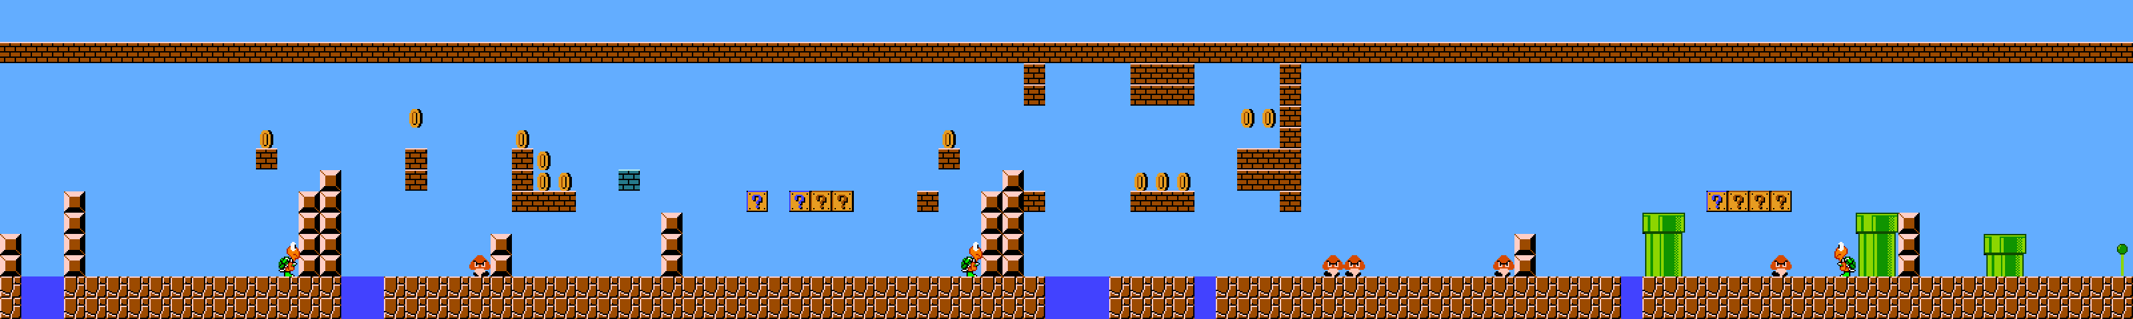
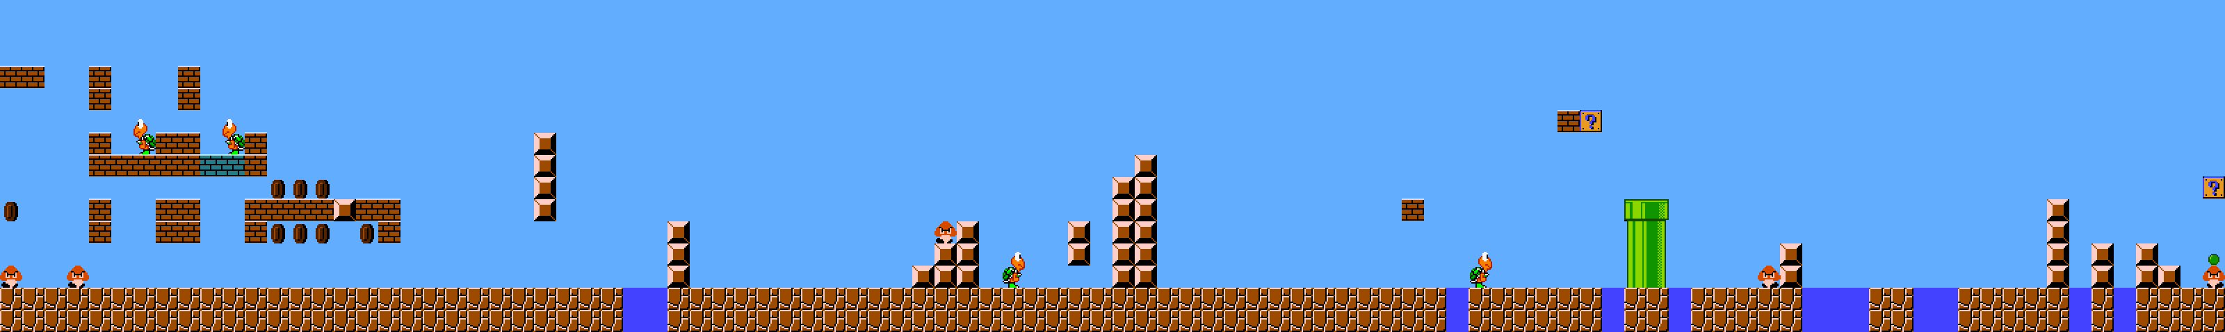
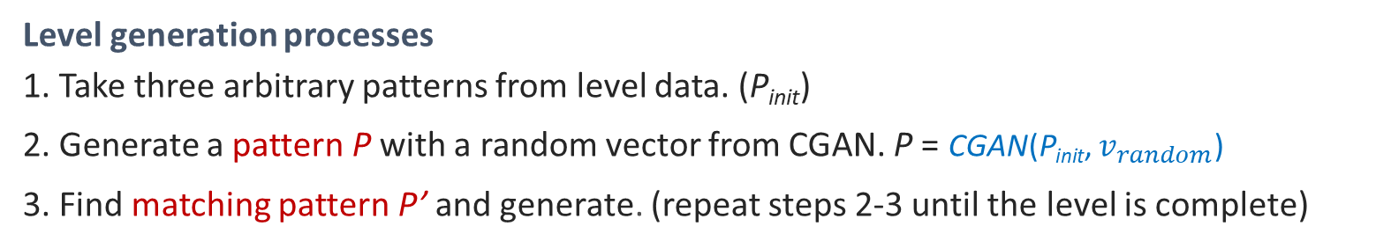
Results
Levels generated from randomly connecting patterns show unnatural connections.
Levels generated from CGAN and Matching are naturally connected and playable.
Level generation processes
1. Take three arbitrary patterns from level data. (P_{init})
2. Generate a pattern P with a random vector from CGAN. P = CGAN(P_{init}, $v_{random}$)
3. Find matching pattern P’ and generate. (repeat steps 2-3 until the level is complete)
Note: If the initial patterns are underground, the algorithm will generate underground patterns.

Slide 23
Conclusion
In this research, a novel PCGML method that generates on-demand & naturally connected levels in the Super Mario game is developed.
Experiment results highlight that the proposed technique can generate naturally connected levels compared to search-based PCG.
Future work can include the following aspects:
  Considering other factors such as difficulty, entertainment level, etc.
  Employing human-like AI to assess playability based on human capability.
  Applying/modifying the proposed technique to suit other game genres.

Slide 24
References
Murray Campbell, et al. "Deep blue." Artificial Intelligence 134.1-2 pp. 57-83 (2002).
Kunihito Hoki, "Bonanza-the computer Shogi program." [Online] Available: http://www. geocities. jp/bonanza shogi (2018/02/05).
David Silver, et al. "Mastering the game of Go with deep neural networks and tree search." Nature 529.7587 pp.484-489 (2016).
A. P. Badia, et al. “Agent57: Outperforming the Atari human benchmark,” in Proceedings of the 37th International Conference on Machine Learning, 119. 2020, pp. 507–517.
Vinyals, O., Babuschkin, I., Czarnecki, W.M. et al. Grandmaster level in StarCraft II using multi-agent reinforcement .
Kokolo Ikeda, et al. "Detection and labeling of bad moves for coaching go." Computational Intelligence and Games pp.1-8 (2016).
Sato, Naoyuki et al. Estimation of Player’s Preference for Cooperative RPGs Using Multi-Strategy Monte-Carlo Method, IEEE CIG 2015, pp.51-59, 2015-08.
Fujii naito, et al. Autonomously Acquiring Video-Game Agent's Human-like behaviors with Biological Constraints, Transactions of Information Processing Society of Japan, pp. 1655-1644 (2014)
T. Shu, Z. Wang, J. Liu, and X. Yao, “A novel Cnet-assisted evolutionary level repairer and its applications to super mario bros,” in 2020 EEE Congress on Evolutionary Computation (CEC), 2020, pp. 1–10.
J. Togelius, et. al. , “The 2009 mario AI competition,” 08 2010

Slide 25
THANK YOU
Q&A

Slide 26
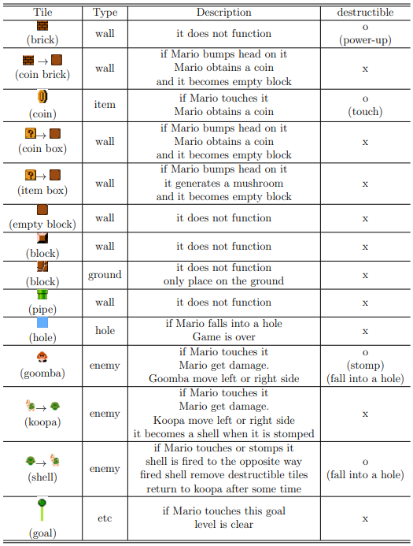
Appendix) Mario tiles information

Slide 27
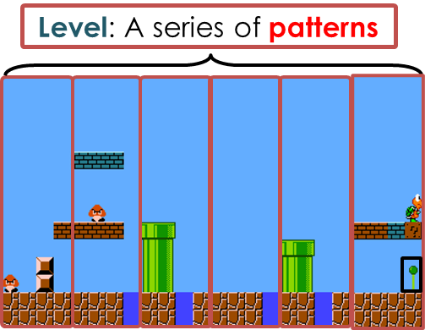
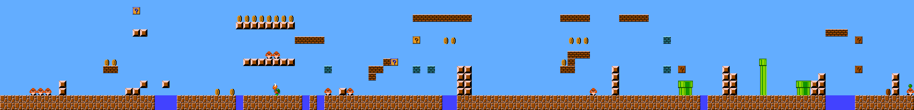
Preliminary experiment
To validate whether a series of random patterns is natural.
Processes
1. Start from a random pattern from the Super Mario level data.
2. Choose the next connected pattern from data with probability p or a random pattern.
3. Concatenate the chosen pattern in the generating level. Repeat Steps 2. & 3. until the level is complete.
The larger p value, the closer to the original level at which the actual concatenation is used.
P=0.9
P=0.3
P=0.1
Unnatural parts

Slide 28
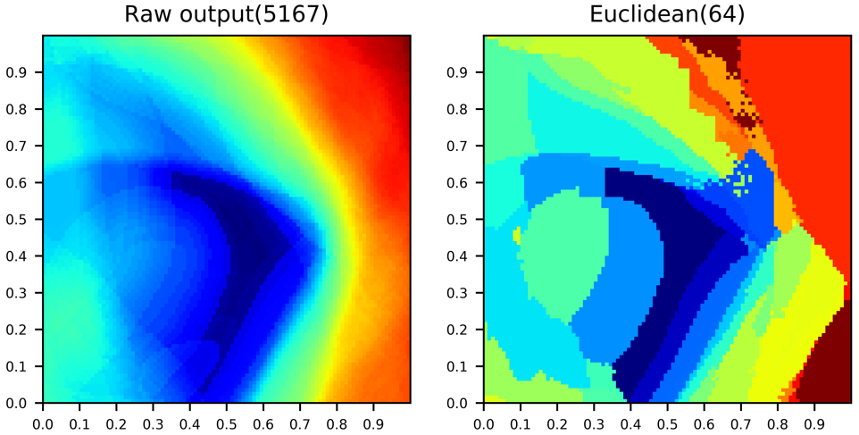
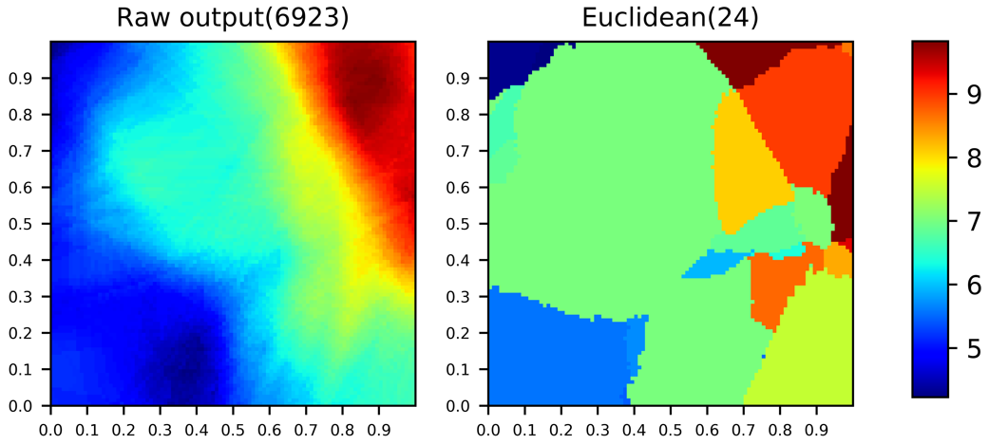
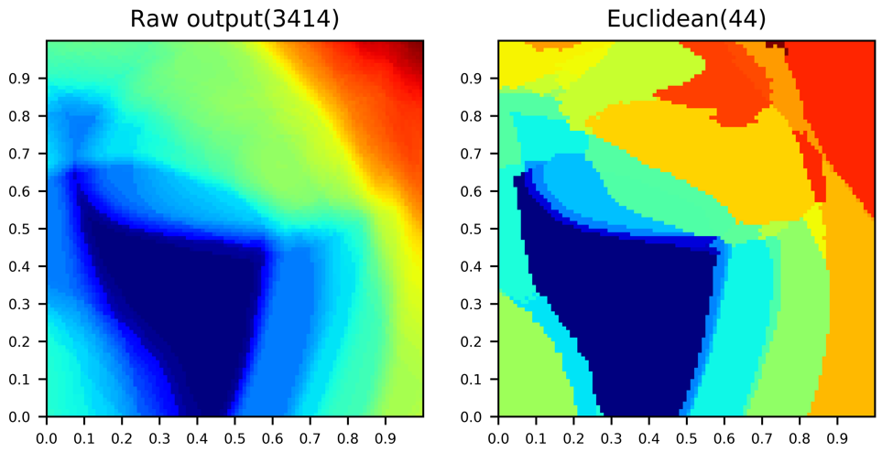
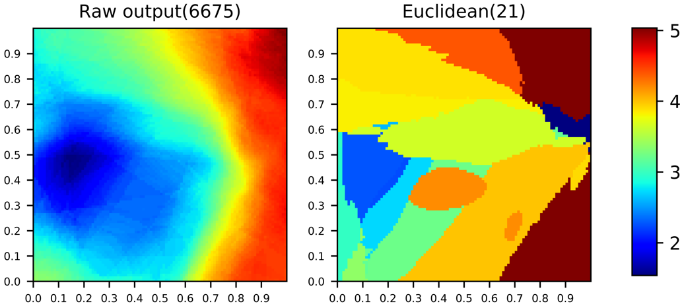
Appendix) Verification of CGAN
The overall vector space was investigated, and it showed a desirable distribution.
Matching (Euclidean) does not collapse the trend of raw output from CGAN.
unique patterns
Euclidean distance between outputs and empty pattern is calculated.

