Slide 1



Design and Evaluating a Method Using
Project Corpus for Inferring Software Description
Kohei Terakawa, Sinan Chen, Masahide Nakamura
Kobe University, Japan
E-mail: odajin@ws.cs.kobe-u.ac.jp
JCSSE 2023, June 29
Notes:
Hello Everyone.
I’m Kohei Terakawa from Kobe University , Japan.
Today. I would like to talk about design an evaluating a method using project corpus for inferring software description.

Slide 2


Research Background
The environment surrounding software is constantly changing
  Addressing non-functional requirements
  Changes in users and usage patterns
  The appearance of competing products
    → required for SW change and technical debt arises
Technical debt
  Products that will eventually have to be modified
    Code not compatible with API version updates
    Ancient framework
→ Need for software upcycling
Notes:
First of all, Let me give you the background.
The environment surrounding software is constantly changing.
Specifically，
・Addressing non-functional requirements
・Changes in users and usage patterns
・The appearance of competing products , and so on.
This situation requires software to change. At the same time, technical debt arise.
Let me explain what technical debt.
We call it the product with problems that will eventually be modified.
For example, Code not compatible with API version updates and Ancient framework .
This requires an action called software upcycling.

Slide 3
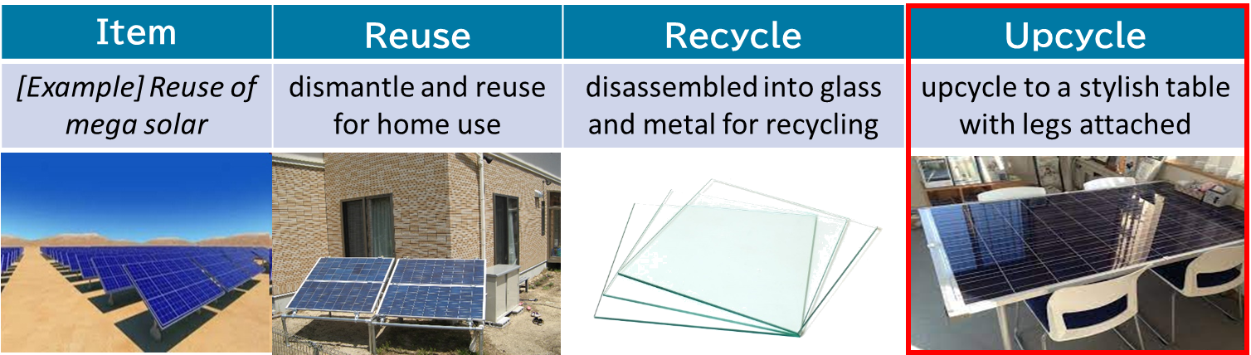
What is Upcycling?
Activity that makes full use of trash for new value
The challenge for upcycling contexts of software
  Existence of not managed repositories
    README files are usually missing or outdated
→ Need to understand software without documentation
Notes:
Let me explain software upcycling.
We defined the activity that makes full user of trash for new value.
Let’s consider solar panels as an example.
Reuse of a solar panel means to use it again as a solar panel in another location, for example for home use.
Recycle of a solar panel is to disassemble the panel and make it into another product, such as glass.
Upcycle is to take advantage of the shape of the panel as a board, and use it as a fashionable table.
In the context of software, we are examining the concept of upcycling.
The challenge is the existence of unmanaged repositories.
In many field of software development , README files are missing or outdated.
-------------------------
So in order to do the software upcycling, we need to understand software without documentation.

Slide 4
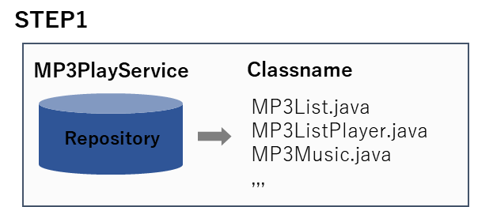
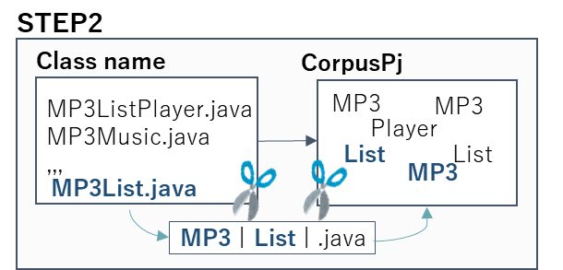
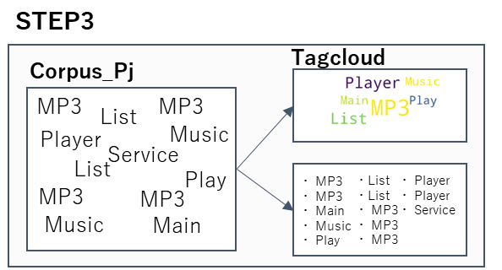
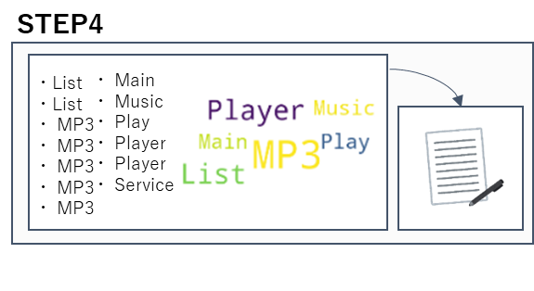
Previous Research:
Software Overview Estimation Method
Goal: Efficiently infer the overview without README
Key Idea: Focus on the composition of the class name
  Class names related to the purpose and functionality of the software
Approach
  Step 1：Repository Mining
  Step 2：Creating project corpus(CorpusPj)
  Step 3：Processing of corpusP j(tagcloud img, lexicographic order)
  Step 4：Inference of purpose and function
MP3Music.java
package jp.kobe.u.cs27.player.mp3layer
import java.io.IOException;
,,,
public class MP3ListPlayer{
static private MP3Listlayer instance,,
Handling MP3 sound files?
Music
MP3
Notes:
We conducted a previous research on software upcycling.
The goal was to efficiently infer the overview of the software without using the README.
The key idea was to focus on the composition of the class name.
We made the prediction that class names related to the purpose and functionality of the software.
The approach consisted of four parts.
In Step 1, we obtain the class names by repository mining.
In Step 2, we split the class name into words, which we define as CorpusPj.
In Step 3, we create tagcloud images from the obtained words and sorted in lexicographic order.
In Step 4, we show these images to the participants and ask them to guess the outline of the software.
However, the effectiveness of this method is still unclear.

Slide 5
Goal and Approach
Goal: Experimental evaluation of the previously proposed method
Experimental Challenging
  Experiments on participants using the method
  Itemized evaluation of the methods
Approach
  (A1-1) Experimental Design (A1-2) Implementation and evaluation methods
  (A2-1) Experimental Results (A2-2) Results of Q1 scoring
  (A3-1) Result that accuracy rate was high (A3-2) Result that accuracy rate was low
Notes:
Here’s the goal and approach in my research.
What we tried to do was conduct the experimental evaluation of the previously proposed method.
And, There are two experimental challenging.
One is to conduct experiments on subjects using the method, and the other is do itemized evaluation of methods.
Approach consists of six parts.
In (A1-1) and (A1-2), we present the experimental setup, execution, and evaluation methods.
In (A2-1) and (A2-2), we present the experimental results.
In (A3-1) and (A3-2), the experimental results are divided into high and low scores and discussed.

Slide 6
(A1-1) Experimental Design
Participants: 12 individuals (Students in our laboratory)
  Project Scope: Our Laboratory’s GitLab at Kobe University
  Number of Experimental Projects: 10 projects
  Randomly selected from 154 Java projects in the GitLab
 | Summary |  | Summary
No.1 | NewLINEAgentService Service that sends LINE messages using LINE Bot | No.6 | ENISHI Enishi’s back-end-services
No.2 | KobeDemographicAPI API to obtain population data for each town and street in Kobe City | No.7 | MP3PlayService MP3 playback service based on a given URL
No.3 | LifeActivityMailer Email notification service when there is a change in environmental sensors | No.8 | virtual-care-giver Excutes care scenarios using virtual agents calling out, reminding the user of forgotten items, schedule management YouTube playback, etc.
No.4 | BLEAdapter Adapter that formats BLE(Bluetooth Low Energy)data and adapts it to specific framework | No.9 | thin-cas Lightweight command line application to perform Context Aware Servie with ECA rules
No.5 | enishi_mock Mock of Enishi mobile application.Enishi is a job matching service on the street using a passing-by framework | No.10 | StateCacheService Cache application state.Holds arbitrary state and information as identifier and Json
Notes:
This slide shows the experimental design.
We conducted the experiment on 12 students.
We also selected projects from Gitlab, which is maintained in our laboratory.
There are 154 projects in Gitlab, and we use 10 randomly selected projects in the experiment.
The following table shows the names and overviews of the software used in the experiments.

Slide 7
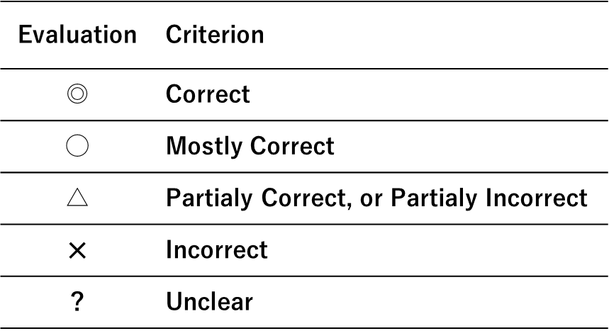
(A1-2) Implementation & Evaluation Methods
Implementation method
  Project Corpus Creation Method
    Utilize Python for repository mining
    Usage: data formatting, class name splitting
  Question Format: Present the CorpusPj
    in alphabetical order and tag cloud image
  Conduct a survey using Google Forms
    (Q1) Please list the functionalities of this system
    (Q2) Please list the technologies and mechanisms used in the system
    (Q3) Please provide a brief description of the system in 1-2 sentences
Evaluation Method: Project administrator rates on a 5-point scale
Notes:
Here is our set-up for the experiment.
To create CorpusPj, ^ we use Python for repository mining.
We also use it for string formatting, class name segmentation.
In the experiment,We present CorpusPj ^ to the subjects when ask them questions.
The question paper has a lexicographically ordered list ^ and a tag cloud image on it.
We collect responses by using GoogleForm.
The following three questions are asked.
Q1 is 「Please list the functionalities of this system
Q2 is 「Please list the technologies and mechanisms used in the system
Q3 is 「Please provide a brief description of the system in 1-2 sentences
For the evaluation, gitlab administrator rates the answers on a 5-point scale.
As you can see in this table, The evaluation is done roughly.

Slide 8
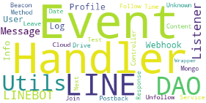
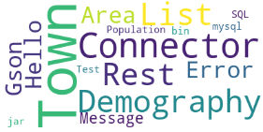
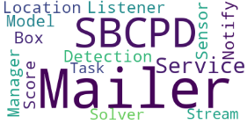
Example of a Corpus Created from Repository
 | CorpusPj | Tag cloud
Q1 | Beacon Cloud Content Controller DAO DAO DAO DAO Date Drive Event Event Event Event Event Event Event Event Event Event Follow Handler Handler Handler Handler Handler Handler Handler Handler Http Http Info Info Join LINE LINE LINE LINE LINE LINE LINEBOT LINEBOT LINEBOT Leave Listener Listener Listener Log Log Message Message Message Method Mongo Next Postback Profile Profile Response Service Test Time Unfollow Unknown User User Utils Utils Utils Utils Webhook Webhook Wrapper
Q2 | 1 45 5 Area Connector Demography Demography Error Gson Hello List List Message My Population Rest Rest SQL Test Town Town Town Town bin connector jar mysql
Q3 | Box Detection Listener Location Mailer Mailer Mailer Mailer Manager Model Notify SBCPD SBCPD Score Sensor Service Service Solver Stream Task
…
Notes:
What you see here is the example of a corpus created from repository.
On the left, you can see the words created as corpusPj, ^ and on the right, you can see the tagcloud image created using those words.

Slide 9
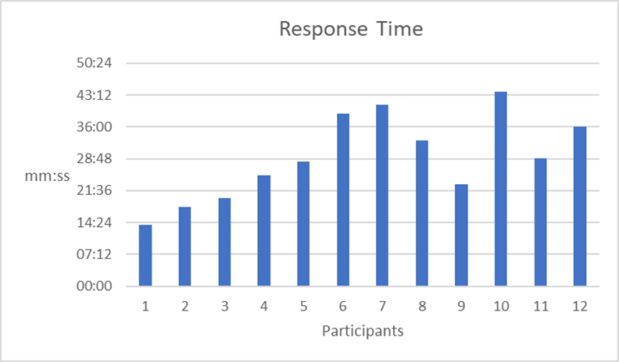
(A2-1) Experimental Results
Example Answers
  (Q1: Functionalities)
    Email sending feature
    retrieving status from sensors
  (Q2: Used Technologies) Gmail API
  (Q3: Overview in 1-2 sentences)
    Sending environmental information
    for specific locations via email
Average Answering Time for Participants: 30 minutes
  Shortest: 13 minutes
  Longest: 44 minutes
  On average, participants provided answers within 3 minutes
Notes:
Here's the experimental result.
There are the actual recorded responses in this experiment.
Subjects answered Q1~3 for each of the 10 pieces of software, for a total of 30 responses.
The average total response time was 30 minutes.
The shortest response time was 13 minutes and the longest was 44 minutes.
This means that, on average, the respondents spent three minutes on a single piece of software.

Slide 10
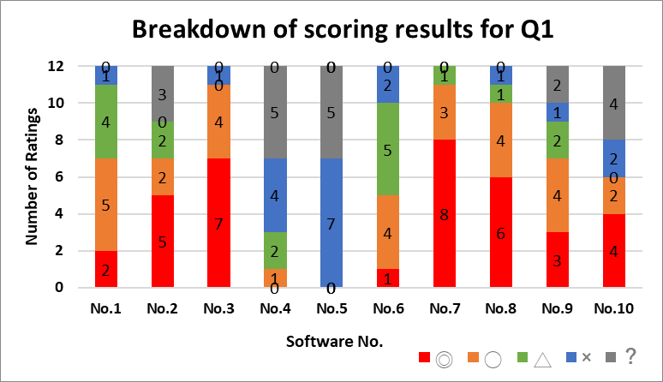
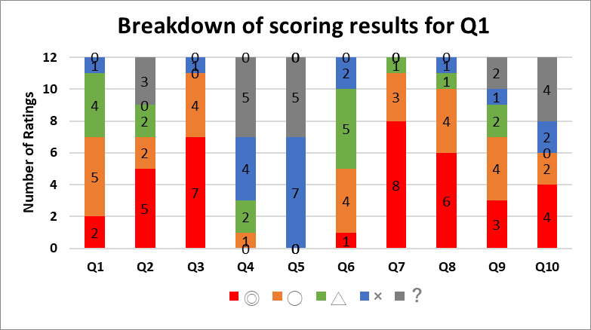
(A2-2) Results of Q1 scoring
(Q1): Please list the functionalities of this system in bullet points
Extremely high or low percentage of correct answers were seen
  → Focus on each of them
Evaluation | Criterion
◎ | ■ Correct
◯ | ■ Mostly Correct
△ | ■ Partialy Correct, or Partialy Incorrect
✕ | ■ Incorrect
？ | ■ Unclear
Notes:
Due to time constraints, this presentation will focus only on Q1 among Q1, Q2, and Q3.
Here are the results of Q1.
The question text for Q1 was “Please list the functionalities of this system in bullet points”.
Please Look at the graph on the left.
The color of the bars indicates the grade of the evaluation ^ , and the horizontal axis shows the software number.
You can see that there are software with extremely high correct answer rates ^ and software with extremely low correct answer rates.
In the following sections, we will focus on each of them.

Slide 11
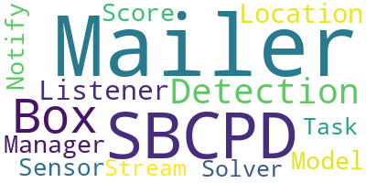
(A3-1) Is it possible to understand the function?
The accuracy rate was high: (No.3) LifeActivityMailer
  (Function 1): Monitoring time-series data from sensors
  (Function 2): Notifying sensor owners via email
Factors: Presence of words related to functionalities
  Sensor, Box, Score, Detection -> Detecting sensor box values (→ Function 1)
  Mailer, Notify -> Sending notifications via email (→ Function 2)
Inferring function from word sense relationships
  Sensor↔Detection and Mailer↔Notify
CorpusPj | tagcloud
Box Detection Listener Location Mailer Mailer Mailer Mailer Manager Model Notify SBCPD SBCPD Score Sensor Service Service Solver Stream Task
Notes:
In this slide, we focus on the software with the highest scores.
The software with the highest percentage of correct responses was LifeActivityMailer (No. 3).
This software has two main functions.
First, it monitors time-series data from sensors.
The second is to send email notifications to sensor owners.
The CorpusPj created is shown in the table below.
One of the factors was the presence of words related to the functionality.
For example, the words Sensor, Box, Score, and Detection were included in CorpusPj. This is related to function 1, Detecting sensor box values.
The words Mailer and Notify are associated with function 2, Sending notifications via email.
So, participants could make inferences based on word sense associations for questions ^ that had a high percentage of correct responses.（？？？継ぎ目）

Slide 12
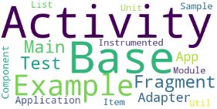
(A3-2) Is it possible to understand the function?
The accuracy rate was low: (No.5) enishi_mock
  (Summary) Repository for conducting screen design for another project (Enishi)
Factors: Lack of necessary information in the corpus.
  Existence of commonly used words in software development -> Example, Module, Test, etc.
  Presence of classes introduced by frameworks or design models
    Activity, Fragment (automatically generated by the Android SDK*)
Project-specific information was difficult to obtain
CorpusPj | tagcloud
Activity Activity Adapter App Application Base Base Component Example Example Fragment Fragment Instrumented Item List Main Main Module My My Sample Test Test Unit Util
Notes:
Now let's focus on the items with lower accuracy rates. The one with a low accuracy rate is enishi_mock, specifically No.5.
The overview is a repository for conducting screen design for another project, Enishi.
We created CorpusPj, which is presented in the table below.
One of the reasons for the low accuracy rate is the lack of important information in CorpusPj.
For example, CorpusPj contains many commonly used words in software development, such as Example, Module, and Test.
Moreover, there are words that rely on specific frameworks and design models.
The terms Activity and Fragment, shown here, are automatically generated when developing using the Android SDK.
In such cases, it becomes difficult to obtain project-specific information, rendering it ineffective for inferring the overview.

Slide 13
Conclusion
Previous Research
  Inferring software overview using project corpus
  Key Idea: Focus on the composition of class names
Goal: To validate the effectiveness of previous research
  Conducted a participant experiment using the proposed method
  Validated the effectiveness of the methodology for RQ
Future Work
  Creating CorpusPj with the method and variable names
  Investigating the inference process for each participant
Notes:
Finally, Here is a summary.
we proposed a method for inferring the overview of software using CorpusPj in our previous research.
The key idea was to focus on the composition of class names.
The Goal of this study was to validate the effectiveness of the previous research.
We conducted experiments using the proposed method and verified its effectiveness based on the research questions.
As for future work, we plan to create CorpusPj with the method and variable names, and investigating the inference process for each participant.

Slide 14
THANK YOU
Welcome Your Questions or Comments
E-mail: odajin@es4.eedept.kobe-u.ac.jp
Notes:
This concludes my presentaion.
Thank you for your attention.

Slide 15
About the Participants
Participants in the experiment: Students of Informatics
Programming Skills Taken
  C, Java, SpringBoot
Breakdown of students
  5 B4 students
  4 M1 students
  3 M2 students

Slide 16
Q2 scoring results
Many questions have an accuracy rate of over 80% for correct answers (red, orange).
There were noticeable cases of no response.
Questions 4, 5, and 10 had low accuracy rates.

Slide 17
RQ2: Is it possible to identify the technology used?
High accuracy rate project: (Question 6) ENISHI
  (Overview): A service that performs job matching in public places.
Inferences based on technical terms:
  Example: MySQL: A type of database management system
    mysql → Perform CRUD operations on the database
Inferences about software architecture:
  Example: Controller → Designed based on the Model-View-Controller (MVC) model

Slide 18
Q3 scoring results
(Problem statement):Describe the system in one or two lines
Q1 and Q2 have consistently high correct answer rates.
  Understanding the functionality and technologies leads to a better grasp of the system's overview.
The total number of correct answers decreases compared to Q1 and Q2.
  There are cases where individuals failed to comprehend the system's overview despite understanding its functionality and technologies.

Slide 19
RQ3: Is it possible to get an overview?
Project with decreased correct answer rate from Q1: (Q8) virtual-care-giver
  Overview: A web application that executes care scenarios using a virtual agent.
  Functionality: YouTube playback, schedule management.
Factors:Some participants misunderstood certain functionalities as the overall project overview.
  Example of misunderstanding: Playing YouTube videos and asking for feedback.
    This is only a part of the project's functionalities.
    The overview should focus on the virtual agent providing various types of care.

Slide 20
A2: Answer to RQs
RQ1: Is it possible to understand the functionality through project corpus?
  It is possible if the responsibilities of classes are well divided.
    If a single class has multiple roles, it becomes difficult to extract functionalities.
RQ2: Is it possible to infer the used technologies through project corpus?
  It is possible based on knowledge of technical terms.
    It is possible to infer the expected behavior from technical terms, which helps in determining functionalities.
RQ3: Is it possible to infer the overview through project corpus?
  Understanding the project's functionalities and used technologies is necessary.
    Considering multiple functionalities of the project, summarizing the purpose becomes feasible.

Slide 21
Paper Title
Author name
dept. name of organization (of Affiliation)
The 20th International Joint Conference on Computer Science and Software Engineering
28th June-1st July 2023
Naresuan University Phitsanulok, THAILAND

Slide 23
THANK YOU
QUESTION & ANSWER

