Slide 1



Effects of Speech Duration on Preserving
the Identity of Synthesized Voice
Papapin Supmee, Klittiya Suwanmalai, Natkrita Hanchoenkul, Napa Sae-Bae and Banphatree Khomkham
Department of Computer Science
Srinakharinwirot University
Bangkok, Thailand
The 20th International Joint Conference on Computer Science and Software Engineering
28th June-1st July 2023
Naresuan University Phitsanulok, THAILAND

Slide 2
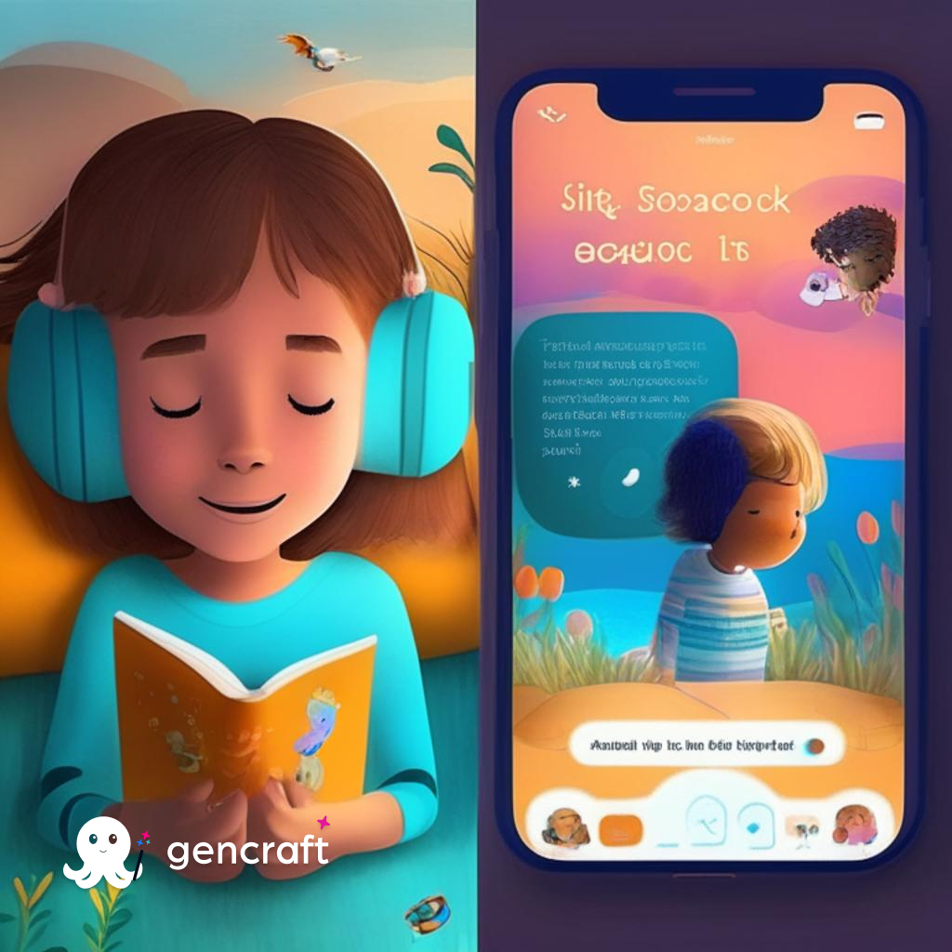
Introduction
Advanced speech synthesis models use transfer learning to preserve the speaker's identity in multispeaker text-to-speech synthesis.
They efficiently generate high-quality voice signals from short speech samples, enhancing usability.
These models have diverse applications, including personalized children's book reading and scenarios with limited speech samples.
2

Slide 3
Contribution
Investigated the impact of speech duration on identity preservation in a speech-synthesized model using Thai speech samples.
Conducted two experiments to evaluate the model's identity preserving performance:
  Experiment 1 : Examined the quality of the identity vector derived from the speech synthesized model based on different speech durations.
  Experiment 2 : Assessed the identity preserving performance of the synthesized voice signal generated by the model in independent speaker recognition systems.

Slide 4
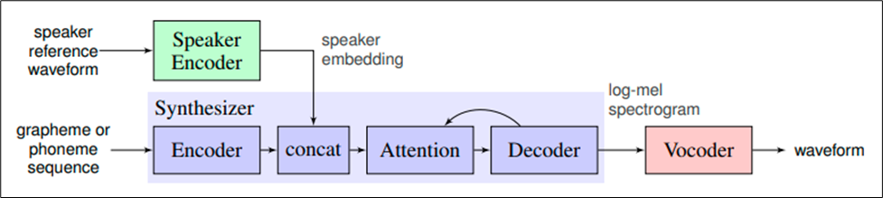
Speech Synthesized Model
  The speech-synthesized model introduced by Jia et al. (2018) is employed.
  The model consists of three independently trained neural networks:
    Recurrent speaker encoder
    Sequence-to-sequence synthesizer
    Autoregressive WaveNet vocoder

Slide 5
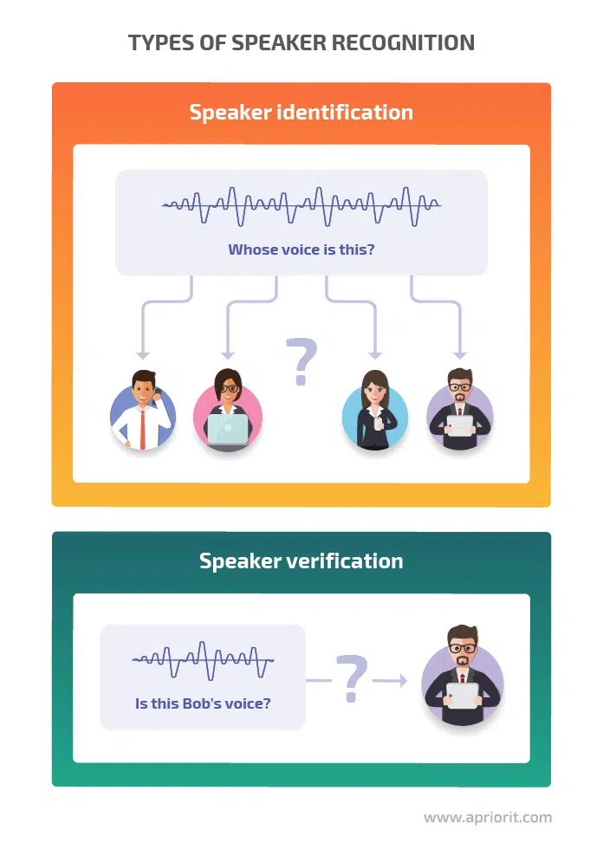
Speaker Recognition Models
Speaker recognition models perform two tasks:
  speaker identification and verification.
Text-independent models focus on determining speaker identity based on speech characteristics.
Speaker embeddings are generated from unconstrained speech utterances.
These models were trained on a composite dataset:
  SpeakerNet (Koluguri et al., 2010)
  TITANET_L (Koluguri et al., 2020)
  ECAPA_TDNN (Dawalatabad et al., 2021)
These models are different from the ones used in the speech synthesized model.
Image from: https://www.apriorit.com/dev-blog/759-ai-speaker-recognition

Slide 6
Dataset
  Dataset: LOTUS database (subset of Thai Speech Recognition corpus from NECTEC)
  24 individuals' speech data with transcribed text
  Clean speech environment recordings using a medium-quality microphone
Table 1.The table shows the length interval of the audio Files in each group.
Group | Speech Duration (seconds) | Number of recordings
Group A | 1-3 | 232
Group B | 4-7 | 397
Group C | 8-13 | 170
Group D* | >13 | 36
* Note that the audio files in group D were discarded as some people did not have audio files in this group resulting in a small quantity of audio files in this group.

Slide 7
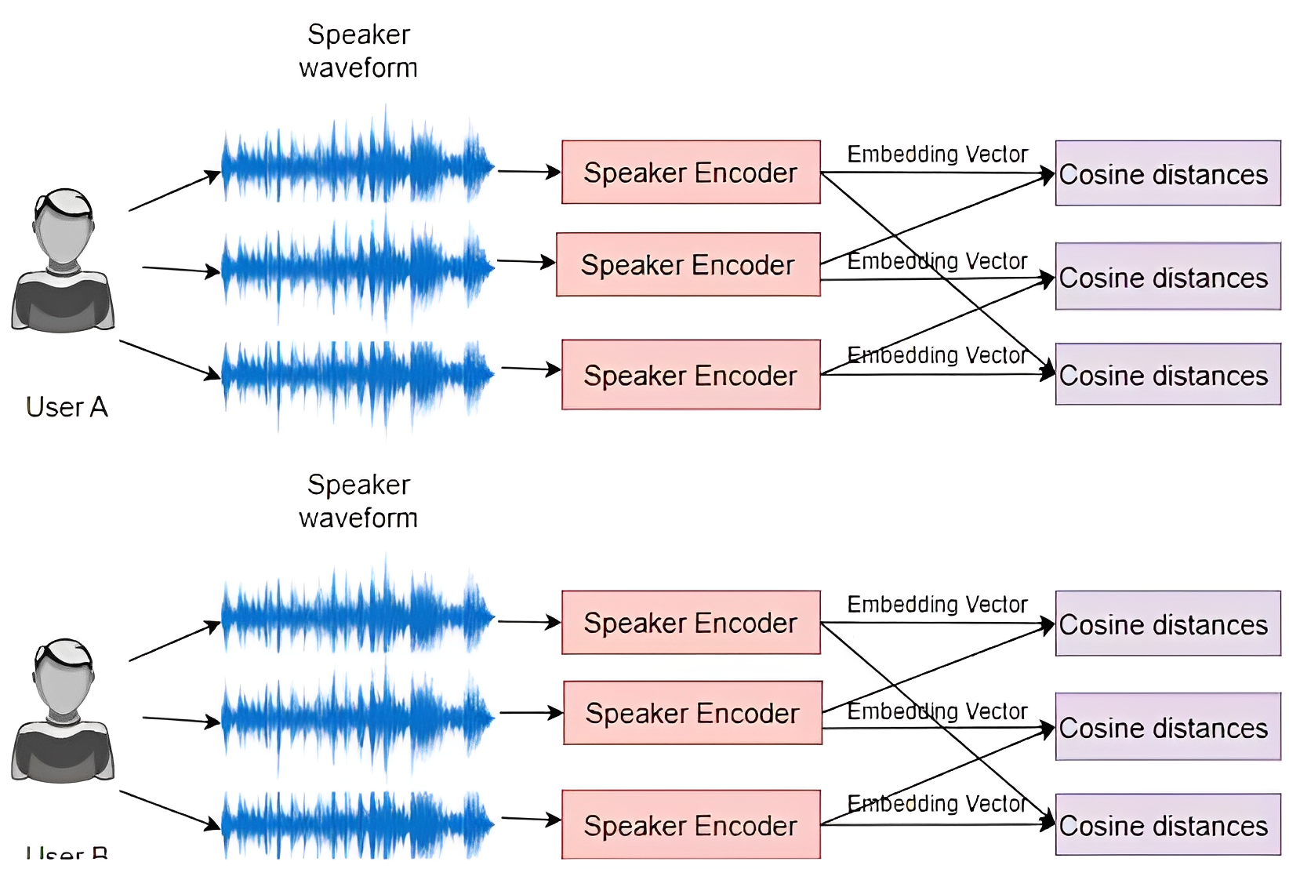
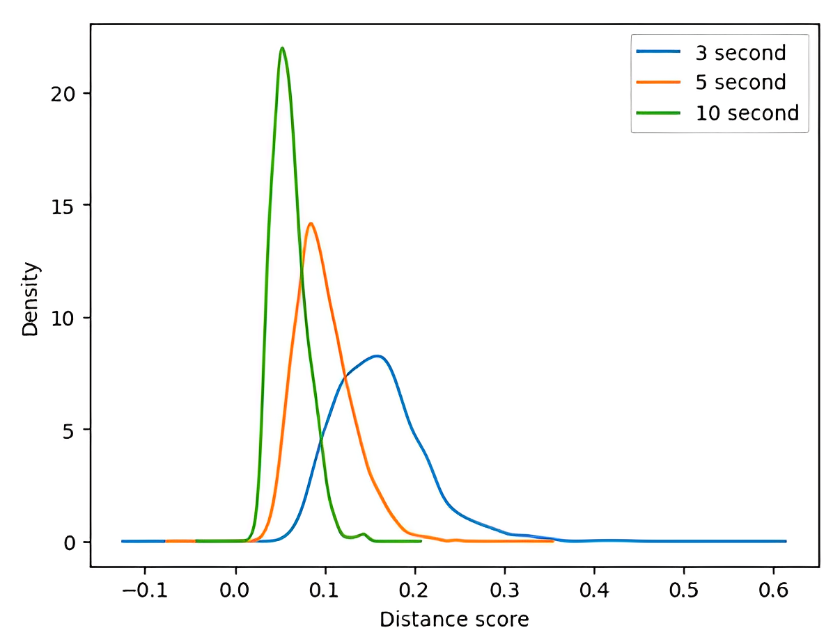
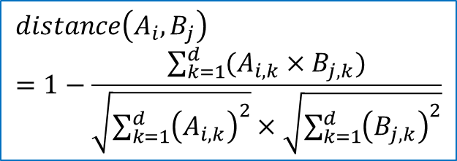
Experiment 1: Similarity of Identity Embedding Vectors
$$distance\left(A_{i},B_{j}\right)=1−\frac{\sum_{k=1}^{d}{(A_{i,k}×B_{j,k})}}{\sqrt{{\sum_{k=1}^{d}{\left(A_{i,k}\right)}}^{2}}×\sqrt{{\sum_{k=1}^{d}{\left(B_{j,k}\right)}}^{2}}}$$
User A
User B
Fig.1. The diagram for deriving cosine distances between each user’s embedding vectors
Fig.2. Kernel Density Plot (KDE) plot of 24 individuals

Slide 8
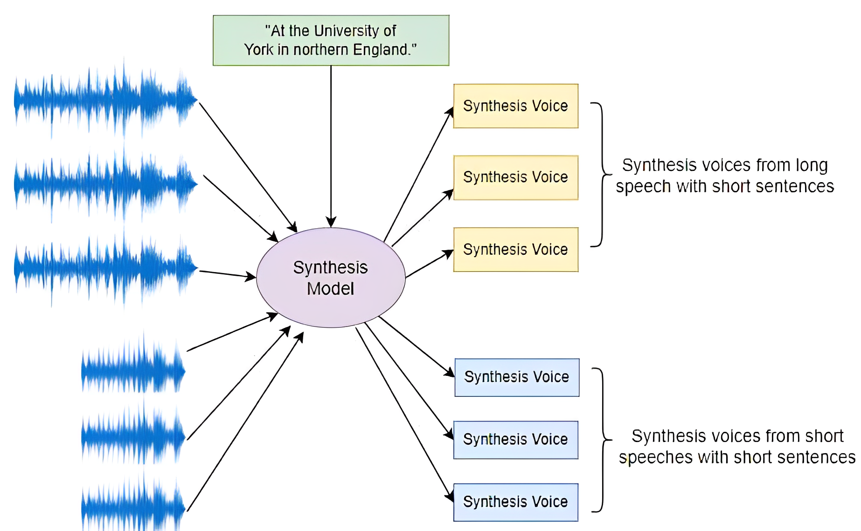
Experiment 2: Identity preserving characteristic on synthesized speech with varied durations
  Identity vector and text were used to synthesize identity-preserving speech.
  Baseline EER accuracy for all models on the LOTUS dataset, with one sample per user used for enrollment.
Table 2. EER of each voice verification models evaluated on Thai speech dataset.
Voice verification model | Baseline EER (%)
SpeakerNet | 2.68
TITANET_L | 0.59
ECAPA_TDNN | 1.21
Fig.3. The diagram for synthesizing voices with a short sentences from different speech duration.

Slide 9
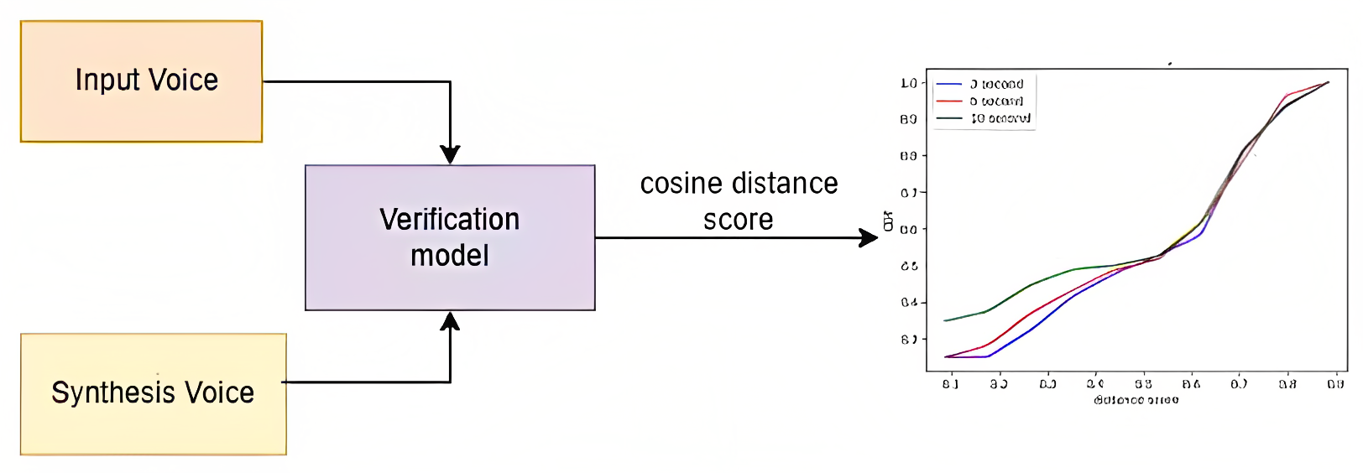
Experiment 2: Identity preserving characteristic on synthesized speech with varied durations
  Dissimilarity score between the original speeches and synthesized voices derived from independent speaker verification model.
  2 files were selected for each group of the 24 users.
  The dissimilarity between user's speeches and synthesized voices generated from the longest duration (8-13 seconds) was the lowest on average.
Fig.4. The diagram for verification performance.

Slide 10
Experiment 2: Identity preserving characteristic on synthesized speech with varied durations
  2. Verification performance of synthesized voice.
  One speech from each user was used for enrollment.
  The synthesized voices from the two speeches were used for genuine verification attempts, including short and long texts.
  Synthesized voices from all other users were used for imposter verification attempts.
  Longer durations of original speech resulted in synthesized voices with higher identity-preserving quality and lower verification error.
Table 3. EER of all verification system
Speaker verification model | EER (%)
 | Group A (1-3 secs) | Group B (4-7 secs) | Group C (8-13 secs)
SpeakerNet | 21.96 | 20.85 | 18.75
TITANET_L | 18.75 | 6.36 | 14.83
ECAPA_TDNN | 17.08 | 17.59 | 16.29

Slide 11
Conclusion
  Study Objective: Investigating the voice synthesizing model with Thai speech
  Experiment 1: Evaluating embedding vector similarity based on different speech durations
    Findings: Longer speech duration leads to closer and more stable embedding vectors
  Experiment 2: Evaluating similarity between speech and synthesized voice based on different speech durations
    Findings: Synthesized voices from longer speech are more similar to the original speech compared to shorter speech
  Recommendation: Speech duration of around 10 seconds is recommended for model utilization in applications
  Limit: Small dataset, same environment, range of speech duration
  Future research: Improving the robustness and reliability of voice synthesis models

Slide 12
THANK YOU
QUESTION & ANSWER

