Slide 1



CCE-Stream: Semi-supervised Stream Clustering
using Color-based Constraints
Kritsana Treechalong , Thanawin Rakthanmanon & Kitsana Waiyamai
Department of Computer Science,
Kasetsart University, KPS, Thailand
Department of Computer Engineering,
Kasetsart University, BKK, Thailand
&
The 20th International Joint Conference on Computer Science and Software Engineering
28th June-1st July 2023
Naresuan University Phitsanulok, THAILAND

Slide 2
Content
Introduction
Related Work
Motivations
Objective
Methodology
Experimental Evaluation
Summary
Notes:
for content of my presentation , first, I talk to introduction and related work for u see the problem, second objective and methodology to solve the problem ,final we show experimental evolution of this paper and summary

Slide 3
Introduction
Clustering
Stream Clustering
Constraint
Constraint based on Stream Clustering
Notes:
At the beginning, let me give you brief details of Clustering, Stream Clustering,

Slide 4
Clustering
Clustering is count as “Unsupervised Learning
Clustering is grouping set of data objects into one or more groups of similar objects called “Cluster (s)”
Notes:
What is Clustering, clustering is process to grouping similar data point to same group , we call group is cluster ,and the process is clustering
From this example, we have many data points in space dimension and we want to group the datapoint . The process that grouping data points into 3 cluster

Slide 5
Stream Clustering
Performs clustering task over data streams
Data stream is set of multidimensional records arriving with time stamps
Four main characteristics of stream clustering
  Unlimited data & limited memory
  Process data in only single pass
  Use summarized data instead of all data
  Support the evolution of data streams
Notes:
Unlike thanditional clustering
Stream Clustering, Stream clustering is a process that performs clustering task over data stream while the Data stream is incoming datapoint but different time
see in Example , we have datapoint incoming and SC try to grouping datapoint over time
four main characteristics of Stream clustering are “Process…”, “Use summarize…”

Slide 6
Stream Clustering Techniques
Many stream clustering techniques have proposed
Some stream clustering techniques:
  HP-Stream, CluStream, DenStream and SED-Stream
  SED-Stream is one of the most recent techniques (2014)
  It supports all types of clustering structure evolutions
  Appearance
  Disappearance
  Self-evolution (resize or move)
  Merge
  Split
Notes:
For the SC tec exsample hpsrtream clustream
one of the most recent techniques is SED stream
and It supports all types of clustering structure evolutions

Slide 7
SED-Stream
An evolution-based technique for stream clustering
Dimension selection is performed
Each new stream data point is processed
Old stream data point is faded
Detection 5 clustering structure evolution types
  Cluster Appearance
  Cluster Disappearance
  Cluster Self-evolution (resize or move)
  Clustering Merge
  Clustering Split
Notes:
SED is evobase tec
Process every datapoint and fade old data out
And SED-Stream have selection dim techin
Why do I have to mention about “SED-Stream”? Because it’s the easiest technique to give you an understanding about Stream clustering.
SED-Stream can detec 5 clustering structure evolution types arre appear dis

Slide 8
Cluster Structure Evolution : Appearance
Appearance
  A new cluster can appear if there is a sufficiently dense group of data points in one area.
Cluster Appearance
Notes:
When u grouping datapoint to group and density of that group is high it mean cluster apperance

Slide 9
Cluster Structure Evolution : Dis-appearance
Dis-appearance
  A cluster disappears when existence of its data is diminished over time.
  Evolution operations are not performed against that cluster for a long period of time
  This cluster is not up to date
Notes:
while the process keeps working , and some cluster doesn’t have any data point go in for a long period of time
It mean this cluster is not up to date , we will delete this cluster

Slide 10
Cluster Structure Evolution : Self-evaluation
Self-evaluation
  A cluster can change its behavior, which results in
  evolution of Size or Position
Notes:
when data point is assigned to cluster or data point is faded out, the cluster will recalculate its radius and center. We call this self eva

Slide 11
Cluster Structure Evolution : Merge
Merge
  A pair of clusters can be merged if their characteristics are very similar.
  Resulting cluster must cover the behavior of the pair.
2 clusters are close
Notes:
When the process keeps working, and two clusters are close or intersect. It will be merged into new cluster. Because it similar behavior

Slide 12
Cluster Structure Evolution : Split
Split
  A cluster can be split into two smaller clusters if the behavior inside the cluster is obviously separated.
2 peaks in a dimension
Notes:
In 1 cluster when We find the 2 peak in 1 dimensions…. we can divide data points into two groups. Because the behavior in defferent
Now, you may already have a basic knowledge about stream clustering. So let’s talk about problem of stream clustering

Slide 13
Constraint
The state of being checked, restricted, or compelled to avoid or perform some action. ¹
Constraints allow you to further restrict the domain of an attribute.²
Constraints Clustering
  Grouping set of data objects that exploit prior knowledge in term of “Constraints”
  Semi-supervised Learning
Notes:
เงื่อนไขหรือ conctraint มาดูที่มีคนนิยาม
นิยามโดยทั่วๆไป คือ ตรวจสอบ บังคับ เพื่อหลีกหรือทำบางอย่าง
ดาต้าเบส คือ กำหนด หรือ ควบคุม โดเมน

Slide 14
Instance-Level Constraints
Must-Link Constraint (ML)
  Must-Link Constraints specify that a pair of points x and y must be assigned to the same cluster denote as Must-Link(x,y)
Cannot-Link Constraint (CL)
  Cannot-Link Constraints specify that a pair of points x and y cannot be assigned to the same cluster denote as Cannot-Link(x,y)

Slide 15
SEDC-Stream
Extend from SED-Stream
Integrate Instance-Level Constraints to guide SED-stream
  Must-Link on Cluster Splitting
  Cannot-Link on Cluster Assignment
Constraints Operations for Data Streams
  Constraint Activation
  Constraint Fading
Constraint must be selected for a good clustering quality
Not support all stream behavior such as Merge
+

Slide 16
Motivations
Improve performance of stream clustering with Constraints
  Use all constraints to improve clustering quality
  Support all clustering operations via Instance-Level Constraints

Slide 17
Objective
Develop technique for Stream Clustering using Constraints
  Modify Instance-Level Constraints to Dynamic Constraints
  Add an new cluster representation
  Extend stream clustering operations using Constraints

Slide 18
“CCE-Stream”
CCE-Stream uses constraints to guide the clustering process => Semi-supervised stream clustering
In CCE-Stream, we
  Modify Instance-Level Constraints
  Add an new cluster representation
  Extend stream clustering operations using Constraints
Notes:
SSE is semi-super we use background knowledge to make new cluster representation and extent SC operation
To improve output clustering quality.
///////So in this RS we propose

Slide 19
Our Ideas
Use of constraints
  Relations of constraint points evolve over time
Add characteristic of cluster in terms of Color
  Then, Manage clustering operations via Color
+
+
+
+
Notes:
Idea กว้างๆ
ปกติเราทำการรวมกลุ่มข้อมูล จัดกลุ่มข้อมูลต่างๆ เป้าหมายของการจัดกลุ่มหลังจากจัดแล้วคือะไร
คือการที่เราจะบอกว่ากลุ่มกลุ่มนั้นที่เราจัดมีสมาชิคกล้ายๆกันนี้คือกลุ่มของอะไร คลาสอะไร
ยกตัวอย่างเรามีหนังสือหลายๆเล่ม เราก็จัดๆๆ ออกเป็นกลุ่มๆแล้วเราก็จะได้ หนังสือวิทยาศาสตร์ หนังสือนิยาย หนังสือข่าว
สรุปแล้วในทุกๆกลุ่มก็จะมีตัวแทนว่าเป็นอะไร เราจึงมีไอเดีย ทำไมเราไม่จัดกลุ่มไปพร้อมกำหนดไปพร้อมกันเลยว่าเป็นกลุ่มอะรตาม ct ที่เข้ามา
ว่า จุดนี้ควนอยู่กับจุดนี้ ไม่ควรอยู่กับจุดนี้ ในรูปแบบของสีเนื่องจากเราไม่รู้เฉลยแต่เรารู้ว่ามันคล้ายเลยให้อยู่ในลักษณะสี

Slide 20
Constraints
Must-Link Constraint (ML)
  A pair of points x and y with same color
Cannot-Link Constraint (CL)
  A pair of points x and y with different color

Slide 21
New Cluster Representation
Color-of-cluster(CoC)
  CoC = Majority Color of constraints in a cluster
CoC is RED
Notes:
SSE-Stream utilize background knowledge in the form of labeled data points
Labeled data points can be immediately utilized for determining the class of clusters, and effectively support the changing behavior of data streams
And we make new cluster representation is class of cluster classofcluster is mahori
from example assume White points are unlabeled data point
Colored points are labeled data point which each color is represent class of data point.
In this cluster , there are two red points and one blue point in the cluster. The Classofcluster of this cluster is red

Slide 22
New Cluster Representation
Color-of-cluster(CoC)
  CoC = Majority color of constraints in a cluster
CoC is neutral
Notes:
And some cluter don’t have labeled data point we call this cluster is neutarl cluster

Slide 23
Extension of Evolution Operations
CoC & Constraints are combined to extend clustering operations
  Find Closest Cluster
  Force Split
  Cluster Merge
Notes:
Now we have label datapoint and ClassoofCluster to extent the operation are
Find Closest Cluster ,Force Split,Cluster Merge
and we explain on next slide

Slide 24
Find Closest Cluster
Find Closest Cluster
  Verify a new constraint point
  Find its appropriate cluster
  Three possible cases must be decided
Notes:
Our teching Find Closest Cluster
When datapoint coming we check is unlabel data point or label datapoint
If it is label datapoint we have 2 case for manage it

Slide 25
Find Closest Cluster
Case 1 : First-component Must-Link constraint or First-component Cannot-Link constraint
+
+
?
Notes:
ต้องบอกก่อนว่า ct เป็นคู่ก็จริงแต่เวลาเข้ามาในระบบมันมาที่ละ ส่วน และทีละคู่

Slide 26
Find Closest Cluster
Case 1 : First-component Must-Link constraint or First-component Cannot-Link constraint
+
+

Slide 27
Find Closest Cluster
Case 1 : First-component Must-Link constraint or First-component Cannot-Link constraint
+
+
Notes:
If distance between the labeled data point and all clusters is more than their radius, then SSE will be assigned to the closest cluster having same coc or undefined Coc.

Slide 28
Find Closest Cluster
Case 1 : First-component Must-Link constraint or First-component Cannot-Link constraint
?
+
+
Notes:
If distance between the labeled data point and all clusters is more than their radius, then SSE will be assigned to the closest cluster having same coc or undefined Coc.

Slide 29
Find Closest Cluster
Case 1 : First-component Must-Link constraint or First-component Cannot-Link constraint
+
+
Notes:
If distance between the labeled data point and all clusters is more than their radius, then SSE will be assigned to the closest cluster having same coc or undefined Coc.

Slide 30
Find Closest Cluster
Case 1 : First-component Must-Link constraint or First-component Cannot-Link constraint
+
+
Notes:
If distance between the labeled data point and all clusters is more than their radius, then SSE will be assigned to the closest cluster having same coc or undefined Coc.

Slide 31
Find Closest Cluster
Case 2 : Second-component Must-Link constraint
+
+
Notes:
If distance between the labeled data point and all clusters is more than their radius, then SSE will be assigned to the closest cluster having same coc or undefined Coc.

Slide 32
Find Closest Cluster
Case 2 : Second-component Must-Link constraint
?
?
+
+
?
?
Notes:
If distance between the labeled data point and all clusters is more than their radius, then SSE will be assigned to the closest cluster having same coc or undefined Coc.

Slide 33
Find Closest Cluster
Case 2 : Second-component Must-Link constraint
+
+
Notes:
If distance between the labeled data point and all clusters is more than their radius, then SSE will be assigned to the closest cluster having same coc or undefined Coc.

Slide 34
Find Closest Cluster
Case 2 : Second-component Must-Link constraint
+
+
+
Notes:
If distance between the labeled data point and all clusters is more than their radius, then SSE will be assigned to the closest cluster having same coc or undefined Coc.

Slide 35
Find Closest Cluster
Case 2 : Second-component Must-Link constraint
+
+
+
Notes:
If distance between the labeled data point and all clusters is more than their radius, then SSE will be assigned to the closest cluster having same coc or undefined Coc.

Slide 36
Find Closest Cluster
Case 2 : Second-component Must-Link constraint
+
+
+
Notes:
If distance between the labeled data point and all clusters is more than their radius, then SSE will be assigned to the closest cluster having same coc or undefined Coc.

Slide 37
Find Closest Cluster
Case 2 : Second-component Must-Link constraint
+
+
+
Notes:
If distance between the labeled data point and all clusters is more than their radius, then SSE will be assigned to the closest cluster having same coc or undefined Coc.

Slide 38
Find Closest Cluster
Case 2 : Second-component Must-Link constraint
+
+
+
Notes:
If distance between the labeled data point and all clusters is more than their radius, then SSE will be assigned to the closest cluster having same coc or undefined Coc.

Slide 39
Find Closest Cluster
Case 2 : Second-component Must-Link constraint
+
+
+
Notes:
If distance between the labeled data point and all clusters is more than their radius, then SSE will be assigned to the closest cluster having same coc or undefined Coc.

Slide 40
Find Closest Cluster
Case 3 : Second-component Cannot-Link constraint
+
+
Notes:
If distance between the labeled data point and all clusters is more than their radius, then SSE will be assigned to the closest cluster having same coc or undefined Coc.

Slide 41
Find Closest Cluster
Case 3 : Second-component Cannot-Link constraint
+
+
Notes:
ยกตัวอย่างที่อยู่นอกกลุ่ม จุดแรก

Slide 42
Find Closest Cluster
Case 3 : Second-component Cannot-Link constraint
+
+
Notes:
If distance between the labeled data point and all clusters is more than their radius, then SSE will be assigned to the closest cluster having same coc or undefined Coc.

Slide 43
Find Closest Cluster
Case 3 : Second-component Cannot-Link constraint
+
+
Notes:
If distance between the labeled data point and all clusters is more than their radius, then SSE will be assigned to the closest cluster having same coc or undefined Coc.

Slide 44
Find Closest Cluster
Case 3 : Second-component Cannot-Link constraint
+
+
+
Notes:
If distance between the labeled data point and all clusters is more than their radius, then SSE will be assigned to the closest cluster having same coc or undefined Coc.

Slide 45
Find Closest Cluster
Case 3 : Second-component Cannot-Link constraint
+
+
Notes:
If distance between the labeled data point and all clusters is more than their radius, then SSE will be assigned to the closest cluster having same coc or undefined Coc.

Slide 46
Find Closest Cluster
Case 3 : Second-component Cannot-Link constraint
+
+
Notes:
If distance between the labeled data point and all clusters is more than their radius, then SSE will be assigned to the closest cluster having same coc or undefined Coc.

Slide 47
Find Closest Cluster
Case 3 : Second-component Cannot-Link constraint
+
+
Notes:
If distance between the labeled data point and all clusters is more than their radius, then SSE will be assigned to the closest cluster having same coc or undefined Coc.

Slide 48
Find Closest Cluster
Case 3 : Second-component Cannot-Link constraint
+
+
Notes:
If distance between the labeled data point and all clusters is more than their radius, then SSE will be assigned to the closest cluster having same coc or undefined Coc.

Slide 49
Find Closest Cluster
Case 3 : Second-component Cannot-Link constraint
+
+
Notes:
If distance between the labeled data point and all clusters is more than their radius, then SSE will be assigned to the closest cluster having same coc or undefined Coc.

Slide 50
Find Closest Cluster
Case 3 : Second-component Cannot-Link constraint
+
+
Notes:
If distance between the labeled data point and all clusters is more than their radius, then SSE will be assigned to the closest cluster having same coc or undefined Coc.

Slide 51
Find Closest Cluster
Case 3 : Second-component Cannot-Link constraint
+
+
Notes:
If distance between the labeled data point and all clusters is more than their radius, then SSE will be assigned to the closest cluster having same coc or undefined Coc.

Slide 52
Find Closest Cluster
Case 3 : Second-component Cannot-Link constraint
+
+
Notes:
If distance between the labeled data point and all clusters is more than their radius, then SSE will be assigned to the closest cluster having same coc or undefined Coc.

Slide 53
Find Closest Cluster
Case 3 : Second-component Cannot-Link constraint
+
+
Notes:
If distance between the labeled data point and all clusters is more than their radius, then SSE will be assigned to the closest cluster having same coc or undefined Coc.

Slide 54
Find Closest Cluster
Case 3 : Second-component Cannot-Link constraint
+
+
Notes:
If distance between the labeled data point and all clusters is more than their radius, then SSE will be assigned to the closest cluster having same coc or undefined Coc.

Slide 55
Find Closest Cluster
Case 3 : Second-component Cannot-Link constraint
+
+
?
Notes:
If distance between the labeled data point and all clusters is more than their radius, then SSE will be assigned to the closest cluster having same coc or undefined Coc.

Slide 56
Find Closest Cluster
Case 3 : Second-component Cannot-Link constraint
+
+
Notes:
If distance between the labeled data point and all clusters is more than their radius, then SSE will be assigned to the closest cluster having same coc or undefined Coc.

Slide 57
Find Closest Cluster
Case 3 : Second-component Cannot-Link constraint
+
+
+
Notes:
อีกกรณี
ต่อไป หน้าต่อไปสมมุติมีกลุ่มเพิ่ม

Slide 58
Find Closest Cluster
Case 3 : Second-component Cannot-Link constraint
+
+
+
+
Notes:
If distance between the labeled data point and all clusters is more than their radius, then SSE will be assigned to the closest cluster having same coc or undefined Coc.

Slide 59
Find Closest Cluster
Case 3 : Second-component Cannot-Link constraint
+
+
+
+
Notes:
If distance between the labeled data point and all clusters is more than their radius, then SSE will be assigned to the closest cluster having same coc or undefined Coc.

Slide 60
Find Closest Cluster
Case 3 : Second-component Cannot-Link constraint
+
+
+
+
Notes:
If distance between the labeled data point and all clusters is more than their radius, then SSE will be assigned to the closest cluster having same coc or undefined Coc.

Slide 61
Find Closest Cluster
Case 3 : Second-component Cannot-Link constraint
+
+
+
+
Notes:
If distance between the labeled data point and all clusters is more than their radius, then SSE will be assigned to the closest cluster having same coc or undefined Coc.

Slide 62
Find Closest Cluster
Case 3 : Second-component Cannot-Link constraint
+
+
+
+
Notes:
If distance between the labeled data point and all clusters is more than their radius, then SSE will be assigned to the closest cluster having same coc or undefined Coc.

Slide 63
Find Closest Cluster
Case 3 : Second-component Cannot-Link constraint
+
+
+
+
Notes:
If distance between the labeled data point and all clusters is more than their radius, then SSE will be assigned to the closest cluster having same coc or undefined Coc.

Slide 64
Find Closest Cluster
Case 3 : Second-component Cannot-Link constraint
+
+
+
+
Notes:
If distance between the labeled data point and all clusters is more than their radius, then SSE will be assigned to the closest cluster having same coc or undefined Coc.

Slide 65
Find Closest Cluster
Case 3 : Second-component Cannot-Link constraint
+
+
+
+
Notes:
If distance between the labeled data point and all clusters is more than their radius, then SSE will be assigned to the closest cluster having same coc or undefined Coc.

Slide 66
Find Closest Cluster
Case 3 : Second-component Cannot-Link constraint
+
+
+
+
Notes:
If distance between the labeled data point and all clusters is more than their radius, then SSE will be assigned to the closest cluster having same coc or undefined Coc.

Slide 67
Find Closest Cluster
Case 3 : Second-component Cannot-Link constraint
+
+
+
+
Force Split
Notes:
If distance between the labeled data point and all clusters is more than their radius, then SSE will be assigned to the closest cluster having same coc or undefined Coc.

Slide 68
Find Closest Cluster
Case 3 : Second-component Cannot-Link constraint
+
+
+
+
Notes:
If distance between the labeled data point and all clusters is more than their radius, then SSE will be assigned to the closest cluster having same coc or undefined Coc.

Slide 69
Find Closest Cluster
Case 3 : Second-component Cannot-Link constraint
+
+
+
+
+
Notes:
If distance between the labeled data point and all clusters is more than their radius, then SSE will be assigned to the closest cluster having same coc or undefined Coc.

Slide 70
Find Closest Cluster
Case 3 : Second-component Cannot-Link constraint
+
+
+
+
+
Notes:
If distance between the labeled data point and all clusters is more than their radius, then SSE will be assigned to the closest cluster having same coc or undefined Coc.

Slide 71
Force Split
Force Split
  If a cluster has more than one color
  Force split operation will separate a cluster into two clusters.
Notes:
Force Split operation
When a cluster has more than 1 class it mean that cluster is not pure we want to force split it

Slide 72
Force Split
Force Split Example
  Method
    Select the best dimension for split.
    Split cluster into two smaller clusters.
    - Existing constraint points are divided into new closest cluster.
    3. Set Coc.
Notes:
And this is method
For example, we notice that there are 2 red class object and one blue class object in one cluster. We want to split it
First we select the best dim for split and split it from that dim
And after split set classofcluster of new cluster

Slide 73
Cluster Merge
Cluster Merge
  With knowledge about cluster color from Coc,
  Nearby clusters will not be merged if color of those clusters are different
Notes:
Cluster Merge
When 2 cluster to close or intersection but class of cluster are diffferent we don’t merge it
Because if u merge it cluster quirity is reduce

Slide 74
Cluster Merge
Cluster Merge
+
+
+
+
Clusters are not merged
Notes:
For example, when red and blue clusters are close but the Coc is different. SSE will not merge the 2 cluster.

Slide 75
Evaluation and Experimental Result
Experimental Setup
CCE is compared with SEDC and SED-Stream
Datasets
Constraint points represent 1% of all data points
10 sets of constraints are randomly generated
Experimental results are the average of 10 sets
Dataset | #Record | #attribute | #Class
Forest Cover Type | 581,012 | 10 | 7
Electricity | 45,312 | 8 | 2
Notes:
ตาราง dataset

Slide 76
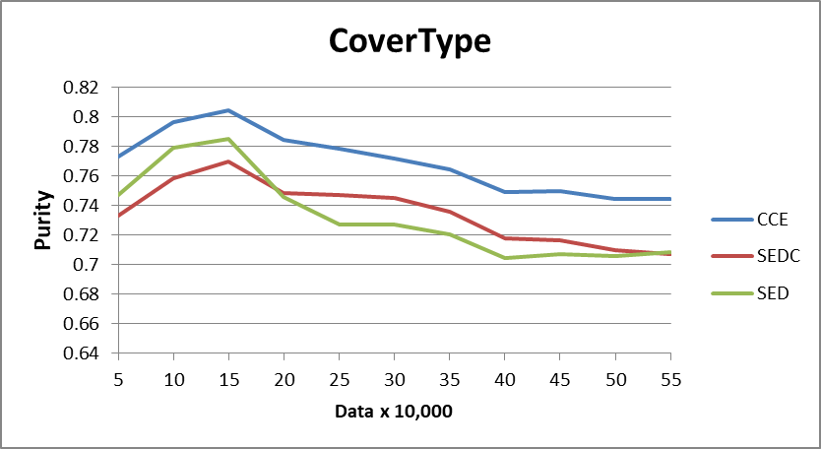
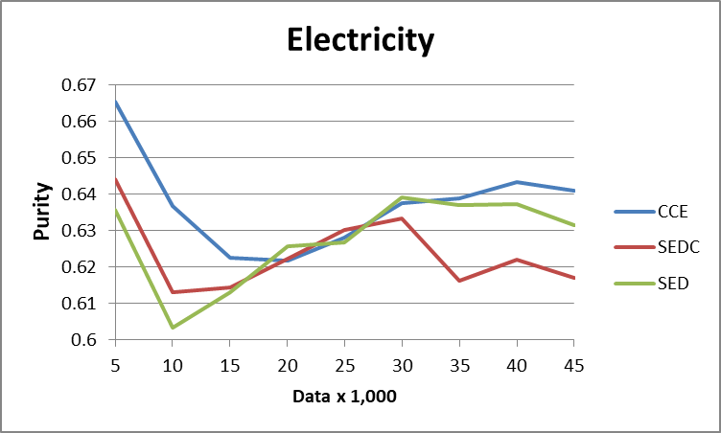
Evaluation & Experimental Results
Clustering Quality in terms of Purity
For only 1% of data.
Covertype : The purity Increase 3.4% (SEDC) and 3.7% (SED)
Electricity : The purity Increase 1.4% (SEDC) and 1.0% (SED)
Notes:
. on covertype elec and netwprk intru we can increase 4.2 % 10% and 0.5% in term of purity , respectively
Network Intrusion is a very simple dataset, where its distribution is clear
and gradual. Thus, every stream clustering algorithm generates high clustering quality
For more difficute dataset such as Forest cover type and electicity, SSE-
stream is able to generate higher clustering quality than SED-Stream
because SSE generate more pure cluster
and next

Slide 77
Evaluation & Experimental Results
Clustering Quality in terms of F-measure
For only 1% of data.
Covertype : The f-measure Increase 2.2% (SEDC) and 1.0% (SED)
Electricity : The f-measure Increase 2.5% (SEDC) and 0.3% (SED)
Notes:
. on covertype elec and netwprk intru we can increase 4.2 % 10% and 0.5% in term of purity , respectively
Network Intrusion is a very simple dataset, where its distribution is clear
and gradual. Thus, every stream clustering algorithm generates high clustering quality
For more difficute dataset such as Forest cover type and electicity, SSE-
stream is able to generate higher clustering quality than SED-Stream
because SSE generate more pure cluster
and next

Slide 78
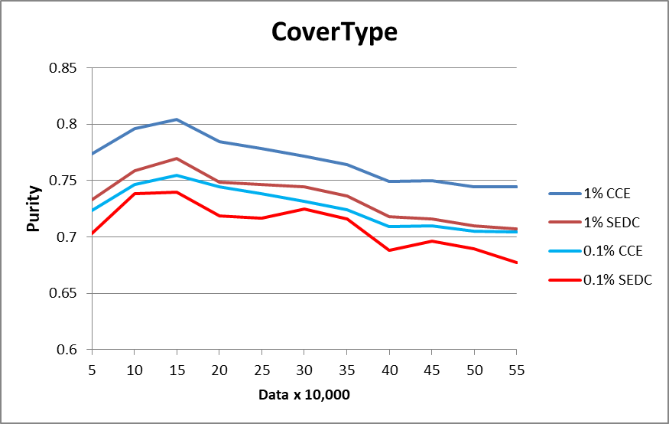
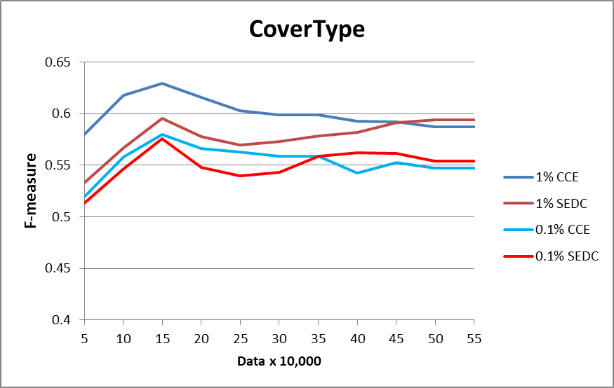
Evaluation and Experimental Result
Clustering Quality with respect to % of constraint data points [1% -> 0.1%]
For only 0.1% of data on Covertype dataset ,
The purity Increase 3.0% and the f-measure Increase 1.9%
Notes:
we decrease percentage of labeled datapoint from 1 to 0.1
We notice that with very small percentage of labeled data points only 0.1%, the clustering quality of SSE-
Stream is still increased. Thus, usage of labeled data has a very high positive effect to the output clustering quality

Slide 79
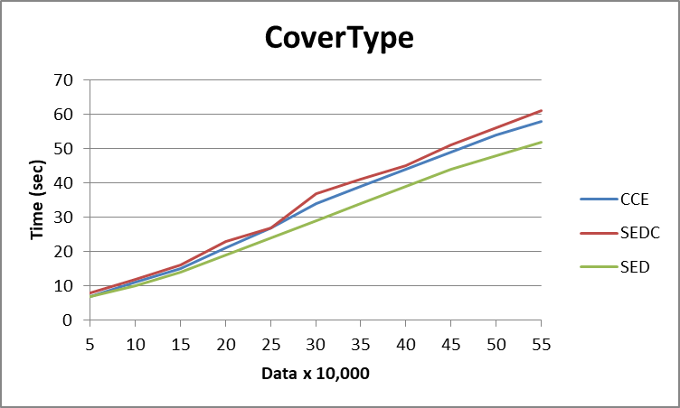
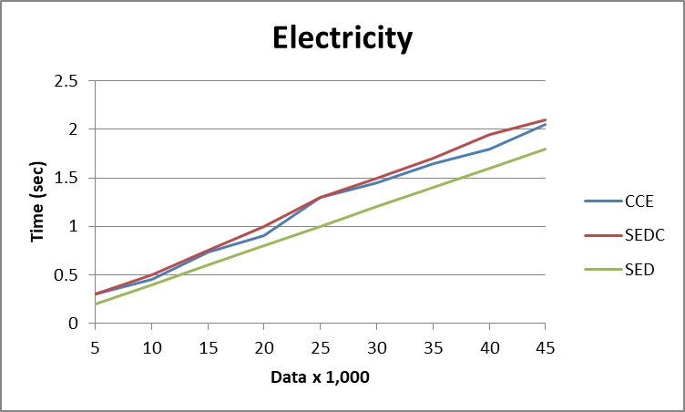
Evaluation & Experimental Results
Execution time
The execution time of CCE-Stream is a bit faster than SEDC-Stream
Notes:
compares execution time. It shows that
For execution time of SSE-Stream is a bit slower than SED-Stream. because SSE-Stream required more time to manage labeled data points and execute the clustering operations

Slide 80
Summary
Improve performance of stream clustering with Constraints
  Use all constraints to improve clustering quality
  Support all clustering operations via Instance-Level Constraints

Slide 81
THANK YOU
QUESTION & ANSWER

