Slide 1






Modified Feature Extraction to Apply PSO
for Solving Handwritten Digits
Jiraphat Samleepant
King Mongkut University Technology of North Bangkok
The 20th International Joint Conference on Computer Science and Software Engineering
28th June-1st July 2023
Naresuan University Phitsanulok, THAILAND
  Outline
  Introduction
  Related work
  Proposed work
  Experimental Results
  Conclusion
Notes:
Good afternoon, Mr. Chairman, and the audience.
My name is Jiraphat Samleepant. I come from King Mongkut's University of Technology North Bangkok.
I’m going to present the topic of ”Modified Feature Extraction to Apply PSO for Solving Handwritten Digits".

Slide 2
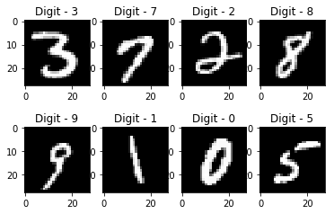
Modified Feature Extraction to Apply PSO
for Solving Handwritten Digits
Jiraphat Samleepant
King Mongkut University Technology of North Bangkok
The 20th International Joint Conference on Computer Science and Software Engineering
28th June-1st July 2023
Naresuan University Phitsanulok, THAILAND
  Outline
  Handwritten Digits Recognition (HDR) is a widely used technology and has been presented in research topics in various fields.
  Introduction
  Related work
  Proposed work
  Experimental Results
  Conclusion
Notes:
The contents can be divided into five sections.
First, Introduction
Second, Related Work
Third, Proposed Work
Fourth, Experimental Results
And finally, Conclusion
Let’s start with the Introduction.

Slide 3
  Introduction
  Outline
  Handwritten Digits Recognition (HDR) is a widely used technology and has been presented in research topics in various fields.
  But everyone’s handwriting is different. It can be the personal markings and interpretation of them into human abilities.
  Related work
  Proposed work
  Experimental Results
  Conclusion
Notes:
Handwritten Digits Recognition (HDR) is a widely used technology and has been presented in research topics in various fields.

Slide 4
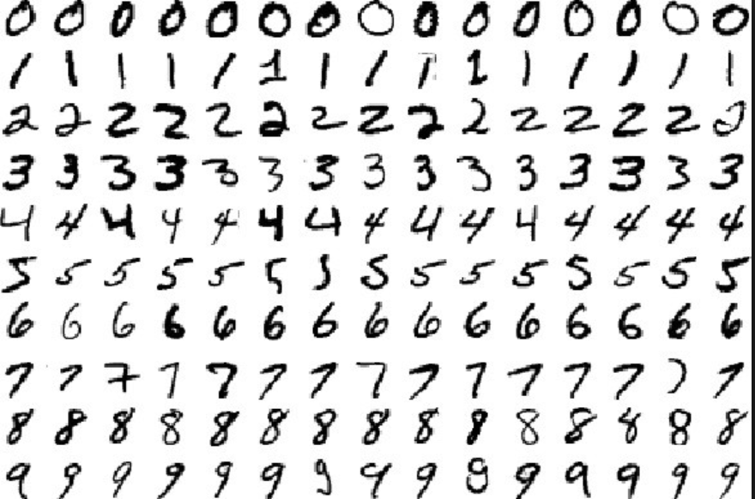
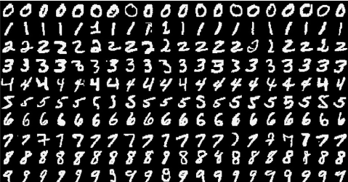
  Introduction
  Handwritten Digits Recognition (HDR) is a widely used technology and has been presented in research topics in various fields.
  It depends on the personality of the writer, and even though the same letter is written twice by the same person at that time, it’s not the same.
  But everyone’s handwriting is different. It can be the personal markings and interpretation of them into human abilities.
Notes:
Handwritten Digits Recognition (HDR) is a widely used technology and has been presented in research topics in various fields.
But everyone’s handwriting is different. It can be the personal markings and interpretation of them into human abilities.

Slide 5
  Introduction
  Handwritten Digits Recognition (HDR) is a widely used technology and has been presented in research topics in various fields.
  It depends on the personality of the writer, and even though the same letter is written twice by the same person at that time, it’s not the same.
  But everyone’s handwriting is different. It can be the personal markings and interpretation of them into human abilities.
  Handwriting has several important characteristics that make this type of work very challenging.
Notes:
It depends on the personality of the writer, and even though the same letter is written twice by the same person at that time, it’s not the same.

Slide 6
  Introduction
  Outline
  Outline
  It depends on the personality of the writer, and even though the same letter is written twice by the same person at that time, it’s not the same.
  Handwriting has several important characteristics that make this type of work very challenging.
  Related work
  Proposed work
  Experimental Results
  Conclusion
Notes:
It depends on the personality of the writer, and even though the same letter is written twice by the same person at that time, it’s not the same.
Handwriting has several important characteristics that make this type of work very challenging.

Slide 7
  Outline
  It depends on the personality of the writer, and even though the same letter is written twice by the same person at that time, it’s not the same.
  Introduction
  Handwriting has several important characteristics that make this type of work very challenging.
  Related work
  Proposed work
  Experimental Results
  Conclusion
Notes:
In the next section, let’s see about Related Work.

Slide 8
  Outline
  Introduction
  As previous mention, Handwritten Digits Recognition (HDR) has high variability due to the unique characteristics of handwritten digits.
  Related work
  Proposed work
  Experimental Results
  Conclusion
Notes:
In the next section, let’s see about Related Work.

Slide 9
  Related work
  Outline
  Introduction
  As previous mention, Handwritten Digits Recognition (HDR) has high variability due to the unique characteristics of handwritten digits.
  Proposed work
  To overcome that problem, There is a researcher that uses Particle Swarm Optimization (PSO) to evaluate the recognition rate.
  Experimental Results
  Conclusion
Notes:
As previous mention, Handwritten Digits Recognition (HDR) has high variability due to the unique characteristics of handwritten digits.

Slide 10
  Related work
  Outline
  Handwritten digits recognition using Particle Swarm Optimization or Freeman Chain Code + PSO + 5 Folds Cross-Validation.
  This algorithm is not only searching for all the answers but searching only the area that is the best answer. It makes reducing the scope of the search and possible to search efficiently, thus saving time.
  Introduction
  As previous mention, Handwritten Digits Recognition (HDR) has high variability due to the unique characteristics of handwritten digits.
  Proposed work
  To overcome that problem, There is a researcher that uses Particle Swarm Optimization (PSO) to evaluate the recognition rate.
  Experimental Results
  Conclusion
Notes:
As previous mention, Handwritten Digits Recognition (HDR) has high variability due to the unique characteristics of handwritten digits.
To overcome that problem, There is a researcher that uses Particle Swarm Optimization (PSO) to evaluate the recognition rate.

Slide 11
  Related work
  Handwritten digits recognition using Particle Swarm Optimization or Freeman Chain Code + PSO + 5 Folds Cross-Validation.
  This algorithm is not only searching for all the answers but searching only the area that is the best answer. It makes reducing the scope of the search and possible to search efficiently, thus saving time.
  As previous mention, Handwritten Digits Recognition (HDR) has high variability due to the unique characteristics of handwritten digits.
  To overcome that problem, There is a researcher that uses Particle Swarm Optimization (PSO) to evaluate the recognition rate.
  But adopting improper pre-processing of the input image can affect the recognition rate.
  Therefore, pre-processing and feature management are very important in this work.
Notes:
Handwritten digits recognition using Particle Swarm Optimization or Freeman Chain Code + PSO + 5 Folds Cross-Validation.
This algorithm is not only searching for all the answers but searching only the area that is the best answer. It makes reducing the scope of the search and possible to search efficiently, thus saving time.

Slide 12
  Related work
  Outline
  Handwritten digits recognition using Particle Swarm Optimization or Freeman Chain Code + PSO + 5 Folds Cross-Validation.
  This algorithm is not only searching for all the answers but searching only the area that is the best answer. It makes reducing the scope of the search and possible to search efficiently, thus saving time.
  Introduction
  Proposed work
  Experimental Results
  But adopting improper pre-processing of the input image can affect the recognition rate.
  Therefore, pre-processing and feature management are very important in this work.
  Conclusion
Notes:
Handwritten digits recognition using Particle Swarm Optimization or Freeman Chain Code + PSO + 5 Folds Cross-Validation.
This algorithm is not only searching for all the answers but searching only the area that is the best answer. It makes reducing the scope of the search and possible to search efficiently, thus saving time.
But adopting improper pre-processing of the input image can affect the recognition rate.
Therefore, pre-processing and feature management are very important in this work.

Slide 13
  Outline
  Handwritten digits recognition using Particle Swarm Optimization or Freeman Chain Code + PSO + 5 Folds Cross-Validation.
  This algorithm is not only searching for all the answers but searching only the area that is the best answer. It makes reducing the scope of the search and possible to search efficiently, thus saving time.
  Introduction
  Related work
  Proposed work
  Experimental Results
  But adopting improper pre-processing of the input image can affect the recognition rate.
  Therefore, pre-processing and feature management are very important in this work.
  Conclusion
Notes:
In the next section, let’s see about the Proposed Work.

Slide 14
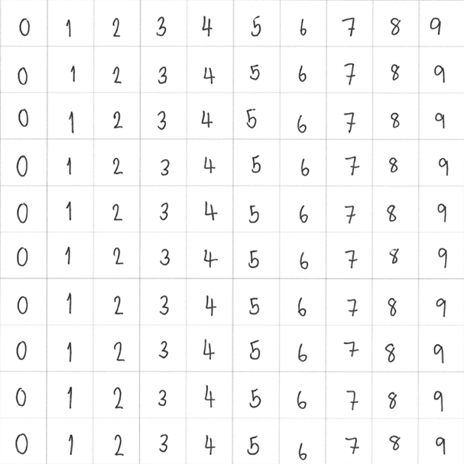
  Outline
  Data preparation
  The individual handwritten numbers where each dataset must be
  “written by the same person”.
  Introduction
  Related work
  Proposed work
  Experimental Results
  Conclusion
Notes:
In the next section, let’s see about the Proposed Work.

Slide 15
  Proposed work
  Outline
  Data preparation
  The individual handwritten numbers where each dataset must be
  “written by the same person”.
  Introduction
  Related work
  The digits are two sets of numbers 0 to 9 that must have
  “non-pseudo-characteristic writing”.
  Experimental Results
  Conclusion
Notes:
I’m going to talk about Data Preparation before I continue to talk about my flowchart.
The individual handwritten numbers where each dataset must be written by the same person.

Slide 16
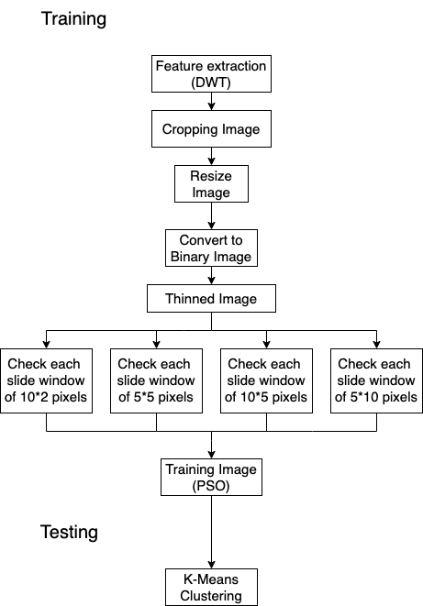
  Proposed work
  Outline
  Data preparation
  The individual handwritten numbers where each dataset must be
  “written by the same person”.
  Introduction
  Related work
  The digits are two sets of numbers 0 to 9 that must have
  “non-pseudo-characteristic writing”.
  Experimental Results
  Conclusion
Notes:
I’m going to talk about Data Preparation before I continue to talk about my flowchart.
The individual handwritten numbers where each dataset must be written by the same person.
The digits are two sets of numbers 0 to 9 that must have non-pseudo-characteristic writing.

Slide 17
  Proposed work
  Data preparation
  The individual handwritten numbers where each dataset must be
  “written by the same person”.
  The digits are two sets of numbers 0 to 9 that must have
  “non-pseudo-characteristic writing”.
Notes:
This is my flowchart.
I’m going to present the first step.

Slide 18

  Proposed work
  Step1
  Cropping the frame with the handwritten numbers inside.
  The DWT method is used to extract the important lines to remove noise.
  Image segmentation is applied to crop the white outer image for centering the numbers.
  The image is resized to 10*10 pixels for ease to find the quantity of the black pixel.
Notes:
This is my flowchart.
I’m going to present the first step.

Slide 19
  Step1
  Step1
  The individual handwritten numbers where each dataset must be
  “written by the same person”.
  The digits are two sets of numbers 0 to 9 that must have
  “non-pseudo-characteristic writing”.
  Cropping the frame with the handwritten numbers inside.
  The DWT method is used to extract the important lines to remove noise.
  Image segmentation is applied to crop the white outer image for centering the numbers.
  The image is resized to 10*10 pixels for ease to find the quantity of the black pixel.
Notes:
The first step is cropping the frame with the handwritten numbers inside.
Then, the Discrete wavelet transform (DWT) method is used to extract the important lines to remove noise.
Image segmentation is applied to crop the white outer image for centering the numbers.
And the image is resized to 10*10 pixels in the final step as a digital number that can easily find the quantity of the black pixel.

Slide 20

  Step1
  Step2
  Thinning is a method in which the input data removes the outer layer of the number until it’s a single pixel wide.
  Cropping the frame with the handwritten numbers inside.
  The DWT method is used to extract the important lines to remove noise.
  Image segmentation is applied to crop the white outer image for centering the numbers.
  The image is resized to 10*10 pixels for ease to find the quantity of the black pixel.
Notes:
In the second step, I’m introducing a newly invented method called "Thinned and Checked pixel Chain Code processing (TCCC)", as the feature extraction.
The process that makes thinning the input images and checking pixels by pixel to get the digit codes that indicate the numbers.

Slide 21
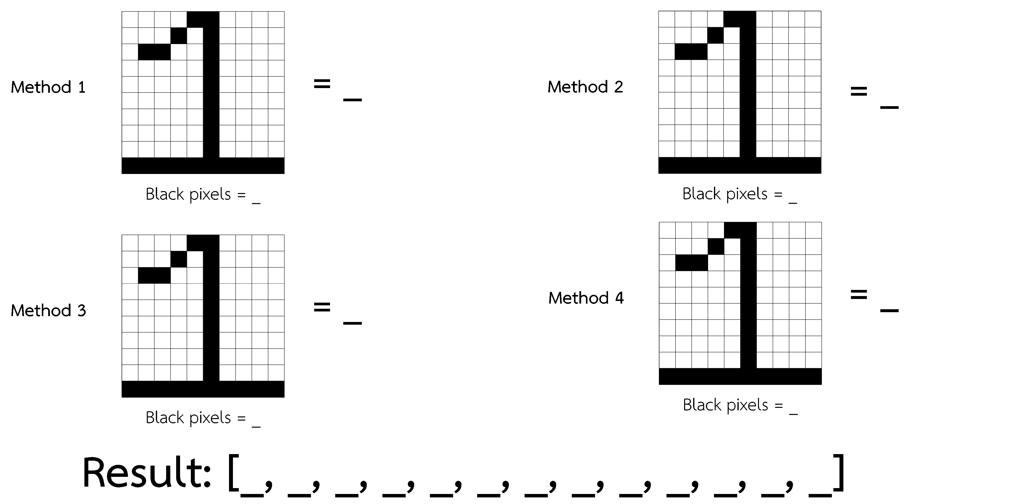
  Step2
  Step1
  The individual handwritten numbers where each dataset must be
  “written by the same person”.
  The digits are two sets of numbers 0 to 9 that must have
  “non-pseudo-characteristic writing”.
  Thinning is a method in which the input data removes the outer layer of the number until it’s a single pixel wide.
  The total number of black pixels obtained by the four methods is summarized.
Notes:
This method, Thinning is a method in which the input data removes the outer layer of the number until it’s a single pixel wide.

Slide 22
  Step2
  Step3
  Thinning is a method in which the input data removes the outer layer of the number until it’s a single pixel wide.
  The total number of black pixels obtained by the four methods is summarized.
Notes:
The black pixels counting method uses to count the black pixel are as follows:
First, the 10*2 pixels windowed image is created, which starts moving from top to bottom according to the input image, moving two rows at a time without overlapping the previous count.
Second, the 5*5 pixels windowed image is created, which starts moving from left to right, and top to bottom without overlapping the previous count.
Third, the 5*10 pixels windowed image is created, which starts moving from top to bottom without overlapping the previous count.
Fourth, the 10*5 pixels windowed image is created, which starts moving from left to right without overlapping the previous count.
When the process is complete, the total number of black pixels obtained by the four methods is summarized.
The shaded part represents the image with the windowed image and the total output value has 13 characters.
The first five obtained values are from the first method's count. The next four obtained values are from the second method's count. The next two obtained values are from the third method's count. and the last two obtained are from the fourth method's count, respectively.

Slide 23
  Step2
  Step3
  Step4
  The total number of black pixels obtained by the four methods is summarized.
Notes:
In the third step, The previous results were introduced into the PSO method to enter training. Output is the model that is used for clustering.

Slide 24
  Outline
  Introduction
  Related work
  Step3
  Proposed work
  Experimental Results
  Conclusion
  Step4
Notes:
In the testing, the K-means method is used for the clustering. It works seamlessly with PSO because the output is a decimal point. It enables to calculation of the distance of values from each digit for accuracy.

Slide 25
  Outline
  Introduction
  Related work
  Proposed work
  Experimental Results
  Conclusion
  Step4
Notes:
In the next section, let’s see about Experimental Results.

Slide 26
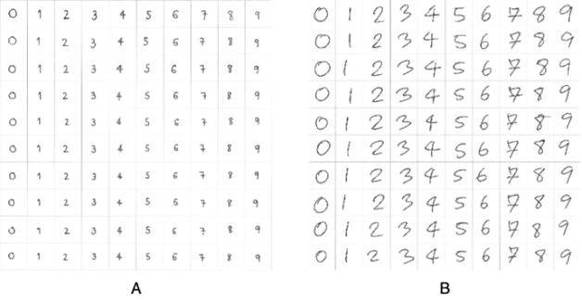
  Outline
  Introduction
  Related work
  Proposed work
  Experimental Results
  Conclusion
  Data used
  1st Experiment
  2nd Experiment
  3rd Experiment
Notes:
In the next section, let’s see about Experimental Results.

Slide 27
  Experimental Results
  Outline
  Introduction
  Data used
  Related work
  1st Experiment
  Proposed work
  2nd Experiment
  3rd Experiment
  Conclusion
Performance comparison for all digits
Technique | Data used | Recognition Rate
Pytesseract | Individual Handwriting | 17.43%
Google Lens | Individual Handwriting | 47.40%
Apple Live Text | Individual Handwriting | 40.71%
TCCC + PSO (Proposed Method) | Individual Handwriting | 93.40%
Notes:
The proposed method was tested on A4 paper using the blank grid and the 1.0 mm black gel pen.
In the Experiments, 35 participants were used.
They were instructed to fill up the table with numbers ranging from 0 to 9. However, the numbers on the individual test papers were mixed. Someone wrote small digits, while others wrote large digits.

Slide 28
  Experimental Results
Performance comparison for all digits
Technique | Data used | Recognition Rate
Pytesseract | Individual Handwriting | 17.43%
Google Lens | Individual Handwriting | 47.40%
Apple Live Text | Individual Handwriting | 40.71%
TCCC + PSO (Proposed Method) | Individual Handwriting | 93.40%
  Data used
  1st Experiment
  2nd Experiment
  3rd Experiment
  Performance comparison for the small digits
Technique | Recognition Rate
Pytesseract | 4.00%
Google Lens | 32.00%
Apple Live Text | 0.00%
TCCC + PSO (Proposed Method) | 92.22%
  Performance comparison for the large digits
Technique | Recognition Rate
Pytesseract | 11.00%
Google Lens | 80.00%
Apple Live Text | 85.00%
TCCC + PSO (Proposed Method) | 95.56%
Notes:
In the first experiment, the results were the average of the recognition rate of all tests. In this work, we compared with Python-tesseract (Pytesseract), Google Lens, and Apple Live Text.
When the benchmarking test was completed, the results of this work compared to the compared techniques.
This experiment produces very satisfactory results. This work receives a 93.40% recognition rate.

Slide 29
  Experimental Results
  Performance comparison for the small digits
Performance comparison for all digits
Technique | Recognition Rate
Pytesseract | 4.00%
Google Lens | 32.00%
Apple Live Text | 0.00%
TCCC + PSO (Proposed Method) | 92.22%
  Data used
Technique | Data used | Recognition Rate
Pytesseract | Individual Handwriting | 17.43%
Google Lens | Individual Handwriting | 47.40%
Apple Live Text | Individual Handwriting | 40.71%
TCCC + PSO (Proposed Method) | Individual Handwriting | 93.40%
  1st Experiment
  2nd Experiment
  Performance comparison for the large digits
Technique | Recognition Rate
Pytesseract | 11.00%
Google Lens | 80.00%
Apple Live Text | 85.00%
TCCC + PSO (Proposed Method) | 95.56%
  3rd Experiment
Comparison of this work with the related one
Technique | Data used | Recognition Rate
Freeman Chain Code + PSO + 5 Folds Cross-Validation | MNIST | 82.60%
TCCC + PSO (Proposed Method) | MNIST | 95.57%
Notes:
In the second experiment, the obvious limitation of the techniques is the small size of the digits.
Apple Live Text has limitations in this regard because when the input image is too small, it's unable to capture and recognize the number at all. The next limitation is image noise, such as grid lines, dust, etc.
The 3 compared techniques are unable to distinguish the disturbance.
This enables them to estimate that the interlacing grid is a "1" or "l" or "|", for example, "112l3|4". And these results cannot be accurately sorted into numbers 0 to 9.
In my work, pre-processing is performed by cropping the frame containing the handwritten numbers inside, then using the DWT method to remove noises and the image segmentation for cropping the white outer image to center the digits. It obviously resolves the limitations. The comparison of the techniques was tested with the sample sets that were written by the participants at the small size and normal size. (They wrote it themselves without being defined or ordered to write in small size)

Slide 30
  Experimental Results
  Outline
  Performance comparison for the small digits
Technique | Recognition Rate
Pytesseract | 4.00%
Google Lens | 32.00%
Apple Live Text | 0.00%
TCCC + PSO (Proposed Method) | 92.22%
  Introduction
  Data used
Comparison of this work with the related one
  Related work
Technique | Data used | Recognition Rate
Freeman Chain Code + PSO + 5 Folds Cross-Validation | MNIST | 82.60%
TCCC + PSO (Proposed Method) | MNIST | 95.57%
  1st Experiment
  Proposed work
  2nd Experiment
  Performance comparison for the large digits
  3rd Experiment
Technique | Recognition Rate
Pytesseract | 11.00%
Google Lens | 80.00%
Apple Live Text | 85.00%
TCCC + PSO (Proposed Method) | 95.56%
  Conclusion
Notes:
In the third experiment, as mentioned in the related work, in my work, the MNIST database containing classes 0 to 9 of 1,000 samples was used.
A total of 800 samples were tested as part of the training set. The results are compared to the mean total recognition rate.
This work received a 95.57% recognition rate. It indicates the individual's handwritten digits, including the pre-processing method. Furthermore, having an effective method before starting the training process can influence the recognition rate.

Slide 31
  Outline
  Introduction
  Data used
Comparison of this work with the related one
  Related work
Technique | Data used | Recognition Rate
Freeman Chain Code + PSO + 5 Folds Cross-Validation | MNIST | 82.60%
TCCC + PSO (Proposed Method) | MNIST | 95.57%
  1st Experiment
  Proposed work
  2nd Experiment
  Experimental Results
  3rd Experiment
  Conclusion
Notes:
In the final section, let’s see about the Conclusion.

Slide 32
  Outline
  Introduction
  The rigorous pre-processing and feature extraction method before the training and the testing process is important for making more recognition rate.
  Related work
  Proposed work
  Experimental Results
  Conclusion
Notes:
In the final section, let’s see about the Conclusion.

Slide 33
  Conclusion
  Outline
  Introduction
  The rigorous pre-processing and feature extraction method before the training and the testing process is important for making more recognition rate.
  Related work
  Proposed work
  Experimental Results
  The 93.40% recognition rate in this work clearly shows that efficient image pre-processing and feature extraction contribute to a higher, more accurate recognition rate result.
Notes:
The rigorous pre-processing and feature extraction method before the training and the testing process is important for making more recognition rate.

Slide 34
  Conclusion
  Outline
  Introduction
  The rigorous pre-processing and feature extraction method before the training and the testing process is important for making more recognition rate.
  Related work
  Proposed work
  Experimental Results
  The 93.40% recognition rate in this work clearly shows that efficient image pre-processing and feature extraction contribute to a higher, more accurate recognition rate result.
Notes:
The rigorous pre-processing and feature extraction method before the training and the testing process is important for making more recognition rate.
The 93.40% recognition rate in this work clearly shows that efficient image pre-processing and feature extraction contribute to a higher, more accurate recognition rate result.

Slide 35
  Outline
  Introduction
  The rigorous pre-processing and feature extraction method before the training and the testing process is important for making more recognition rate.
  Related work
  Proposed work
  Experimental Results
  The 93.40% recognition rate in this work clearly shows that efficient image pre-processing and feature extraction contribute to a higher, more accurate recognition rate result.
  Conclusion
THANK YOU
QUESTION & ANSWER
Notes:
These are the topic of ”Modified Feature Extraction to Apply PSO for Solving Handwritten Digits”.

Slide 36
  Outline
  Introduction
  Related work
  Proposed work
  Experimental Results
  Conclusion
THANK YOU
QUESTION & ANSWER
Notes:
Thank you for your attention. Any question?

