Slide 1



Customer Churn Prediction Using Weight Average Ensemble Machine Learning Model
I Nyoman Mahayasa Adiputra
Khon Kaen University
The 20th International Joint Conference on Computer Science and Software Engineering
28th June-1st July 2023
Naresuan University Phitsanulok, THAILAND

Slide 2
INTRODUCTION
PROPOSED METHOD
EXPERIMENTAL RESULT
CONCLUSION
What is customer churn?
Why use machine learning in customer churn?

Slide 3
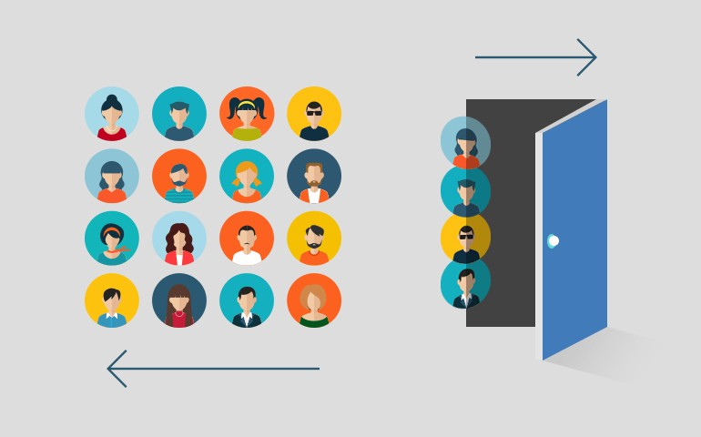
Customer Churn?
Customer churn is a state that customer cancels the subscription of a product
Finding a new customer is five times more expensive than retaining an existing customer*
Effective and efficient churn prediction enable to see that customer is about to stop using product
Company can provide retention and budgeting strategy from customer churn prediction result
* Fornell, C., & Wernerfelt, B. (1987). Defensive marketing strategy by customer com- plaint management: A theoretical analysis. Journal of Marketing Research, 24(4), 337–346.

Slide 4
INTRODUCTION
PROPOSED METHOD
EXPERIMENTAL RESULT
CONCLUSION
How the framework works?

Slide 5
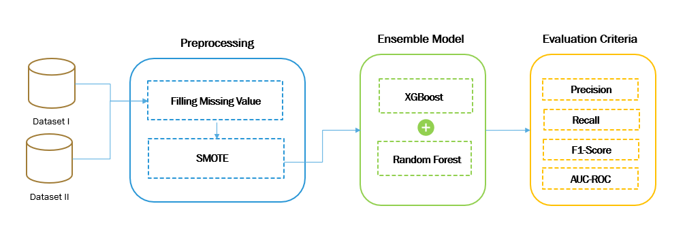
The Framework
Fig. 1. Framework of customer churn prediction using ensemble
Latest study shown XGBoost + Random forest achieve best performance in ensemble model*
*K. HASAN, A. ALAM, D. DAS, E. H. 3 and M. HASAN, "Diabetes Prediction Using Ensembling of Different Machine Learning Classifiers," IEEE Access, 2020

Slide 6

SMOTE* : Synthetic Minority Over-sampling Technique
Simple and efficient over sampling technique
Use for handle unbalanced data
Oversampling data in minority class
Use k-nearest neighbor algorithm to find closest data
*N. V. Chawla, K. W. Bowyer, L. O. Hall and W. P. Kegelmeyer, "SMOTE: Synthetic Minority Over-sampling Technique," Journal of Artificial Intelligence Research , vol. 16, 2002

Slide 7
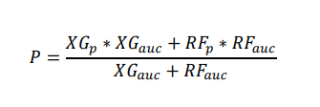
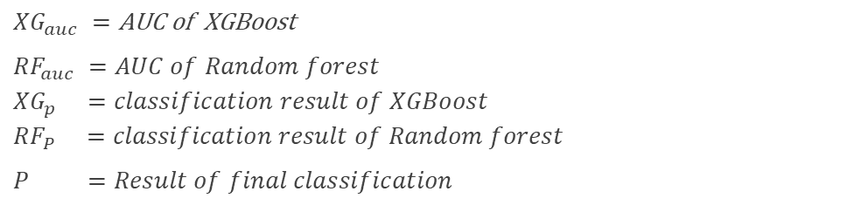
Weight average ensemble learning
$${XG}_{auc} =\text{AUC} \text{of} \text{XGBoost}$$
$$RF_{auc} =AUC of Random forest \\ XG_{p} =classification result of XGBoost \\ RF_{P} =classification result of Random forest$$
$$P =Result of final classification$$

Slide 8
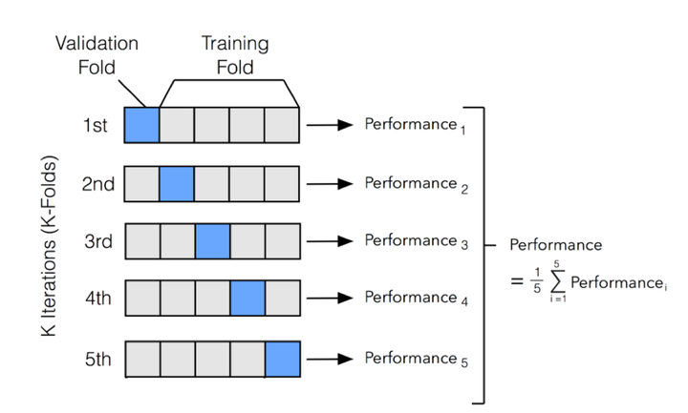
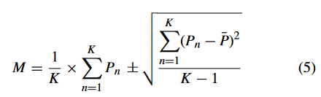
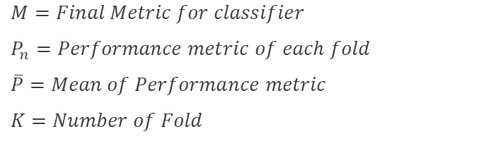
K-fold cross validation
$M=Final Metric for classifier$
$$P_{n}=Performance metric of each fold$$
$$\overline{P}=Mean of Performance metric$$
$$K=Number of Fold$$
Fig 2 : 5-folds cross validation*
*Z. Shen. (2020, March. 12). "3 min of Machine Learning: Cross Vaildation" [Online]. Available: https://zitaoshen.rbind.io/project/machine_learning/machine-learning-101-cross-vaildation/.

Slide 9
INTRODUCTION
PROPOSED METHOD
EXPERIMENTAL RESULT
CONCLUSION
Is ensemble model achieving good performance?

Slide 10
Dataset overview
INDUSTRY | SAMPLES | FEATURE | CHURNED | CHURN RATE
TELCO ª | 7,043 | 19 | 1,869 | 26.54%
INSURANCE ^{b} | 33,908 | 16 | 3,967 | 11.70%
Table 1 : Dataset of customer churn
ª https://www.kaggle.com/datasets/blastchar/telco-customer-churn
^{b} https://www.kaggle.com/datasets/k123vinod/insurance-churn-prediction-weekend-hackathon

Slide 11
Experiment result
INDUSTRY | WORK | F1-Score | AUC | Time (s)
TELCO | X. Wen,et al* | 0.635 | 0.849 | 4.8
 | This research | 0.850 | 0.857 | 3.6
INSURANCE | X. Wen,et al* | 0.623 | 0.932 | 20.85
 | This research | 0.947 | 0.990 | 28
Table 2 : Final experiment result from this research and compare with recent work
Proposed method can improve around 35% and 52% in F1-score
Time spend in insurance dataset is higher than recent study
*Xiaohuan Wen, Yanhong Wang, Xiaodong Ji, Mamadou Kaba Traoré,Three-stage churn management framework based on DCN with asymmetric loss,Expert Systems with Applications,Volume 207,2022

Slide 12
INTRODUCTION
PROPOSED METHOD
EXPERIMENTAL RESULT
CONCLUSION
What are we got from this research?

Slide 13
Conclusion & future works
There is 2 stages that important to improve customer churn prediction :
  Handle unbalanced data
  Ensemble Machine Learning Model
SMOTE is good for balancing data, but takes more time spent on big ratio between minority and majority class data
Prove the model in multi-industry of customer churn data
Develop a customer segmentation and strategy from churn prediction

Slide 14
“No matter how clever your algorithm, if your training data is bad, your algorithm won’t be able to perform well.”
Chip Huyen, 2022

Slide 15
THANK YOU
QUESTION & ANSWER

