Slide 1


28-Days To
THRIVE
With Detoxification & Weight-Loss

Slide 2

Over 70% of Diseases and Chronic Illnesses are caused by unhealthy lifestyles and are
PREVENTABLE!

Slide 3
The Average Person Is Sedentary 93% Of The Time
McDonald's Feeds More Than 46 Million People A Day - More Than The Entire Population Of Spain
1 out of 3 Children Born In The Year 2000 Will Develop Diabetes In Their Lifetime
On Average, 40% Of Family Meals Are Eaten Outside The Home

Slide 4

Don’t Fall For Clever Marketing
    Adding Vitamins to an UNHEALTHY
    Food will not make it HEALTHY!
    PROCESSED FOODS:
    ANYTHING in a box or bag that had to go through a machine to make it!
    JUST SAY NO!
    They do not provide your body with the nutrients it needs and will make you hungrier faster!

Slide 5
North Americans eat 31% more packaged food than fresh food, and they consume more packaged food per person than their counterparts in nearly all other countries.
If you want to get Sexy...
Eliminate Processed Foods!

Slide 6
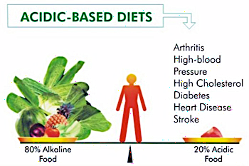
Notes:
Alkalizing and Acidic Foods
When you eat, you have to consider something more than just the amount of calories or pounds you are likely to gain from what you’re putting in your mouth. What you eat also does something to a chemical balance in your body, which when disrupted can cause various health problems. Disease thrives in an acidic system and can not survive in an Alkaline system. If currently you are experiencing things such as frequent headaches, fatigue or recurring allergies, fever or colds, then you might already be having that chemical imbalance in your body. What you need to do is first, make sure you are getting chiropractically adjusted on a regular basis. Next, consume the right kinds of foods that will restore this imbalance to a normal and healthier one. The Greens First Shake that you received with your QuickStart Program is a great and easy start! Don’t skip your Greens!
All About pH Level
In the body, both alkaline and acid simultaneously occur, producing a certain ratio. This alkalinity or acidity is measured on a scale of 0 to 14, the pH balance – wherein 7 is considered neutral, lower than 7 is acidic, and higher than 7 is alkaline. The body is better off with high alkalinity than acidity. There are many factors why the pH level of the body becomes predominantly acidic. When this level is reached, the body must be supplied with alkaline in order to neutralize and get rid off the excess levels of acid trapped inside the body. However, if not properly put in right, acidosis takes place – which is linked to a lot of imaginable health problems, from minor to lethal ones.
Foods to Avoid
In order to prevent excessive acid in the body, it is key to keep the body’s pH level at normal. One way of maintaining this chiefly alkaline level in the body is through the diet approach. Many people will find sticking to a diet consisting of alkaline foods sources somewhat difficult. In order to restore the normal chemical level in the body, one must avoid some of the most hard-to-resist foods on the planet: dairy products, seafood, chocolate, instant foods, condiments, alcohol, coffee, carbonated beverages and others. If you are accustomed to eating fast food regularly, you need to resist temptations all around you in order to follow a diet rich in alkalizing foods.
Foods that Have Plenty of Alkalinity
As a general rule of thumb, your daily meals should be 3/4 alkaline – this means that each time you eat, you should see to it that the foods you put in your mouth should contain 3 times as much alkaline as they do acid. The following are some commonly-known alkaline foods. It pays to have them on a list and placed on the refrigerator door or become staples when you do your grocery shopping.
Vegetables – artichokes, cabbage, carrots, radish, watercress, spinach, turnip, garlic, lettuce, asparagus, onion, peas, leeks, chives, celery, kale, brussels sprouts, cucumber
Fruits – avocado, lemon, lime, grapefruit, watermelon, pear, apple, banana, berries, cantaloupe, grapes, peach
Seeds, nuts & grains – pumpkin, sesame, flax, sunflower, almonds, flax, lentils
Drinks – water, juiced veggies and fruits (not the store bought stuff-freshly juiced), almond milk, herbal teas.
Fats & oils – olive, flax, coconut

Slide 7
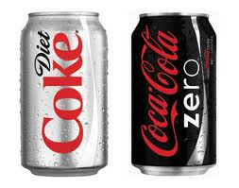
A University of Texas Health Science Center study found that the more diet sodas a person drank, the greater their risk of becoming overweight. Downing just two or more cans a day increased waistlines by 500%
If you want to get Sexy...
Eliminate Sodas!
Artificial sweeteners can disrupt the body’s natural ability to regulate calorie intake based on the sweetness of foods. That means people who consume diet foods are more likely to overeat, because your body is being tricked into thinking it’s eating sugar, and you crave more.
Notes:
Why too many soft drinks can lead to nutrient deficiencies...
Research reveals that kids (and adults, too!) who drink too much soda and soft drinks may not be getting essential vitamins and minerals that fight disease and build a strong body.
What's the problem with soda?
Regular soda/soft drinks provide a lot of sugar and calories without vitamins and minerals needed to grow strong and stay that way. Too much soda can cause undesirable weight gain but the story gets even worse. The research shows that kids who drink a lot of soft drinks (even diet drinks) come in dangerously low on some key nutrients:
Vitamin A - Needed for healthy eyes and to fight off colds, flu and other nasty bugs. Vitamin A is also a necessary ingredient in building and maintaining strong bones.
Calcium - Needed to build and strengthen healthy bones and teeth. Calcium is also important for muscles to grow and work properly, and helps maintain a regular heartbeat. Calcium may also help lower blood pressure in people with high blood pressure.
Magnesium - Important for nerve and muscle function and helps the body absorb and use calcium. Magnesium may also help keep blood pressure controlled and may help prevent osteoporosis (a thinning bone disease).
Vitamin B12 - Maintains healthy nerves and is necessary to make new cells in the body. Also prevents a blood disorder called pernicious anemia.
Need More Reasons? This Is What Happens to Your Body Within an Hour of Drinking one can of cola.
Within the first 10 minutes, 10 teaspoons of sugar hit your system. This is 100 percent of your recommended daily intake, and the only reason you don’t vomit as a result of the overwhelming sweetness is because phosphoric acid cuts the flavor.
Within 20 minutes your blood sugar spikes, and your liver responds to the resulting insulin burst by turning massive amounts of sugar into fat.
Within 40 minutes, caffeine absorption is complete; your pupils dilate, your blood pressure rises, and your liver dumps more sugar into your bloodstream.
Around 45 minutes, your body increases dopamine production, which stimulates the pleasure centers of your brain – a physically identical response to that of heroin.
After 60 minutes, you’ll start to have a sugar crash.
Is Diet Soda Better?
Studies are revealing that artificial sweeteners:
Stimulate your appetite.
Increase carbohydrate cravings.
Stimulate fat storage and weight gain.
Your body still experiences the same insulin effects from Diet sodas as it does with regular sodas, the difference……MORE CHEMICALS. (REF: Dr. Joseph Mercola | January 12 2008)

Slide 8
Sodas Will Not Help You THRIVE…
Within the first 10 minutes, 10 tsp of sugar hit your system. This is 100% of your recommended daily intake, and the only reason you don’t vomit as a result of the overwhelming sweetness is because phosphoric acid cuts the flavor.
Within 20 minutes your blood sugar spikes, and your liver responds to the resulting insulin burst by turning massive amounts of sugar into fat.
Within 40 minutes, caffeine absorption is complete; your pupils dilate, your blood pressure rises, and your livers dumps more sugar into your bloodstream.
Around 45 minutes, your body increases dopamine production, which stimulates the pleasure centers of your brain – a physically identical response to that of heroin.
After 60 minutes, you’ll start to have a sugar crash.

Slide 9

If you want to THRIVE...
Eliminate The Cardio Madness!
Requires Large Amounts Of Carbohydrates (SUGAR)
Decreases Efficient Fat Metabolism
Increases Stress Hormone Cortisol
Increases Systemic Inflammation
Increases Oxidative Damage
Boring
Plateaus In Weight Loss

Slide 10



If you want to get THRIVE...
Get Unplugged!
Notes:
Stress is one of the number one reasons why people cannot
drop the pounds! This is not the time to use this as an excuse and throw in the towel. We all have stress! By
taking 15 minutes every day to totally relax, that means get off your email, no computer, no phone calls,
make sure the kids are occupied… just you and some quiet time so you can recharge! Try reading a book,
take a hot bath, go for a walk….whatever centers you!

Slide 11
Since 1988, Dr. Leif Salford and his colleagues at Lund University Hospital in Sweden has exposed over 1,600 experimental animals to low-level radiation.
Their results were consistent and worrisome: radiation, including that from cell phones, caused the blood-brain barrier to leak -the brain's first line of defense against infect and toxic chemicals
In those animals that had been
exposed to a cell phone, up to 2%
of the neurons in all areas of the
brain were shrunken and
degenerated.

Slide 12
If you want to THRIVE...
Research Shows!
Aerobic & resistance exercise can decrease the risk of heart disease by 20–60%
An alkaline diet results in bone health, reduce muscle wasting, as well as mitigating other chronic diseases such as hypertension and strokes.
Decreasing stress can decrease your chances of heart disease by up to 70%
Regular Chiropractic Care can boost the immune system by as much as 200%

Slide 13
THRIVING……… Wellness Defined
Move Often
Eat to Fuel Not Fill
GET ADJUSTED
Have A Happy Mind
TRUE
VITALITY

Slide 14

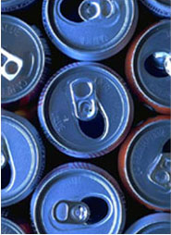
LETS TAKE THE ACIDITY TEST
HOW IS YOUR PH?
5.5 5.8 6.0 6.4 6.8 7.2 7.6 8.0
Notes:
Remember what we talked about….The more acidic your body is, the more you will retain weight, be susceptible to illness you are! The minimum that you want your body to be is at 7.0

Slide 15

If you want to THRIVE...
Drink Greens!
GREENS FIRST
SUPER FOOD DRINK MIX
Balance Your Nutrition
Alkalize Your Body
Get 15+ Servings Of Fruits
& Vegetables Per Serving

Slide 16
If you want to THRIVE...
Eat A Healthy Breakfast!
Fresh Fiber in the Morning
  Have Protein and a Fruit
  Eat within an hour of waking
  Meal with the most calories of the day
  On average people eat 300+ calories less per day when they eat a substantial breakfast

Slide 17
THRIVE Breakfast examples
  Hard Boiled Eggs with Berries
  Fruit Smoothie with Protein Powder
  Egg with Tomato and Fresh Basil with a side of fruit
  Almond Butter and a Banana

Slide 18


If you want to THRIVE...
Eat Throughout The Day!
DO NOT TRY THE FAD DIETS THAT CAUSE YOU TO FEEL LIKE YOU ARE CONSTANTLY HUNGRY!
Notes:
This will only cause you to binge and fall off the wagon!

Slide 19
If you want to THRIVE...
Eat Throughout The Day!
  Your body needs FUEL!!!
Just like your car needs gas and can’t
run without it!
  When you decrease your food intake too low, your body goes into starvation mode and it begins to store energy sources and reserves

Slide 20
If you want to THRIVE...
Have a Colorful Diet!
  Eat all of the colors of the rainbow to ensure that you get all the necessary nutrients.
  Load your diet fruits and veggies (75% of them Raw/Uncooked)
  Stop Eating by 7:00pm
  Have a lean source of protein at every meal along with a fruit or veggie
  Take Greens and Quality Supplements

Slide 21
If you want to THRIVE...
Drink Water!
You should drink ½ your body weight per day.
Stick to only 1 Cup of coffee per day
Forget the SODAS!

Slide 22
If you want to THRIVE...
Workout 5 Days Per Week!
The Benefits Of Interval Training
(Fast, Short Intense Bursts With Recovery)
Increases Muscle Fiber Strength
Increases Aerobic Capacity (Work Ability)
Increases Muscle Mitochondria (The Main Energy Production Center)
Increases Insulin Sensitivity
Increases Natural Growth Hormone Production
Notes:
Do you want to improve your aerobic and exercise performance in less time than that of traditional endurance training? If so, then interval training is just what the exercise physiologist ordered. Research proves that you can improve your endurance and recovery from intense bouts of exercise with just one hour per week of interval training compared with five hours per week of traditional endurance training!
Athletes know the benefits of intervals; they use them all the time to improve their performance, and they know that intervals help speed up recovery so they can get going quickly after a blast of energy (like a sprint).
Interval training is a method of training where you increase and decrease the intensity of your workout between aerobic and anaerobic training. Interval training in Sweden, where some say it originated, is known as fartlek training (Swedish for "speed play"). The protocol for interval training is to push your body past the aerobic threshold for a few moments and then return to your aerobic conditioning level with the objective of improving your performance (speed, strength, and endurance). The aerobic threshold is the intensity where your body switches from burning a greater percentage of fat to a greater percentage of carbohydrate and is generally 85% of your maximum heart rate (train below 85% and it's aerobic; train above 85% and it's anaerobic). The idea is to set up work to active-recovery ratios (work: active-recovery) in intervals of minutes. For instance, let's say you usually train comfortably at 6 mph on the treadmill. So, after your warm up and a few minutes at 6 mph, you sprint for one minute at 7.5 mph and then jog again at 6 mph for three minutes (1:3 ratio: a total of four minutes). You continue these intervals for the length of your workout. If you are not a runner, you can do this with any form of exercise….Riding the bike at a comfortable pace, then peddling harder and faster to reach your target Heart rate.
Notice with all of your Core Performance workouts, you have periods that are pushing you hard followed by rest to recover. Use this same philosophy in workouts that you are doing outside of Core Performance to maximize your calorie burn fat burn, decrease plateaus, faster recovery, and to keep your workouts fun and challenging!

Slide 23
If you want to THRIVE...
Workout 5 Days Per Week!
See better Results from Your Workouts In a
Fraction of the Time!
Warm up for 15 minutes, adding a few 20-sec. bursts at the end to prepare for the workout.
Go 30 seconds at a nearly all-out effort. Take 3 minutes active recovery and repeat the 30 on/3 off pattern 5 or 6 more times.
Finish with a 5-10min cool down.

Slide 24
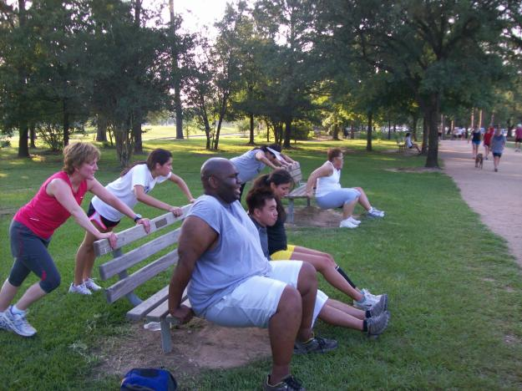
JOIN GROUP WORKOUTS
For Accountability and Motivation!
Notes:
THIS IS AN OPTIONAL SLIDE! THIS IS THE COMMUNITY AND CORPORATE ONSITE WORKOUTS THAT DOCORS AROUND THE WORLD ARE USING TO SEE THE GREATEST RESULTS! IF YOU WANT TO GET OUT TO THE MASSES AND INCREASE YOUR INCOME AND NEW PATIENT FLOW SIGNIFICANTLY, CONTACT US TO SIGN UP FOR THE NEXT CORPORATE TRAINING!!! AT THE TRAINING YOU WILL NOT ONLY BECOME AN EXPERT IN CORPORATE WELLNESS BUT YOU WILL ALSO BE CERTIFIED TO OFFER PROGRAMS THAT WILL POSITION YOU AS THE WELLNESS EXPERT IN YOUR COMMUNITY
CONTACT: Dr. Cherine Van Wagner cvanwagner@creatingwellness.com

Slide 25
It Starts With Your Morning Rituals
(Your Hour of Power)
If you want to THRIVE...
Start Your Day With A Sexy Mindset!
Rise 30-60 minutes earlier than normal
Put your feet on the floor when alarm goes off
Meditate or pray for 10-15 minutes
Exercise aerobically and/or anaerobically for a minimum of 30 minutes
Start your morning with a nutritious breakfast
End your day with a gratitude meditation or prayer for 10 minutes

Slide 26
If you want to THRIVE...
Get Sleep!
If you are sleep deprived you will tend to eat more sweet and starchy foods, rather than healthy foods.
Researchers suspect that cravings stemmed from the fact that your brain is fueled by glucose (blood sugar); therefore, when lack of sleep occurs, your brain searches for carbohydrates.
In short, sleep deprivation puts your body into a pre-diabetic state, and makes you feel hungry, even if you’ve already eaten.

Slide 27
THRIVE Wellness Quiz
True or False
It is possible that a person could have heart disease, cancer, high blood pressure and yet not feel a symptom?
TRUE or FALSE
Notes:
True! Often the first sign of a heart attack it the attack itself! The problem has existed for many years! Review how 70% of diseases are preventable…..

Slide 28
THRIVE Wellness Quiz
True or False
Can you judge your health by how you feel?
TRUE or FALSE
Notes:
Explain to the patient how you see this every day in your office with the symptoms/ lack of symptoms of subluxations. The nerve is only made up of 10% pain receptors. That means that they are often basing their health on a 10% accurate warning system! You can use the example of a cavity.

Slide 29

“Take good care of your body. It’s the only place you have to Live.” -Jim Rohn

Slide 30

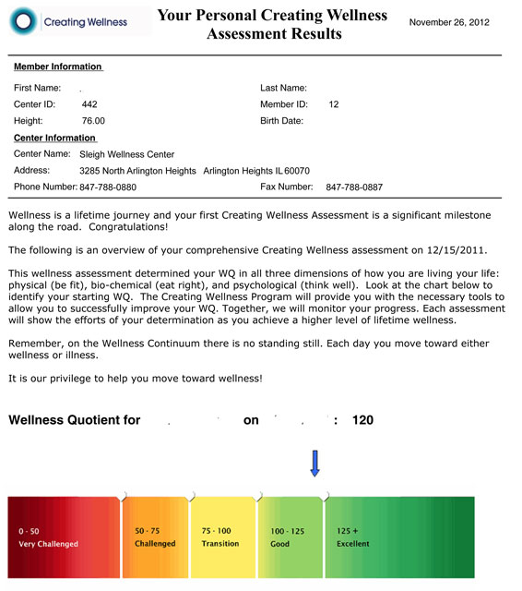
Step 1
Step 2
Notes:
Optional Slide for those of you who have the CLA Insight Millenium

Slide 31
28-Days To
THRIVE
Detox &Weight-Loss Wellness Challenge
Jan. 14th – Feb. 12th

Slide 32

If you want to THRIVE ...
JOIN THE DETOX & WEIGHT-LOSS WELLNESS CHALLENGE!
STEP 1:
MAXIMIZE YOUR THRIVE WEIGHT LOSS
THRIVE
MEAL PLANS
  Meal Plans
  Recipes
  Shopping Lists

Slide 33

If you want to THRIVE ...
JOIN THE DETOX & WEIGHT-LOSS WELLNESS CHALLENGE!
GET LEANER FASTER
STEP 2:
THRIVE
INTERVAL WORKOUTS
  3 Beginner Workouts
  3 Advanced Workouts
  Supportive Advice to Maximize Your Fitness
Notes:
These workouts were designed by Dr. Cherine VanWagner. They focus on the importance of balance within the body to create freedom with modifications for limitations and help to prevent overuse and u=injury. The will give your patients the best results possible in the shortest amount of time. Your patients can look forward to burning up to 600 calories per workout. These workouts will support their chiropractic care and make their adjustments hold longer!

Slide 34

If you want to THRIVE ...
JOIN THE DETOX & WEIGHT-LOSS WELLNESS CHALLENGE!
STEP 3:
JOIN AN ACCOUNTABILTY GROUP
THRIVE
GROUP WORKOUTS
Get Double The Results In The Same Amount Of Time
Make Working Out Fun
Burn Up To 600 Calories Per Hour
Notes:
THIS IS AN OPTIONAL SLIDE IF YOU ARE CORPORATE AND COMMUNITY WELLNESS CERTIFIED! CONTACT DR. CHERINE VANWAGNER FOR MORE DETAILS ON HOW YOU CAN UTILIZE THIS TO CREATE A NEW PATIENT MAGNET FOR YOUR OFFICE! DRCHERINEVW@YAHOO.COM

Slide 35
If you want to THRIVE ...
JOIN THE DETOX & WEIGHT-LOSS WELLNESS CHALLENGE!
INCREASE YOUR ENERGY
STEP 4:
GREENS FIRST
SUPER FOOD DRINK MIX
Balance Your Nutrition
Alkalize Your Body
Get 15+ Servings Of Fruits & Vegetables Per Serving
Notes:
1 month Greens First Should be included in their program as well as Dream Protein

Slide 36


If you want to THRIVE ...
JOIN THE DETOX & WEIGHT-LOSS WELLNESS CHALLENGE!
Before
After

Slide 37
If you want to THRIVE ...
JOIN THE DETOX & WEIGHT-LOSS WELLNESS CHALLENGE!
GET STARTED TODAY
STEP 5:
SEE THE FRONT DESK
FOR MORE INFORMATION &
TO RESERVE YOUR SPOT TODAY!

Slide 38

If you want to THRIVE ...
JOIN THE DETOX & WEIGHT-LOSS WELLNESS CHALLENGE!
THRIVE
WEIGHT- LOSS
CHALLENGE
Buy 1
Get 1
50% Off!
Buy 2
Get 1 FREE!
If You Sign Up Today!
Only 30 Sexy Spots Available

Slide 39
28-Days To
THRIVE
With Detoxification & Weight-Loss

