Slide 1
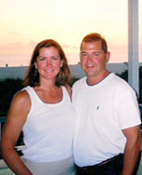
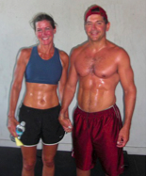

Start THRIVING in 28 Days
Wellness Workshop
Jan. 28th 6:00-7:00pm
You’re Invited!
LEARN THE DOCTOR’S SECRETS TO:
Maximize Weight Loss
Build Lean Muscle
Increase Energy
Improve Digestion
Decrease Blood Pressure
Manage, Prevent, Reverse Diabetes
Reduce Joint Pain
Decrease Medications
Reduce Cholesterol
Improve Mental Clarity
Decrease Inflammation
Look & Feel Younger
THRIVE!
Jan. 28th, 2014 6:00- 7:00 pm
at Office Name Here
RESERVE YOUR SEAT TODAY! – Only 30 Spots
804-270-6010
11391-C Nuckols Road Glen Allen, VA 23059

