Slide 1

Managing Inflammation with Dietary Fats and Other Nutrients
With
Dr. Ritamarie Loscalzo

Slide 2
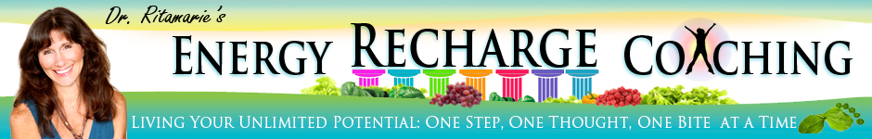
Medical Disclaimer: The information in this presentation is not intended to replace a one-on-one relationship with a qualified health care professional and is not intended as medical advice. It is intended as a sharing of knowledge and information from the research and experience of Dr. Ritamarie Loscalzo, drritamarie.com, and the experts who have contributed. We encourage you to make your own health care decisions based upon your research and in partnership with a qualified health care professional.

Slide 3
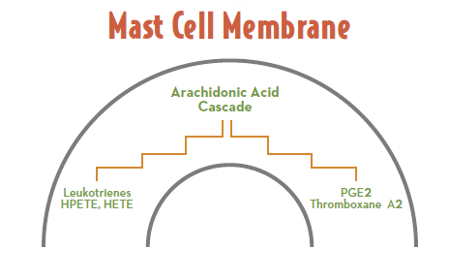
Producing Pro-Inflammatory Agents

Slide 4
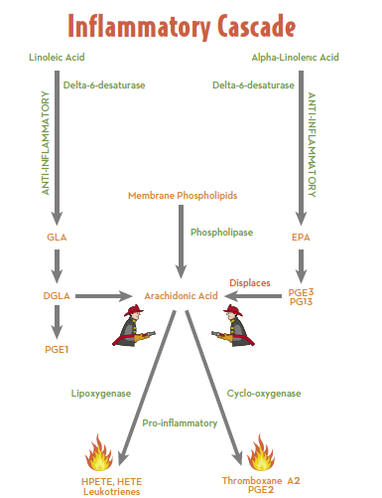

Slide 5
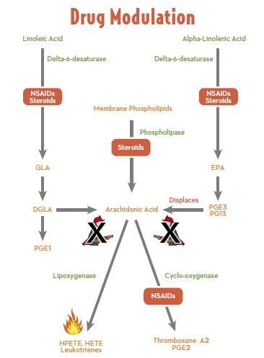

Slide 6
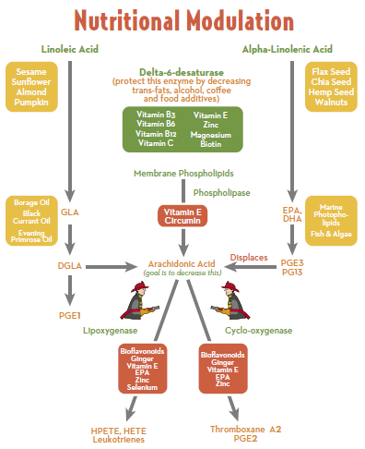

Slide 7
