Slide 1

3 Ways Your Digestive Health Affects Your Energy, Your Mood, and Your Sex Drive
... and how to restore balance using my proven system for gut healing.
Dr. Ritamarie Loscalzo

Slide 2

The Importance of Digestive Wellness

Slide 3
Medical Disclaimer: The information in this presentation is not intended to replace a one-on-one relationship with a qualified health care professional and is not intended as medical advice. It is intended as a sharing of knowledge and information from the research and experience of Dr. Ritamarie Loscalzo, drritamarie.com, and the experts who have contributed. We encourage you to make your own health care decisions based upon your research and in partnership with a qualified health care professional. This presentation is provided for informational purposes only and no guarantees, promises, representations or warranties of any kind regarding specific or general benefits, have been or will be made by Dr. Ritamarie Loscalzo, her affiliates or their officers, principals, representatives, agents or employees. Dr. Ritamarie Loscalzo is not responsible for, and shall have no liability for any success or failure, acts and/or omissions, the appropriateness of the participant’s decisions, or the use of or reliance on this information.

Slide 4

You Are In The Right Place If
You’re tired of having to unbutton your pants after eating because you’re bloated and gassy

Slide 5

You Are In The Right Place If
Your moods are unpredictable and you’re finding it hard to focus

Slide 6

You Are In The Right Place If
Your sex drive is gone and you’d like
to have it back

Slide 7

You Are In The Right Place If
You are having trouble losing weight in spite of eating a relatively clean diet

Slide 8
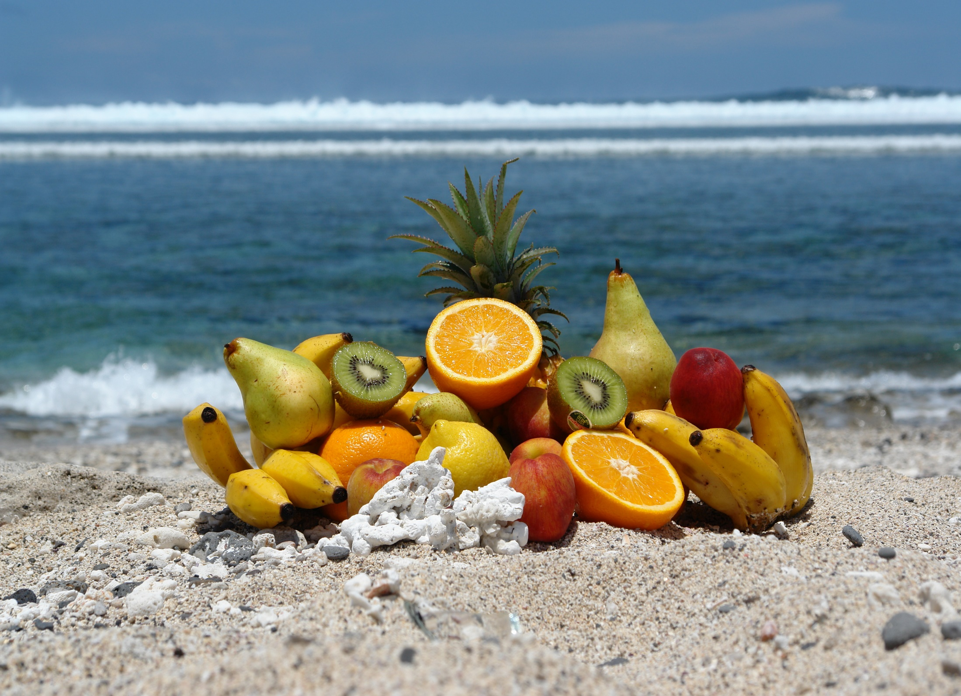
What You
Will Learn

Slide 9

What You’ll Learn Today…
How to know if your gut is contributing to symptoms in other parts of your body and zapping your energy (even if you don't have obvious gut symptoms)

Slide 10
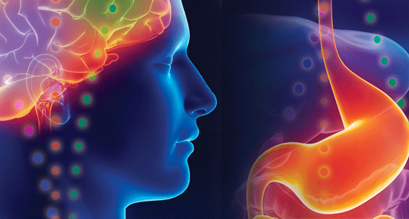
What You’ll Learn Today…
How your gut is connected to your brain (via the vagus nerve) and what impact that has on your mood, focus, and ability to digest your food

Slide 11

What You’ll Learn Today…
Which hormones control digestion
(and how to keep everything in balance
so you can look and feel great)

Slide 12

What You’ll Learn Today…
How leaky gut and digestive impairment affect your thyroid, adrenals, sex hormones, and blood sugar regulating hormones resulting in fatigue, weight gain, and loss of libido

Slide 13
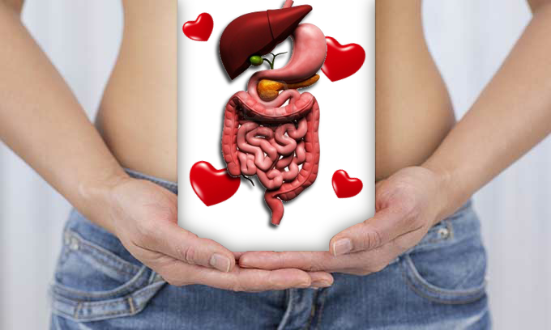
What You’ll Learn Today…
My system for restoring digestive health so you can regain energy, balance, and joy (and fit in your clothes with comfort and confidence!)

Slide 14

When You Stay Until…
Two tools to get you started!

Slide 15

My Digestion Recovery Story

Slide 16
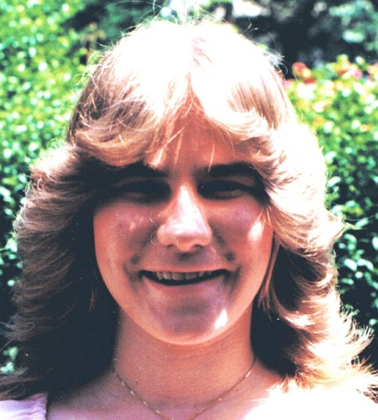




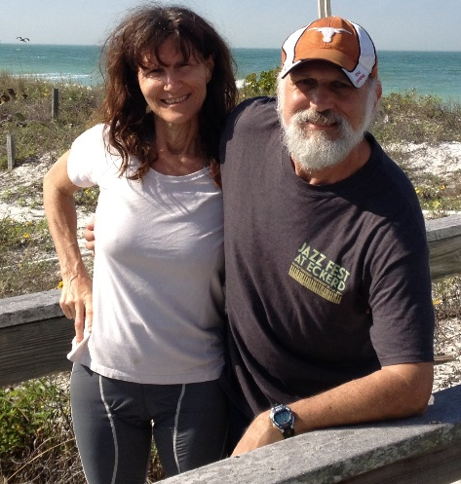

Slide 17

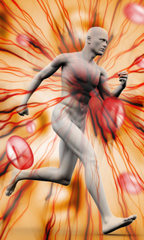
Your Digestive Tract’s Job
The role of your digestive system is to take nutrients from the foods you eat so that the cells of your body can use them.

Slide 18
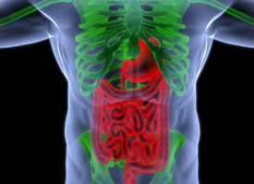
3 Main
Functions
of Digestive
System
Digestion
Breaks down
food into
molecules your
body can use
Absorption
Molecules
absorbed
into blood
and carried
through body
Elimination
Wastes
eliminated
from body

Slide 19
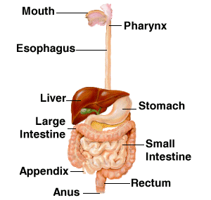
The Digestive Tract

Slide 20
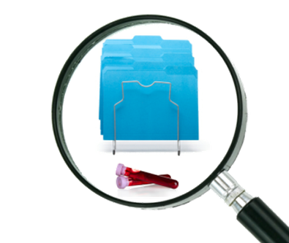
How to Know if Your Gut is Contributing to Symptoms in Other Parts of Your Body
Targeted questionnaires
Blood testing
Specialized testing
  Lab tests
  Home tests

Slide 21

Does Your Digestion Need Help?
Obvious
Not So Obvious
Acne
Eczema
Brain fog
Fatigue
Depression and anxiety
ADD
Headaches
Hormone swings
Thyroid imbalance
Adrenal fatigue
Blood sugar imbalance
Allergies
Autoimmune disease
Frequent illness
Asthma
Joint pain
Fibromyalgia
Bloating
Gas
Flatulence
Burping
Pain
Hemorrhoids
Irritable bowel
Diarrhea
Constipation
Crohn’s
Diverticulitis
Colitis
Heartburn
Ulcers

Slide 22
3 Ways Your Digestive Health Affects Your Energy, Your Mood, and Your Sex Drive
Nutrient and
toxin absorption

Slide 23
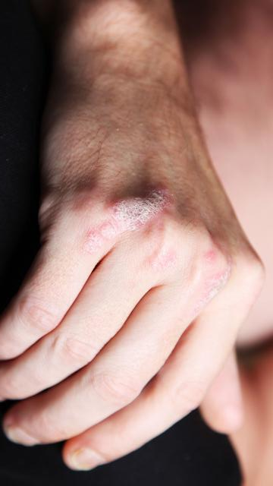
Digestion Recovery Story

Slide 24
Digestion and Your Brain
How your gut is connected to your brain (via the vagus nerve) and what impact that has on your mood, focus, and ability to digest your food

Slide 25
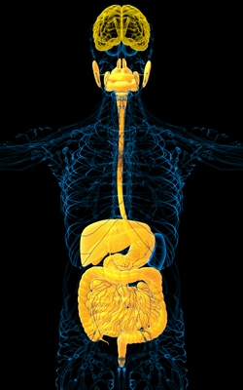
How Your Gut Is
Connected To Your Brain
Vagus nerve
Neurotransmitters
Leaky gut
Allergens
Inflammation
Mood, memory, and focus
Ability to digest your food

Slide 26

The Psychology of Digestion
Digestion Begins in your HEAD and HEART
-- Not Your Gut!!!
  Impact of thoughts
  Fight/flight effects on digestion
  Relaxation effects on digestion
  Role of breathing on digestion
  Pre-meal ritual

Slide 27
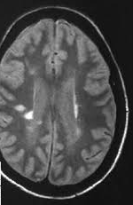
Digestion Recovery Stories

Slide 28

Which Hormones Control Digestion
…and how to keep everything in balance
so you can look and feel great

Slide 29
Hormones That Directly Control Digestion
Hormone | Produced by | Action
Leptin | Fat cells | Signals satiety
Ghrelin | Stomach lining | Signals hunger
Gastrin | Stomach | Production of stomach acid
Cholecystokinin (CCK) | Small intestine | Production of pancreatic juices and emptying of gall bladder
Secretin | Duodenum | Stimulates bicarbonate production by pancreas, bile production by liver, and pepsin by stomach
Peptide YY | Mainly ileum and colon, but a little in other parts of GI tract | Inhibits gastric motility, increases water and electrolyte absorption in colon, may suppress pancreatic secretion, increases efficiency of digestion
Incretins: GIP: Gastric Inhibitory Peptide and GLP: Glucagon-Like Peptide | Small intestine | Increases insulin, inhibits glucagon release, slows rate of absorption of nutrients by reducing gastric emptying
Somatostatin | Stomach, intestine, pancreas | Inhibits gastrin, CCK, secretin, GIP and also growth hormone, TSH, glucagon and insulin
Dopamine | Brain and GI mucosa | Reduces motility and protects mucosa
Serotonin | Brain and GI mucosa | Inhibits gastric acid and stimulates mucus

Slide 30
Other Hormones Indirectly Involved in Digestion
Thyroid
Cortisol
Insulin
Estrogen
Progesterone
Growth Hormone
Testosterone

Slide 31
3 Ways Your Digestive Health Affects Your Energy, Your Mood, and Your Sex Drive
Nutrient and
toxin absorption
Hormone and
neurotransmitter balance

Slide 32
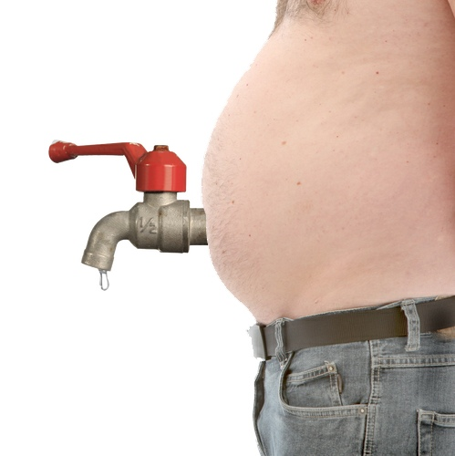
How Leaky Gut and Digestive Impairment Affect…
Thyroid
Adrenals
Blood sugar
regulating hormones
Sex hormones

Slide 33
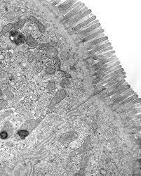
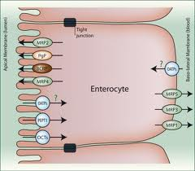
Intestinal Absorption
Basic cells lining small intestine and colon

Slide 34
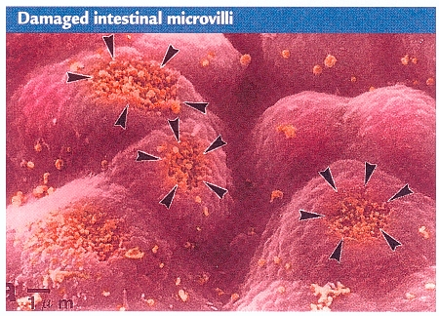
Damaged Intestine

Slide 35
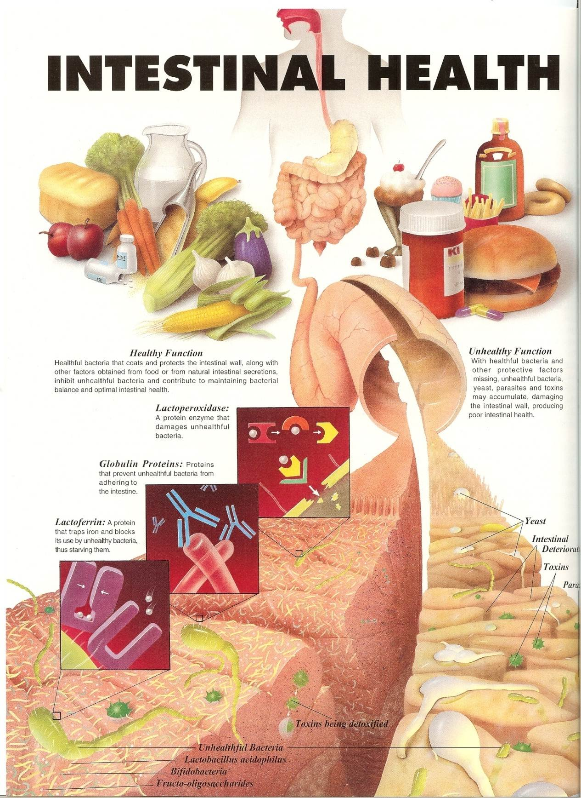
Leaky Gut

Slide 36
How Leaky Gut and Digestive Impairment Affect…
Thyroid
Adrenals
Blood sugar
regulating hormones
Sex hormones

Slide 37




Adrenal Burnout is Stealing Your Sex Drive
Cortisol
Pregnenolone
DHEA
Testosterone
Estrone
Estrogen
Progesterone

Slide 38
3 Ways Your Digestive Health Affects Your Energy, Your Mood, and Your Sex Drive
Nutrient and
toxin absorption
Hormone and
neurotransmitter balance
Inflammation and immune stress

Slide 39
Restoring Digestive Health
Regain energy, balance, and joy (and fit in your clothes with comfort and confidence!)

Slide 40

The 4R Process
Remove
Replace
Repair
Reinoculate

Slide 41

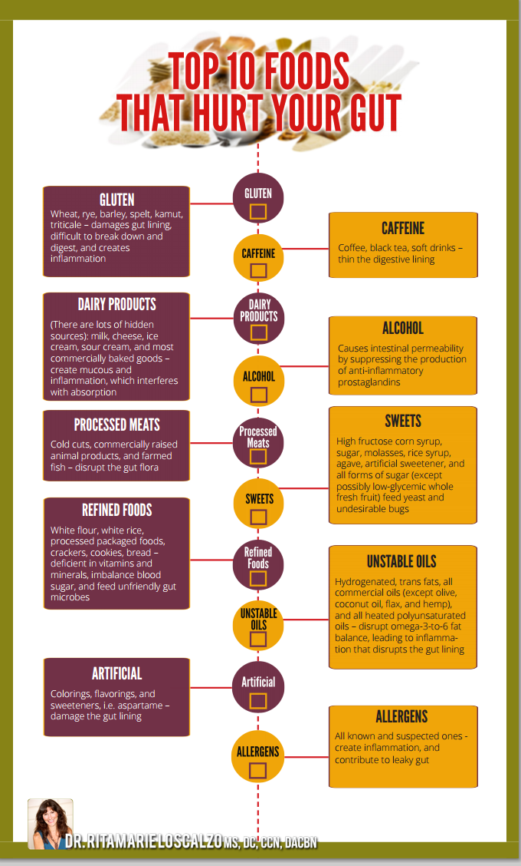

Slide 42
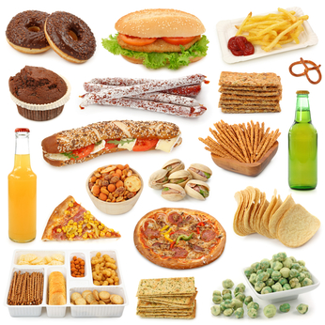
Remove the Top 3 Foods That
Slow or Damage Your Gut
Sugar and processed foods
Trans and heated fats
Allergens,
especially gluten

Slide 43

Remove Allergens
Common allergens
  Gluten
  Dairy
  Egg
  Peanuts
  Corn
  Soy
Known allergens
Foods you eat frequently
Foods you crave
Foods you don't digest well

Slide 44
Remove Unfriendly Organisms
Symbiotic relationship
Dangerous relationship contributing to disease
Diet and Lifestyle Factors

Slide 45

Remove Stressors That Trigger
Digestive Dysfunction
Mental and emotional stress
  Sleep quality and quantity
Inflammation and infection
  Digestive imbalance – leaky gut, candida, parasites
  Immune system imbalance
Diet and lifestyle
  Nutrient depleted foods
  Toxic, high-glycemic foods
  Obesity
  Late night eating
Environmental stresses
  Toxic exposures
  Injuries

Slide 46

My #1 most powerful tool for protecting yourself from the damaging effects of stress:

Slide 47
The 4R Process
Remove
Replace
Repair
Reinoculate

Slide 48

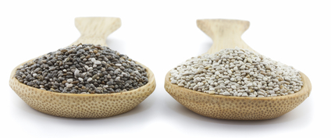
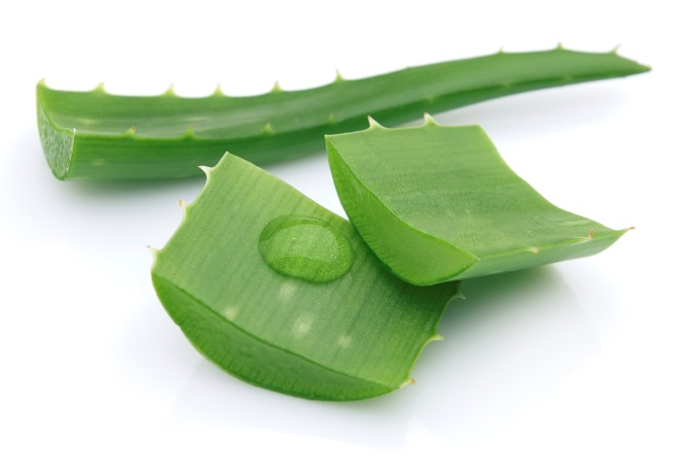
Foods and Herbs that Soothe and Heal
What They Do
The List Includes:
Rebuild the mucous layer
Reduce inflammation
Lubricate the digestive tract
Nourish body fluids
and tissues
Chlorophyll – greens
Probiotic and prebiotic foods
Chia seed
Flax seed
Cinnamon
Licorice
Slippery elm
Aloe vera gel
Marshmallow
Irish moss
Chamomile
Fenugreek
Plantain
Calendula
Yarrow

Slide 49
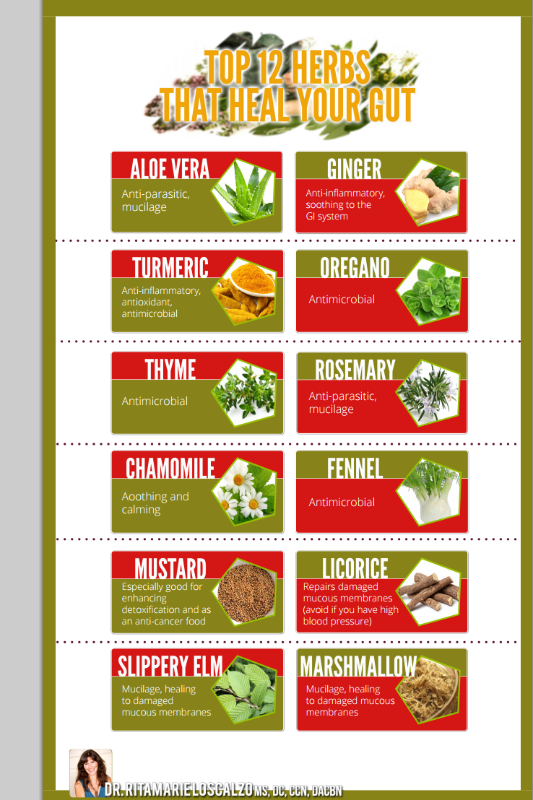

Slide 50
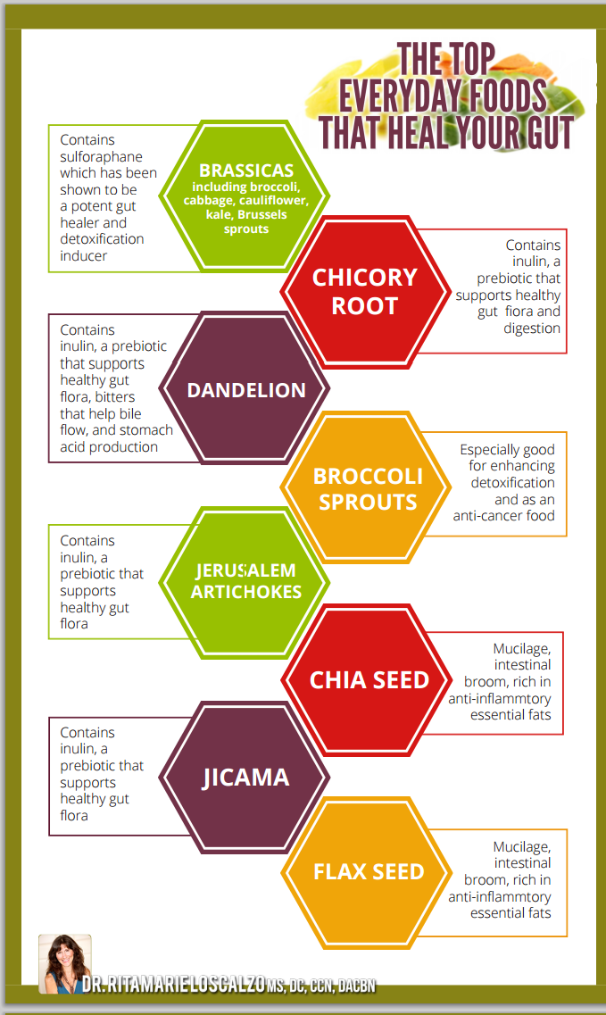
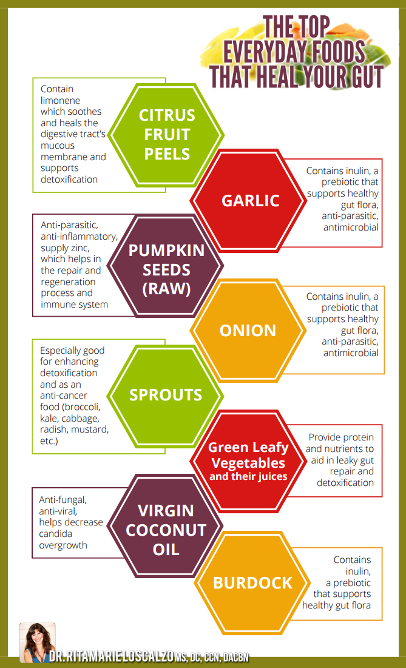

Slide 51
Top 5 Gut Soothing Foods and Herbs
Slippery elm
Aloe vera
Licorice root
Omega-3 rich foods
Probiotic and prebiotic rich foods
Notes:
A Checklist for the Care and Feeding of Your Thyroid Gland:
Use whole, unrefined sea salt.
Eat sea vegetables regularly.
Eat lots of green leafy vegetables, or better yet, green smoothies daily to provide an abundance of the minerals and vitamins that the thyroid needs. Wild edibles like chickweed, dandelion, Lambsquarters and Purslane are all good choices, as are parsley, spinach, collard greens and beet greens.
Use a shower filter or whole house filter to take out the chlorine, or shower with the window open to allow the chlorine gases to escape.
Use ozone or salt filtration systems in swimming pools instead of chlorine and bromine.
Get plenty of fresh air and sunshine to assure adequate Vitamin D.
Avoid antihistamines, aspirin and sulfa drugs as much as possible.
Avoid processed, nutrient depleted foods with thyroid inhibiting preservatives and non iodized salt.
If you grow your own vegetables, fertilize with seaweeds or grow in sea water to increase iodine content.
Minimize isolated soy protein.
Enjoy brassicas regularly (broccoli, kale, cauliflower, cabbage), but be sure to eat sea vegetables with them so there is no chance of anti-thyroid effect.
Exercise regularly to keep a steady flow of oxygen to your cells and up-regulate your metabolism.
Take time out to de-stress. Stress disrupts the endocrine system, and has an impact on thyroid health. Find things daily to appreciate. Appreciation has been shown to restore endocrine balance and immune system integrity.

Slide 52

Simple Meals That
Leave You Feeling
Balanced, Energetic, and Sexy

Slide 53


Slide 54
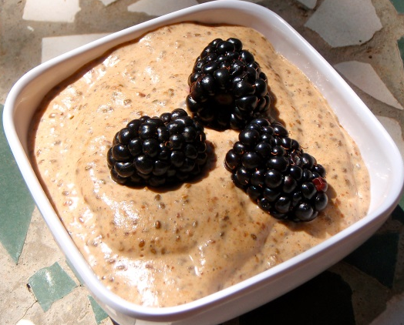
Gut Healing Porridge
Ingredients:
2 tablespoon chia seed
1 teaspoon psyllium
1 tablespoon flax seed
16 ounces nut milk (e.g. sesame seed,
coconut, almond or your choice)
blended with 4 prunes and 1/2 cup blueberries
Directions:
  Soak chia, psyllium and flax seeds in 1/2 the nut milk for several hours, ideally overnight.
  Add remainder of nut milk mixture and serve.
This porridge increases gut healing SCFAs (short chain fatty acids)

Slide 55

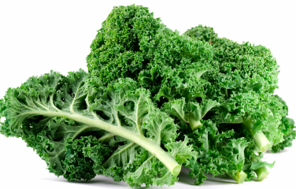
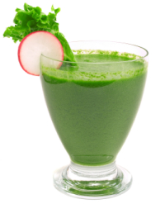
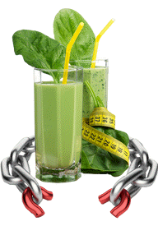
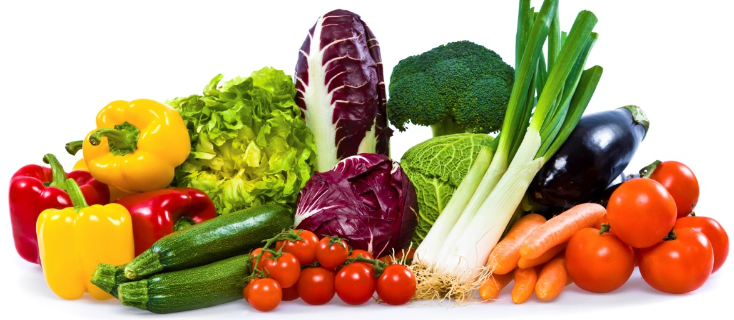

Slide 56
The 4R Process
Remove
Replace
Repair
Reinoculate

Slide 57
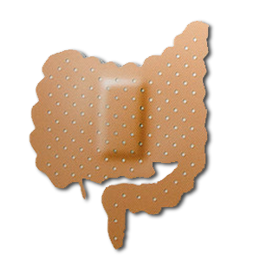
Repairing
Leaky Gut

Slide 58
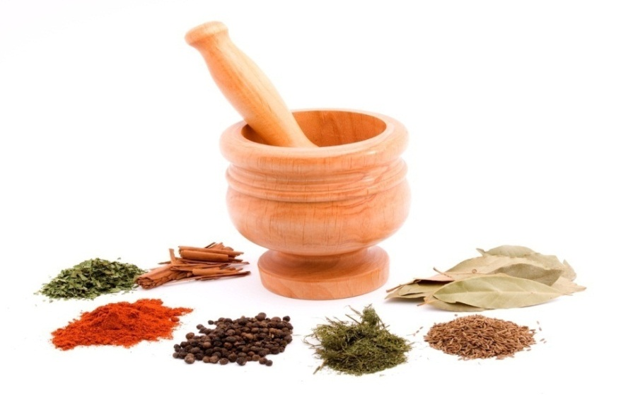
Repair
Your Digestive Tract Lining
Mucilagenous herbs and foods
Therapeutic foods
Gut healing supplements
Anti-inflammatory herbs and foods
Gut healing meal replacements
Bitters
Carminatives

Slide 59
The 4R Process
Remove
Replace
Repair
Reinoculate

Slide 60
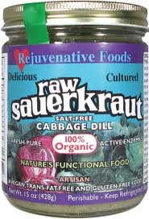
Probiotics to Re-Inoculate Your Gut
Kim chee
Sauerkraut
Coconut kefir
Seed yogurt
Kombucha
Rejuvalec
Miso
Supplements

Slide 61

The Cost Of Digestive Imbalance
Comfort
Relationships
Side effects of medication
Inability to fully participate in activities you love
Cost of clothing due to increased waist size at the end of the day
Impairment of focus and memory impacts job function, which leads to loss of financial freedom
Loss of freedom in general

Slide 62


Slide 63


Slide 64


Slide 65


Slide 66


Slide 67


Slide 68

What’s Possible for You…
Feel good in your body and confident in your appearance

Slide 69

What’s Possible for You…
Be fully present for your loved ones

Slide 70

What’s Possible for You…
Have boundless energy for fun, family, and relationships

Slide 71

What’s Possible for You…
Get your brain back to focused and clear, so you can skyrocket your success

Slide 72
What’s Possible for You…
Experience true connection and intimacy that fosters deep and meaningful relationships

Slide 73

What’s Possible for You…
Know exactly what to eat and how to eat it, so that your gut feels comfortable, and you’re energized and satisfied with your food

Slide 74
Dr. Ritamarie’s
Happy Belly System
Stage 1: Discover the Healing Power
of Your Second Brain
Stage 2: Optimize Your Fuel Generator
for Maximum Energy
Stage 3: Boost Your Nutrient Absorption So You Feel Amazing
Stage 4: Break Free of Your Gut Bugs
Stage 5: Boost Elimination and Get Rid of Toxins

Slide 75

Make a Commitment to Yourself, to Your Vision, to Your Life, and to the World

Slide 76

Implementing Dr. Ritamarie’s
Happy Belly System…
Introducing GRAND
Gut Repair and Alkalizing Nutrition for Digestion

Slide 77


Results of Participation…
Look forward to eating instead of dreading it.
Feel energized after eating and throughout
the day.
Experience a sense of calmness and clarity.
Enjoy better moods and improved relationships.
Focus and perform better at work.
Eliminate embarrassing sounds and odors from “down there.”
Feel confident that you know exactly what to eat.

Slide 78

The Precise Strategies You Need to
Heal Your Gut So You Can Live Your Life Again!
Enjoy the Energy and Vitality That Reflect the Vibrant Individual You Truly Are!

Slide 79
Dr. Ritamarie’s
Happy Belly System
Stage 1: Discover the Healing Power
of Your Second Brain
Stage 2: Optimize Your Fuel Generator
for Maximum Energy
Stage 3: Boost Your Nutrient Absorption So You Feel Amazing
Stage 4: Break Free of Your Gut Bugs
Stage 5: Boost Elimination and Get Rid of Toxins

Slide 80

Implementing Dr. Ritamarie’s
Happy Belly System…
5 Content Modules
Get guidance and instruction for
taking charge of your
digestive process.
Each module contains video,
audio, digital versions of the slides,
and full transcripts

Slide 81

Implementing Dr. Ritamarie’s
Happy Belly System…
3 Months VLM Office Hours
With Dr. Ritamarie
Or one of her personally trained practitioners (done once a month) to get your questions answered and to get guidance in personalizing the program to meet
your specific needs.

Slide 82

Implementing Dr. Ritamarie’s
Happy Belly System…
Recipe Collection
The digital recipe guide e-book includes over 100 pages of delicious, easy-to-make, gut-friendly, plant-based recipes. Mix and match recipes to make endless meal combinations.

Slide 83

Implementing Dr. Ritamarie’s
Happy Belly System…
Menu Guidelines
Access helpful strategies for making meal-planning a breeze. Know how to plan your breakfast, lunch, and dinner and use a helpful template you can personalize to create gut healing and soothing meals.

Slide 84

Implementing Dr. Ritamarie’s
Happy Belly System…
Program Action Guide
Know exactly what to do with a
step-by-step action and implementation plan.
Receive additional support from
Dr. Ritamarie and her team of coaches through each of the helpful module progress journals.

Slide 85
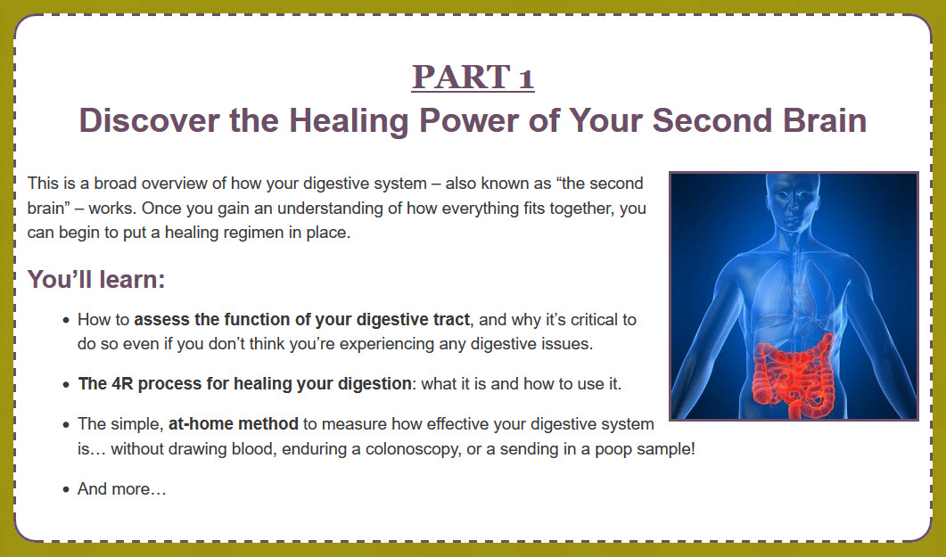

Slide 86
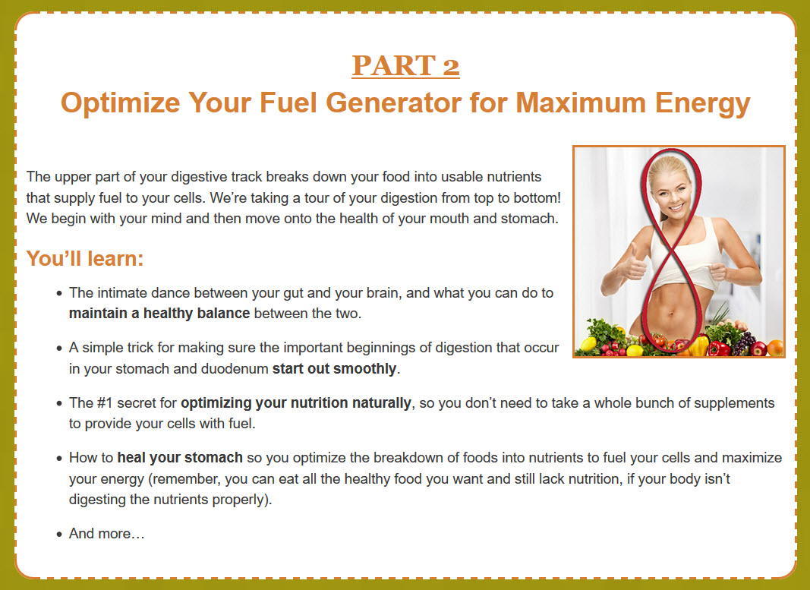

Slide 87
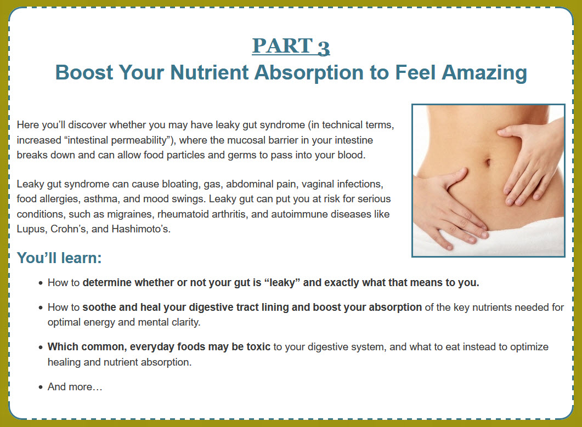

Slide 88
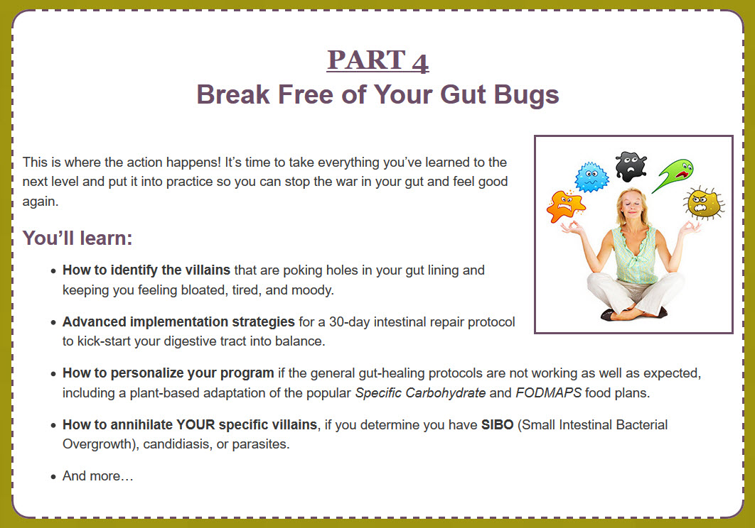

Slide 89
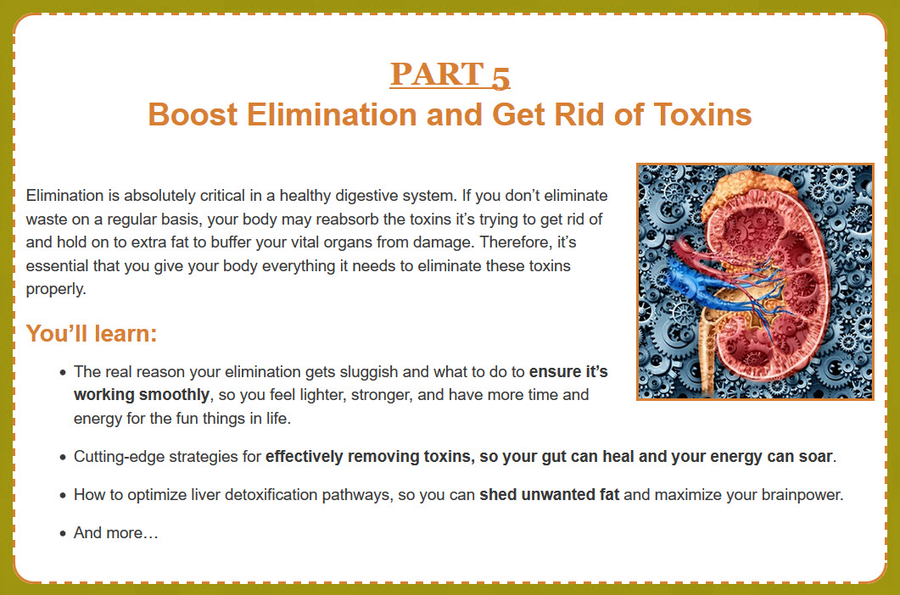

Slide 90

Dr. Ritamarie’s Happy Belly System…
GRAND Program
Here’s What You Get:
5 Core Training Modules (Value $497)
3 Months Group Coaching and Q&A Calls (Value $997)
Gut Healing Recipe Collection and Menu Guidelines (Value $47)
Module-by-Module Action Steps and Progress Journals (Value $197)
Assessments and a Step-by-Step Program Action Guide (Value $197)
A Private, Members-Only Facebook Group (Value $297)
Total Value: $2232.00

Slide 91

Dr. Ritamarie’s Happy Belly System…
GRAND Program Bonus #1
Gut Repair and Alkalizing Nutrition for Digestion
Two Months FREE Access to Our VITAL Health Community
You’ll get access to monthly online resources including a live food preparation class, an informative and empowering health topic webinar, an open forum Q&A coaching call with Dr. Ritamarie, and access to our active, VITAL Community Facebook Group.
Value: $49.94

Slide 92

Dr. Ritamarie’s Happy Belly System…
GRAND Program Bonus #2
Gut Repair and Alkalizing Nutrition for Digestion
30-Day Transforming Stress System
Transform stress into resourcefulness and achieve optimal hormone balance by accessing a 30-day series of short, guided audios that can take you on a restorative “mini-vacation” in as little as 1 minute.
Value: $97.00

Slide 93

Dr. Ritamarie’s Happy Belly System…
GRAND Program Bonus #3
Gut Repair and Alkalizing Nutrition for Digestion
Food Preparation
Video Library
These online videos contain actual demos of healthy and delicious foods to support you as you participate in the program.
Value: $97.00

Slide 94

Dr. Ritamarie’s Happy Belly System…
GRAND Program Bonus #4
Gut Repair and Alkalizing Nutrition for Digestion
Creating a Healing Kitchen Guide e-Book
This digital e-book is a compilation of foods, supplements, and equipment that are Dr. Ritamarie-approved (and personally used in many cases) that you can use to access clean, organic, and reliable foods and nutrients.
Value: $27.00

Slide 95

Dr. Ritamarie’s Happy Belly System…
GRAND Program Bonus #5
Gut Repair and Alkalizing Nutrition for Digestion
Eating Better, Spending Less: A Special Report from John Robbins
You’ll receive a collection
outlining 22 principles of
inexpensive and healthy eating;
these are strategies that can save
you money and improve the quality of your life and health.
Value: $37.00

Slide 96

Dr. Ritamarie’s Happy Belly System…
GRAND Program Bonus #6
Gut Repair and Alkalizing Nutrition for Digestion
Advanced Techniques for Boosting Energy Through the Microbiome
Access a recorded presentation from Steph Jackson, founder of the Core Reset Program. Learn how imbalanced flora can affect your immune system, hormones, and energy.
Value: $97.00

Slide 97
Dr. Ritamarie’s Happy Belly System…
Here’s What You Get:
5 Online Digestive Repair and Optimization Modules ($497)
3 Months Group Coaching and Q&A Calls ($997)
Recipe Collection, Menu Guidelines, Program Action Guide, Facebook Group, Assessments, and Coach Monitored Journals ($738)
Bonus #1: 2 month VITAL Community Membership ($49.94)
Bonus #2: Dr. Ritamarie’s 30-Day Transforming Stress System ($97)
Bonus #3: The Food Preparation Video Library ($97)
Bonus #4: The Creating a Healing Kitchen e-Book ($27)
Bonus #5: Special Report from John Robbins ($37)
Bonus #6: Boosting Energy Webinar with Steph Jackson ($97)
Value: $2636.94

Slide 98


Slide 99

Case Study 1: Veronica
Decades of chronic digestive issues
Food allergies
“I am so impressed by Dr. Ritamarie! She has taught me way more than I ever knew and she made it so easy to understand. I am finally seeing improvements which have eluded me for decades. My only regret is that I didn’t discover her programs sooner. I will forever be grateful for the huge health gains I am experiencing in my digestion and food allergies.
Thank you Dr. Ritamarie!”

Slide 100

Case Study 2: Patty
  Health coach with leaky gut
  Gas and bloating
  Trying for over a year to heal it
  Lost 10 pounds
“I have been trying to work on my leaky gut for over a year and could never seem to get myself organized enough to do the work. When I started this program with Dr. Ritamarie, everything clicked. I found the program very informative and laid out in a format that made the recommendations very easy to follow. I finally was able to heal my digestion and get rid of my bloating, stomach pains, and digestive upset. I have also lost 10 pounds. Very excited.”

Slide 101

Case Study 3: Heidi
  Health coach with digestive issues since mid 20’s
  Bloating
  Constipation and diarrhea
  Gas
  Ultrasounds, CT scans couldn’t pinpoint problem - trying for over a year to heal it
“Once I began following the protocols, the bloating and diarrhea went away. I started experiencing 2 – 3 bowel movements per day. Gas disappeared… I have also begun to share this information with clients, favorite part!! Thank you for all that you do, my life is definitely so much richer and healthier.”

Slide 102


Slide 103

Dr. Ritamarie’s Happy Belly System…
Investment
Value $2636.34
Investment $497

Slide 104


Slide 106

Dr. Ritamarie’s Happy Belly System…
GRAND Program
30-Day Money Back Guarantee
You make this investment at no risk because you’re covered by my personal Satisfaction Guarantee. I am so confident that if you apply the information in this program and if you give the strategies an honest effort, you’ll see huge results in your life.
So I’d like you to spend the next month learning and applying the tools we’re sharing. Complete the modules delivered during the first month, come to the live coaching calls and ask for help, and fill out the progress journals at the end of each module. If at the end of that month, you don’t feel that the program is for you, I ask that you fill out our refund request form and send it to us along with your module progress journal entries, and I’ll make every attempt to help you succeed.
If we both agree that this program is not for you, I’ll issue you a prompt refund. I must receive your refund request form and progress journal entries within 30 days from the date of your purchase.
Register NOW at www.HappyBellySystem.com

Slide 107


