Slide 1




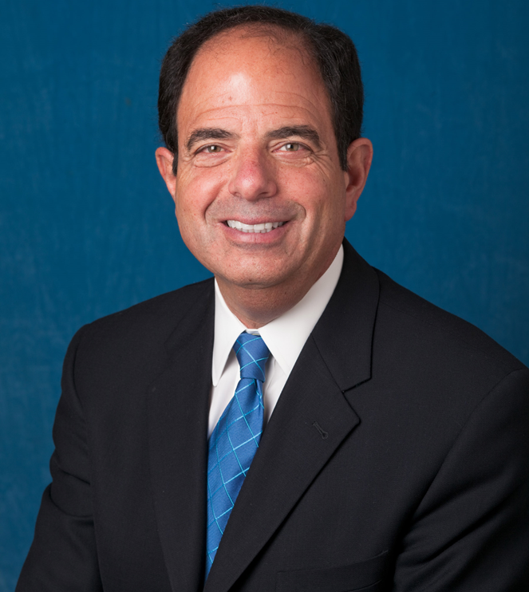

Industry Update
The Best of Both Worlds
2017
ARC
Phoenix, AZ
January 19-21
Bob Goldberg
2017 ASI Reseller Conference
#2017arc

Slide 2
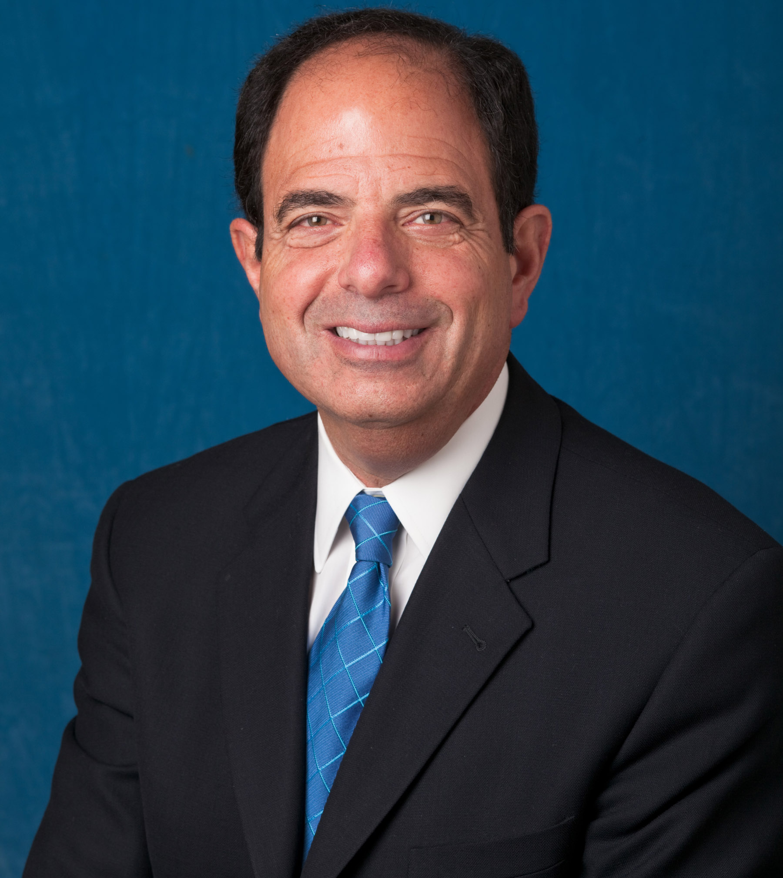
WELCOME
Why Am I Here?
Can An Attorney Possibly Provide Anything Worth Knowing?
Why ASI?
The Road To Success
Avoiding the Speed Bumps of Failure

Slide 3

BRING JOBS BACK

Slide 4
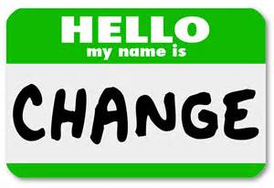
CHANGING MARKETPLACE
Technology Changes
Equipment Advances
Dominate Forces
Card Companies
Congress
PCI Council
EMVCo
Consolidation

Slide 5
ARE YOU PREPARED TO ANSWER THESE QUESTIONS???
Is Vendor QIR Certified? On List?
Does Agreement Require Vendor to Maintain PCI-SSC Compliance?
Does Vendor Require Remote Access?
IS there Multi-Factor Authentication?
Does Vendor Agree to Cooperate In Forensic Investigations.
Vendor Carry Cyber Insurance?
Vendor Assist With Notification if Breach?
IF NO...To ANY QUESTION CONSIDER ANOTHER VENDOR
Notes:
Questions Visa is telling Merchants to ask Resellers

Slide 6
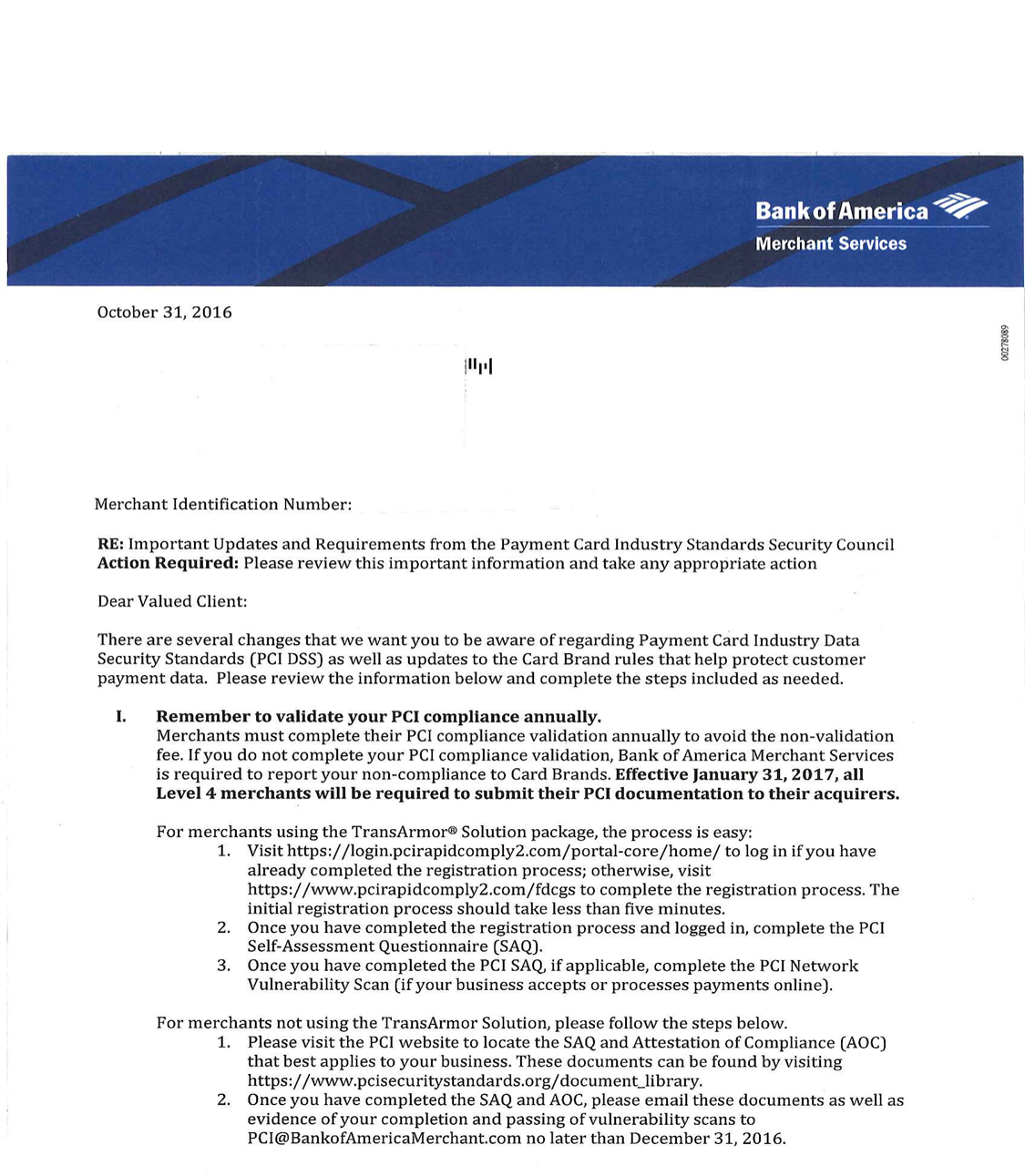
PCI Changes

Slide 7
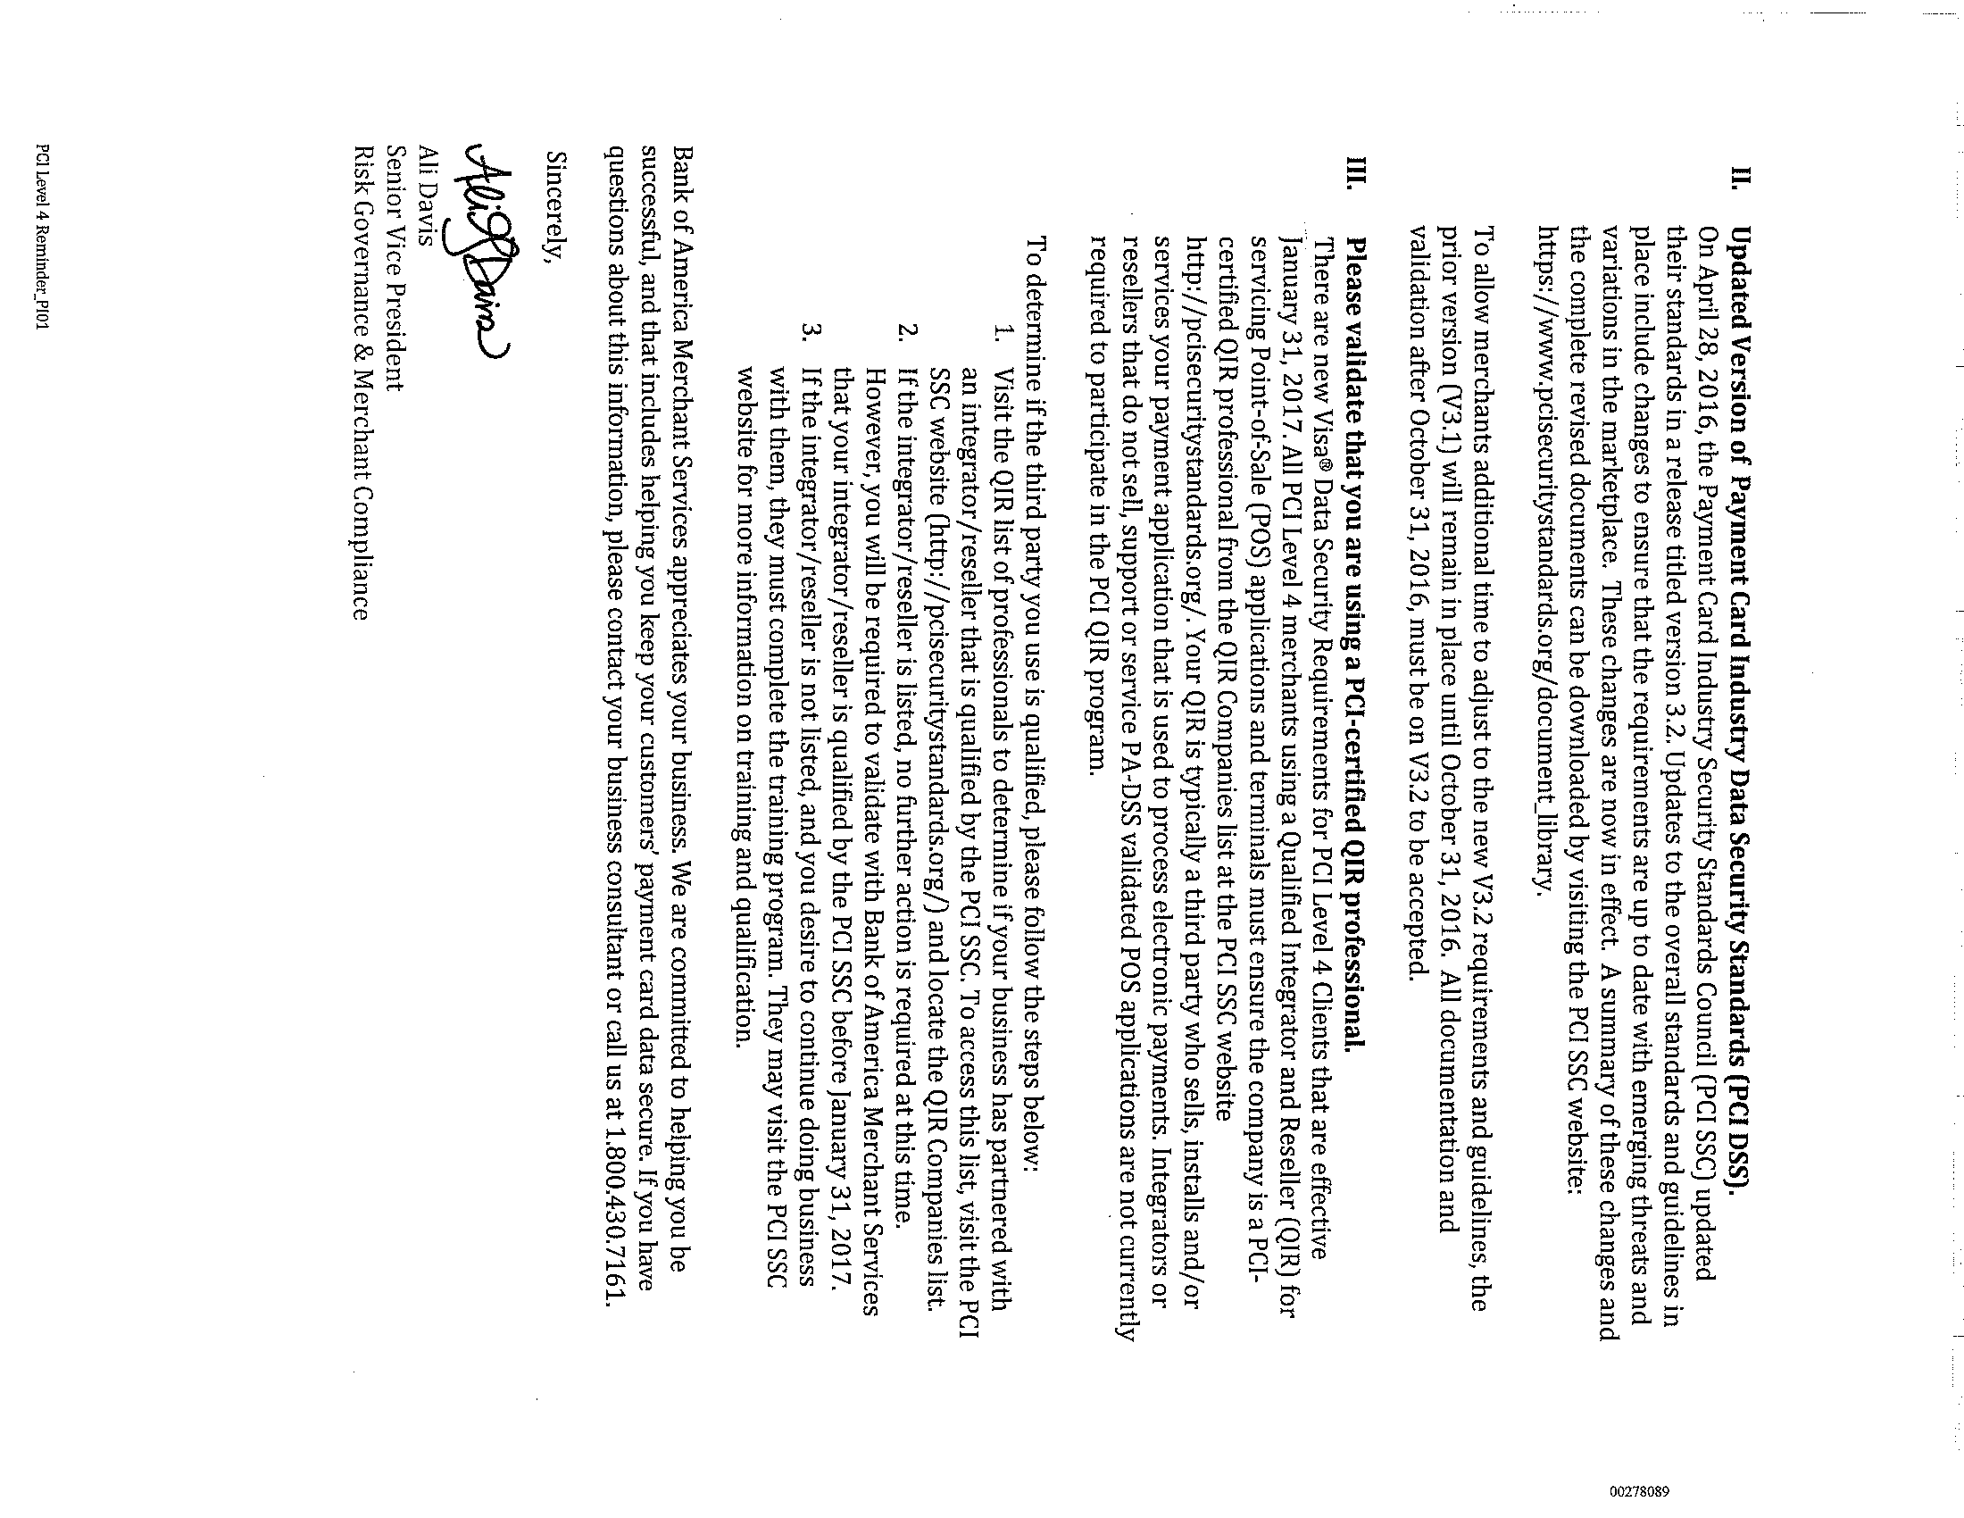

Slide 8

RESTAURANTS HUNGER FOR TECHNOLOGY
Restaurant Sales Exceed Grocery Sales
All Segments Growing
Technology Increases Sales
Productivity
Loyalty
Modernize
Mobilize
Customer Paging
Chatbots
Automated Messaging

Slide 9
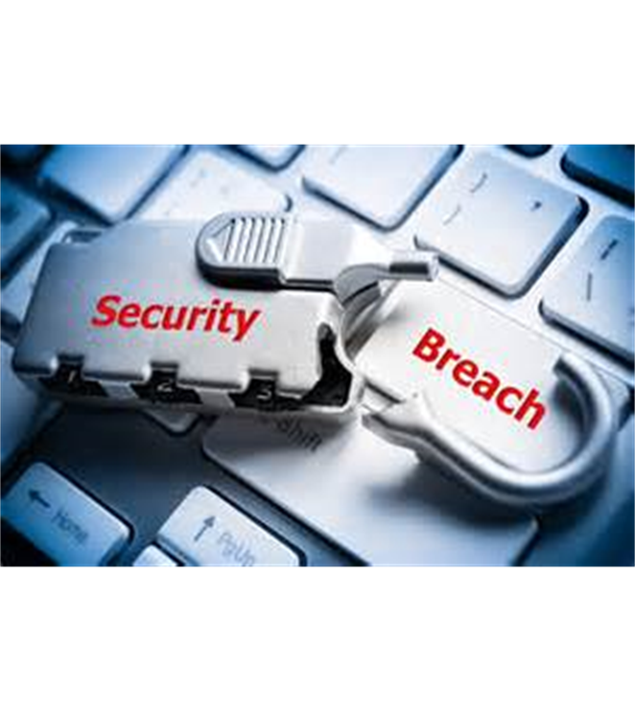
DISEASE OR CURE?
Breaches Well Publicized
Fast Food
Fine Dinning
Retail
Cost
  Dollars
  Reputation
Dollars Growth v. Compliance

Slide 10

THE CARD COMPANIES
Squeezing Dollars
Excessive Interchange Rates
Cost of Fraud
Market Dominance
Payment Card Industry Data Security Standard-PCI DSS
PCI DSS V3.2, Best Practices thru 1/31/2018
Europay, MasterCard, Visa… EMVCo

Slide 11

DEFECTIVE SYSTEM
PCI Compliance Cost
EMV Compliance Costs
United States Highest Fraud In World
Liability Shifting
Punitive Fines Breaches
Decertification
Rush To Profits

Slide 12

CARD COMPANY CHALLENGES
Home Depot
Walmart
Kroger
Congress
Federal Trade Commission
National Retail Federation
RSPA

Slide 13

RESELLER: CURE OR DISEASE?
QIR-Quickly Indict Resellers
Integrators Fall In Gap
No Big Change
No Reseller Downside
Education; Training; Best Practices
Reseller Field Input
Liability Shift
Not Enforce/Punish
Economic Incentives/Penalties

Slide 14
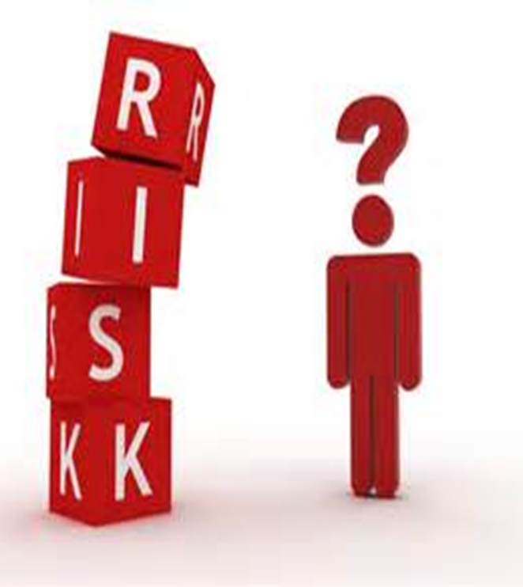
RESELLER RISKS
QIR Status Material Fact
Sale of Non-Compliant Solution
In/Out Scope-Payment Logistics
QIR Status Has Burdens
Merchant Fined For Breach
Acquirer Certification of Merchant
Merchant Sues Reseller

Slide 15
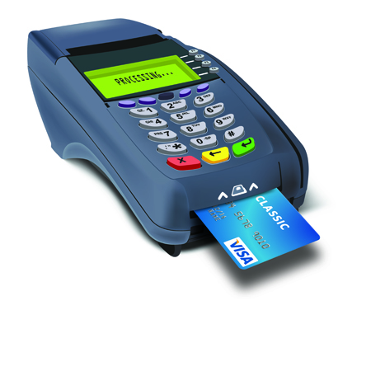
EMV
EMV-Encourage Merchant Violence
Implementation/10-1-15
B&R Supermarket-NCR Solution Not Certified
Liability Shift
Chargeback Fee $5-30/Incident
Interchange Fees Unchanged
Chip & Signature
Card Not Present Fraud
Friendly Fraud

Slide 16

THE THREATS
Free Systems
Regulations
Reduced Margins
Difficult Growth
Consolidation
Payment Companies Offer POS
BMT Buys Reseller
Tablet Start Ups
Demographics
Aging Resellers
Internet Sales
Supplier As A Competitor
Surveys/Questionnaires

Slide 17

OPPORTUNITIES
1 Million + Restaurant Locations
8 of 10 Owners Entry Level Start
Recurring Revenue
Firewall Management
Network Management
Remote Monitoring
Digital Signage
Cloud Services
Video Surveillance
Gift/Loyalty

Slide 18

THE POS CHANNEL
Dealer Strengths
  Service
  Relationships
  Trust
  Flexibility
  Operations
  Knowledge
  Commitment/Stability
  Influence
  Strategic Partnerships

Slide 19

TRUSTED ADVISORS
Deeper Client Engagement
Office Efficiency
Security
Environmental Impact
Planning
Price v. Value
Communication

Slide 20

INCOHERENT SPEECH
mPOS-Mobile Point of Sale
P2PE-Point To Point Encryption
PCI-Payment Card Industry
PED-Pin Entry Device
QIR-Qualified Integrator or Reseller
SAQ-Self Assessment Questionnaire
VAR-Value Added Reseller

Slide 21
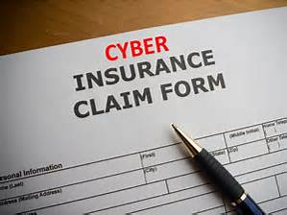
CYBER INSURANCE
Exclusions
P.F. Chang’s “Cyber Security By Chubb”
$5 Million Limit
$1.7 Million Forensic Investigation/Litigation Costs
MasterCard $2 Million Fees & Assessments
Contractual Liability

Slide 22

ASI
Dedicated to Reseller Channel
Innovative
Enhancements
Independent
Payments Solutions
Best of Both Worlds POS Product Solutions

Slide 23

QUESTIONS????
Contact Information:
Bob Goldberg
bob.goldberg@sfnr.com
312/648-2300

