Slide 1



Content created by Laura Jacobs

Slide 2

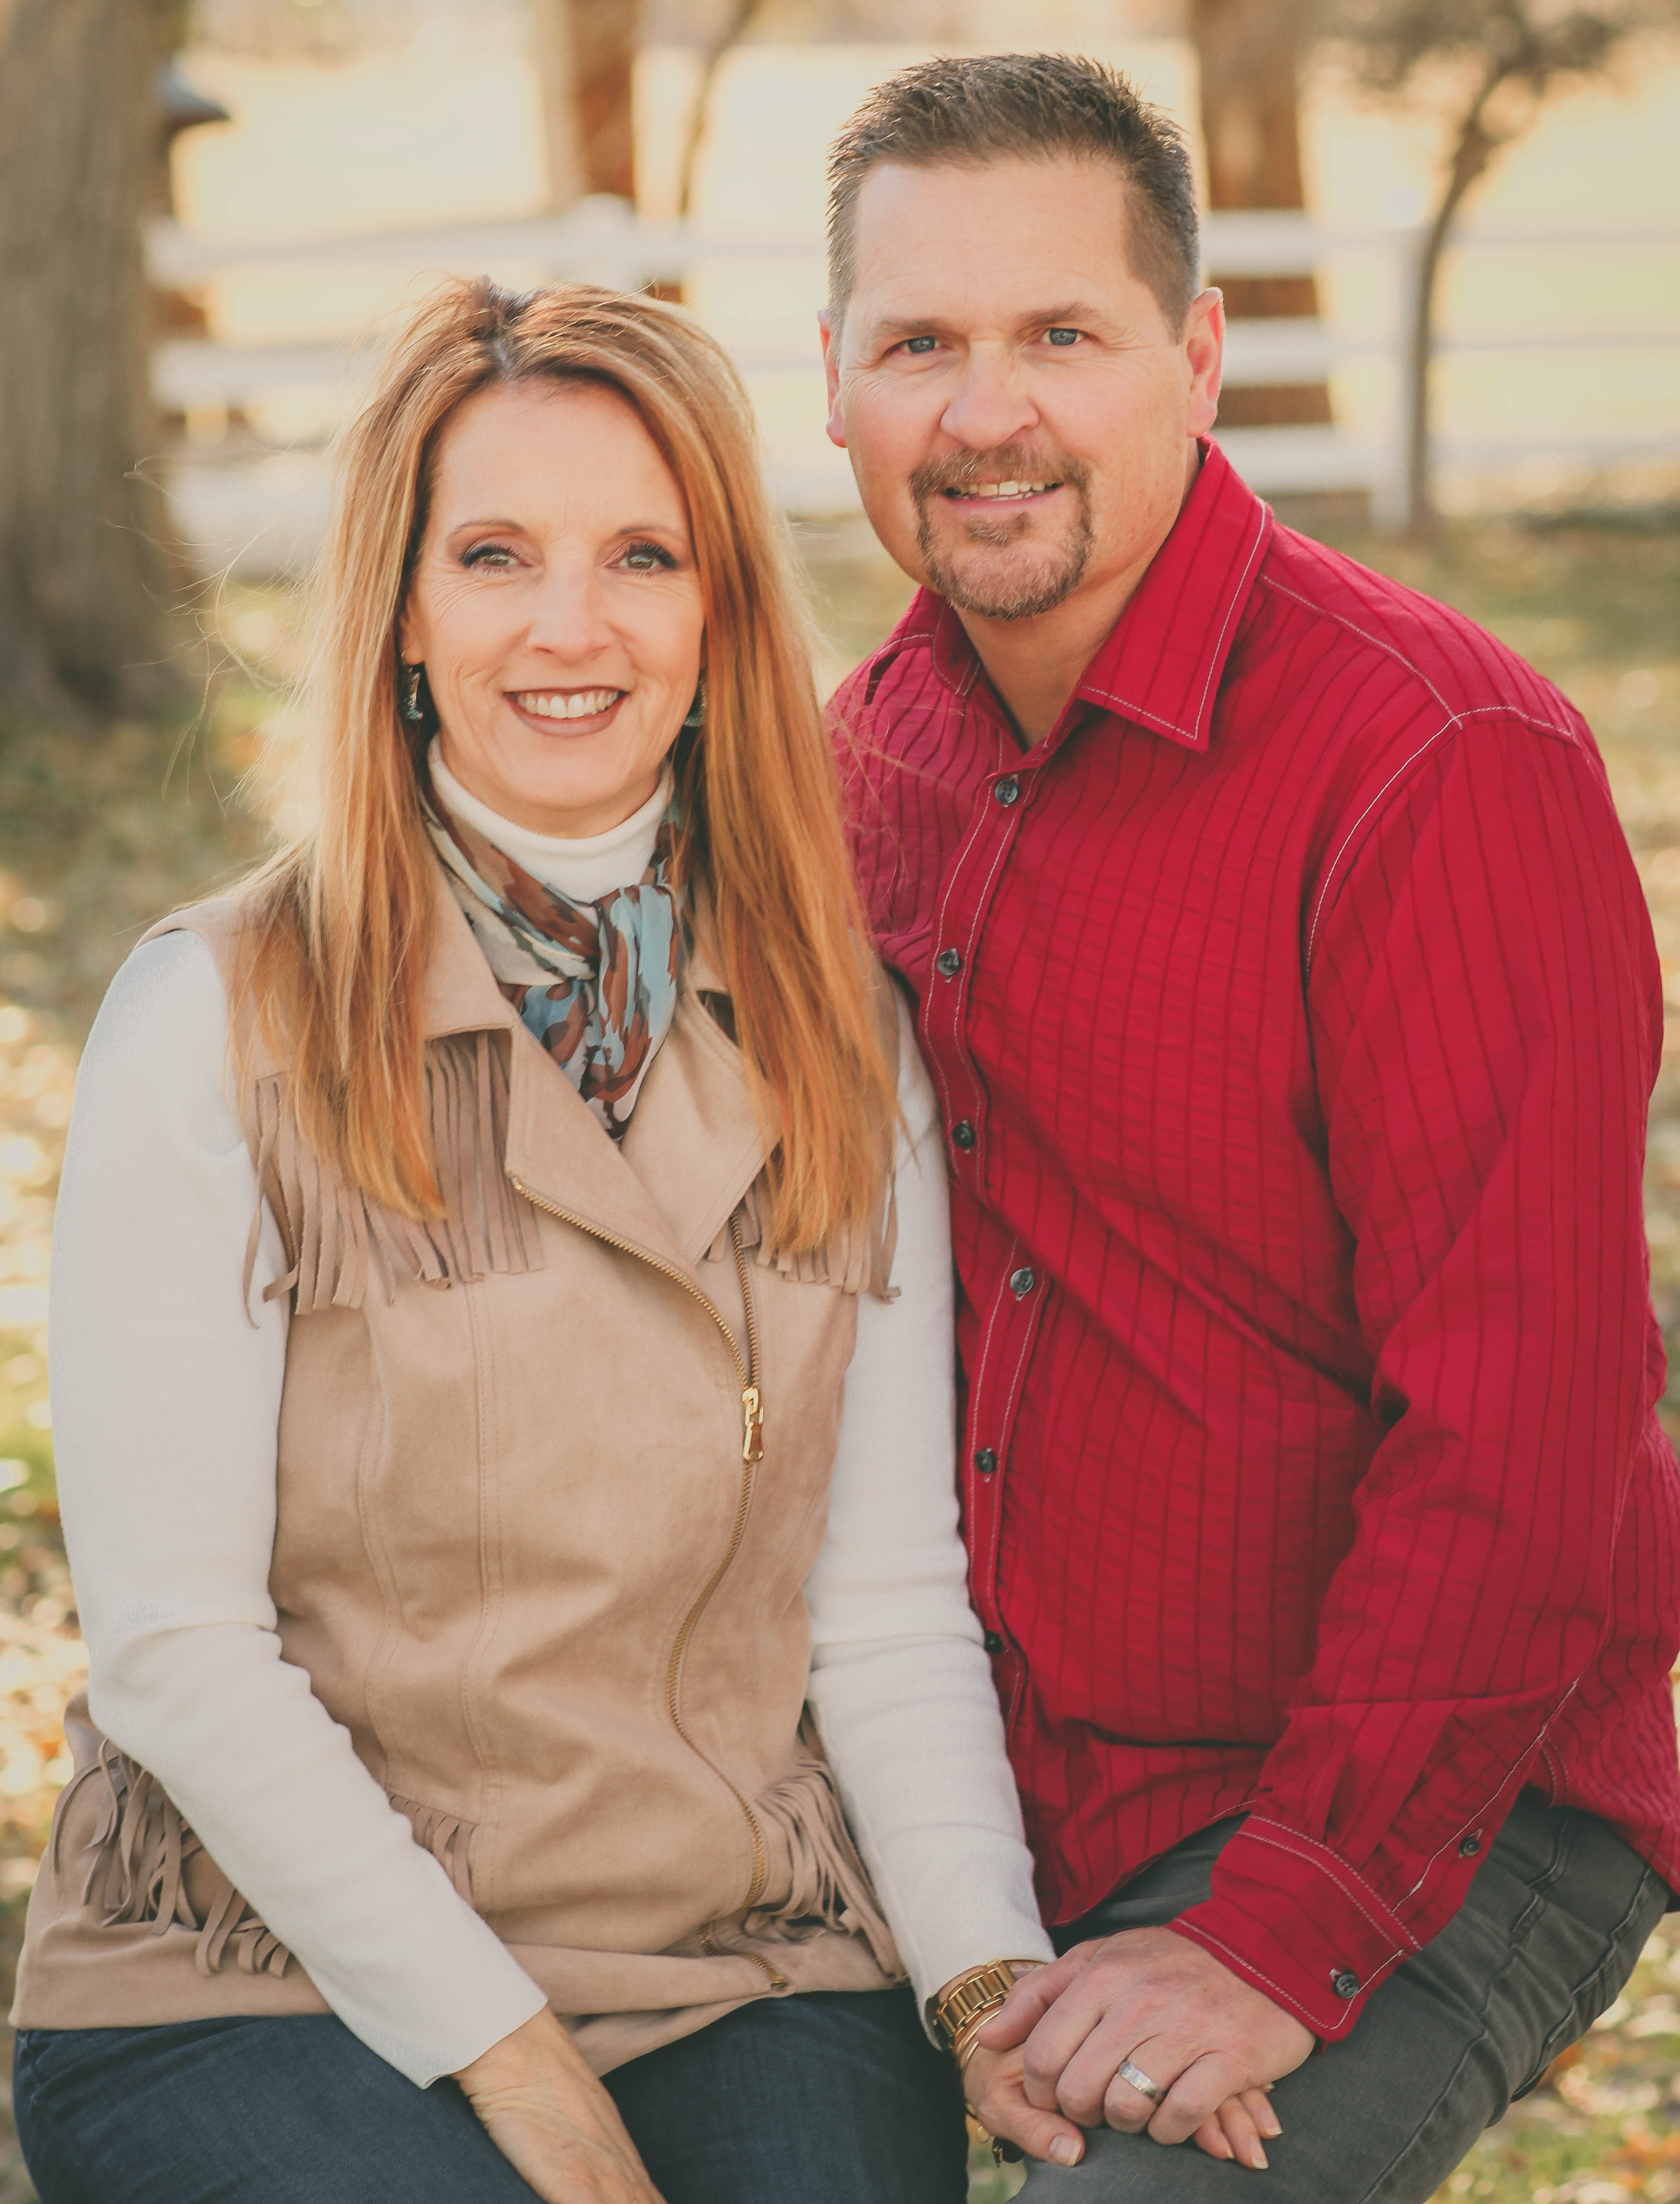
Laura Jacobs
Wife, Mom of 5, Grandma 1 ½
doTERRA Presidential Diamond
doTERRA US Founder
Author and Wellness Expert
International Speaker
TV Show Host & Producer
★

Slide 3
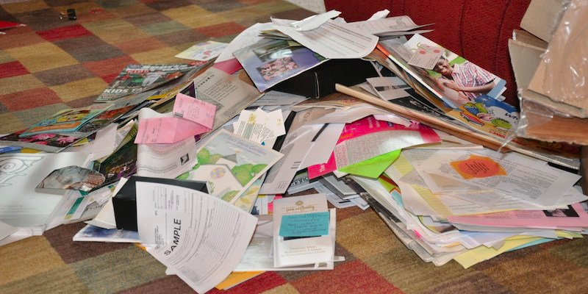
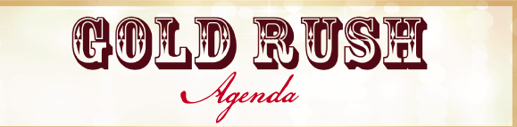
Awareness

Slide 4

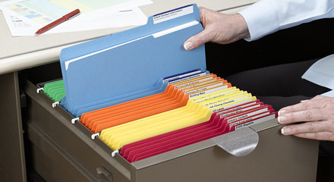
Filing System
Foundation
Intention

Slide 5
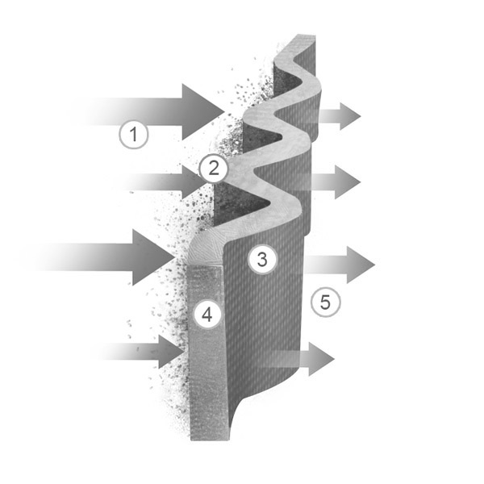

Best Practices
Filter through a systematic approach
Principles
= ACTION

Slide 6
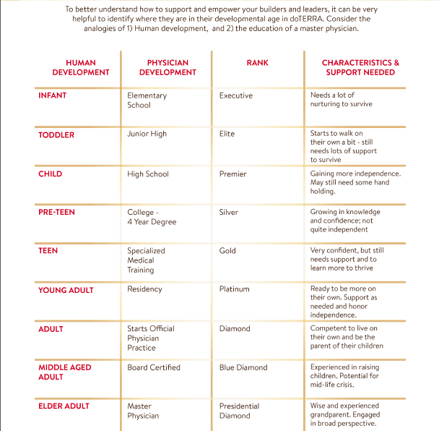


Slide 7
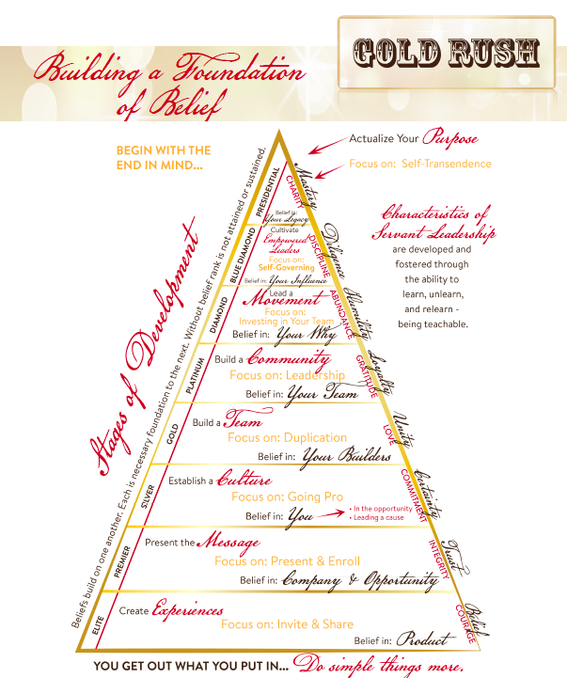


Slide 8
BELIEF & ACTION
+ − × ÷
The “Multipliers”
Of Success
Intention:
★

Slide 9
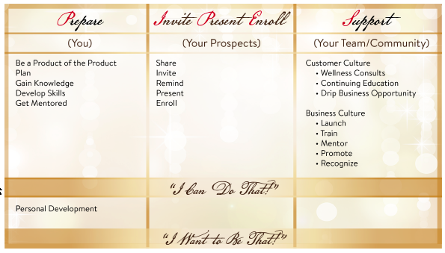


Slide 10
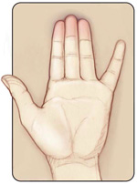
P IPE S
Prepare Invite Present Enroll Support

Slide 11
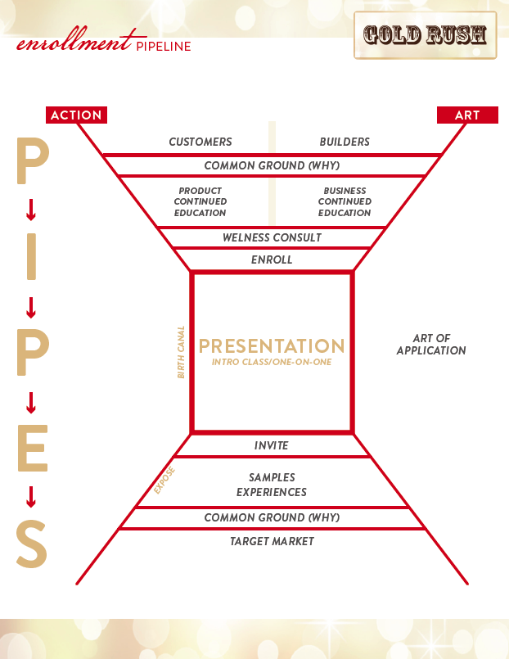

Slide 12
People are attracted to your WHY, your passion!

Slide 13
Create experiences by telling stories and sharing samples

Slide 14
Build Belief in product and the doT opportunity

Slide 15
Wellness Consult
Continuing Ed
Invite to Share
Drip Business Opportunity
REMEMBER – everyone is a customer

Slide 16
Launcn
Train
Mentor
Promote
Recognize

Slide 17
People are attracted to your WHY, your passion!

Slide 19
Elite

Slide 20
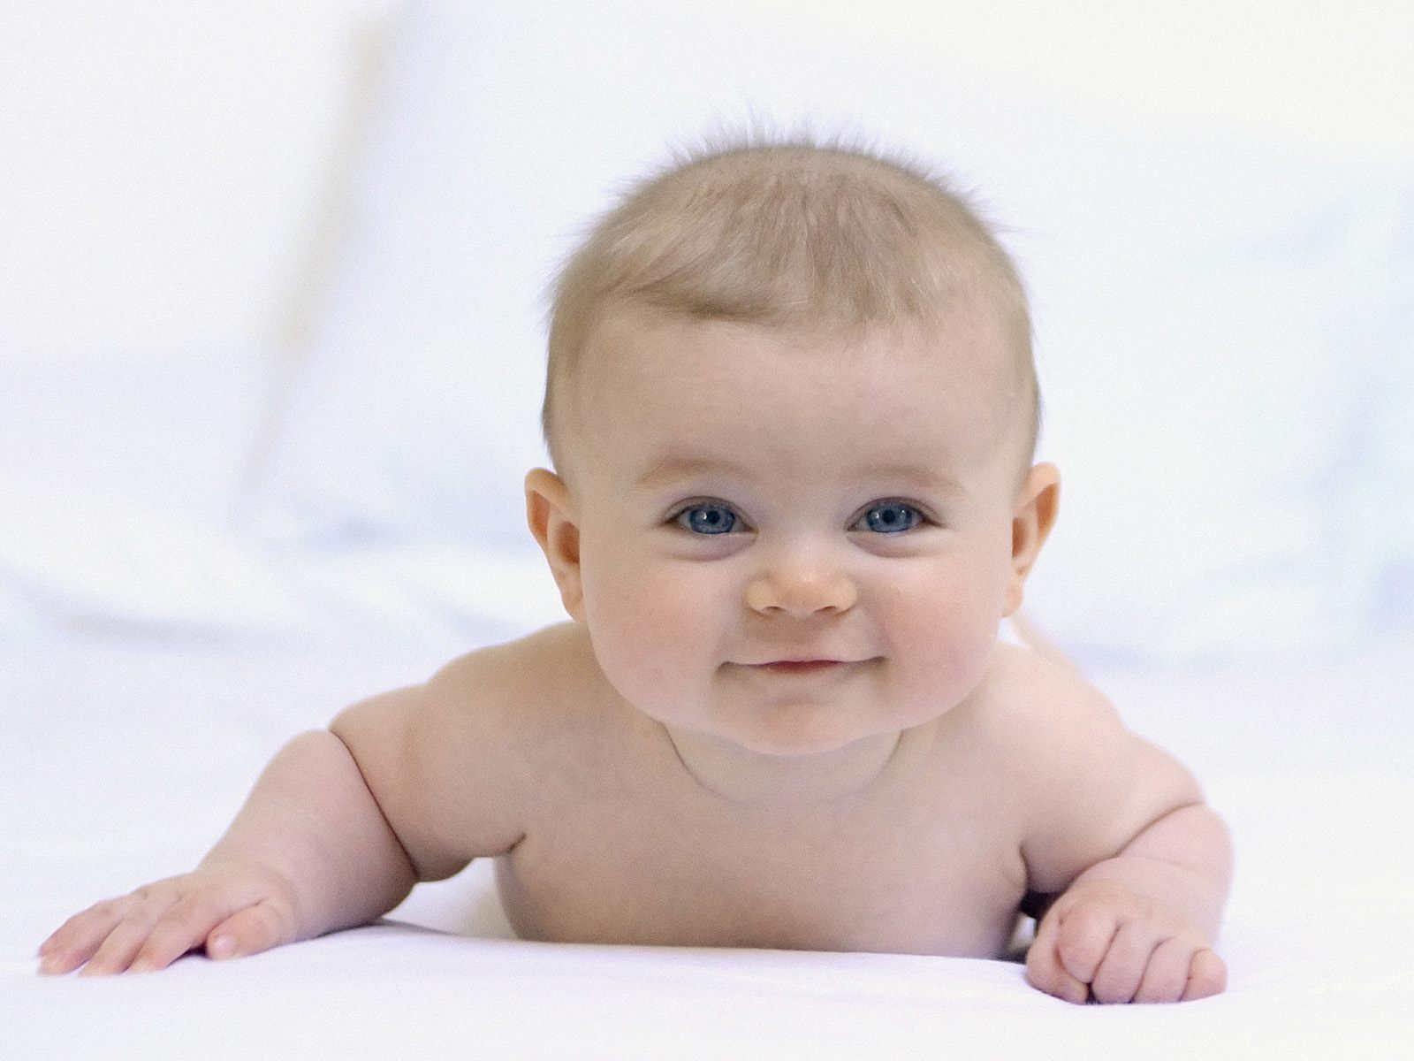
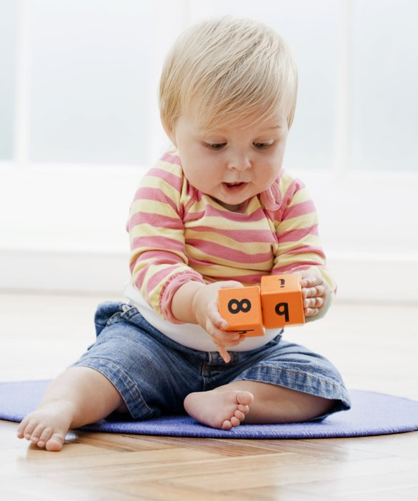
When the ordinary is
still extraordinary.
Create Experiences
What Infants/Toddlers Do Best
Elite

Slide 21
What is “Age Appropriate Training” for an up and coming
Elite so they can create experiences?
Meet Them Where They Are
Elite

Slide 22
P IPE S
Prepare Invite Present Enroll Support
What PIPES are needed to go Elite?
P – Write Names List, set 30 day goal, schedule presentations
I – Share samples & stories with prospects; invite to learn more
P – Get prospects in front of a message (product, opportunity)
E – Get prospects in front of an enrollment invitation
S – Make sure enrollee opens and uses their products
Elite

Slide 23
P IPE S
Prepare Invite Present Enroll Support

Slide 24
Elite

Slide 25
Premier

Slide 26
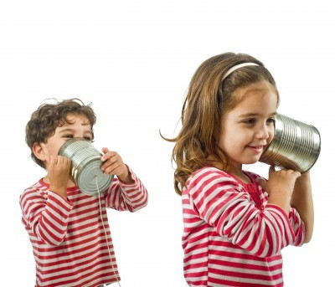

Be the Messenger.
Present the Message
What Children Do Best
Premier

Slide 27
What is “Age Appropriate Training” for an up and coming
Premier so they can present the message and enroll?
Meet Them Where They Are
Premier

Slide 28
P IPE S
Prepare Invite Present Enroll Support
What PIPES are needed to go Premier?
P – Write Names List, set 30 day goal, schedule presentations
I – Share samples & stories with prospects; invite to learn more
P – Present the message (product, opportunity)
E – Create enrollments – their own and others
S – Make sure enrollee opens and uses their products; Launch new Builders; Success Check-ins; refer Builders to training
Premier

Slide 29
Premier

Slide 30
Silver

Slide 31

Realize the power of being yourself and inviting others
to join you.
Establish Culture
What Pre-Teens Do Best
Silver

Slide 32
Silver
What is “Age Appropriate Training” for an up and coming Silver so they
can establish culture?
Meet Them Where They Are

Slide 33
P IPE S
Prepare Invite Present Enroll Support
What PIPES are needed to go Silver?
P – Write Names List, set 30 day goal, schedule presentations
I – Share samples & stories with prospects; invite to learn more
P – Present the message (product, opportunity)
E – Create enrollments – their own and others
S – Make sure enrollee opens and uses their products; launch new Builders; mentor; refer Builders to training; teach Cont. Ed; promote events
Silver

Slide 34
Silver

Slide 35
Drum roll . . .

Slide 36
Gold

Slide 37

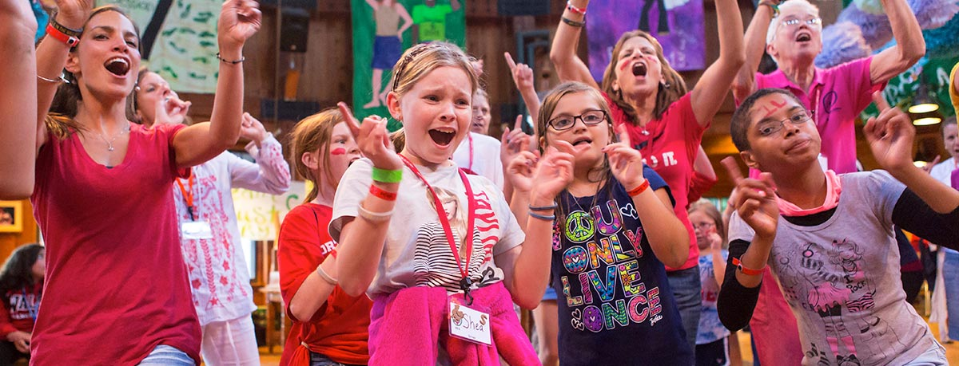
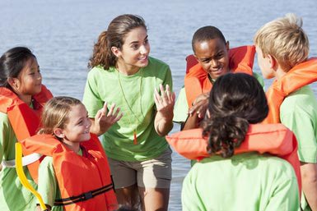
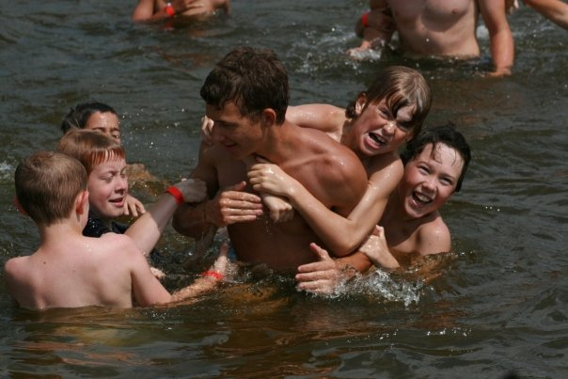
Empowering others to believe in themselves and to invite people to join them.
Build a Team
What Teens Do Best
Gold

Slide 38
Gold
What is “Age Appropriate Training” for an up and coming Gold so
they can build a team?
Meet Them Where They Are

Slide 39

Duplication!
P IPE S
Prepare Invite Present Enroll Support
What PIPES are needed to go Gold?
P – Write Names List, set 30 day goal, schedule presentations
I – Share samples & stories with prospects; invite to learn more
P – Present the message (product, opportunity)
E – Create enrollments – their own and others
S – Make sure enrollee opens and uses their products; launch new Builders; mentor; refer Builders to training; teach Cont. Ed; promote events; recognition
Gold

Slide 40
Duplication!

Slide 41
P IPE S
Prepare Invite Present Enroll Support

Slide 42
P IPE S
Prepare Invite Present Enroll Support
What if you leave out the IPEing
And just Hang Loose?

Slide 43
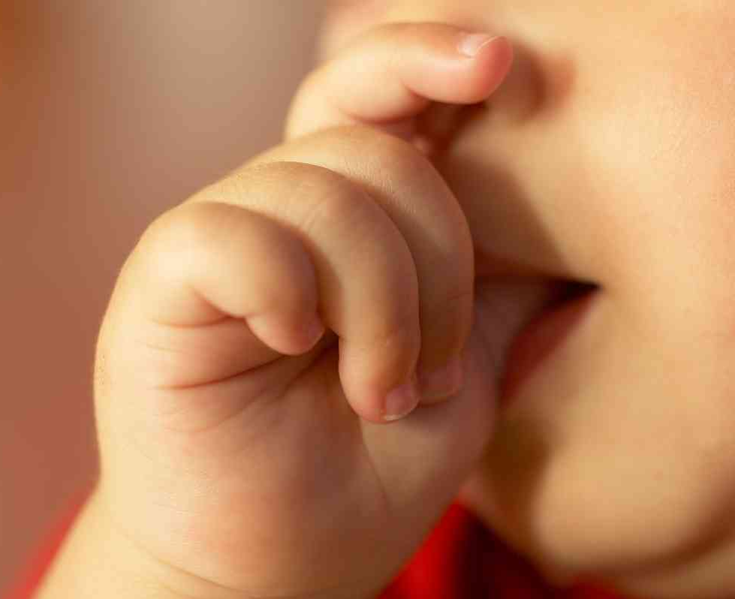
P
Prepare
Overly focused on
preparing and Self-development?

Slide 44
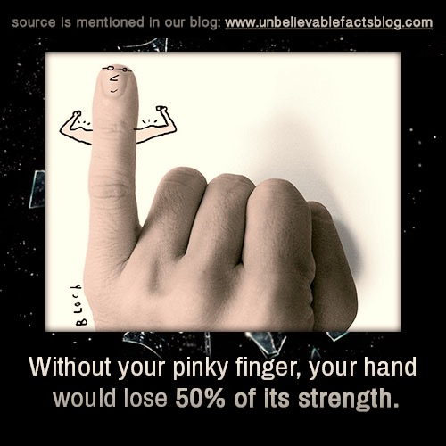
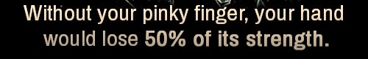
SUPPORTing your team is VITAL!

Slide 45
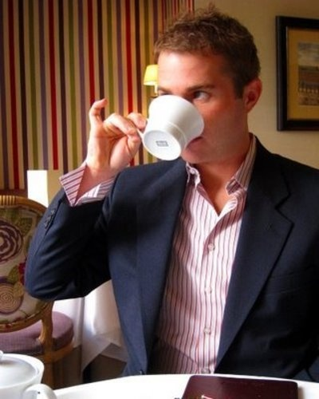
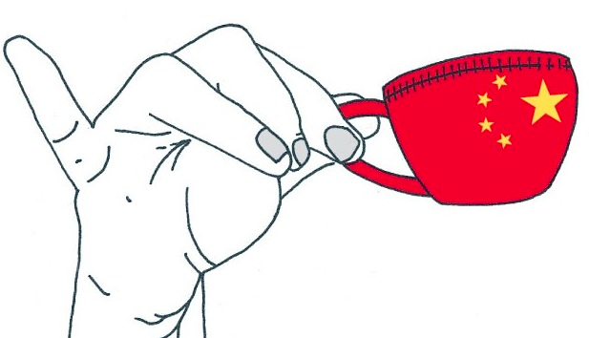

Does the Pinky Stand Alone?
Pretending to be engaged?
When extended alone, the pinky finger is considered to represent pretense.

Slide 46

PIPES.
The NEW Live Long and Prosper in your doTERRA
business.
P IPE S
Prepare Invite Present Enroll Support

Slide 47
BELIEF & ACTION
+ − × ÷
The “Multipliers”
Of Success
Intention:
★

Slide 48
The following extra slides that can be
used for higher ranks,
additional training,
Transitions to other training, etc.

Slide 53
WHOLE BRAIN LEARNING
Feel
Say
See
Hear
Say It to Believe It!

Slide 54
Best Practices
Filter through a systematic approach
Principles
= ACTION
Each Builder/Leader takes systems and principles and decides how to implement these are there best practices.

