Slide 1
Review
Notes:
Tell the student that we are going to review letters and sounds, sound out words, review our sight words and talk about what you learned this year.
Click to go to the next slide.

Slide 2
Let’s Review Letters!
Q
R
S
T
U
q
r
s
t
u
q
t
r
u
s
Notes:
Notes to Teacher:
Teacher: “Today, we are going to review some uppercase and lowercase letters.”
Click to show the uppercase Q.
Ask: “What letter is this?” (Uppercase Q.)
Click to show the uppercase R.
Ask: “What letter is this?” (Uppercase R.)
Click to show the uppercase S.
Ask: “What letter is this?” (Uppercase S.)
Click to show the uppercase T.
Ask: “What letter is this?” (Uppercase T.)
Click to show the uppercase U.
Ask: “What letter is this?” (Uppercase U.)
Teacher: “Now, let’s look at the lowercase letters.”
Click to show q. Ask: “What letter is this?” (Lowercase q.)
Click to move and match Q to q.
Click to show t. Ask: “What letter is this?” (Lowercase t.)
Click to move and match T to t.
Click to show r. Ask: “What letter is this?” (Lowercase r.)
Click to match R to r.
Click to show u. Ask: “What letter is this?” (Lowercase u.)
Click to match U to u.
Click to show s. Ask: “What letter is this?” (Lowercase s.)
Click to match S to s.
Applaud student’s effort.
Click to move to the next slide.

Slide 3
Let’s Review Letters- 2
V
W
X
Y
Z
v
w
x
y
z
z
y
x
w
v
Notes:
Notes to Teacher:
Teacher: “Let’s look at some more letters.”
Click to show the uppercase V.
Ask: “What letter is this?” (Uppercase V.)
Click to show the uppercase W.
Ask: “What letter is this?” (Uppercase W.)
Click to show the uppercase X.
Ask: “What letter is this?” (Uppercase X.)
Click to show the uppercase Y.
Ask: “What letter is this?” (Uppercase Y.)
Click to show the uppercase Z.
Ask: “What letter is this?” (Uppercase Z.)
Teacher: “Now, let’s look at the lowercase letters.”
Click to show z. Ask: “What letter is this?” (Lowercase z.)
Click to move and match Z to z.
Click to show y. Ask: “What letter is this?” (Lowercase y.)
Click to move and match Y to y.
Click to show x. Ask: “What letter is this?” (Lowercase x.)
Click to match X to x.
Click to show w. Ask: “What letter is this?” (Lowercase w.)
Click to match W to w.
Click to show v. Ask: “What letter is this?” (Lowercase v.)
Click to match V to v.
Applaud student’s effort.
Click to move to the next slide.

Slide 4
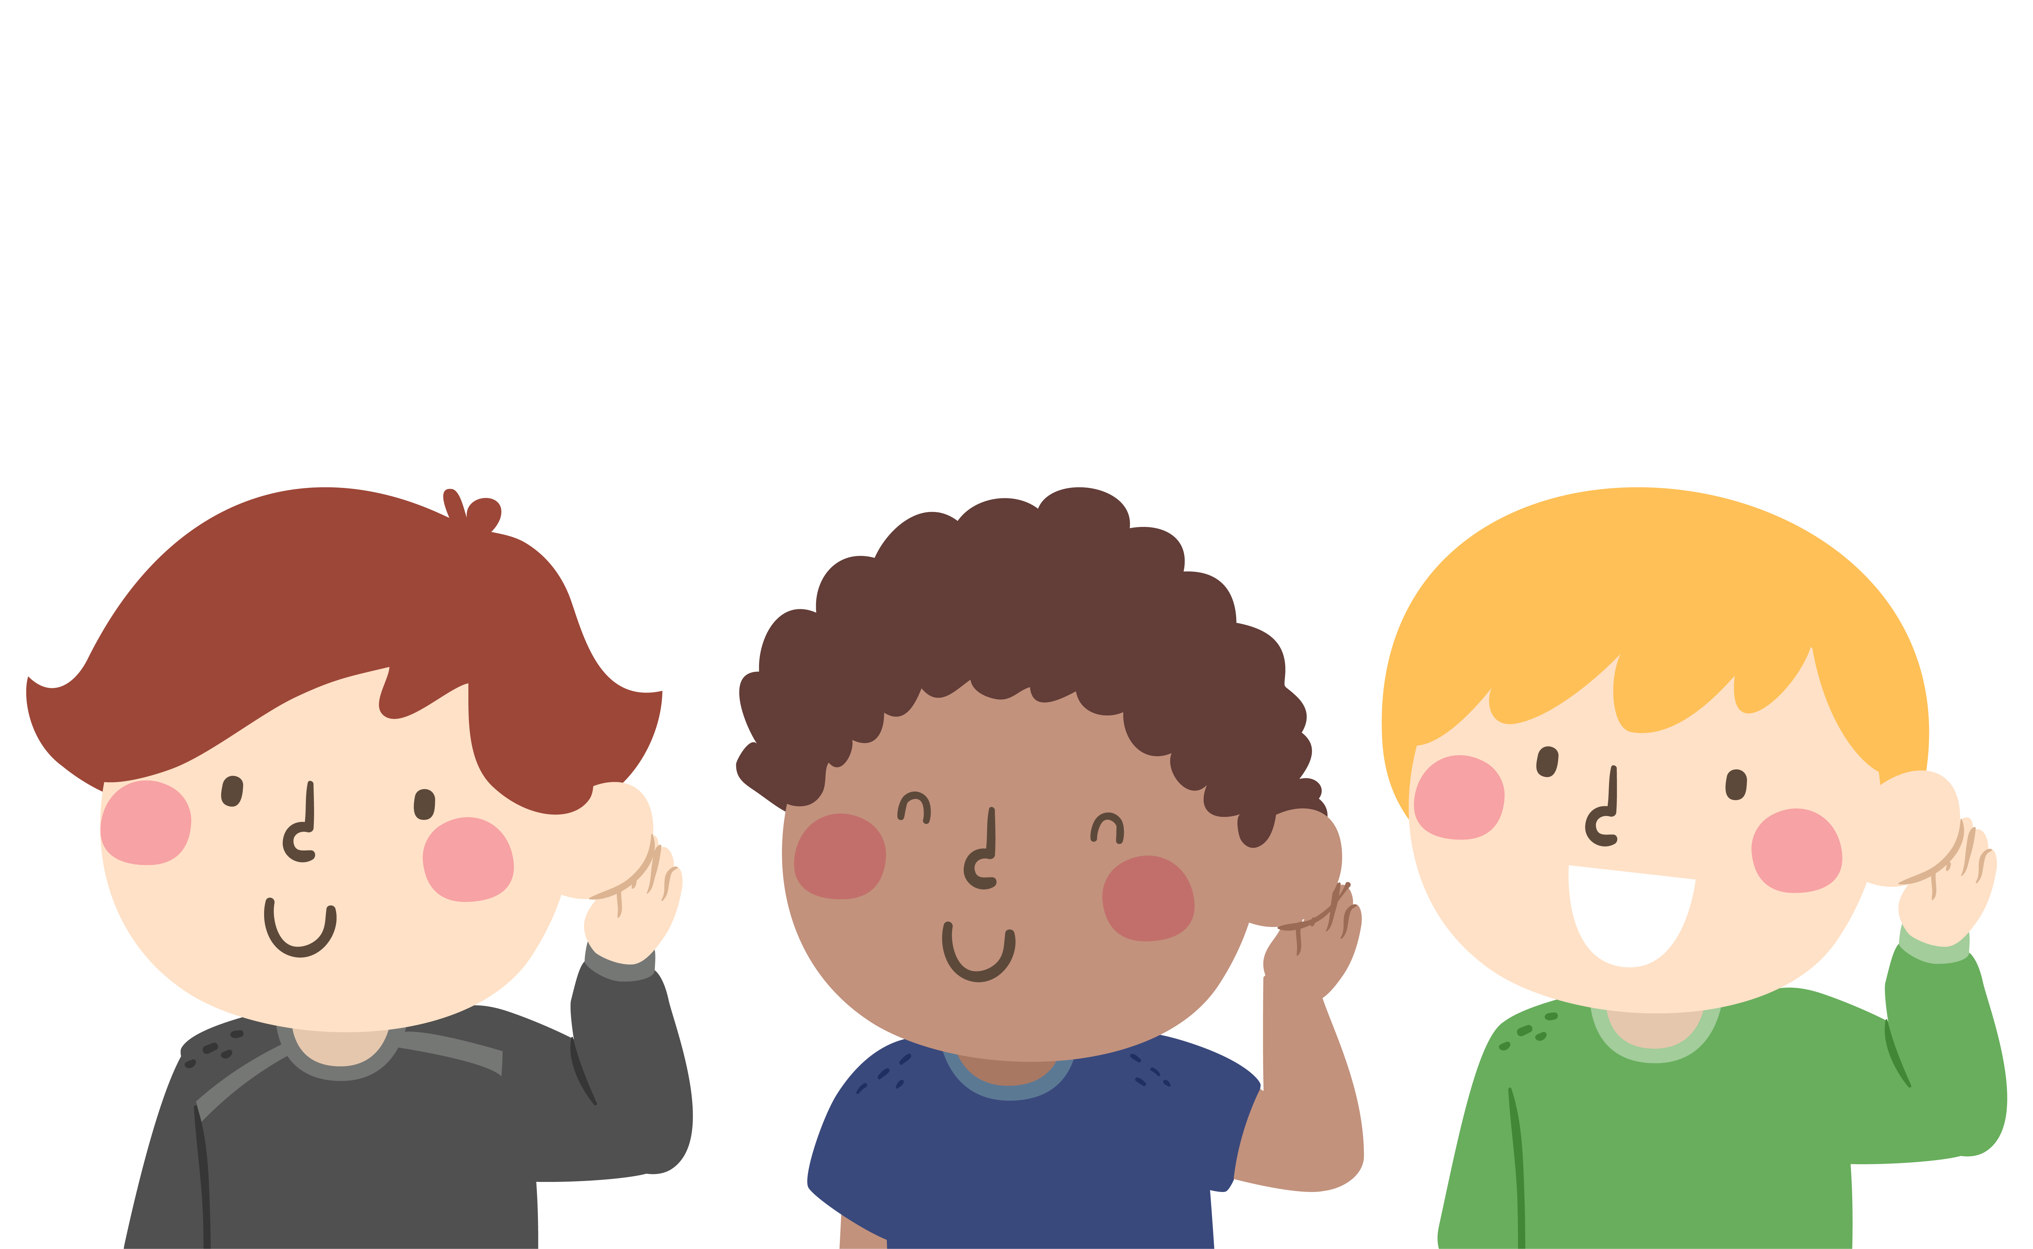




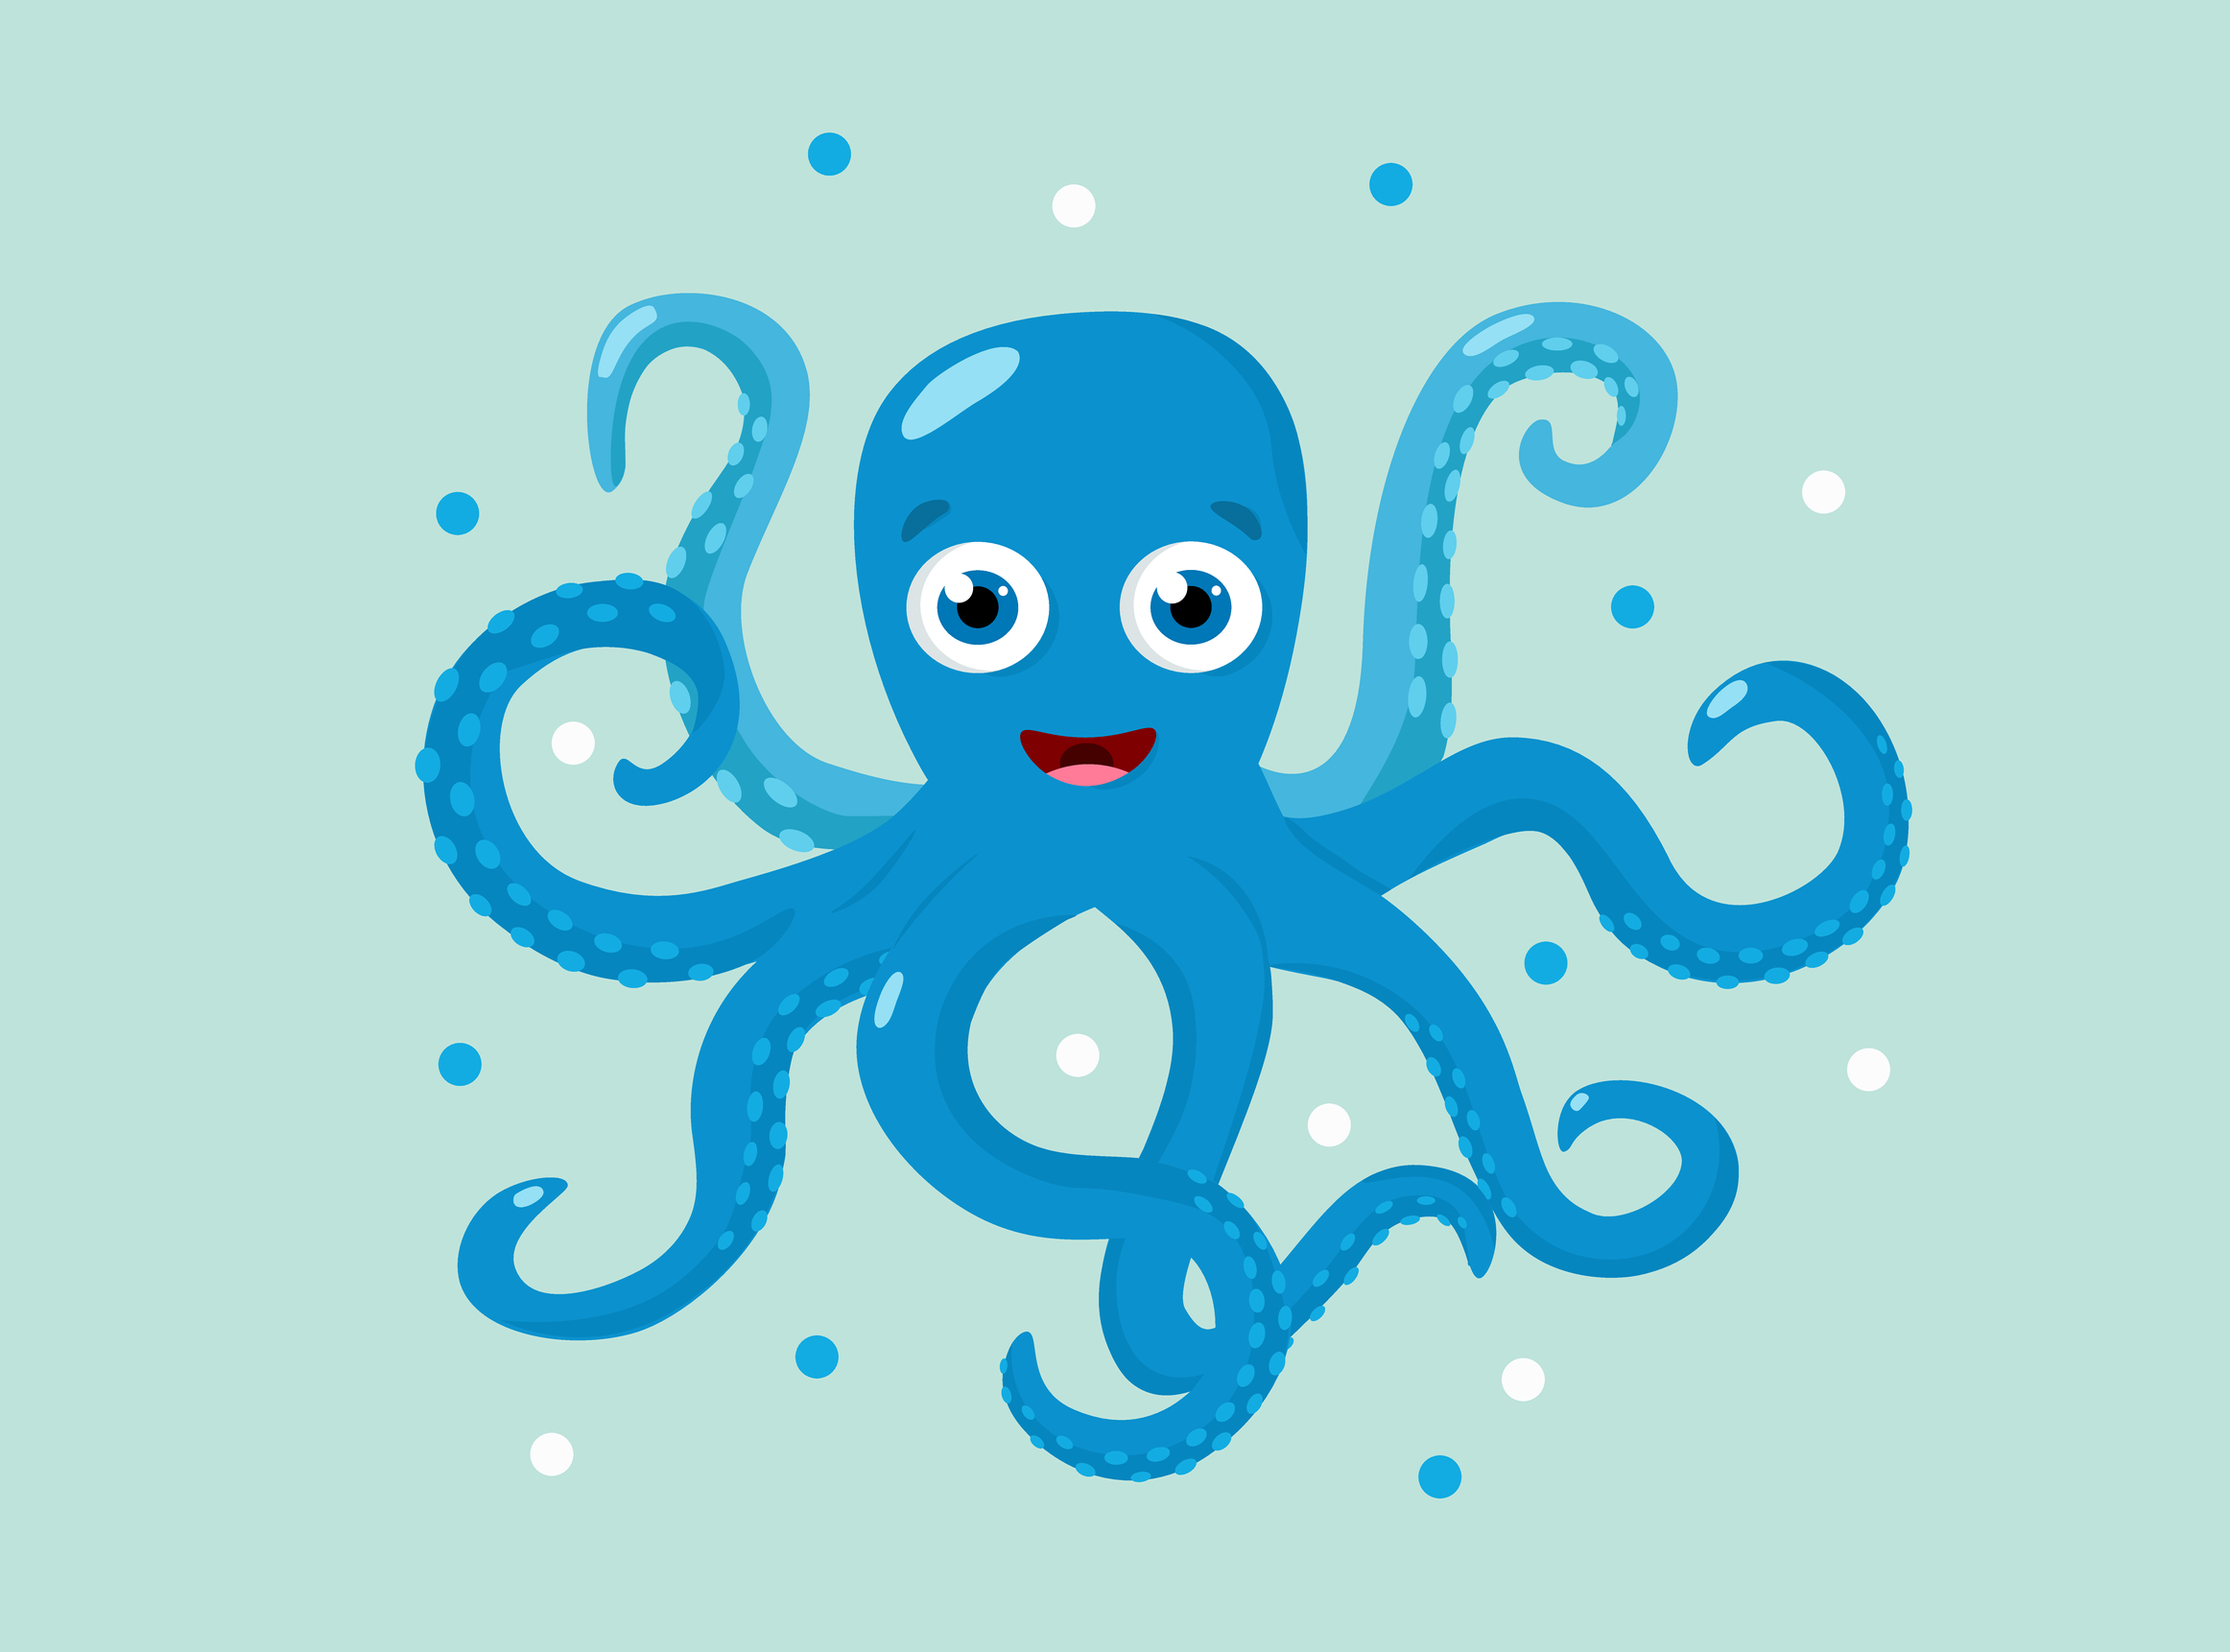
Let’s Review Short Vowel Sounds
a
e
i
o
u
Notes:
Notes to Teacher:
Click to show the image of the children listening.
Teacher: “Before we read words, let’s review the sounds of short vowels.”
Click to show a and apple.
Ask: “What sound does it make if it is a short a?” (/a/, as in apple.)
Click to show e and elephant.
Ask: “What sound does it make if it is a short e?” (/e/, as in elephant.)
Click to show i and igloo.
Ask: “What sound does it make if it is a short i?” (/i/, as in igloo.)
Click to show o and octopus.
Ask: “What sound does it make if it is a short o?” (/o/, as in octopus.)
Click to show u and umbrella.
Ask: “What sound does it make if it is a short u?” (/u/, as in umbrella.)
Applaud student’s effort.
Click to move to the next slide.

Slide 5



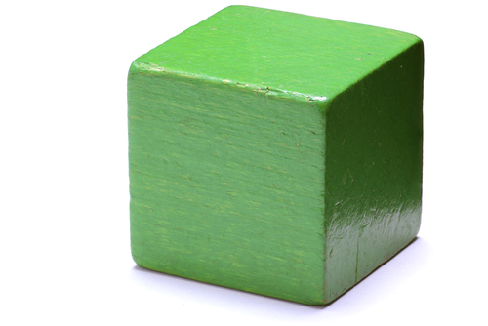
Sound It Out
cap
cape
cub
cube
Notes:
Notes to Teacher:
Click to show the image of the reading detective.
Teacher: “Let’s read some words.”
Click to bring up the word cap.
Ask: “What is this?” (Cap.)
If student is struggling to read the word, point to each letter and help him/her sound it out: /k/ + /a/ + /p/ = cap.
Click to bring up the picture of a cap.
Click to bring up the word cape.
Ask: “What happens when I add this silent e to the word cap?” (Cap becomes cape.)
If student is struggling to read the word, point out each letter and help him/her sound it out: /k/ + long /a/ sound + /p/ {The e is silent} = cape.
Click to bring up the picture of the superheroes with an arrow pointing to the cape.
Teacher: “Let’s look at two more words.”
Click to bring up the word cub.
Ask: “What is this?” (Cub.)
If student is struggling to read the word, point to each letter and help him/her sound it out: /k/ + /u/ + /b/ = cub.
Click to bring up the picture of a cub.
Click to bring up the word cube.
Ask: “What happens when I add this silent e to the word cub?” (Cub becomes cube.)
If student is struggling to read the word, point out each letter and help him/her sound it out: /k/ + long /u/ sound + /b/ {The e is silent} = cube.
Click to bring up the picture of the cube.
Applaud student’s effort.
Teacher: “You did a great job reading these words!”
Click to move to the next slide.

Slide 6
Sight Word Challenge
soon
please
out
ran
this
Notes:
Notes to Teacher:
Teacher says: “Can you read these sight words?” (There are 5 words on this slide.)
Click to show the word “soon.””– When it appears on the screen, ask: “What word do you see?”
When student responds “soon,” applaud his/her answer.
If student does not respond correctly, teacher will tell the student that the word is “soon.” Have student say the word “soon.” (Student repeats.)
Click to show the next word, “please.”– When it appears on the screen, ask: “What word do you see?”
When student responds “please,” applaud his/her answer.
If student does not respond correctly, teacher will tell the student that the word is “please.” Have student say the word “please.” (Student repeats.)
Click to show the next word, “out.” – When it appears on the screen, ask: “What word do you see?”
When student responds “out,” applaud his/her answer.
If student does not respond correctly, teacher will tell the student that the word is “out.” Have student say the word “out.” (Student repeats.)
Click to show the next word, “ran.” – When it appears on the screen, ask: “What word do you see?”
When student responds “ran,” applaud his/her answer.
If student does not respond correctly, teacher will tell the student that the word is “ran.” Have student say the word “ran.” (Student repeats.)
Click to show the final word, “this.” – When it appears on the screen, ask: “What word do you see?”
When student responds “this,” applaud his/her answer.
If student does not respond correctly, teacher will tell the student that the word is “this.” Have student say the word “this.” (Student repeats.)
“Let’s look at another group of words.”
Click to show the arrow.
Click to go to the next slide.

Slide 7
Sight Word Challenge
too
white
under
was
well
Notes:
Notes to Teacher:
Click to show the word “too.””– When it appears on the screen, ask: “What word do you see?”
When student responds “too,” applaud his/her answer.
If student does not respond correctly, teacher will tell the student that the word is “too.” Have student say the word “too.” (Student repeats.)
Click to show the next word, “white.”– When it appears on the screen, ask: “What word do you see?”
When student responds “white,” applaud his/her answer.
If student does not respond correctly, teacher will tell the student that the word is “white.” Have student say the word “white.” (Student repeats.)
Click to show the next word, “under.” – When it appears on the screen, ask: “What word do you see?”
When student responds “under,” applaud his/her answer.
If student does not respond correctly, teacher will tell the student that the word is “under.” Have student say the word “under.” (Student repeats.)
Click to show the next word, “was.” – When it appears on the screen, ask: “What word do you see?”
When student responds “was,” applaud his/her answer.
If student does not respond correctly, teacher will tell the student that the word is “was.” Have student say the word “was.” (Student repeats.)
Click to show the final word, “well.” – When it appears on the screen, ask: “What word do you see?”
When student responds “well,” applaud his/her answer.
If student does not respond correctly, teacher will tell the student that the word is “well.” Have student say the word “well.” (Student repeats.)
“Now, let’s look at our last group of words.”
Click to show the arrow.
Click to go to the next slide.

Slide 8

Sight Word Challenge
what
want
who
will
yes
Notes:
Notes to Teacher:
Click to show the word, “what.””– When it appears on the screen, ask: “What word do you see?”
When student responds “what,” applaud his/her answer.
If student does not respond correctly, teacher will tell the student that the word is “what.” Have student say the word “what.” (Student repeats.)
Click to show the next word, “want.”– When it appears on the screen, ask: “What word do you see?”
When student responds “want,” applaud his/her answer.
If student does not respond correctly, teacher will tell the student that the word is “want.” Have student say the word “want.” (Student repeats.)
Click to show the next word, “who.” – When it appears on the screen, ask: “What word do you see?”
When student responds “who,” applaud his/her answer.
If student does not respond correctly, teacher will tell the student that the word is “who.” Have student say the word “who.” (Student repeats.)
Click to show the next word, “will.” – When it appears on the screen, ask: “What word do you see?”
When student responds “will,” applaud his/her answer.
If student does not respond correctly, teacher will tell the student that the word is “will.” Have student say the word “will.” (Student repeats.)
Click to show the final word, “yes.” – When it appears on the screen, ask: “What word do you see?”
When student responds “yes,” applaud his/her answer.
If student does not respond correctly, teacher will tell the student that the word is “yes.” Have student say the word “yes.” (Student repeats.)
Click to show the smiley face and applaud student’s effort.
Click to go to the next slide.

Slide 9

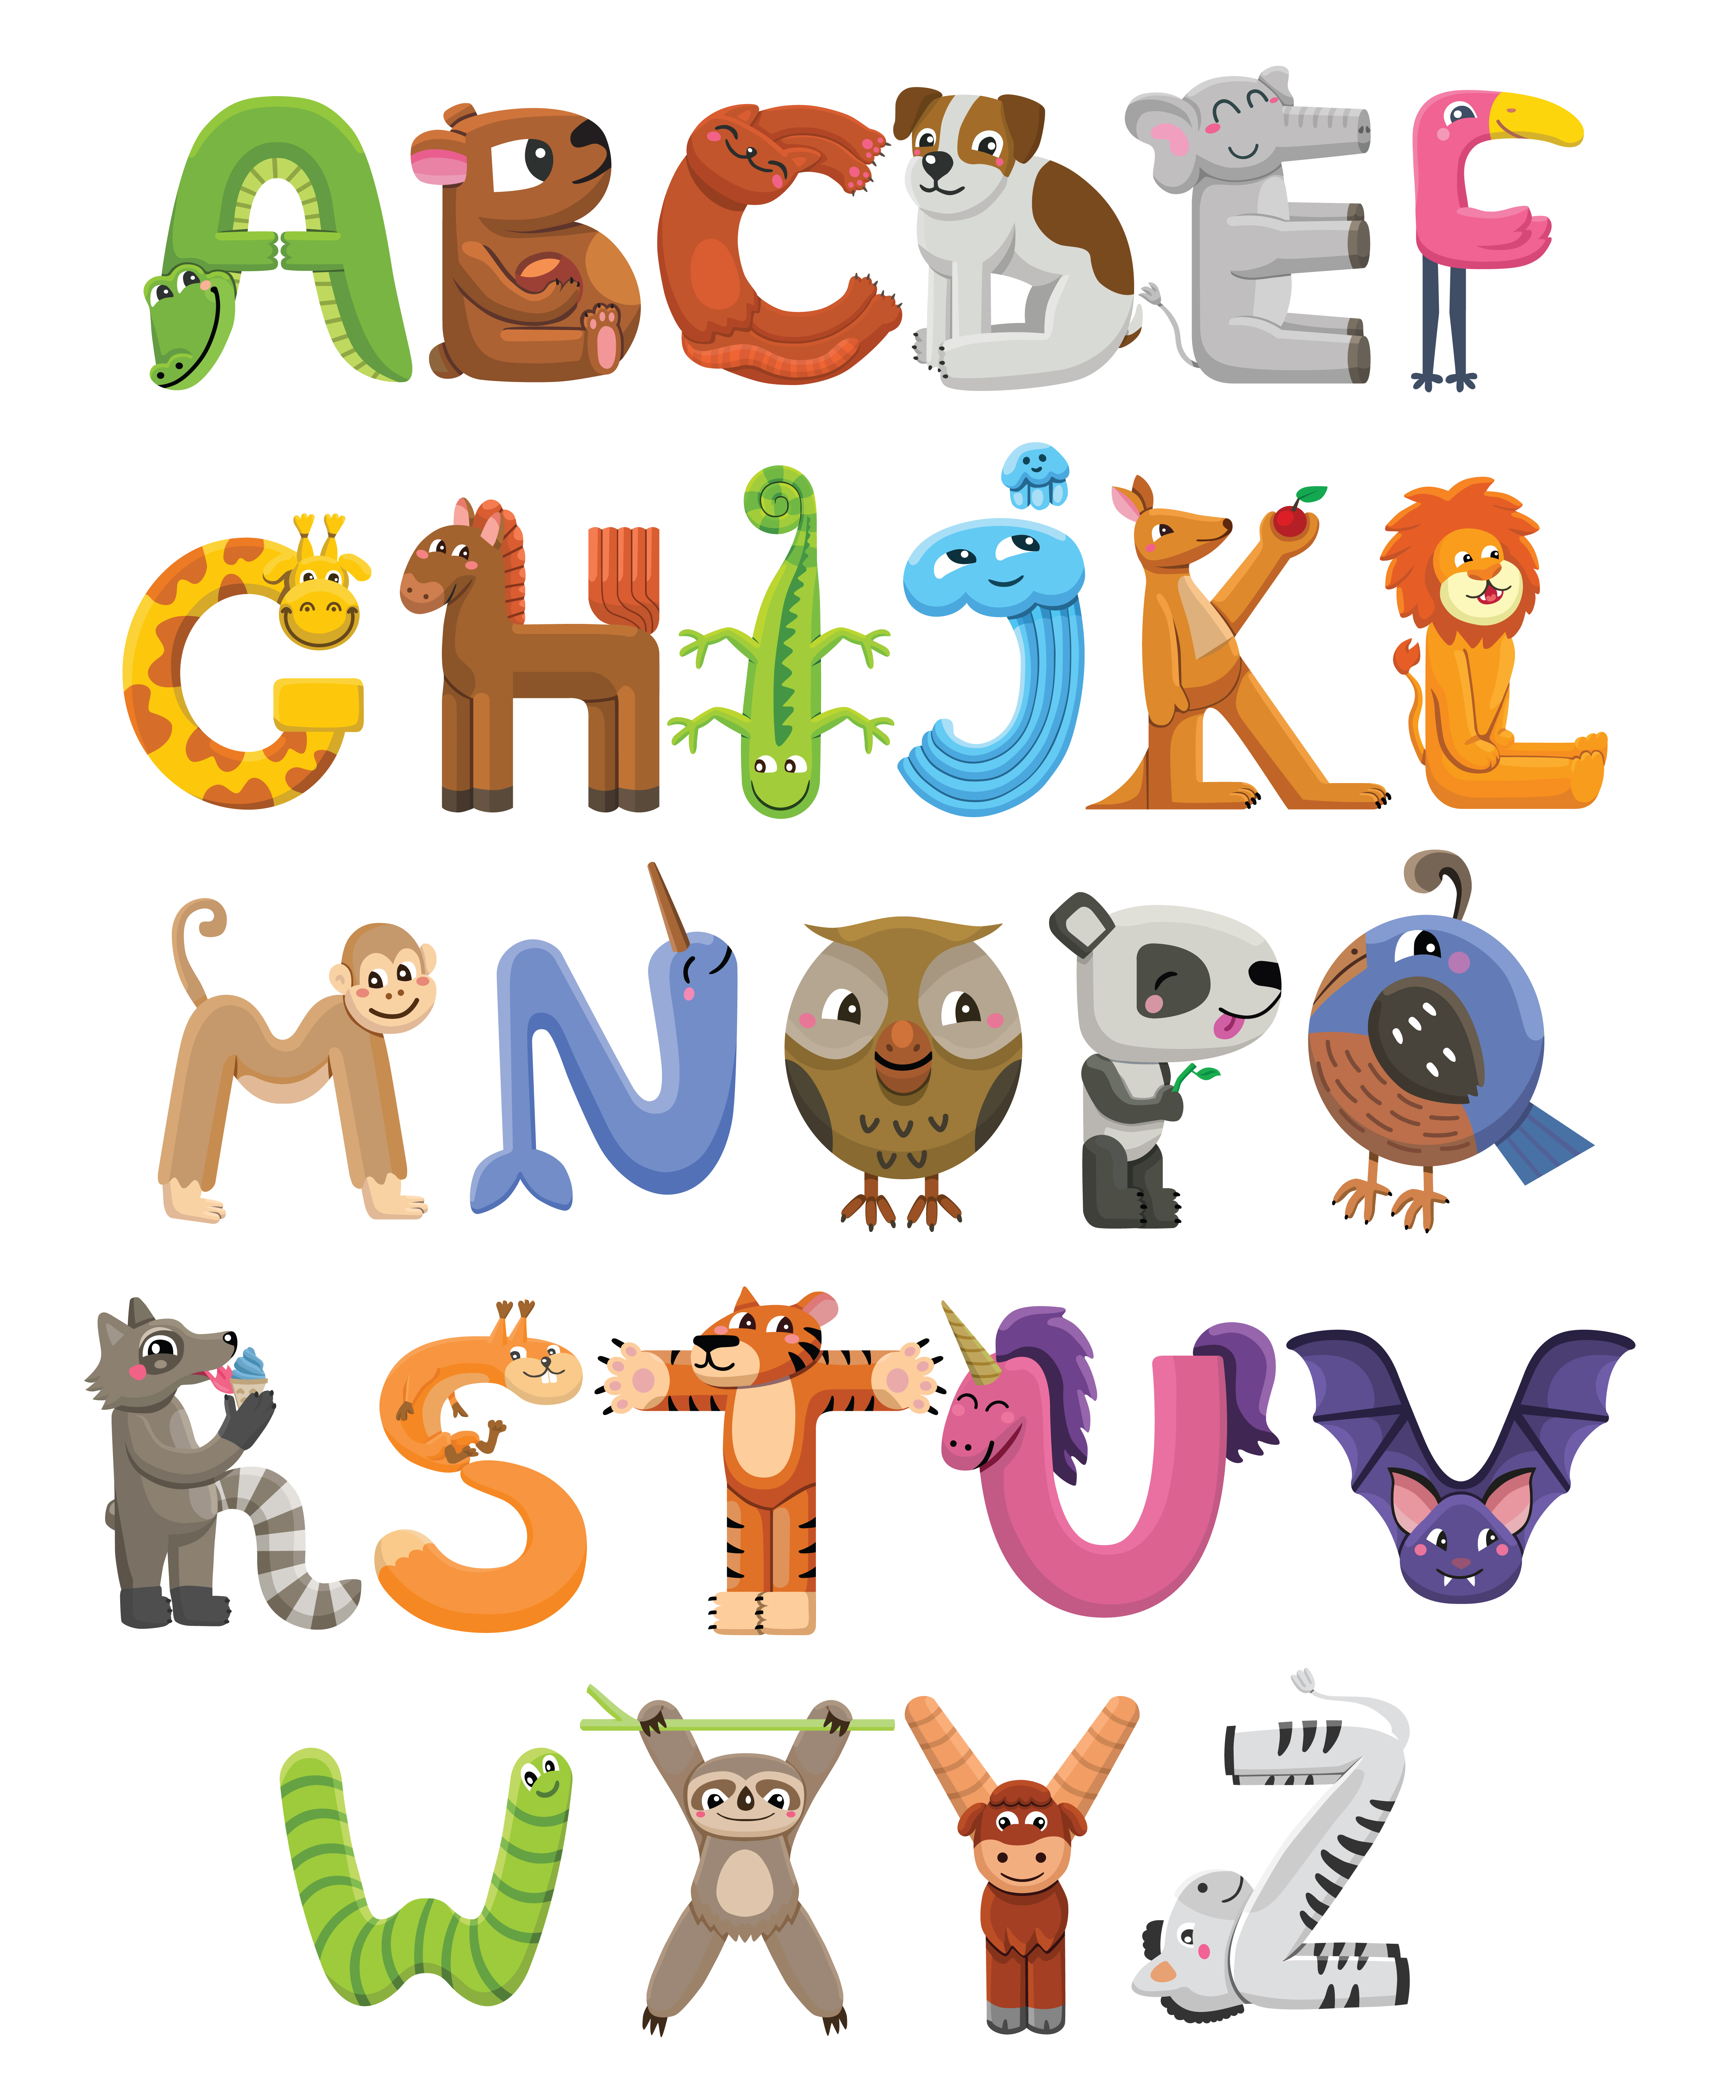


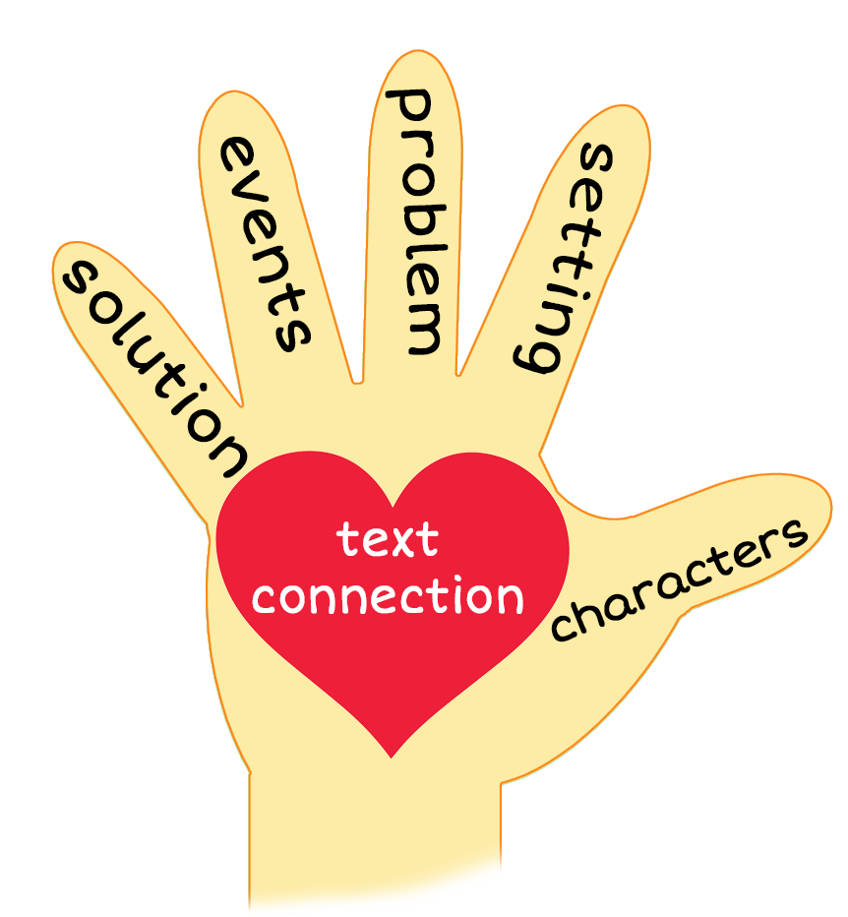
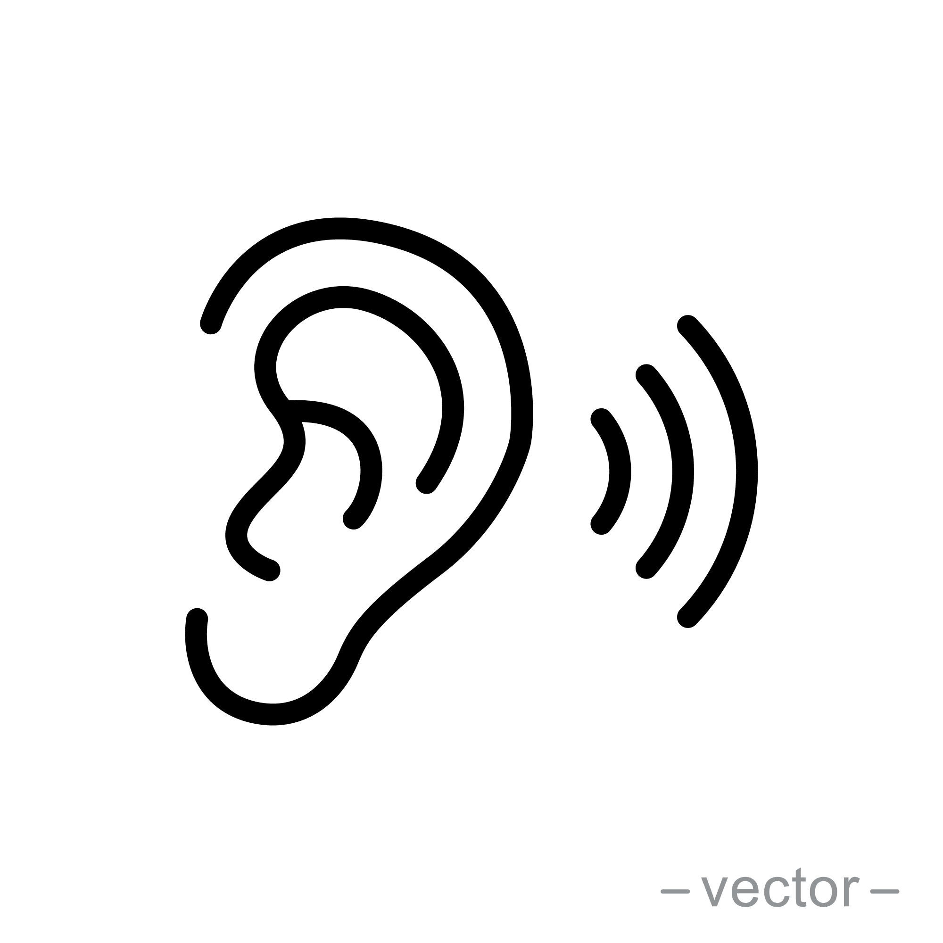

Wrap It Up!
Notes:
Notes to Teacher:
Teacher: “This year, you learned a lot! Let’s take a look at some of the things you learned. What does each picture remind you of?”
Click to bring up the picture of the children with the book.
Ask: “What does this remind you of?” (Possible answers: I learned to read this year! I learned how to become a better reader. I learned about different kinds of stories. I read many different stories this year. I learned about the parts of the book. I learned about what the author/illustrator does.)
Click to bring the image to the alphabet.
Ask: “What does this remind you of?” (Possible answers: I learned letters and sounds. I learned about words that begin with each letter.)
Click to bring up the paper and pencil.
Ask: “What does this remind you of?” (Possible answers: I learned how to hold a pencil. I learned how to write each letter. I learned how to write words. I learned how to be a good writer.)
Click to bring up the hand for the 5-finger retell.
Ask: “What does this remind you of?” (Possible answer: I learned how to retell a story.)
Click to bring up the ear.
Ask: “What does this remind you of?” (Possible answer: I learned how to be a good listener. I learned how to listen for the sounds in each word. I learned how to ear spell.)
Click to bring up the question mark.
Ask: “What does this remind you of?” (Possible answers: I learned about ending marks. I learned to ask lots of questions. I learned how to ask and answer questions to talk about the books I read.)
Click to bring up the star.
Tell student how proud you are of him/her. Remind him/her to continue to be a great reader and writer.
Applaud student’s efforts in completing this course.
Click to the next slide.

Slide 10
Q & A
Any Questions?
Notes:
Ask – “Do you have any questions about anything that you learned in this lesson?”

