Slide 1
Phonics of the Week
Long u; _u_e
Notes:
Tell the student that we are going to review the long u with the silent e, review some letters and our sight words and complete a story retell for Who Will Say Yes?
Click to go to the next slide.

Slide 2

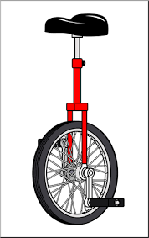
Check It Out!
Uu
unicorn
unicycle
Notes:
Notes to Teacher:
Click to show the letters Uu on the screen.
Teacher: “Point to the letters on the screen. “What sound does the long u make? (Student will answer /u/, as in unicorn.)
If student is struggling, teacher will model making the long /u/ sound and have the student repeat: /u/, like in unicorn /u/, /u/, /u/.
Click to show the next image –unicorn. When it appears on the screen, ask, “What is this?” If student responds “unicorn,” applaud his/her answer. If student does not respond correctly, teacher will tell student that it is a picture of unicorn. Click to show the word “unicorn.”
Click to show a picture of the unicycle. When it appears on the screen, ask, “What is this?” When student responds “unicycle,” applaud his/her answer. If student does not respond correctly, teacher will tell student that it is a picture of unicycle. Click to show the word “unicycle.”
Applaud student’s efforts.
Click to go to the next slide.

Slide 3
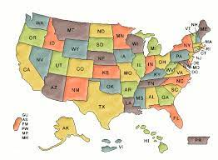

Let’s Practice!
Uu
United States
of America
tree
Notes:
Notes to Teacher:
Click to bring up the letters (Uu) to the slide.
Teacher: “What sound does the long u make?” (Long u sound, as in unicorn.) If student makes long u sound, applaud his/her answer.
If student is still unsure, remind him/her by making long /u/ sound like /u/ as in unicorn. (Student should repeat teacher.)
Teacher: “Remember, today we are talking about words that begin with the long u sound.”
Click to show a picture of a map of the United States of America. When it appears on the screen, ask, “What is this a map of?” When student responds “United States of America,” applaud his/her answer. If student does not respond correctly, teacher will tell student that it is a picture of the United States of America. Click to show the word “United States of America.”
Click to show a picture of a tree. When it appears on the screen, ask, “What is this?” When student responds “tree,” applaud his/her answer. If student does not respond correctly, teacher will tell student that it is a picture of a tree. Click to show the word “tree.”
After identifying the pictures (United States of America and tree,) ask:
Teacher: “Which picture begins with the long /u/ sound?” (United States of America.)
If student is struggling to name the picture that begins with the long u sound, teacher will assist by saying each picture name and asking if it begins with the long u sound:
- “United States of America– Does it begin with the long u sound?” (Yes.)
- “Tree- Does it begin with the long u sound?” (No.)
Teacher: “Which picture begins with the long u sound?” (United States of America.)
Click to remove the tree from the screen.
Teacher will applaud efforts of student.
Click to go to the next slide.

Slide 4

Sound It Out
c
u
b
e
cube
Notes:
Notes to Teacher:
Click to show the word cube.
Ask: “What does this say?”
Remind student that the e is silent
Click to show line through e representing that it is silent.
As you click to show each letter, encourage the student to tell you what sound each letter makes:
Click to show c = “/k/”
Click to show u = “long /u/ sound,” like in unicorn
Click to show b = “/b/”
Click to show e=silent; e does not make a sound. It makes the u say its name.
Teacher: “Let’s put all of the sounds together and sound the word out:
/c/ + long /u/ + b = cube”
Click to show a picture of a cube with an arrow pointing to the word cube.
Applaud efforts.
Click to go to the next slide.

Slide 5
Let’s Review Letters!
G
H
I
J
K
g
h
i
k
j
i
g
k
h
j
Notes:
Notes to Teacher:
Teacher: “Today, we are going to review some uppercase and lowercase letters.”
Click to show the uppercase G.
Ask: “What letter is this?” (Uppercase G.)
Click to show the uppercase H.
Ask: “What letter is this?” (Uppercase H.)
Click to show the uppercase I.
Ask: “What letter is this?” (Uppercase I.)
Click to show the uppercase J.
Ask: “What letter is this?” (Uppercase J.)
Click to show the uppercase K.
Ask: “What letter is this?” (Uppercase K.)
Teacher: “Now, let’s look at the lowercase letters.”
Click to show i. Ask: “What letter is this?” (Lowercase i.)
Click to move and match I to i.
Click to show g. Ask: “What letter is this?” (Lowercase g.)
Click to move and match G to g.
Click to show k. Ask: “What letter is this?” (Lowercase k.)
Click to match K to k.
Click to show h. Ask: “What letter is this?” (Lowercase h.)
Click to match H to h.
Click to show j. Ask: “What letter is this?” (Lowercase j.)
Click to match J to j.
Applaud student’s effort.
Click to move to the next slide.

Slide 6
Let’s Review Letters!
L
M
N
O
P
l
m
n
p
o
p
l
n
o
m
Notes:
Notes to Teacher:
Teacher: “Let’s look at some more letters.”
Click to show the uppercase L.
Ask: “What letter is this?” (Uppercase L.)
Click to show the uppercase M.
Ask: “What letter is this?” (Uppercase M.)
Click to show the uppercase N.
Ask: “What letter is this?” (Uppercase N.)
Click to show the uppercase O.
Ask: “What letter is this?” (Uppercase O.)
Click to show the uppercase P.
Ask: “What letter is this?” (Uppercase P.)
Teacher: “Now, let’s look at the lowercase letters.”
Click to show p. Ask: “What letter is this?” (Lowercase p.)
Click to move and match P to p.
Click to show l. Ask: “What letter is this?” (Lowercase l.)
Click to move and match L to l.
Click to show n. Ask: “What letter is this?” (Lowercase n.)
Click to match N to n.
Click to show o. Ask: “What letter is this?” (Lowercase o.)
Click to match O to o.
Click to show m. Ask: “What letter is this?” (Lowercase m.)
Click to match M to m.
Applaud student’s effort.
Click to move to the next slide.

Slide 7
Sight Words
who
will
yes
Notes:
Notes to Teacher:
Teacher says: “Let’s look at our sight words from this week.” (There are 3 words on this slide.)
Click to show the word “who.”– When it appears on the screen, ask: “What word do you see?”
When student responds “who,” applaud his/her answer.
If student does not respond correctly, teacher will tell the student that the word is “who.” Have student say the word “who.” (Student repeats.)
Click to show the next word, “will.” - When it appears on the screen, ask: “What word do you see?”
When student responds “will,” applaud his/her answer.
If student does not respond correctly, teacher will tell the student that the word is “will.” Have student say the word “will.” (Student repeats.)
Click to show the final word, “yes.” – When it appears on the screen, ask: “What word do you see?”
When student responds “yes,” applaud his/her answer.
If student does not respond correctly, teacher will tell the student that the word is “yes.” Have student say the word “yes.” (Student repeats.)
Applaud student’s effort.
Click to go to the next slide.

Slide 8

Sight Word Practice
park
Who will go to the park?
Notes:
Notes to Teacher:
Click to bring up the image of the park.
Ask:” What is this?” (Park.)
Click to label the park.
If student is ready, allow him/her to read each sentence to you. If student is not ready, assist him/her in reading.
Remind student to look at the picture when reading the sentence.
Click to make the question appear to allow student to practice reading sight words: Who will go to the park?
Applaud all efforts.
Click to move to next slide.

Slide 9
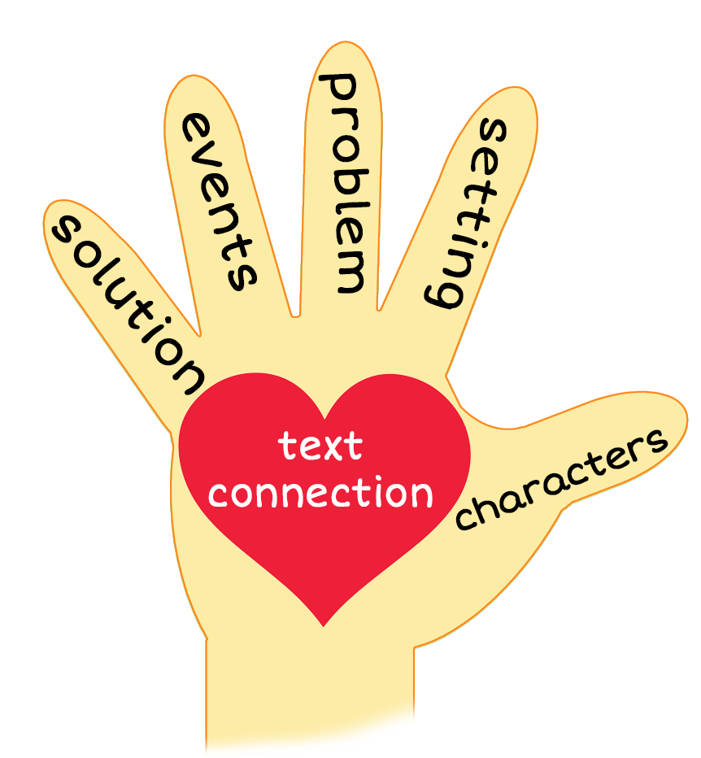

Who Will Say Yes?
Notes:
Notes to Teacher:
Teacher: “This week, you read the story, Who Will Say Yes? Let’s use our strategy to retell the story together.”
Click to bring the image to the slide.
“Let’s work on our story retell together.”
Characters: “Who were the characters in the story?” (Characters: Family of four.)
Setting: “What was the setting of the story? Where did it take place?” (We do not really know the setting of the story. We did see the outdoors when we looked at the huge tube and the dune.)
Problem – “What was the problem in the story?” (There were not any problems in the story. The characters were presented with questions.)
Events: “What happened in the story?” (Someone asked who would like a cube, a cute mule, a dune and a huge tube.)
The boy wanted to play with the cube.
The mom wanted to ride the cute mule.
The dad wanted to ride the dune.
The girl wanted the huge tube.
Ending: “What happened at the end of the story?” (Everyone said yes to something!)
Connection: Possible questions to ask to help student to connect to this story:
Did you ever play with a cube?
Did you ever see a mule?
Did you ever see a dune?
Did you ever ride in a huge tube?
What was your favorite part of the story? Why?
Main Idea: What is this story about? (This story was about the family saying yes to playing with a cube and riding in a huge tube, on a dune and on a cute mule.)
Applaud student’s efforts in completing this story retell.
Click to the next slide.

Slide 10
Q & A
Any Questions?
Notes:
Ask – “Do you have any questions about anything that you learned in this lesson?”

