Slide 1
Phonics of the Week
Long i; _i_e
Notes:
Tell the student that we are going to review the long i with the silent e, review our sight words and complete a story retell for Under the White Bed.
Click to go to the next slide.

Slide 2
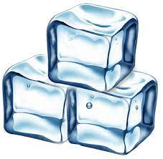
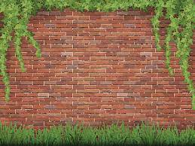
Check It Out!
Ii
ice
ivy
Notes:
Notes to Teacher:
Click to show the letters Ii on the screen.
Teacher: “Point to the letters on the screen. “What sound does the long i make? (Student will answer /i/ as in ice.)
If student is struggling, teacher will model making the long /i/ sound and have the student repeat: /i/ like in ice /i/, /i/, /i/.
Click to show a picture of ice. When it appears on the screen, ask, “What is this?” When student responds “ice,” applaud his/her answer. If student does not respond correctly, teacher will tell student that it is a picture of ice. Click to show the word “ice.”
Click to show the next image –ivy. When it appears on the screen, ask, “What do you see hanging on the brick wall?” If student responds “ivy,” applaud his/her answer. If student does not respond correctly, teacher will tell student that it is a picture of ivy. Click to show the word “ivy.”
Applaud student’s efforts.
Click to go to the next slide.

Slide 3

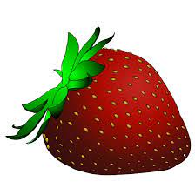
Let’s Practice!
strawberry
Ii
ice cream
Notes:
Notes to Teacher:
Click to bring up the letters (Ii) to the slide.
Teacher: “What sound does the long i make?” (Long i sound as in ice.) If student makes long i sound, applaud his/her answer.
If student is still unsure, remind him/her by making long /i/ sound like /i/ as in ice. (Student should repeat teacher.)
Teacher: “Remember, today we are talking about words that begin with the long i sound.”
Click to show a picture of the strawberry. Ask: “What do you see?” (Strawberry.) Applaud correct answer or assist in telling the correct name for the picture. Click to show the word strawberry.
Click to show the ice cream. Ask: “What is in the cone?” (Ice cream.) Applaud correct answer or assist in telling the correct name for the picture. Click to show the words: ice cream.
After identifying the pictures (strawberry and ice cream,) ask:
Teacher: “Which picture begins with the long /i/ sound?” (Ice cream.)
If student is struggling to name the picture that begins with the long i sound, teacher will assist by saying each picture name and asking if it begins with the long i sound.
- “Strawberry– Does it begin with the long i sound?” (No.)
- “Ice cream- Does it begin with the long i sound?” (Yes.)
Teacher: “Which picture begins with the long i sound?” (Ice cream.)
Click to remove the strawberry from the screen.
Teacher will applaud efforts of student.
Click to go to the next slide.

Slide 4

Meet Long i with Silent e
kite
Notes:
Notes to Teacher:
Click to show the word kite.
Assist student in sounding out the word:
k=/k/
i= long/i/
t=/t/
e=silent
Click to show the picture of the kite and applaud student’s efforts.

Slide 5
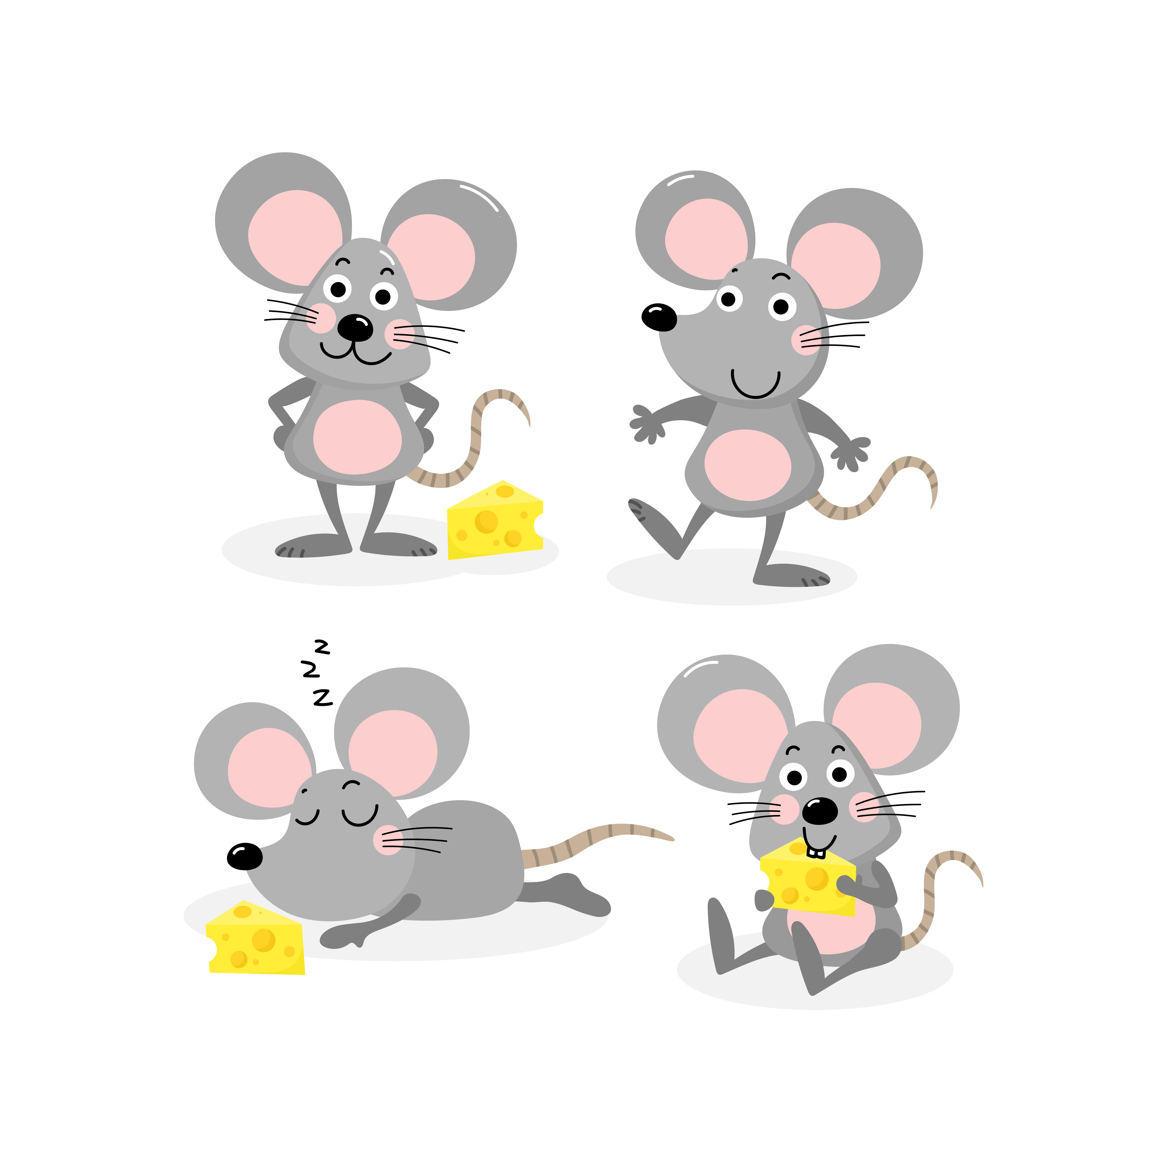
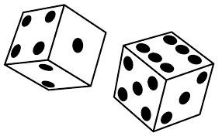
Sound It Out!
dice
Notes:
Notes to Teacher:
Teacher: “Let’s look at another word and two pictures.”
Click to show the pictures of the dice and mice.
Ask students to identify the pictures (Dice and mice.) If student is struggling, assist him/her in naming the pictures.
Click to show the word dice.
Ask: “What word do you see?” (Dice.)
If student is struggling, assist him/her in sounding out the word: /d/ + long /i/ + /s/ (silent e.)
Ask: “What picture matches the word?” (The first picture of the dice.)
Click to circle the dice, as well as remove the picture of the mice.
Applaud student’s effort.
Click to move to the next slide.

Slide 6


Word Work
nine
Notes:
Notes to Teacher:
Click to show the image of the number 5.
Ask: “What number is this?” (Five.)
Click to show the image of the number 9.
Ask: “What number is this?” (Nine.)
Click to show the word nine.
Assist student in sounding this word out: /n/ + long/i/ + /n/
{/e/ + silent e.}
Ask: “What word do you see?” (Nine.)
Click to circle the number 9 as the picture of the number 5 disappears.
Applaud student’s effort.
Click to move to the next slide.

Slide 7
Sight Words
white
under
was
Notes:
Notes to Teacher:
Teacher says: “Let’s look at our sight words from this week.” (There are 3 words on this slide.)
Click to show the word “white.”– When it appears on the screen, ask: “What word do you see?”
When student responds “white,” applaud his/her answer.
If student does not respond correctly, teacher will tell the student that the word is “white.” Have student say the word “white.” (Student repeats.)
Click to show the next word, “under.” - When it appears on the screen, ask: “What word do you see?”
When student responds “under,” applaud his/her answer.
If student does not respond correctly, teacher will tell the student that the word is “under.” Have student say the word “under” (Student repeats.)
Click to show the final word, “was.” – When it appears on the screen, ask: “What word do you see?”
When student responds “was,” applaud his/her answer.
If student does not respond correctly, teacher will tell the student that the word is “was.” Have student say the word “was.” (Student repeats.)
Applaud student’s effort.
Click to go to the next slide.

Slide 8
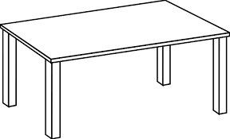
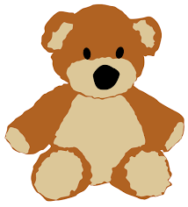
Sight Word Practice
table
bear
The bear is under the white table.
Notes:
Notes to Teacher:
Before reading this sentence, talk about possible unknown words by labeling the picture together.
Click to bring up the image of the table.
Ask:” What is this?” (Table.)
Click to label the table.
Click to bring up the image of the bear.
Ask: “What is this?” (Bear.)
Click to label the bear.
Ask: “Where is the bear?” (The bear is under the table.)
If student is ready, allow him/her to read each sentence to you. If student is not ready, assist him/her in reading.
Remind student to look at the picture when reading the sentence.
-Click to make the sentence appear on the slide with image: The bear is under the white table.
Applaud all efforts.
Click to move to next slide.

Slide 9
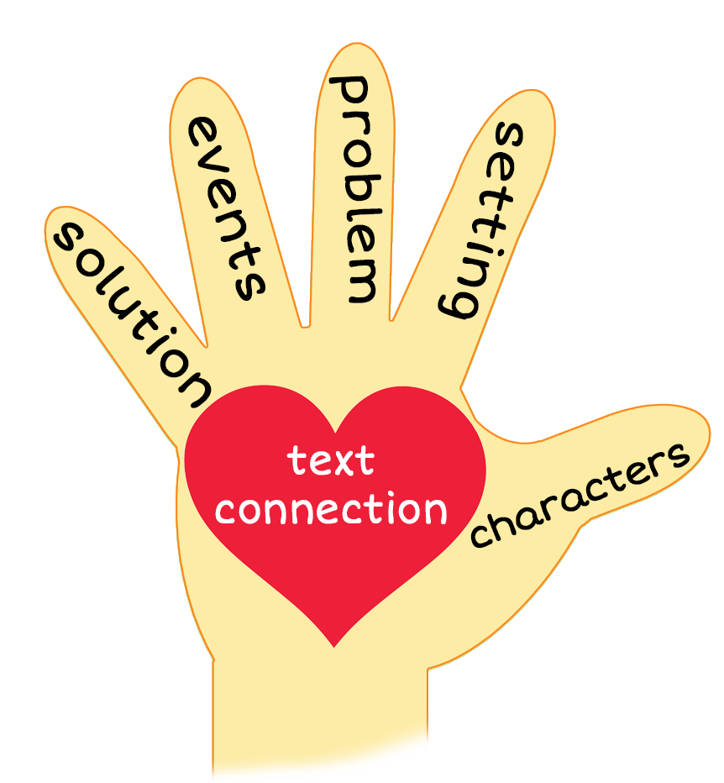
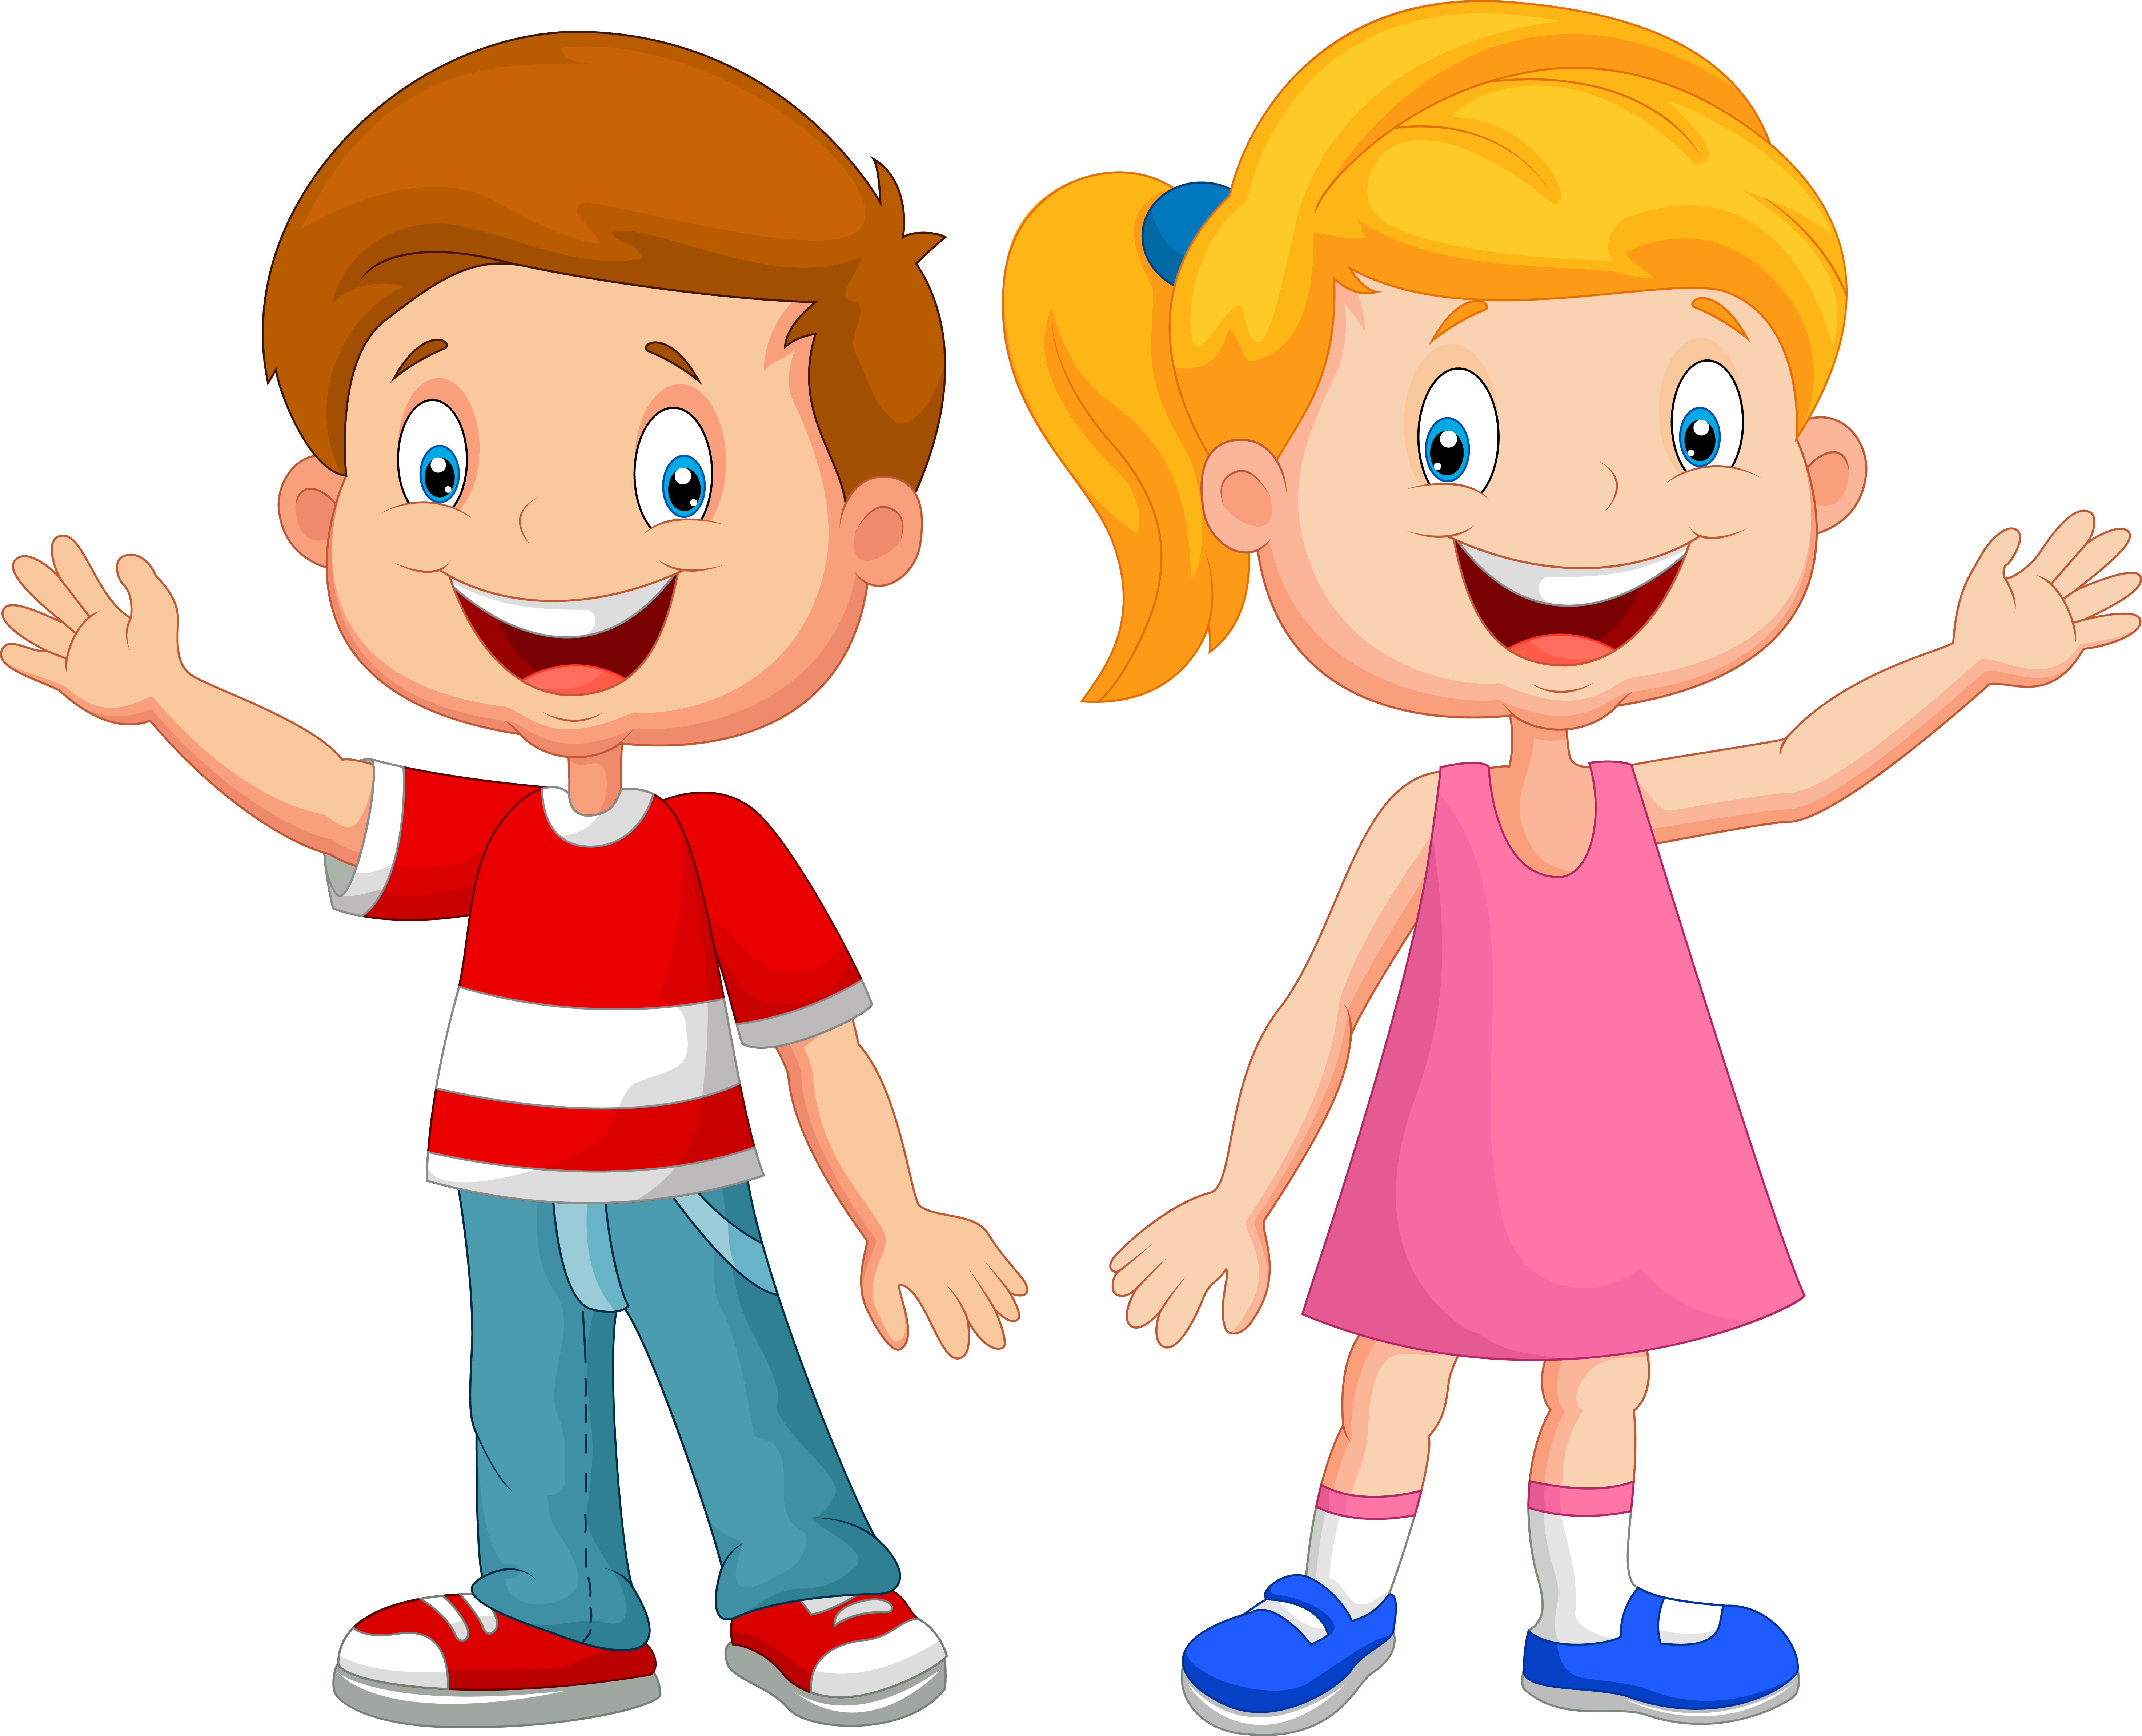
Under the White Bed
Notes:
Notes to Teacher:
Teacher: “This week, you read the story, Under the White Bed. Let’s use our strategy to retell the story together.”
Click to bring the image to the slide.
“Let’s work on our story retell together.”
Characters: “Who were the characters in the story?” (Characters: Girl and Boy.)
Setting: “What was the setting of the story? Where did it take place?” (This story took place in the house. The setting changed at the end of the story. The characters were outside at the end of the story.)
Problem – “What was the problem in the story?” (The children were trying to figure out what was under the white bed.)
Events: “What happened in the story?” (The boy was asking questions about things that might be under the white bed.)
The boy wondered if there were dice, a hive or mice under the white bed.
The girl said there were not dice, a hive or mice under the white bed.
The boy asked the girl if she saw a bike.
The girl told him she did see a bike under the white bed.
The boy asked the girl if she liked the bike.
She told the boy that it was a nice bike.
Ending: “What happened at the end of the story?” (The children went outside. The girl got ready to ride the bike, and the boy got ready to go on a hike.)
Connection: Possible questions to ask to help student to connect to this story:
Did you ever wonder what was under your bed?
What was the funniest thing you found under your bed?
How do you think the children felt at the end of this story?
What was your favorite part of the story? Why?
Main Idea: What is this story about? (The boy was wondering what was under the white bed.)
Applaud student’s efforts in completing this story retell.
Click to the next slide.

Slide 10
Q & A
Any Questions?
Notes:
Ask – “Do you have any questions about anything that you learned in this lesson?”

