Slide 1
Phonics of the Week
Long e;Double e
Notes:
Tell the student that we are going to review the long a with the silent e, look at words with double e, review our sight words and complete a story retell for The Sheep Ran.
Click to go to the next slide.

Slide 2
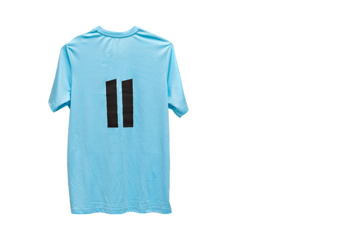

Check It Out!
Ee
eagle
eleven
Notes:
Notes to Teacher:
Click to show the letters Ee on the screen.
Teacher: “Point to the letters on the screen. “What sound does the long e make? (Student will answer /e/, as in eagle.)
If student is struggling, teacher will model making the long/e/ sound and have the student repeat: /e/, like in eagle: /e/, /e/, /e/.
Click to show a picture of an eagle. When it appears on the screen, ask, “What is this?” When student responds “eagle,” applaud his/her answer. If student does not respond correctly, teacher will tell student that it is a picture of an eagle. Click to show the word “eagle.”
Click to show the next image –eleven. When it appears on the screen, ask, “What number do you see on this shirt?” If student responds “eleven,” applaud his/her answer. If student does not respond correctly, teacher will tell student that it is a picture of a number eleven. Click to show the word “eleven.”
Applaud student’s efforts.
Click to go to the next slide.

Slide 3
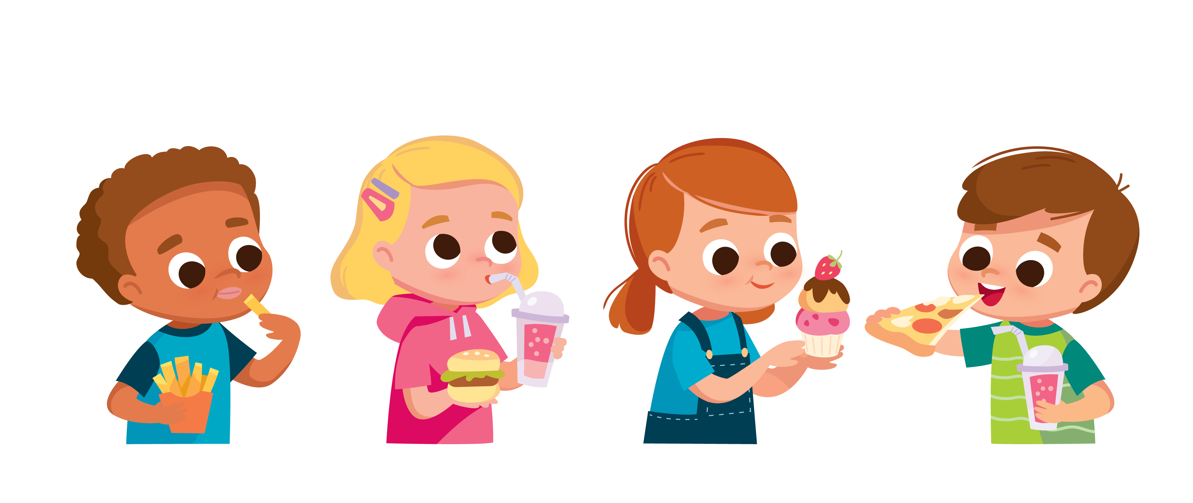
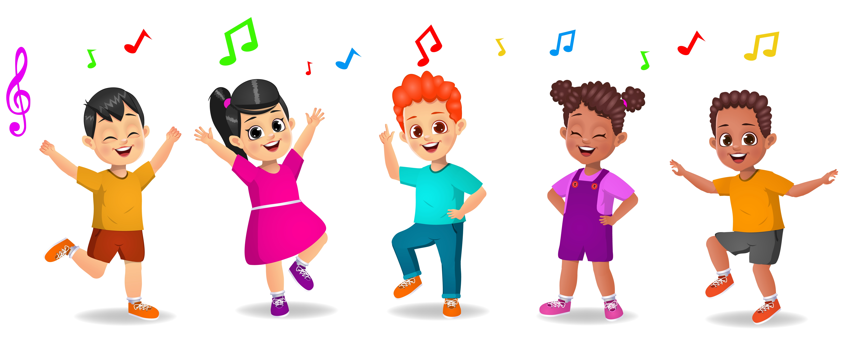
Let’s Practice!
eat
Ee
sing
dance
Notes:
Notes to Teacher:
Click to bring up the letters (Ee) to the slide.
Teacher: “What letters do you see?” (Ee.) If student says Ee, applaud his/her answer.
If student is still unsure, remind him/her by saying “Ee.” (Student should repeat teacher.)
Teacher: “Remember, today we are talking about words with the long e sound.”
Click to show a picture of the children eating. Ask: “What are the children doing? (The children are eating.) Applaud correct answer or assist in telling the correct name for the picture. Click to show the word eat.
Click to show the children singing (or dancing.). Ask: “What are the children doing?” (They are dancing or singing. Either or both answers are correct.) Applaud correct answer or assist in telling the correct name for the picture. Click to show the words sing and dance.
After identifying the pictures (eat and sing/dance,) ask:
Teacher: “Which picture begins with the long /e/ sound?” (Eat.)
If student is struggling to name the picture that begins with the long e sound, teacher will assist by saying each picture name and asking if it begins with the long e sound.
- “Eat – Does it begin with the long e sound?” (Yes.)
- “Sing - Does it begin with the long e sound?” (No.)
- “Dance - Does it begin with the long e sound?” (No.)
Teacher: “Which picture begins with the long e sound?” (Eat.)
Click to remove the children singing/dancing from the screen.
Teacher will applaud efforts of student.
Click to go to the next slide.

Slide 4

Double e Work
ee
jeep
j
ee
jeep
p
Notes:
Notes to Teacher:
Teacher: “Let’s look at two letters.”
Click to bring ‘ee’ to the slide.
Ask: “When you see ‘ee’ together, what sound do you make?” (Long e sound.)
If student is struggling, remind him that when we see ‘ee’ together, we make the long e sound, like e as in eagle.
Click twice to show the word ‘jeep’ and picture.
Model sounding out this word:
Click to bring up j. Say /j/.
Click to bring up ee. Make long /e/ sound.
Click to bring up p. Say /p/.
Click to bring up the word ‘jeep.’
Teacher: “Let’s put those sounds together: /j/ + /ee/ + /p/ = jeep.”
Click to bring up an arrow pointing to the word jeep.
Applaud student’s effort.
Click to move to the next slide.

Slide 5

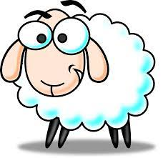
Sound It Out!
f
ee
t
feet
sh
ee
p
sheep
Notes:
Notes to Teacher:
Teacher: “Let’s try another word with the double e.”
Click to show the word ‘feet.’
Model sounding out this word:
Click to bring up f. Say /f/.
Click to bring up ee. Make long /e/ sound.
Click to bring up t. Say /t/.
Teacher: “Let’s put those sounds together: /f/ + /ee/ + /t/ = feet.
Click to bring up the word ‘feet,’ with an image of feet.
Teacher: “Let’s try one more.”
Click to show the word ‘sheep.’
Model sounding out this word:
Click to bring up sh. Say /sh/.
Click to bring up ee. Make long /e/ sound.
Click to bring up p. Say /p/.
Teacher: “Let’s put those sounds together: /sh/ + /ee/ + /p/ = sheep.
Click to bring up the word ‘sheep,” with an image of a sheep.
Applaud student’s effort.
Click to move to the next slide.

Slide 6

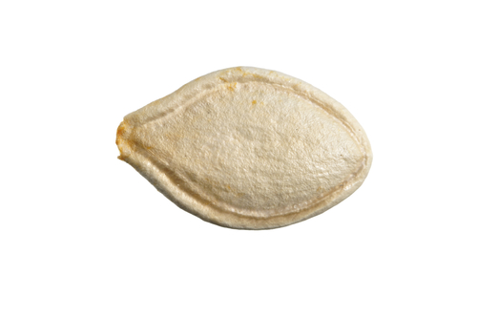
Word Work
th
r
ee
s
ee
d
three
seed
Notes:
Notes to Teacher:
Click to show the picture of the number 3.
Ask: “What number is this?” (Three.)
Click to show the picture of the seed.
Ask: “What is this?” (Seed.)
Teacher: “We are going to practice making sounds for the letters we see and then read the word.”
Click to bring up ‘th.’
Ask: “What sound does ‘th’ make? (/th/.)
Click to bring up ‘r.’
Ask: “What sound does it make?” (/r/.)
Click to bring up the arrow.
Teacher: “Let’s put those sounds together: /th/ + /r/ “
Click to bring up the ‘thr.’
Ask: “What sound do these letters make?” (/thr/.)
Click to bring up ‘ee.’
Ask: What sound does ‘ee’ make?” (long /e/ sound.)
Teacher: “Let’s sound these parts out and then put them together: /thr/ + /ee/ = three.”
Click to bring up the word three.
Ask: “What word do you see?” (Three.)
Click to bring up an arrow that matches the word three to the number 3.
Applaud efforts.
Teacher: “Let’s read one more word.”
Click to bring up ‘s’ and remove the word three and the number 3.
Ask: “What sound does ‘s’ make? (/s/.)
Click to bring up ‘ee.’
Ask: “What sound does ‘ee’ make?” (long /e/ sound.)
Click to bring up ‘d.’
Ask: “What sound does ‘d’ make?” (/d/)
Teacher: “Let’s sound these parts out and then put them together: /s/ + /ee/ + /d/ = seed.”
Click to bring up the word seed.
Ask: “What word do you see?” (Seed.)
Click to bring up an arrow that matches the word seed to the picture of the seed.
Applaud efforts.
Click to move to the next slide.

Slide 7
Sight Words
ran
this
too
Notes:
Notes to Teacher:
Teacher says: “Let’s look at our sight words from this week.” (There are 3 words on this slide.)
Click to show the word “ran.”– When it appears on the screen, ask: “What word do you see?”
When student responds “ran,” applaud his/her answer.
If student does not respond correctly, teacher will tell the student that the word is “ran.” Have student say the word “ran.” (Student repeats.)
Click to show the next word, “this.” - When it appears on the screen, ask: “What word do you see?”
When student responds “this,” applaud his/her answer.
If student does not respond correctly, teacher will tell the student that the word is “this.” Have student say the word “this” (Student repeats.)
Click to show the final word, “too.” – When it appears on the screen, ask: “What word do you see?”
When student responds “too,” applaud his/her answer.
If student does not respond correctly, teacher will tell the student that the word is “too.” Have student say the word “too.” (Student repeats.)
Applaud student’s effort.
Click to go to the next slide.

Slide 8

Sight Word Practice
This dog ran!
Notes:
Notes to Teacher:
If student is ready, allow him/her to read each sentence to you. If student is not ready, assist him/her in reading. Remind student to use the picture to help/her read the words.
-Click to make the sentence appear on the slide with image: This dog ran!
Applaud all efforts.
Click to move to next slide.

Slide 9

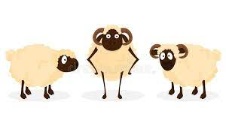
The Sheep Ran
Notes:
Notes to Teacher:
Teacher: “This week, you read the story, The Sheep Ran. Let’s use our strategy to retell the story together.”
Click to bring the image to the slide.
“Let’s work on our story retell together.”
Characters: “Who were the characters in the story?” (Characters: There was a boy and sheep.)
Setting: “What was the setting of the story? Where did it take place?” (The story took place outside.)
Problem – “What was the problem in the story?” (The sheep need to eat.)
Events: “What happened in the story?” (The boy feeds the sheep.)
We meet a little sheep that needs to eat.
A boy feeds the sheep.
As the sheep is eating, other sheep see the boy feeding him.
All of the sheep run to the boy to eat.
Ending: “What happened at the end of the story?” (The boy feeds all of the sheep.)
Connection: Possible questions to ask to help student to connect to this story:
Did you ever feed an animal outside? If so, did any other animals see you feeding it and come over to eat too?
What was your favorite part of the story? Why?
Main Idea: What is this story about? (The sheep ran to the boy to eat.)
Applaud student’s efforts in completing this story retell.
Click to the next slide.

Slide 10
Q & A
Any Questions?
Notes:
Ask – “Do you have any questions about anything that you learned in this lesson?”

