Slide 1
Phonics of the Week
Long a; _a_e
Notes:
Tell the student that we are going to review the long a with the silent e, review our sight words and complete a story retell for Bake a Cake.
Click to go to the next slide.

Slide 2


Check It Out!
Aa
acorn
apron
Notes:
Notes to Teacher:
Click to bring up the letters (Aa) on the screen.
Teacher: “Point to the letters on the screen. “What sound does the long a make? (Student will answer /a/ as in acorn.)
If student is struggling, teacher will model making the long /a/ sound and have the student repeat: /a/ like in acorn /a/, /a/, /a/.
Click to show a picture of an acorn. When it appears on the screen, ask, “What is this?” When student responds “acorn,” applaud his/her answer. If student does not respond correctly, teacher will tell student that it is a picture of an acorn. Click to show the word “acorn.”
Click to show the next image –apron. When it appears on the screen, ask, “What do you see?” If student responds “apron,” applaud his/her answer. If student does not respond correctly, teacher will tell student that it is a picture of an apron. Click to show the word “apron.”
Applaud student’s efforts.
Click to go to the next slide.

Slide 3

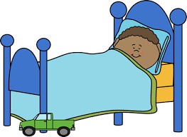
Let’s Practice!
Aa
ate
sleep
Notes:
Notes to Teacher:
Click to bring up the letters (Aa) to the slide.
Teacher: “What letters do you see?” (Aa.) If student says Aa, applaud his/her answer.
If student is still unsure, remind him/her by saying “Aa.” (Student should repeat teacher.)
Teacher: “Remember, today we are talking about words with the long a sound.”
Click to show a picture of the apple. Ask: “What happened to this apple?” (Someone ate the apple.) Applaud correct answer or assist in telling the correct name for the picture. Click to show the word ate.
Click to show the child sleeping. Ask: “What is this boy doing?” (He is sleeping.) Applaud correct answer or assist in telling the correct name for the picture. Click to show the word sleep.
After identifying the pictures (ate and sleep,) ask:
Teacher: “Which picture begins with the long /a/ sound?” (Ate.)
If student is struggling to name the picture that begins with the long a sound, teacher will assist by saying each picture name and asking if it begins with the long a sound.
- “Ate– Does it begin with the long a sound?” (Yes.)
- “Sleep- Does it begin with the long a sound?” (No.)
Teacher: “Which picture begins with the long a sound?” (Ate.)
Click to remove the sleeping child from the screen.
Teacher will applaud efforts of student.
Click to go to the next slide.

Slide 4


Meet Long a with Silent e
can
cane
Notes:
Notes to Teacher:
Teacher: “Let’s look at some pictures.”
Click to show the word ‘can’ with the picture of a can.
Ask: “What does this word say?” (Can.)
Ask: “What happens when I add the silent e to the end of the word can?”
Click to show an arrow to the word ‘cane.’
Allow student to think about it and tell you that the silent e makes the letter a say its name. Can turns into cane. The silent e at the end of the word makes the letter a say its name.
Click to show the picture of a cane.
Applaud student’s effort.
Click to move to the next slide.

Slide 5



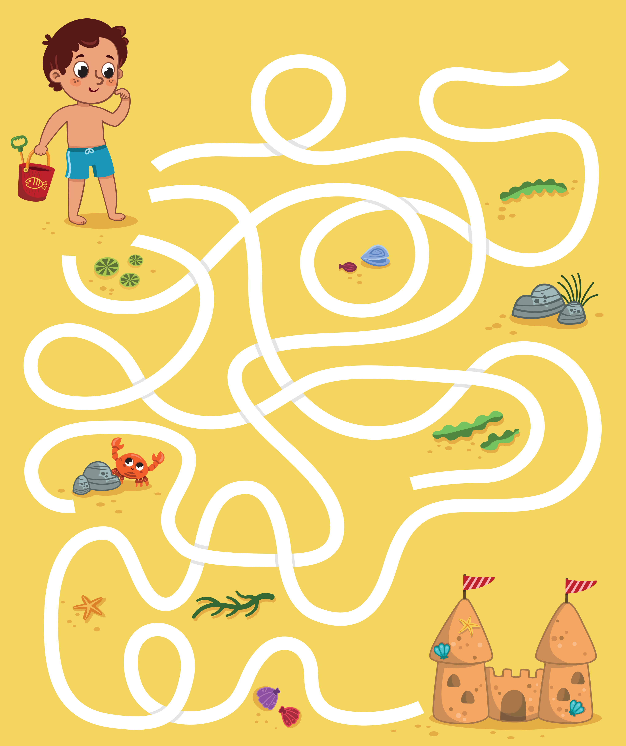
Sound It Out!
maze
cake
vase
Notes:
Notes to Teacher:
Remind student that the magic e at the end of the word, makes the letter a say its name.
Click to show a book and the word cake.
Ask: “What does this word say?” (Cake.) Applaud correct answer or assist student in sounding out the word ‘cake.”
Click to show picture of the cake.
Click to show the word vase.
Ask: “What does this word say?” (Vase.) Applaud correct answer or assist student in sounding out the word ‘vase.”
Click to show picture of the vase (with an arrow pointing to the vase.)
Click to show the word maze.
Ask: “What does this word say?” (Maze.) Applaud correct answer or assist student in sounding out the word ‘maze.”
Click to show picture of a maze.
Applaud student’s effort.
Click to move to the next slide.

Slide 6



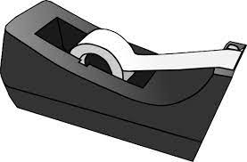
Word Work
lake
tape
rake
Notes:
Notes to Teacher:
Click to show the image of the children reading.
Click again to show an arrow pointing to a lake.
Ask: “What is this?” (Lake.)
Click to show the tape.
Ask: “What is this?” (Tape.)
Click to show the rake.
Ask: “What is this? (Rake.)
Click to show the word rake.
Ask: “What is this word?” (Rake.)
Click to match the word rake to picture of the rake.
Click to show the word lake.
Ask: “What is this word?” (Lake.)
Click to match the word lake to picture of the lake.
Click to show the word tape.
Ask: “What is this word?” (Tape.)
Click to match the word tape to picture of the tape.
Applaud student’s effort.
Click to move to the next slide.

Slide 7
Sight Words
soon
out
please
Notes:
Notes to Teacher:
Teacher says: “Let’s look at our sight words from this week.” (There are 3 words on this slide.)
Click to show the word “soon.”– When it appears on the screen, ask: “What word do you see?”
When student responds “soon,” applaud his/her answer.
If student does not respond correctly, teacher will tell the student that the word is “soon.” Have student say the word “soon.” (Student repeats.)
Click to show the next word, “out.” - When it appears on the screen, ask: “What word do you see?”
When student responds “out,” applaud his/her answer.
If student does not respond correctly, teacher will tell the student that the word is “out.” Have student say the word “out” (Student repeats.)
Click to show the final word, “please.” – When it appears on the screen, ask: “What word do you see?”
When student responds “please,” applaud his/her answer.
If student does not respond correctly, teacher will tell the student that the word is “please.” Have student say the word “please.” (Student repeats.)
Applaud student’s effort.
Click to go to the next slide.

Slide 8

Sight Word Practice
Please go down.
sit
Notes:
Notes to Teacher:
If student is ready, allow him/her to read each sentence to you. If student is not ready, assist him/her in reading.
Click to make the sentence appear on the slide with image: Please go sit down.
Applaud all efforts.
Click to move to next slide.

Slide 9

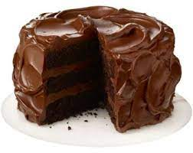
Bake a Cake
Notes:
Notes to Teacher:
Teacher: “This week, you read the story, Bake a Cake. Let’s use our strategy to retell the story together.”
Click to bring the image to the slide.
“Let’s work on our story retell together.”
Characters: “Who were the characters in the story?” (Characters: There were a few different children in this story.)
Setting: “What was the setting of the story? Where did it take place?” (The story took place in a kitchen.)
Problem – “What was the problem in the story?” (The children had to wait to bake a cake and then had to wait to take out the cake.)
Events: “What happened in the story?” (The characters were asking questions about baking a cake.)
The children asked if they could please bake a cake.
They were told that they could bake it soon.
First, they had to take out the pan.
Then, they had to take out the ingredients.
They had to make the cake batter.
After they placed it in the oven, they had to wait for it to bake.
Finally, they were able to take the cake out of the oven.
Ending: “What happened at the end of the story?” (The children were finally able to have a slice of cake at the end of the story.)
Connection: Possible questions to ask to help student to connect to this story:
Did you ever have to wait for something that you really wanted?
If so, how did you feel while you were waiting for it?
How do you think the children felt during this story?
What was your favorite part of the story? Why?
Main Idea: What is this story about? (The children wanted to bake a cake.)
Applaud student’s efforts in completing this story retell.
Click to the next slide.

Slide 10
Q & A
Any Questions?
Notes:
Ask – “Do you have any questions about anything that you learned in this lesson?”

