Slide 1
Phonics of the Week
Wh
Notes:
Tell the student that we are going to review the phonogram wh, talk about question words, review our sight words and complete a story retell for Whale Ride.
Click to go to the next slide.

Slide 2


wh
What Do You See?
whale
wheel
Notes:
Notes to Teacher:
Click to bring the letters ‘wh’ to the screen.
Teacher: “What letters do you see on the screen? (Wh.) “What sound does ‘wh’ make? (Student will answer /wh/.)
If student is struggling with this phonogram:
(Point to the phonogram -wh.) “/wh/ like in whale.” (Student repeats.)
If student is struggling, teacher will model making the /wh/ sound and have the student repeat: /wh/ like in whale /wh/, /wh/, /wh/.
Click to show a picture of a whale. When it appears on the screen, ask, “What is this?” When student responds “whale,” applaud his/her answer. If student does not respond correctly, teacher will tell student that it is a picture of a whale. Click to show the word “whale.”
Click to show the next image –wheel. When it appears on the screen, ask, “What do you see?” If student responds “wheel,” applaud his/her answer. If student does not respond correctly, teacher will tell student that it is a picture of a wheel. Click to show the word “wheel.”
Applaud student’s efforts.
Click to go to the next slide.

Slide 3


Let’s Practice!
wh
whistle
car
Notes:
Notes to Teacher:
Click to show the letters ‘wh’ on the slide.
Teacher: “What letters do you see?” (Wh.) If student says wh, applaud his/her answer.
If student is still unsure, remind him/her by saying “wh.” (Student should repeat teacher.)
Click to show a picture of a whistle. Ask: “What is this?” (Whistle.) Applaud correct answer or assist in telling the correct name for the picture. Click to show the word whistle.
Click to show a car. Ask: “What is this?” (Car.) Applaud correct answer or assist in telling the correct name for the picture. Click to show the word car.
After identifying the pictures (whistle and car,) ask:
Teacher: “Which picture begins with the /wh/ sound?” (Whistle.)
If student is struggling to name the picture that begins with wh, teacher will assist by saying each picture name and asking if it begins with /wh/?
- “Whistle– Does it begin with /wh/?” (Yes.)
- “Car- Does it begin with /wh/?” (No.)
Click to remove the car from the screen.
Teacher will applaud efforts of student.
Click to go to the next slide.

Slide 4
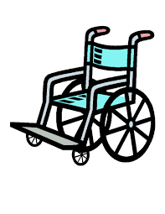

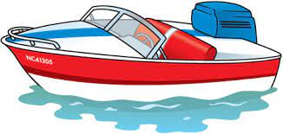
Show What You Know!
wheelchair
wheat
boat
Notes:
Notes to Teacher:
Teacher: “Let’s look at some more pictures.
Click to show wheelchair.
Ask: “What is this?” (Wheelchair.)
“Does wheelchair begin with /wh/?” (Yes.)
Click to show wheat.
Ask: “What is this?” (Wheat.)
“Does wheat begin with /wh/?” (Yes.)
Click to show the boat.
Ask: “What is this?” (Boat.)
“Does boat begin with /wh/?” (No.)
Click to take the boat off of the slide.
Applaud student’s effort.
Click to move to the next slide.

Slide 5
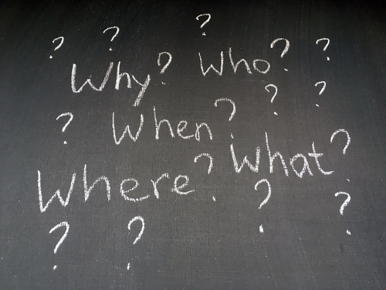
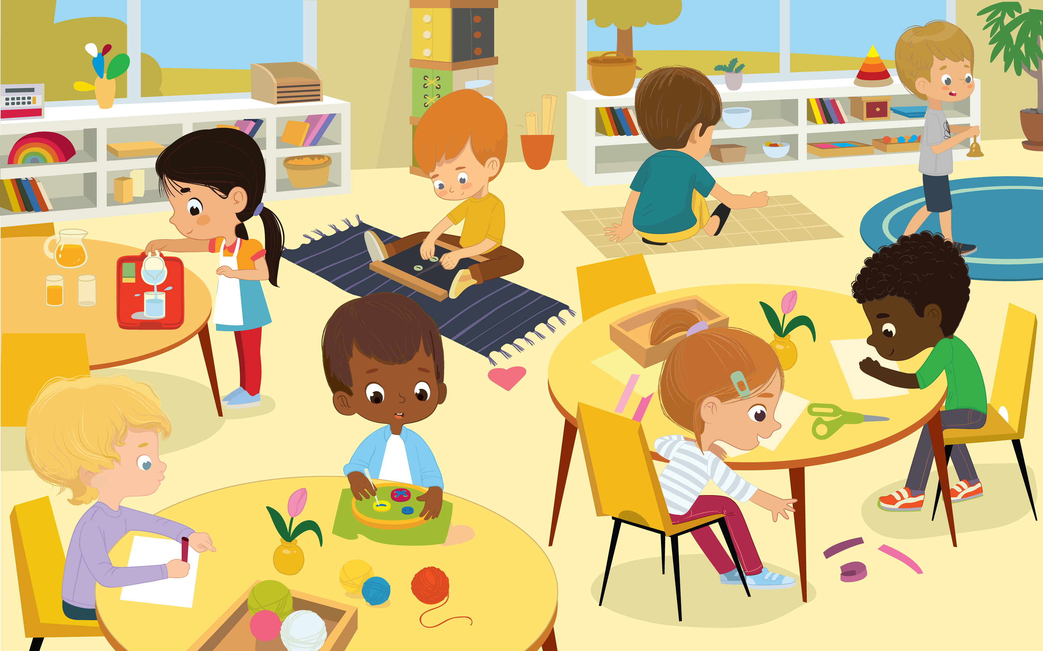
Question Words
Notes:
Notes to Teacher:
Click to show the image of the question words.
Teacher: “Many question words begin with wh.”
Click to bring picture of a classroom on the slide.
Teacher: “Let’s look at this picture and answer the question words by looking at this classroom. “
Click to circle the question word – who?
Ask: “Who do you see?” (Children.)
Click to circle the question word – what?
Ask: “What are they doing?” (Answers will vary.)
Click to circle the question word – where?
Ask: “Where are they at?” (They may be at school in a classroom. They may be at a daycare.)
Click to circle the question word – when?
Ask: “When do you think they arrived at school?” (Answers will vary. Most children may say they arrived in the morning.)
Click to circle the question word – why?
Ask: “Why are they there?” (Answers will vary. They may be at school to learn. They may be at daycare while their families are at work.”
Applaud student’s effort.
Teacher: “You did a great job answering question words by looking at a picture!”
Click to move to the next slide.

Slide 6
Sight Words
must
new
no
now
on
Please go to the next slide.
Notes:
Notes to Teacher:
Teacher says: “I am going to bring sight words onto the slide. Can you read these sight words to me?” (There are 5 words on this slide.)
Click to show the word “must.””– When it appears on the screen, ask: “What word do you see?”
When student responds “must,” applaud his/her answer.
If student does not respond correctly, teacher will tell the student that the word is “must.” Have student say the word “must.” (Student repeats.)
Click to show the next word, “new.”– When it appears on the screen, ask: “What word do you see?”
When student responds “new,” applaud his/her answer.
If student does not respond correctly, teacher will tell the student that the word is “new.” Have student say the word “new.” (Student repeats.)
Click to show the next word, “no.” – When it appears on the screen, ask: “What word do you see?”
When student responds “no,” applaud his/her answer.
If student does not respond correctly, teacher will tell the student that the word is “no.” Have student say the word “no.” (Student repeats.)
Click to show the next word, “now.” – When it appears on the screen, ask: “What word do you see?”
When student responds “now,” applaud his/her answer.
If student does not respond correctly, teacher will tell the student that the word is “now.” Have student say the word “now.” (Student repeats.)
Click to show the final word, “on.” – When it appears on the screen, ask: “What word do you see?”
When student responds “on,” applaud his/her answer.
If student does not respond correctly, teacher will tell the student that the word is “on.” Have student say the word “on.” (Student repeats.)
“Let’s look at another group of words.”
Click to show the arrow.
Click to go to the next slide.

Slide 7
Sight Words
our
that
there
pretty
she
Please go to the next slide.
Notes:
Notes to Teacher:
Click to show the word “our.””– When it appears on the screen, ask: “What word do you see?”
When student responds “our,” applaud his/her answer.
If student does not respond correctly, teacher will tell the student that the word is “our.” Have student say the word “our.” (Student repeats.)
Click to show the next word, “that.”– When it appears on the screen, ask: “What word do you see?”
When student responds “that,” applaud his/her answer.
If student does not respond correctly, teacher will tell the student that the word is “that.” Have student say the word “that.” (Student repeats.)
Click to show the next word, “there.” – When it appears on the screen, ask: “What word do you see?”
When student responds “there,” applaud his/her answer.
If student does not respond correctly, teacher will tell the student that the word is “there.” Have student say the word “there.” (Student repeats.)
Click to show the next word, “pretty.” – When it appears on the screen, ask: “What word do you see?”
When student responds “pretty,” applaud his/her answer.
If student does not respond correctly, teacher will tell the student that the word is “pretty.” Have student say the word “pretty.” (Student repeats.)
Click to show the final word, “she.” – When it appears on the screen, ask: “What word do you see?”
When student responds “she,” applaud his/her answer.
If student does not respond correctly, teacher will tell the student that the word is “she.” Have student say the word “she.” (Student repeats.)
“Now, let’s look at our last group of words.”
Click to show the arrow.
Click to go to the next slide.

Slide 8

Sight Words
they
saw
ride
say
so
Notes:
Notes to Teacher:
Click to show the word, “they.””– When it appears on the screen, ask: “What word do you see?”
When student responds “they,” applaud his/her answer.
If student does not respond correctly, teacher will tell the student that the word is “they.” Have student say the word “they.” (Student repeats.)
Click to show the next word, “saw.”– When it appears on the screen, ask: “What word do you see?”
When student responds “saw,” applaud his/her answer.
If student does not respond correctly, teacher will tell the student that the word is “saw.” Have student say the word “saw.” (Student repeats.)
Click to show the next word, “ride.” – When it appears on the screen, ask: “What word do you see?”
When student responds “ride,” applaud his/her answer.
If student does not respond correctly, teacher will tell the student that the word is “ride.” Have student say the word “ride.” (Student repeats.)
Click to show the next word, “say.” – When it appears on the screen, ask: “What word do you see?”
When student responds “say,” applaud his/her answer.
If student does not respond correctly, teacher will tell the student that the word is “say.” Have student say the word “say.” (Student repeats.)
Click to show the final word, “so.” – When it appears on the screen, ask: “What word do you see?”
When student responds “so,” applaud his/her answer.
If student does not respond correctly, teacher will tell the student that the word is “so.” Have student say the word “so.” (Student repeats.)
Click to show the smiley face and applaud student’s effort.
Click to go to the next slide.

Slide 9
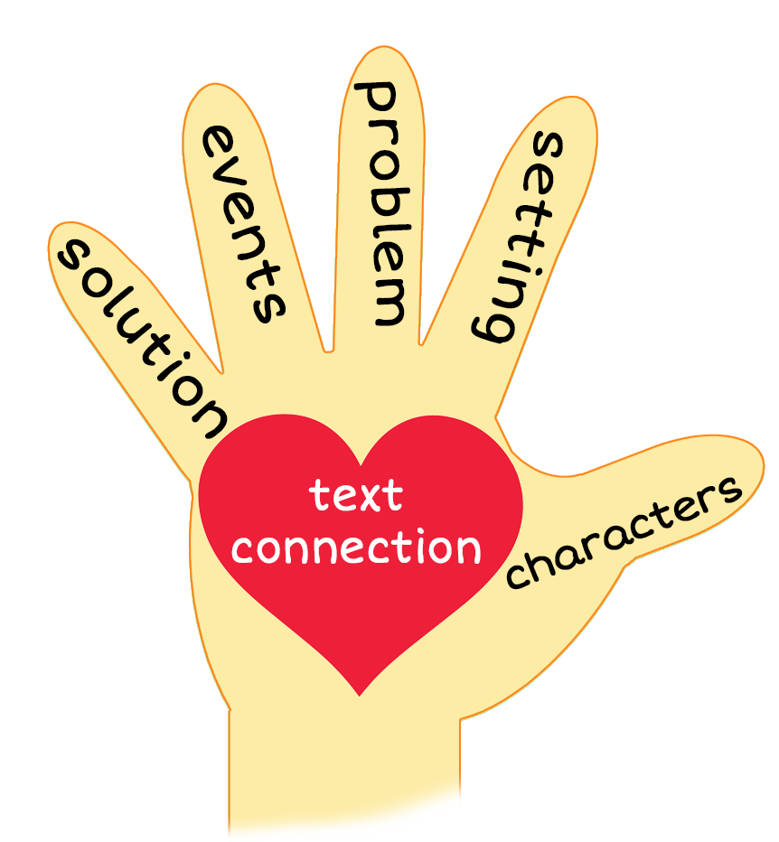
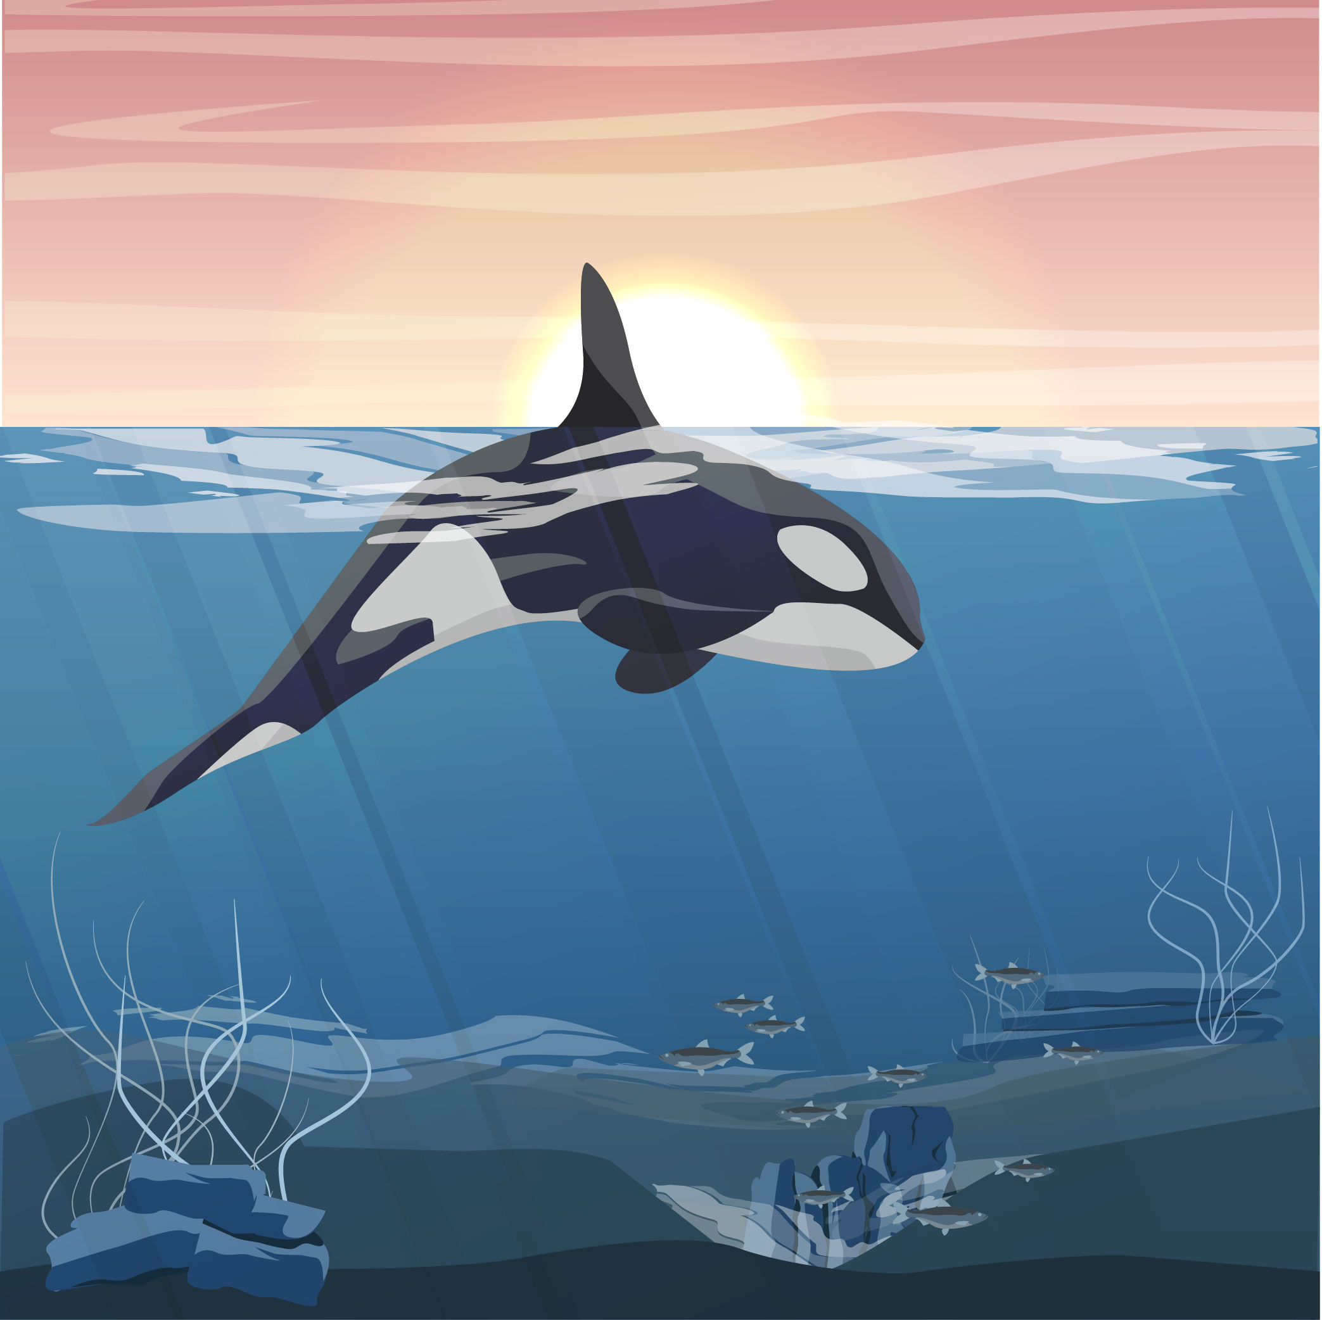
Whale Ride
Notes:
Notes to Teacher:
Teacher: “This week, you read the story, Whale Ride. Let’s use our strategy to retell the story together.”
Click to bring the image to the slide.
“Let’s work on our story retell together.”
Characters: “Who were the characters in the story?” (Characters: There were two children, a mom and whales in this story.)
Setting: “What was the setting of the story? Where did it take place?” (The story took place on the beach and in the ocean.)
Problem – “What was the problem in the story?” (The mom did not want the children to take a whale ride.)
Events: “What happened in the story?” (The children saw many whales and wanted to take a ride on the whale.)
The children saw a few different whales.
The children wanted to go for a ride on a whale.
Mom said they could not go for a whale ride!
Ending: “What happened at the end of the story?” (The children were not able to go for a whale ride.)
Connection: Possible questions to ask to help student to connect to this story:
How do you think the children felt about the whales?
How did Mom feel about the children riding the whale?
What was your favorite part of the story? Why?
Main Idea: What is this story about? (This story was about children seeing whales at a beach. They wanted to go on a whale ride, but Mom said no!)
Applaud student’s efforts in completing this story retell.
Click to the next slide.

Slide 10
Q & A
Any Questions?
Notes:
Ask – “Do you have any questions about anything that you learned in this lesson?”

